Slide 1

Explore South Pole Science with the Wisconsin IceCube Particle Astrophysics Center (WIPAC)
Jim Madsen
UW-River Falls Physics Department
WIPAC Associate Director for Education & Outreach
Bringing the Universe to Wisconsin- Platteville • January 29, 2013
wipac.wisc.edu • icecube.wisc.edu

Slide 2
Overview
What is Astrophysics?
Why the South Pole?
WIPAC and the IceCube Neutrino Observatory

Slide 3
Astrophysics
Physics of the Universe
  Study outer space and the objects that occupy it
  Need messengers to gain information
  Technology leads to discoveries and new knowledge
  Golden age on the brink of exciting results

Slide 4
Three Mysteries of the Universe
Particles from space with a trillion times more energy than those created in nuclear reactions
  Ultra High Energy Cosmic Rays (UHE CR)
Daily explosions that “outshine” the rest of the universe
  Gamma Ray Bursts (GRBs)
Matter five times more abundant than atoms that can’t be directly detected
  Dark Matter

Slide 5
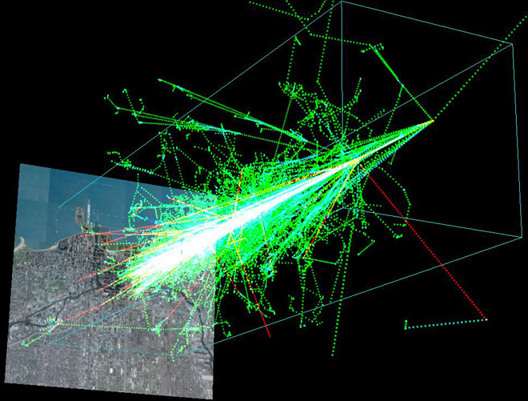
Ultra-High Energy
Cosmic Rays
Single particles with
enormous energies
Detect secondary
particles
Rare, (1 per square
  kilometer per century!) large events require huge detectors
Composition, source, and mechanism unknown
www.wired.com/wiredscience/2011/03/cosmic-ray-origins/

Slide 6
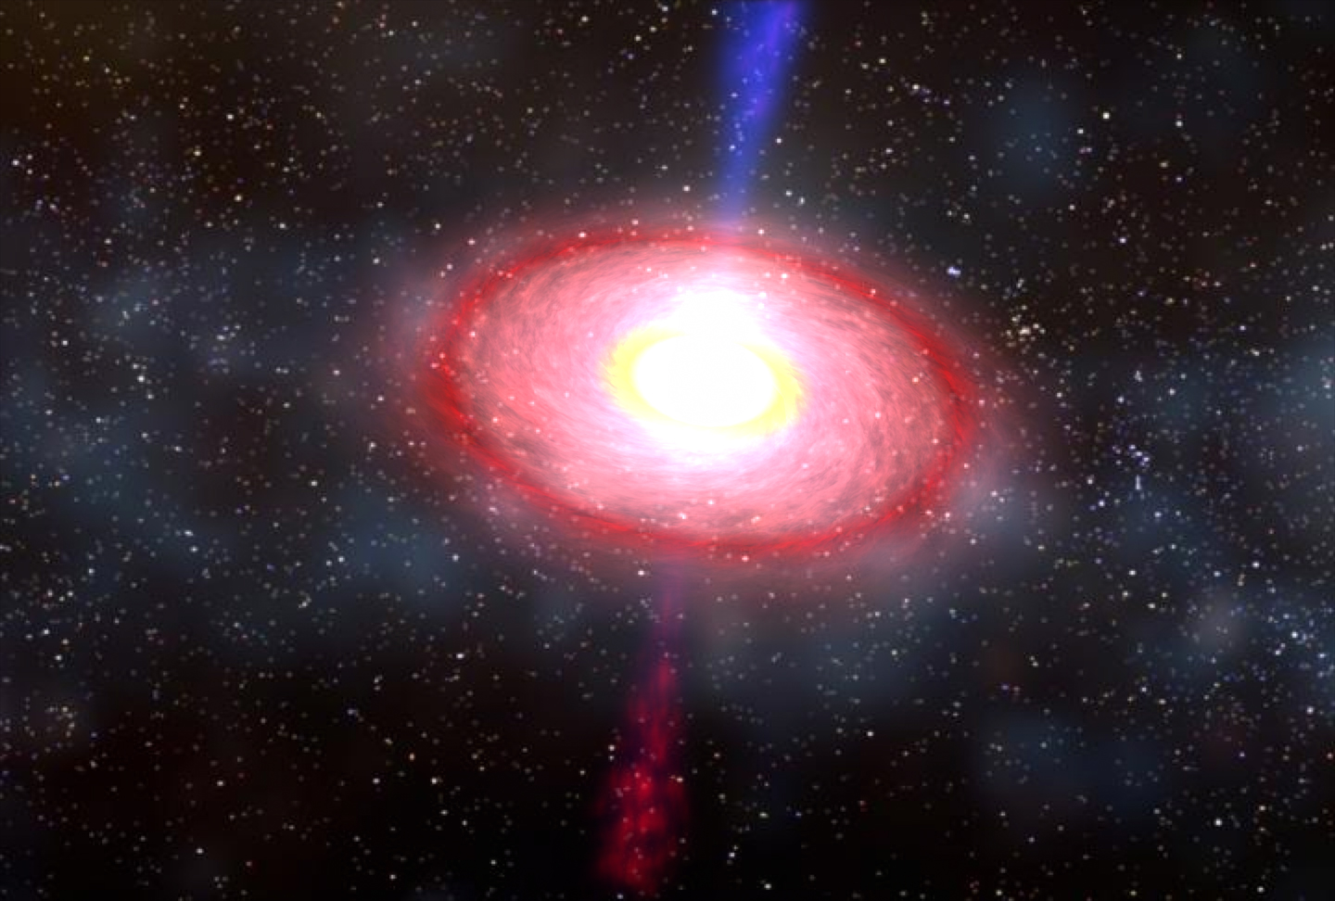
Gamma Ray Bursts
Short, (milliseconds to seconds) explosions that release more energy than a million trillion suns (more energy in gamma rays than the rest of the universe!)
Shorter GRBs involve
black holes
source of UHE CRs ?
MAYBE NOT!
http://www.nasa.gov/mission_pages/swift/bursts/short_burst_oct5.html

Slide 7
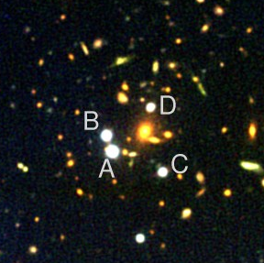
Dark Matter
Unknown stuff that
makes up about 20%
of the universe
Large concentrations can
  produce multiple images of one object
No direct detection to date but consistent, confirming evidence
http://www.sdss.org/news/releases/20031217.lensing.html

Slide 8

Exploring a New Way
Existing messengers
(light, cosmic rays) aren’t
telling the whole story
Need new approach
to crack these cases
Are neutrinos the answer?
        A Failure to Communicate?

Slide 9
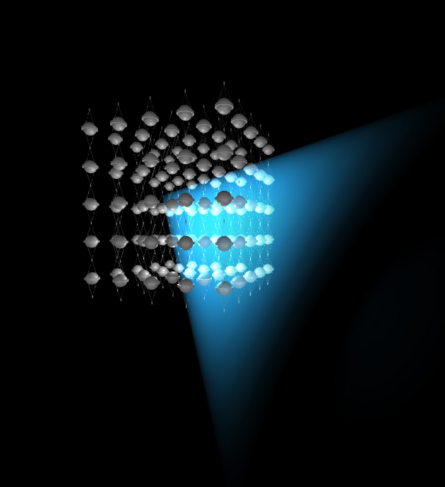
“Seeing” Neutrinos
muon (charged particle)
lattice of light detectors in a clear medium (water or ice)
incoming
neutrino
interaction

Slide 10

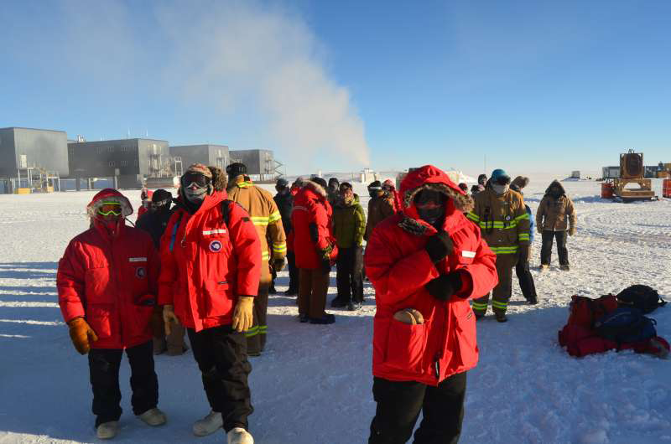
Making it work
Locations with clear, pristine deep water French Mediterranean Sea or….
Locations with clear, pristine ice
South Pole, Antarctica
http://dallinallison.blogspot.com/2011/05/la-cote-dazur.html

Slide 11
Why work at the South Pole?
Extreme cold?
6 months of darkness?
6 months of light?
Desert like conditions and high altitude?
Ice two miles thick?

Slide 12
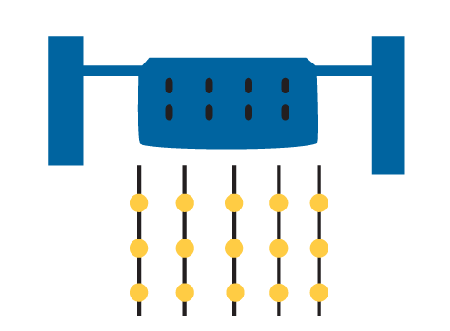
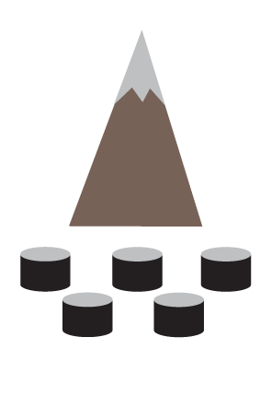
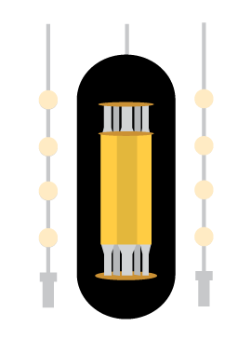

Wisconsin IceCube Particle Astrophysics Center
IceCube
ARA
HAWC
DM-Ice

Slide 13
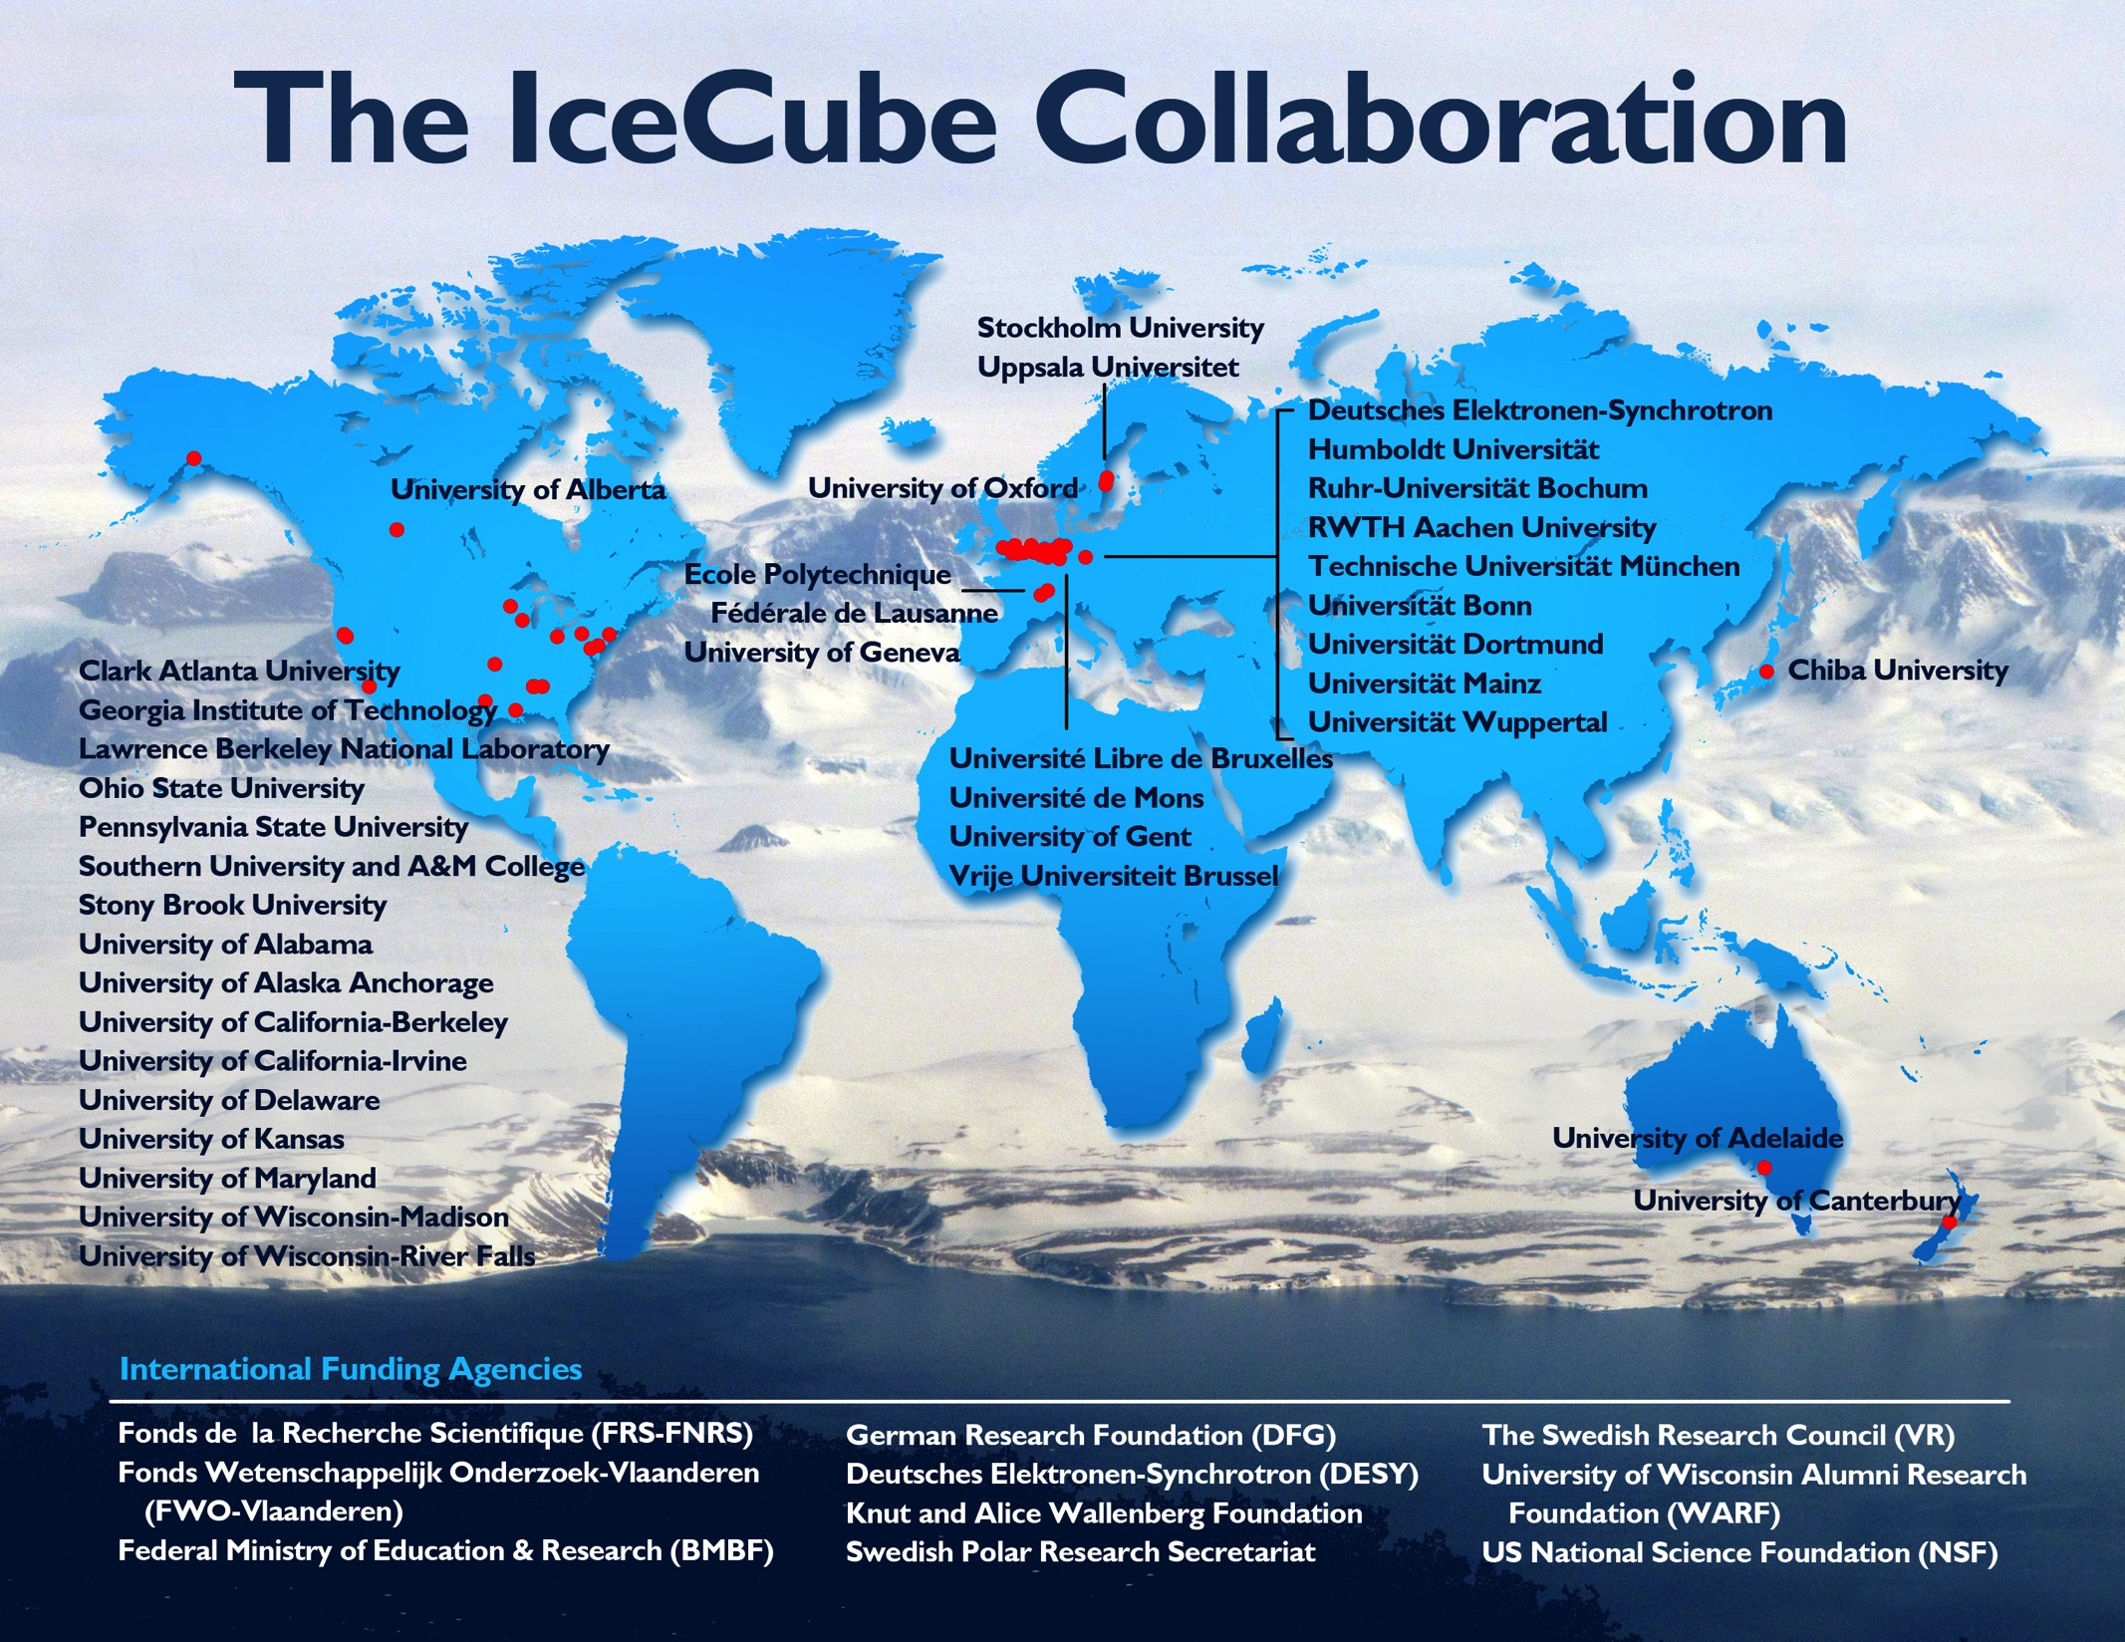

Slide 14
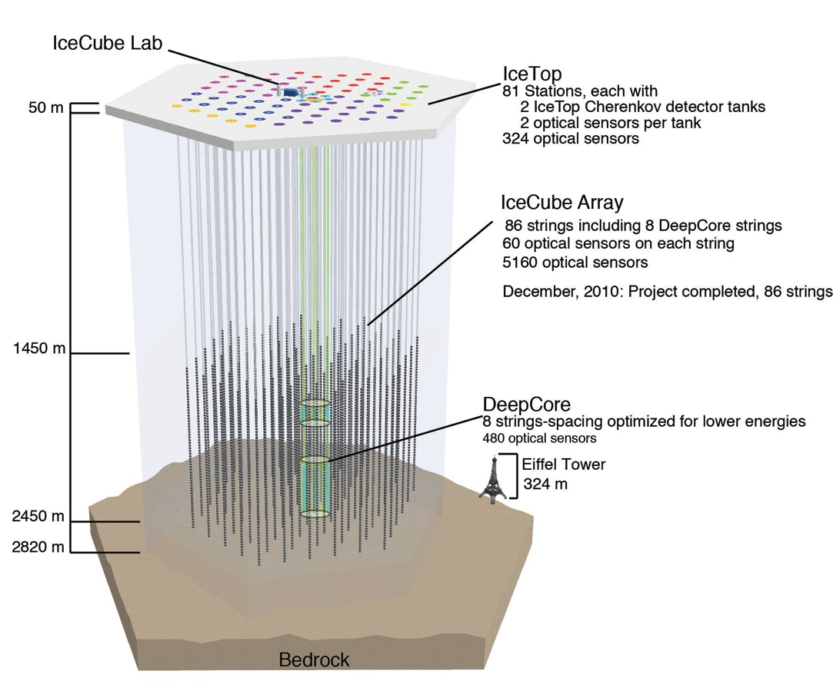
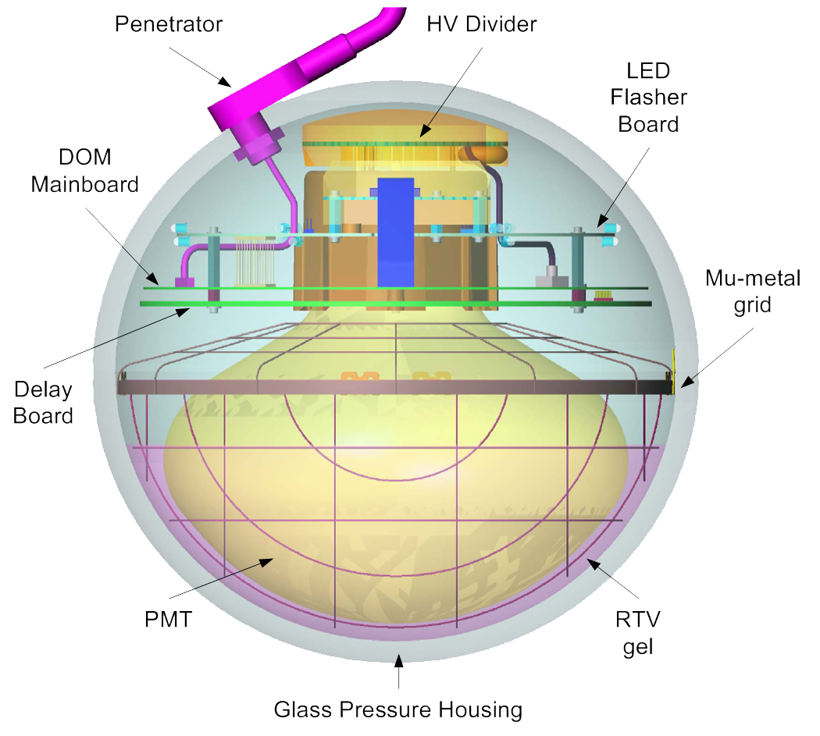
The IceCube Neutrino Observatory

Slide 15
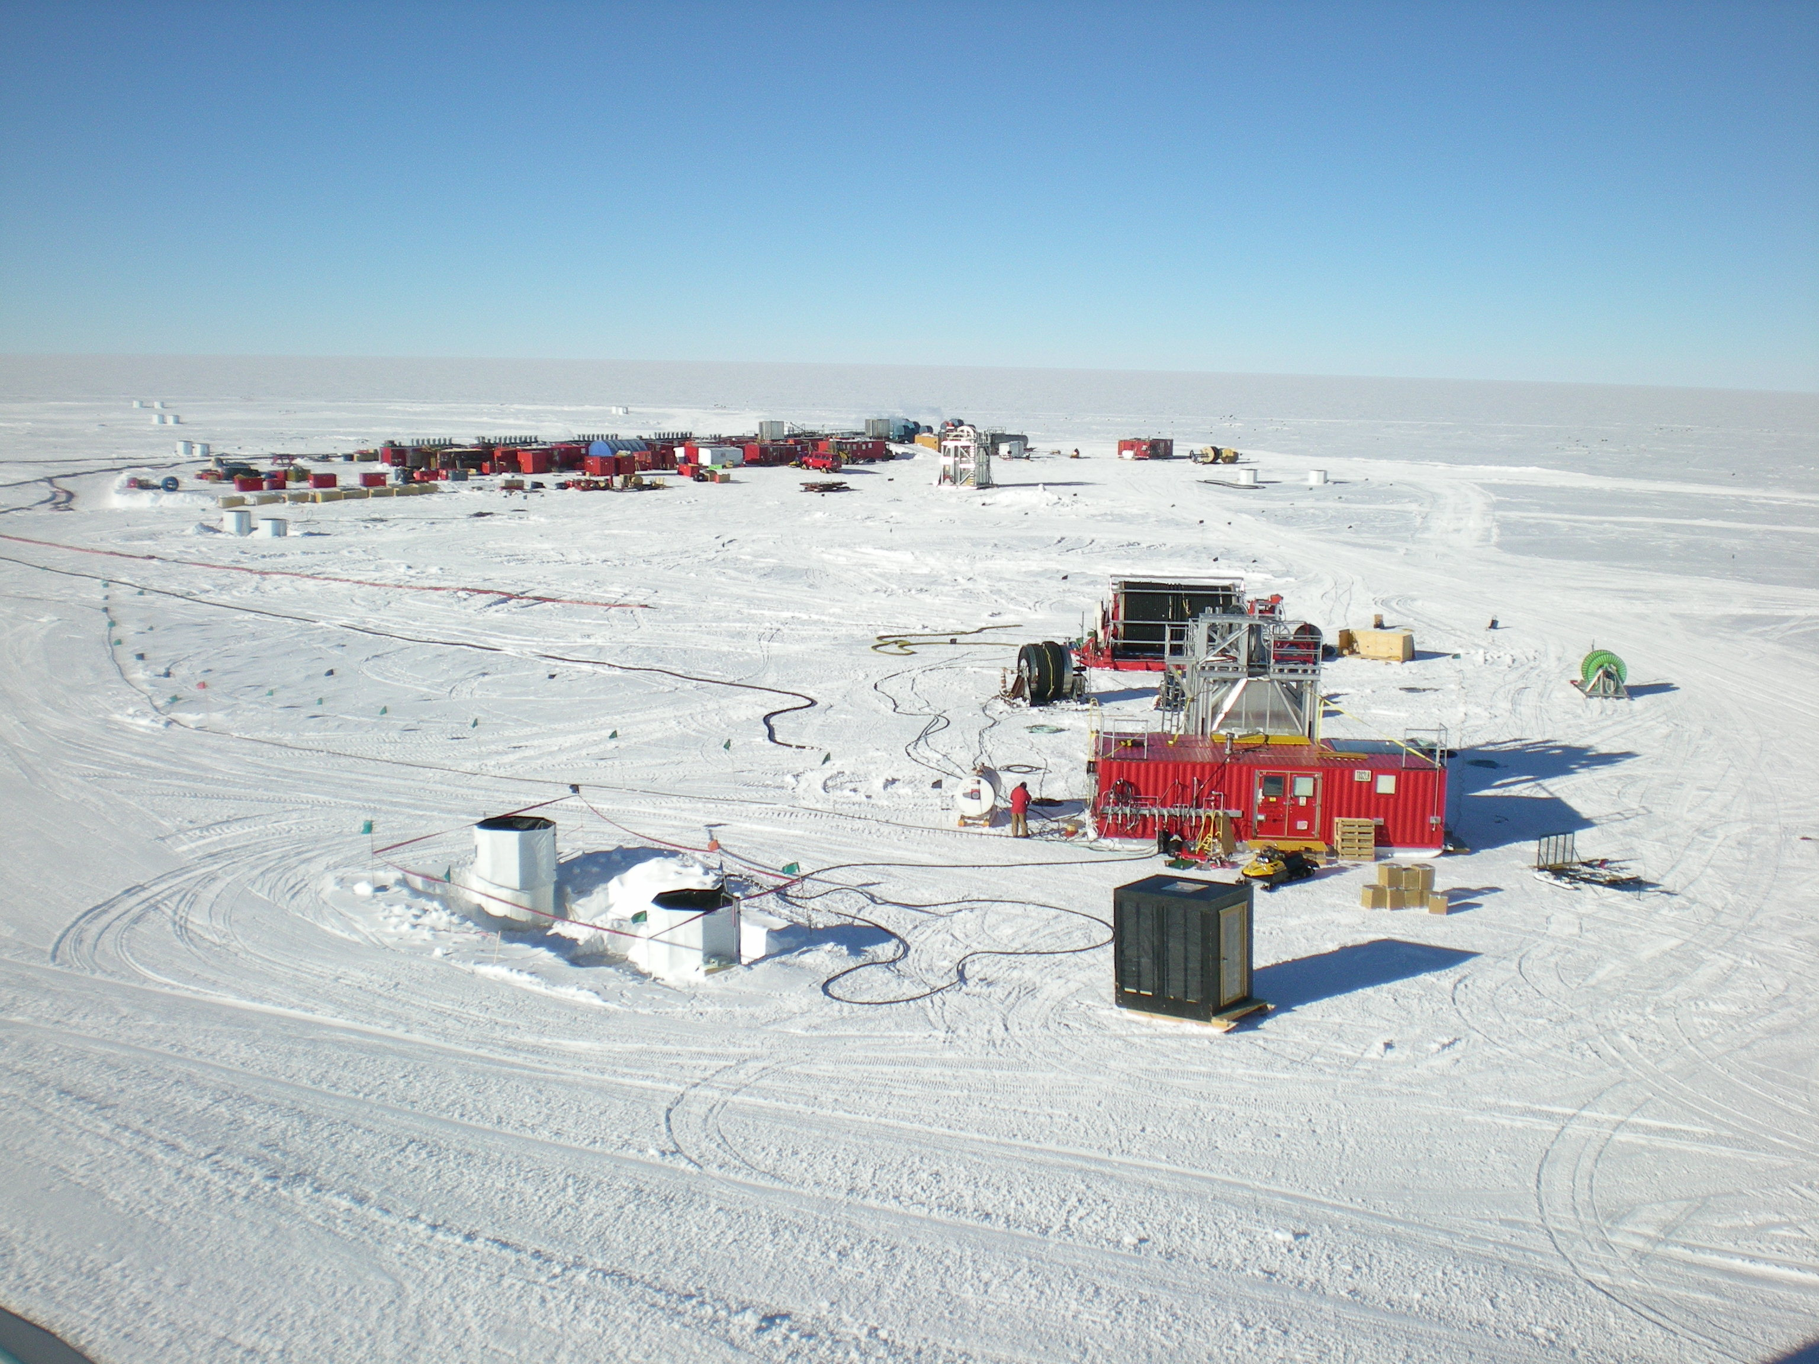


Construction: Drill site
Drill camp (5 MW hot water heater)
Hose Reel (~25,000 lbs)
Hot water hoses
IceTop Tanks
(with sun shields)
Drill speeds ~ 2 m/minute
  ~40 hours to complete a hole
  ~12 hours to deploy a string
15

Slide 16
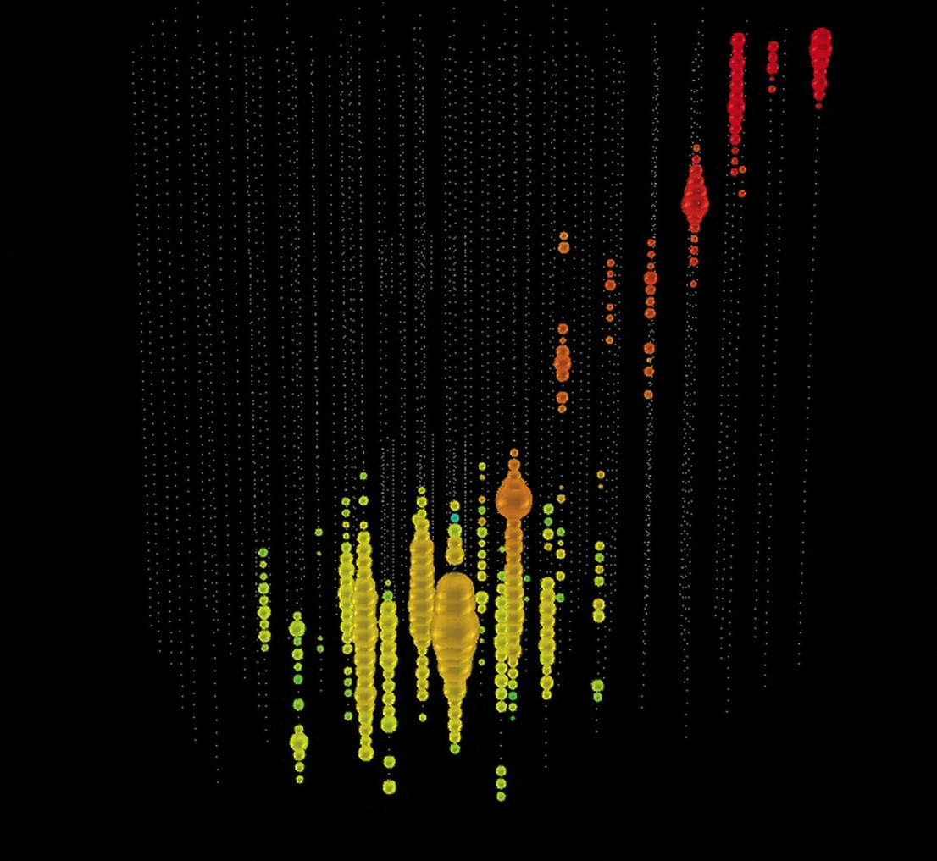
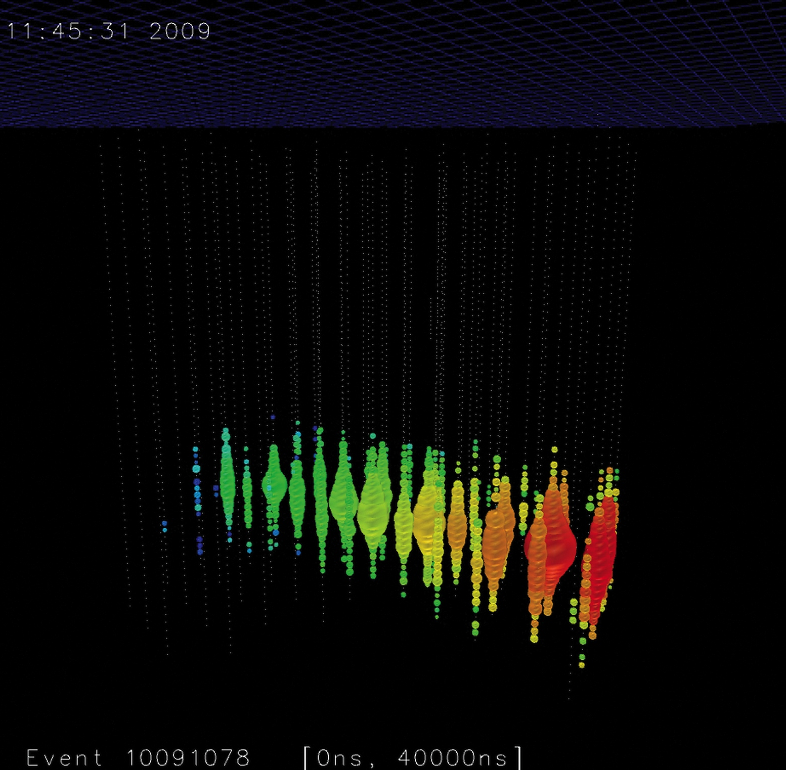
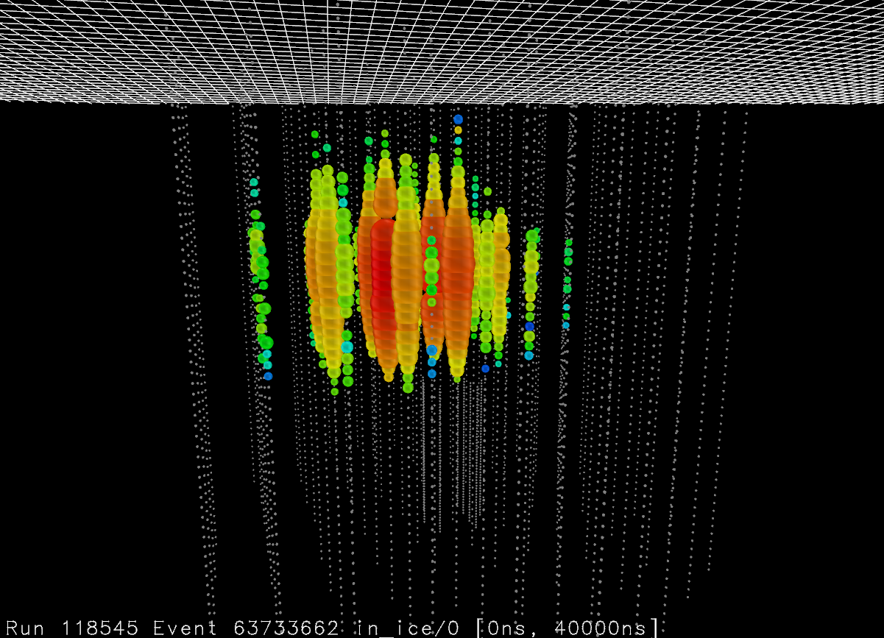
What does IceCube See?
IceCube records light from charged particles traveling faster than light in the ice
  Time sequence gives direction
  Amount of light is proportional to energy
  Pattern indicates flavor (Electron, Muon, or Tau)
Each year,
  ~10¹¹ cosmic rays
  ~10⁵ atmospheric neutrinos
  ~? astrophysical neutrinos

Slide 17
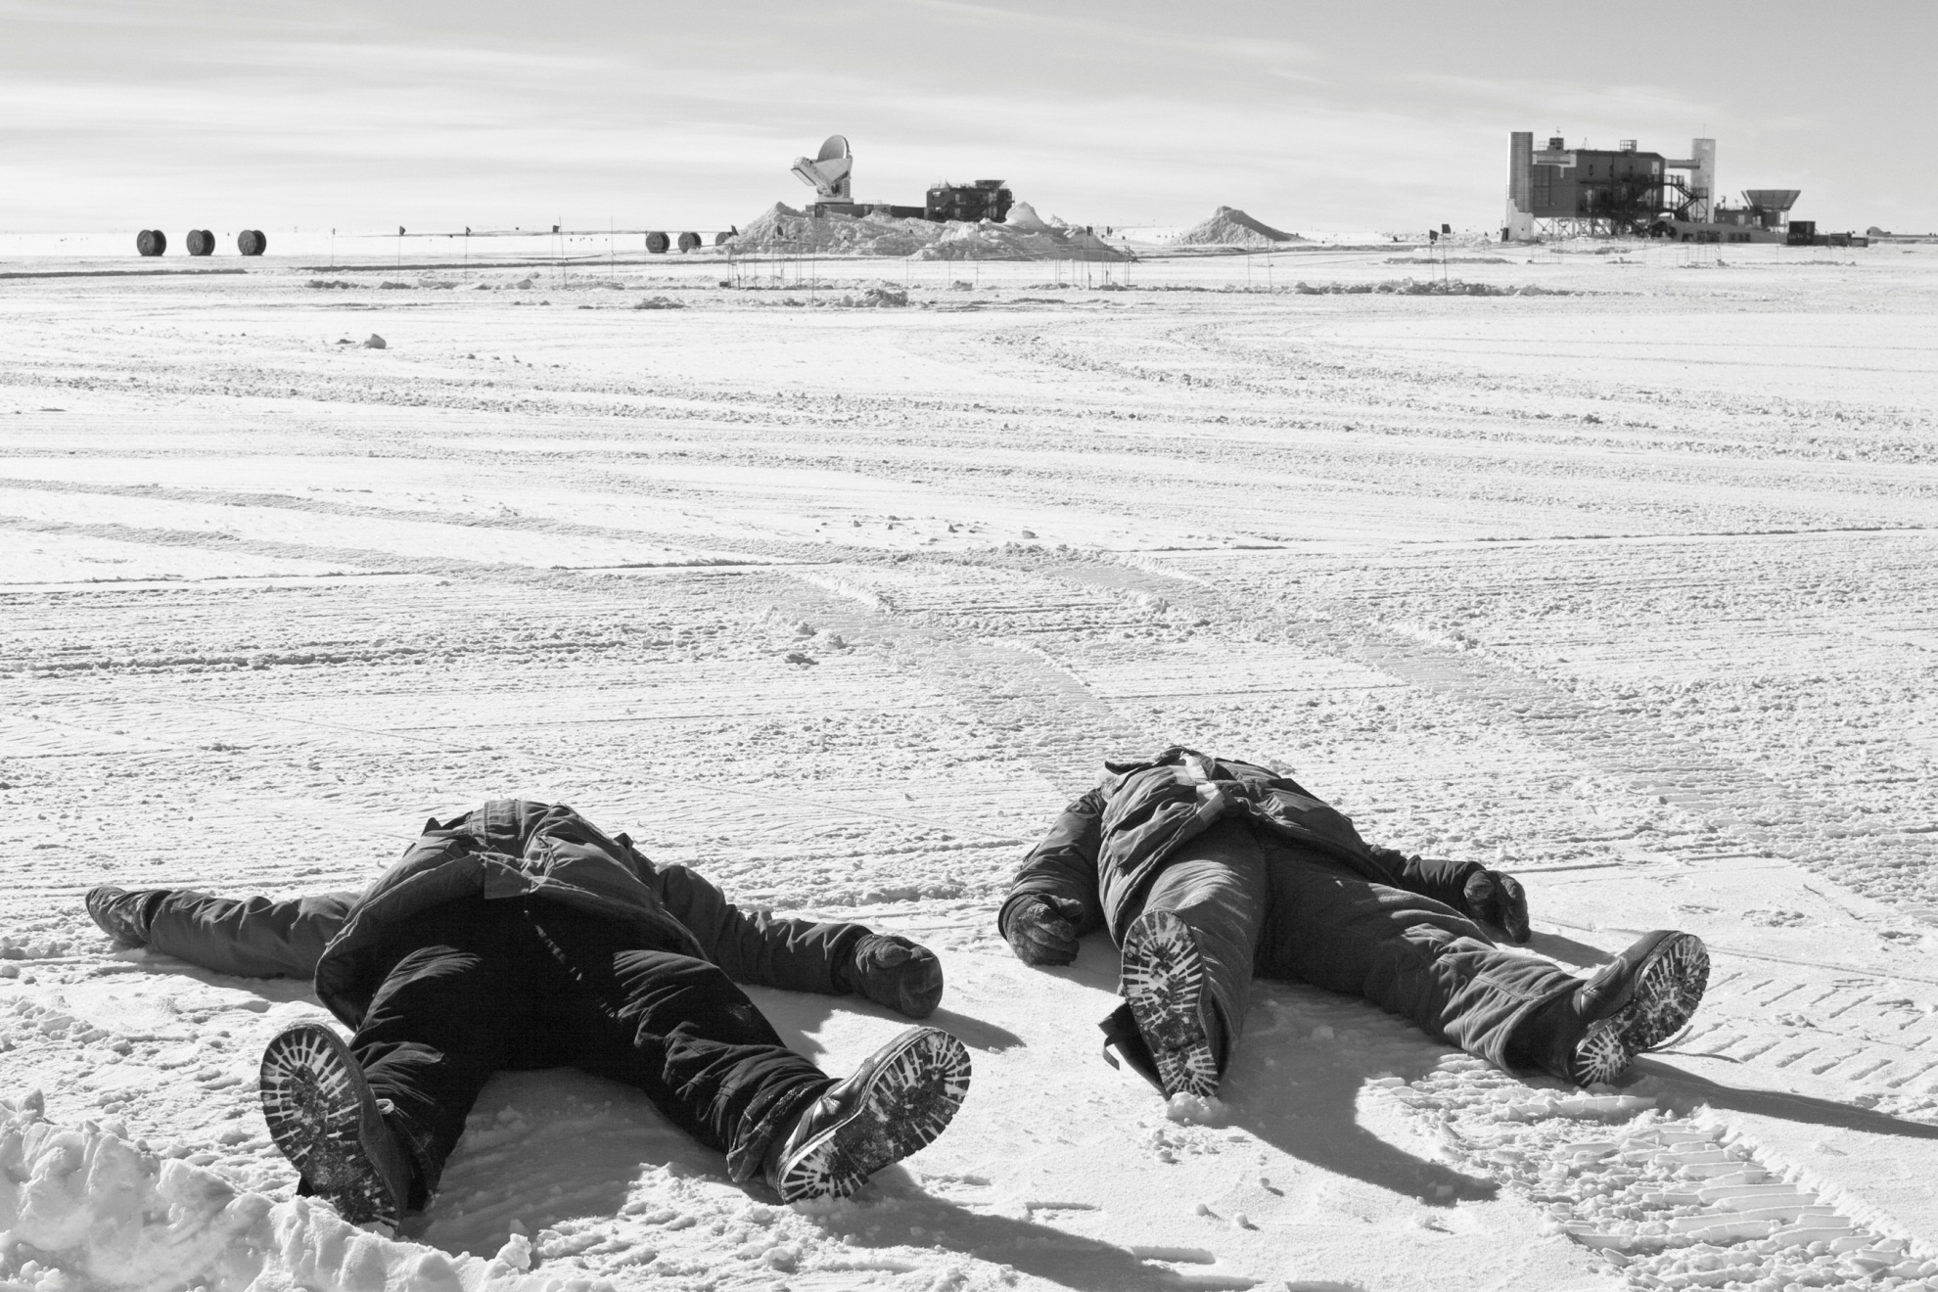
A few things to remember…
  Universe is immense & mostly unexplored
  Science & technology enable both to advance
  Partners in Wisconsin are at the forefront of these efforts

Slide 18
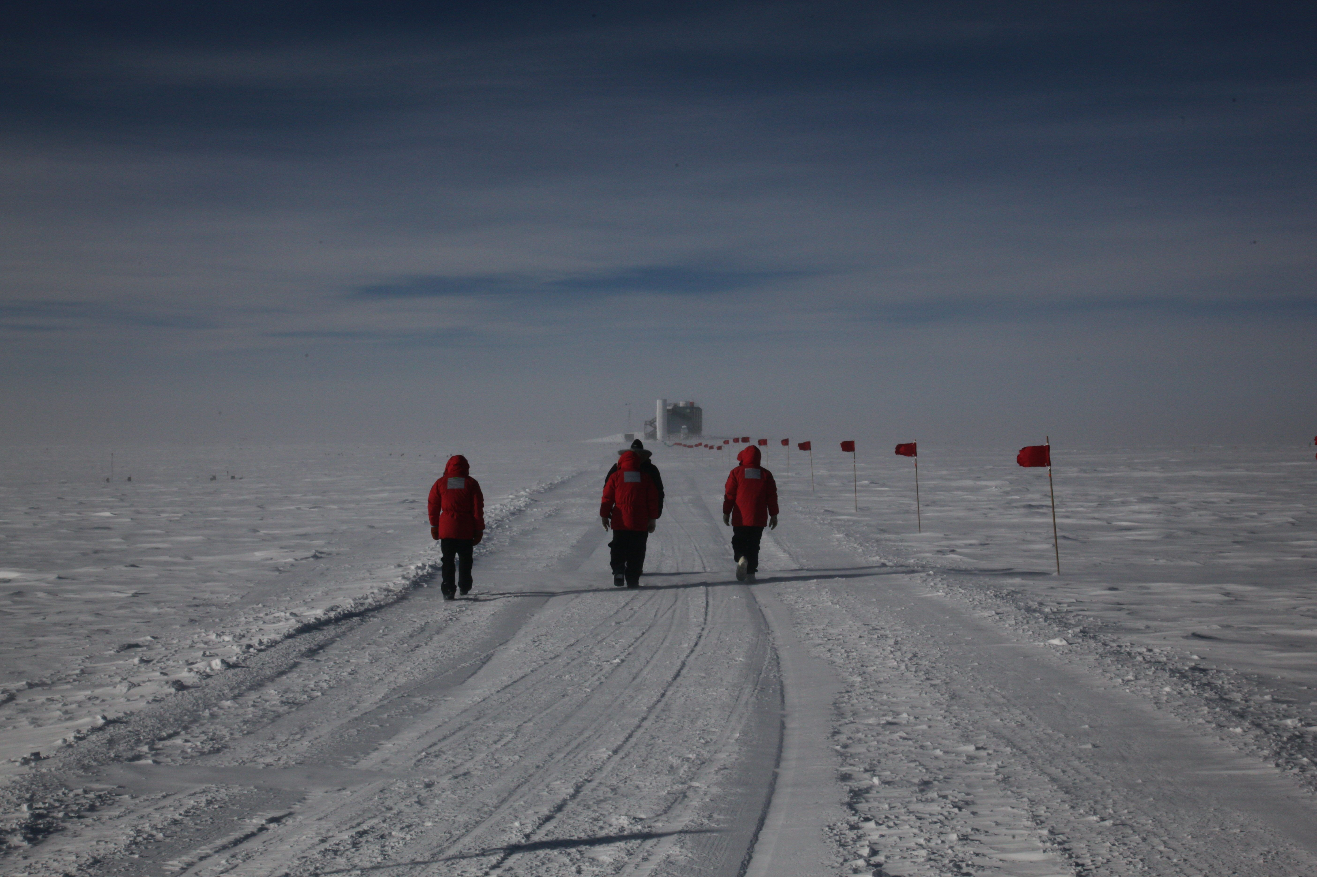
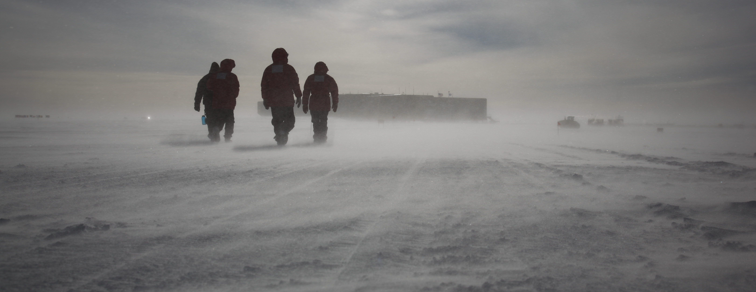

Slide 19
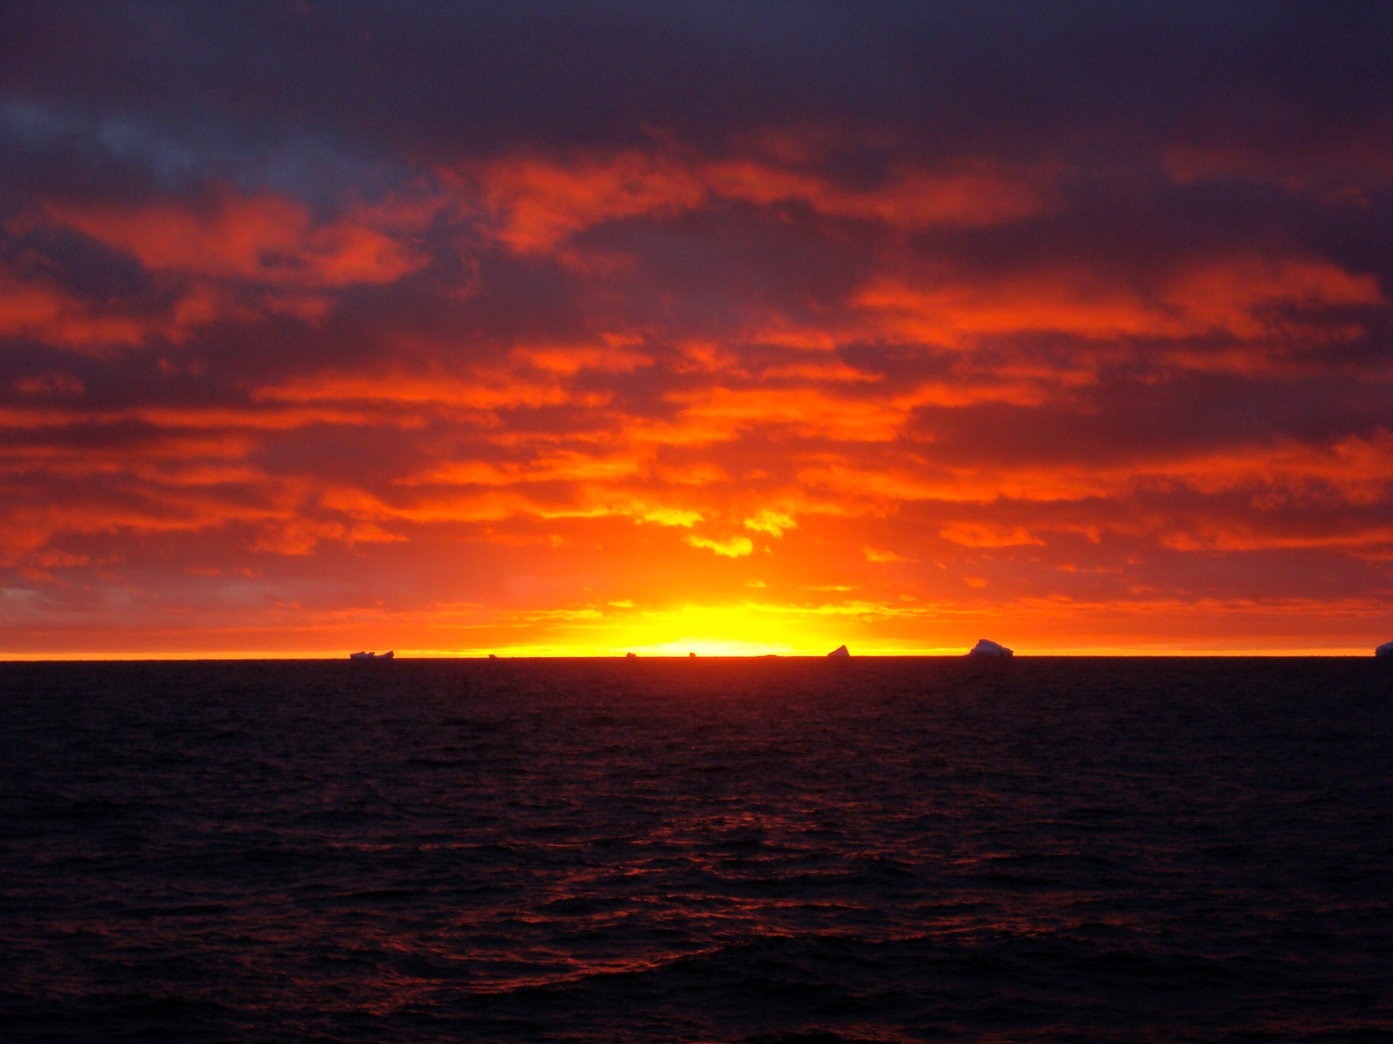
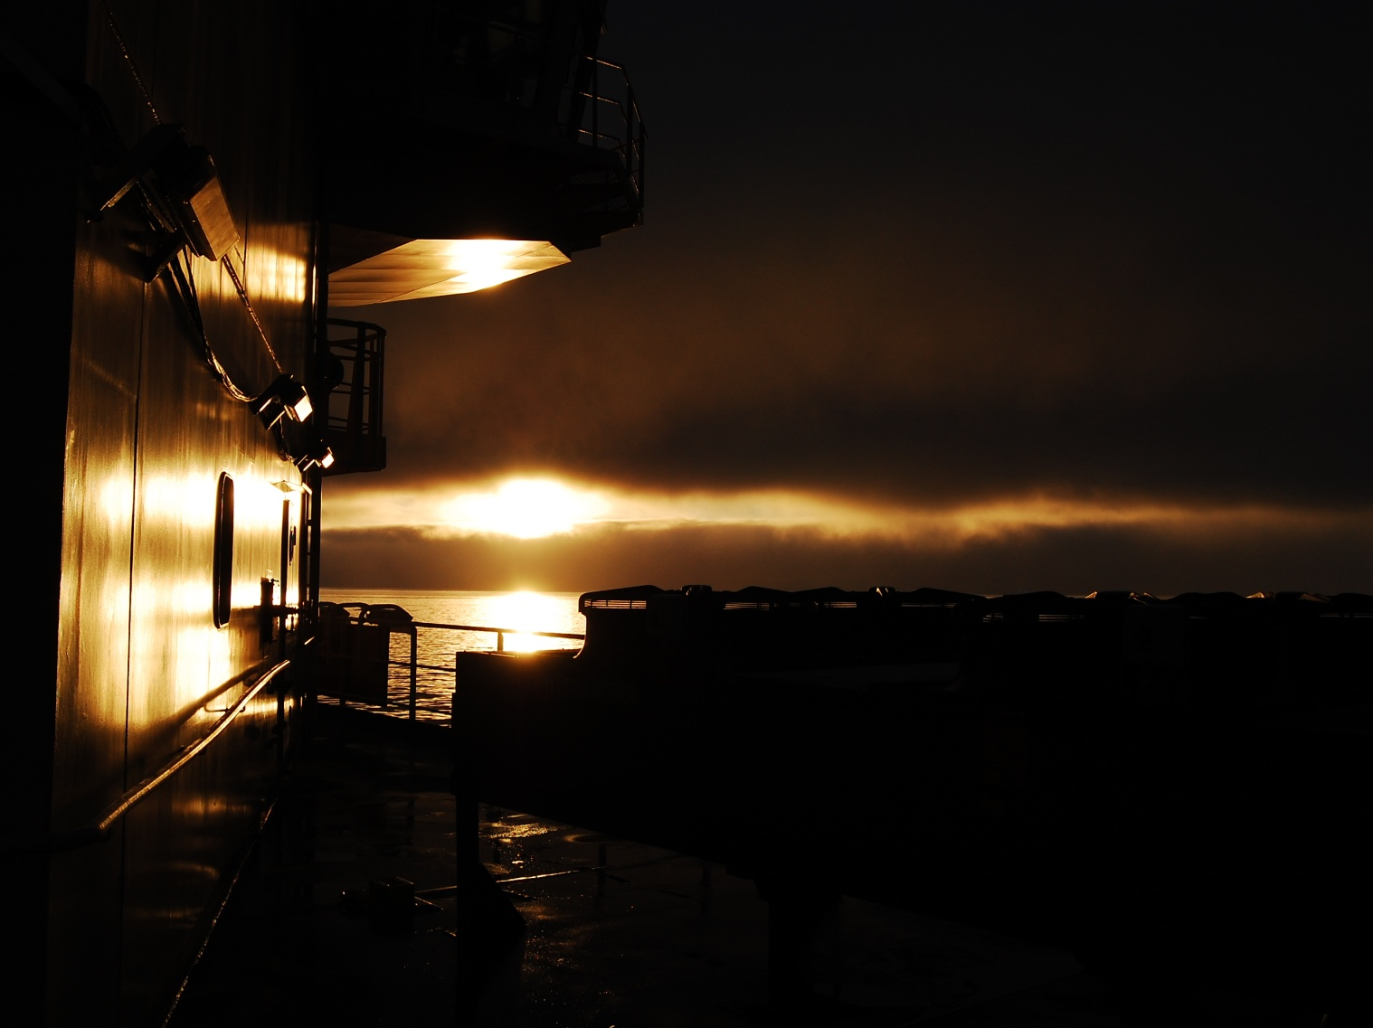
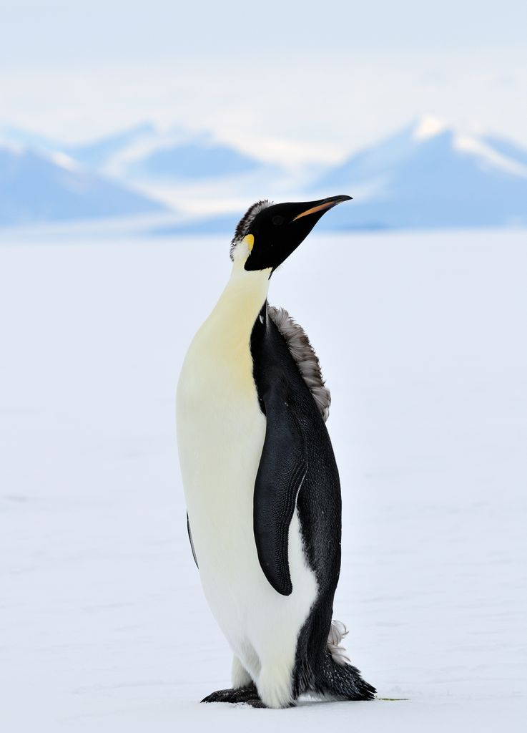
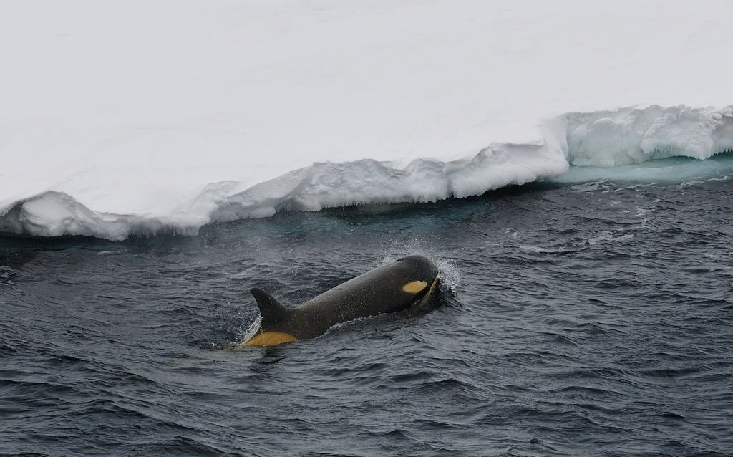
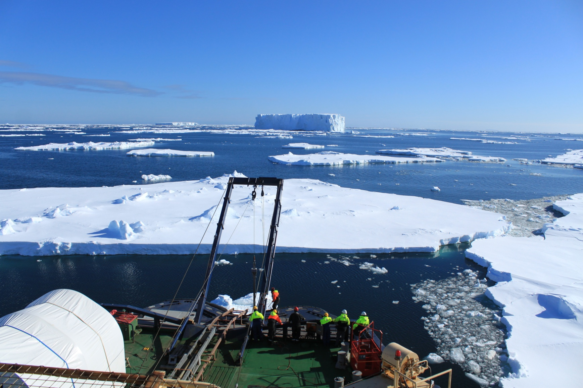

Slide 20
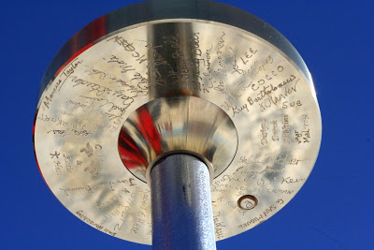
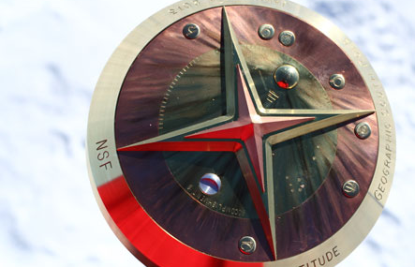

Slide 21
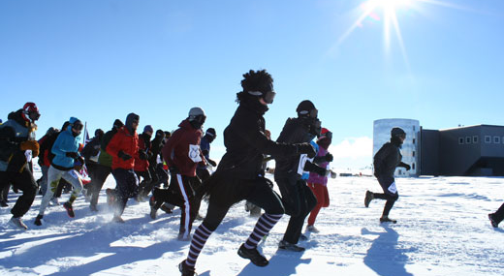
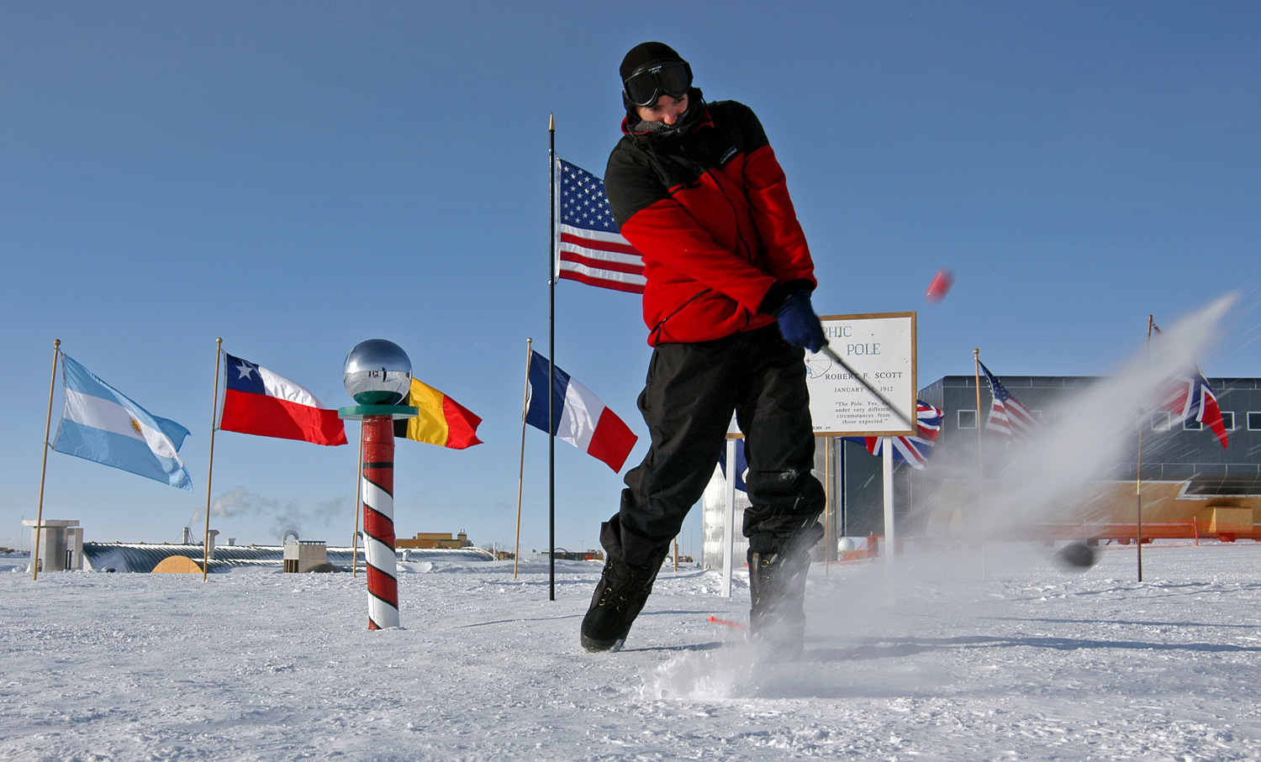

Slide 22
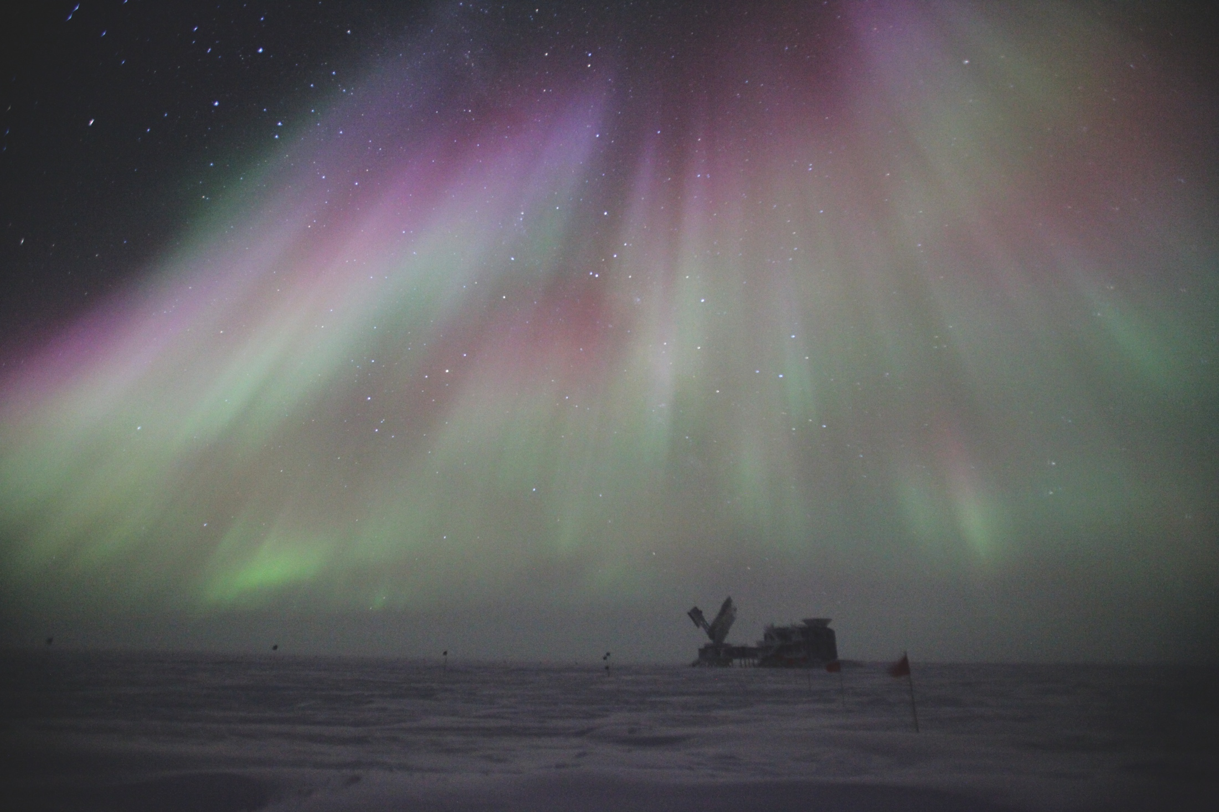

Slide 23
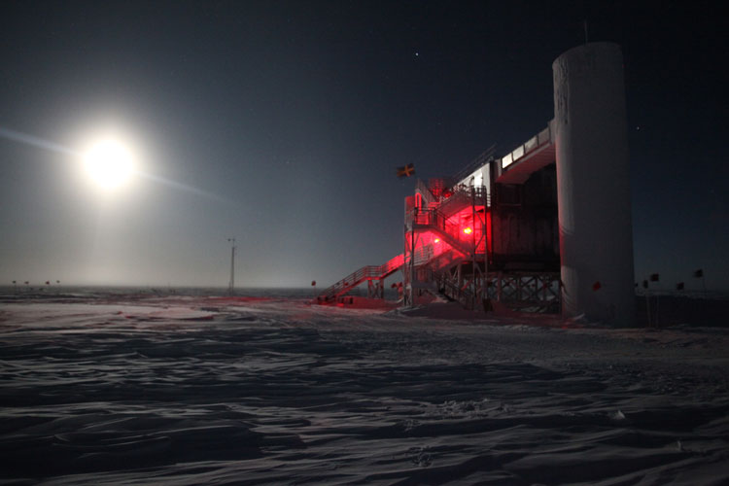

Slide 24
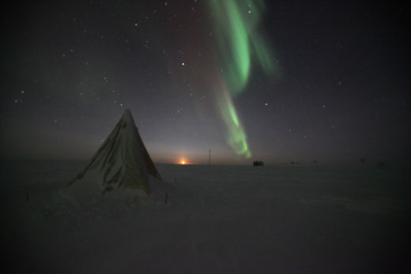

Slide 25
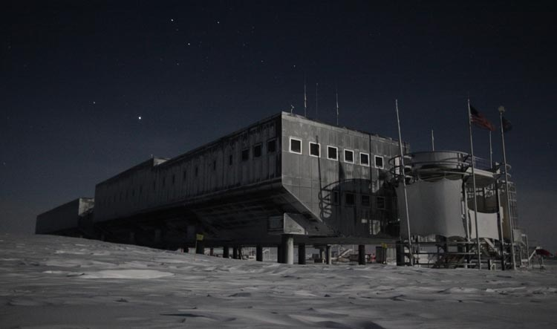

Slide 26
