Slide 1
IceCube
- construction, performance and operation
Albrecht Karle
University of Wisconsin-Madison

Slide 2
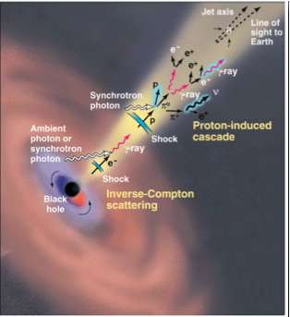
High energy particles in the Universe
Cosmic Rays
  Observed up to 10^21 eV
  Diffuse, mass composition
Gamma Rays
  Observed up to ~100 TeV
  Numerous TeV point sources resolved
Neutrinos
  Atmospheric neutrinos observed up to 300 TeV
  Solar neutrinos and SN1987a at lower energies

Slide 3
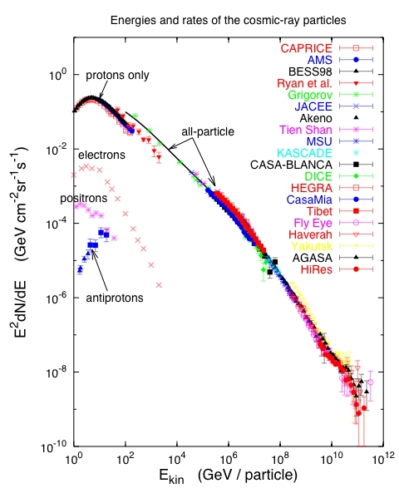
Cosmic Rays and Neutrino Sources
Cosmic rays
knee
1 part m⁻² yr⁻¹
Ankle
1 part km⁻² yr⁻¹
T. Gaisser 2005
Notes:
Cosmic rays have been observed to energies above 1E20eV. Spectrum and composition give some ideas of the nature of the acceleration and transport.
Most candidates of astrophysical neutrinos are closely related to the observation of high energy cosmic rays. We know that cosmic rays exist to highest energies. Possible sources are SN remnants, active galaxies or gamma ray bursts. Neutrino production may take place in the source region or on other, not too dense targets such as the Earth’s atmosphere, the interstellar medium or the cosmic microwave background.

Slide 4
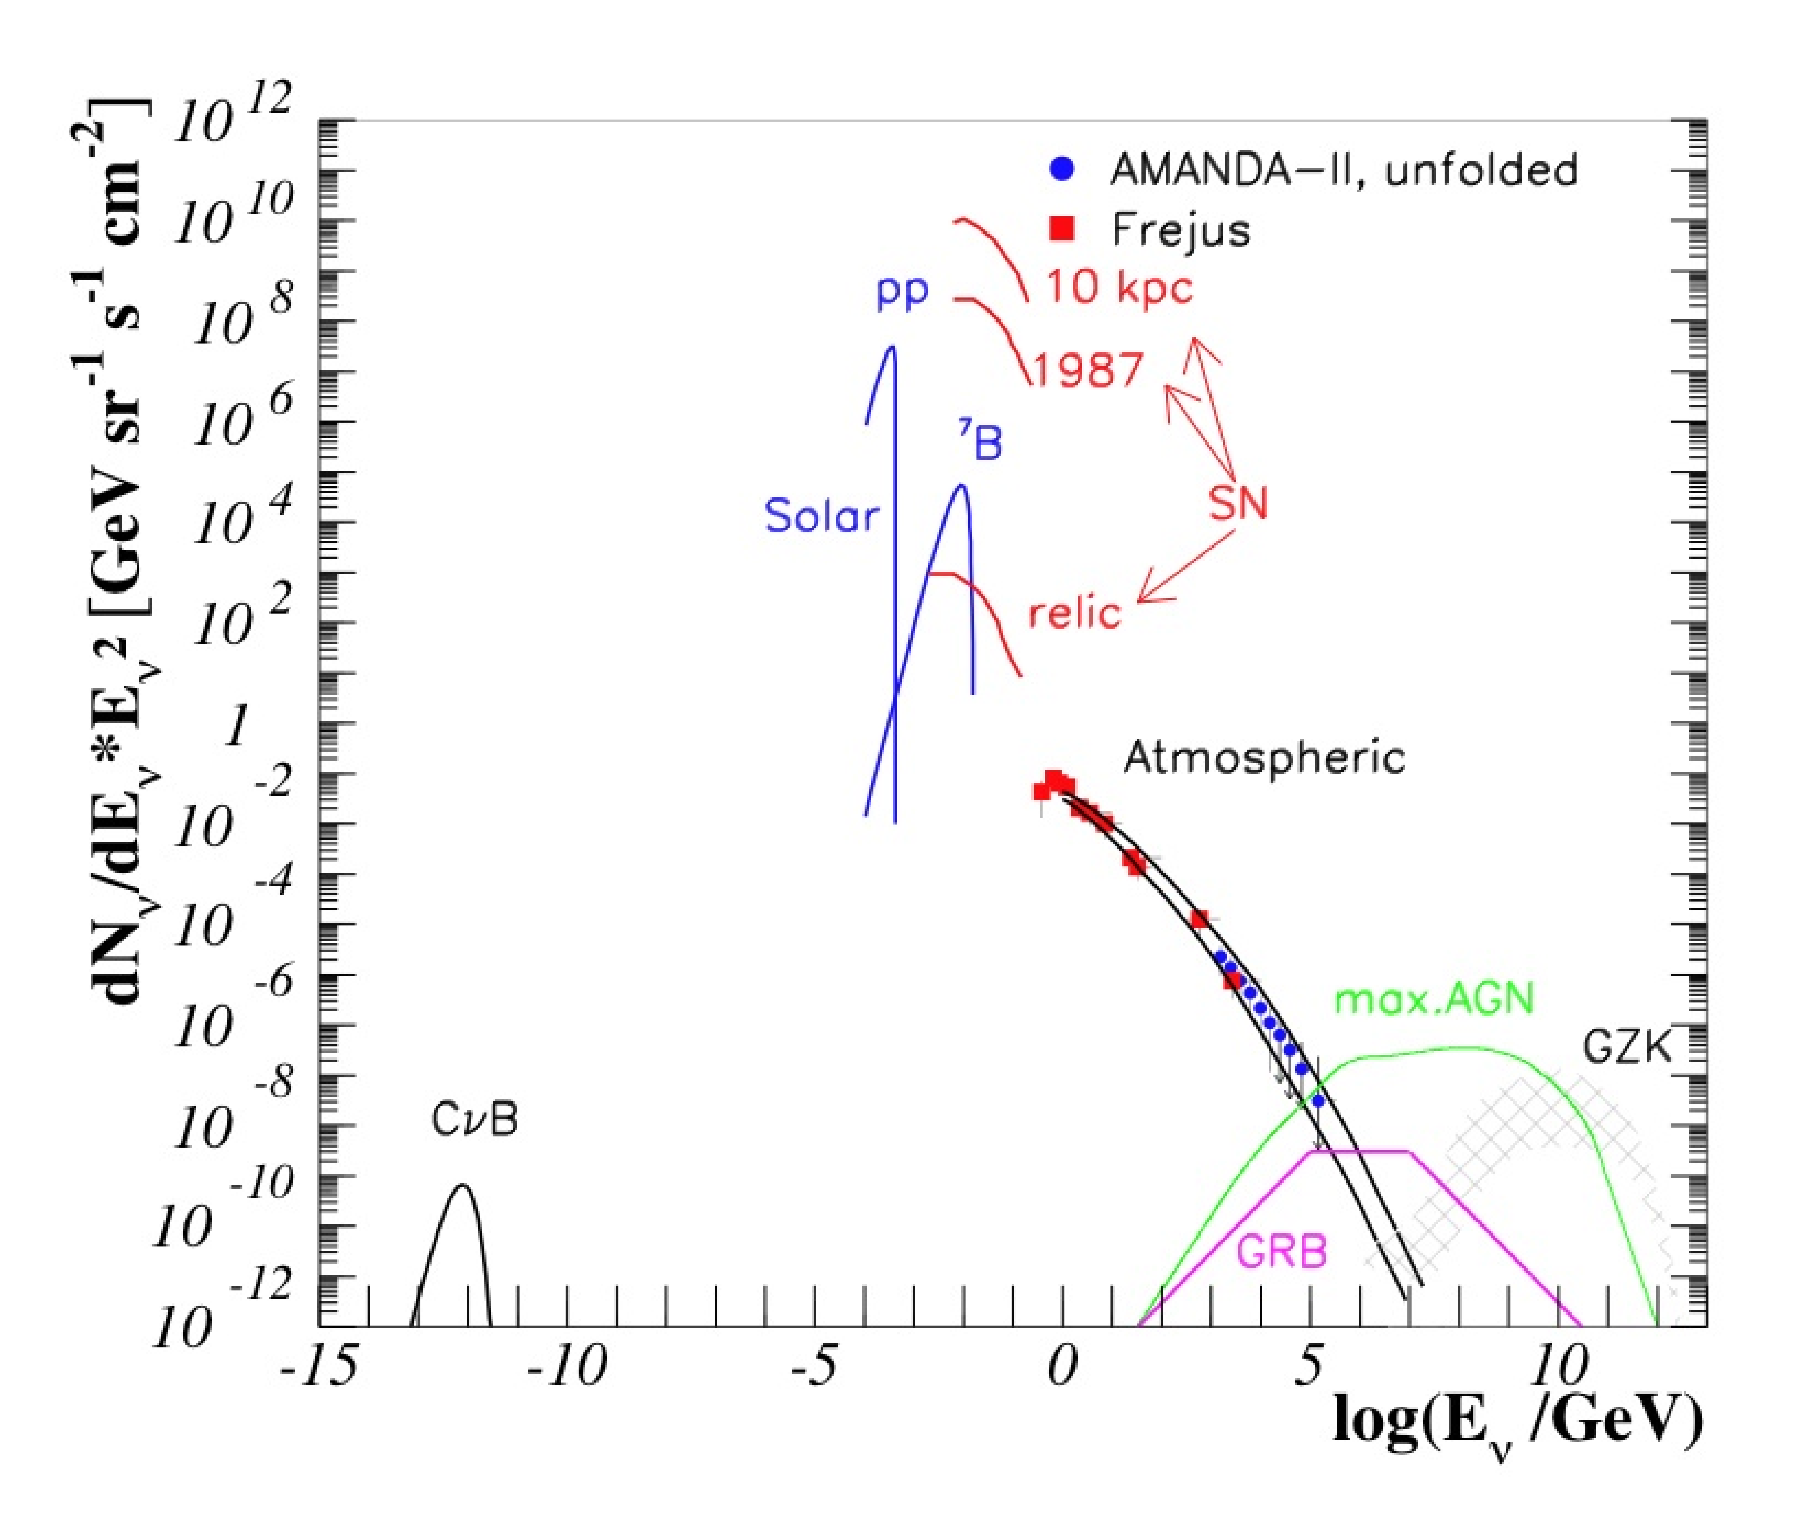
Neutrinos
MeV energy
neutrino astrophysics
High energy
neutrino astronomy:
Small fluxes,
Need large detectors,
Note wide energy range

Slide 5
A few remarks on the beginnings of IceCube

Slide 6
deep detector shielded by water or ice
Muon
First envisioned by Greisen, Markov 1960
Pioneering effort: DUMAND near Hawaii
First and second generation telescopes in 90’s,
proof of principle : Baikal, AMANDA (S Pole), also NESTOR (Greece).

Slide 7
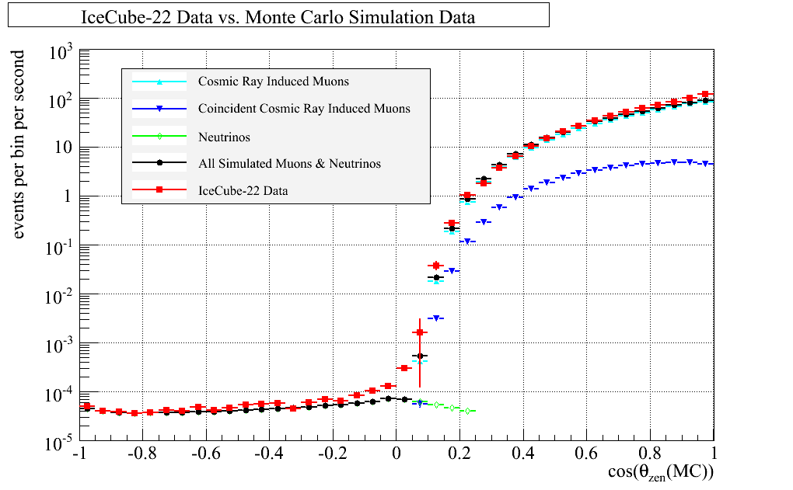
Neutrino telescopes, originally primarily thought of as muon detectors
Neutrino-induced muons
from all directions
Downward atmospheric muons
→ P. Berghaus et al., ISVHECRI-08, also HE1.5
Low energies: Use Earth as filter; look for neutrinos from below (GeV to PeV)
High energies: Apply energy cut for downgoing atmospheric background (>PeV)

Slide 8
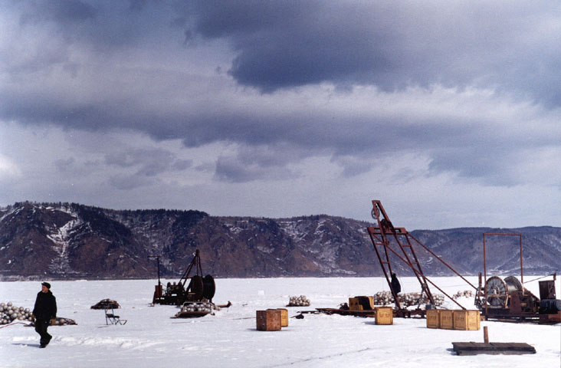
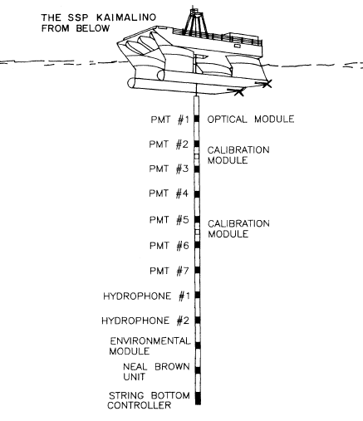
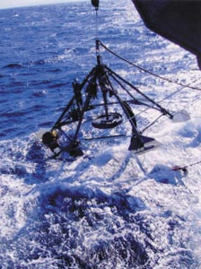
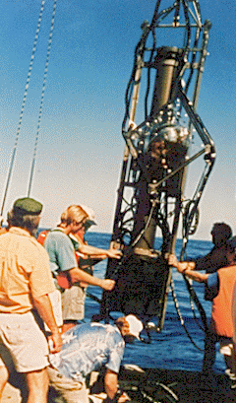
Early Projects in water
Baikal
DUMAND
(Hawaii)
NESTOR
of the shore of Greece

Slide 9
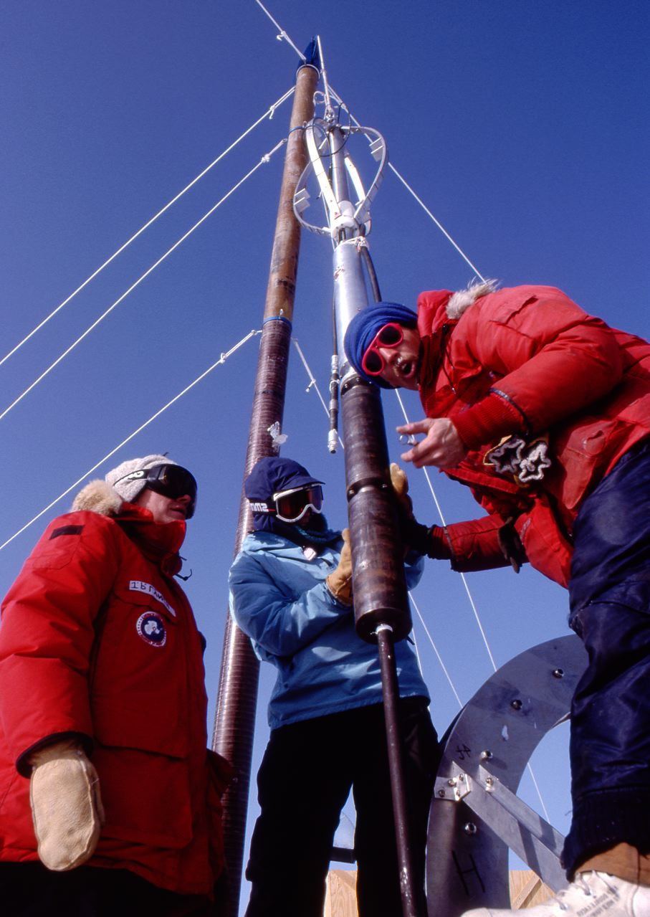
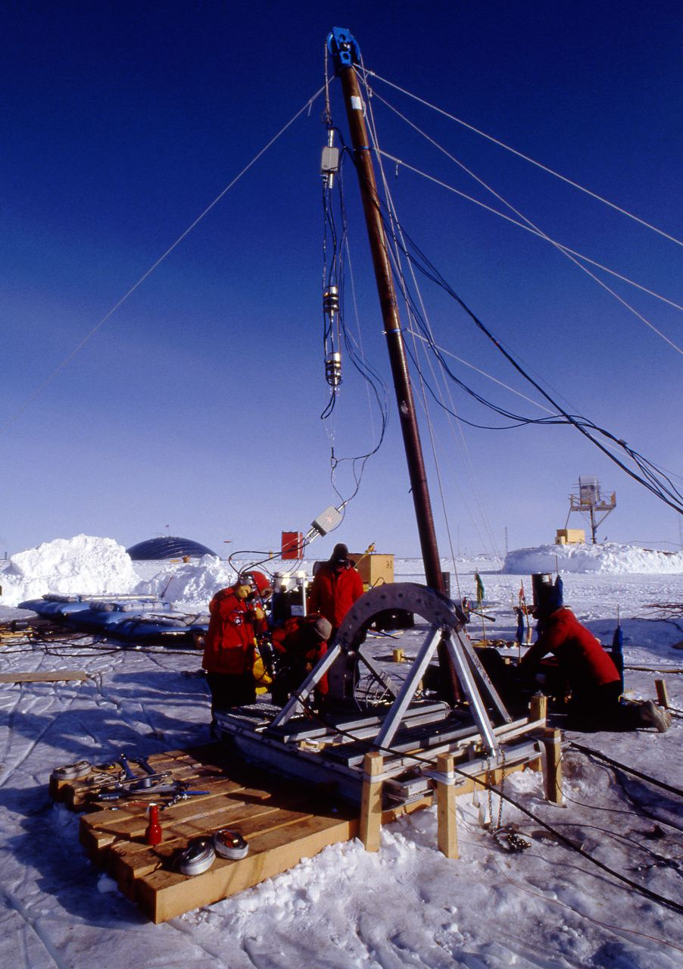
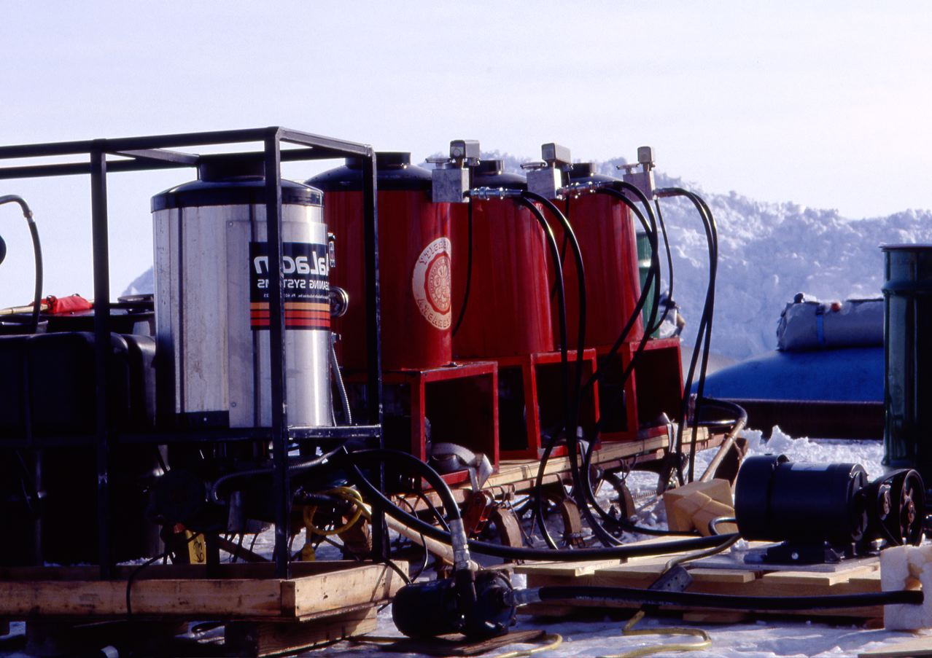
South Pole
- the ice option
ICRC1989
1991/92 first small PMTs deployed
Test of hot water drilling at South Pole
Heaters and pumps
to melt the holes

Slide 10
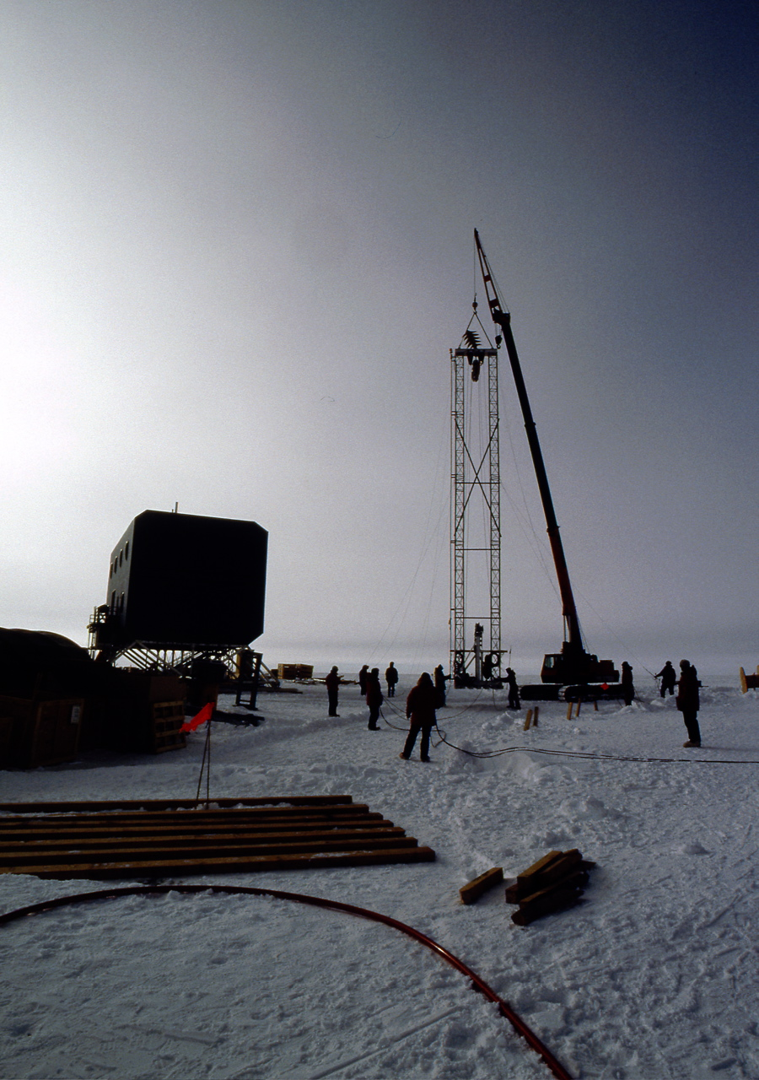
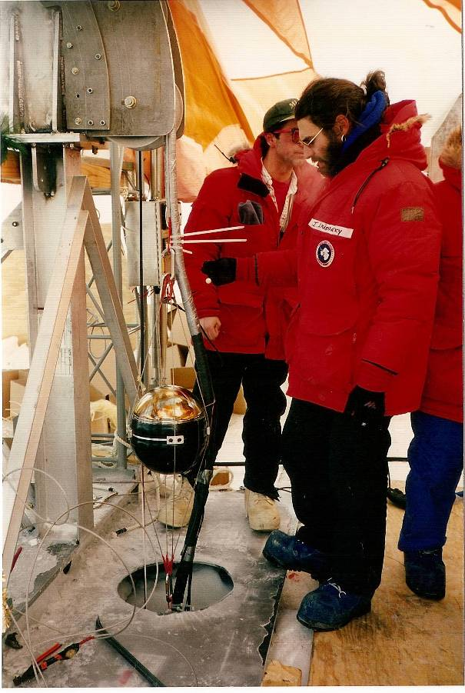
South Pole 93/94
AMANDA-A
80 sensors at 800-1000 m depth.
Results indicate very little absorption,
However, presence of bubbles causes photons to scatter.
→ Need to go deeper!
The upper floor is what is visible today of the M. A. Poverantz Observatory.
Snow level 7 m higher than in 94 near this building.

Slide 11
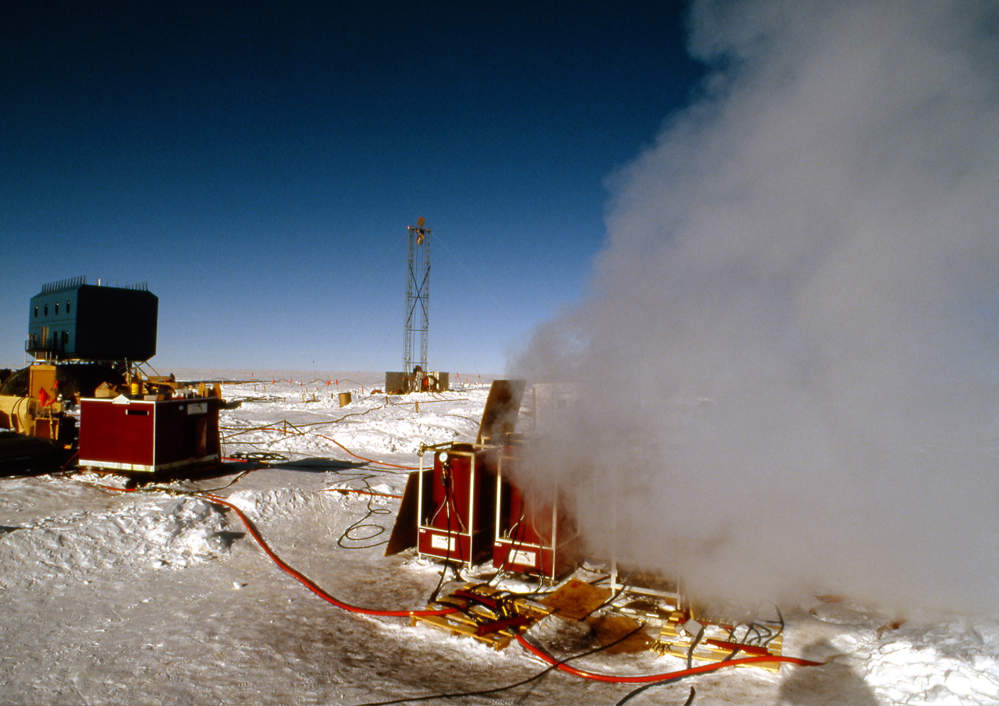
1995/96:
4 strings to 1900m depth (AMANDA_B4)

Slide 12
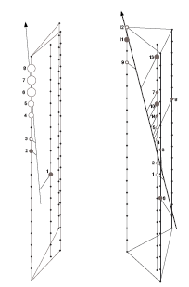
1995/96:
The ice is clear.
PMTs work 2000m under ice
Suitable for a neutrino telescope!
Significant international contributions
to instrument hardware.
B4: first 2 neutrino candidates →

Slide 13
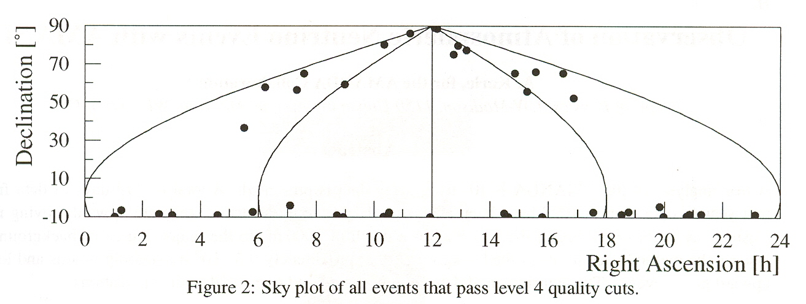
Skyplot of the
very first 17
Nu candidates
in B10
B10 skyplot
published
in Nature 2001

Slide 14
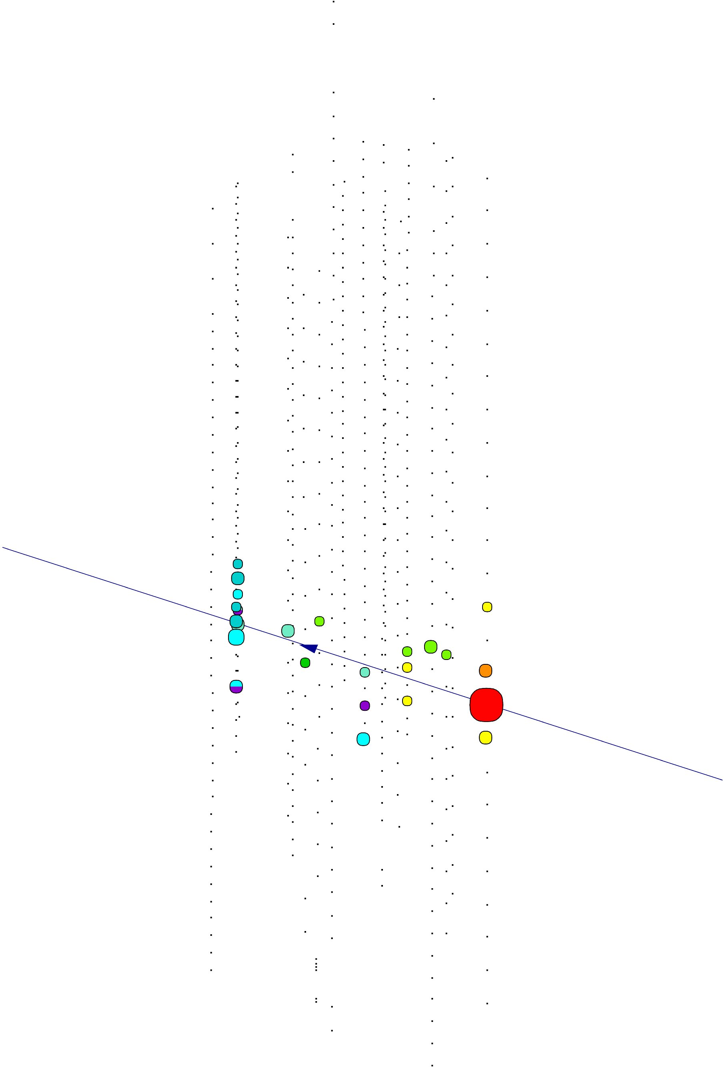
1999-2000: add 6 deeper strings
to complete AMANDA-II with 19 strings
AMANDA-II
Nearly horizontal neutrino
1 km
99/00
200 m
2 km

Slide 15
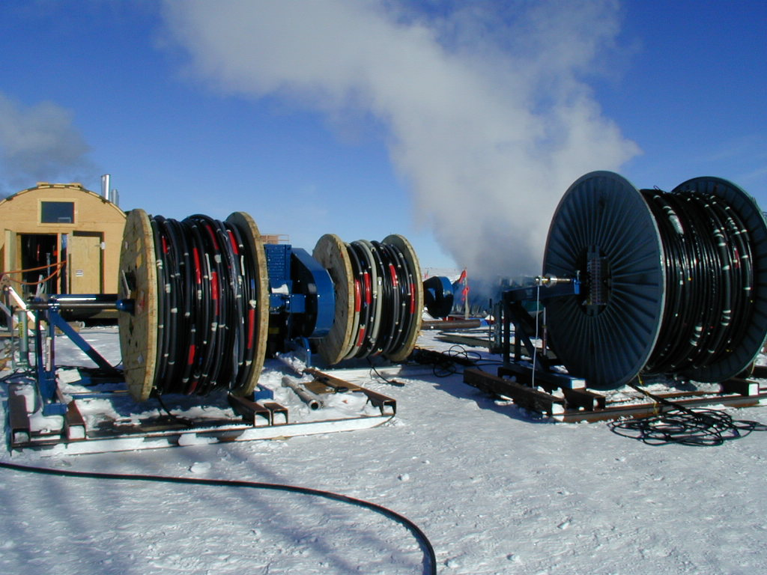
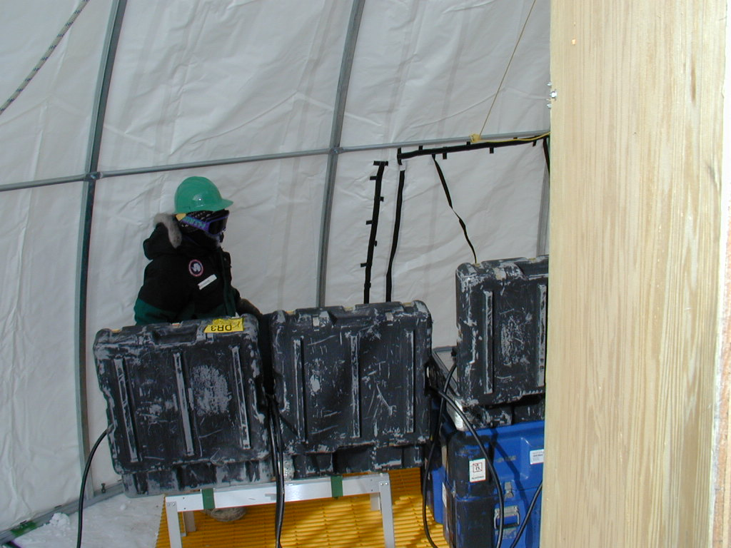

Slide 16
NATURE 2001

Slide 17
1999 – IceCube proposal
By 1999 the following ingredients for a large IceCube proposal were obtained.
A strong international collaboration has formed.
It had been demonstrated that
  the ice is excellent down to 2500m depth.
  Drilling technology is established and modeling has improved such that fuel and logistics requirements are solid (they were conservative).
  The deep Antarctic ice is suitable for building a large neutrino telescope. (AMANDA had seen neutrinos consistent with predictions.)
  A detector technology was demonstrated that would require only limited maintenance and power.
During the proposal process (2 years) AMANDA-II was completed and the first results solidified the above statements.
  Challenge that needed to be demonstrated before the final award was given, was that a University based collaborative research effort could make the transition to a very large project with adequate management etc.

Slide 18
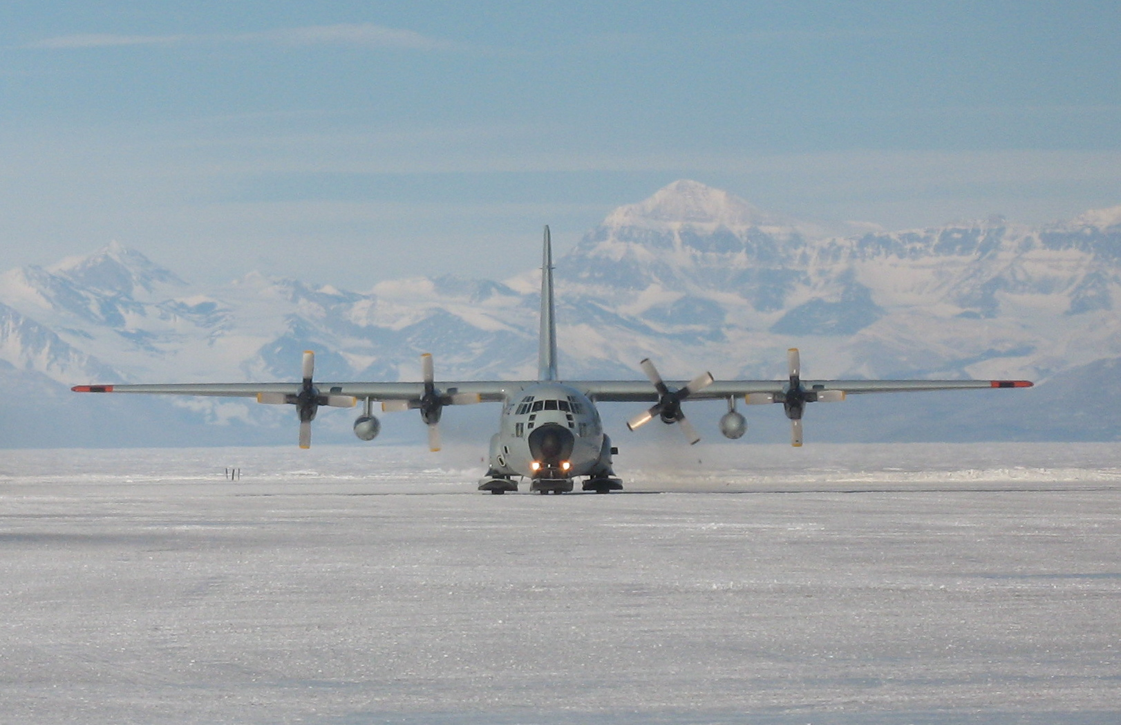
Logistics
900 tons of Cargo and fuel
300 “Hercules” LC 130 missions (skiers)

Slide 19
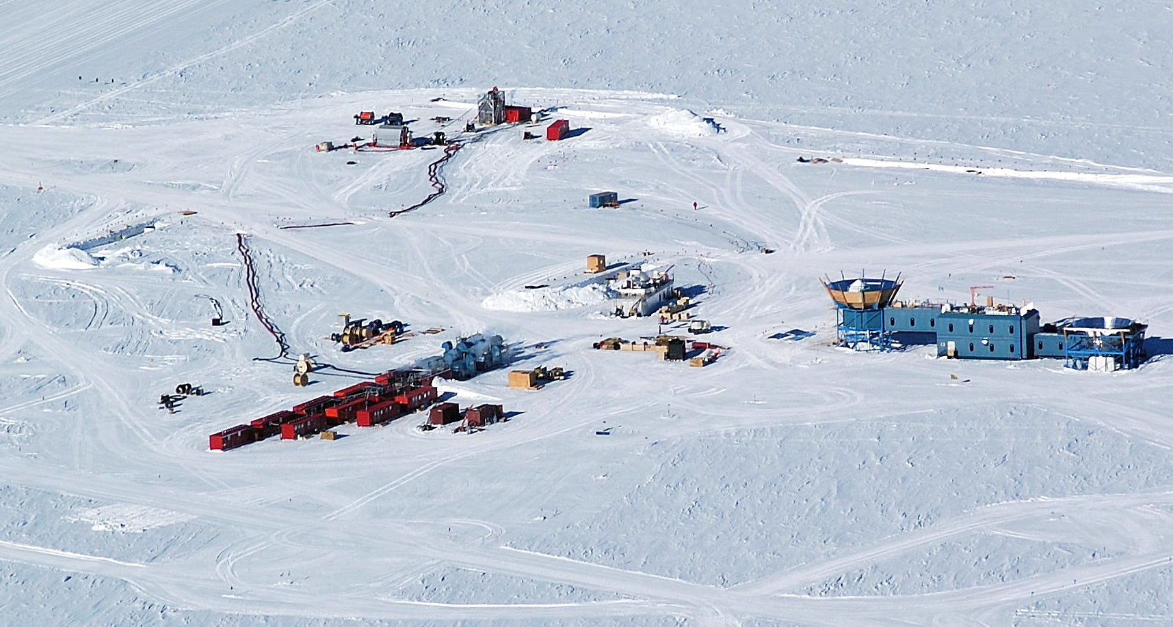
Hot Water drilling
IceCube construction

Slide 20
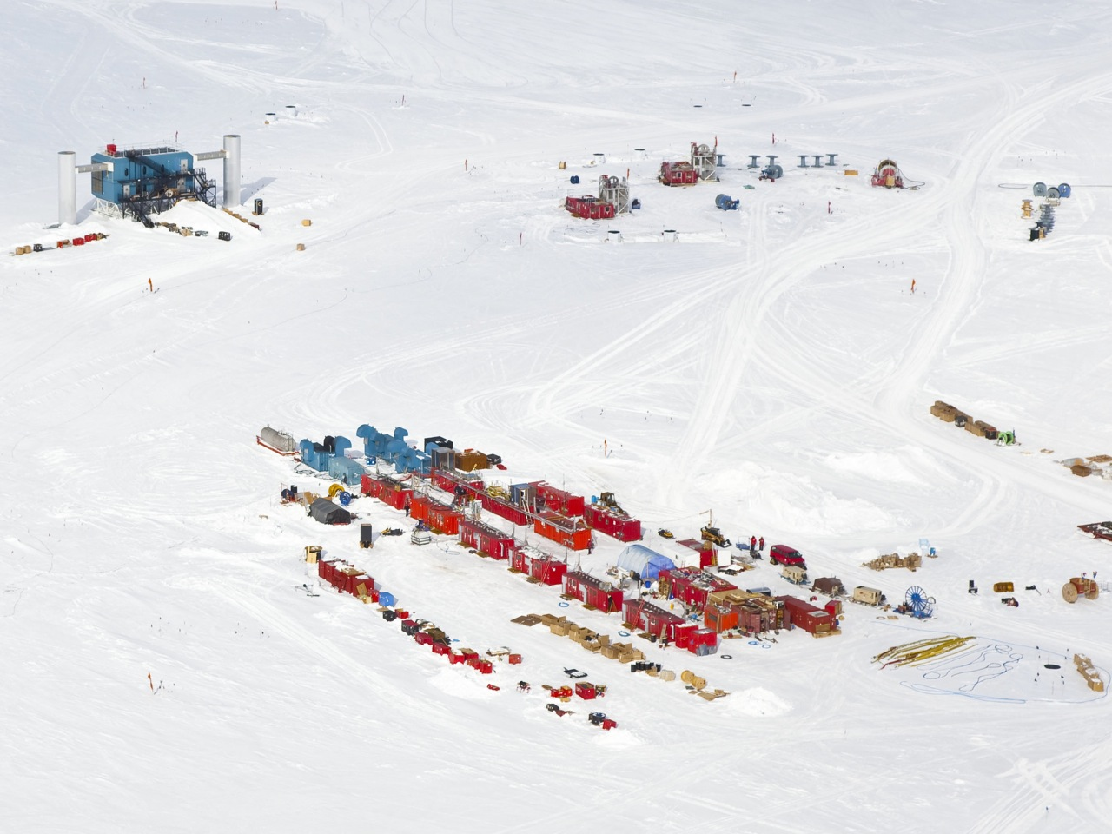

Slide 21
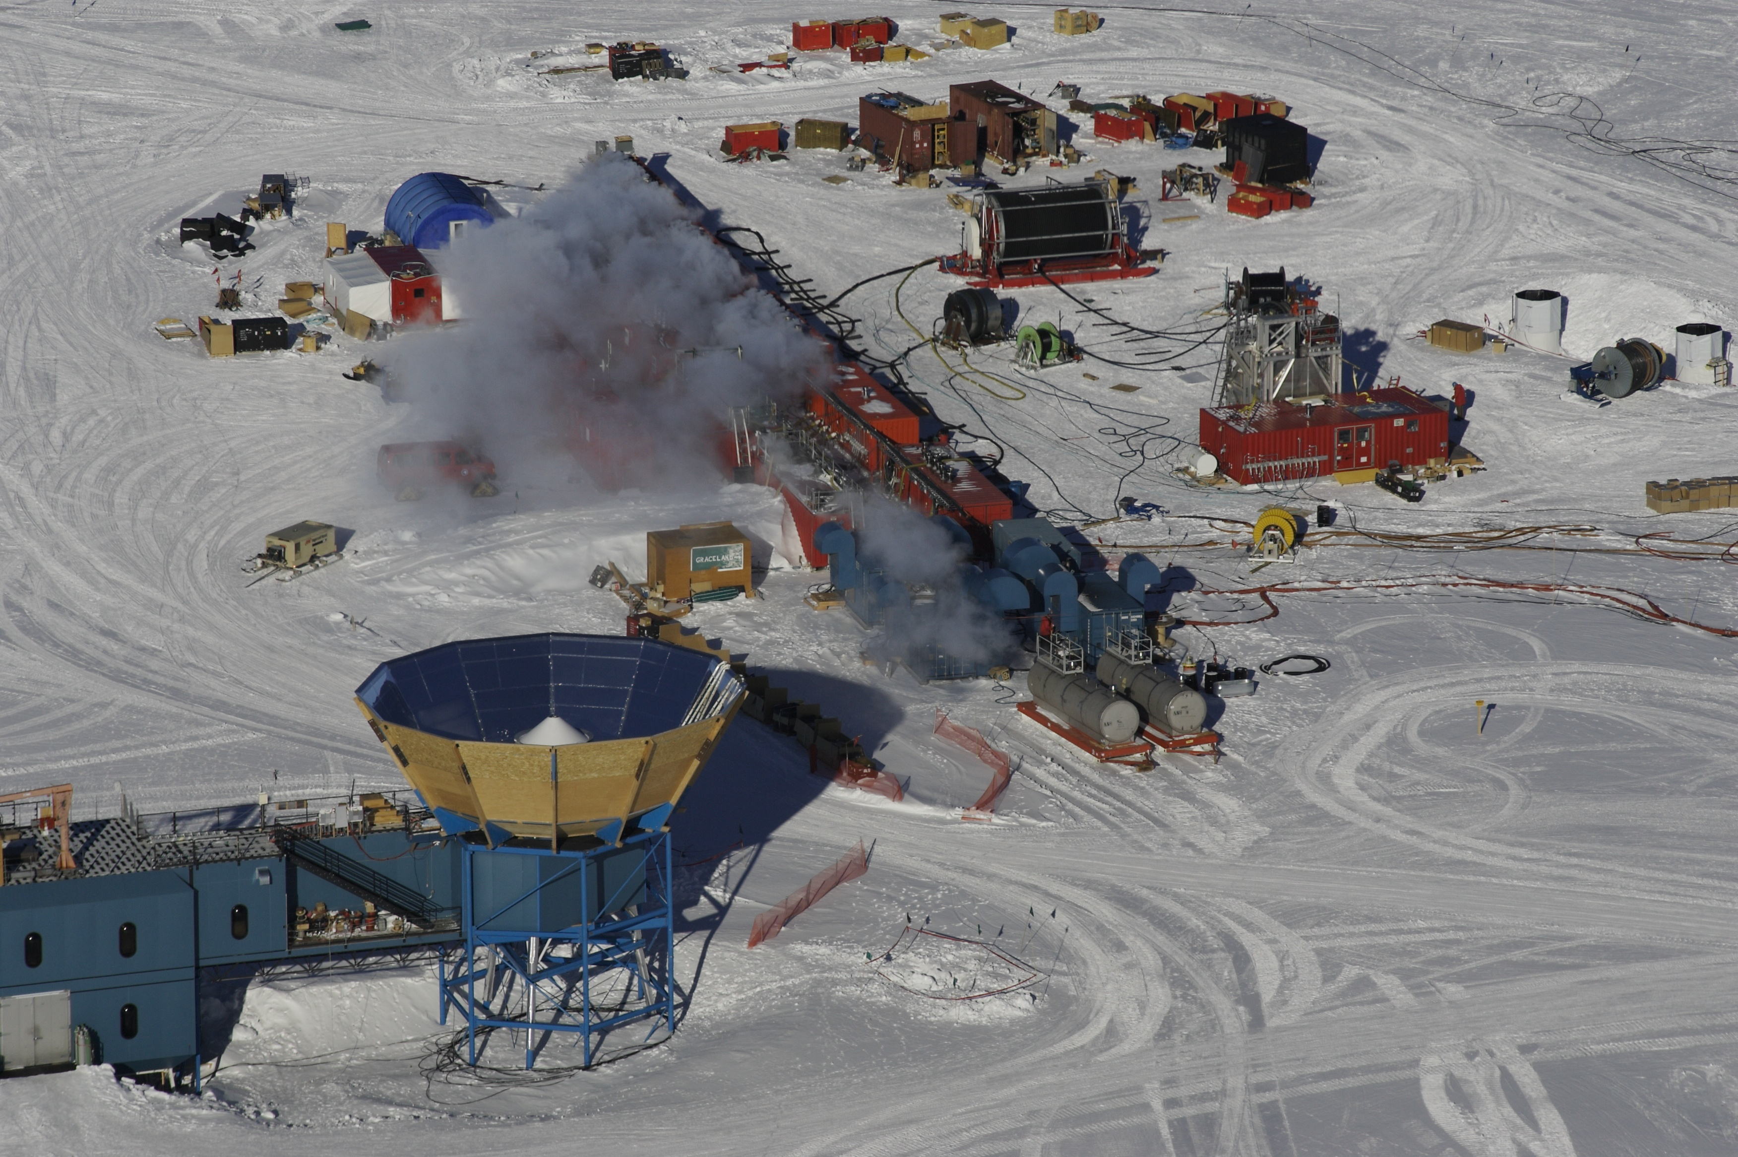
IceCube Site
The drill heating plant
Thermal power: 5 MW
Pressure: 140 bar
Flow: 800 L/m (90°C)
24 h to drill to 2500m
Most importantly:
an excellent crew of drillers!

Slide 22
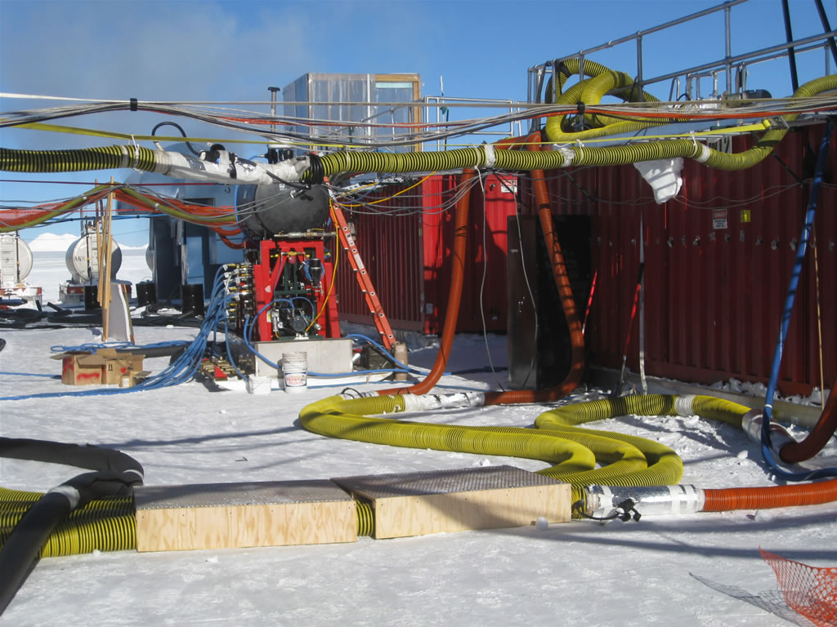

Slide 23
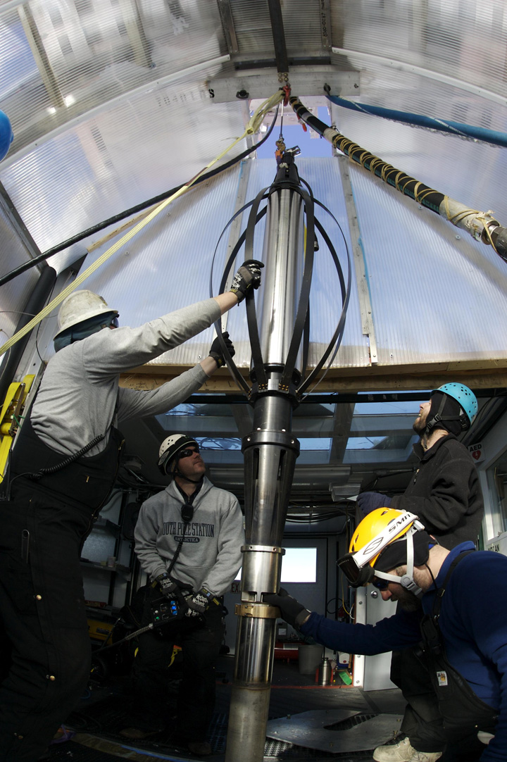
Drillers pull out the drillhead.
Safety:
A big challenge!
After 7 years, and initial difficulties,
only 3 incidents with loss of time
in >100 person years of work time.
Buy-in in safety culture,
retention of people important.

Slide 24
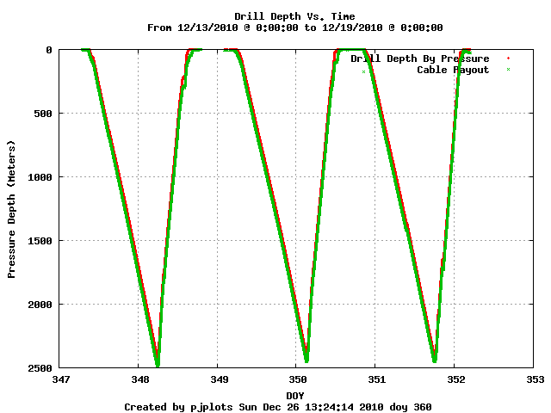
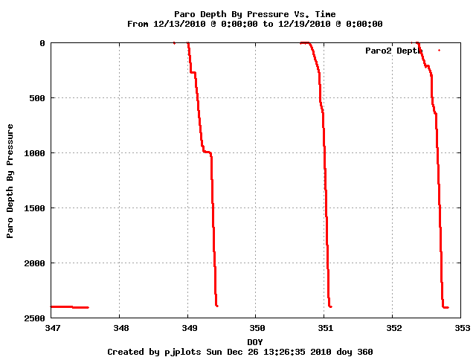
Drilling and deployment Dec. 13-18, 2010
Drill
Depth [meter]
Deploy
Day of year

Slide 25
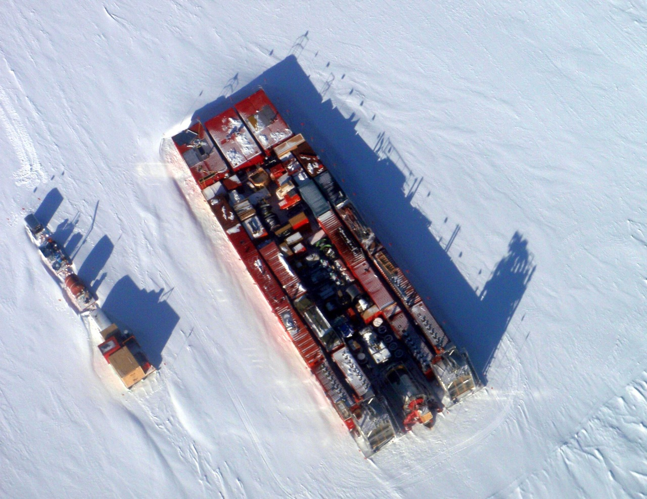
The IceCube Drill in long term storage configuration
Location: downwind from dark sector

Slide 26
Comment on possible future drill mobilization
Most drill equipment is at South Pole
Exceptions:
  drill hose (McMurdo, warmer),
  drill heads, motor drives, computers (Wisconsin)
  one generator (ConUS for refurbishment)
Mobilization:
  takes 4 weeks longer than usual IceCube season (start drilling second half of December)
Drill is complex system, removing pieces will likely result in substantial redesign, rebuild efforts.

Slide 27
60 photomultipliers/string
Installation time:
10h/string
Cables meet sensors for the first
time during the deployment.
Quality program requires close
collaboration with manufacturers.

Slide 28
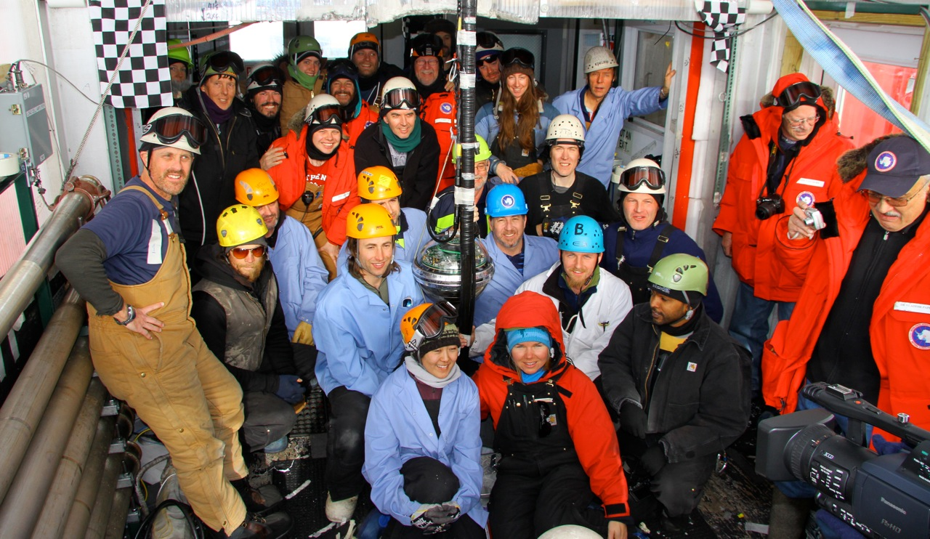
Dec 18, 2010 Last DOM deployed.

Slide 29
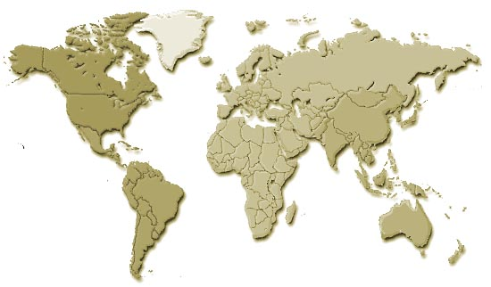
The IceCube Collaboration
Germany:
DESY-Zeuthen
Universität Mainz
Universität Dortmund
Universität Wuppertal
Humboldt Universität
MPI Heidelberg
RWTH Aachen
Sweden:
Uppsala Universitet
Stockholm Universitet
USA:
Bartol Research Institute, Delaware
University of California, Berkeley
University of California, Irvine
Pennsylvania State University
Clark-Atlanta University
Ohio State University
Georgia Tech
University of Maryland
University of Alabama, Tuscaloosa
University of Wisconsin-Madison
University of Wisconsin-River Falls
Lawrence Berkeley National Lab.
University of Kansas
Southern University and A&M
College, Baton Rouge
University of Alaska, Anchorage
UK:
Oxford University
Netherlands:
Utrecht University
Switzerland:
EPFL
Belgium:
Université Libre de Bruxelles
Vrije Universiteit Brussel
Universiteit Gent
Université de Mons-Hainaut
Japan:
Chiba University
New Zealand:
University of Canterbury
33 institutions, ~250 members
http://icecube.wisc.edu
Notes:
PAS CITER TOUS LES PAYS MAUS JUSTE UW HALZEN

Slide 30
AMANDA and IceCube deployments
IceTop tanks not inlcuded in table

Slide 31
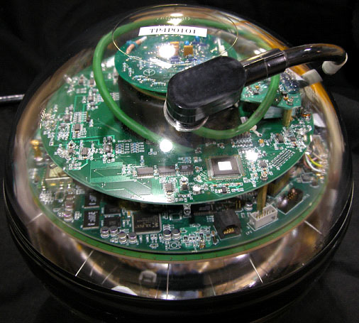
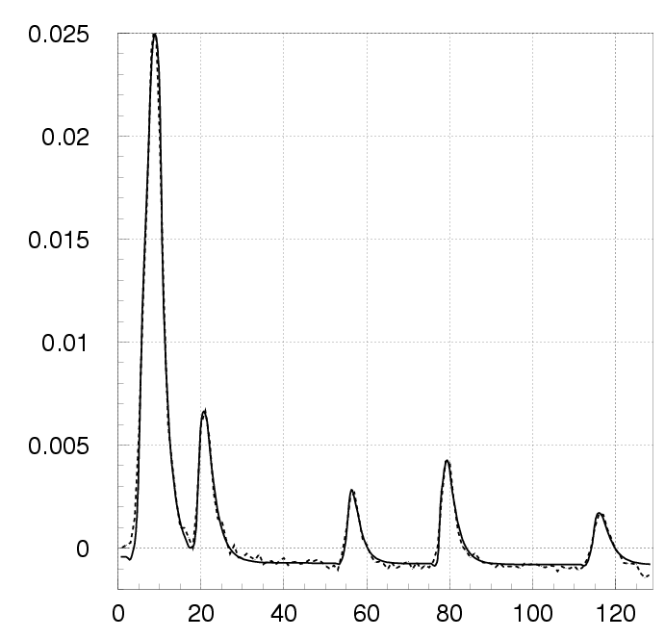
Digital Optical Module (DOM)
PMT: 10 inch Hamamatsu
Power consumption: 3 W
Digitize at 300 MHz for 400 ns with custom chip
40 MHz for 6.4 μs with fast ADC
Dynamic range 500pe/15 nsec
Flasherboard with 12 LEDs
Local HV
Clock stability: 10⁻¹⁰ ≈ 0.1 nsec / sec
Synchronized to GPS time every ≈10 sec
Time calibration resolution = 2 nsec
Digitized Waveform

Slide 32
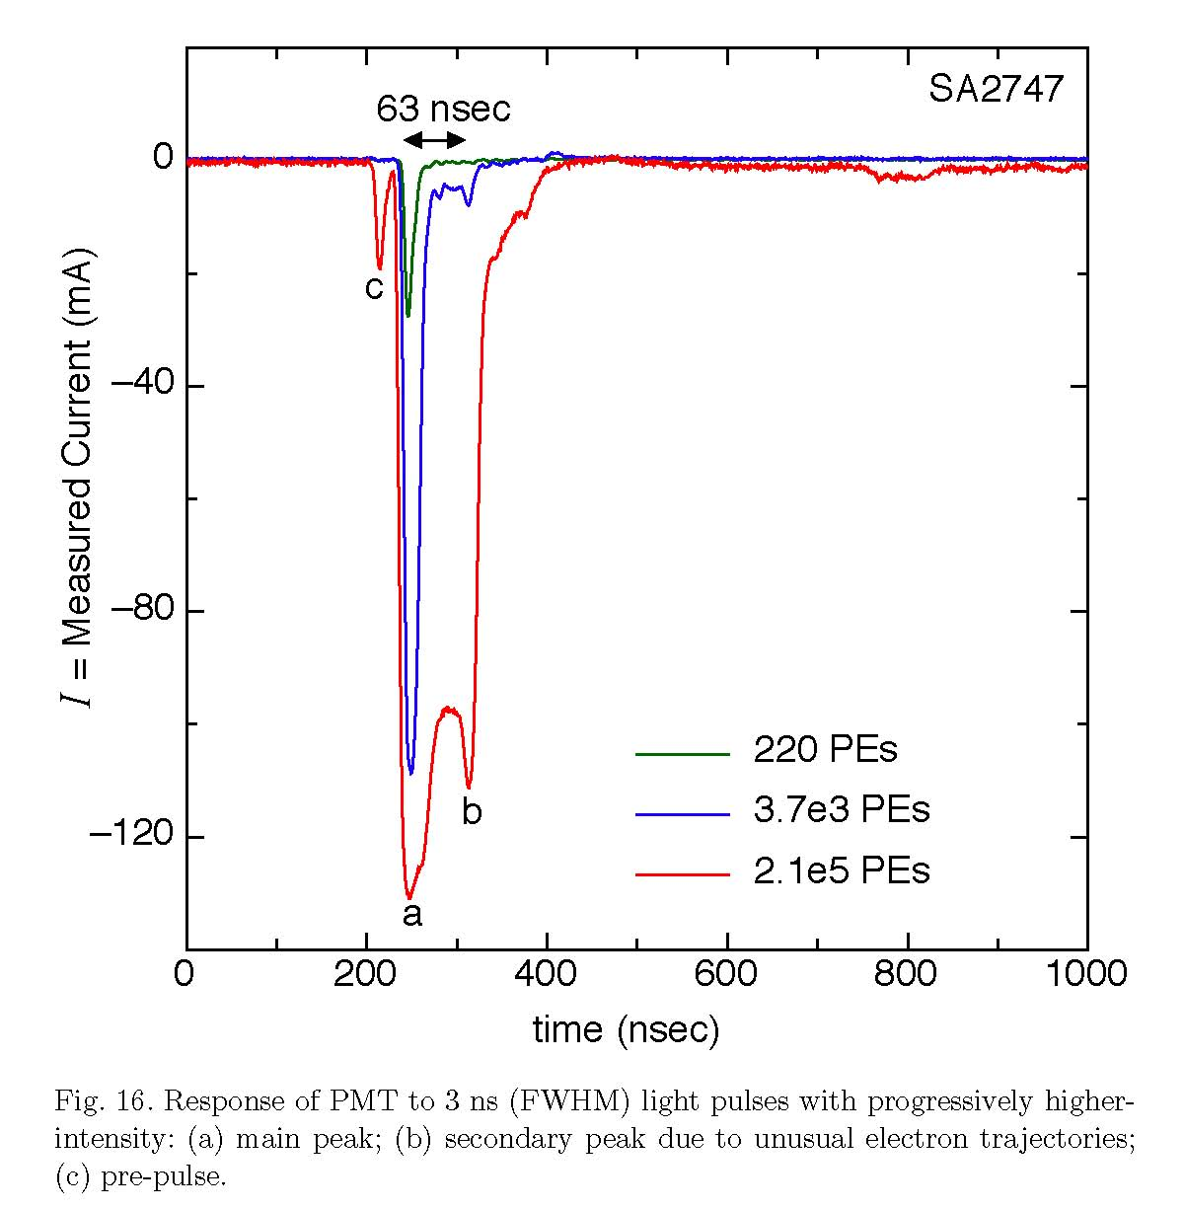
PMT response -
Optical characteristics of DOM
Detailed measurements in lab and analysis of test data.
Calibration and Characterization of the IceCube Photomultiplier Tube. R. Abbasi et al., Feb 2010. 40pp. e-Print: arXiv:1002.2442 [astro-ph.IM]
Example:
PMT response to high amplitude pulses
Main pulse
Secondary peak due to unusual electron trajectories
Pre-pulse (from first dynaode, are below spe threshold. Gain ratio accordiing to first dynode gain)

Slide 33
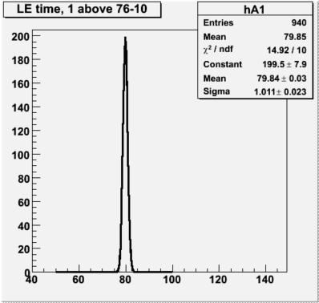
Time resolution:
~1ns for bright pulses
Time difference between neighboring DOMs fired with (bright) flasher pulses: 1 ns.
For SPE pulses add jitter (3 nsec)

Slide 34
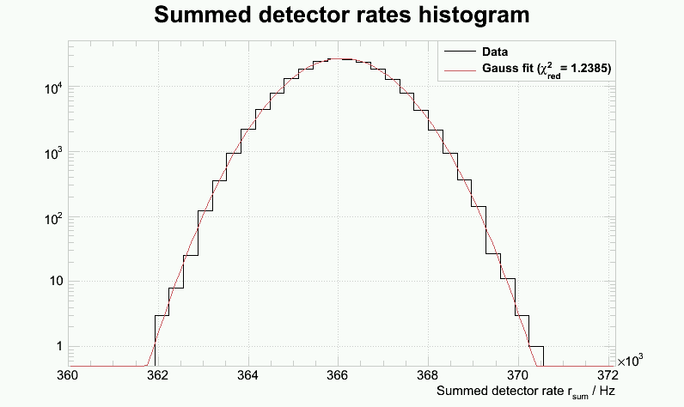
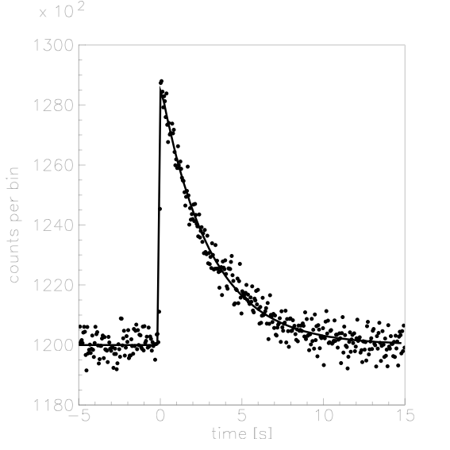
Noise behavior
Very low noise rate due use of low radioactivity glass and good PMT characteristics.
Average rate / sensor (w deadtime):
284.9 +/- 26.2 Hz
sensor noise: stable and as expected.
simulated count rates from
10kpc supernova collapse
Count rates
→ msec resolution of neutrino
emission profile of galactic supernova core collapse
0 5 10 sec

Slide 35
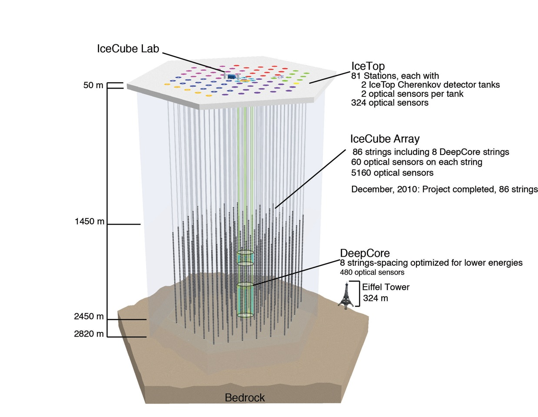
86 strings
(8 Deep Core)
81 IceTop stations
5484 optical sensors
1 billion tons of ice
35

Slide 36
Reliability of sensors
- survival rates before and after commissioning
Some numbers regarding reliability:
Accumulated lifetime as of April 1, 2011: 13,400 DOM years
Lost DOMs during deployment and freeze-in (fail commissioning): 127
Lost DOMs after successful freeze-in and commissioning: 18
  Assuming constant failure rate: The IceCube sensors would live for about 740 years (MTBF).

Slide 37
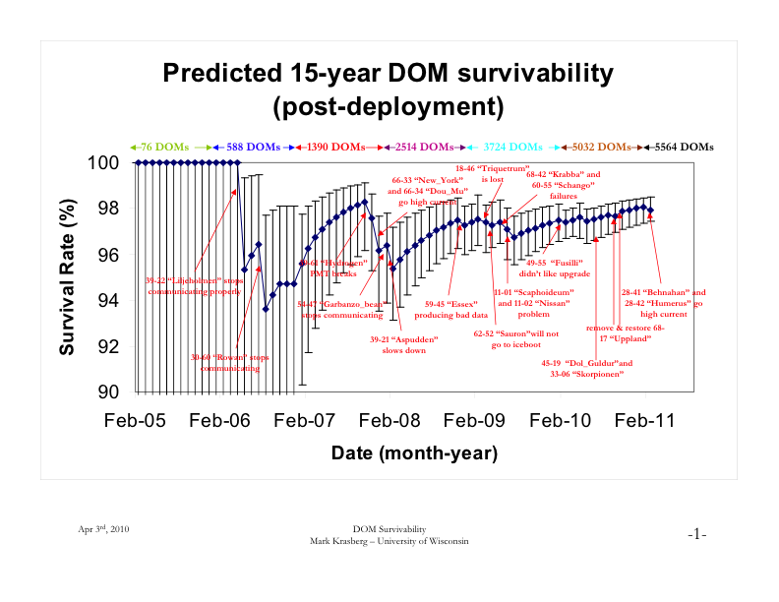

Slide 38
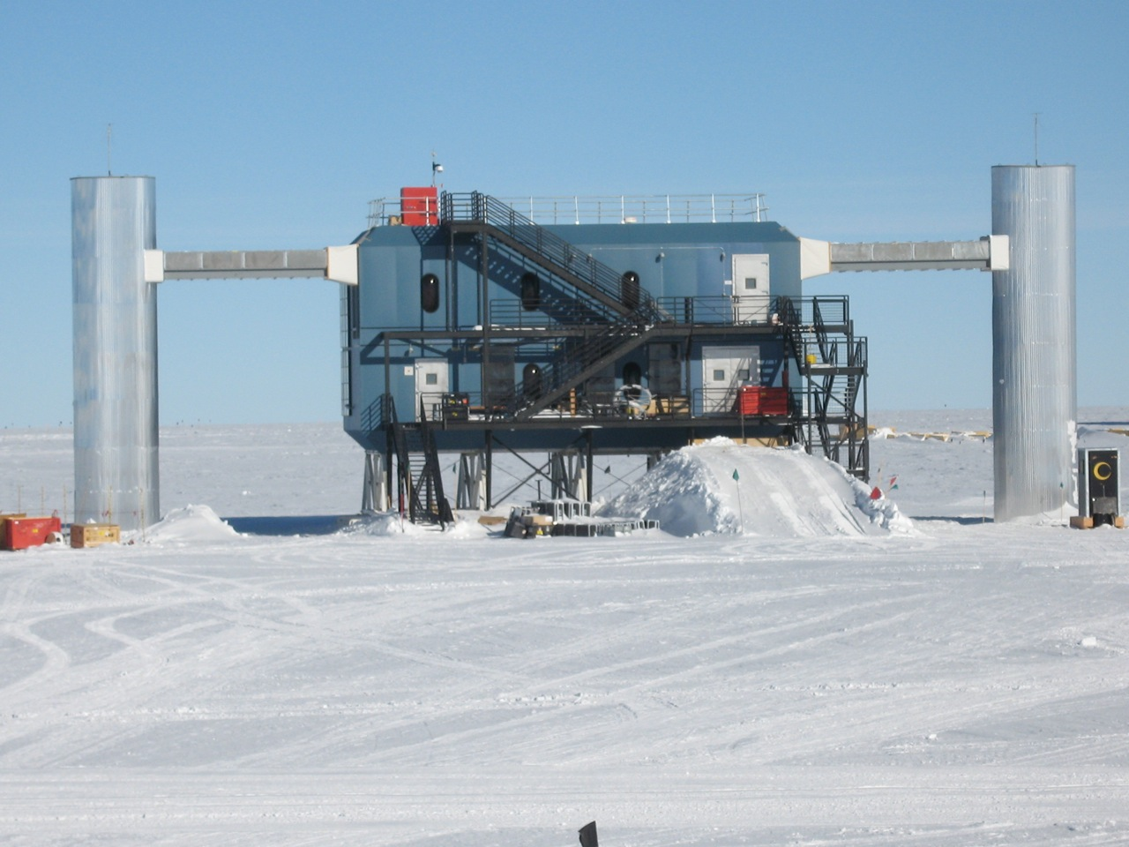
Operational support:
ICL maintenance
~60 kW power to electronics
90 GB/day
2 winterovers
summer population (around 5-7 pop Dec - Jan)

Slide 39
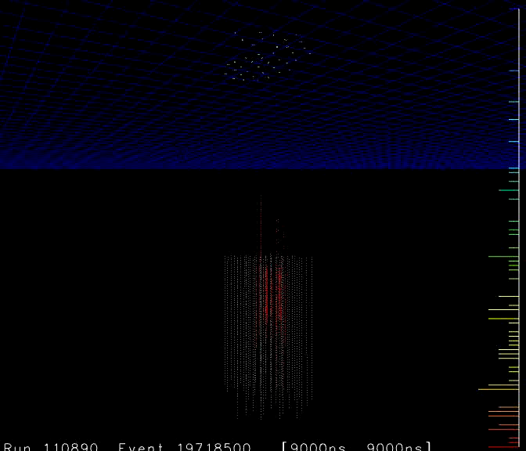
Air shower of ~3E17 eV
Observed by IceTop,
Then by Deep detector strings
2000µ >400GeV
Ice
cosmic ray physics
mass independent
energy resolution,
composition
veto
calibration

Slide 40
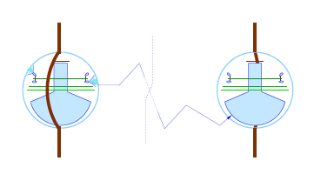
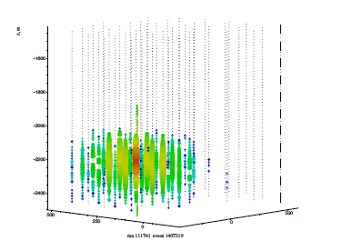
Flasher events used for calibration
All sensors are equipped
with a set of 12 LED flashers.
A 30 ns pulse of only
10 billion photons (400nm)
is visible to a distance of 600m.
These measurements are used
to calibrate the detector
- time
geometry
optical properties of the ice

Slide 41
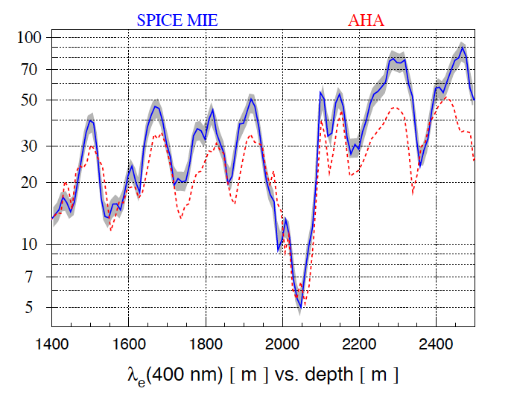
The Ice is very clear
Effective scattering length vs Depth
in internal review
for publication
Eff. Scattering length [m]

Slide 42
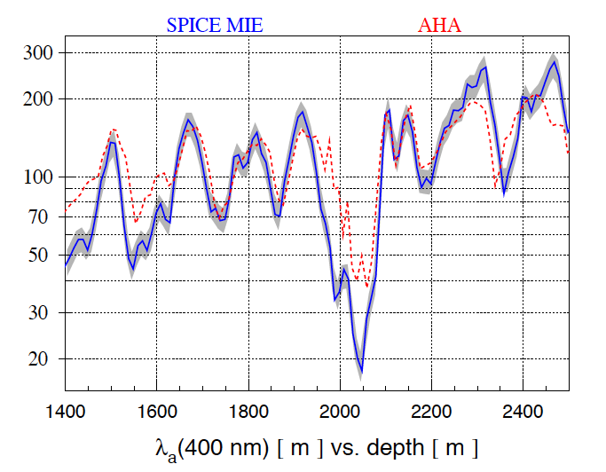
Absorption length vs Depth
Absorption length [m]

Slide 43
Absorption length vs Depth
Absorption length [m]
The South Pole Ice is very clear and well understood. (new paper in preparation)
At depths below 2100m it even better than expected and then assumed in previous models.
→ Excellent medium for particle detection

Slide 44
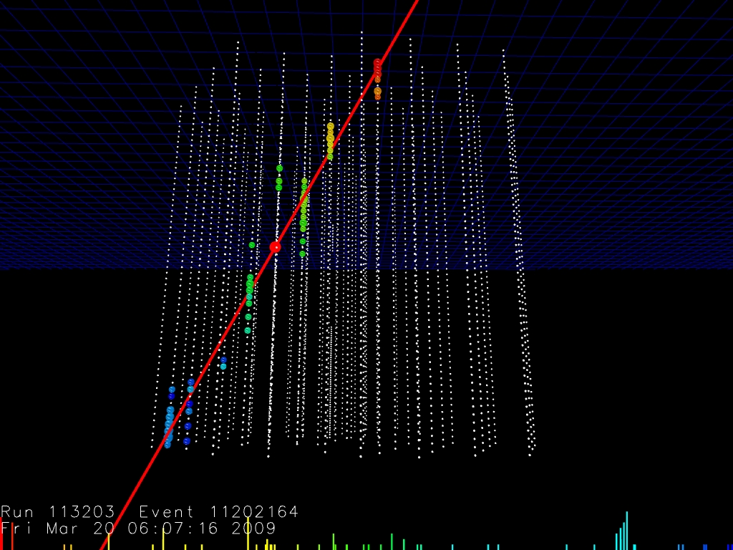
Events

Slide 45
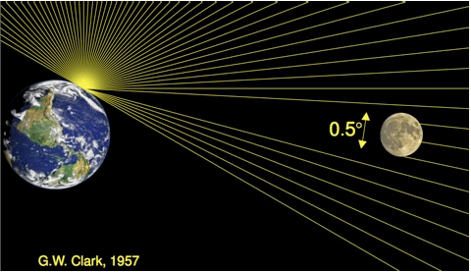
Cosmic rays get stuck in the Moon –
Does IceCube see the moon (shadow)?

Slide 46
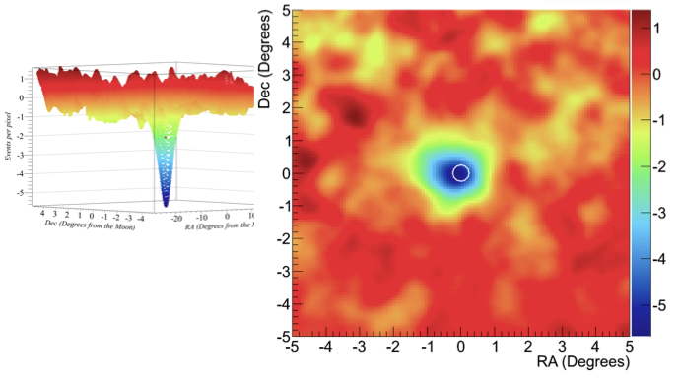
Moon shadow observed in muons –
IceCube points in the right direction!
Center of moon is spot on
to a precision of <0.1 degrees.
Statistical significance with
IC 59: > 10 sigma

Slide 47
Detector operation, rates
Detector performance parameters increase faster than the number of strings
  Longer muon tracks (km scale)
  Improved analysis techniques
Strings | Year | Livetime | μ rate (Hz) | ν rate (/day) | angular resol./°
AMANDAII(19) | 2000-2006 | 3.8 years | 100 | 5 / day | 2.4
IC22 | 2007 | 275 days | 550 | 18 / day | 1.4
IC40 | 2008 | 375 days | 1100 | 38 / day | 0.75
IC59 | 2009 | 360 days | 1900 | 129 / day
IC86test | 2011 | 1 day | 2650 |  | 0.5

Slide 48
Detector operation, rates
Detector performance parameters increase faster than the number of strings
  Longer muon tracks (km scale)
  Improved analysis techniques
Strings | Year | Livetime | μ rate (Hz) | ν rate (/day) | angular resol./°
AMANDAII(19) | 2000-2006 | 3.8 years | 100 | 5 / day | 2.4
IC22 | 2007 | 275 days | 550 | 18 / day | 1.4
IC40 | 2008 | 375 days | 1100 | 38 / day | 0.75
IC59 | 2009 | 360 days | 1900 | 129 / day
IC86test | 2011 | 1 day | 2650 |  | 0.5

Slide 49
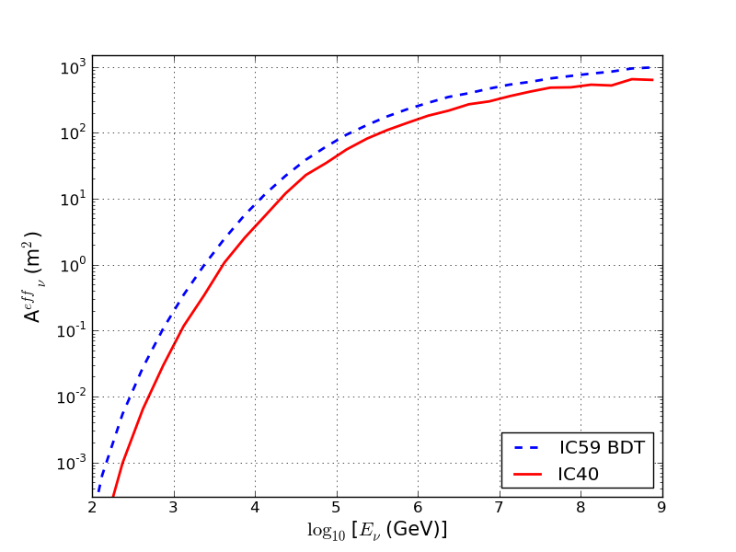
Detector operation, rates
Detector performance parameters increase faster than the number of strings
  Longer muon tracks (km scale)
  Improved analysis techniques
Improvement in effective area
from IC40 to IC59.
Strings | Year | Livetime | μ rate (Hz) | ν rate (/day) | angular resol./°
AMANDAII(19) | 2000-2006 | 3.8 years | 100 | 5 / day | 2.4
IC22 | 2007 | 275 days | 550 | 18 / day | 1.4
IC40 | 2008 | 375 days | 1100 | 38 / day | 0.75
IC59 | 2009 | 360 days | 1900 | 129 / day
IC86test | 2011 | 1 day | 2650 |  | 0.5

Slide 50
Detector operation, rates
Detector performance parameters increase faster than the number of strings
  Longer muon tracks (km scale)
  Improved analysis techniques (expect still significant improvement in the future still)
Strings | Year | Livetime | μ rate (Hz) | ν rate (/day) | angular resol./°
AMANDAII (19) | 2000-2006 | 3.8 years | 100 | 5 / day | 2.4
IceCube 22 | 2007 | 275 days | 550 | 18 / day | 1.4
IceCube 40 | 2008 | 375 days | 1100 | 38 / day | 0.75
IceCube 59 | 2009 | 360 days | 1900 | 129 / day
IceCube 86 test | 2011 | 1 day | 2650 |  | 0.5 (est)
Angular resolution at high energies has still much potential to improve. Current resolution still far from statistical limit.

Slide 51
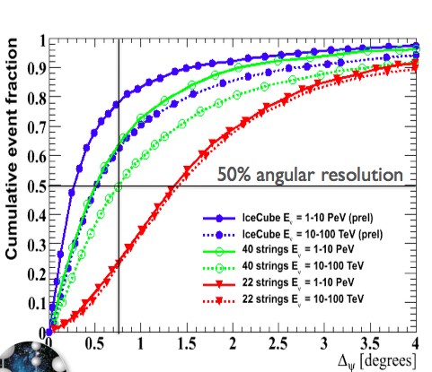
Angular resolution
Median angular resolution
10 – 100 TeV (1 – 10 PeV)
IC40: 0.76° (0.5°)
IceCube: 0.5° (0.3°)
Design expectation 2005: 0.75°
Improved algorithms: better resolution, and resolution improves with energy.
(original performance projection: Astropart.Phys.20:507-532,2004, astro-ph/0305196)

Slide 52
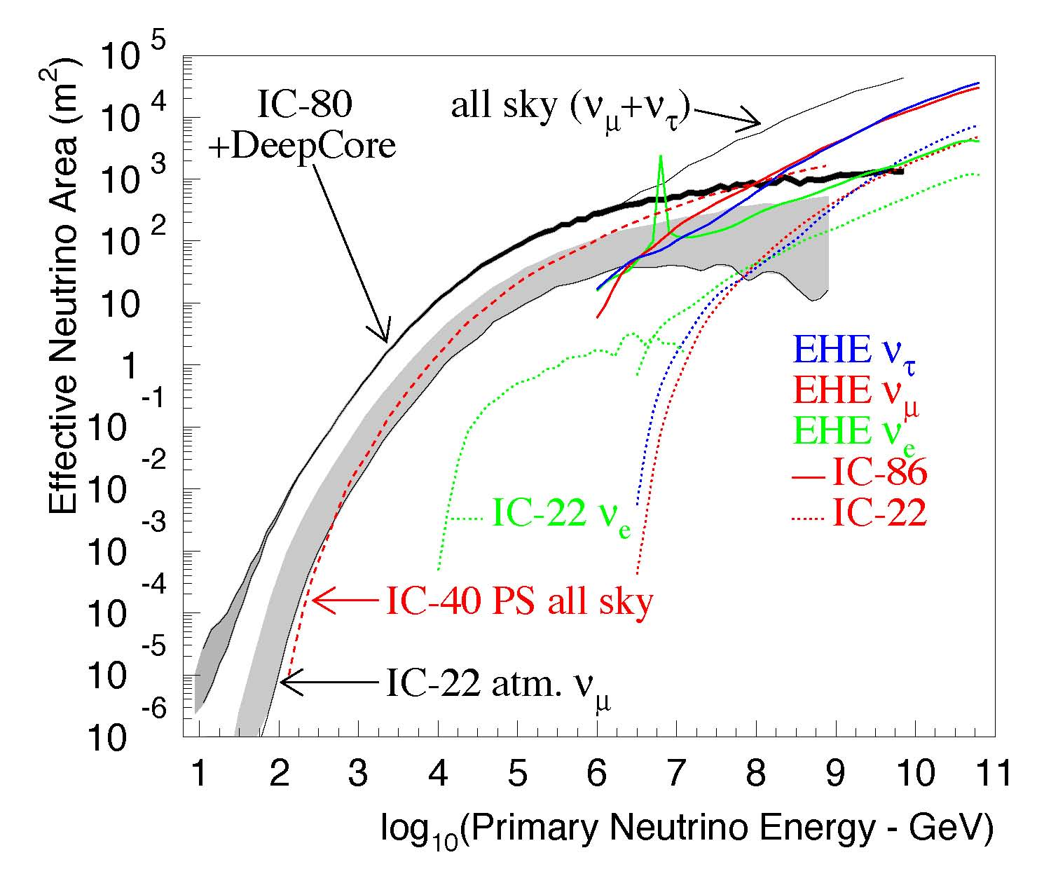
Neutrino effective areas
- Why neutrino telescopes can be used over a wide energy range.
Area at 100 TeV (1TeV)
AMANDA-II: 3m² (0.005)
IceCube 86: 100m² (0.3)
Deep Core lowers threshold from 100 GeV to 10 GeV.
(trigger)
(trigger)
Effective area for ν_{μ}
Strong rise with energy:
  Increase of muon range with energy up to PeV

Slide 53
Outlook
New projects in consideration or prototype phase will be discussed in other talks in this session:
DM-ICE: A new direct dark matter detector in the center of IceCube
ARA, a large radio array (100km^2) for highest energy (GZK) neutrinos
Deep Core upgrade by 18 strings for dark matter and neutrino physics and supernova detection beyond the galaxy
  Visions of extremely dense array inside IceCube to solve precision particle physics questions (eg proton decay)
Also in consideration, a full air shower veto using a surface radio component / basically an extension of IceTop

Slide 54
Summary
Major construction of IceCube has been completed in December 2010, on budget and on schedule.
IceCube drill currently in storage at Pole
High reliability and operational stability
Performance characteristics meet or exceed design goals.

