Slide 1
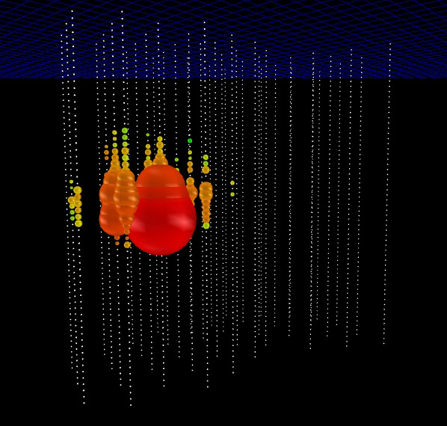
Searching for a Diffuse Flux of Ultra High-Energy Extraterrestrial Neutrinos with IceCube
Henrik Johansson, for the IceCube collaboration

Slide 2
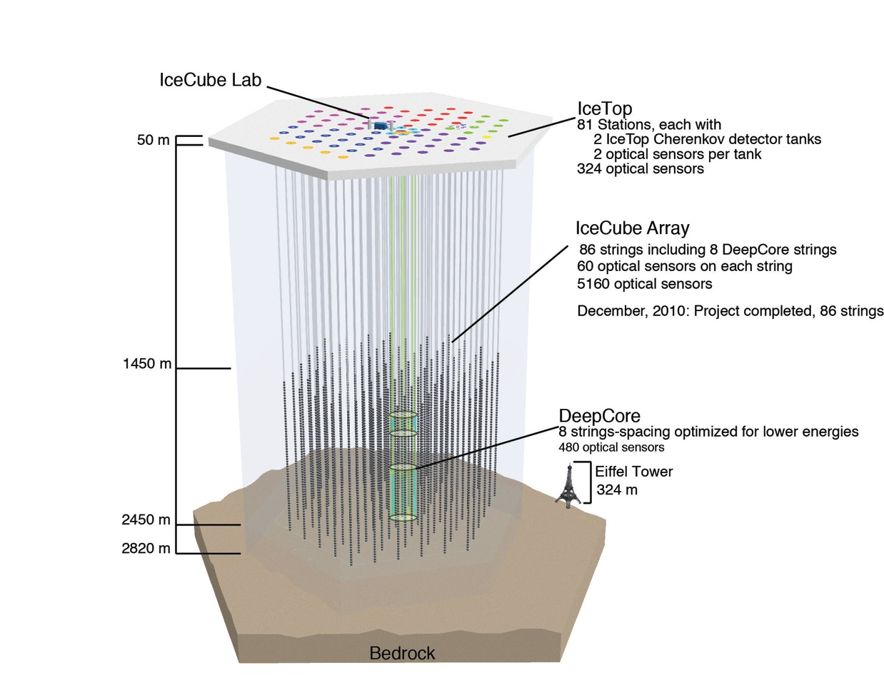
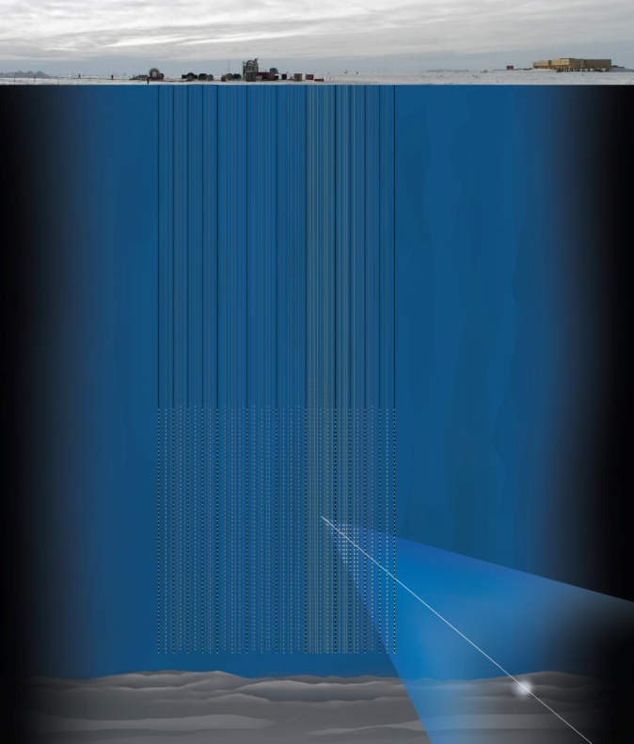
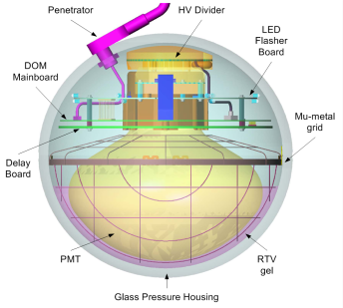
The IceCube Neutrino Observatory

Slide 3
Science goals
Neutrino astronomy is still a young field – only confirmed extraterrestrial sources are the sun and supernova SN1987a. The IceCube neutrino observatory is versatile and allows for a wealth of science. Science goals include:
Reveal sources of the highest energy cosmic rays
Provide information about the nature of the energy release processes behind objects such as AGNs, GRBs
Determine the distribution of cosmic accelerators in the universe
Explore the nature of dark matter
Constrain neutrino oscillation parameters

Slide 4
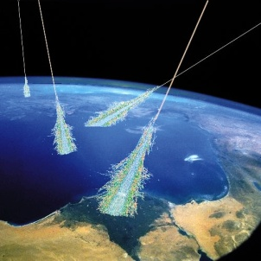
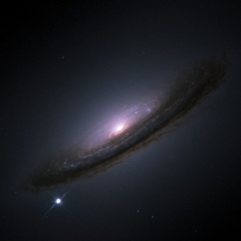
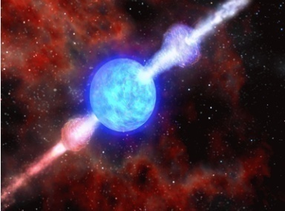
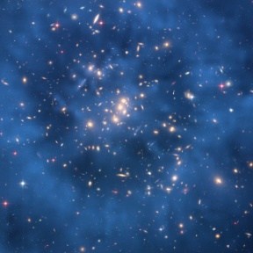
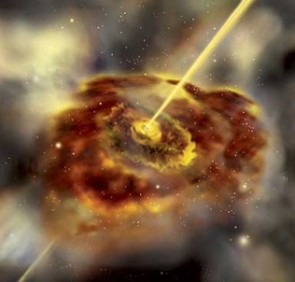
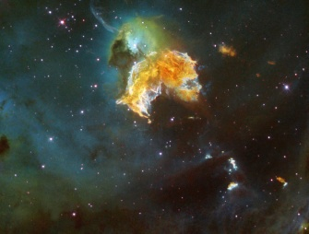
Neutrino sources
Atmospheric neutrinos
Supernovae
Gamma-ray bursts
MeV
GeV
TeV
PeV
EeV
GZK neutrinos
Dark matter
Active galactic nuclei
Supernova remnants

Slide 5
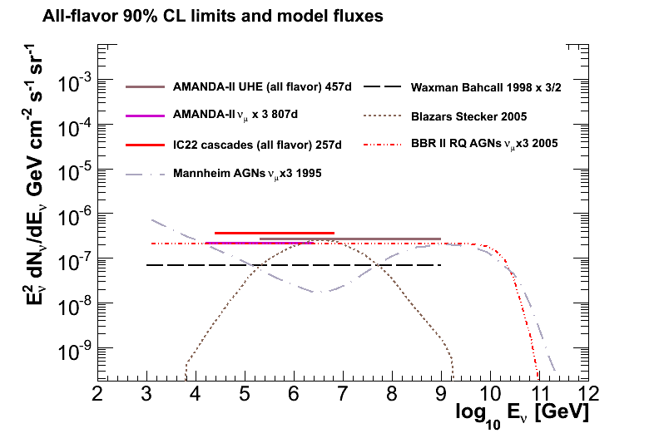
Types of analyses
Point source analyses – resolved and localized flux. Signal region is known, background can be estimated from experimental data.
Diffuse analyses – unresolved flux. Signal region not well known or localized, background estimated from simulation. Simulation verified on subsample of experimental data.

Slide 6
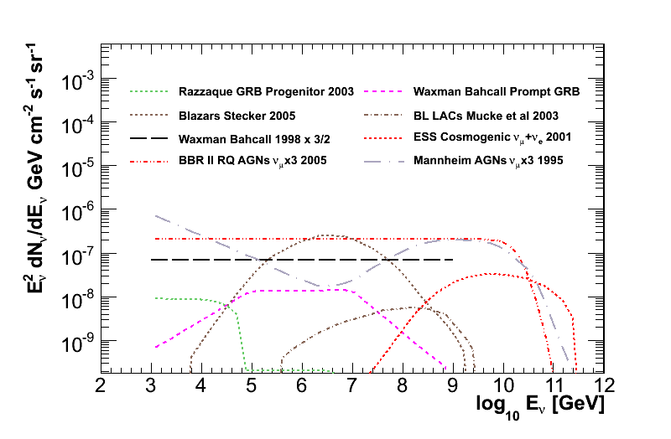
Signal – diffuse analyses
Waxmann-Bahcall upper bound for an all-flavor neutrino flux with energy spectrum E⁻² is 6.75e-8 GeV cm⁻² s⁻¹ sr⁻¹.

Slide 7
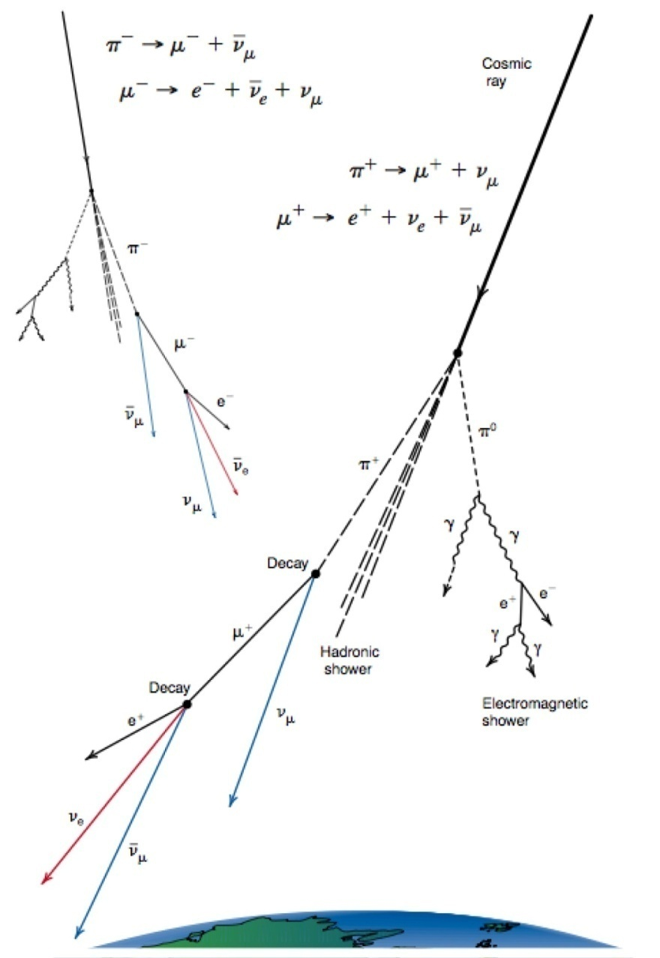
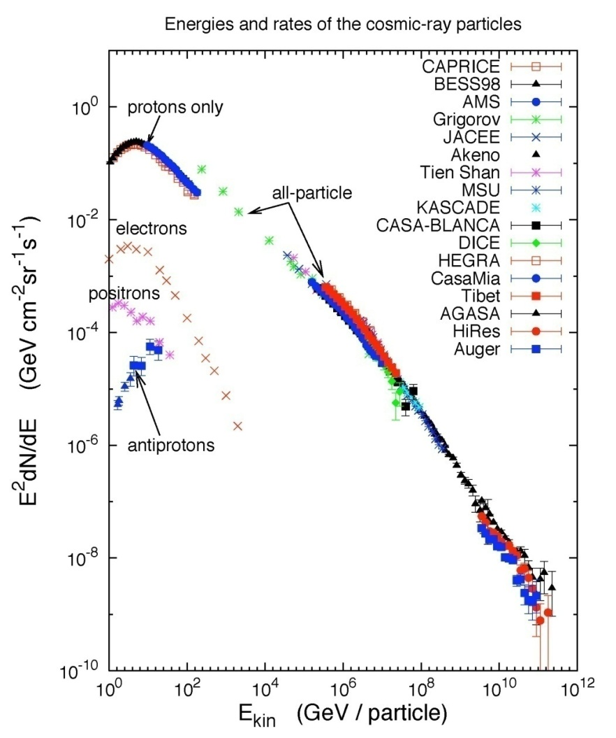
Background – atmospheric μ and ν
Atm μ absorbed in
Earth – down-going
in detector
~E^{-3.2}
~E^{-2.7}

Slide 8
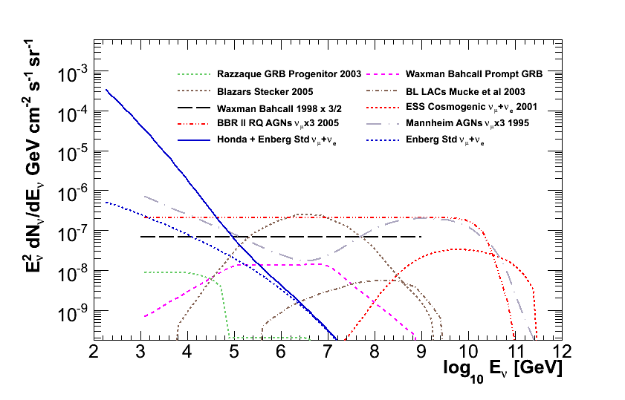
Background – atmospheric ν
Signal energy spectrum, typically E⁻², is harder than for atmospheric muons and neutrinos, which follows cosmic-ray spectrum or softer.

Slide 9
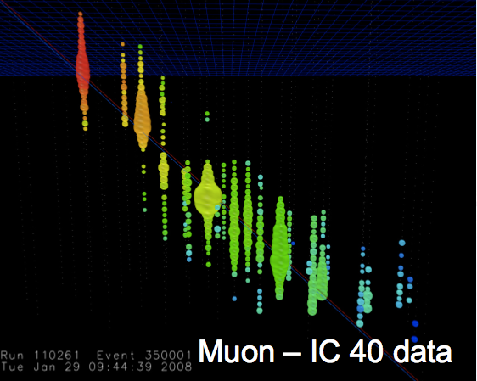
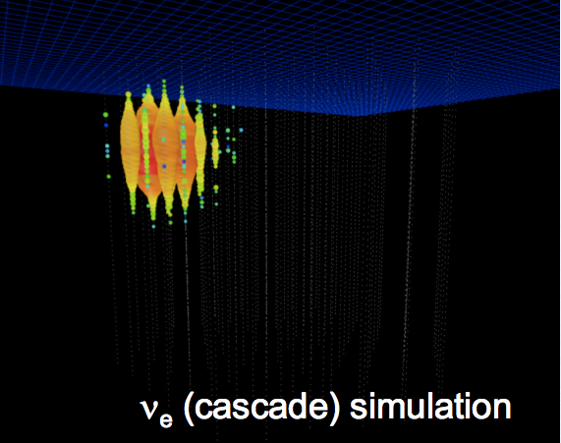
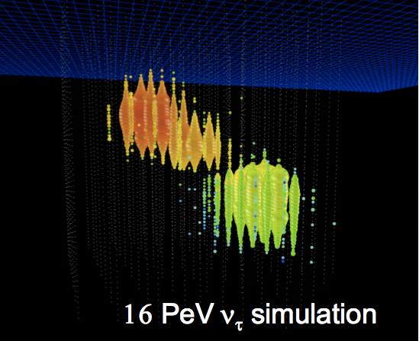
Event topology
Tracks:
Through-going muons
Pointing resolution < 1°
Cascades:
All-flavor ν neutral current
ν_{e} and low energy ν_{τ} charge current
Energy resolution contained events ~10% in log(E)
Composite:
Starting tracks
High energy ν_{τ} (double bangs, lollipops)
Good directional and energy resolution

Slide 10
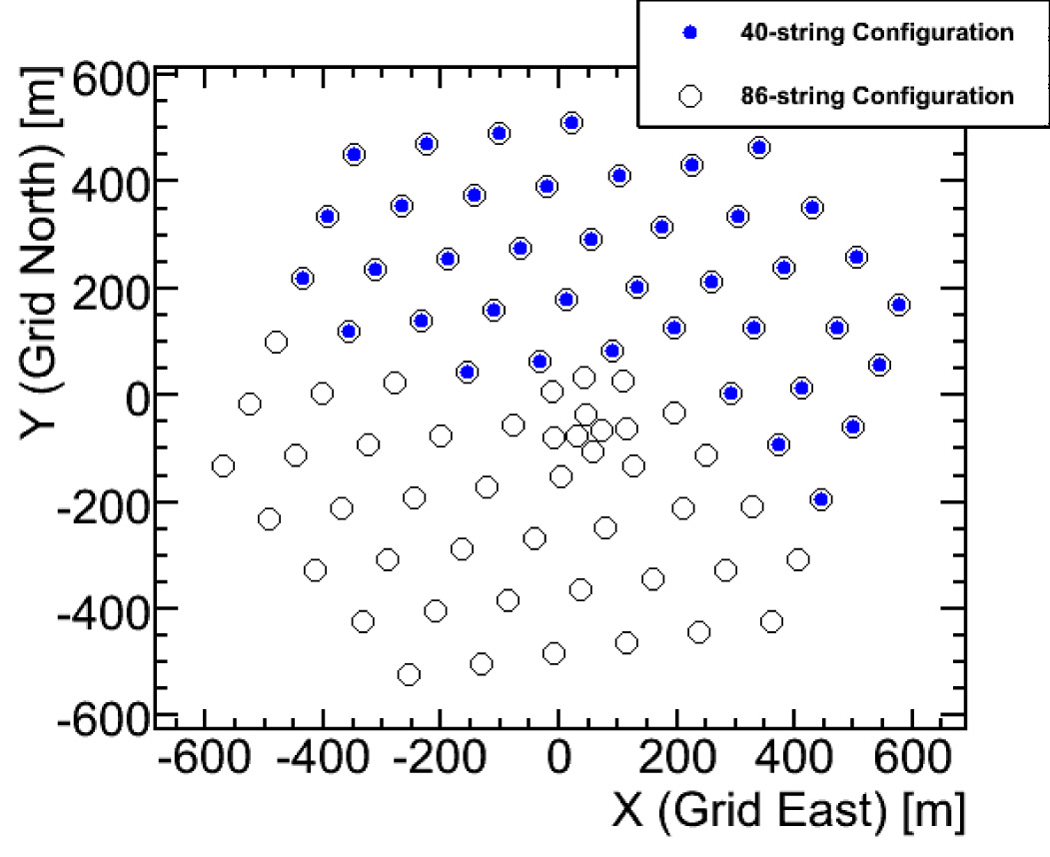
IC40 UHE diffuse analysis
Experimental data from 2008 - 2009

Slide 11
IC40 UHE diffuse analysis
Cascade stream
Track stream
Three event streams are defined based on signal and background event topology.
First IceCube analysis to employ this type of structure.
Quality cut I
Down-going
Up-going
Quality cut II
Energy cut
Coinc cut
Coinc cut
Cascade BDT
Down-going track BDT
Up-going
track BDT

Slide 12
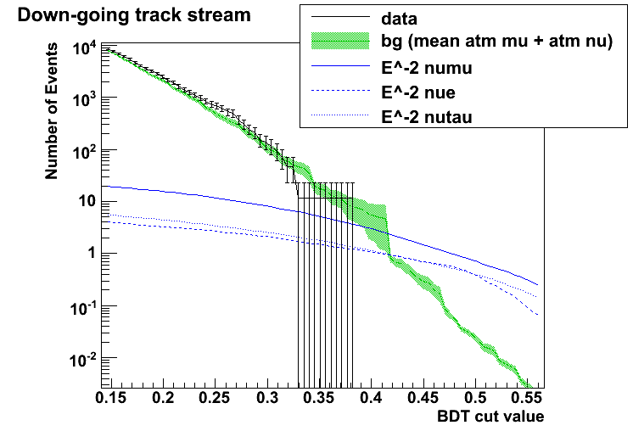
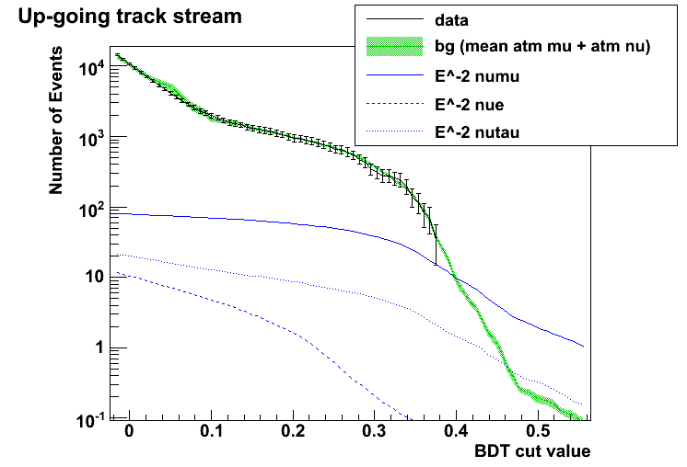
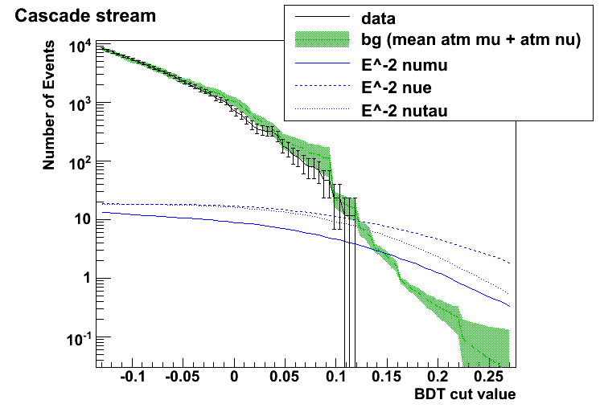
A final cut was defined as an OR between cuts on each of the three BDTs.
The final cut was optimized to give the best sensitivity (”model rejection factor”) to a Waxmann-Bahcall E⁻² test signal flux with energy > 1 PeV.
The analysis follows a blindness procedure. A subsample of experimental data is used to verify simulation predictions. This subsample is not used in the search for a signal.
Final cut
Final cut
Final cut

Slide 13
IC40 UHE diffuse analysis
Preliminary
The final cut predicts 1.2 +/- 0.5 background events for a livetime of 345.7 days. A Waxmann-Bahcall signal flux predicts 17.2 signal events.
The most signal efficient stream is the cascade stream. The cascade stream also lets in most background.
Stream | Atm μ | Atm ν_{μ} | Atm ν_{e} | E⁻² ν_{μ} (WB) | E⁻² ν_{e} (WB) | E⁻² ν_{τ} (WB)
All | 0.17 | 0.62 | 0.43 | 5.59 | 6.68 | 4.94
Track down | 0.01 | 0.05 | 0.01 | 1.03 | 0.57 | 0.54
Track up | 0 | 0.27 | 0.00 | 2.60 | 0.02 | 0.42
Cascade | 0.17 | 0.30 | 0.43 | 2.14 | 6.63 | 4.20

Slide 14
IC40 UHE diffuse analysis
Systematic and statistical uncertainties
Source | Signal (E⁻² ν) | Background (tot)
DOM efficiency | -7.9 %, +7.1 % | -15.5 %, +28.6 %
Ice model | +/- 12.0 % | +/- 12.4 %
Abs energy scale | -3.9 % | -7.9 %
ν x-section | -3.7 %, +2.6 % | -3.4 %, +9.3 %
Atm ν flux norm | - | -22.6 %, +17.1 %
CR flux norm | - | +/- 1.7 %
CR composition | - | +/- 11.4 %
Seasonal variation | - | -10.6 %, +10.7 %
Statistical | +/- 0.97 % | +/- 10.5 %
Total | -15.4 %, +14.2 % | -36.5 %, +41.4 %

Slide 15
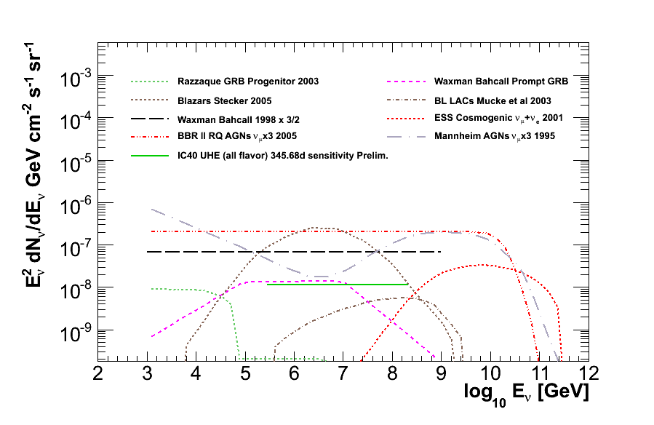
IC40 UHE diffuse analysis
IC40 UHE diffuse analysis preliminary sensitivity: 1.15e-8

Slide 16
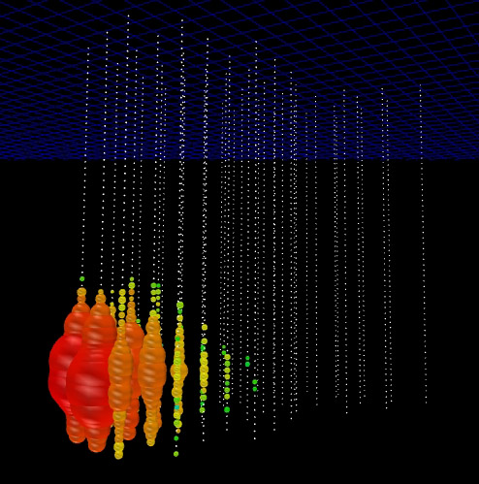
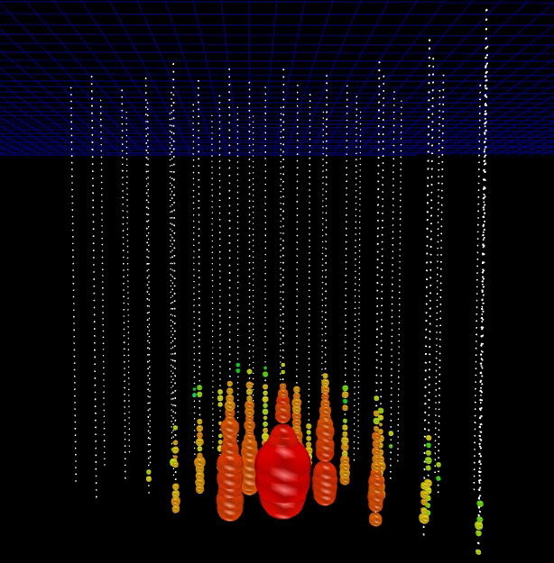
IC40 UHE diffuse analysis
Three events survive the final cut, passing through the cascade stream
Events still under a posteriori investigation regarding the possibility that they could be atmospheric muon background

Slide 17
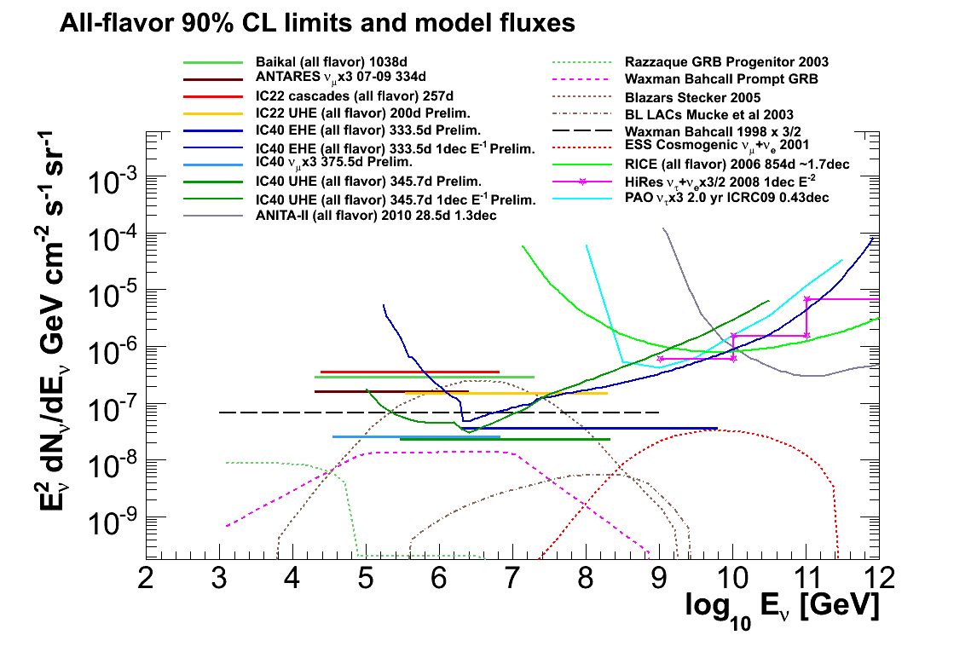
IC40 UHE diffuse analysis preliminary limit: 2.32e-8

Slide 18
Outlook
The final phase of construction of the IceCube Neutrino Observatory was recently completed, resulting in a detector volume of one cubic kilometer.
With increased exposure an improvement in sensitivity to a UHE diffuse neutrino flux of more than an order of magnitude is anticipated. Other improvements are expected from better modeling and simulation of:
The detector
Ice properties
Cosmic-ray composition and flux normalization
Atmospheric neutrino flux normalization and spectrum
Neutrino cross-sections

Slide 19
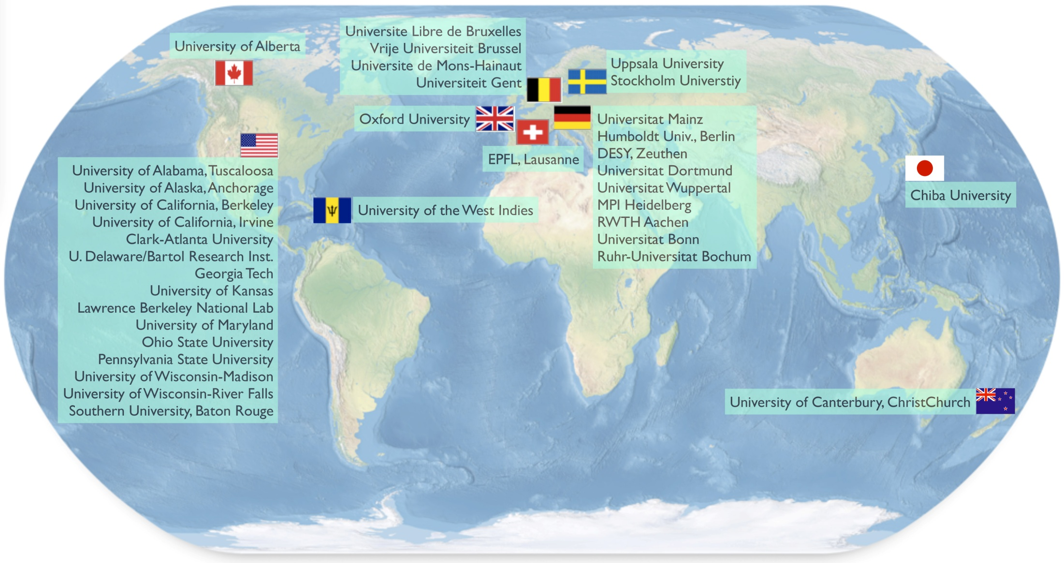
IceCube collaboration

