Slide 1

Surface Cable Assembly (SCA)

Slide 2

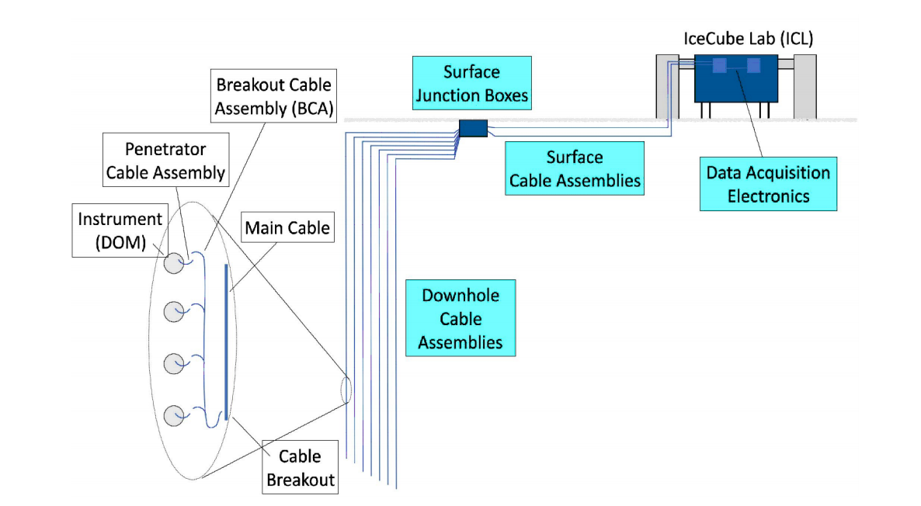
Purpose
(photo of west tower)
Pass electrical signals from the down hole main cable to the IceCube Lab
Runs from ICL to Surface Junction Box
One cable for each Upgrade String (7)

Slide 3
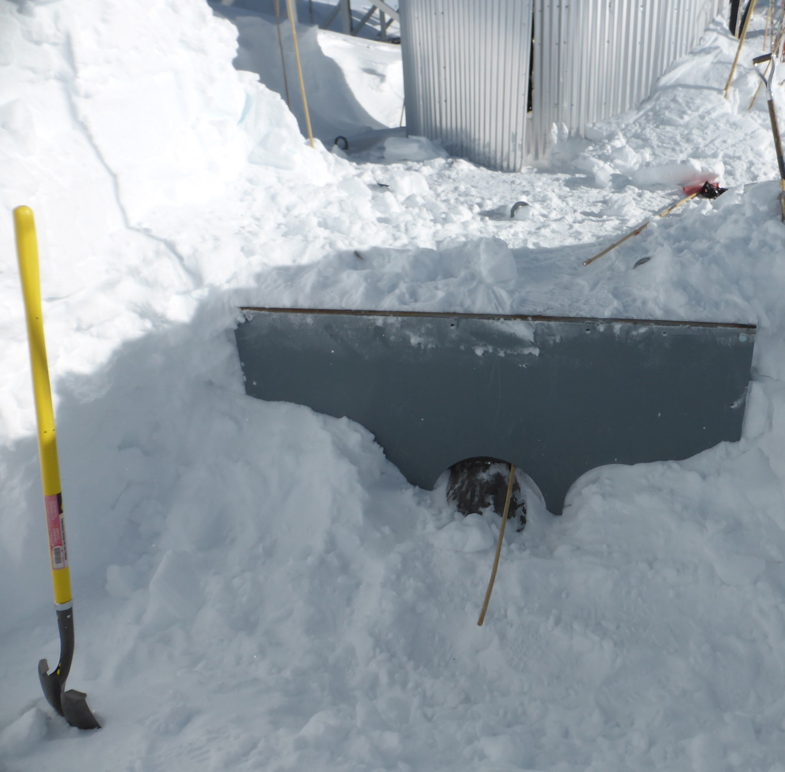
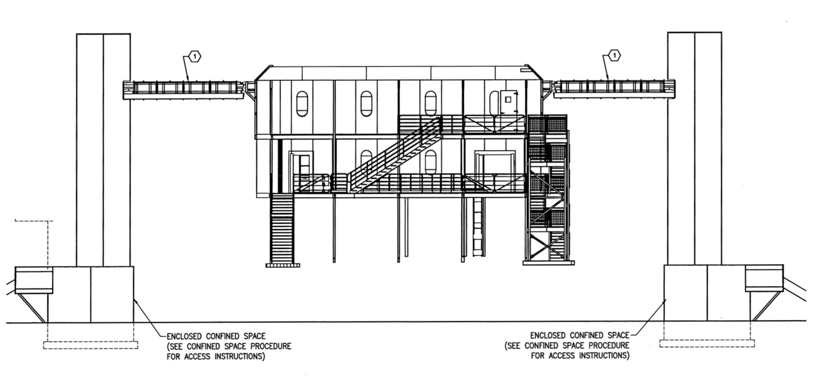
Cable Entry
removable panel
culvert
(photo of west tower)
surface cables x7

Slide 4
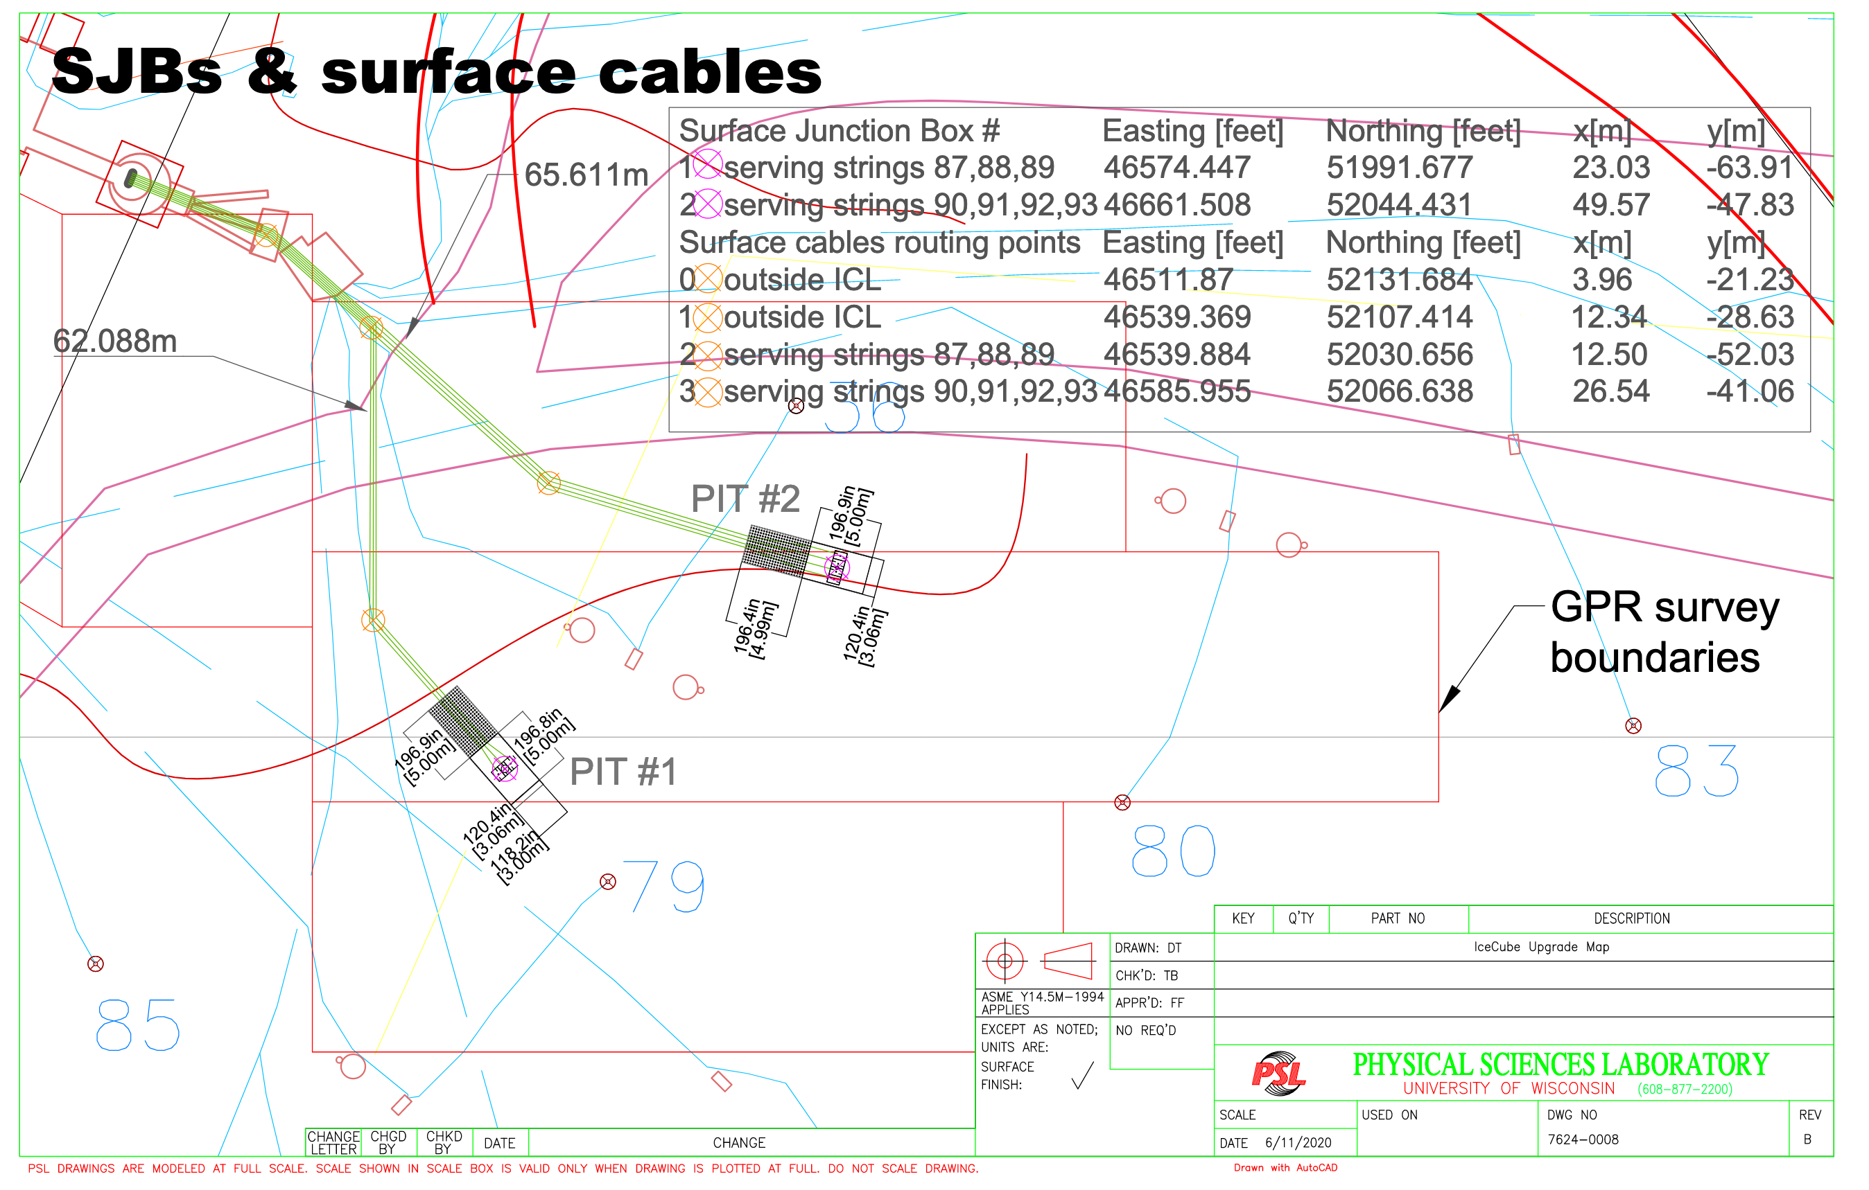
Length Planning: Trench Routes

Slide 5
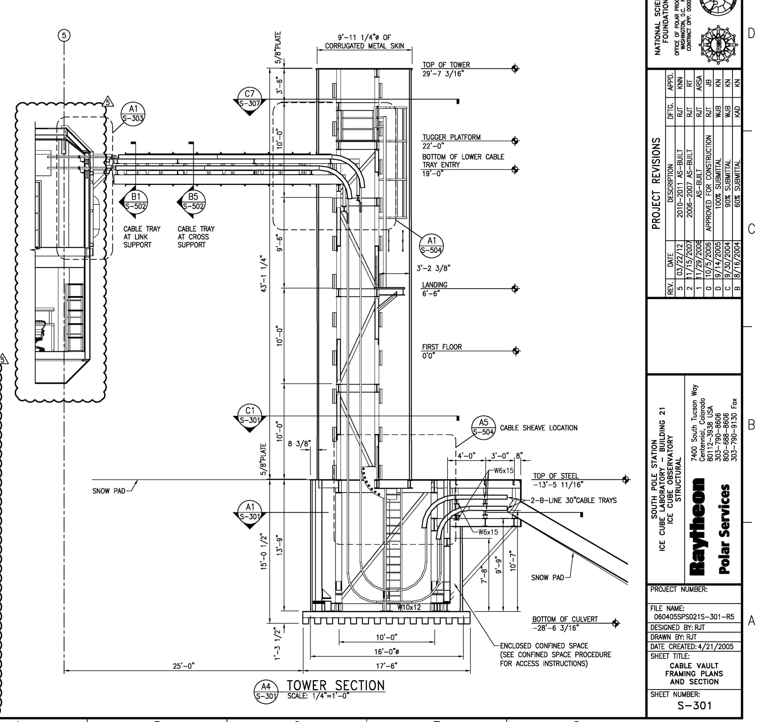
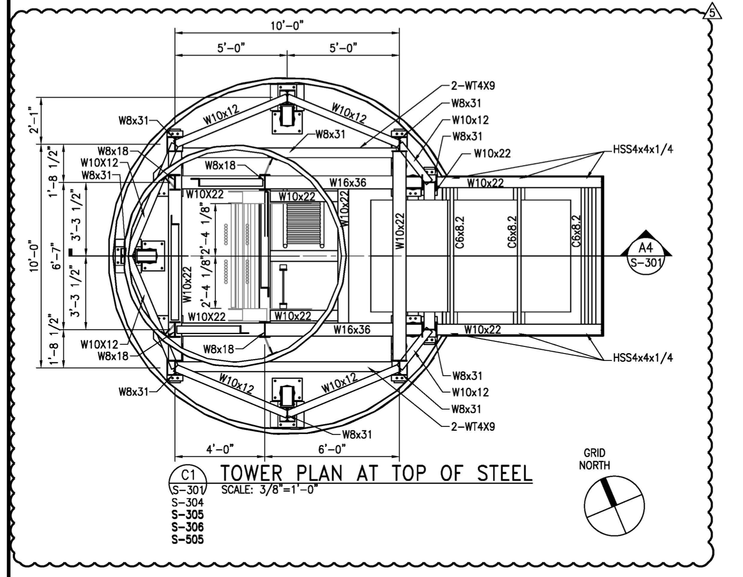
Length Planning: Tower & Bridge Run
slack loop = 2*4.6m
tower elevation and bridge = 9 + 0.9 + 8.4m
xy routing: 2.5m
8.4
0.9
9.0
4.6
2.5
[m]

Slide 6
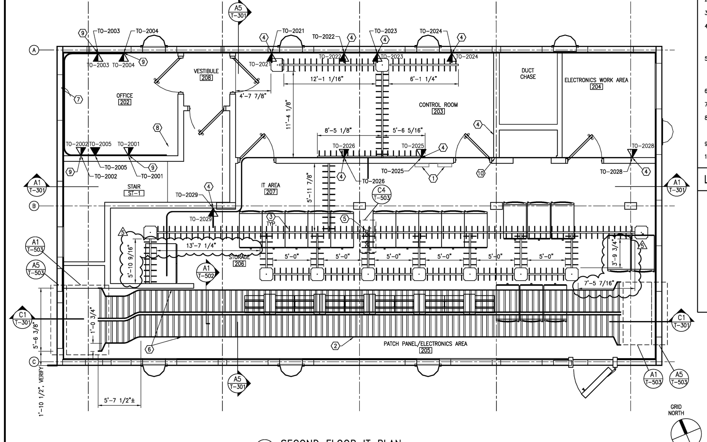
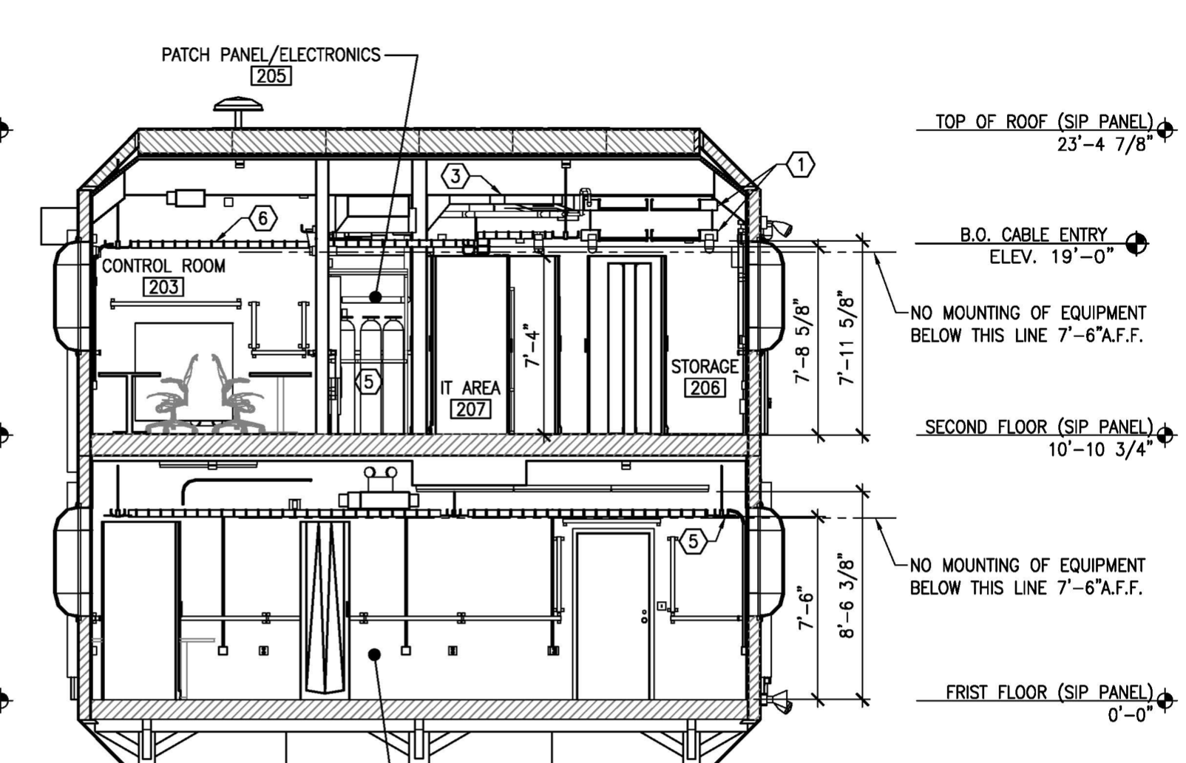
Length Planning: Server Room Routing
Distance to patch panel [m]
  x ≤ 7.7
  y ≤ 1.1
  z ≤ 2.5
2.5
1.1
7.7
3.4
4.3
Cable shield connection
at ICL server room entry
(mid-span strip when installed)

Slide 7
Contingency: Trench Rerouting
+6m
+7m
+13m
+15m covers reasonable trench rerouting

Slide 8
Surface Cable Length
Segment | Length (m)
central SJB to cable tower center (XY) | 62 / 66
central SJB to cable tower base (Z) | 2
cable tower slack loop (30 years) | 10
cable tower rise + cable bridge | 21
contingency: trench move | 15
contingency: tower / ICL rerouting | 5
quad length: ICL entry to patch panel (max) | 12 (2.5 unsheathed)
quad length: SJB entry to patch panel (max) | 3 (unsheathed)
cable length (connector to connector, max) | 134
NB: by using longest trench route, we avoid issues with moving a string from one trench to the another (2+5 deployment scenario)

Slide 9
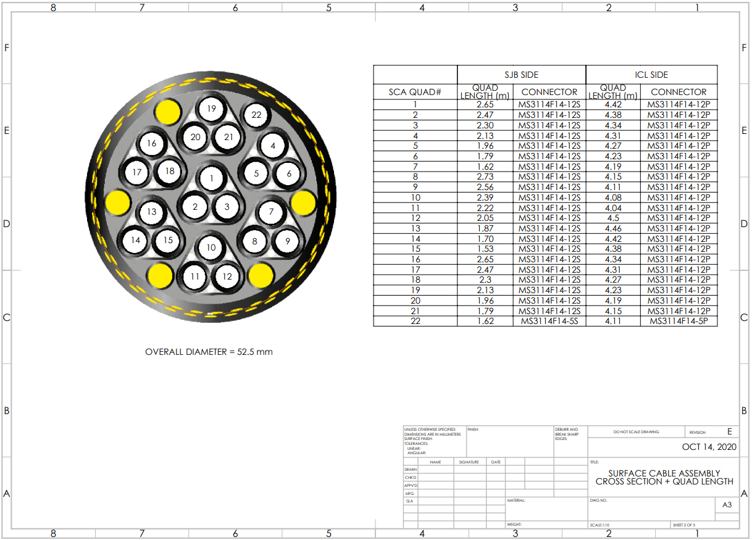
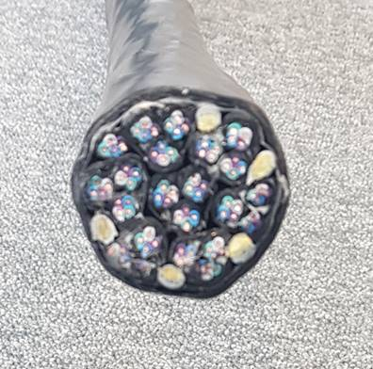
SURFACE CABLE DRAWING
Prototype photo

Slide 10
SJB patch panel / quad lengths

Slide 11
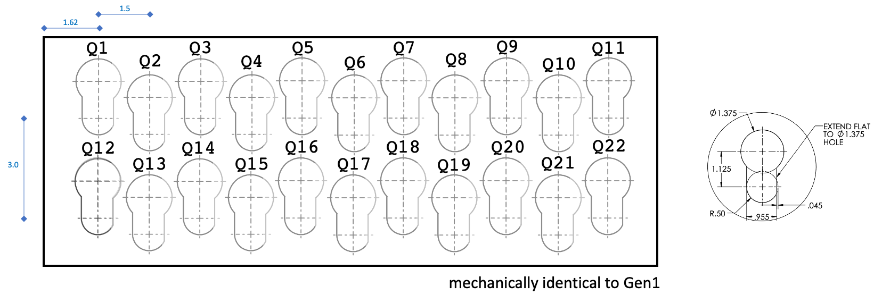
ICL patch panel / quad lengths
FRONT
dimensions in inches
Quad connector lengths staggered based on patch panel layout; optimization TBD (min 177”-15”; max 177")

Slide 12
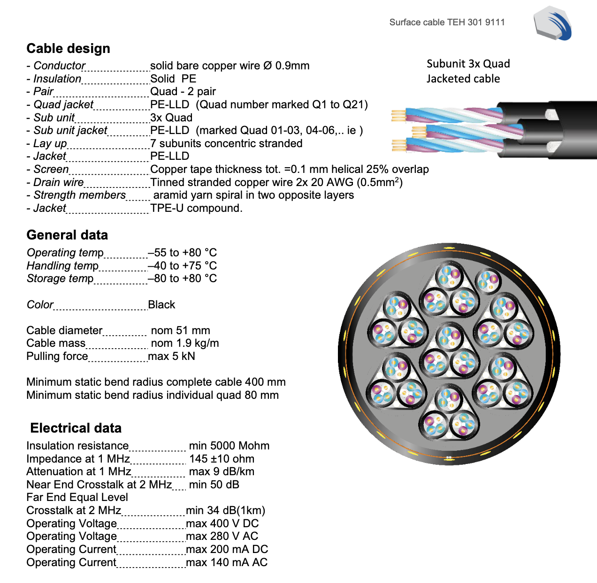
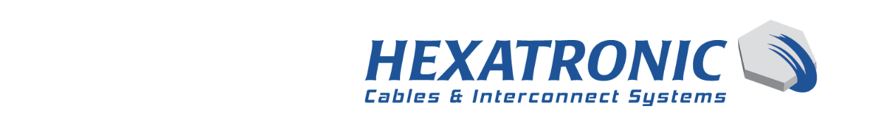
Datasheet

Slide 13
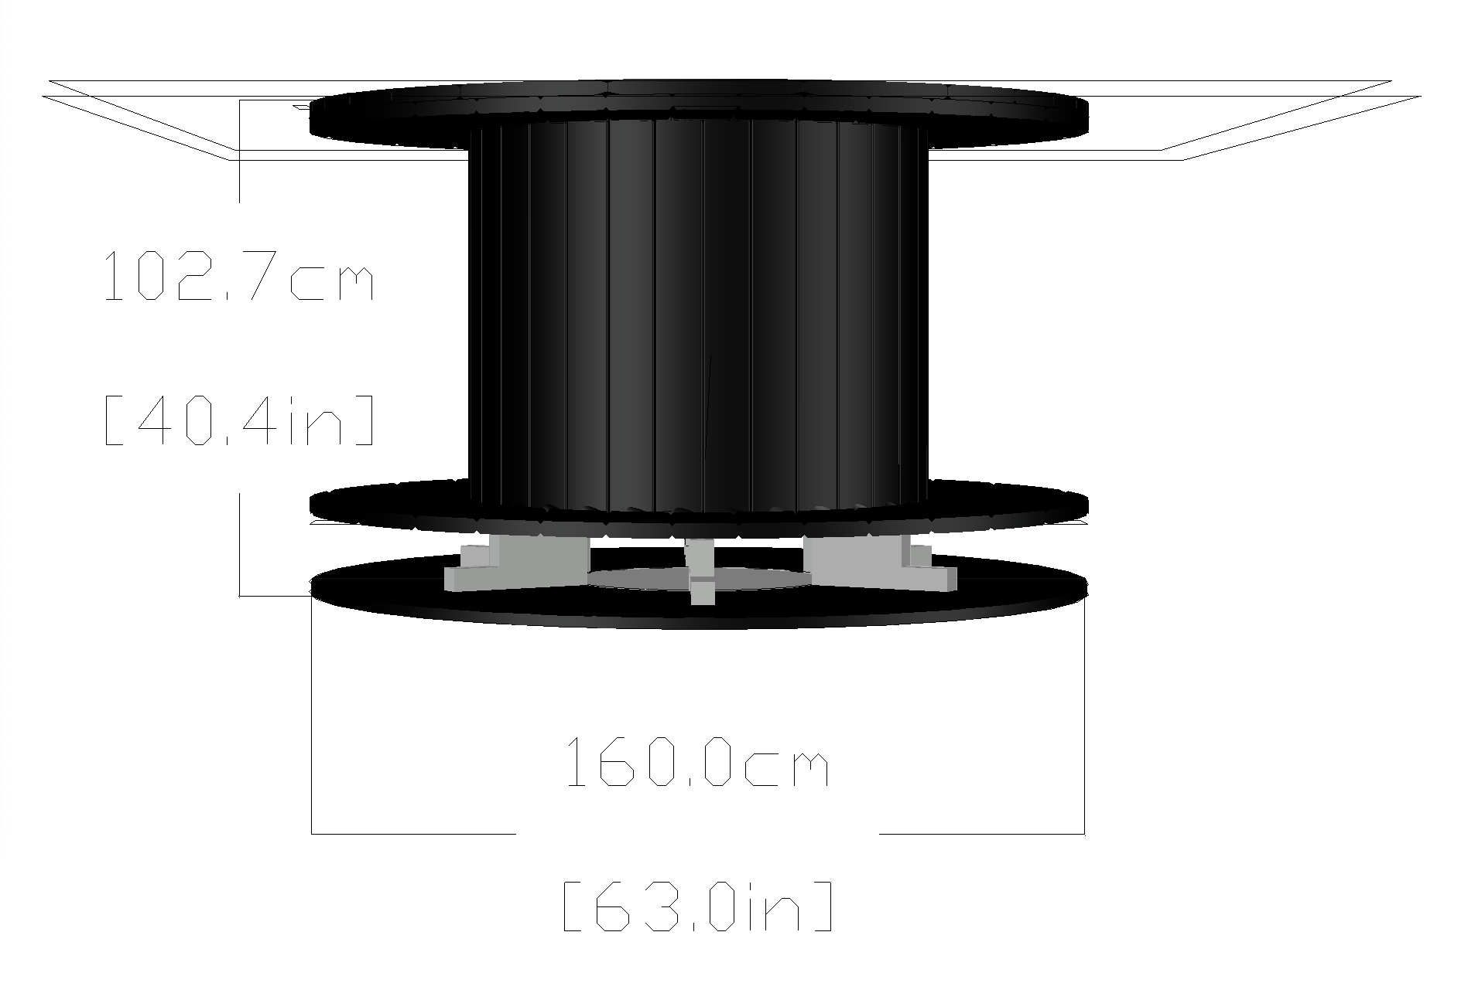

Slide 14
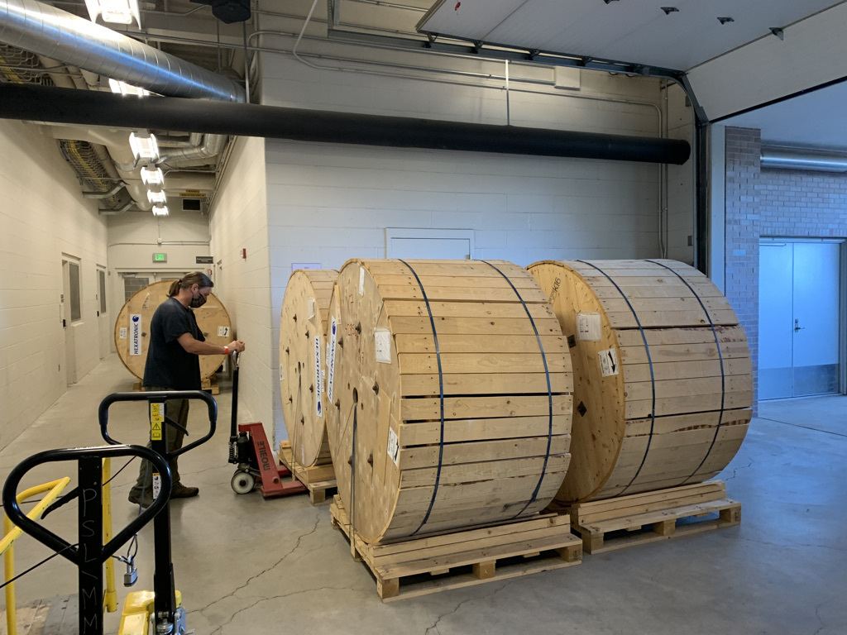
Surface cable spools delivered

