Slide 1
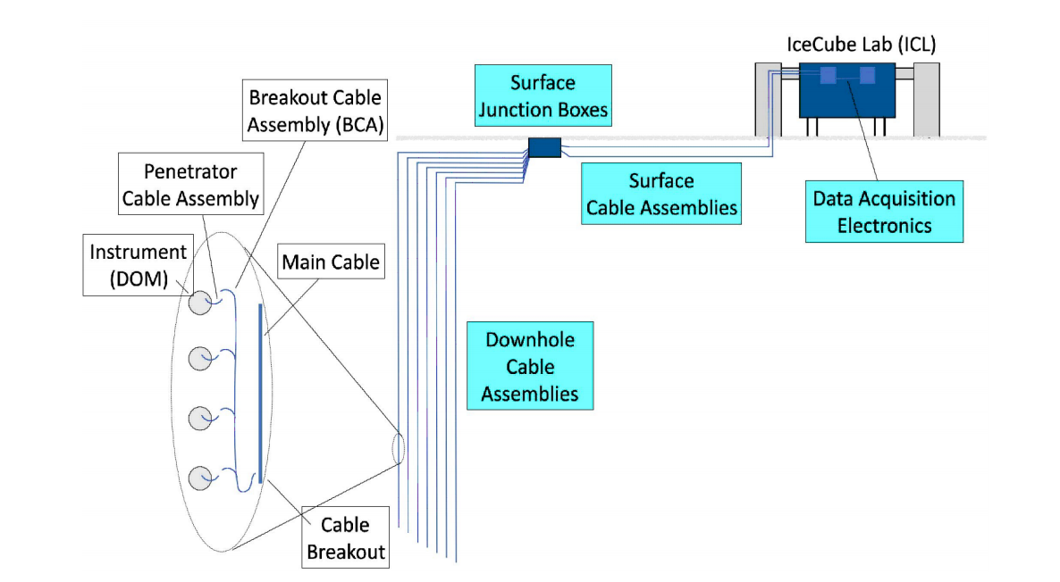
IceCube Upgrade Main Cable Assembly (MCA)
Brings electrical signals from the sensors to the surface junction box
Similar concept to IceCube’s main cable assembly but different build due to market change
Each cable serves one string
  3x 7 quad cables + 3 single quads
  Each pair serves up to 4 DOOMs
  Strength members to support string weight

Slide 2

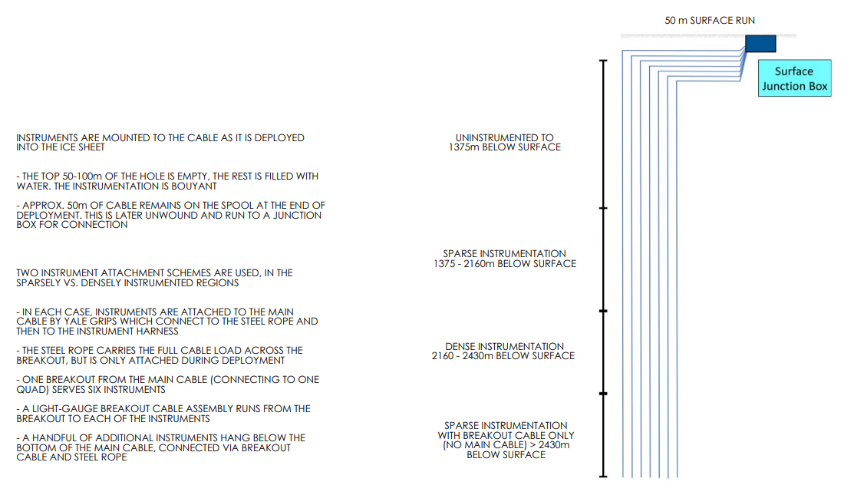
MCA Diagram

Slide 3
General Cable Requirements
Description​ | Requirement​
Lifetime​ | 30 years or more​
Cable shield thickness | 0.10 mm minimum Copper foil, 100% coverage
Cable shield drain wires | Minimum of two 0.8mm or larger copper stranded drain wires, 180° rotational separated
Storage temperature | -40 to +60°C
Handling temperature | -40 to +40°C
Electrical operating temperature | -70 to +20°C. The electrical operating temperature is the temperature at which the Main Cable shall be able to function to the electrical specifications after the cable has been frozen into the ice. Also, the top 25 meters of the Main Cable will be exposed to temperatures as low as –70°C. This section of the cable will be buried in snow and will never be moved.
Maximum operating pressure | 250 bar (3626 psi) or greater
Overpressure | 450 bar (6527 psi) minimum for 7 days
Conductor type | Copper or copper alloy, continuous
Breakout connections | 22 breakouts will be installed along a 1 km section of the cable. In these sections of the cable the outer sheath, inner sheath and shield will be cut open and peeled back so the quads can be connected to the instruments. Please see page __ of this DSN for location of all breakouts
Cable stops | 70 Kellem grips will be attached to the cable. These grips will transfer all of the cable tension to and from the DOMs attached (or act as failsafes in the physics region) to the cable at temperatures between –40 and 0°C

Slide 4
Cable Electrical Requirements
Description​ | Requirement​ | Conditions
Attenuation | 20 dB maximum | 1 MHz, end to end
Crosstalk attenuation | Intra-Quad & Quad-Quad
NEXT Note: these are targets, not hard requirements. | 50 dB minimum (desired) | 100 kHz to 2.0 MHz
 | Decreasing 15 dB / decade | 2.0 MHz to 100 MHz
 | 24 dB minimum (desired) | 100 MHz
ELFEXT Note: these are targets, not hard requirements. | 30 dB minimum (desired) | 100 kHz to 2.0 MHz
 | Decreasing 20 dB / decade | 2.0 MHz to 20 MHz
 | 10 dB minimum (desired) | 20 MHz
Conductor type | Copper or copper alloy, continuous
Conductor size | 19 AWG wire
Differential Impedance | 145 ± 10 ohms | 1.0 MHz, +15 to +30°C, absolute pressure 0.7 to 1.4 bar (10 to 20 psi)
 | 145 ± 20 ohms | 1.0 MHz, -50 to +30°C, absolute pressure 1 to 250 bar (3625 psi), overpressure = 450 bar (6527 psi)
Loop Resistance | 160 ohms maximum | +15 to +30 °C, <145 ohms desired
Hipot test | 2200 VDC minimum, 1.0 micro-amp maximum leakage, 60 seconds minimum duration | All conductors individually tested with all other conductors grounded
Maximum operating voltage | 400 VDC / 280 VAC RMS or greater
Maximum operating current | 200 mA DC / 140 mA AC RMS or greater

Slide 5
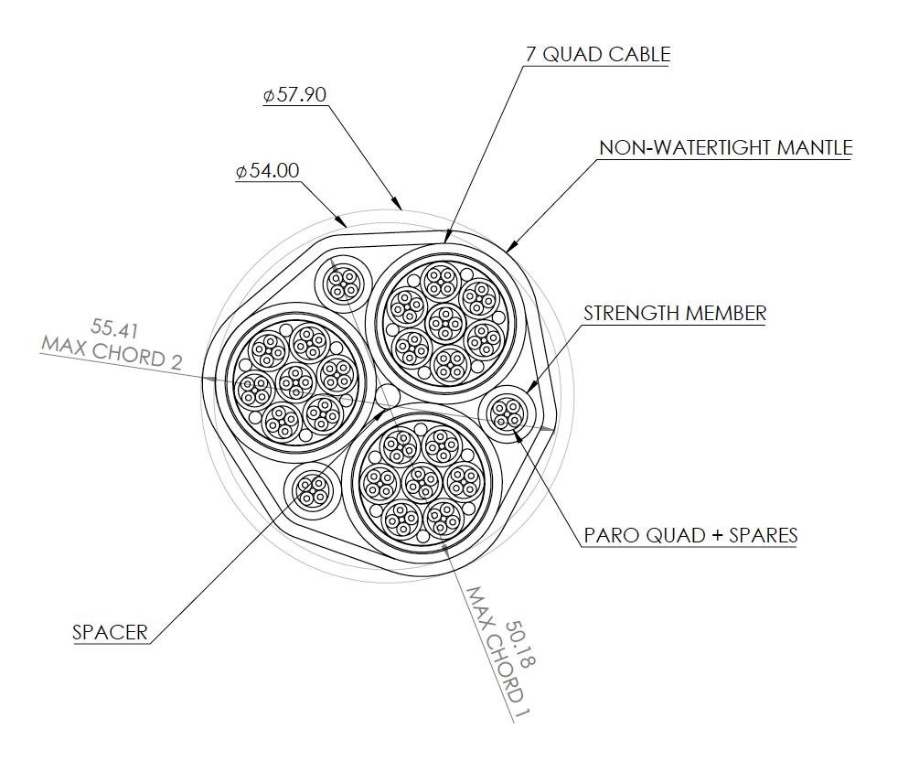
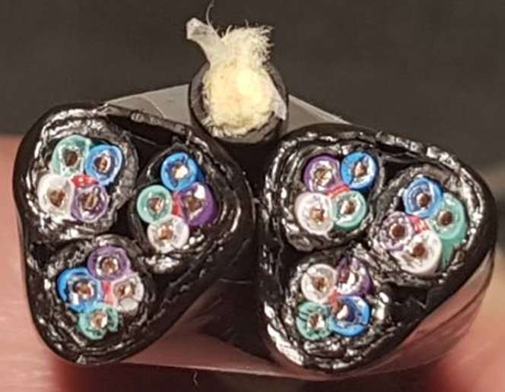
Cable cross section and prototype
Prototype photos
Testing of sample undergoing

Slide 6
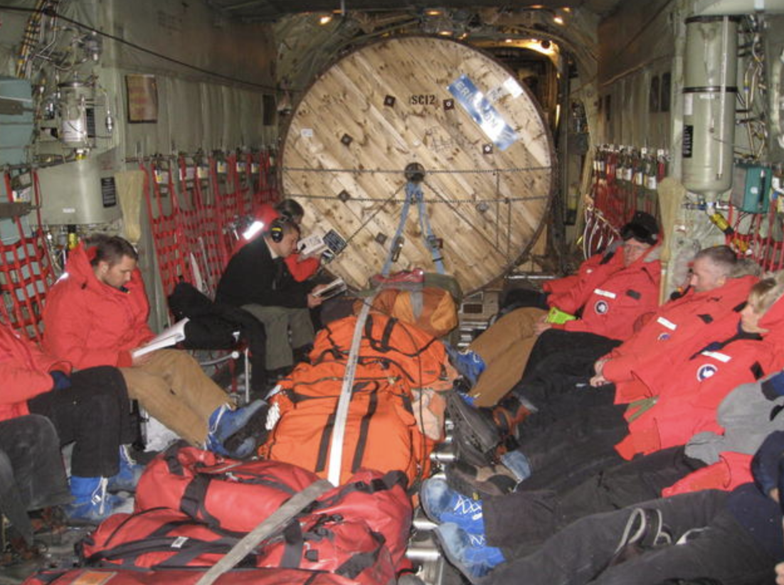
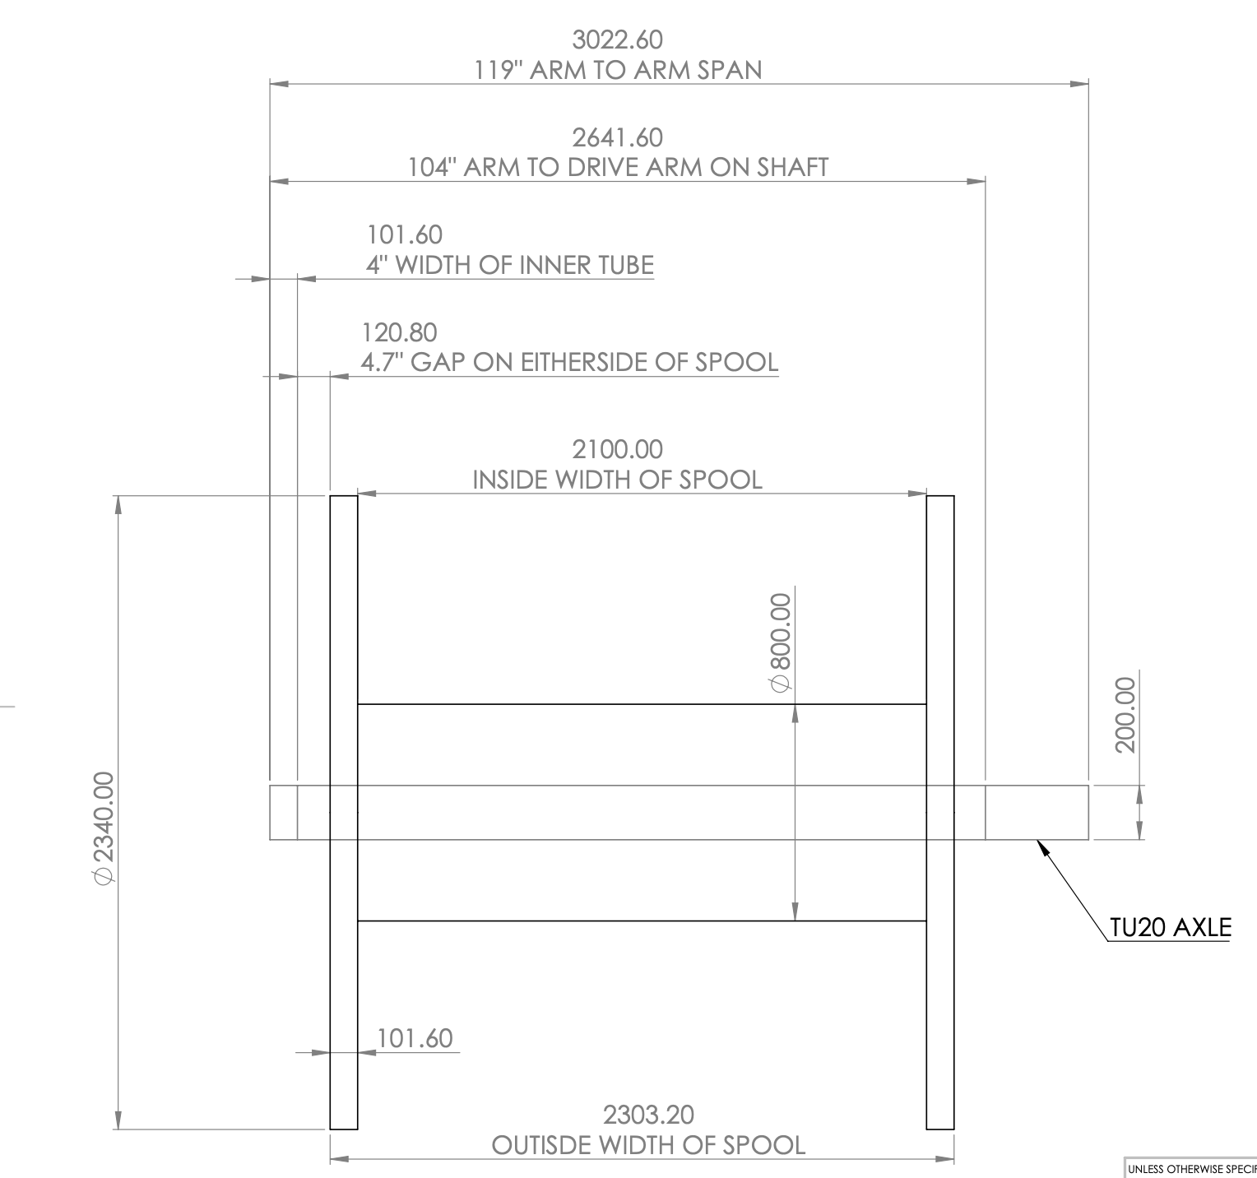
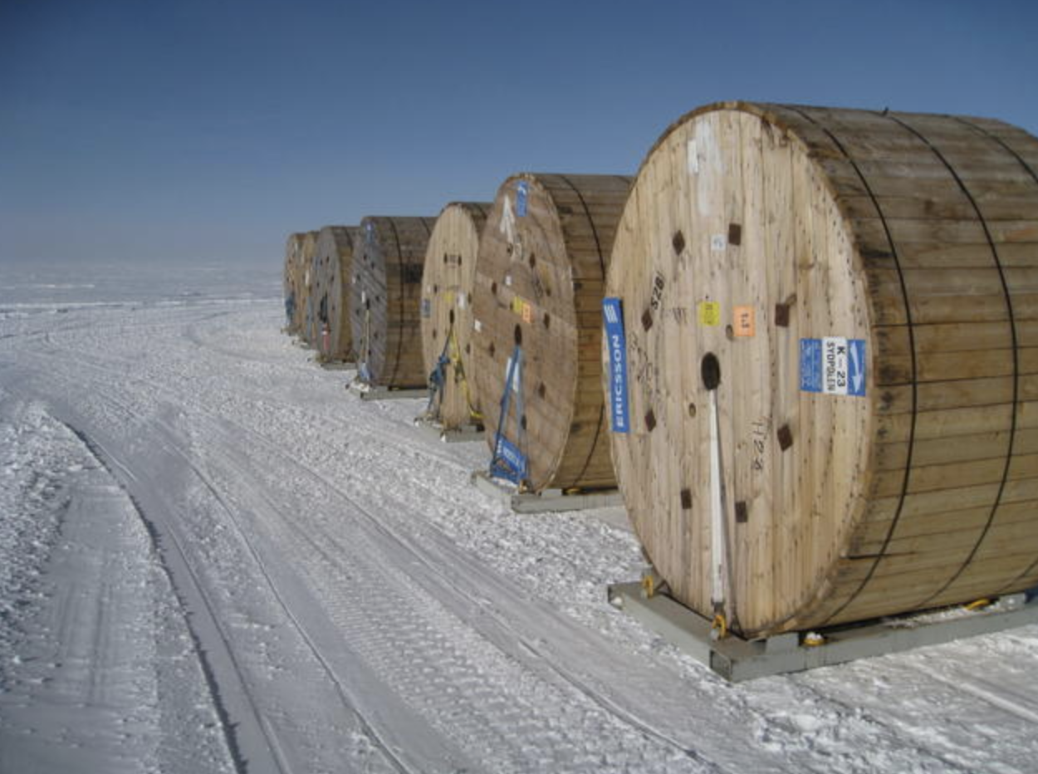
IceCube Upgrade Cable Spools
Upgrade spool drawing
One spool / string
Gen1 spools

