Slide 1
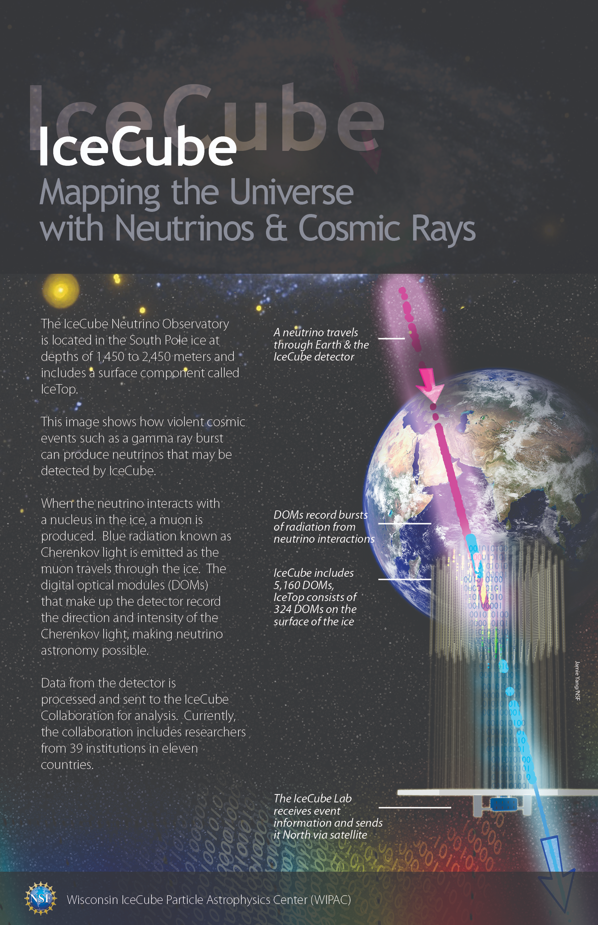
IceCube M&O, the Upgrade, and Gen2
A Project Perspective
Kael Hanson, Director of Operations
IceCube Neutrino Observatory
Software and Computing Advisory Panel (SCAP) Meeting
27 Jan 2021
Notes:
This set of slides serves to (a) provide the overall picture of what IceCube is and

Slide 2
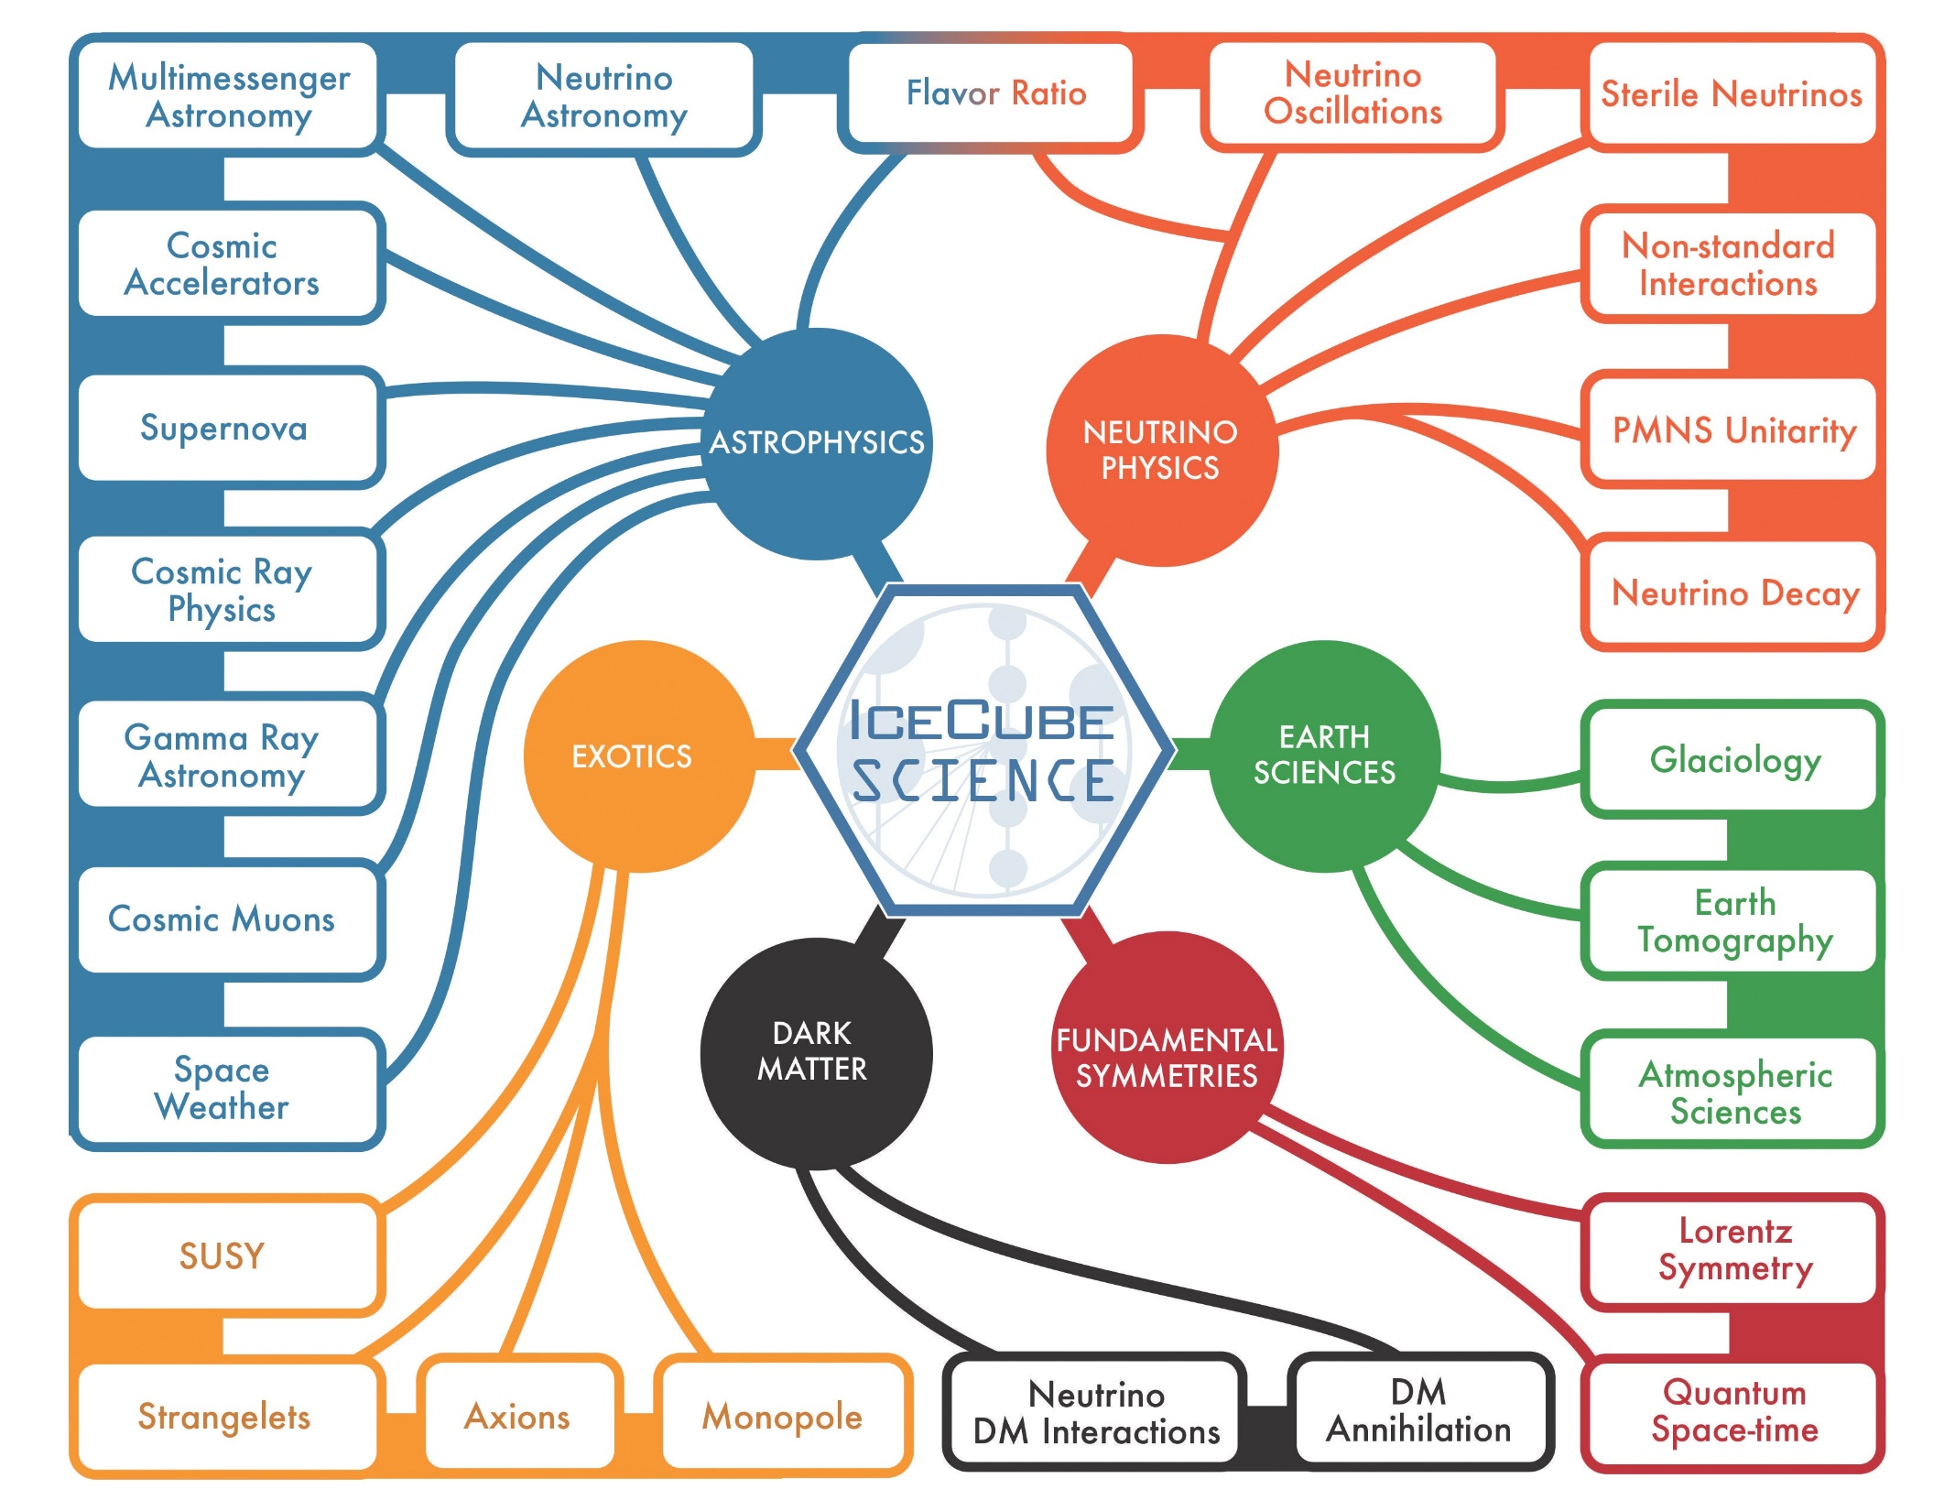
Very broad science program that spans 10 decades in energy (SNe v at MeV to 10 PeV).
Neutrino astrophysics
Beyond SM physics
Neutrino particle properties
Glaciology
RT alerts to MMA community

Slide 3
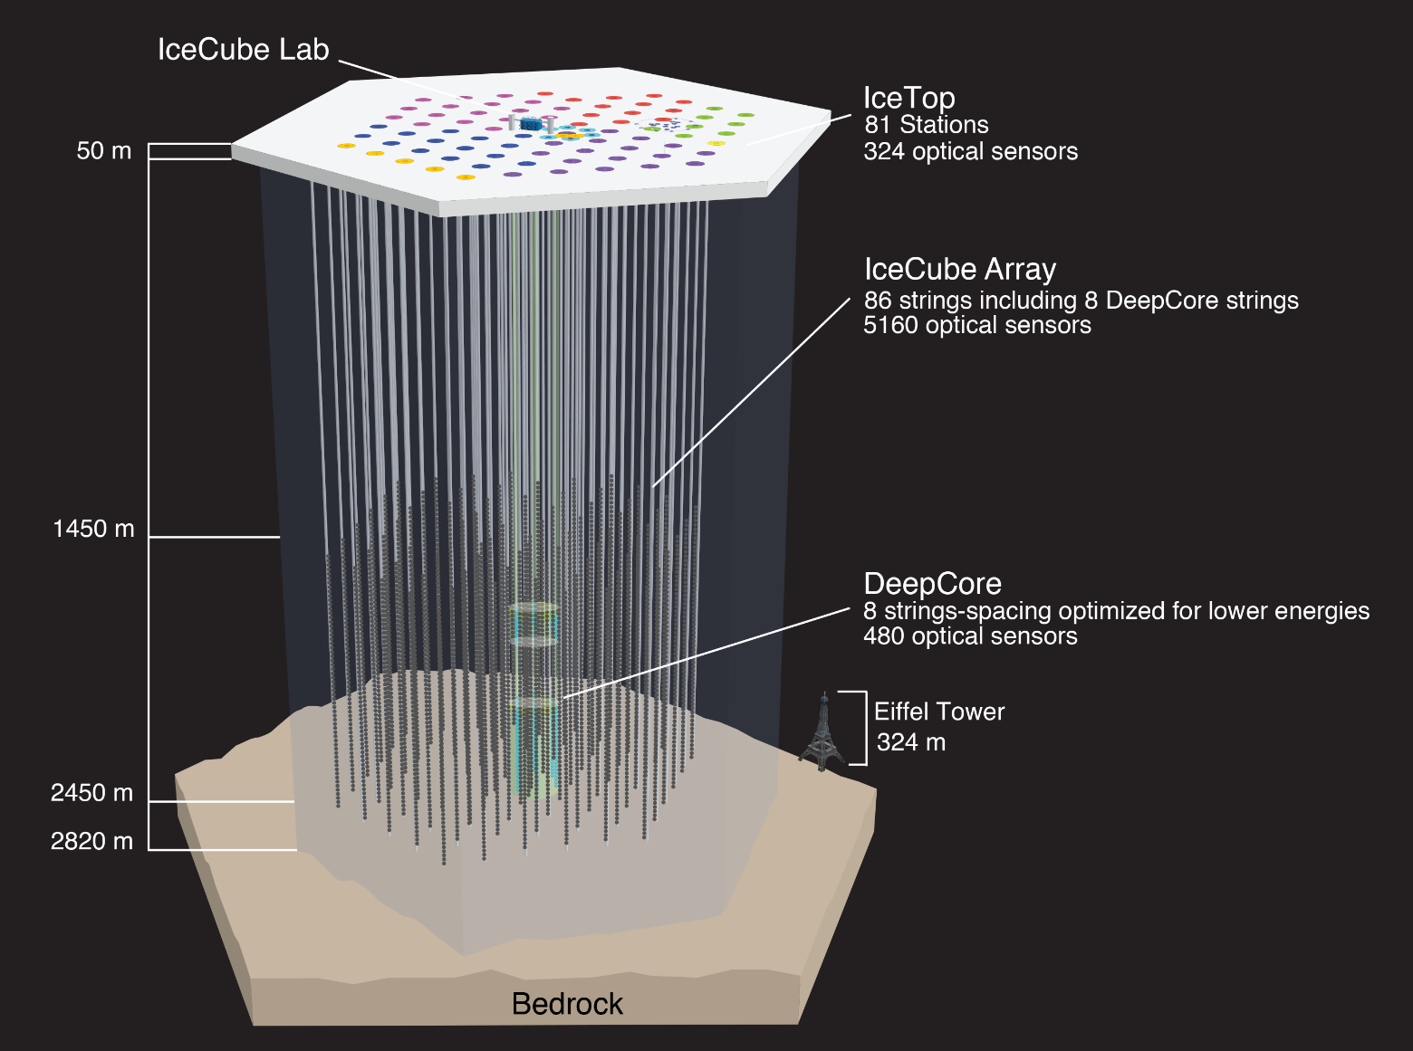
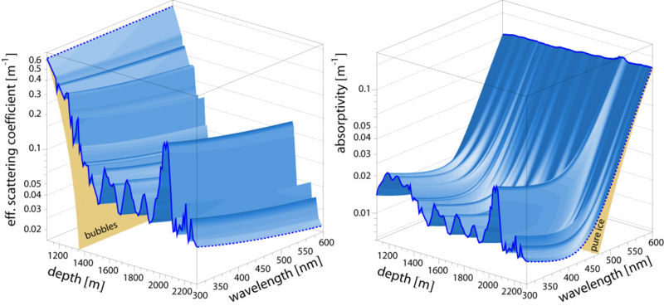
The IceCube Neutrino Detector Array at the Geographic South Pole
Notes:
5160 deep-ice DOMs + 384

Slide 4
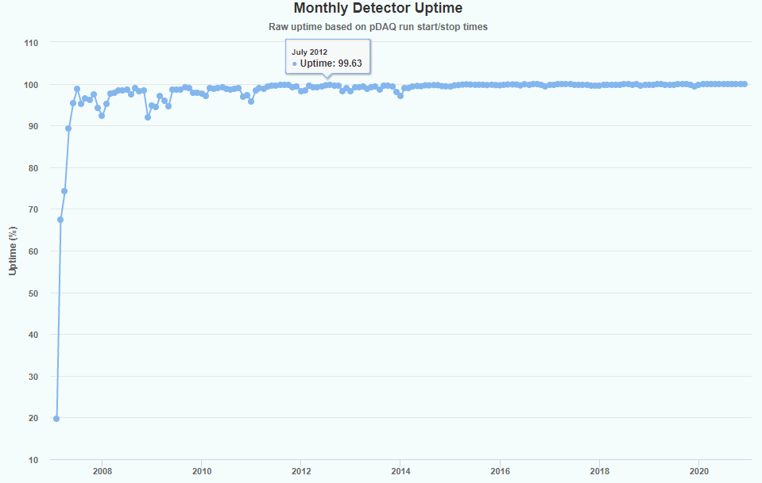
IceCube Data Flow Numbers
~ 3000 Hz of CR events, ~ 3 mHz of atmospheric neutrinos, ~ uHz of astrophysical neutrinos.
1 TB events/day captured to disk by DAQ.
Satellite sends O(100) GB/day filtered data to NH ready for analysis < 2 weeks. Rest is archived on magnetic disk and sent north each year.
Detector uptime routinely >> 99%. Dec 2020 uptime was 99.89%

Slide 5
The IceCube Neutrino Observatory
IceCube (Gen-1): $279 million NSF/MREFC 2002-2012 construction of the existing South Pole Array. IceCube is an NSF major facility.
Management and Operations (M&O): sequence of 5 year, mostly, $7 million/year cooperative agreements between NSF and UW/WIPAC to operate detector and provide infrastructure for Collaboration.
IceCube Upgrade: 5 year (planned, 2018-2023) $23.0 million NSF mid-scale to enhance IceCube neutrino physics and ice calibration.
IceCube Gen2: concept-stage future (2026+) facility enhancement – 10x bigger IceCube for neutrino astrophysics.
IceCube Collaboration: scientific collaboration of 350+ researchers world-wide that provide resources (cash, computing, labor) to M&O and receive computing and storage, processed data, simulated data.

Slide 6
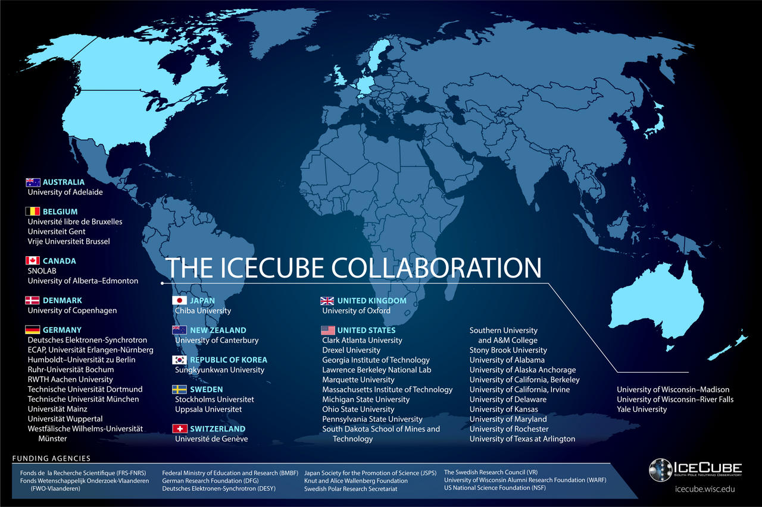
The IceCube Collaboration includes > 300 researchers from 47 institutes in 12 countries.
IceCube is one of the NSF’s large facilities (LIGO, LSST, … 2 dozen others).
The Operations and Management of the facility is handled by WIPAC at UW-Madison. In addition to having a large science group, our center supports the technical aspects: computing, data storage, detector maintenance, …

Slide 7
IceCube Management and Operations
Focus on the Operations aspect of IceCube

Slide 8
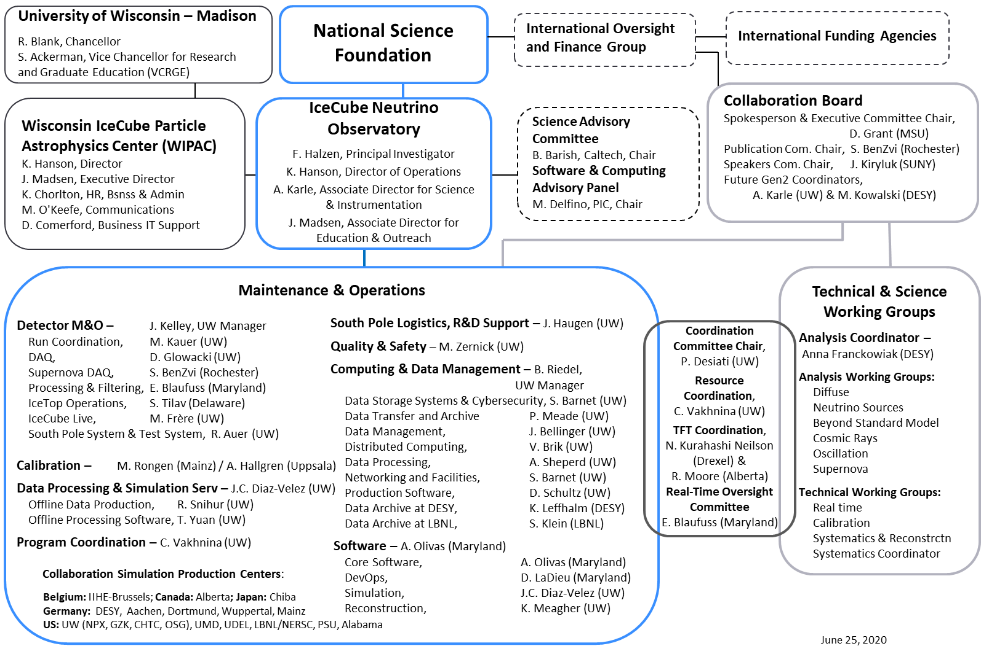
L. Bauerdick, FNAL, Chair

Slide 9
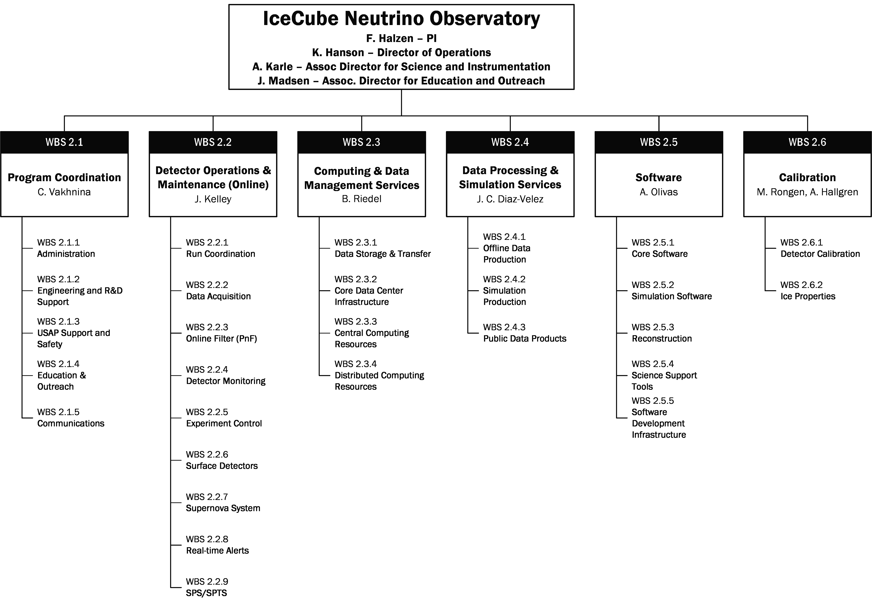
Work Breakdown Structure

Slide 10
M&O Staffing by WBS / Source of Funds (2020)
WBS L2 | NSF M&O Core | NSF Base Grants | U.S. Institutional In-Kind | Europe & Asia Pacific In-Kind | Grand Total
2.1 Program Management | 6.43 | 0.74 | 5.28 | 6.90 | 19.35
2.2 Detector Operations & Maintenance | 14.31 | 2.38 | 3.96 | 8.86 | 29.51
2.3 Computing And Data Management Services | 8.75 | 0.10 | 1.43 | 2.15 | 12.43
2.4 Data Processing & Simulation Services | 2.95 | 0.80 | 1.40 | 5.20 | 10.35
2.5 Software | 3.50 | 1.75 | 6.88 | 8.15 | 20.28
2.6 Calibration | 2.05 | 0.85 | 2.50 | 2.70 | 8.10
Grand Total | 37.99 | 6.62 | 21.45 | 33.96 | 100.02

Slide 11
M&O Responsibilities (2020)
MoU v.28 - 2020 | U.S. Head Count | U.S. FTE | Non-U.S. Head Count | Non-U.S. FTE
Key Personnel | 45 | 11.35 | 43 | 9.65
Scientists | 30 | 7.78 | 29 | 1.15
Post Docs |  | 5.48 |  | 5.22
Grad Students * | 56 | 12.17 | 74 | 16.44
Data Science, Software, IT, Winterovers, Other ** | 36 | 29.28 | 2 | 1.50
* Grad students' full time employment equals to 0.50 FTE
** Other professionals include engineers, program management (E&O, safety, administration, etc.)

Slide 12
M&O Support Needs
Will be further described later: M&O has been flat at $7.0 (actually de-creased due to roll-off of MREFC pre-ops) since 2011.
Thought being that operations becomes easier as observatory matures; this covers things like escalation.
Review / comment our case that operations is not easier
  Support expanding IceCube science program (neutrino physics, evolving use of ML/AI tools).
  Integration of IceCube Upgrade falls largely on M&O (DAQ/Online)
  Provide adequate infrastructure to exploit calibration revolution with new devices deployed in Upgrade to bolster IceCube MMA mission.

Slide 13
IceCube Operations 2021 - 2026
WBS Element | PY1 | PY2 | PY3 | PY4 | PY5
2.1 Program Coordination | 7.3 | 7.3 | 7.3 | 7.3 | 7.3
2.2 Detector Ops. & Maint. | 11.1 | 11.1 | 11.4 | 11.7 | 11.4
2.3 Computing & Data Management | 8.1 | 8.5 | 9.3 | 9.3 | 9.3
2.4 Data Processing and Simulation Services | 2.4 | 2.4 | 2.4 | 2.4 | 2.4
2.5 Software | 4.7 | 7.7 | 7.7 | 7.7 | 7.7
2.6 Calibration | 2.4 | 2.4 | 2.4 | 2.4 | 2.4
GRAND TOTAL | 36.0 | 39.4 | 40.4 | 40.7 | 40.4

Slide 14
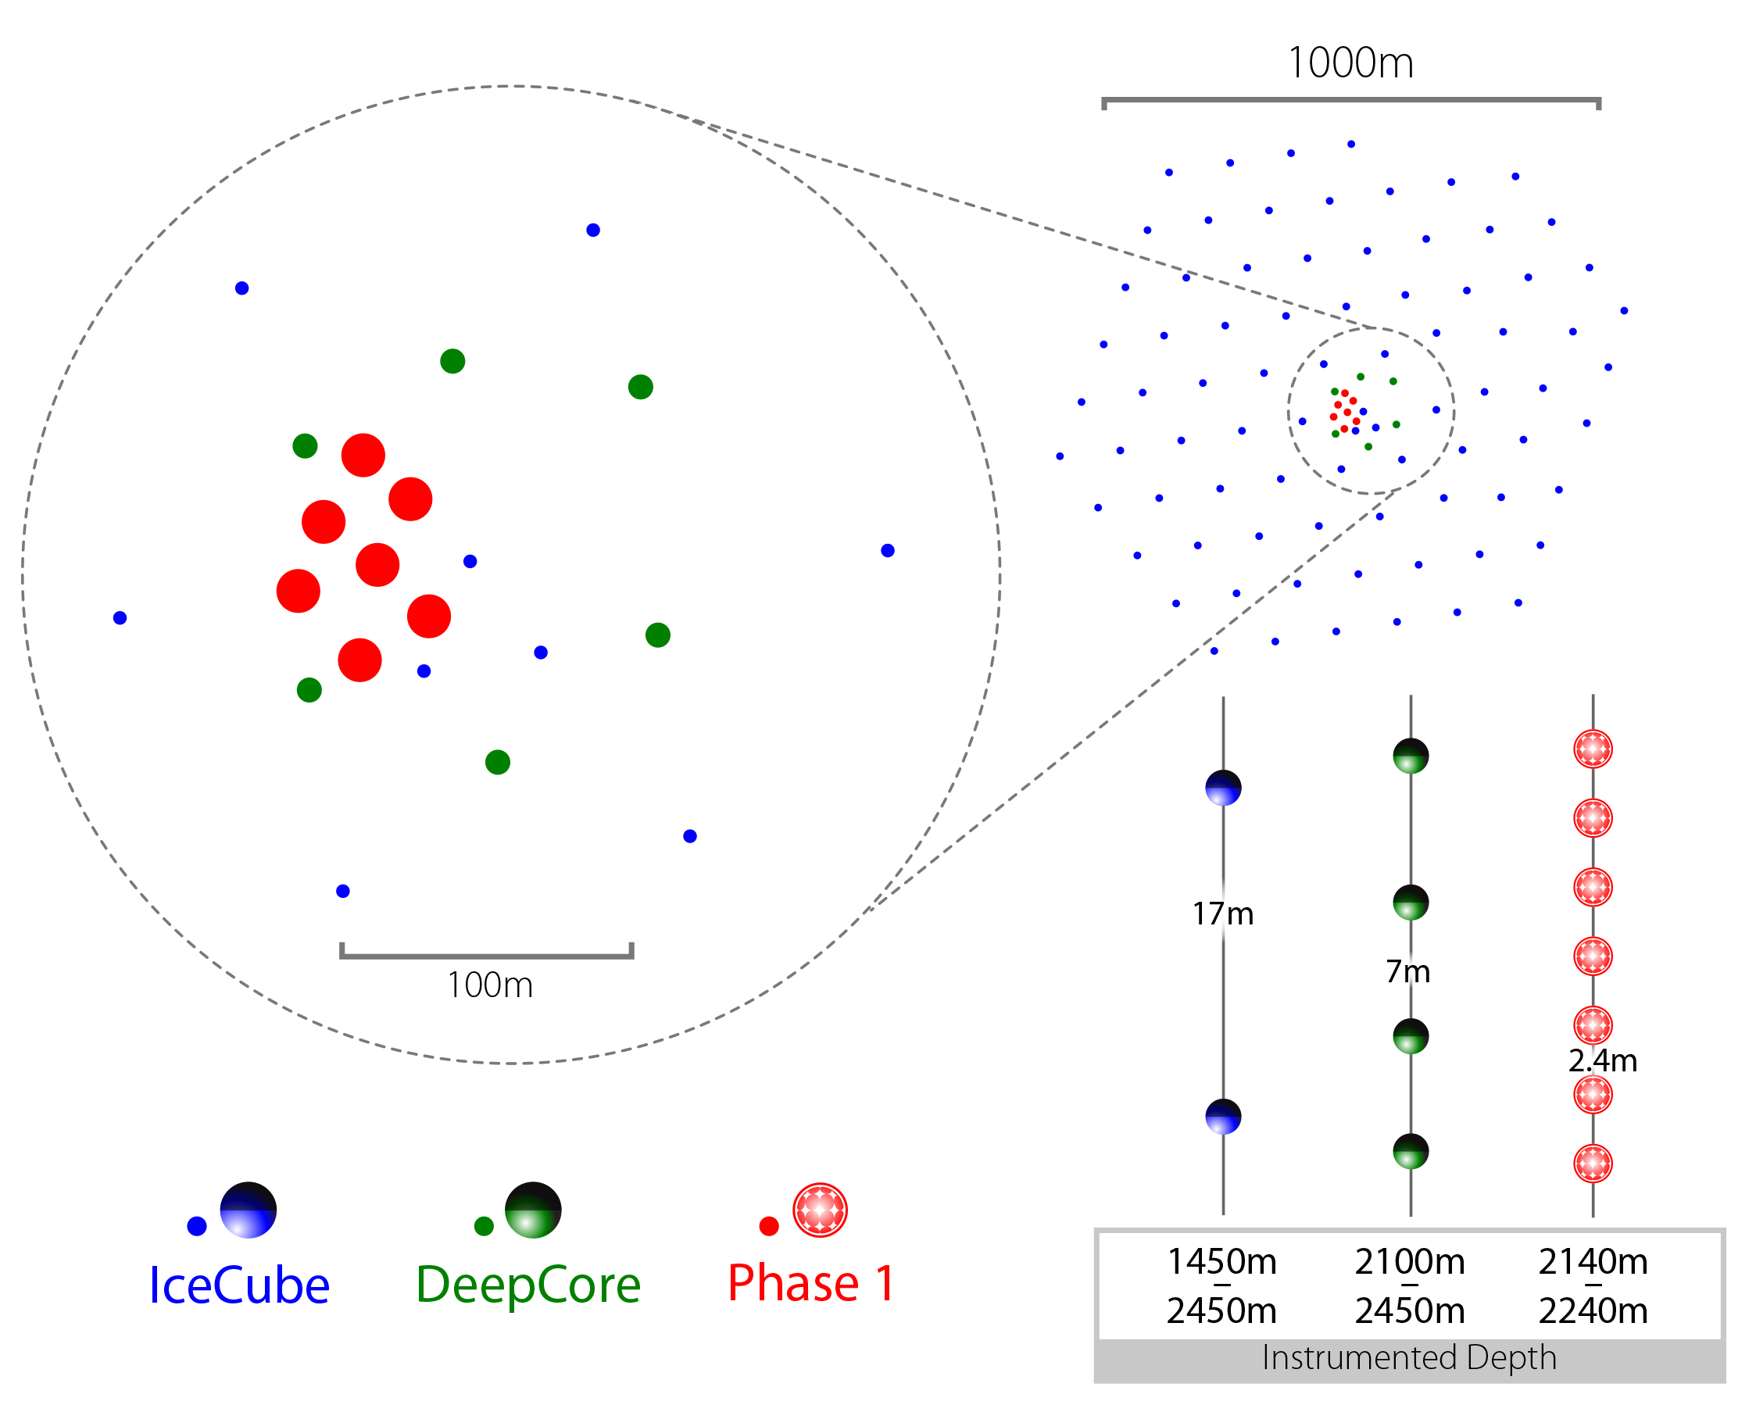
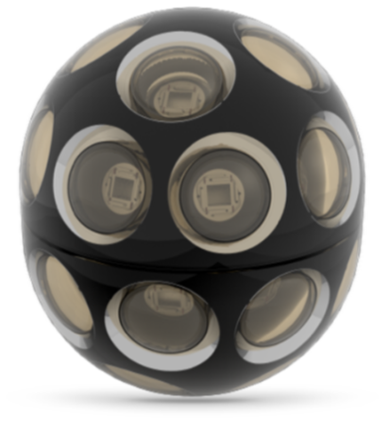
Gen2 Phase 1: First Steps
Science goals:
Probe unitarity of PMNS matrix
Improve calibration and characterization of ice for improved HE multimessenger neutrino astronomy
7 strings (US 3 | JP 2 | DE 2) densely populated with next generation, high performance photodetectors:
Integrates with existing IceCube: data acquisition, event filtering, simulation will require extension;
No significant increase in steady-state operations;
Negligible increase in data rate
+3 kW power (+5% increase relative to IceCube)
Proposed project leverages significant effort already invested by US/Non-US IceCube groups to develop instrumentation and infrastructure for next-generation neutrino detector at South Pole.
Array | String Spacing | Module Spacing | Modules per String
IceCube | 125 m | 17 m | 60
DeepCore | 75 m | 7 m | 60
Phase 1 | 20 m | 2 m | 125

Slide 15
IceCube Upgrade Rebaseline
Technical progress (see EVMS figure at right) good up to Mar 2020.
COVID-19 impact significant for Upgrade
Field season 2020/2021 cancelled outright erasing 1 year from drill refurbishment at Pole.
Further

Slide 16
IceCube Gen2
The Path to the Next Generation Hybrid Neutrino Observatory

Slide 18
COVID-19 Impact on IceCube Operations

