Slide 1

IceCube
francis halzen
cosmic neutrinos: many independent observations
→ muon neutrinos through the Earth
→ starting neutrinos: all flavors
→ Glashow event
improving the detector
from DeepCore to Upgrade
more about TXS 0506+056
icecube.wisc.edu

Slide 2
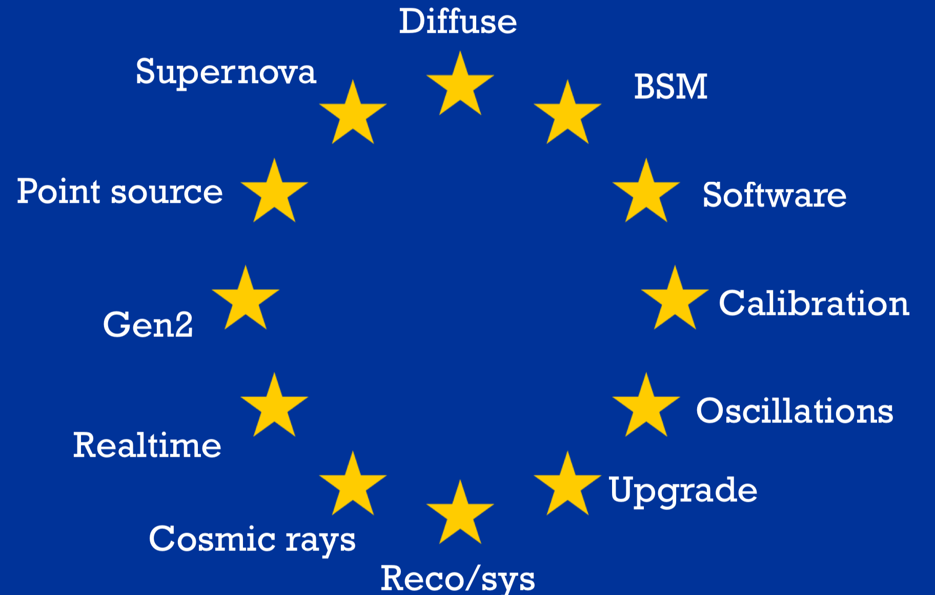

Slide 3
Upgrade 1 GeV
highest energy event
> 10,000,000 GeV

Slide 4
electron and tau neutrinos
muon neutrinos

Slide 5
electron and tau neutrinos
events vs
truncated E
GeV:
>120 cosmic ν_{μ}
per year
10²
10⁴
10⁶
muon neutrinos

Slide 6
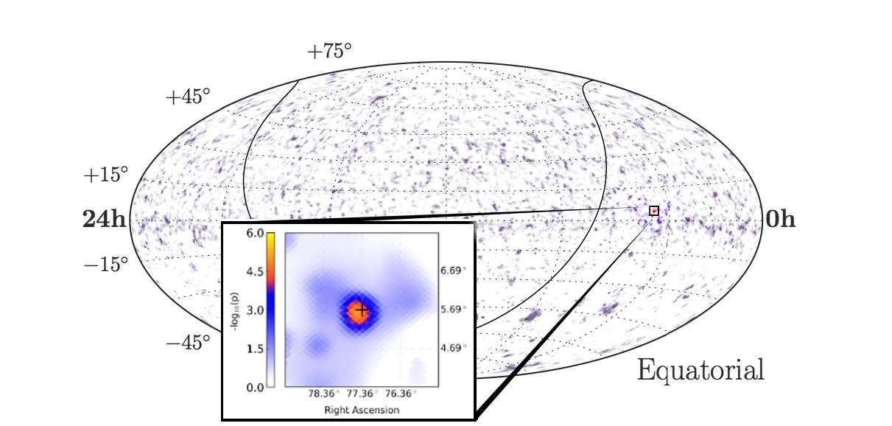
evidence for non-uniform skymap in 10 years of IceCube data :
mostly resulting from 4 extragalactic source candidates
active galaxy NGC 1068

Slide 7
partially contained event with energy 6.3 PeV
resonant production of a weak
intermediate boson by an anti-
electron neutrino interacting with
an atomic electron
q
_
q

Slide 8
q
energy measurement understood
identification of anti-electron neutrinos
_
q

Slide 9
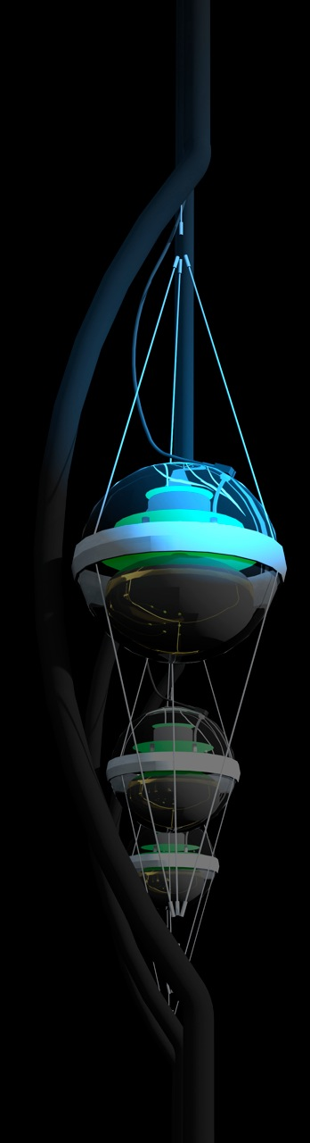
IceCube
francis halzen
cosmic neutrinos: many independent observations
→ muon neutrinos through the Earth
→ starting neutrinos: all flavors
→ Glashow event
improving the detector
from DeepCore to Upgrade
more about TXS 0506+056
icecube.wisc.edu

Slide 10
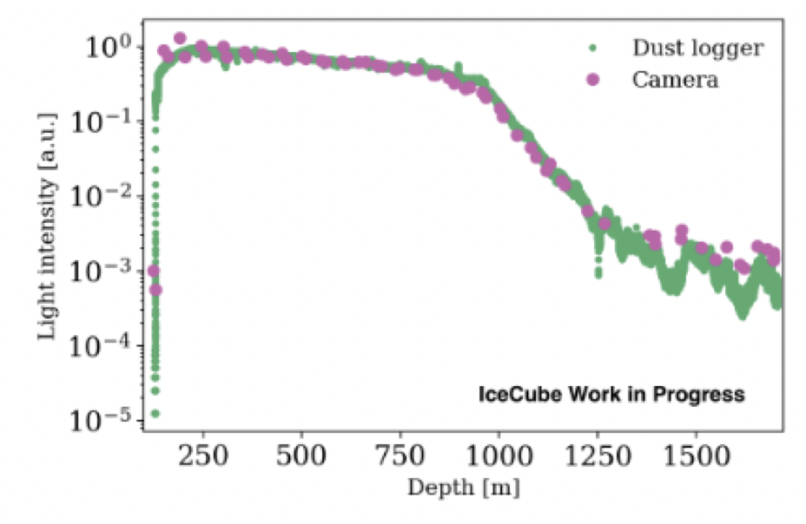
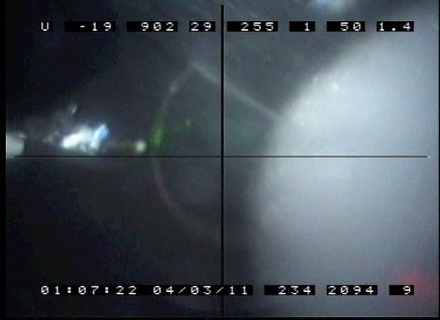
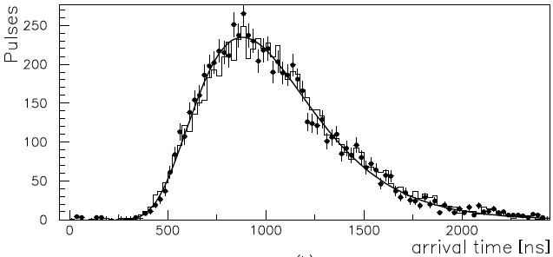
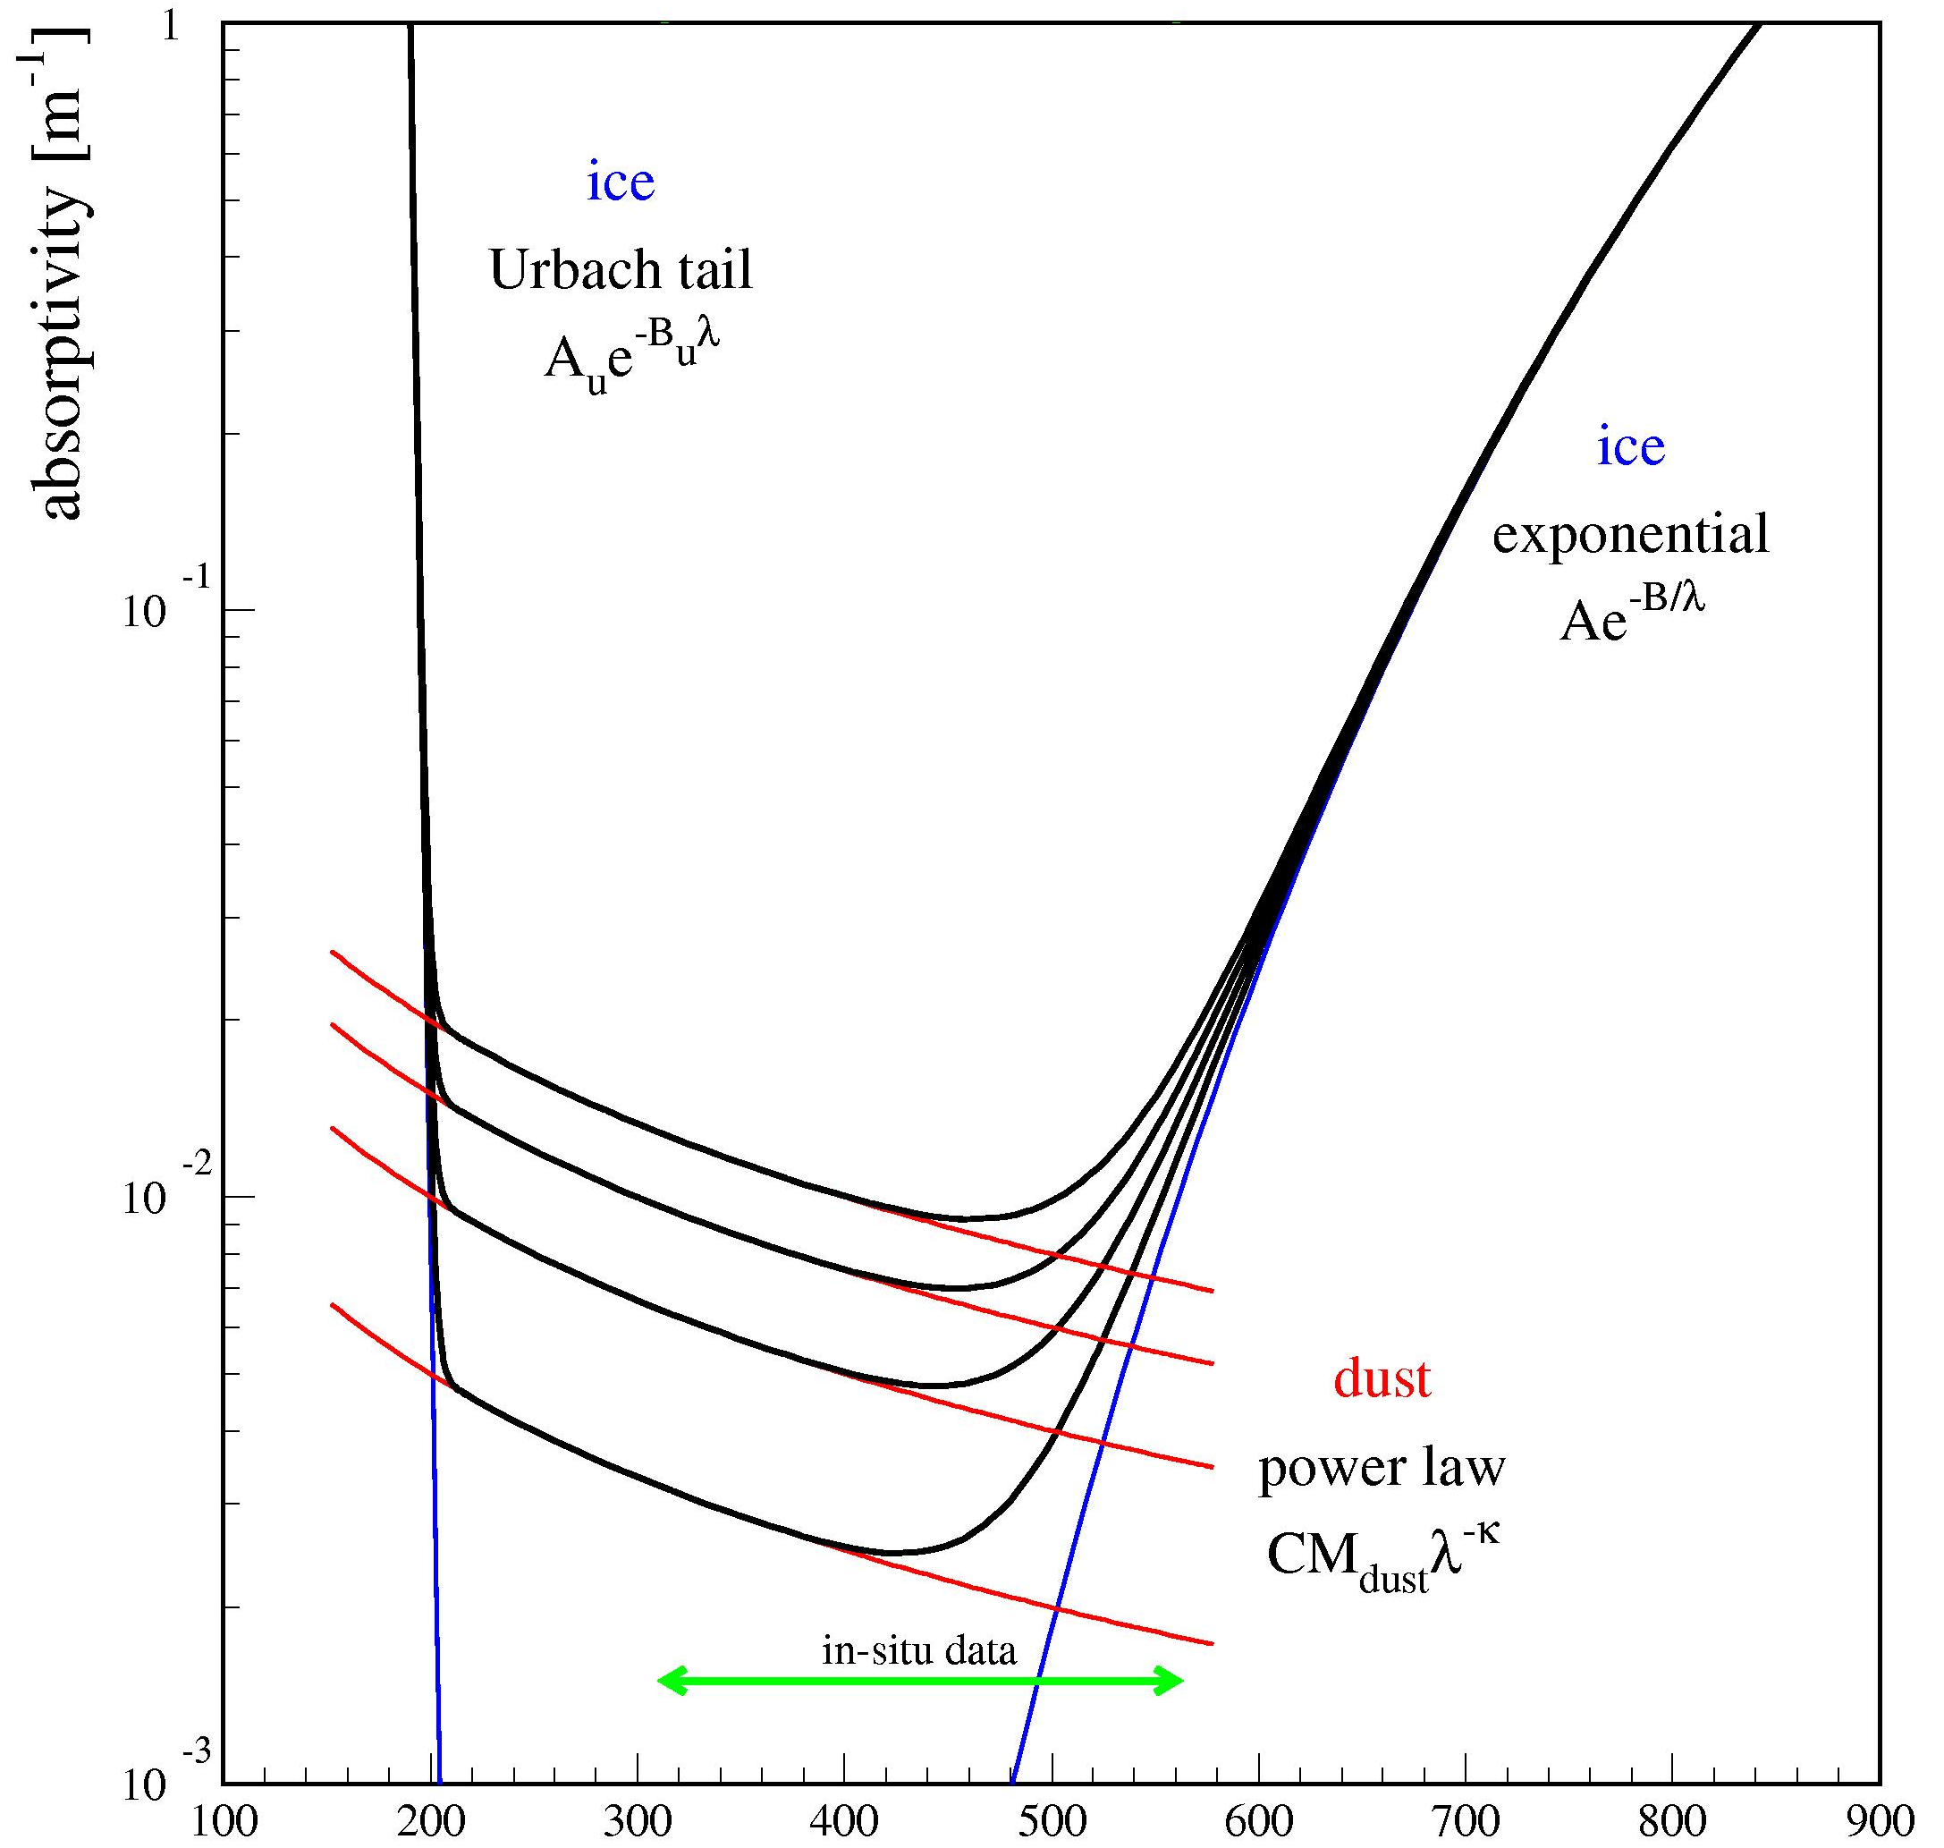
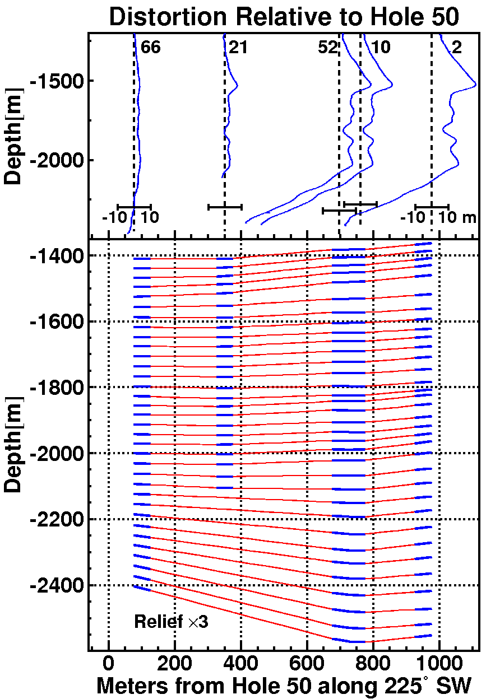
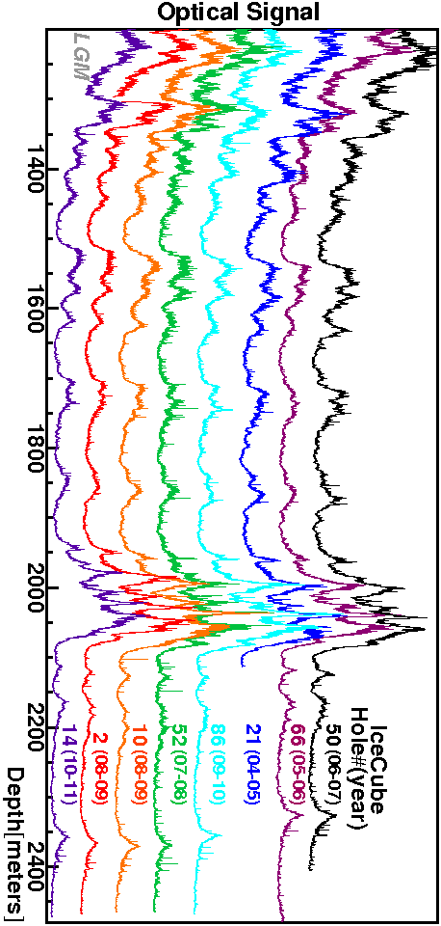
ice: step by step
no air bubbles/hydrates
below 1350 m
hole ice ?
> 100 m
absorption length
limited by dust
ice layers
tilted ice layers
birefringence
N
Ice Layer tilt direction
225º SW
E
Ice flow direction
41º NW
anisotropy
~8% less scattering
41⁰ NW

Slide 11
Improved muon track reconstruction
DNN (energy) and BDT (pointing) reconstruction
angular reconstruction consistent with simulation
insensitive to systematics

Slide 12
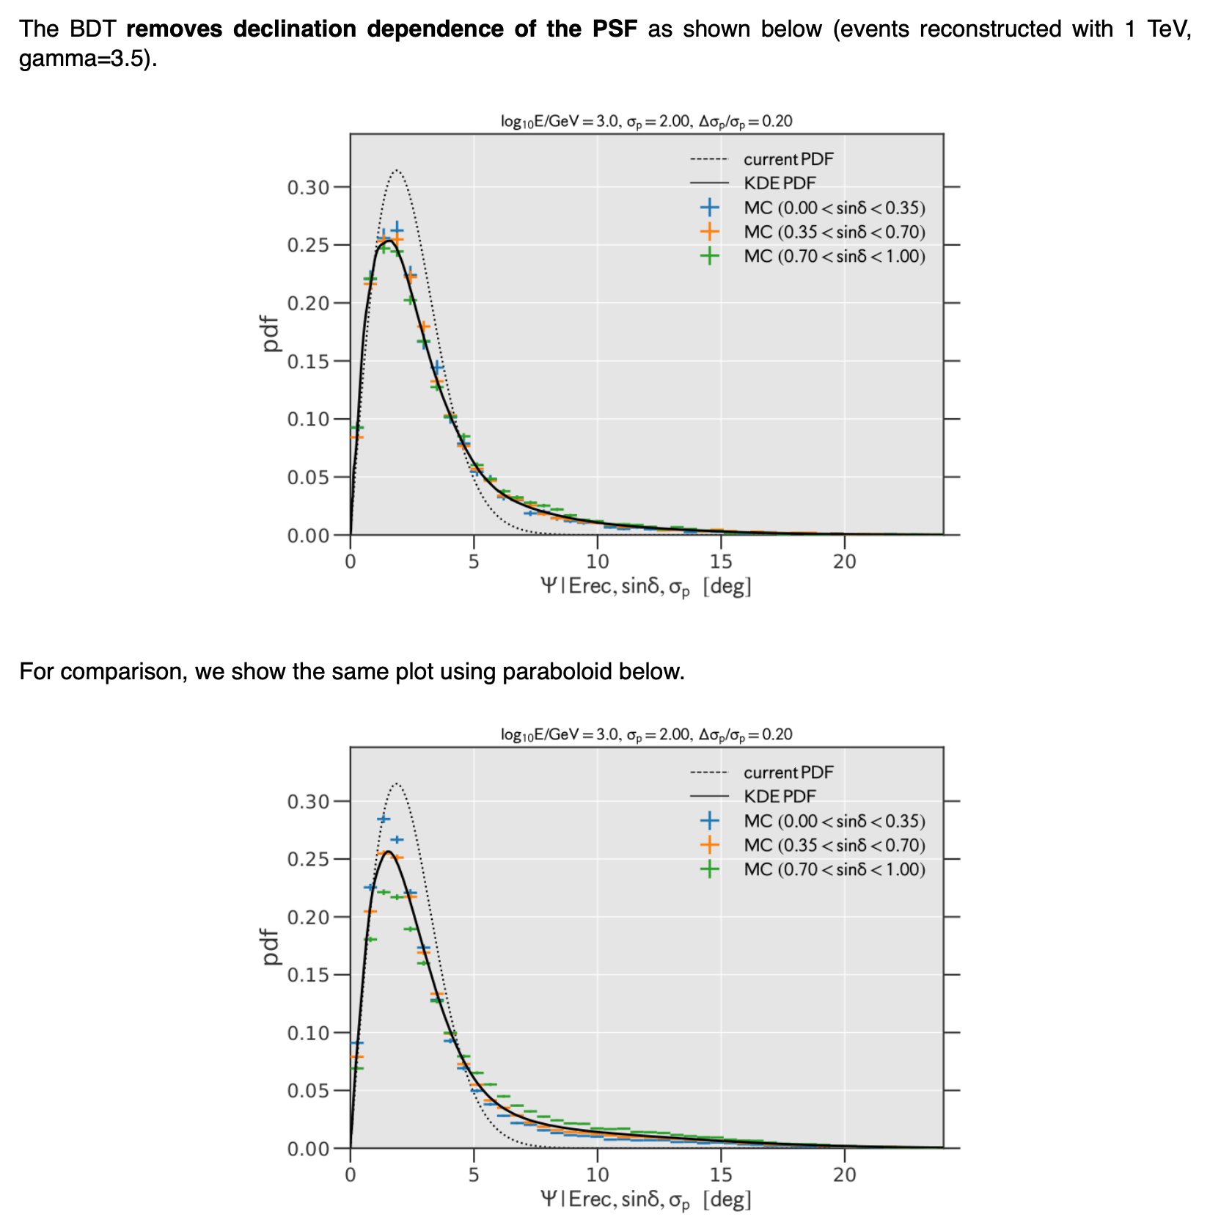
after
before
point spread function:
does not reproduce the
simulation
dependent on declination
sensitive to systematic
errors

Slide 13
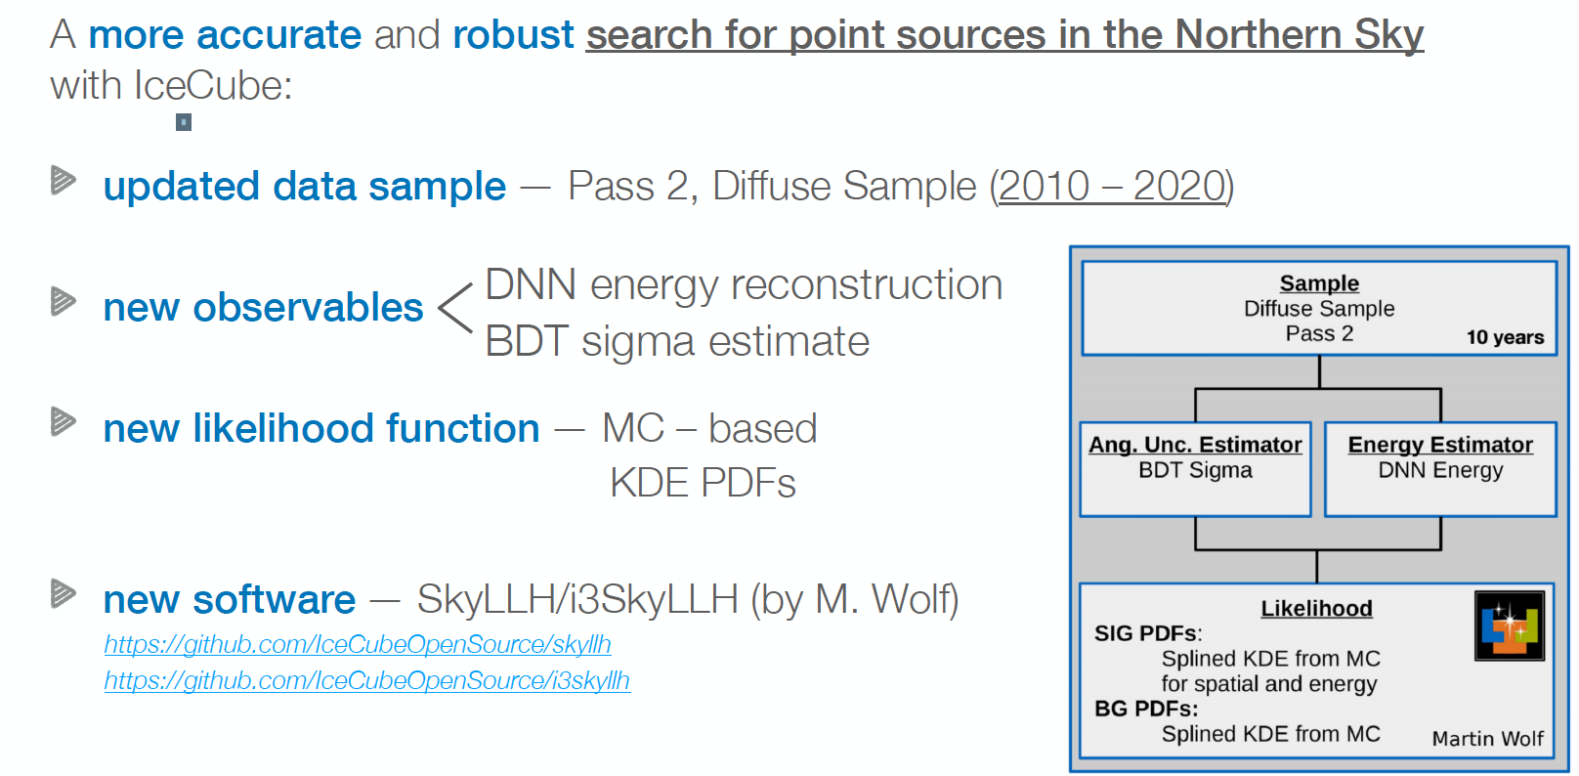
new point source analysis will be unblinded soon

Slide 14
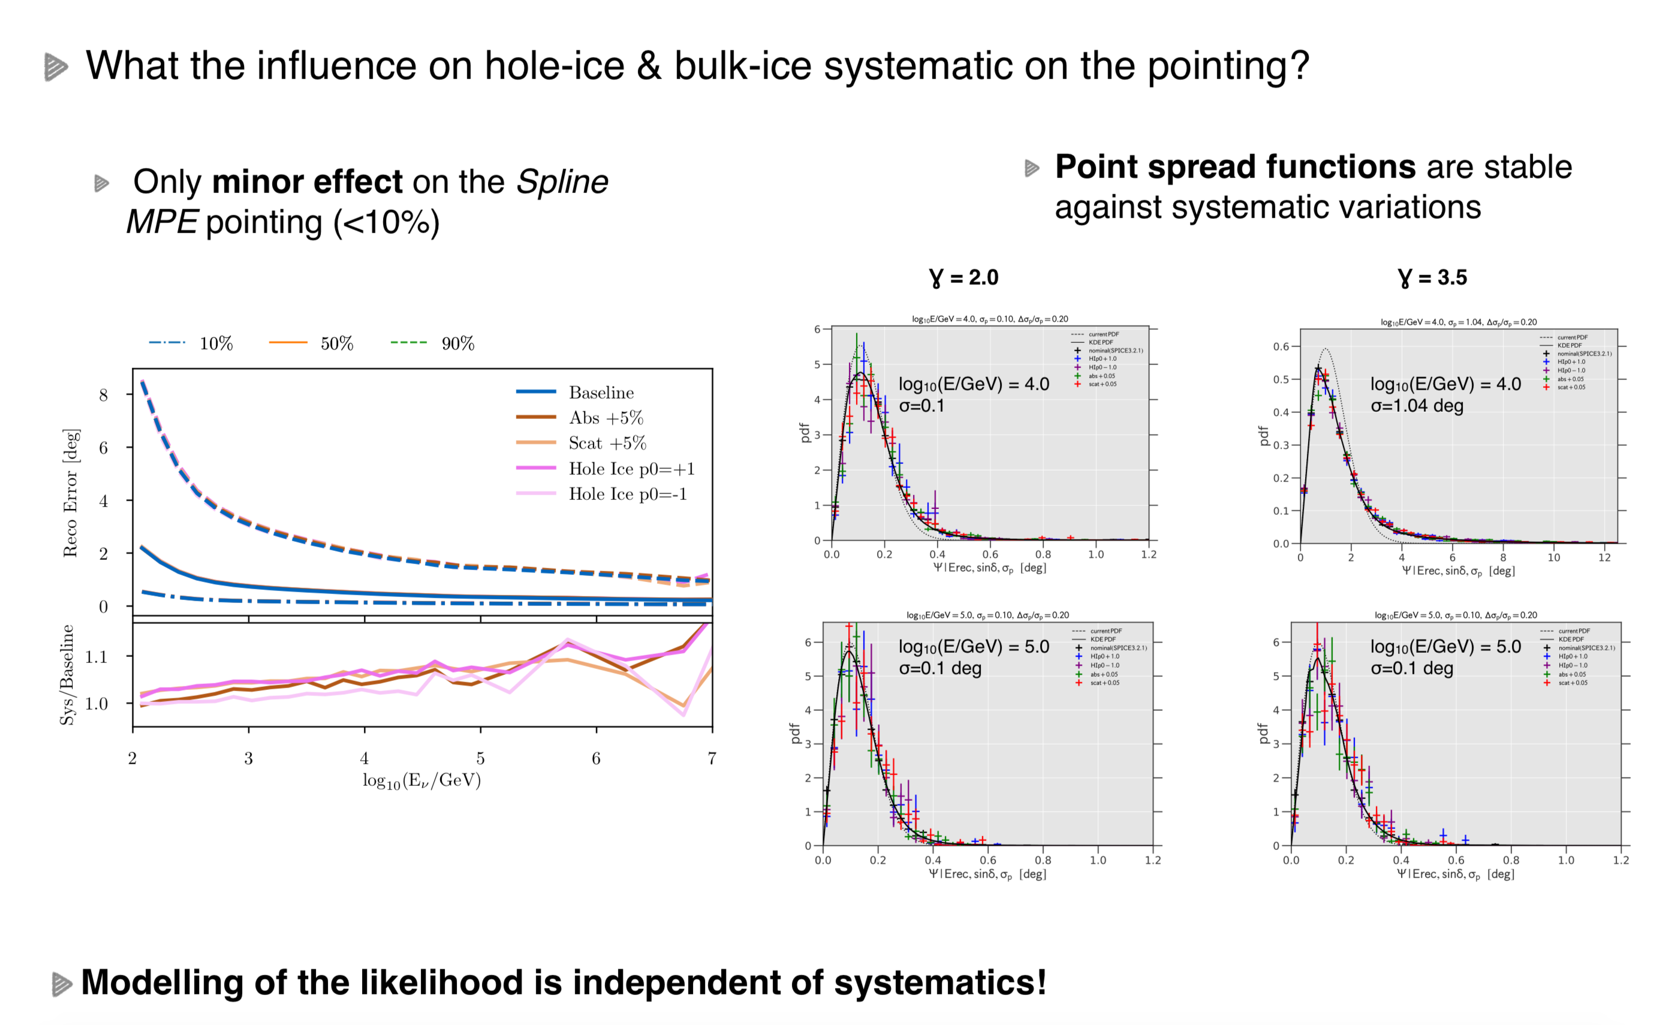

Slide 16
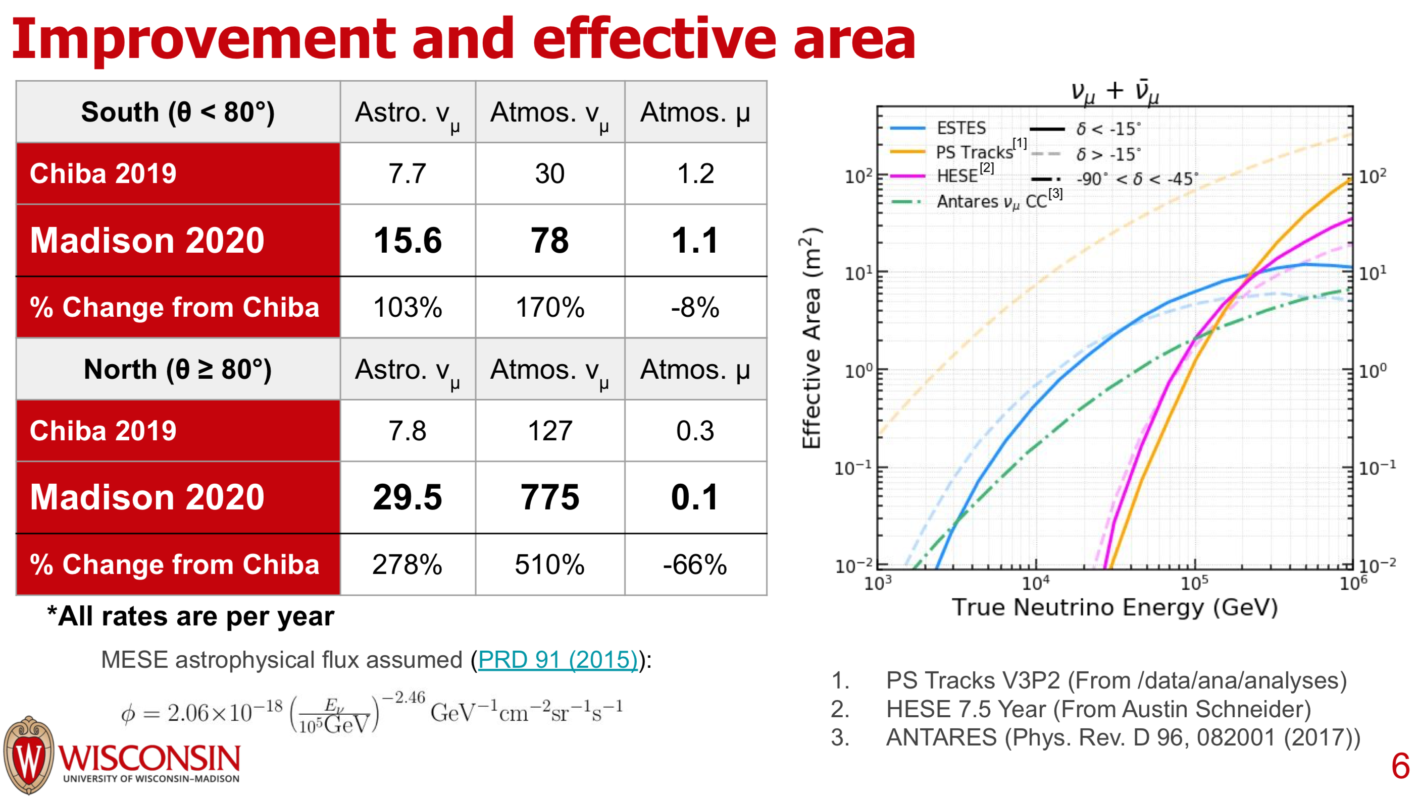
Improved muon track reconstruction
also in Southern hemisphere
IceCube-South
ANTARES

Slide 17
IceCube
francis halzen
cosmic neutrinos: many independent observations
→ muon neutrinos through the Earth
→ starting neutrinos: all flavors
→ Glashow event
improving the detector
from DeepCore to Upgrade
more about TXS 0506+056
icecube.wisc.edu

Slide 18
Deep Core: neutrino oscillations at “higher” energies (5~55 GeV)

Slide 22
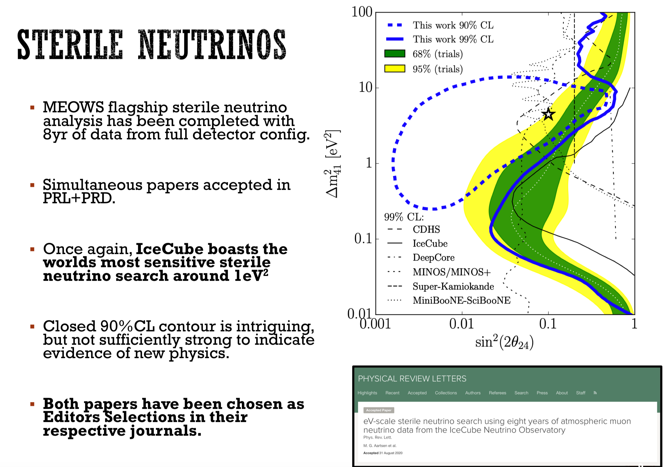

Slide 23
IceCube
francis halzen
cosmic neutrinos: many independent observations
→ muon neutrinos through the Earth
→ starting neutrinos: all flavors
→ Glashow event
improving the detector
from DeepCore to Upgrade
more about TXS 0506+056
icecube.wisc.edu

Slide 25
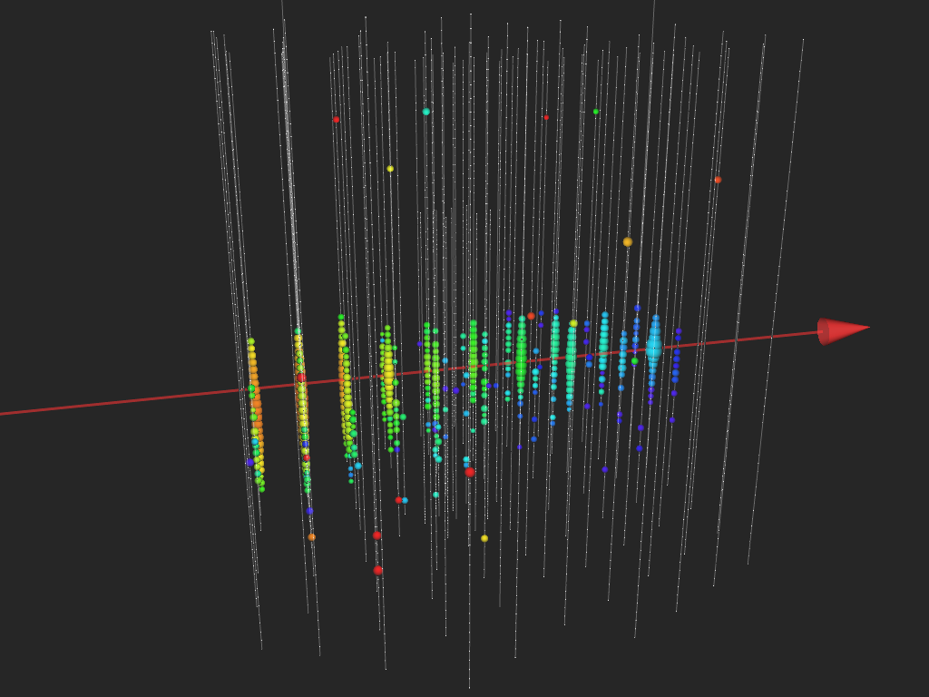
IceCube 170922
290 TeV
Fermi
detects a flaring
blazar within 0.06º
MAGIC
detects emission of
> 100 GeV gammas

Slide 26

search in archival IceCube data:
150-day flare in December 2014 of
19 events (bkg < 6)
spectrum E^{-2.2}
L_{ν} > 10⁴⁷ erg/s

Slide 27
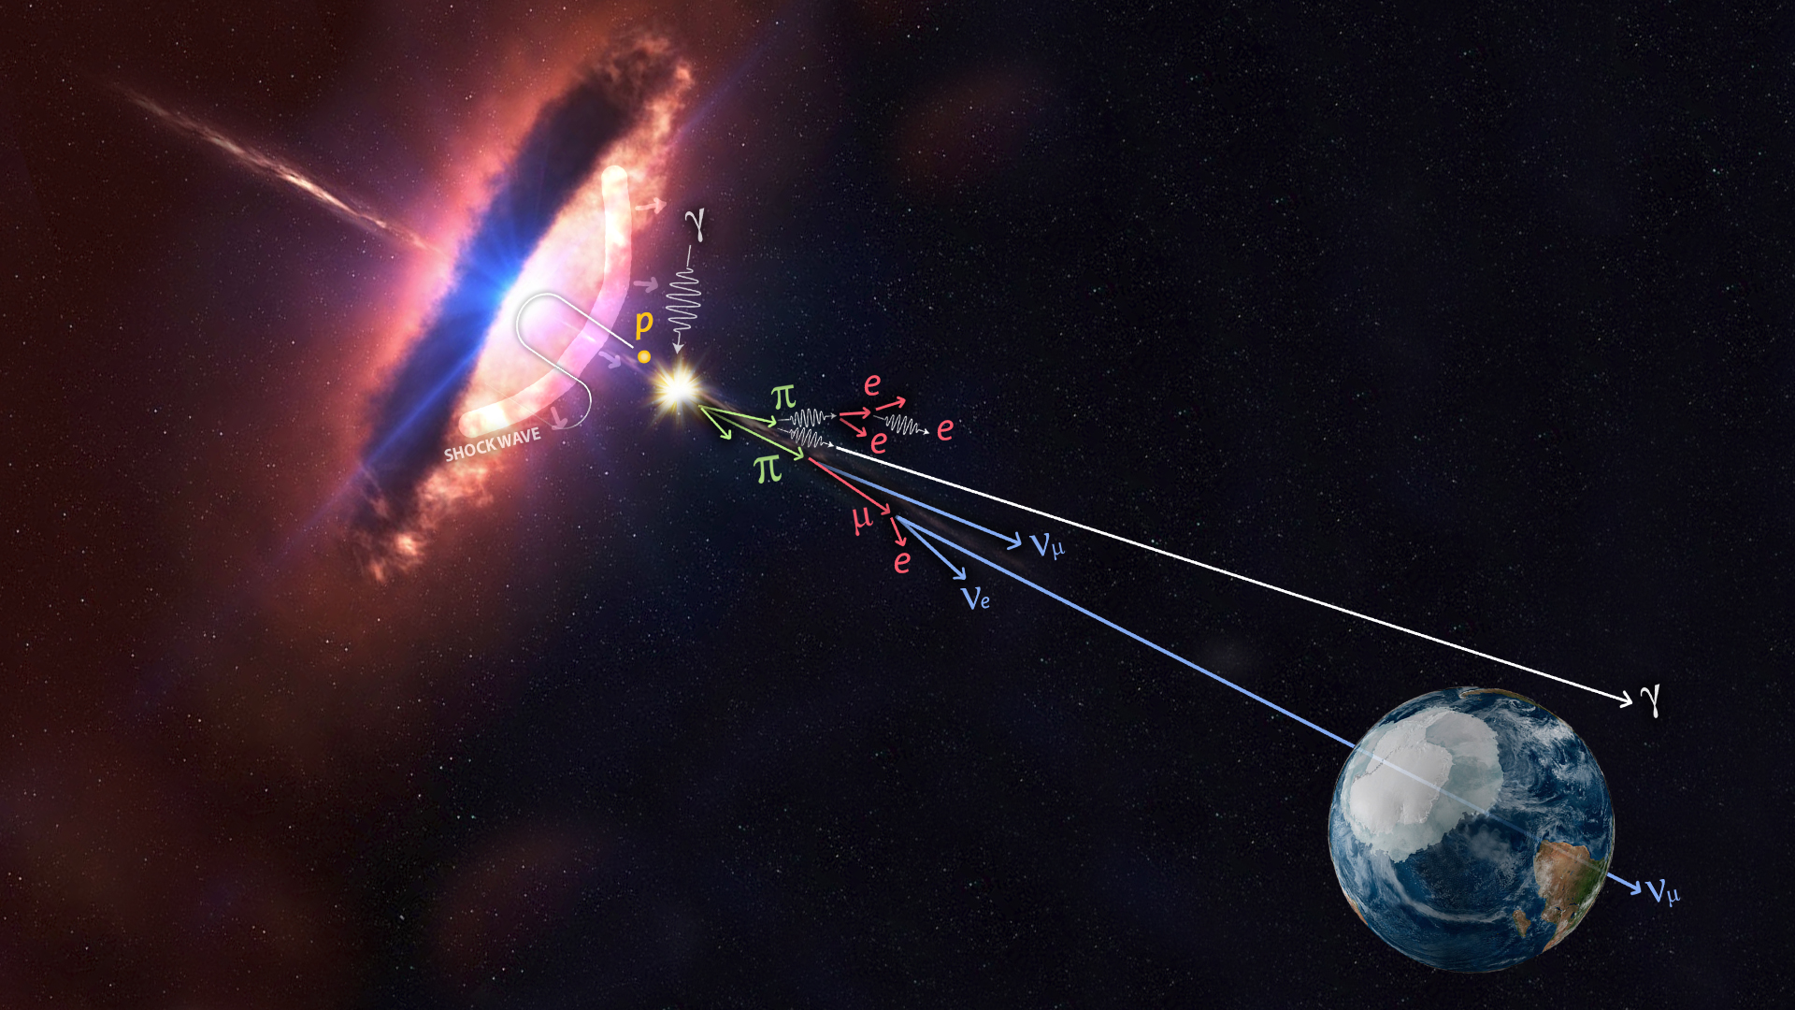
multimessenger astronomy
p + γ → n + π⁺
^{~ cosmic ray + neutrino}
→ p + π⁰
^{~ cosmic ray + gamma}
o

Slide 28
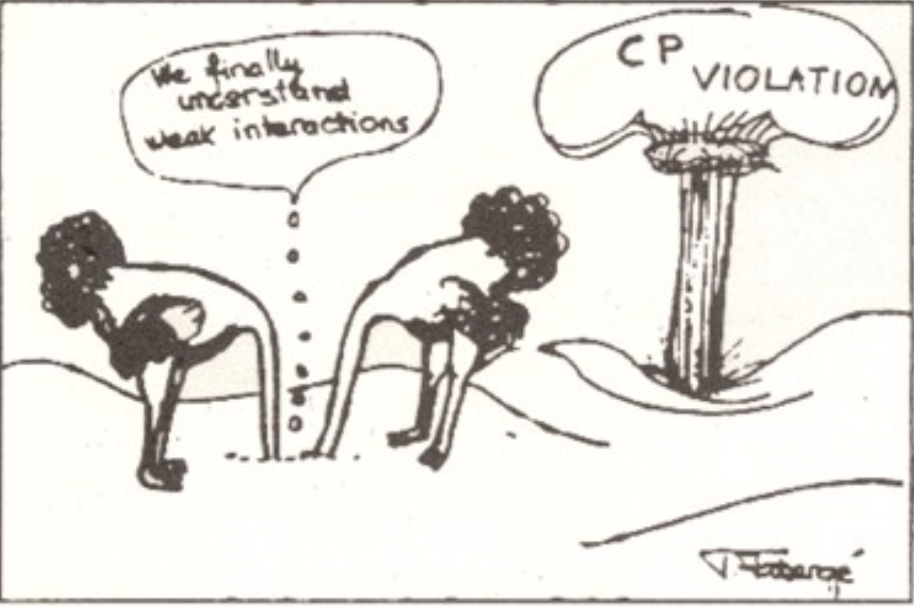
Cabibbo 1966

Slide 29
IC170922
blazar model
14 parameters
<< 1 neutrino

Slide 30
IC170922
blazar model
14 parameters
<< 1 neutrino
2014-15 neutrino
burst

Slide 31
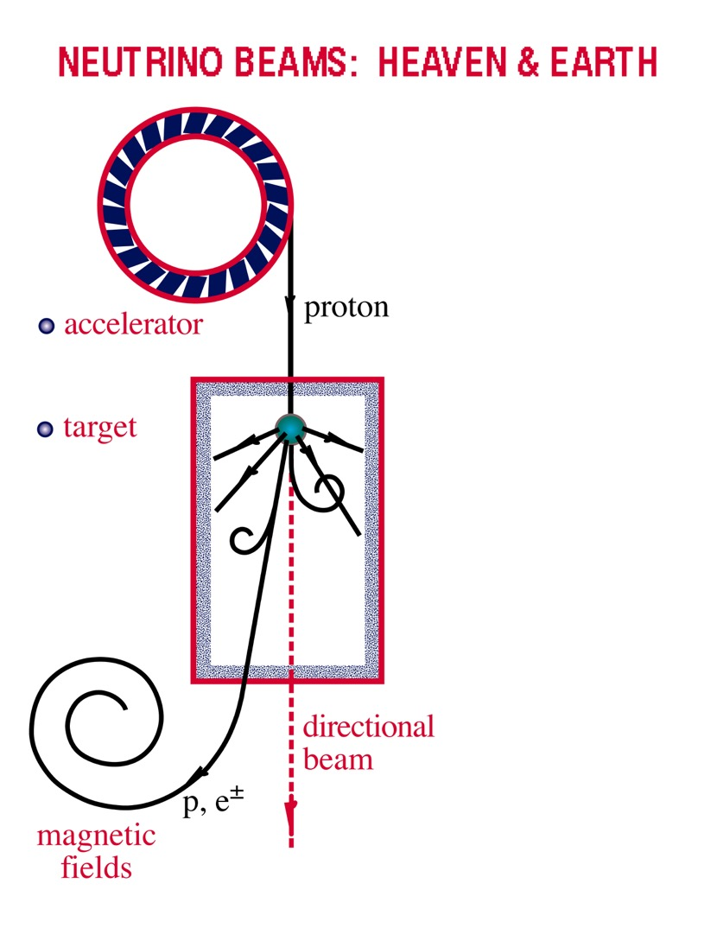
Neutrino Beams: Heaven & Earth
p + γ → n + π⁺
^{→ cosmic ray + neutrino}
ν and γ beams : heaven and earth
NEUTRINO BEAMS: HEAVEN & EARTH
supermassiveblack hole
target ?
a neutrino source needs an accelerator and a target
the target is likely
opaque to gamma
rays

Slide 32
core brightening observed
in a radio burst that started
5 years ago
core expands with
superluminal velocity
A&A. 630 A103
A&A. 632 C3
1912.01743v1
[astro-ph.GA]
TXS 0506+056
beyond 5 milliarcseconds the jet loses its tight collimation…
jet found a target after ~ tens of pc to produce neutrinos

Slide 34
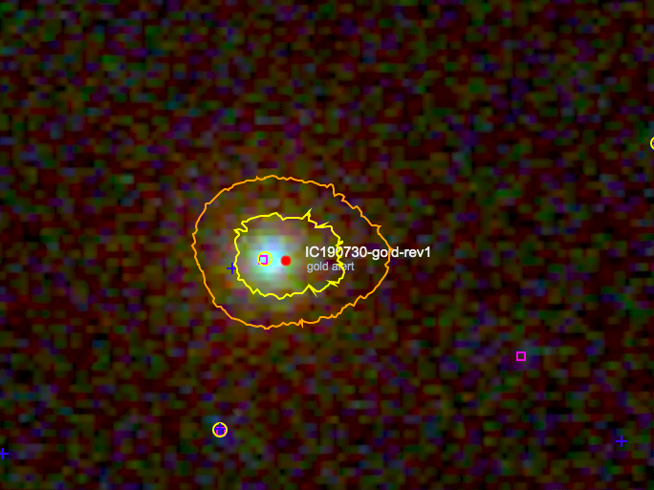
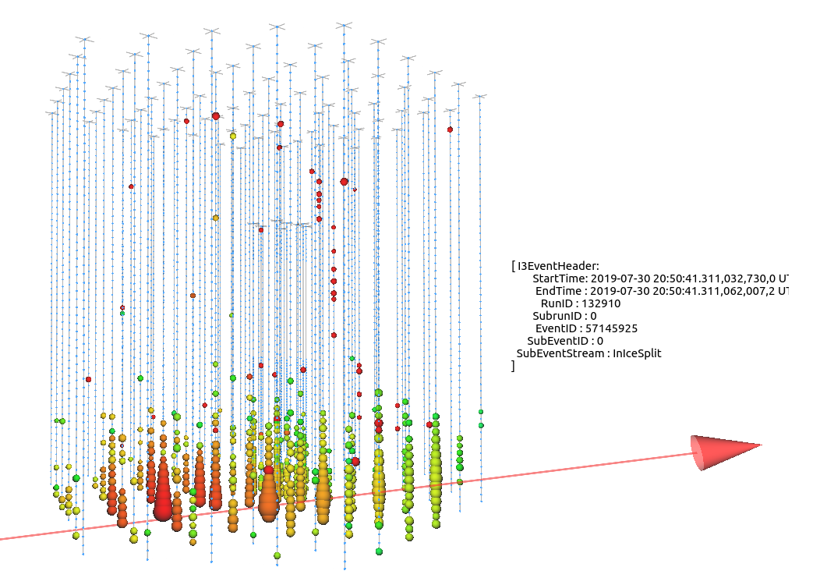
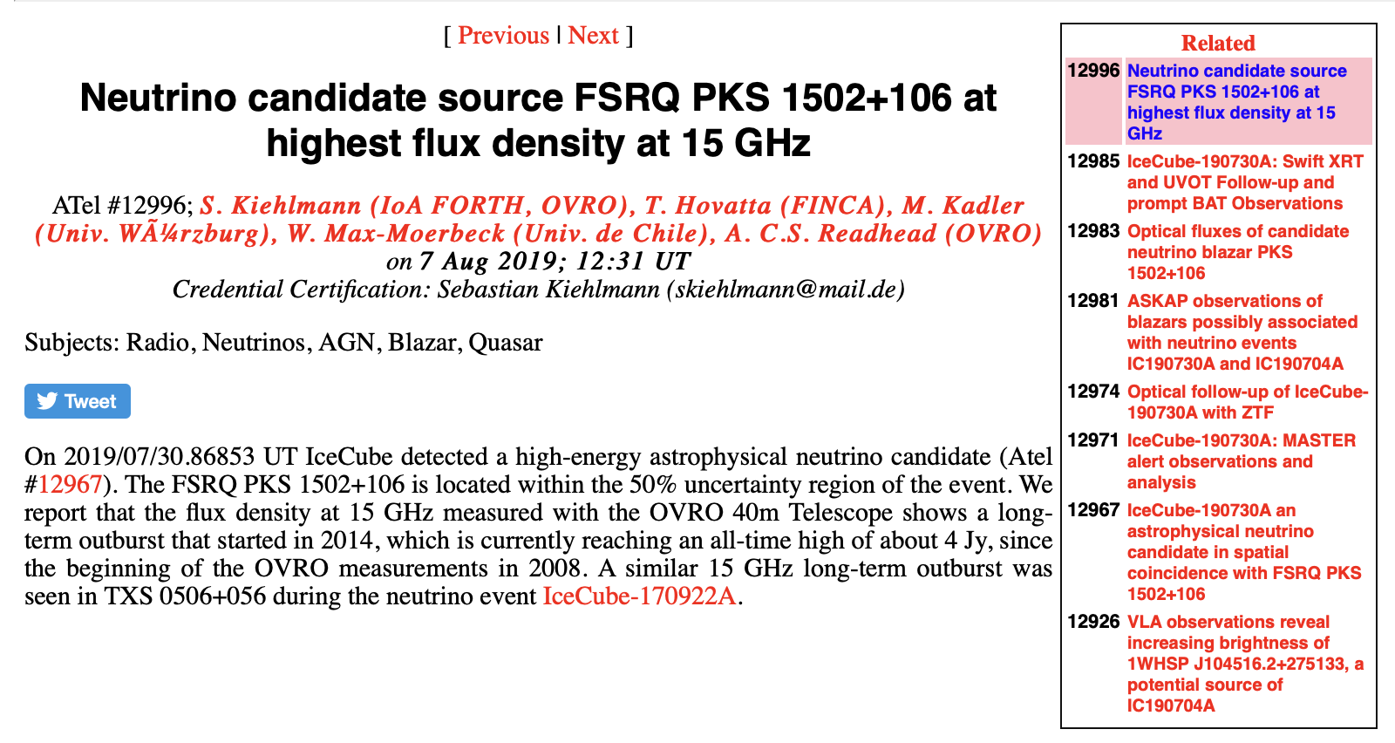
NOT TXS…
IC 190730: 300 TeV
coincident with
PKS 1502+106
radio burst

Slide 35
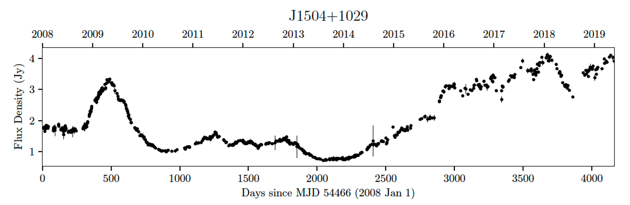
the two highest energy IceCube alerts are coincident
with radio flares
PKS 1502+106
TXS 0506+056

Slide 36
300 TeV
neutrino
produced
PKS 1502+106
γ-ray
target moves
through the jet
blocks
photons
radio
TeV flux days after IC170922

Slide 37
global robotic network of
optical telescopes
connects TXS 0506+056
to IC170922A
“MASTER found the blazar in the off-state after one minute and then switched to on-state two hours after the event. The effect is observed at a 50-sigma significance level”

Slide 38
MASTER
robotic network
optical observations
TXS 0506+056
since 2005
blue panels:
expanded time axis
years → seconds
seconds after
IC170922
seconds after
2014-15 burst
time variation of flux
times
signal-to-noise
hour-scale
variability of the
source after
neutrino emission

Slide 39
THEORY “PROBLEM” RESOLVED: TXS IS NOT A
BLAZAR AT TIMES THAT NEUTRINOS ARE PRODUCED
IceCube's neutrinos are detected from temporally gamma-suppressed blazars
what is the target found in the radio and optical images?
Supermassive stars in the host galaxy? Second jet from
merging galaxy?
multimessenger astronomy is “subtle but not malicious”
some other intriguing events:190730, 191001, 200107…

Slide 40
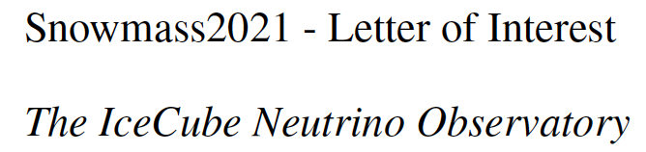
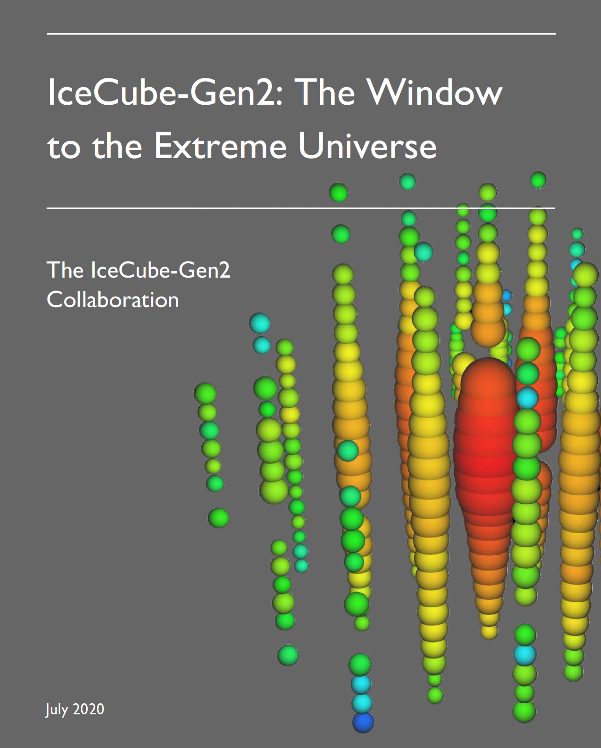

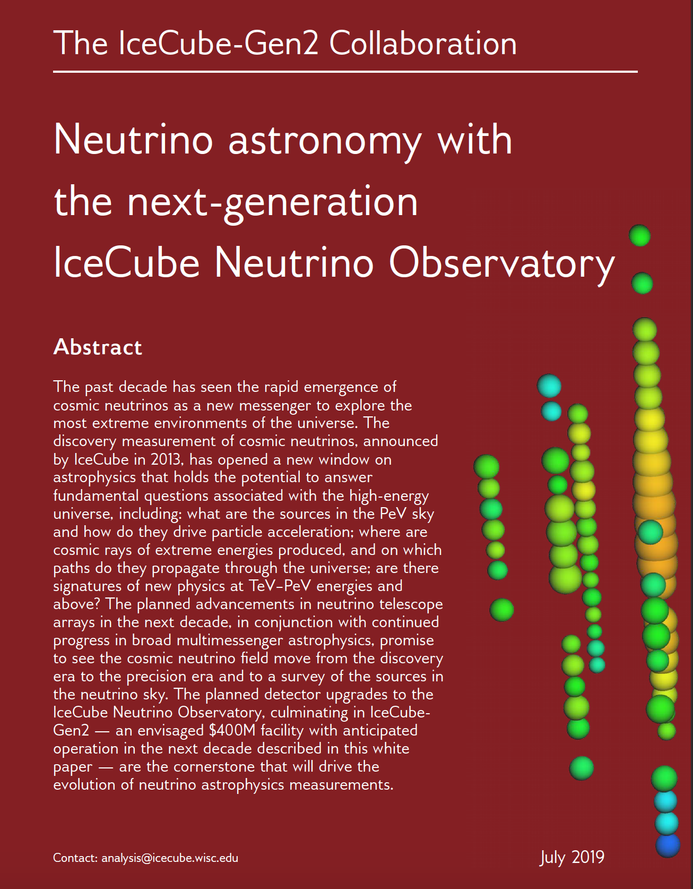
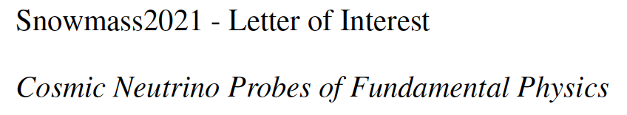
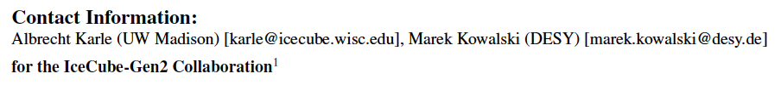
White paper
Decadel review

Slide 41
overflow slides

Slide 43
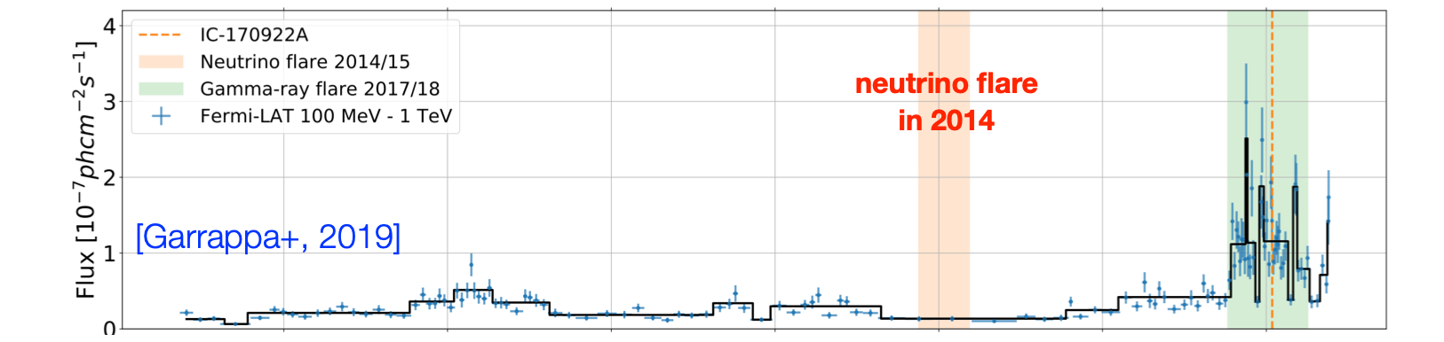
neutrino
gamma ray
radio

