Slide 1
UW Perspective
Steve Ackerman, Vice Chancellor for Research and Graduate Education
Amy Wendt, Interim Associate Vice Chancellor for Research – Physical Sciences
Presentation to IceCube IOFG, September 29, 2020

Slide 2
UW Madison is a Leading Research University
Ranked 8th in 2018 HERD Survey, $1.2B in research expenditures
Ranked 3rd in number of PhDs awarded in 2018 (NSF Survey of Earned Doctorates)
Top 20 rankings for graduate programs in physics, statistics, mathematics, chemistry, earth sciences, computer science, and statistics

Slide 3
What is the OVCRGE and how does it support research on campus?
Oversight and leadership of 17 interdisciplinary research centers
Responsible for research policy and management of all extramural research awards
Oversees compliance with all federal research policies
Oversight for all campus graduate programs
Strategic investment of $60M in support of campus research enterprise in 2019

Slide 4
OVCRGE Research Centers
From particles to prairies
Aquatic Sciences Center
Arboretum
Biotechnology Center
Biotron
Data Science Institute
Center for Genomic Science Innovation
Center for Quantitative Cell Imaging
Institute on Aging
Institute for Molecular Virology
Physical Sciences Lab
Primate Research Center
Space Science & Engineering Center
Stem Cell & Regenerative Medicine Center
Waisman Center
Wisconsin IceCube Particle Astrophysics Center
Wisconsin Energy Institute
Wisconsin Institute for Discovery

Slide 5
Office of the Vice Chancellor for Research and Graduate Education (OVCRGE)
Steve Ackerman
Vice Chancellor for Research and Graduate Education
William Karpus
Graduate School
Dean
Peggy Ziebarth
Assistant to the VCRGE
Natasha Kassulke
Manager of Strategic Communications
Lisa Martin
Associate Dean
Parmesh Ramanathan
Associate Dean
Divisional Associate Vice Chancellors for Research
Nadine Connor
Research Policy and Compliance
Associate Vice Chancellor
Brian Fox
Research Policy and Integrity
Associate Vice Chancellor
OVCRGE
Research Centers
Petra Schroeder
Administration
Associate Vice Chancellor
Kim Moreland
Research and Sponsored Programs
Associate Vice Chancellor
Amy Wendt
Physical Sciences - Interim
Associate Vice Chancellor
Nichelle Cobb
Director of Health Science IRB
Aquatic Sciences Center
Arboretum
Biotechnology Center
Biotron
Data Science Institute
Genomic Science Innovation
Quantitative Cell Imaging
Institute on Aging
Molecular Virology
Primate Research Center
Physical Sciences Lab
Space Science & Engineering
Waisman Center
Wisconsin Energy Institute
Wisconsin Institute for Discovery
WIPAC (IceCube)
Stem Cell
Julie Karpelenia
Human Resources
Assistant Vice Chancellor
Ryan Pingel
Policy and Planning Analyst
Robert Andresen
Associate Director,
Research Financial Services
Human Research Protection Program
Tom Demke
Export Control
Compliance Officer
Lynn Haynes
Director of the Office of Research Compliance
Kathleen Ruby
Assistant to the AVCs
Mark Sweet
Associate Director,
Grant & Contract Services
Casey Pellien
Director of Ed/SBS IRB
Nick Novak
Research Services
Assistant Vice Chancellor
Cynthia Czajkowski
Biological Sciences
Associate Vice Chancellor
Janet Welter
RARC Veterinary Services
Chief Campus Veterinarian
Marwa Bassiouni
RARC Operations
Assistant Director
Rebecca Moritz
Select Agents
Responsible Officer
Russell Schwalbe
Accounting
Assistant Vice Chancellor
Lawrence Berger
Social Sciences
Associate Vice Chancellor
Mark Wegener
Information Technology
Director of Computer Services
Florence Hsia
Arts and Humanities
Associate Vice Chancellor
3/1/2019

Slide 6
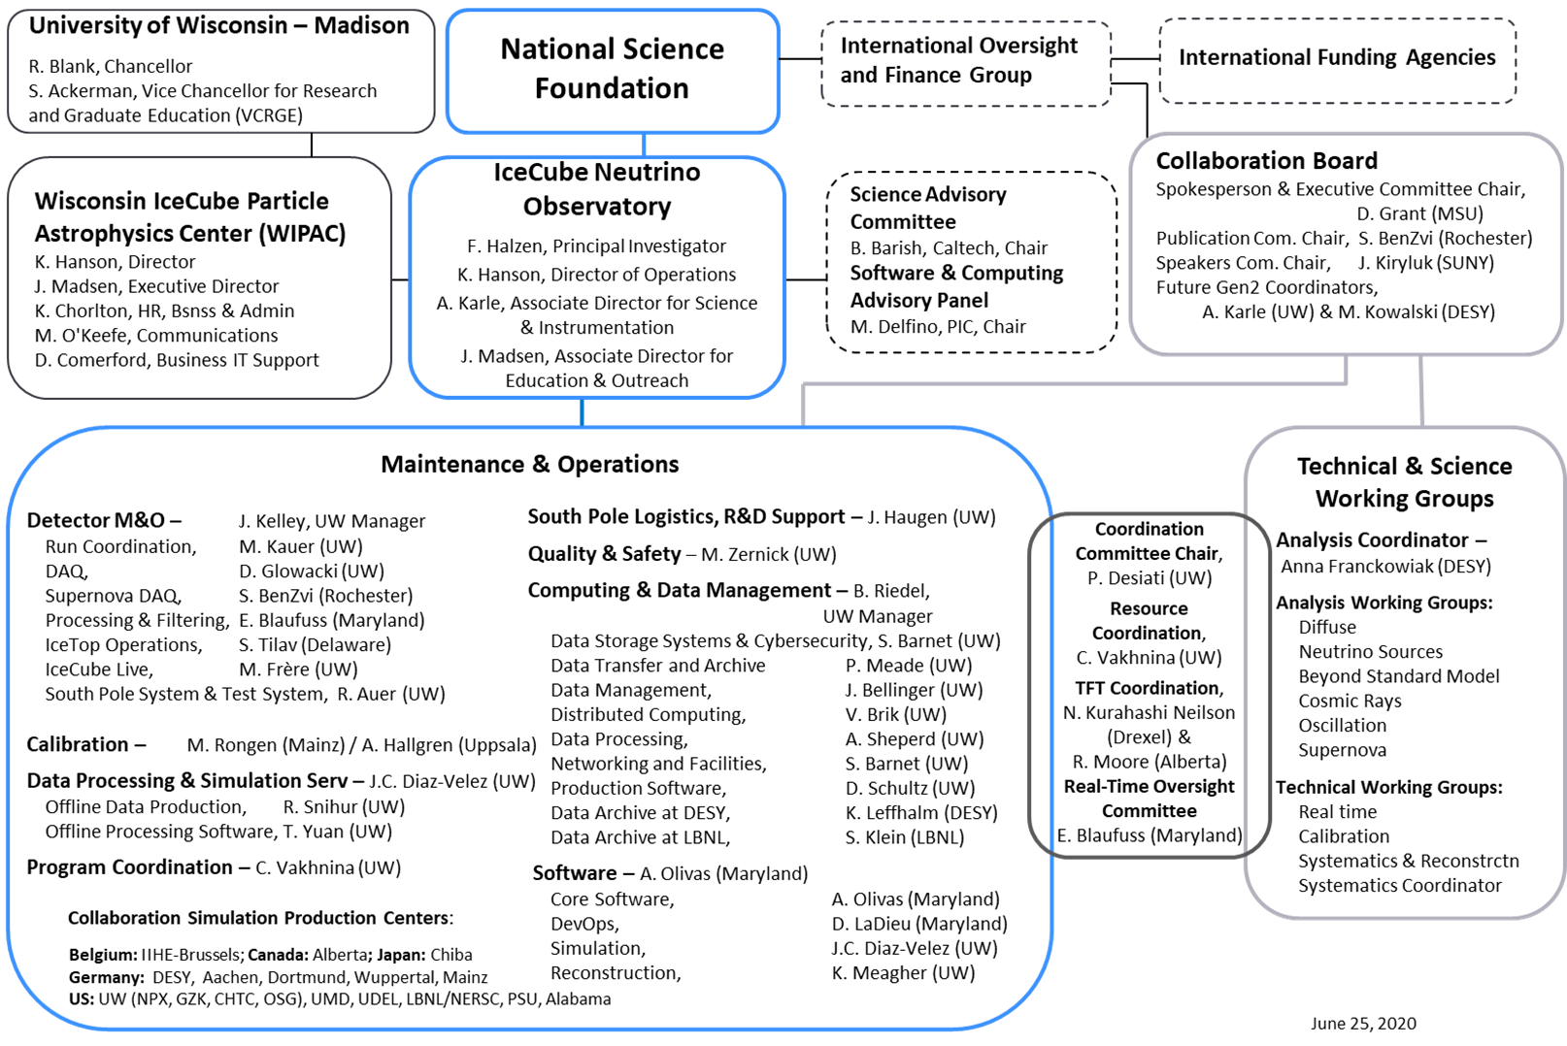

Slide 7
OVCRGE Support for IceCube and Future Facility Enhancements
Campus investment in M&O of $18.5M since 2010.
Providing internal oversight for the project.
Appointing the Director of Operations
Ensuring that the M&O Program has adequate staff and support.
Ensuring that an adequate management structure is established for managing the project and monitoring progress.
Ensuring accurate and timely reporting.
Establishing subawards with other U.S. collaborating institutions and providing appropriate funding.
Establishing MOUs between the UW and non-U.S. collaborators defining the non-U.S. collaborators' deliverables.
Guaranteeing continuity of operations during funding delays.

Slide 8
Lessons Learned from IceCube Construction
During construction of IceCube, over 80% of the $239M was allocated directly to and managed by UW–Madison.
The Graduate School (now OVCRGE) provided support and oversight and helped establish WIPAC as one of its centers to support the large facility.
Project Director (WIPAC Center Director) directly reported to the Vice Chancellor for Research.
Close collaboration between WIPAC and Graduate School (now OVCRGE) ensured that brief delays in funding did not compromise the project.

Slide 9
Celebrating IceCube 10 Year Anniversary
The OVCRGE of UW-Madison is committed to supporting WIPAC to ensure continued success of the IceCube Neutrino Observatory.
The exciting IceCube science is a point of pride for the campus
VIP briefing before the NSF press conference announcing the multi-messenger observation of the TXS blazar.
IceCube featured as UW research success story in public media.
Ongoing consistent and clear communication is essential to future success.
We look forward to working with IceCube through Upgrade construction as well as future expansion.

