Slide 1
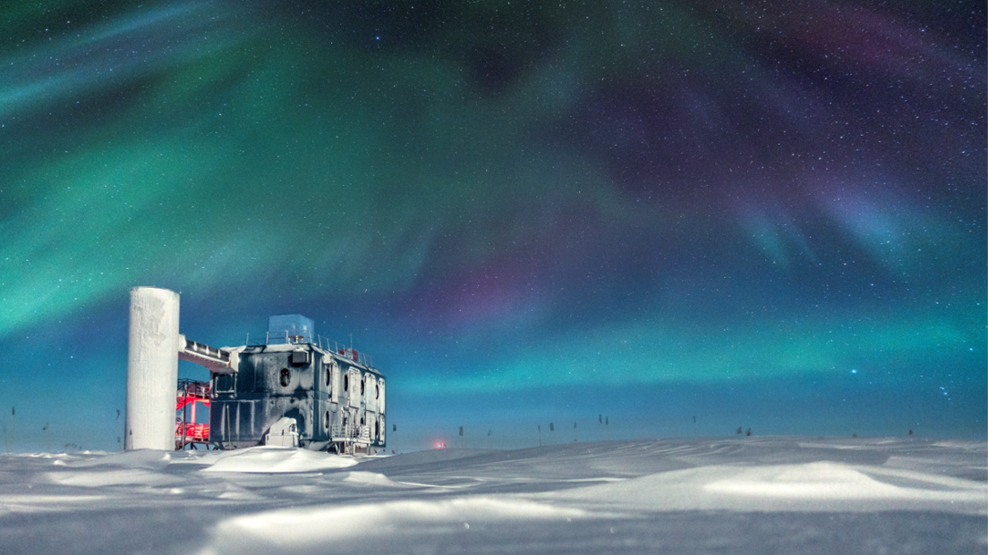
IceCube Upgrade:
Field Seasons Plan & Results
F. Feyzi and IceCube Upgrade Team
ICNO/Upgrade Project - NSF Site Visit Review
March 18, 2020
Notes:
Define 1.2

Slide 2
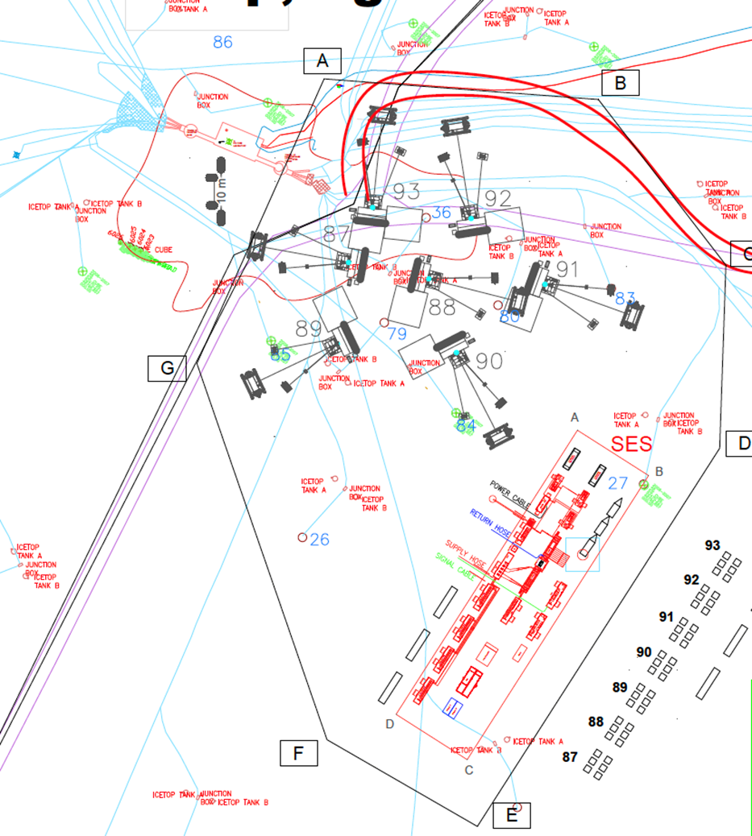
Upgrade Implementation– 22/23 Season Site Plan

Slide 3
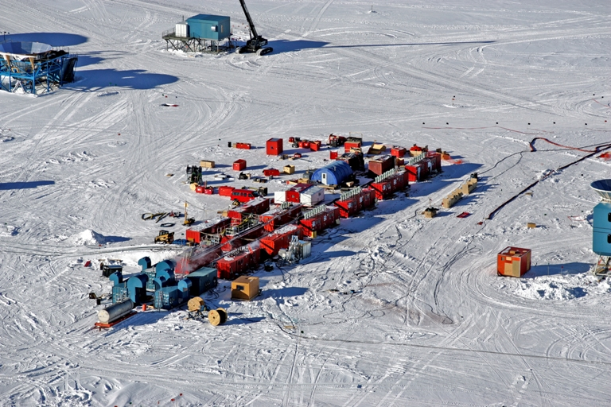
Gen1 EHWD – Seasonal Equipment Site (SES)
Upgrade Drill to be very similar. See van for scale.

Slide 4
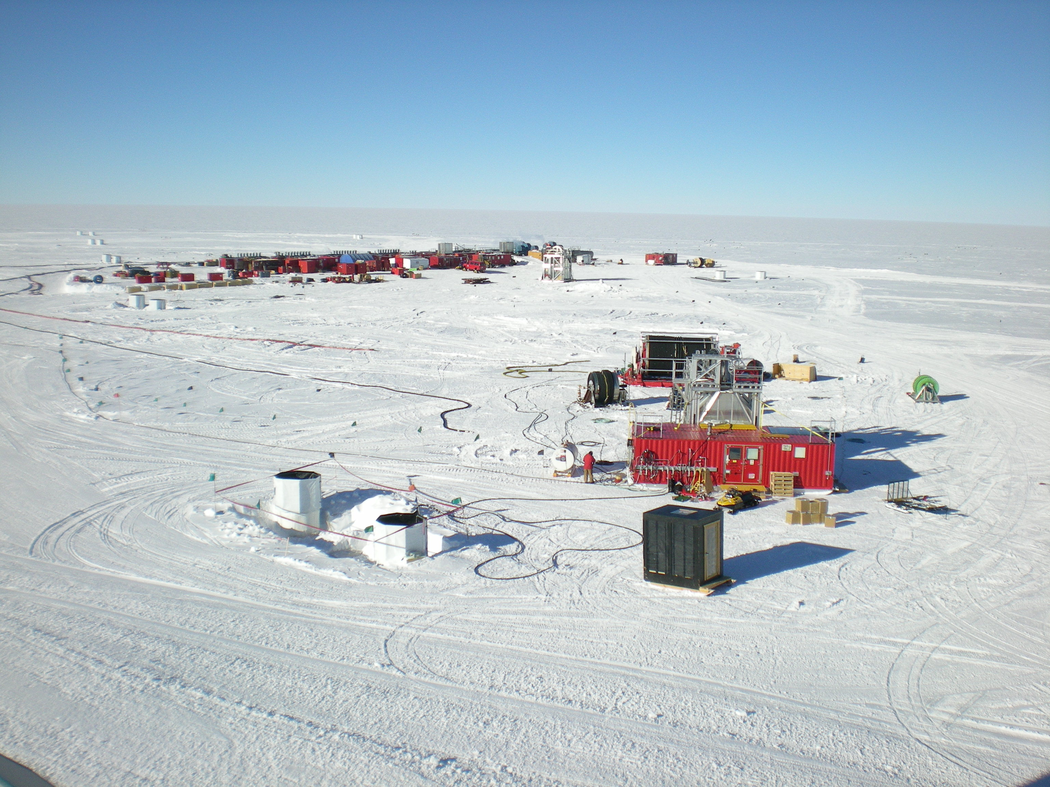
Gen1 EHWD – Tower Operations Site (TOS)
SES
Main hose reel
Tower
IceTop

Slide 5
Drill - Schematic

Slide 6
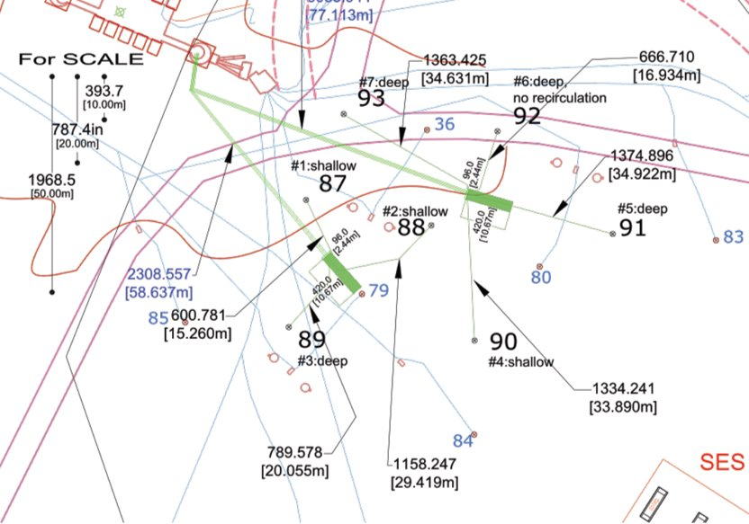
Upgrade Implementation– 22/23 Season Site Plan
ICL
Drill and install instrumentation in holes 87 to 93.
Notes:
Tight configuration. GPR will influence final locations.

Slide 7
Upgrade Implementation– On-Ice Activities (20/21)
PLAN: Deploy team of 12 to South Pole for Full Season
ACTIVITIES:
Drill hose to McMurdo
Generators to NPX, complete repairs
Setup SES out near berms, begin full system integration, begin subsystems repair and testing, limited wet testing
Install motor drives and control system elements
Test ARA drill (used for Rodwell)
Test hose reel heating over winter
Complete modifications to East Tower for Upgrade surface cable entry
Traverse: Gen2, Gen3, UNL Equipment, Fuel Tower, Snowmobiles
Fly: Gen1, IFD, 287B, Control System, DNF, Repairs/Replacements, Return Water Reel, ARA Drill Components
Detail in later slides

Slide 8
Upgrade Implementation : On-Ice Activities (21/22)
PLAN: Deploy team of 15 to South Pole for Full Season
ACTIVITIES:
Set up Seasonal Equipment Site (SES) at 22/23 location
Generators - Final commissioning, power SES
Control system final integration and testing
Drill all 7 firn holes using the Independent Firn Drill (IFD)
Complete wet-test of all sub-systems, full heat
Perform limited test drilling, test hose/cable sync
Install 2 surface junction boxes
Trench, install and pull into the ICL 7 surface cable assemblies
Receive and store all instrumentation for strings 87 and 88
Fly: Drill heads, hose, drill cable reel, drill controls and spares, 2x strings

Slide 9
Upgrade – On-Ice Activities (22/23)
PLAN: Deploy team of 51 to South Pole for Full Season
ACTIVITIES:
Complete set-up of SES & TOS sites
Assemble DOM Handling/Testing Facility
Deep Drilling – 7 holes
String Installation and Commissioning
Decommission, Retro and Store the ICU Drill Equipment

Slide 10
Proposed Upgrade Project and IceCube M&O On-Ice Org Chart – 22/23 Season
Albrecht Karle / Farshid Feyzi
On-Ice Lead
Delia Tosi
String Install Lead
John Kelley / Erik Blaufuss
CPT/Calibration/M&O/C&V/DAQ Lead
Dar Gibson
Drill & Shift 1 Lead
TBD
Drill & Install Mgr
TBDs
Winterovers (2)
TBDs
Shift 2 Drillers (10)
TBDs
Shift 3 Drillers (10)
TBDs
Shift 1 Drillers (9)
TBDs
Core Day String Installers (4)
TBDs
Core Night String Installers (5)
TBDs
Subject Matter Experts (4)
Mike Zernick
Quality & Safety Mgr
Perry Sandstrom
Project Engineer
Population Breakdown
Category / Support | Project | M & O | In-kind | Total
Management | 2 | 0 | 1 | 3
Drill | 15 | 0 | 15 | 30
Deploy | 1 | 0 | 9 | 10
CPT/Cal/M&O/C&V/Eng | 1 | 7 | 0 | 8
Total | 19 | 7 | 25 | 51
Revision 20190321

Slide 11
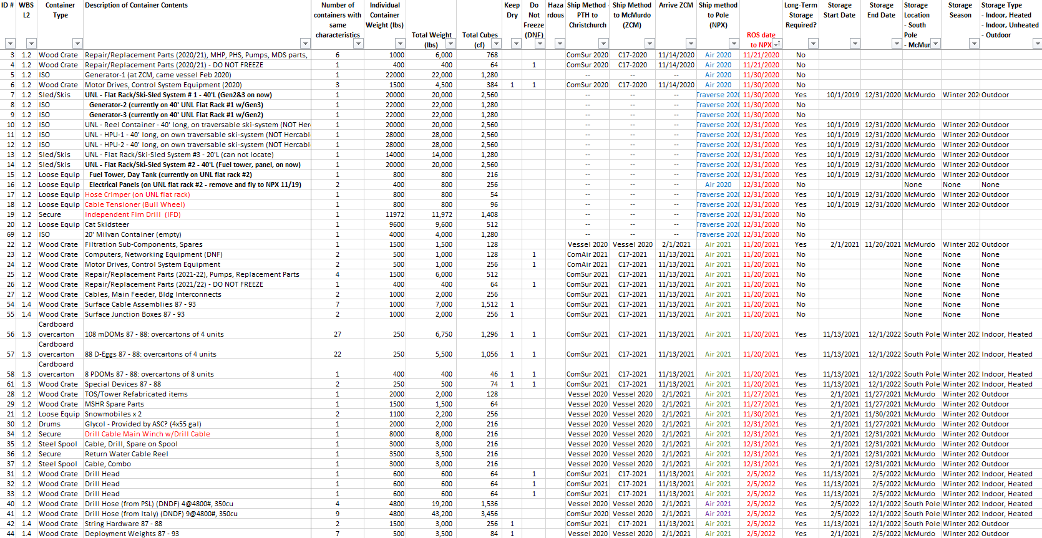
1.2 Implementation– Cargo Plan

Slide 12
20/21 Field Season detail (1)
McMurdo Support needed 20/21
Mostly involves coordinating movement of 'large' items to South Pole either by traverse or Herc
Need to reshuffle almost all equipment for traverse
Considering Ice Cube representative in McMurdo to help manage the process - Oct
Some repair (welding) of sleds, infrastructure and containers for structural concerns
Transport un-traversable ski kits (ISO1, ISO2) to Pole for use there
Is the Science Traverse or any of its equipment available? Additional flatracks?

Slide 13
20/21 Field Season detail (2)
List of Items We Need to Transport to South Pole 20/21
Gen2 and Gen3
Need to be moved to flatrack with ISO2-conversion or ISO3
SPOT-1
Day Tank and Gen Hoods
Need to be moved to flatrack with ISO2-conversion or ISO3
SPOT-1
Gen1 – Put this on a Herc. Otherwise transport on SPOT-1
Firn Drill – Put this on a Herc to avoid transportation damage
287 – Put this on a Herc to expedite delivery
20' Container (empty)
HPU#1 – 40' WISSARD container
HPU#2 – 40' WISSARD container
RCU – 40' WISSARD container

Slide 14
20/21 Field Season detail (3)
EHWD Set-up Basics
Set everything up in drill configuration on groomed area adjacent to winter storage to start season
This will require significant early season heavy equipment support to excavate modules and reels, groom area and set up drill configuration
CRREL Generator for camp power.
1 Fuel tank for Generators
1 Fuel tank for MECC
1 Fuel tank for MHPs. Can be moved when necessary with Ice Cube 287

Slide 15
20/21 Field Season detail (4)
ASC Trades Support needed
Electrical
Follow-up/inspect some of the electrical modifications required for motor drive and control system upgrade.
Finish work on PDM that could not be completed in 19/20
Power SES with CRREL generator + PDM
Carps/Construction
Install fall restraint system on 5 MDSs early season
Build enclosures on top of Water Tanks and to insulate water manifolds
Mechanic
CRREL Gen checks, maintenance and PMs
287B
Snowmobiles

Slide 16
20/21 Field Season detail (5)
Check Ancillary Equipment
Seasonal Equipment Workshop (SEW) is available as electrical team workshop, check condition
Optical Module Lab (OML) - Assess condition, many not be is needed
DOM Sleds – Used to transport DOMs to prep and to deployment no longer available, assess what we could use instead

Slide 17
20/21 Field Season detail (6)
ASC Equipment Support needed
Excavate EHWD and Berms
Set up EHWD in drill configuration
Crane support for mounting PDM and Gens on skis
Manbasket for tower hoist wiring on Tower #2 (1 day)
We would like to request dedicated 287/skidsteer until our 287B arrives
SPO-Loader email worked well last season for next-day requests, confirm this method again be available in 20/21
Pad preparation in Dark Sector
Winter location for heated hose reel (test)

Slide 18
20/21 Field Season detail (7)
Additional ASC Support Requests
200-3000gal water tank and seed water for heater testing
90w gear oil for high pressure pumps (Mobilgear 630 or equivalent)
2-cycle oil for snowmobiles
1000+ gal fuel

Slide 19
Upgrade Drill Hose
Hose Logistics and Storage
Arriving in CHC fall 2020
Vessel to McMurdo 20/21
Winter storage in McMurdo 2021
Fly to NPX 21/22
Install on hose reel 21/22, heat hose reel during 2022 winter
Location
Power
Test this in 20/21
Install hose onto reel at Cryo
Keep hose spools warm until needed
TOS + hose reel + TU20 + space
Consider long-term plan (Gen2)

Slide 20
Backup

Slide 21
Upgrade Implementation – On-Ice Activities (19/20)
PLAN | ACTUAL
Deploy team of 8 to NPX for Full Season | Team of 12 for Full Season
Generators 2 & 3: Repairs, Tune, Prepare, Possible Traverse | Mostly completed
Power Distribution Module: Repair, Sync, Traverse | Completed
UNL Equipment: Secure, Organize, Prepare | Completed
Perform Ground Penetrating Radar | Completed, awaiting CRREL analysis
Perform Structural Inspection of Drill Towers | Completed
Comprehensive Subsystem Inspection, Evaluation, Inventory | Completed
Life-Safety Systems Inspected and Replaced As Needed | Completed
Power-Up and Fire Furnaces | Completed
Winches: Inspect & Test | Completed
Control System: Test Prototype Motor Drives, Test Motors | Completed
ICL: Evaluate Cable Entry and Routing | Completed
Fuel Tower Inspection | Completed

Slide 22
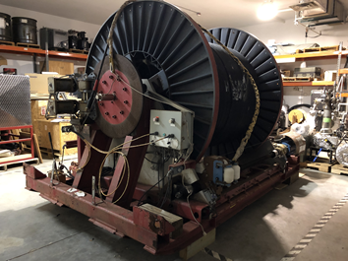
Upgrade Drill Main Cable Reel Contingency Plan
Main Drill Cable Reel Logistics
Current Plan
Vessel ship 20/21
Winter in McMurdo 2021
Traverse to NPX 21/22
Under Consideration
COMSUR 2021
C17 to McMurdo early 21/22
LC130 to NPX early 21/22
Significant change
Also includes tensioner

