Slide 1
M&O Homework Questions
NSF Mid-Term Review of IceCube M&O
2019 | 03 | 14

Slide 2
Question #1 / #2
What are the projections of the needs for personnel to do the required software maintenance? Are the commitments for the in kind support from the MOU’s and the M&O covering this?

Slide 3
Production S/W
Maintenance: 2 FTE required.
Maintenance + active development: ideally 5 FTE total.
Large efforts such a PassX reprocessing take ~1 FTE about 1 year.
Current situation: 2.5 FTE + open search for developer.
Almost entirely supported by Core M&O (NSF) funds.
Engagement of in-kind resources challenging due to expertise required (supercomputer environments, GPU).

Slide 4
Online S/W
Core DAQ – 3 FTE – sufficient support all M&O Core
Supernova DAQ – 0.5 FTE – US in-kind. Model of grad student support has impacted new feature development in SNDAQ due to student turn-over. Critical system is running ~100%. Requires and receives some support from professional S/W developers supported by core M&O.
Online Filters – 7 FTE mostly in-kind. Get good response from collaboration resources because of direct connection to the science.
Planned needs include IceCube Upgrade: anticipate ability to support IceCube M&O + Upgrade development, possibly require 1 embedded S/W developer.

Slide 5
Simulation / Offline
Currently 3 FTE effort just to maintain software. Total effort available in M&O ~ 1 FTE and 3 FTE from Collaboration
Anticipate significant effort needed (1 FTE per module type) to support simulation models of new modules and calibration devices.
Enthusiasm within Collaboration is high to support Upgrade – so far most (90%+) of the Upgrade simulation effort is coming from in-kind. However see comment below.
LE group is very engaged in supporting these activities (T. Stuttard is L3 for Upgrade simulation 100% in-kind contributed labor).

Slide 6
Question #3
New analysis opportunities are going to arise which will require more effort-is this covered?

Slide 7
Reprioritization
We’ve been doing this since beginning of M&O (Pass 2 / Realtime)
When new, sexy physics comes along we have no trouble attracting effort from the Collaboration to focus on this.
For example, recall dip in 2018 publications from Dawn’s presentation: many papers were delayed because collaborators were instead focusing on TXS.
This is still not zero impact globally.

Slide 8
Question #4
What did you present to the SCAP that resulted in the recommendation to look to resources to increase your computing assets by an order of magnitude? (under charge 3 question)

Slide 9
What did you present to the SCAP that resulted in the recommendation to look to resources to increase your computing assets by an order of magnitude?
The main driver for computing resource requirements is simulation production, primarily background simulations.
The following two slides were the key slides in presentations to the SCAP

Slide 10
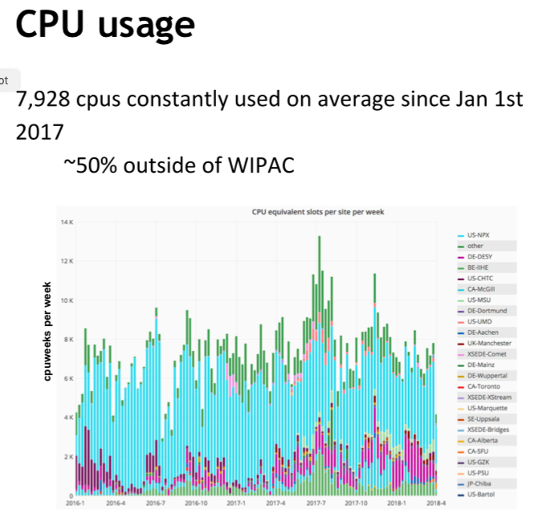
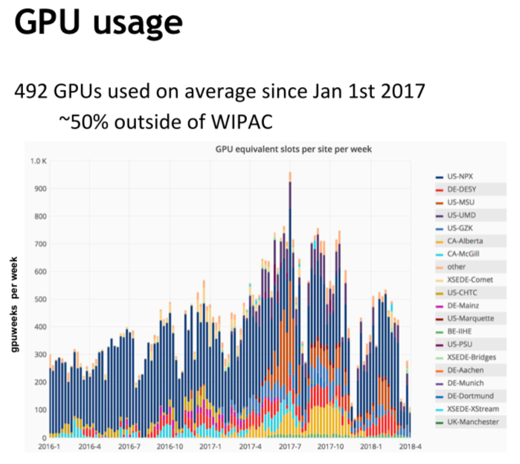
Current resources available:
CPU: ~8000, GPU: ~500
From computing manager
G. Merino’s presentation.
10k CPU
500 GPU

Slide 11
This slide shows what is required to break even with the detector rate:
CPU: ~10000, GPU: ~300

Slide 12
Additional comments that capture the discussion at the SCAP
Current status:
simulation is able to break even: which means we can simulate 1 year of live time in one year.
That’s a success.
What is it we would ideally have: 10 times more.
Explanation for “factor 10”:
Changes of ice model, optical sensor model, physics background models
require in some cases a complete re-simulation.
IceCube has already produced 10 years of live time.
So, if we want to re-simulate full background for a 1:1 ratio, we can never catch up.
It would take one year to do a re-run of the past 10 years.
This is one way to rationalize why a factor of 10 would be desirable.
In some cases it would be even desirable to have more than 1:1 ratio.

Slide 13
Question #5
Response to SCAP with respect to using TITAN- GPU experts are hard to get-is there a plan?

Slide 14
Supercomputers / GPU
IceCube has experience with GPUs and supercomputers – Experience growing with people using more machine learning methods and the resource mix adding more supercomputers experience
Experts interact and cross-pollinate ideas
Training new experts, esp. students, in special bootcamps, e.g. GPU computing or machine learning, or if interested they can deep dive into certain aspects, e.g. ice properties, glaciology.
Working with supercomputers is hard, as each system is a unicorn. Have gained significant expertise over the last 10 years.
Several experts in the collaboration working on supercomputers.
This problem also can be factored into two mostly distinct categories:
Supercomputer experts
GPU developers
The same optimizations which help us to leverage supercomputers help us better exploit computing resources on conventional clusters.

Slide 15
Question #6
Is the escalation covered by increase in efficiency that you have projected?

Slide 16
Managing Escalation /w/ Flat Funding
Escalation was originally built into the cost model for IceCube M&O but was removed to accommodate the flat funding profile from NSF: $7.0 M per year.
This is not an ideal situation, while inflation has been low for 2016-2018, UW Madison is planning across the board wage increases of 3%
We have been dealing with this by:
Pursuing additional resources (INCLUDES, CESAR, …) to support existing M&O staff.
Not filling vacancies (P. Wisniewski, e.g., instead negotiated with UW Campus to support IceCube networking).

Slide 17
Question #7
What is the documentation of the performance of the sub-awards and who approves the payments?

Slide 18
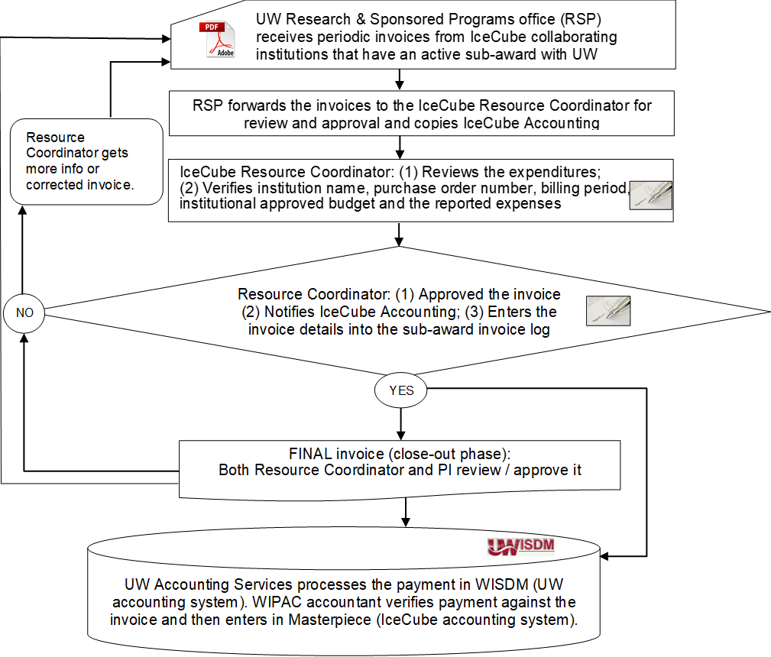
IceCube M&O Sub-award Invoice Approval Process Flow

Slide 19
Documentation of SubAwardee Performance
SoWs and Staffing Matric reviewed by ICC Chair, Software Coordinator, Computing Coordinator, Resource Coordinator, and Director of Operations every 6 months.
UMD Example – 2.9 FTE supported as part of sub-award:
E. Blaufuss: Online filters, core software support
A. Olivas: Software coordinator
D. LaDieu: Software infrastructure support
A small number of institutions have been cut or dropped due to failure to meet deliverables.

