Slide 1
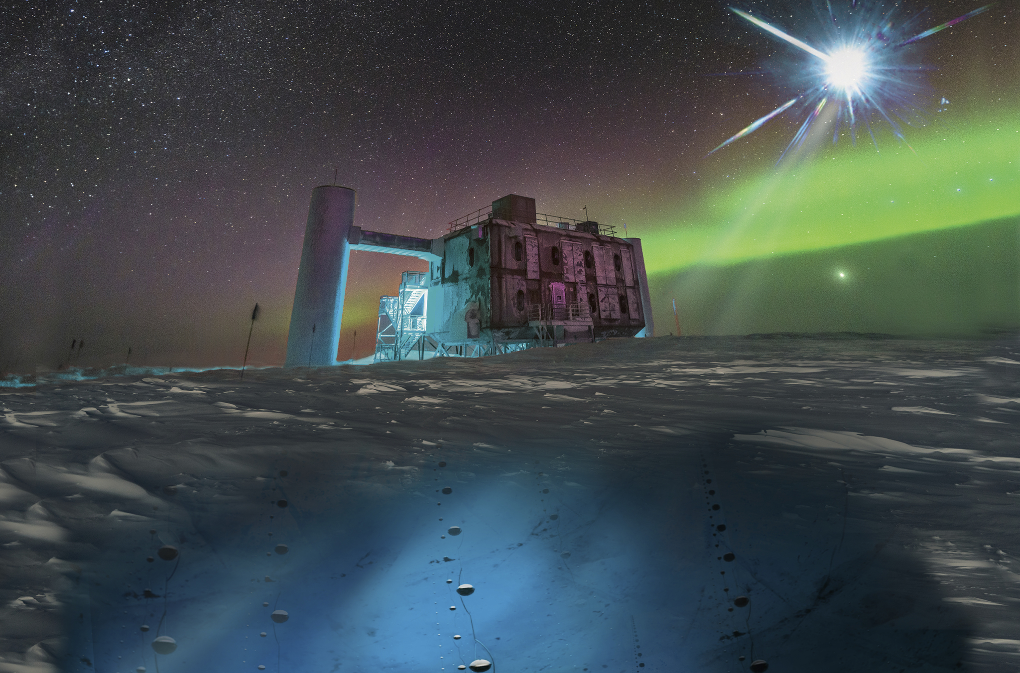

Slide 2
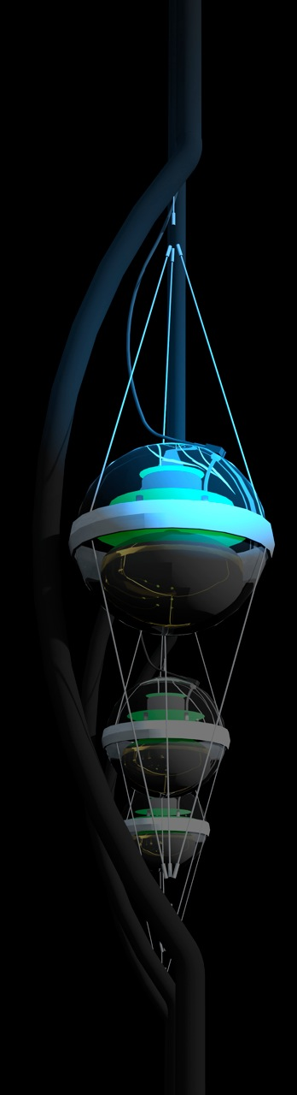

IceCube:
Building a New Window on the Universe
francis halzen
IceCube
cosmic neutrinos: two independent observations
→ muon neutrinos through the Earth
→ starting neutrinos: all flavors
→ tau neutrinos
Fermi photons and IceCube neutrinos
the first high-energy cosmic ray accelerator
icecube.wisc.edu

Slide 3
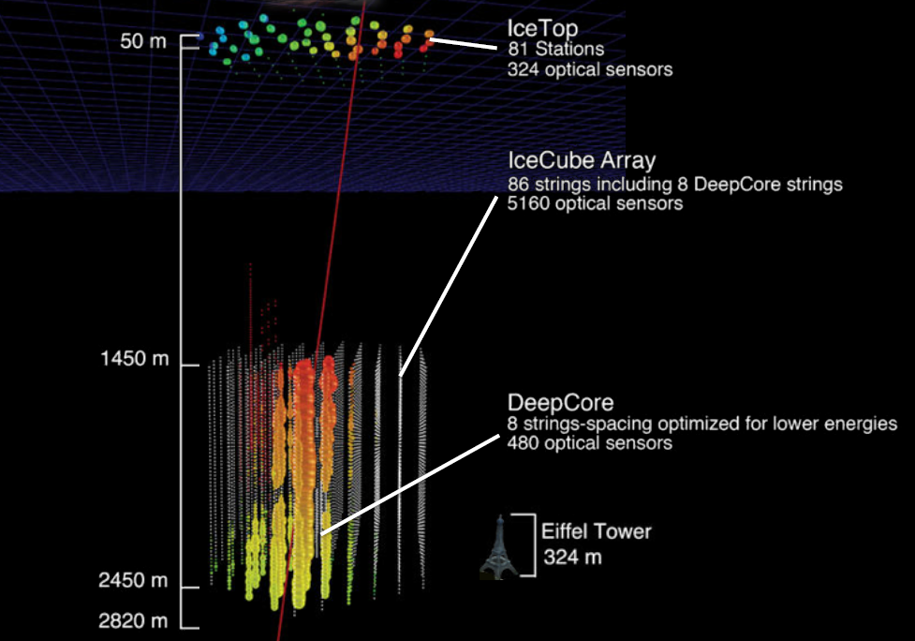
IceCube
5160 PMs
in 1 km³

Slide 4
IceCube
francis halzen
IceCube
cosmic neutrinos: three independent observations
→ muon neutrinos through the Earth
→ starting neutrinos: all flavors
→ tau neutrinos
Fermi photons and IceCube neutrinos
the first high-energy cosmic ray accelerator
iceCube.wisc.edu

Slide 5
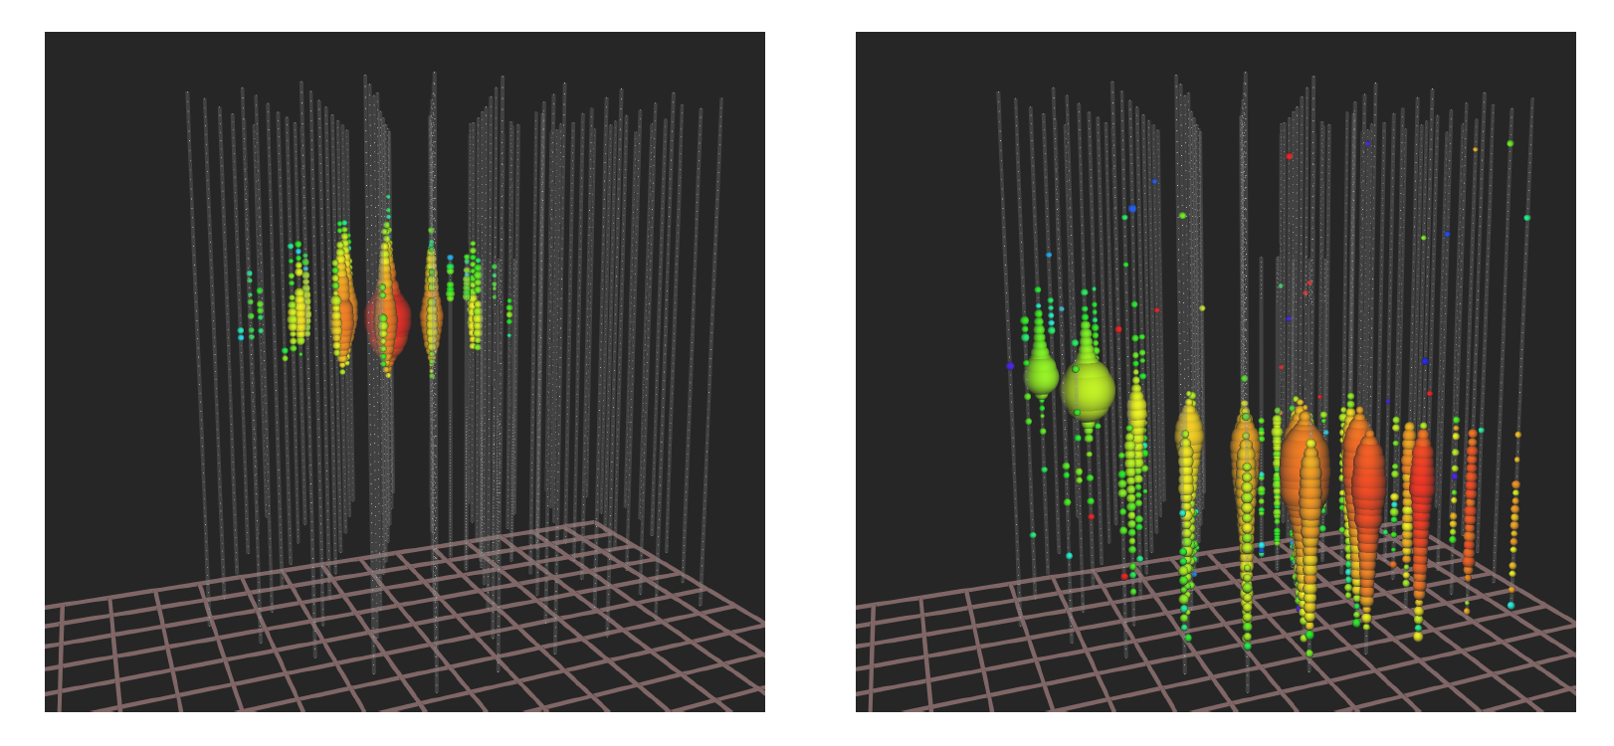

are the three observations consistent?
total energy measurement
all flavors, all sky
astronomy: angular resolution
superior (<0.4º)

Slide 6
starting events
upgoing muons
Glashow
three methods are consistent
excess cosmic flux < 100 TeV?

Slide 7
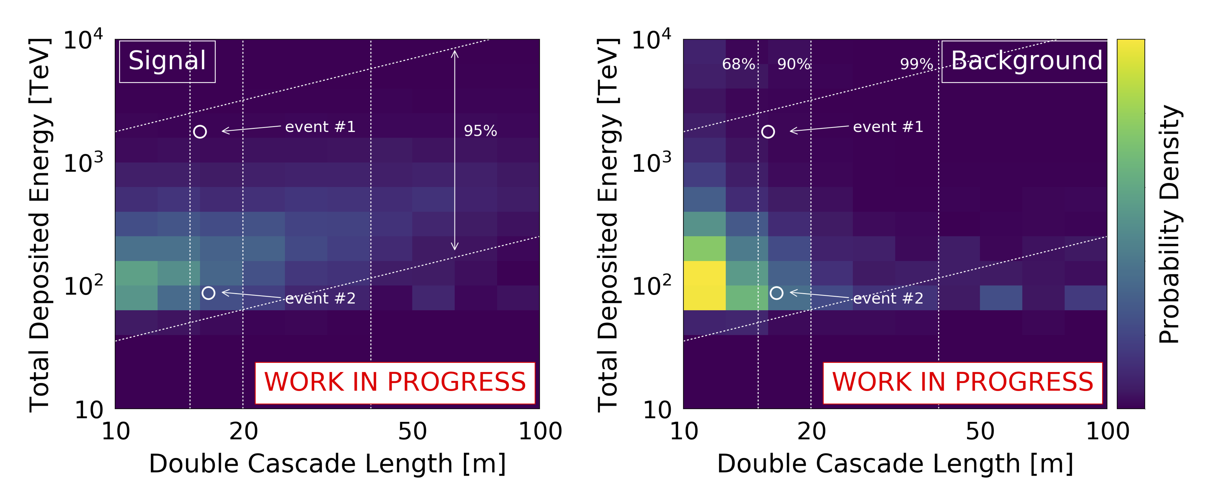
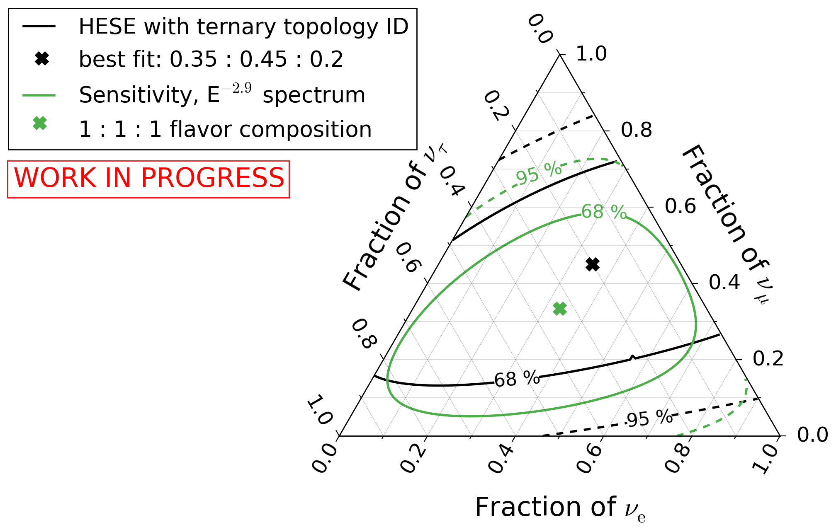
high-energy starting events – 7.5 yr
oscillations of PeV neutrinos over cosmic
distances to 1:1:1

Slide 8
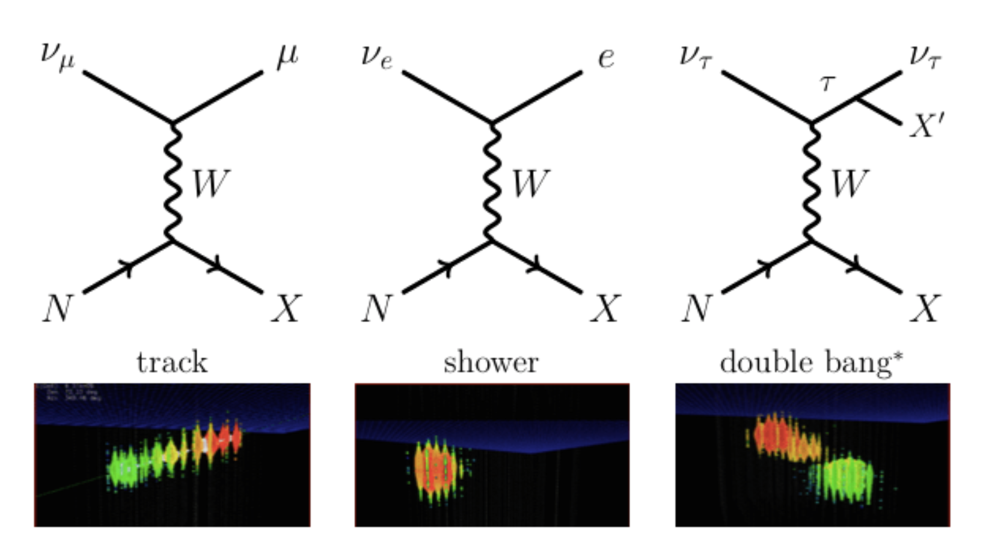
tau decay length:
50m per PeV

Slide 9
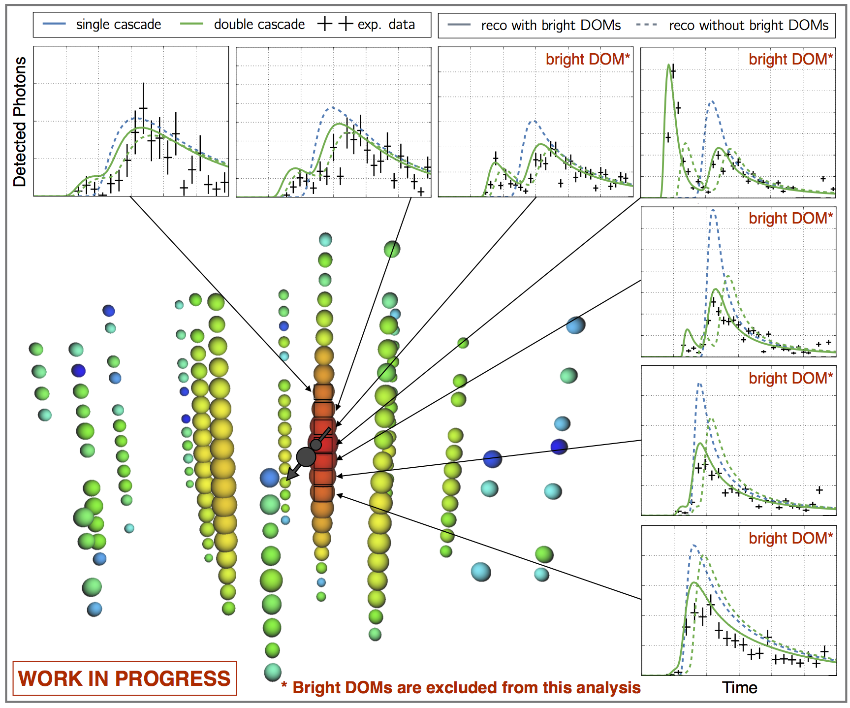
a cosmic tau neutrino: livetime 17m

Slide 10
the first Glashow resonance event:
anti-ν_{e} + atomic electron → real W at 6.3 PeV

Slide 11
Partially contained event with energy ~ 6 PeV

Slide 12
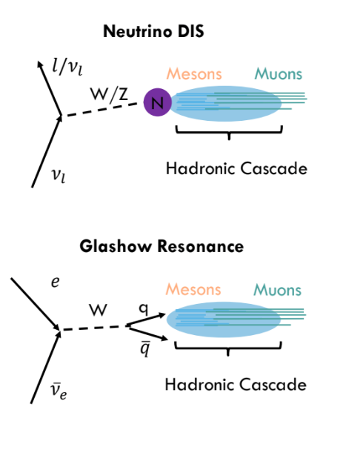
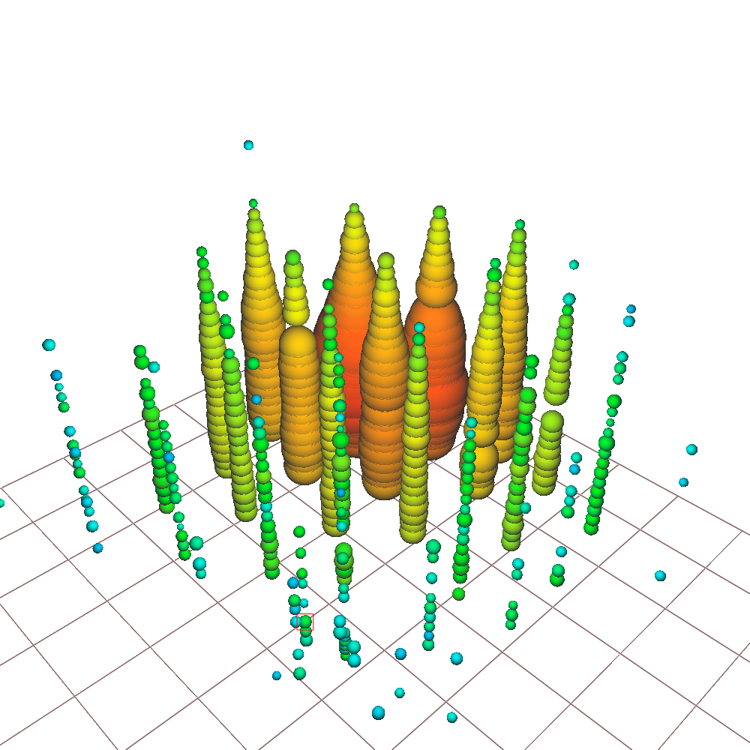
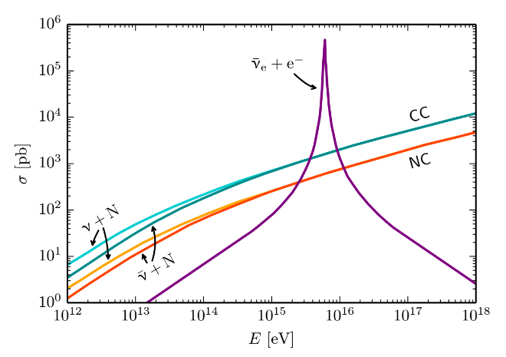
Glashow resonance: anti-ν_{e} + atomic electron → real W
partially-contained PeV search
deposited energy: 5.9±0.18 PeV
typical visible energy is 93%
→ resonance: E_{ν} = 6.3 PeV
work on-going

Slide 13
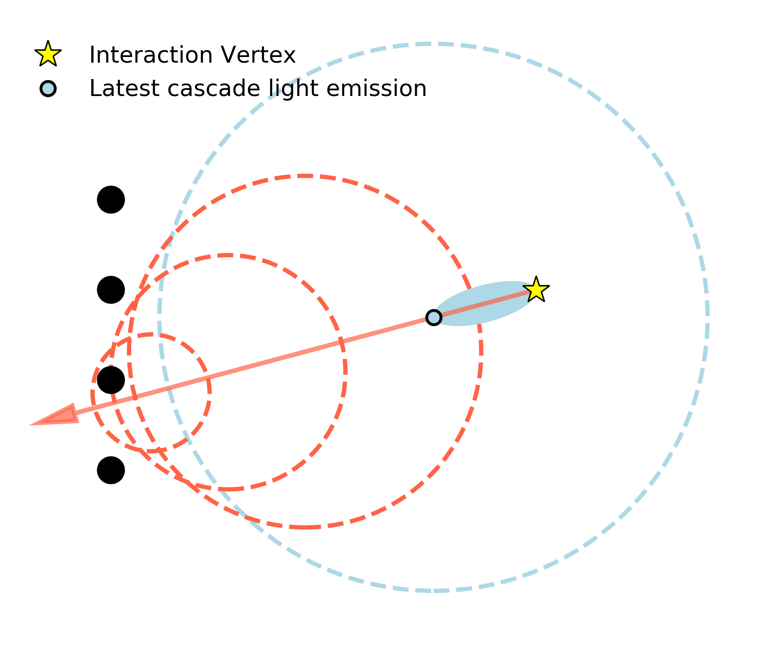
muon (v=c) outraces the light propagating from the electromagnetic component (v<c)
muon
DOM

Slide 14
IceCube
francis halzen
IceCube
cosmic neutrinos: three independent observations
→ muon neutrinos through the Earth
→ starting neutrinos: all flavors
→ tau neutrinos
Fermi photons and IceCube neutrinos
the first high-energy cosmic ray accelerator
iceCube.wisc.edu

Slide 15
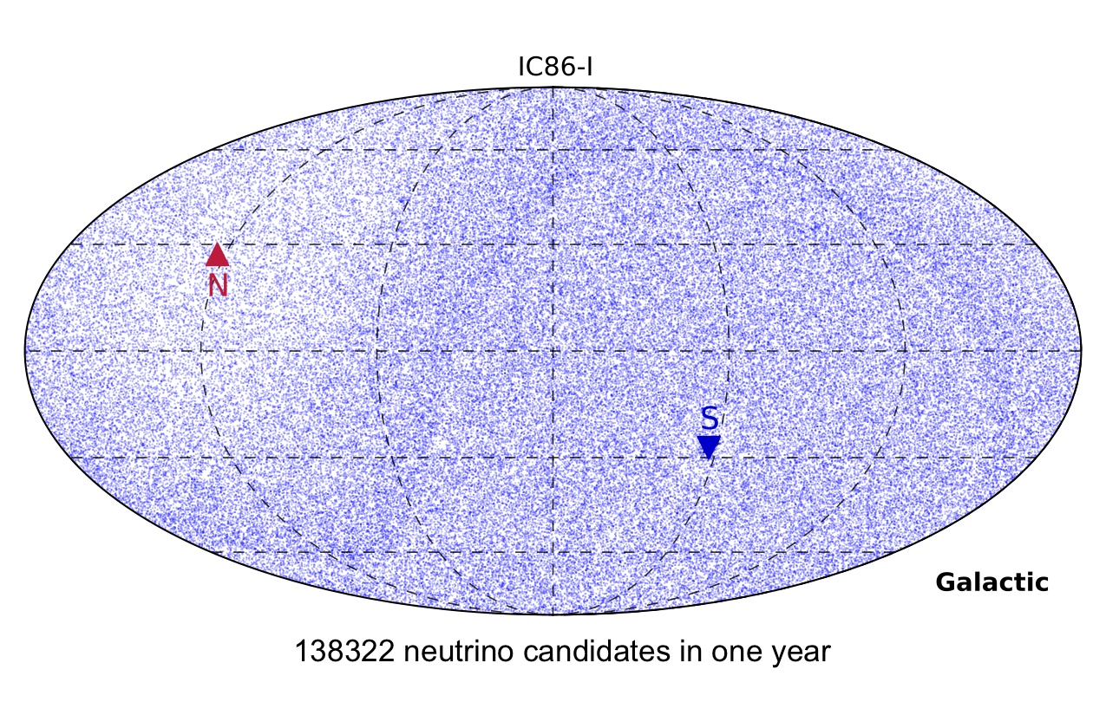
120 cosmic neutrinos
~12 separated from atmospheric background with E>60 TeV
structure in the map results from neutrino absorption by the Earth

Slide 17
we observe a diffuse flux of neutrinos from extragalactic sources

Slide 18
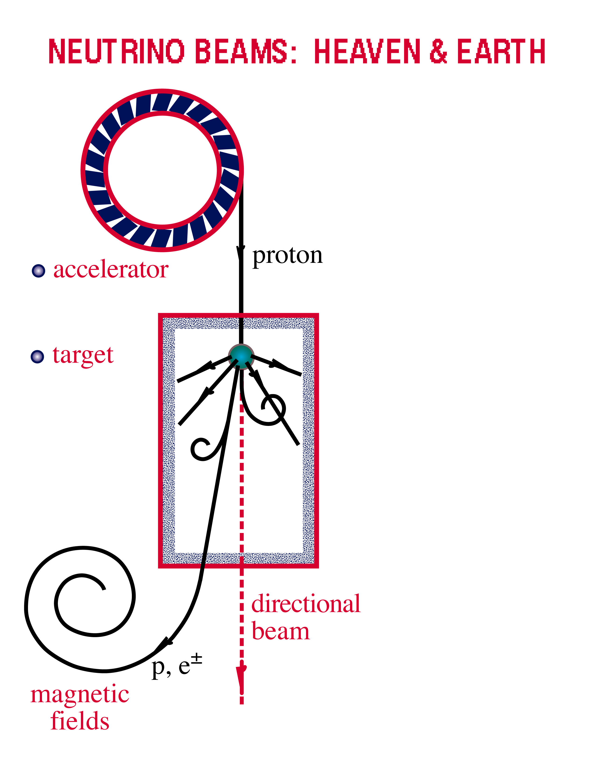
accelerator is powered by
large gravitational energy
Neutrino Beams: Heaven & Earth
ν and γ beams : heaven and earth
NEUTRINO BEAMS: HEAVEN & EARTH
black hole
neutron star
radiation
and dust
p + γ → n + π⁺
^{~ cosmic ray + neutrino}
→ p + π⁰
^{~ cosmic ray + gamma}

Slide 19
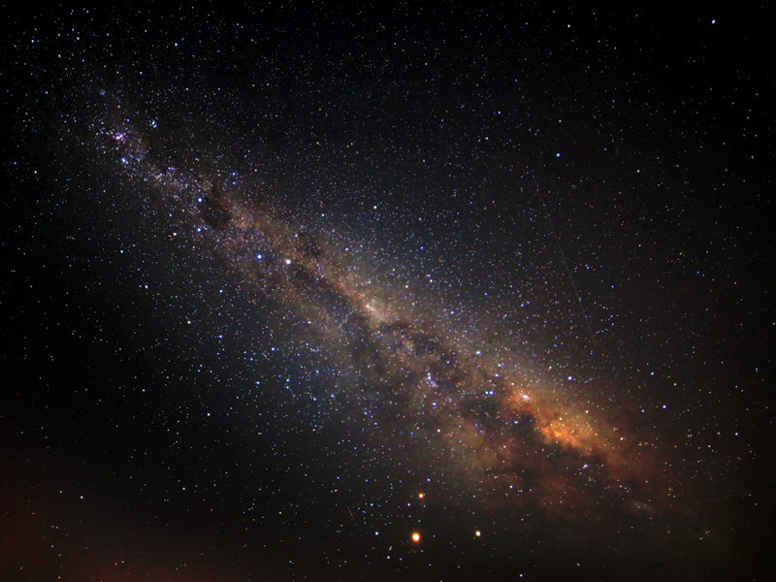
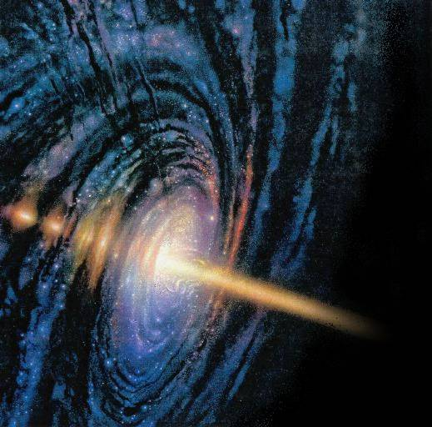
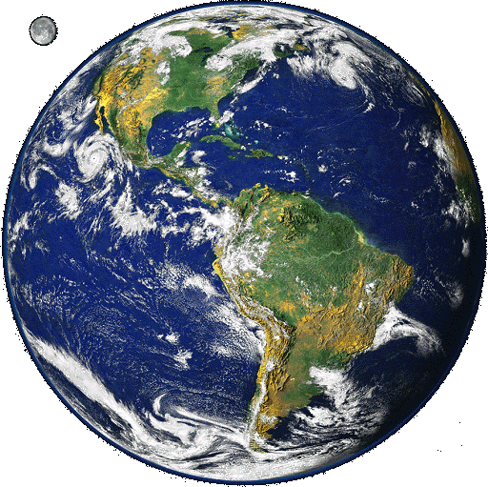
γ + γ_{CMB} → e⁺ + e⁻
γ
e⁺
e⁻
PeV
GeV

Slide 20
Fermi
gammas
cosmic
neutrinos
E^{-2.15}

Slide 21
energy density of neutrinos in the non-thermal Universe is the same as that in gamma-rays
origin of events from opaque sources < 100 TeV ?

Slide 22
IceCube
francis halzen
IceCube
cosmic neutrinos: three independent observations
→ muon neutrinos through the Earth
→ starting neutrinos: all flavors
→ tau neutrinos
Fermi photons and IceCube neutrinos
the first high-energy cosmic ray accelerator
iceCube.wisc.edu

Slide 24
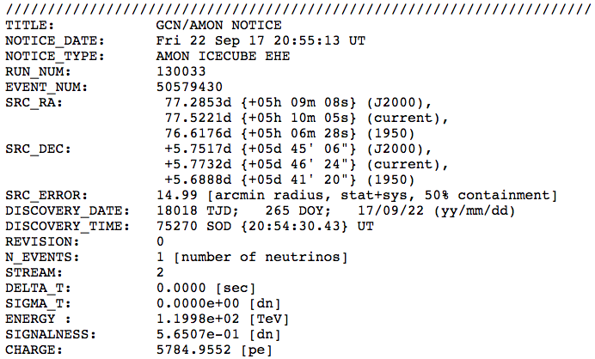
IceCube Trigger
43 seconds after trigger, GCN notice was sent

Slide 26
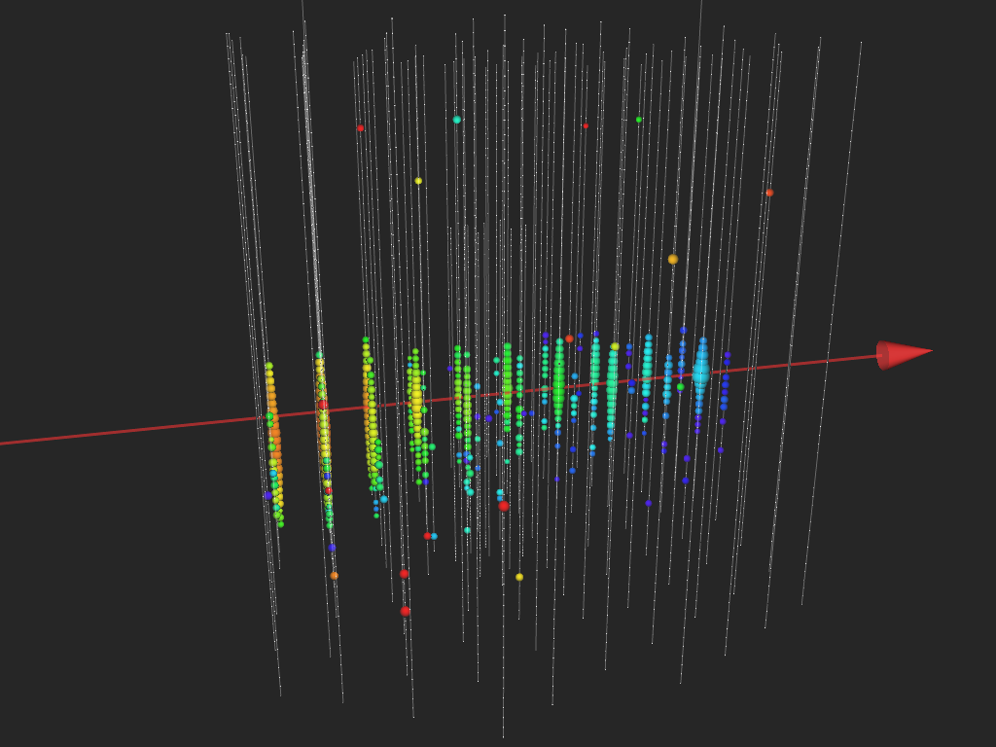
IceCube 170922
Fermi
detects a flaring
blazar within 0.1º
MAGIC
detects emission of
> 100 GeV gammas

Slide 27
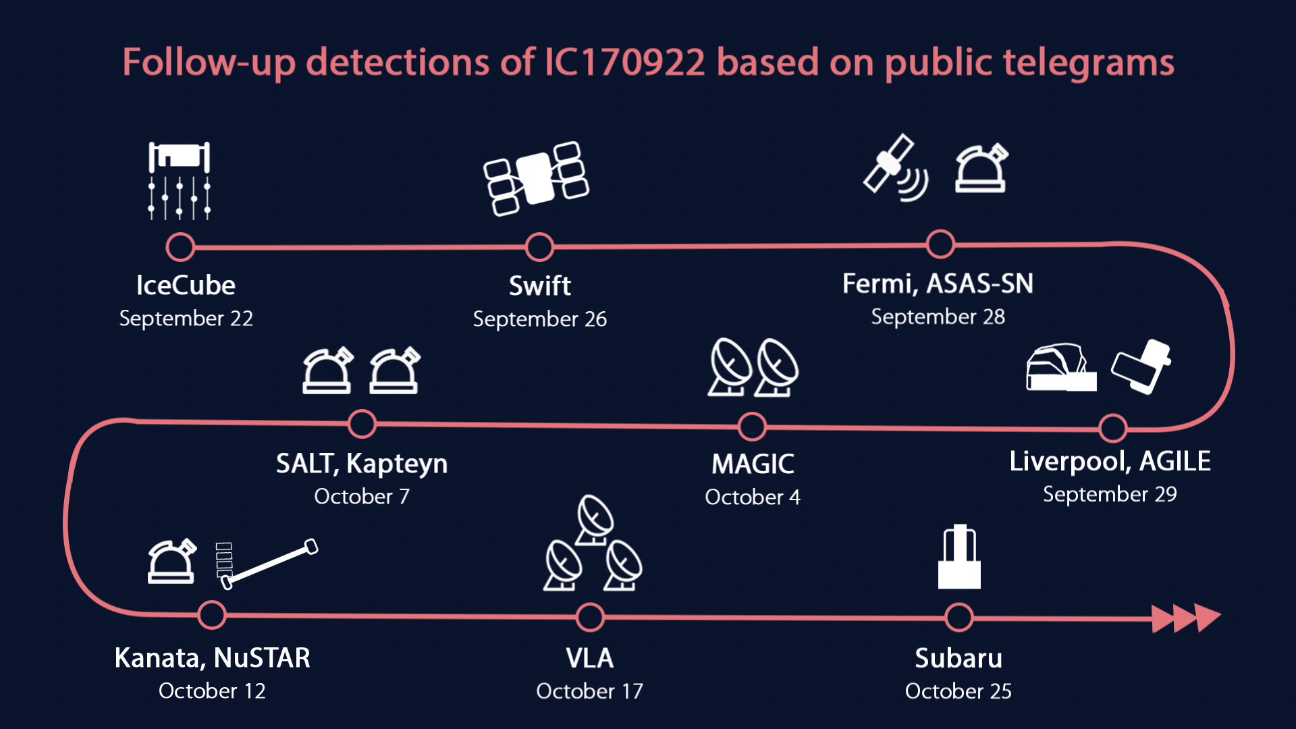

Slide 28
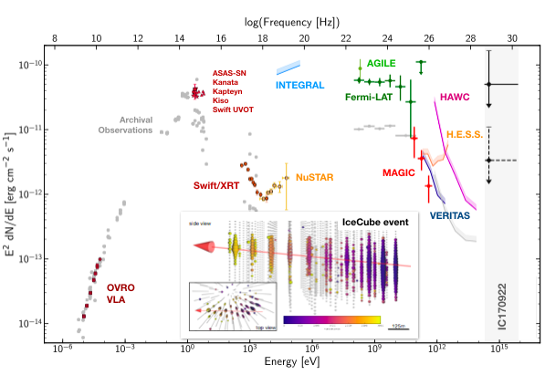
we know this one is hadronic

Slide 29
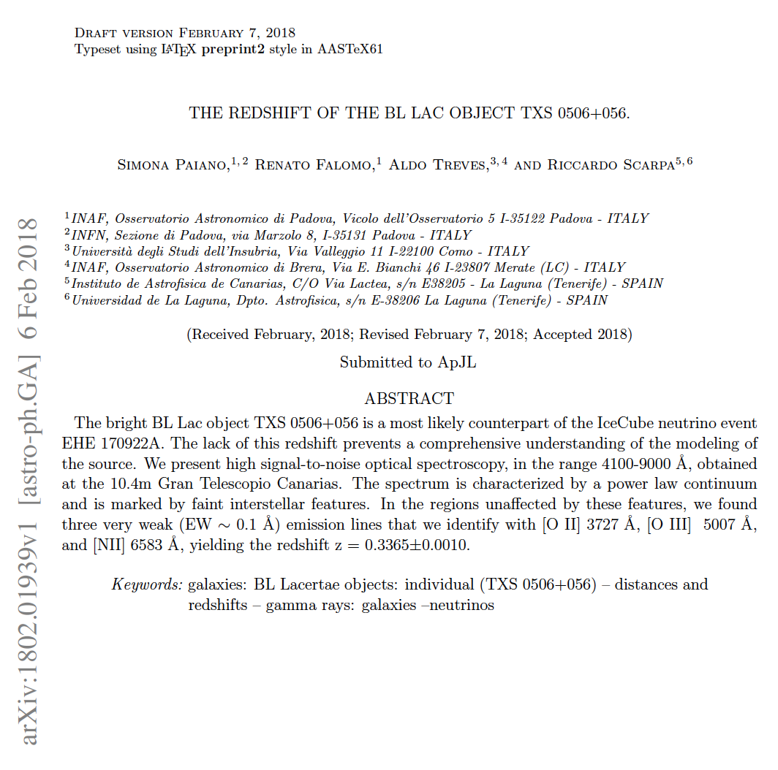
we do not see our own Galaxy
we do not see the nearest extragalactic
sources
we find a blazar at 4 billion lightyears!

Slide 30
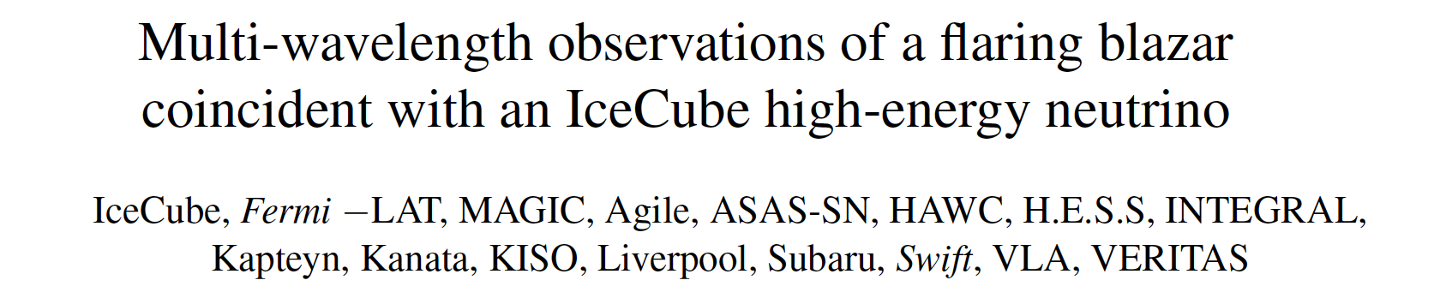
multiwavelength campaign launched by IC 170922
neutrino: time 22.09.17, 20:54:31 UTC
energy 290 TeV
direction RA 77.43º Dec 5.72º
Fermi-LAT: flaring blazar within 0.1º (7x steady flux)
MAGIC: TeV source in follow-up observations
follow-up by 12 more telescopes
→ IceCube archival data (without look-elsewhere effect)
→ Fermi-LAT archival data

Slide 31
search in archival IceCube data:
150 day flare in December 2014 of
19 events (bkg <6)
10⁻⁵ bkg. probability
spectrum E^{-2.1}

Slide 32
we identified a source of high energy cosmic rays:
the active galaxy (blazar) TXS 0506+056 at a redshift of 0.33
extensive multiwavelength campaign will allow us
to study the first cosmic accelerator

Slide 33

Flaring Sources and the Diffuse Neutrino Flux
Neutrino flux from episodic emission from a fraction of a source class
Adopting for the observation of 2014 neutrino burst for TXS:
A special class of blazars that undergo ~ 110-day duration flares like TXS 0506+056 once every 10 years accommodates the observed diffuse flux of high-energy cosmic neutrinos.
https://arxiv.org/pdf/1811.07439.pdf

Slide 34
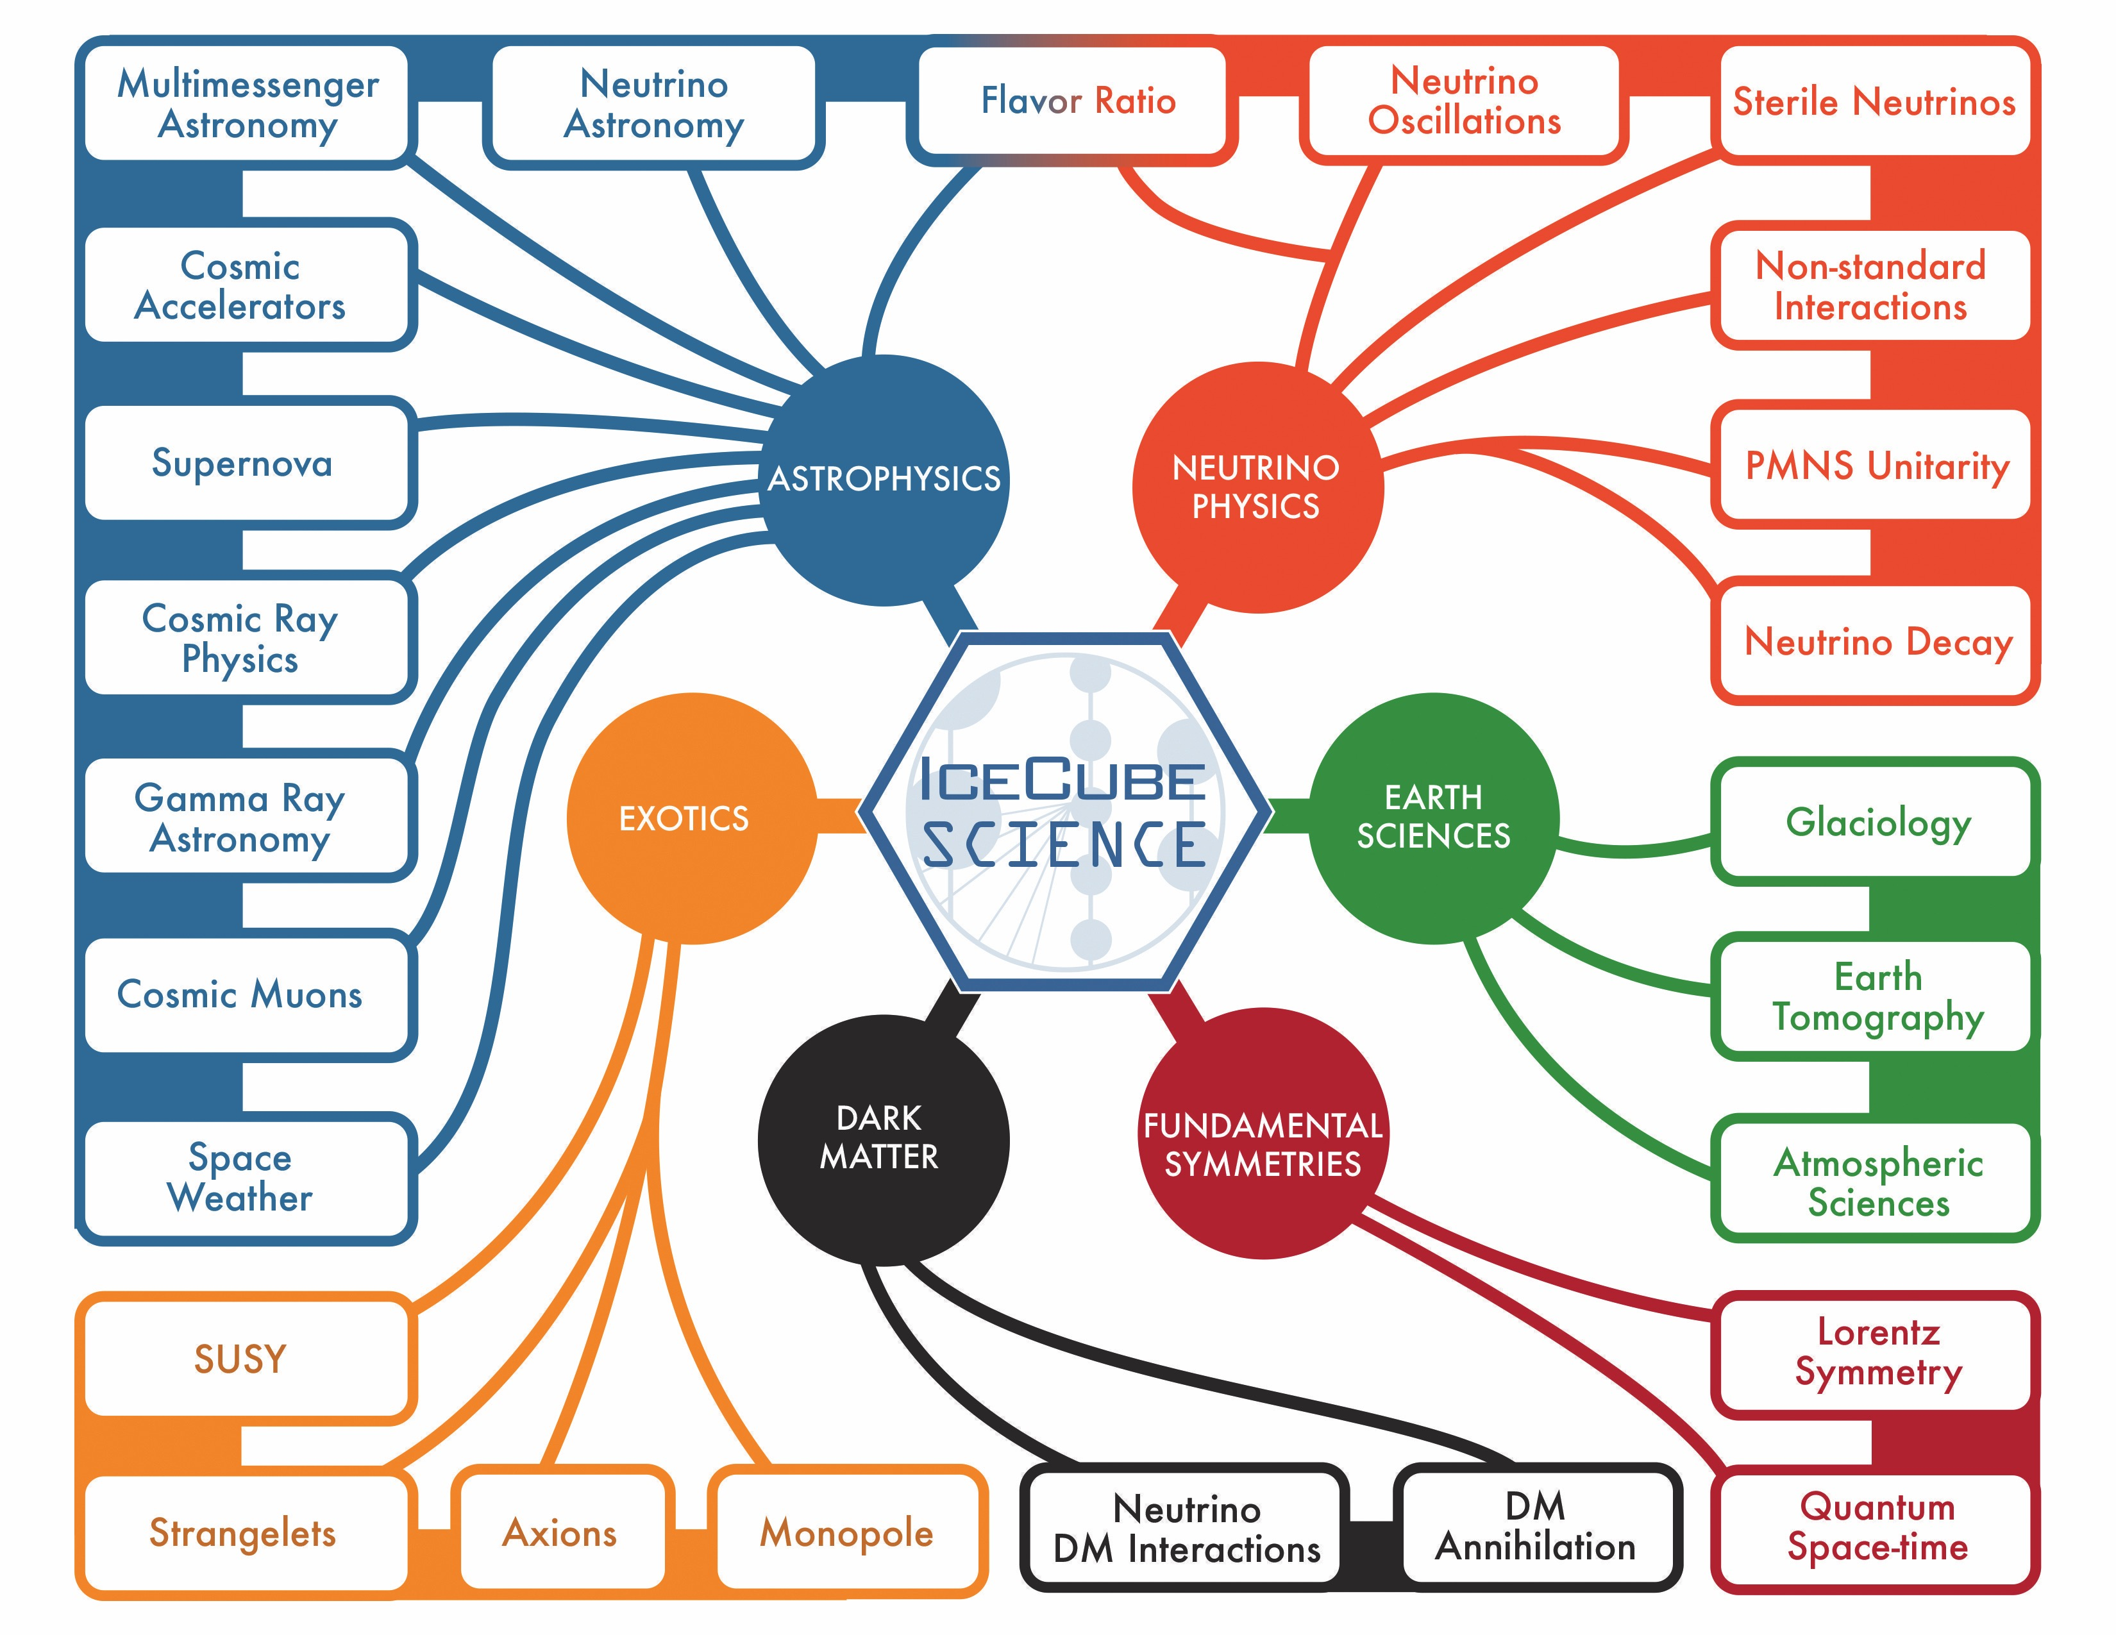

Slide 35
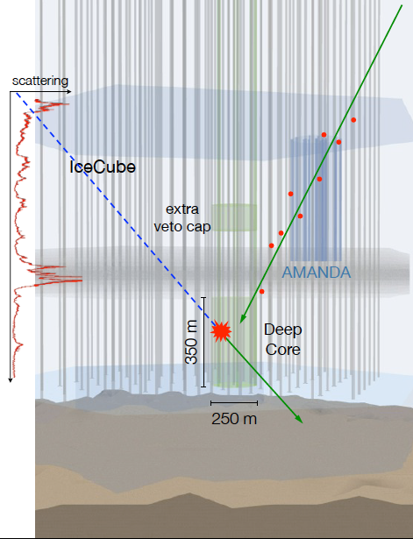
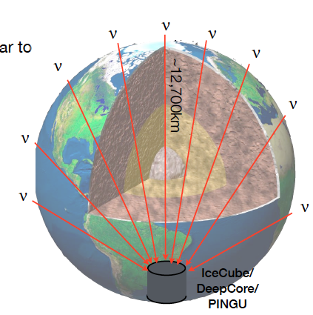
one half million
atmospheric
neutrinos…

Slide 37
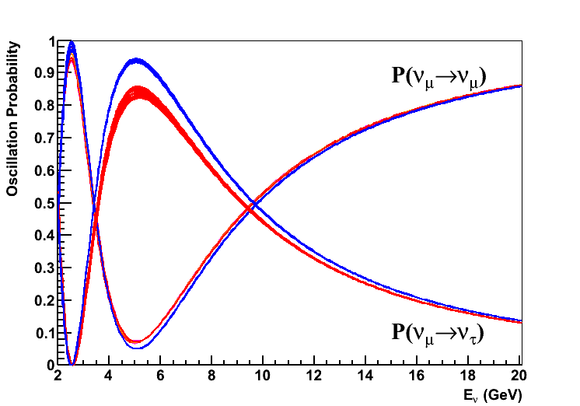
oscillations at 5-55 GeV energy
same oscillation parameters measured in a new
energy range.

Slide 38
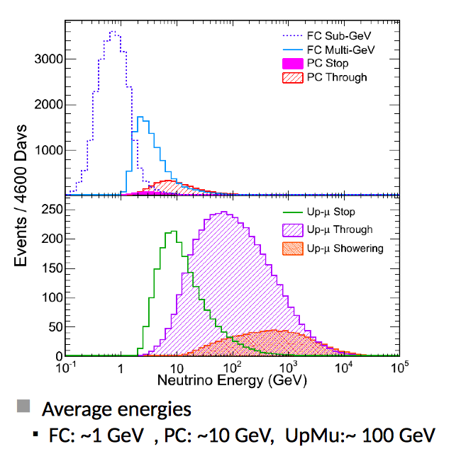
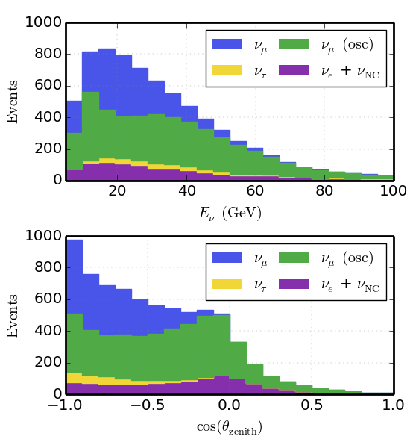
SuperK
IceCube

Slide 40
two independent analyses
one for quality of events
one for statistics
both blind

Slide 44
tau events:

Slide 47
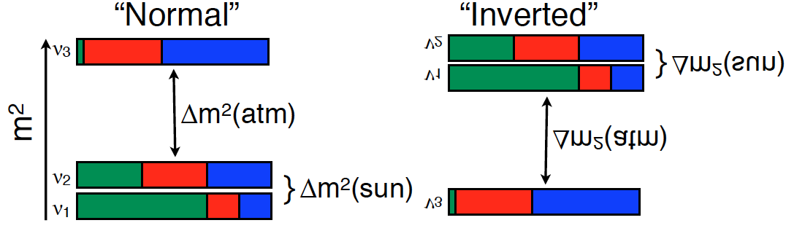
neutrino mass hierarchy ?
present status: probability inverted ordering <15.3%

Slide 48
~ 10 GeV : hierarchy revealed by
“large” matter effects in the Earth
(mostly) neutrino + antineutrino -
sign Δ₁₃ : hierarchy !

Slide 49
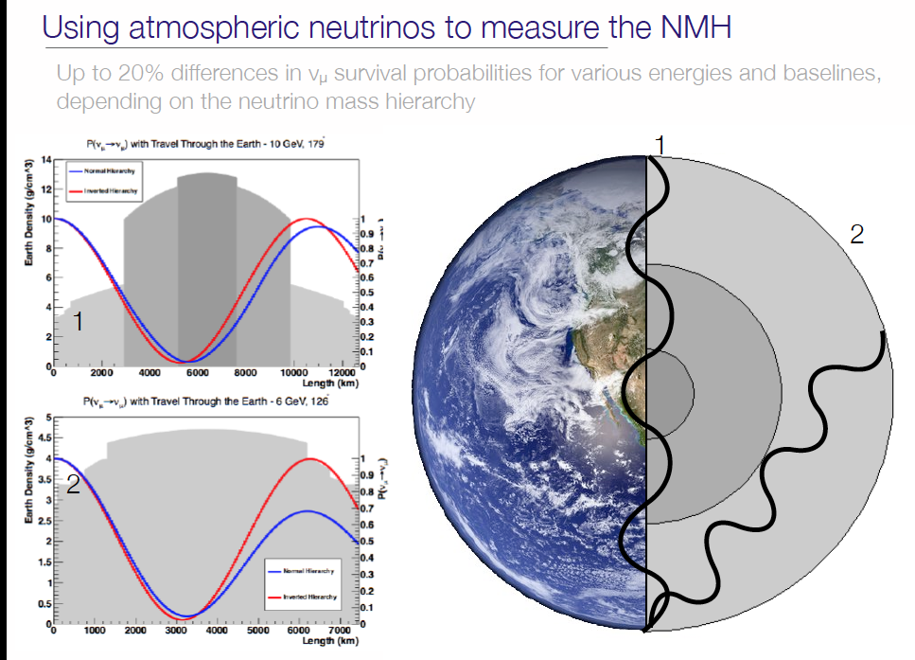

Slide 50
P(ν_{μ} → ν_{μ} )
Normal Hierarchy
Inverted Hierarchy
Map upward ν flux in bins of (E,cosθ);
cosθ= -1 L~12000 Km;
Letter of Intent PINGU- arXiV:1401.2046

Slide 52
soon:
new point source analysis
first HAWC-IceCube search for Galactic sources
dark matter annihilation in the sun: 3→8 years
sterile neutrino: 1→7 years
joint searches with LIGO, ANTARES, AUGER/TA
…
first observation of the core of the Earth

Slide 53
