Slide 1



IceCube Masterclass
Madison, Wisconsin
IceCube Construction and the South Pole
Jim Haugen
March 7, 2018

Slide 2
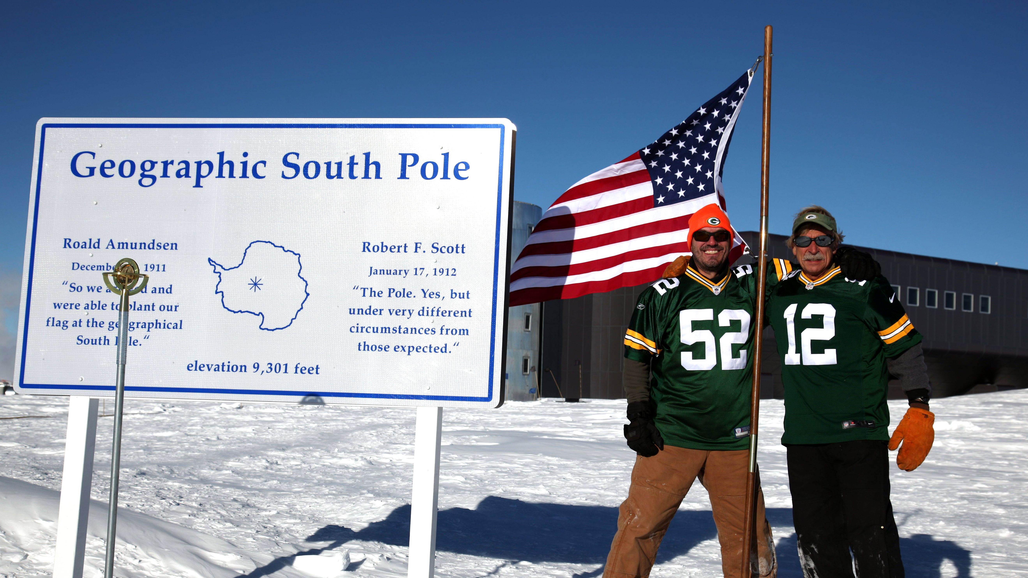
Facilitate the matching of physicist’s ‘dreams’ with an engineer’s ‘reality’
Who am I? How did I get here?
- Green Bay East High School grad from a long time ago
- UW grad in Applied Math, Physics and Engineering (’83)
- Back to Madison in 2001 after wafer fab work in Silicon Valley, a startup in MN and IC foundry work in Thailand
- I am the Instrumentation Mgr and South Pole planner for WIPAC, 7 seasons down on the Ice at Pole…

Slide 3
Briefly, what is IceCube?
This is a federally funded project administered through the National Science Foundation
We completed construction in 2011, started in 2001
We built a Neutrino Telescope (a unique telescope) at the South Pole
Total budget for the project is ~$270M with all US funding managed at the University of Wisconsin
Here is the best part - on time, on budget, on schedule and …..the darn thing works!!!!
http://icecube.wisc.edu/

Slide 4
IceCube Construction Sequence
Design (2001-2004) Use paper, software and prototypes to design and verify the detector will meet scientific requirements. ‘Freeze’ design before production.
Production (2004-2009) Manufacture (integrate and test) with very high quality all of the materials needed at the Pole. Ship on time!
Logistics (2004-2011) Move millions of pounds of cargo to Pole using trucks, ships, and planes. Many constraints to meet. Everything must fit into a Herc! (slide 33) Get 100 people to the Ice each year.
Installation (2004-2011) Simply, get everything into the Ice (also cabling, IceTop, ICL buildout). Use a giant Hot Water Drill to make holes 2450m deep and deploy the ‘instrumentation strings’.
Commissioning (2005-2011) Make the detector works as expected (fingers were crossed in January, 2005)!!!!

Slide 5
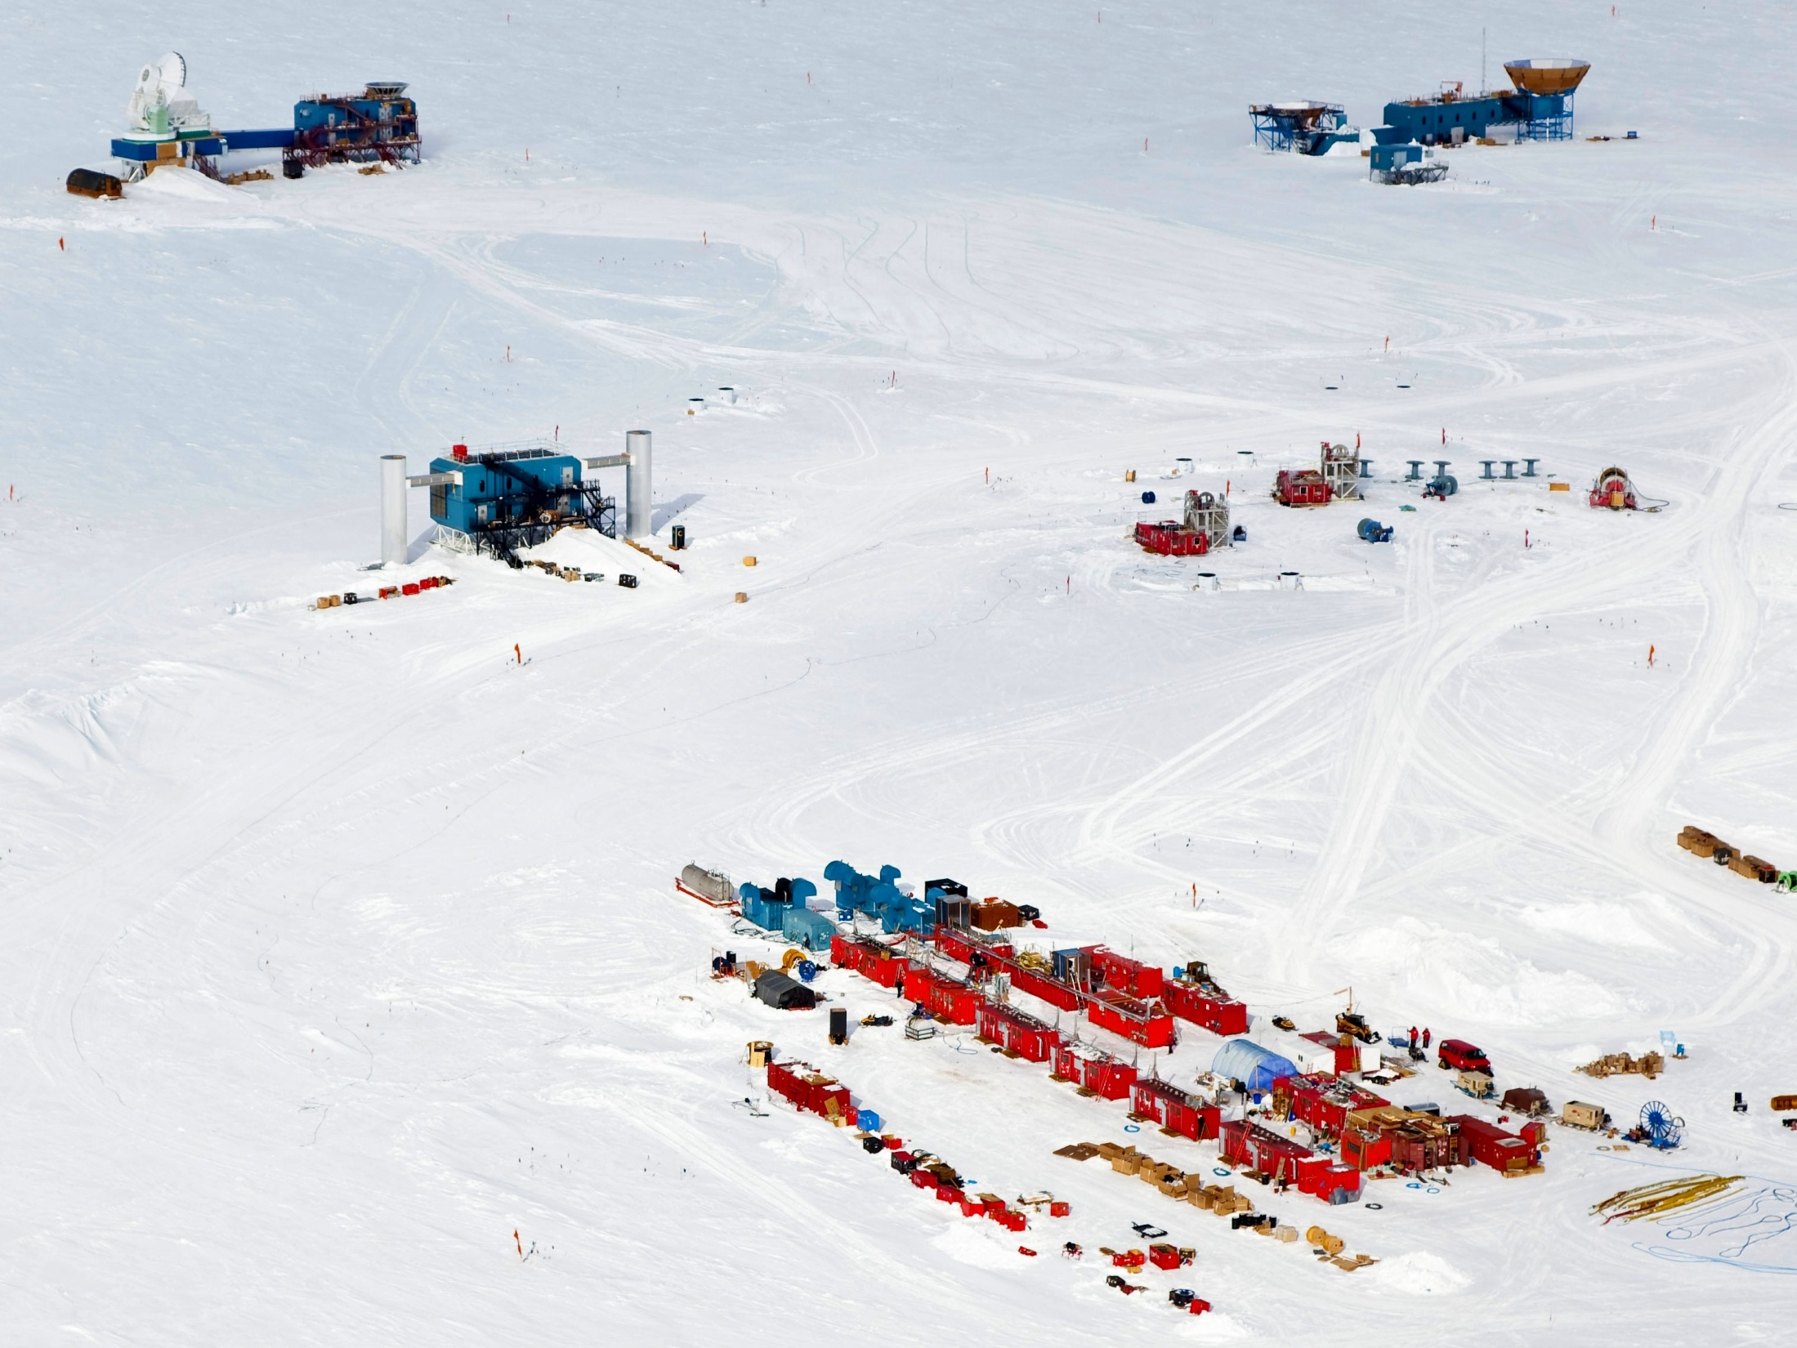
MAPO (Bicep2)
South Pole 10m Telescope
Drilling site
IceCube Counting Laboratory (ICL)
IceCube Enhanced Hot Water Drill (EHWD)

Slide 6
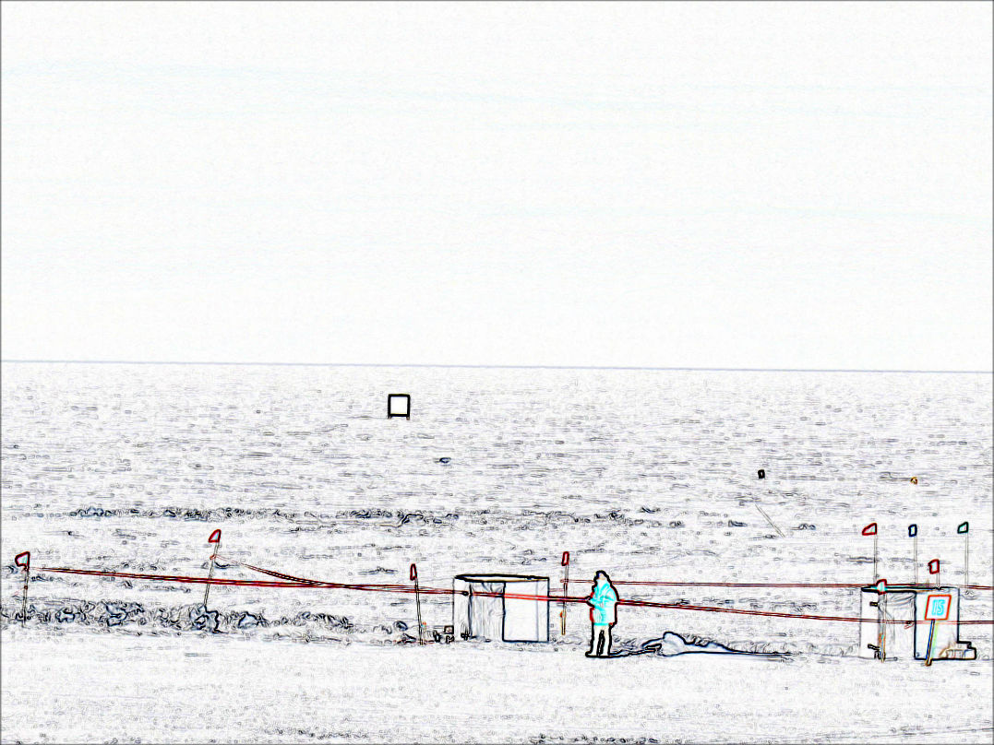
IceCube Instrumentation basics
Main items are:
  Digital Optical Module (DOM)
  Surface to DOM cable
  Surface Cable
  IceTop (tanks, DOMs, cables)
  ICL Servers and IT equipment
  Lots of assorted other stuff

Slide 7
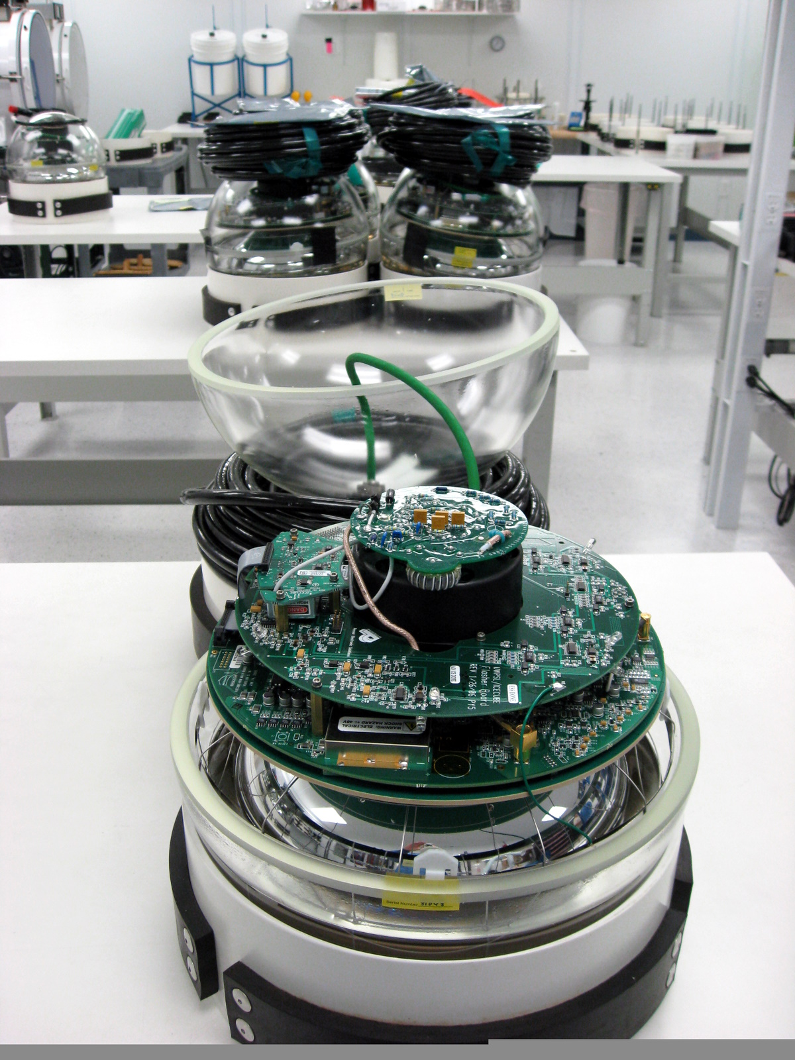
DOMs just before sealing

Slide 8
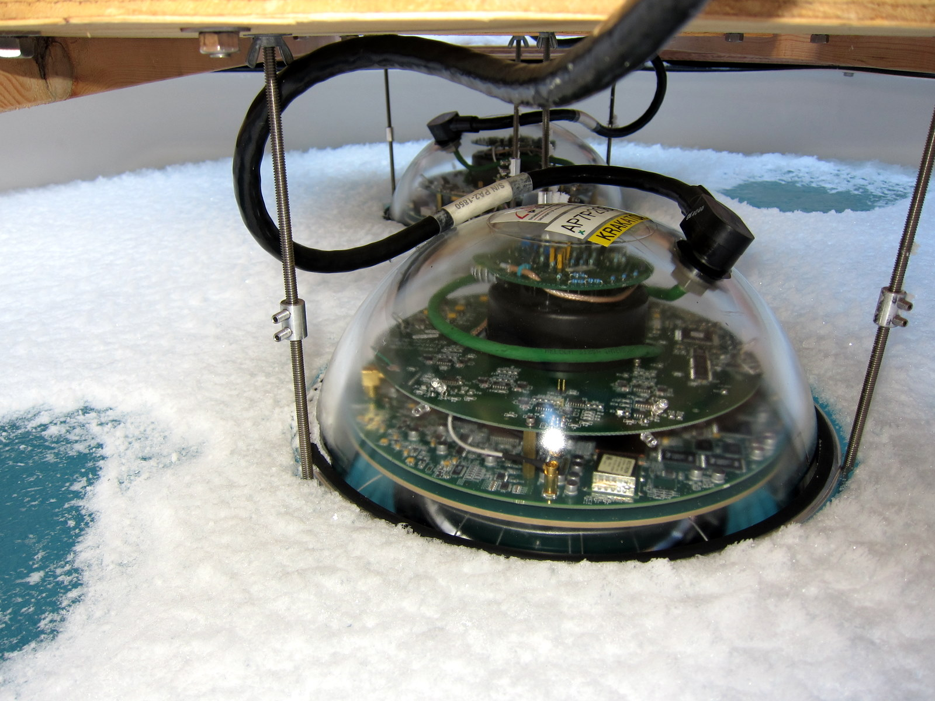
IceTop DOMs

Slide 9
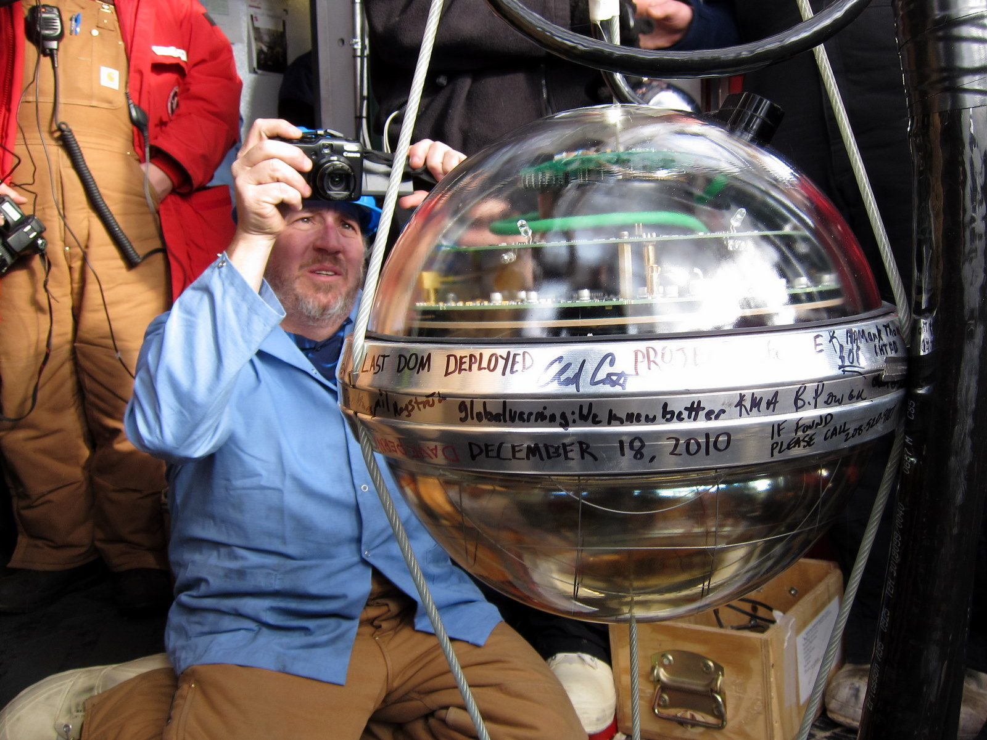
Last one

Slide 10
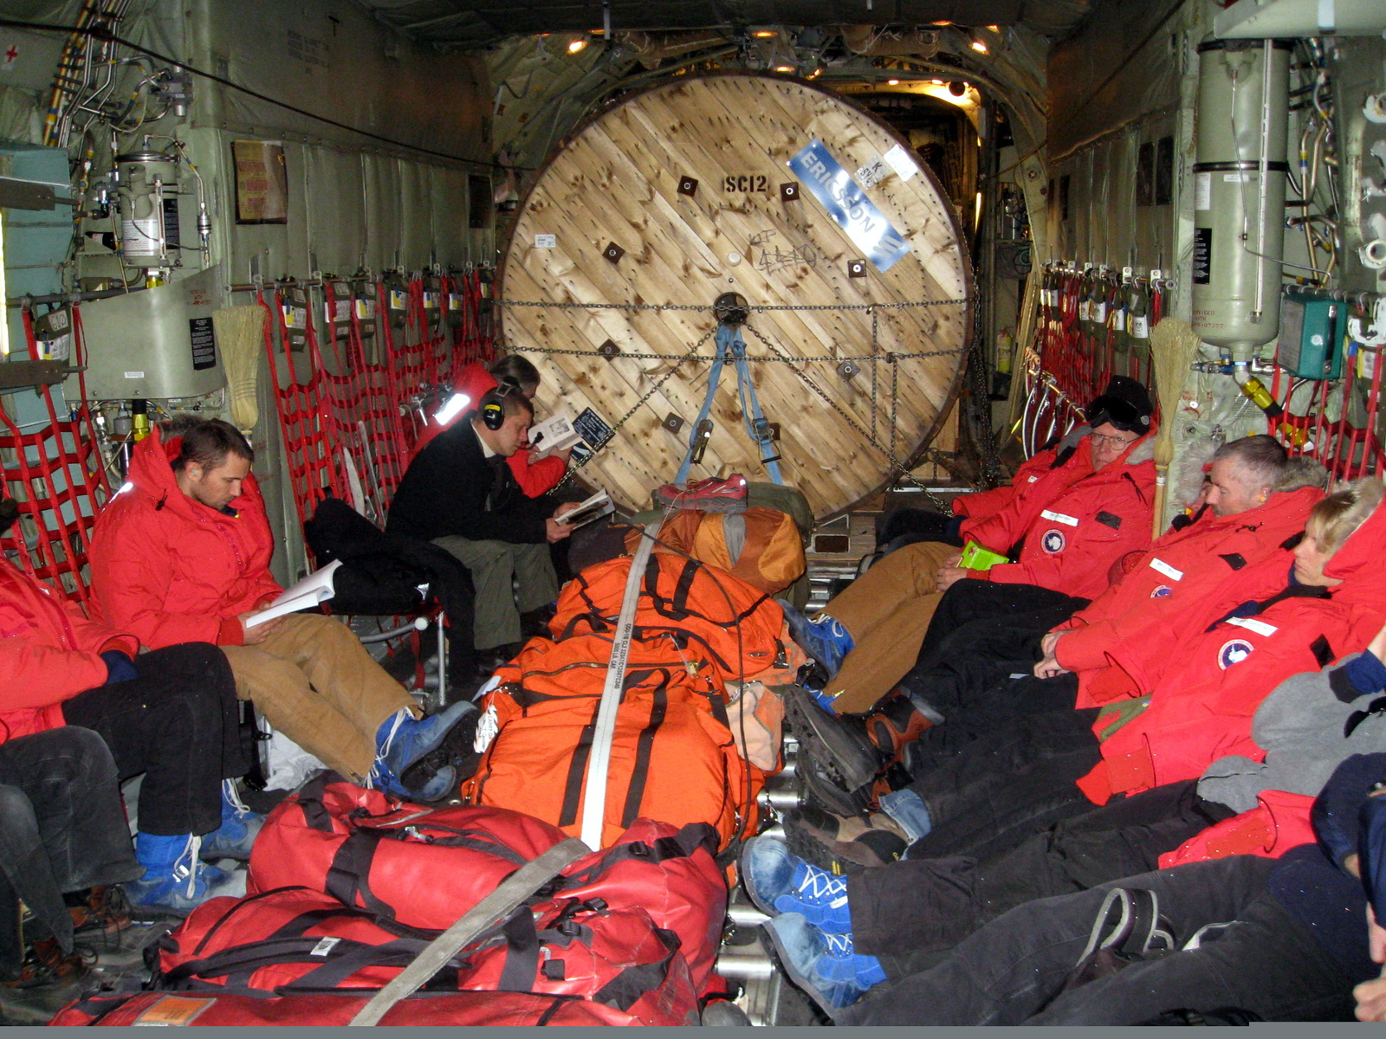
Surface cable in Herc

Slide 11
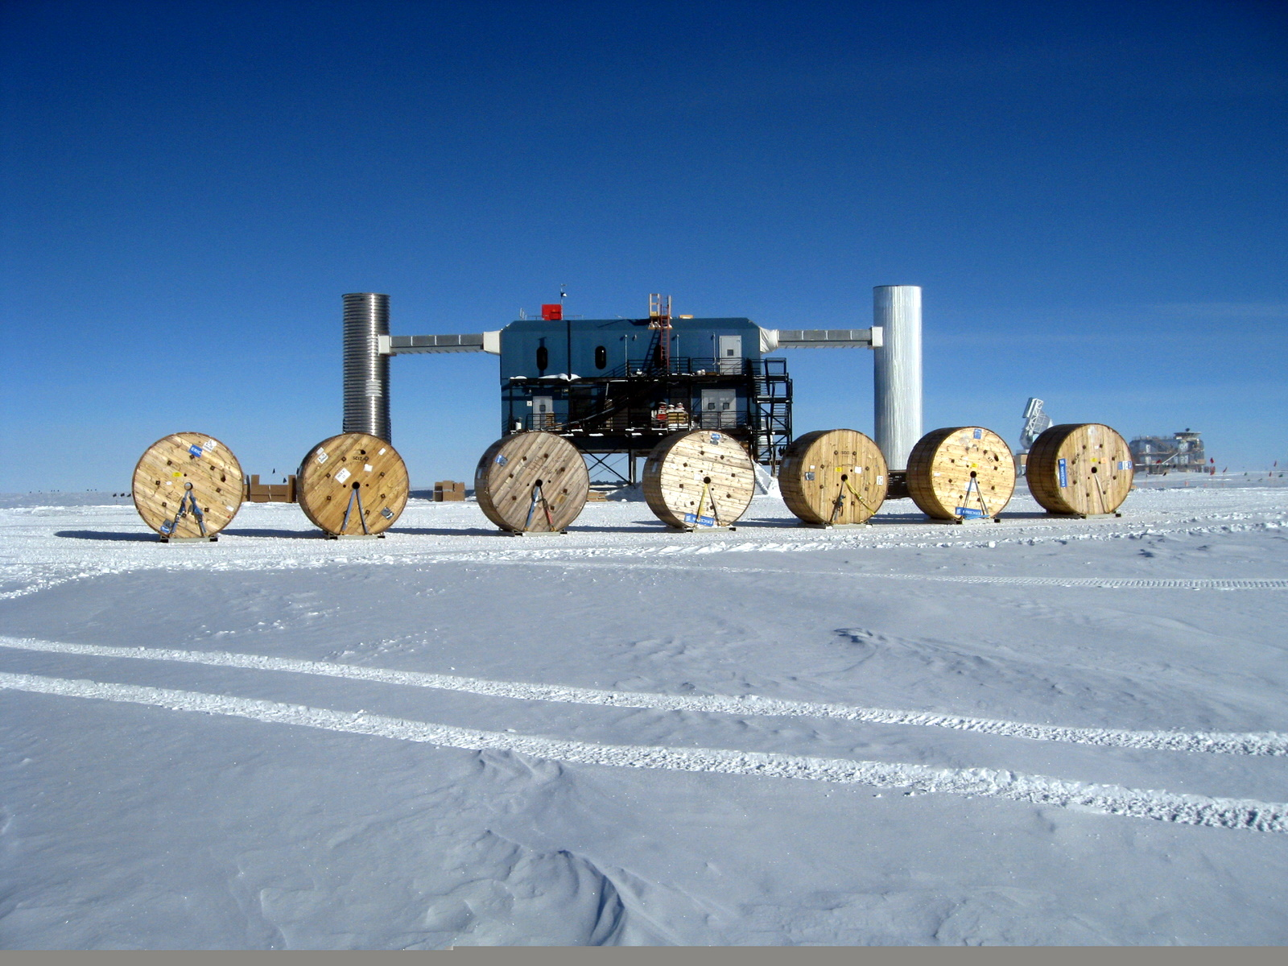
Start of season

Slide 12
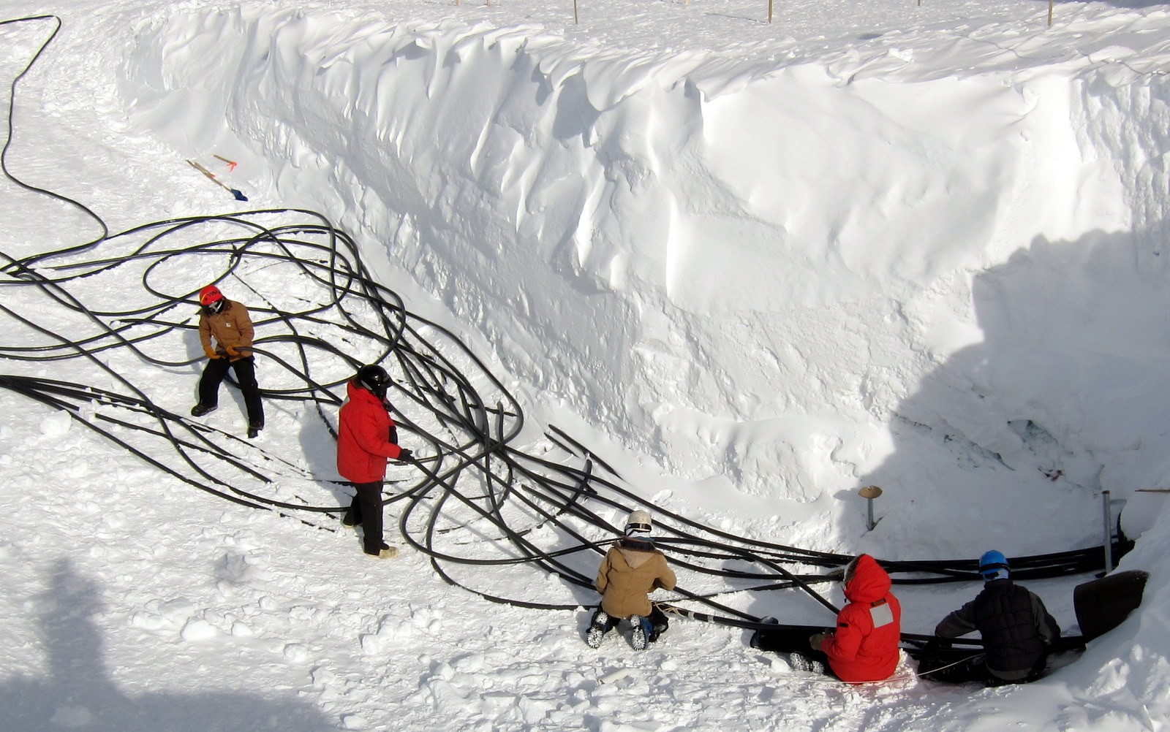
ICL Cable pull

Slide 13
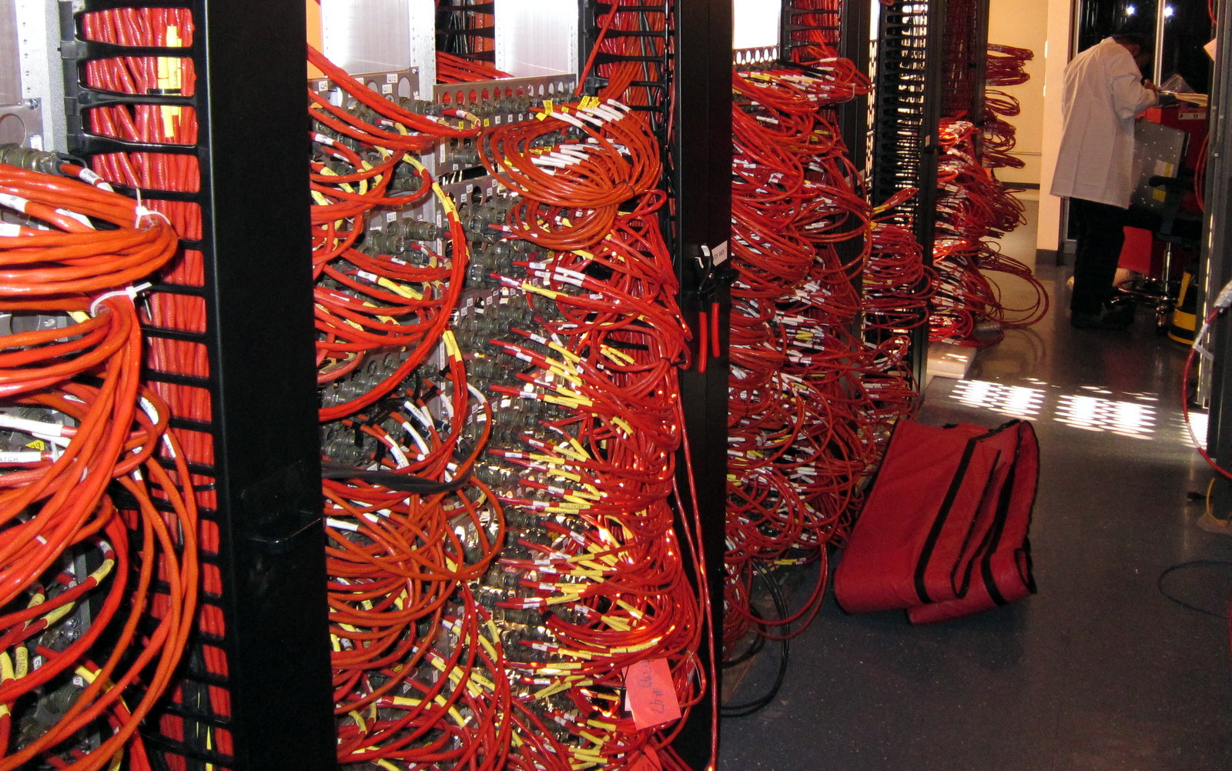
Connections in ICL

Slide 14
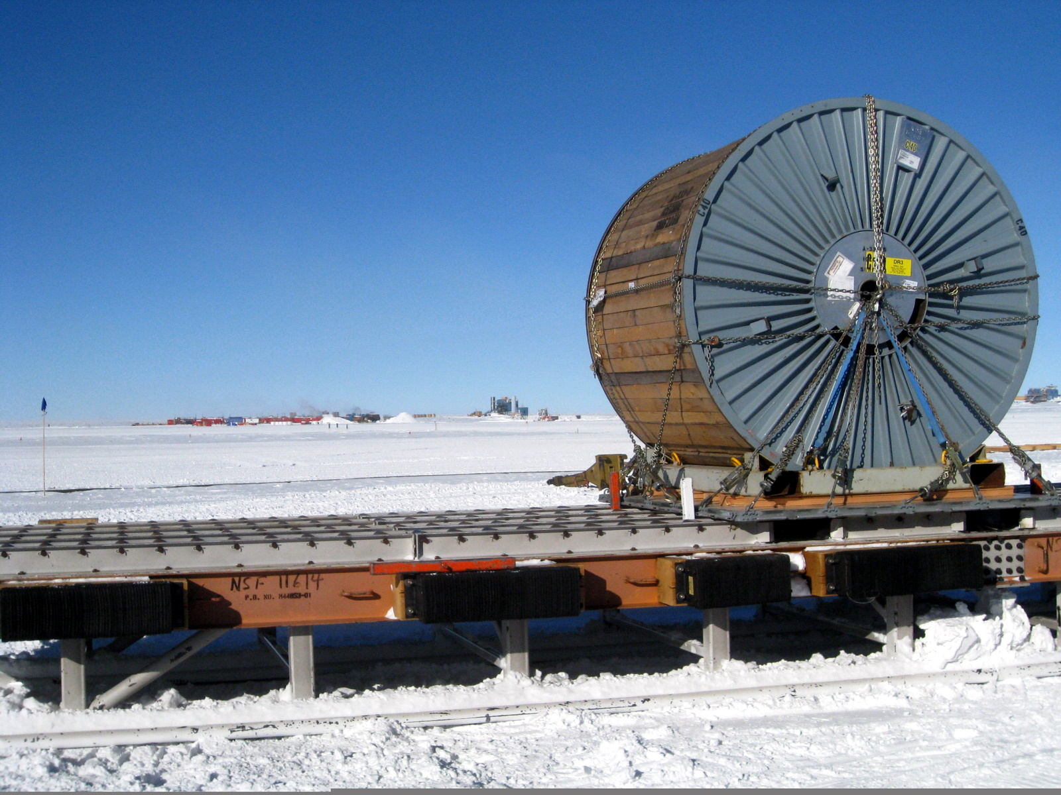
Surface to DOM cable arrives at Pole

Slide 15
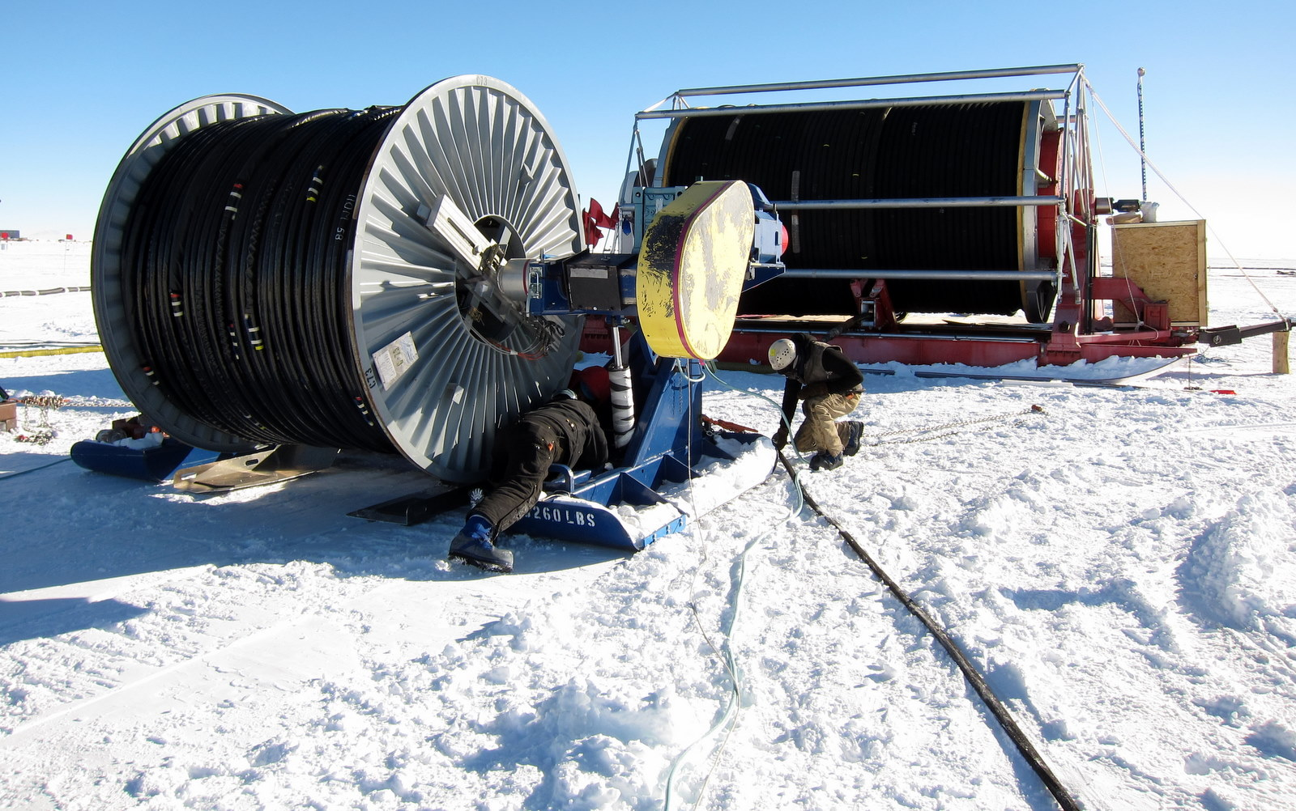
Surface to DOM cable on the TU20 getting ready for deployment

Slide 16
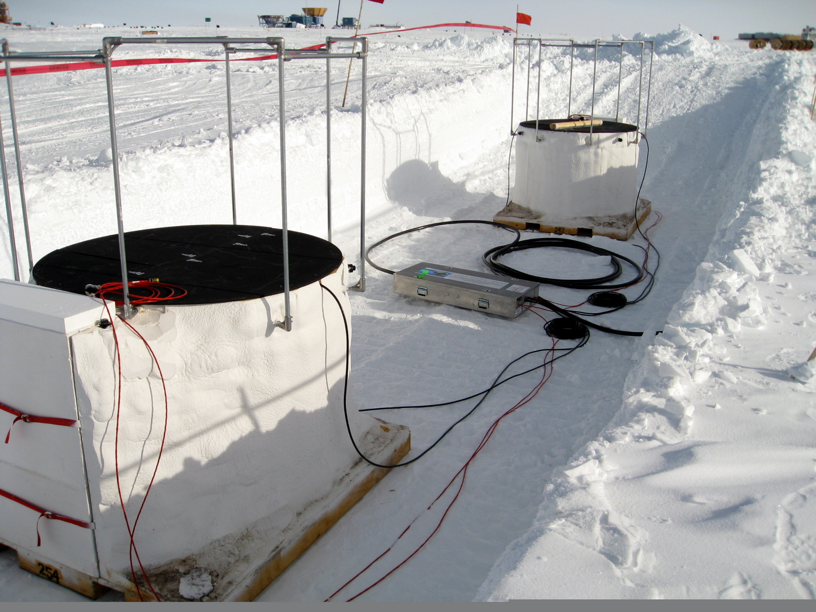
IceTop tanks and Surface Junction Box

Slide 17
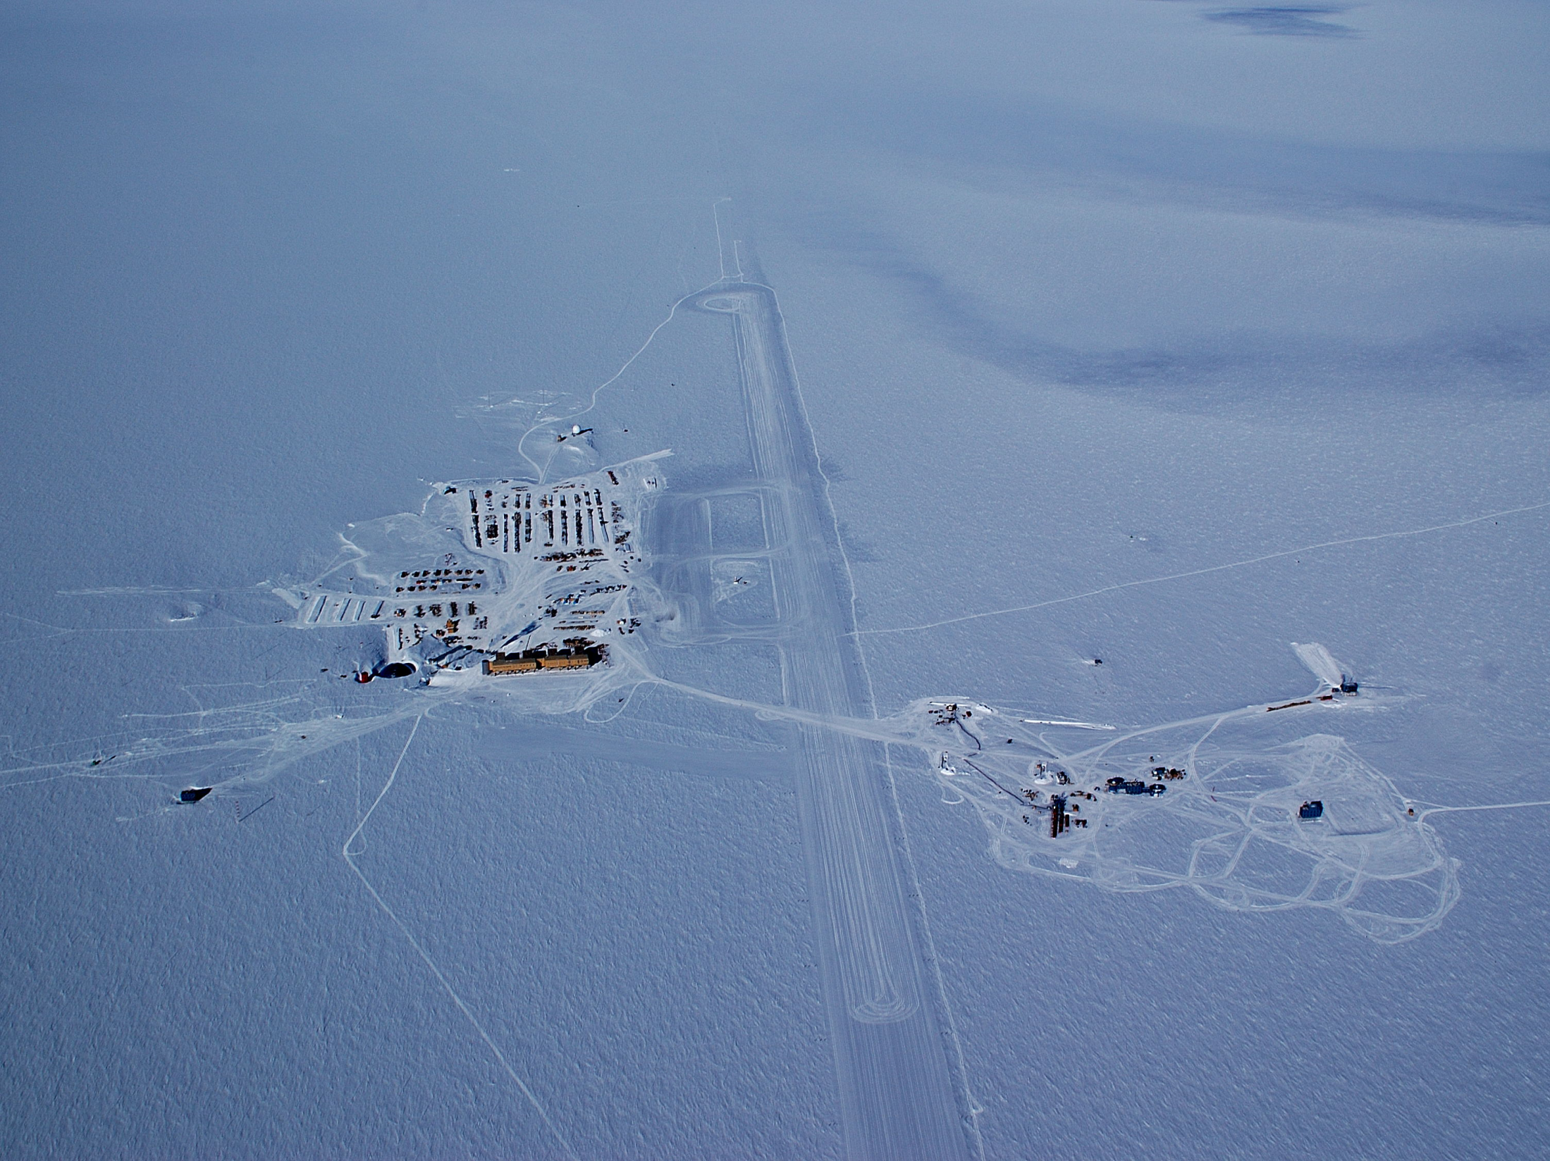
South Pole with IceCube
Getting IceCube in the Ice
The Enhanced Hot Water Drill
IceCube

Slide 18
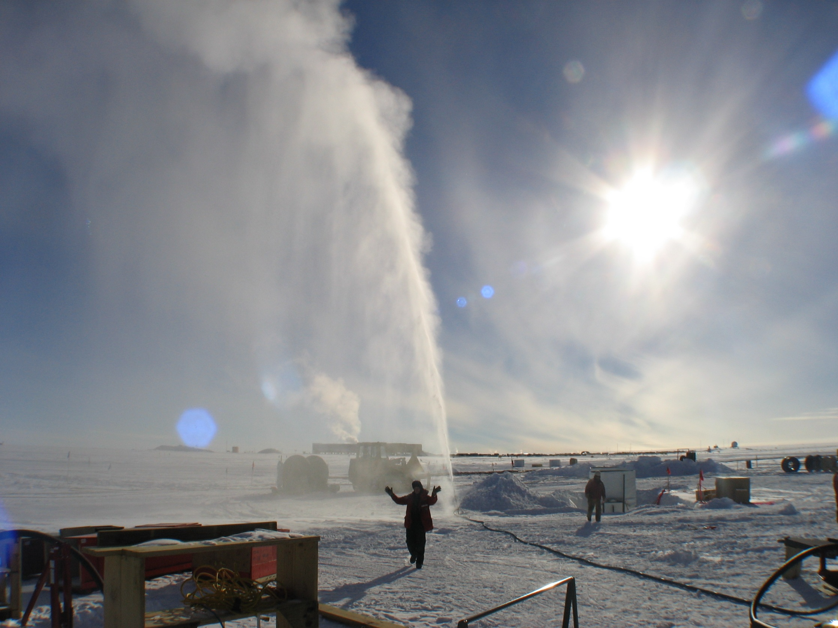
Why a Hot Water Drill?
Hot water + Ice = Hole
Fast
Need a water-filled hole
  DOMs freeze in and become optically coupled with ice sheet
  Fluid supports hole so it doesn’t collapse in on itself
  Allows us to circulate water

Slide 19
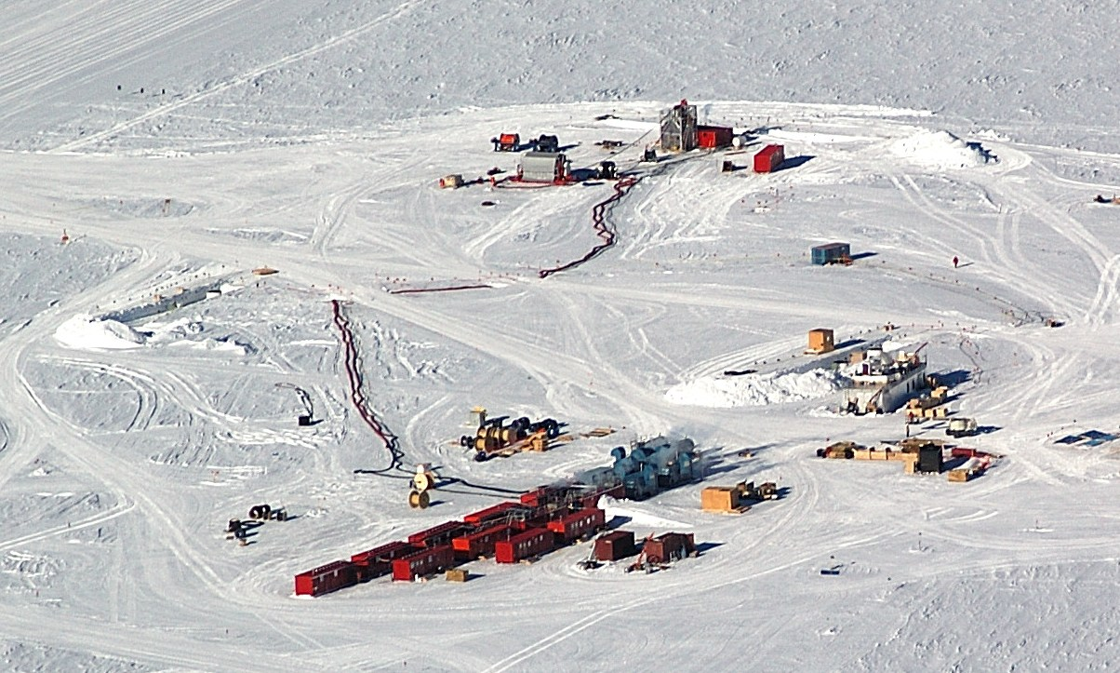
HOLE or TOWER SITE
DRILL CAMP
Notes:
Note person walking

Slide 20
How Did It Do?
2004-2005: 1 (and a half) holes
depth
2009-2010: 20 holes
Notes:
04-05 not actual data, but representative

Slide 21
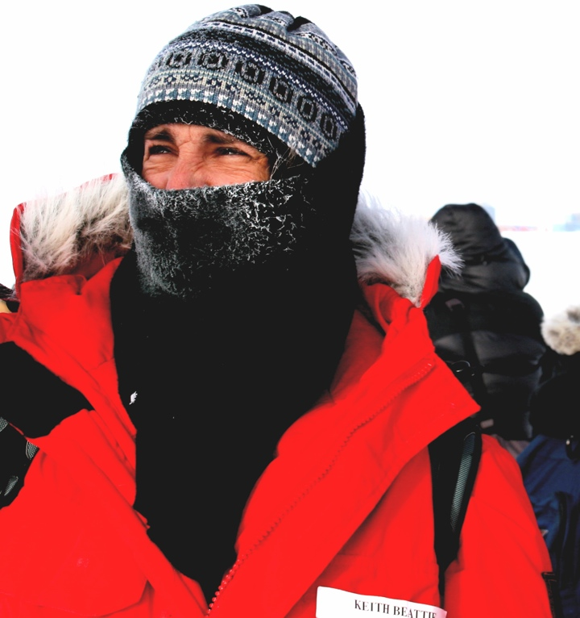
working at the south pole
Fun South Pole Facts
altitude: ~10,000 ft (9000 + thinner air)
mean temperature in Summer: -31F, -35C
mean temperature in Winter: -80F, -62C
precipitation: 2.5mm/yr (Portland: 922.02/yr)
summer population: 280
winter population: 45
water ration: 2 showers/week, 2 minutes each
sunrises or sunsets per year: 1
distance to McMurdo base: 840 miles / 1355 km
indigenous life: microbes
Antarctica has 90% of the earth’s fresh water locked up in its ice
Weirdest thing? The sun just spinning around you each day

Slide 22
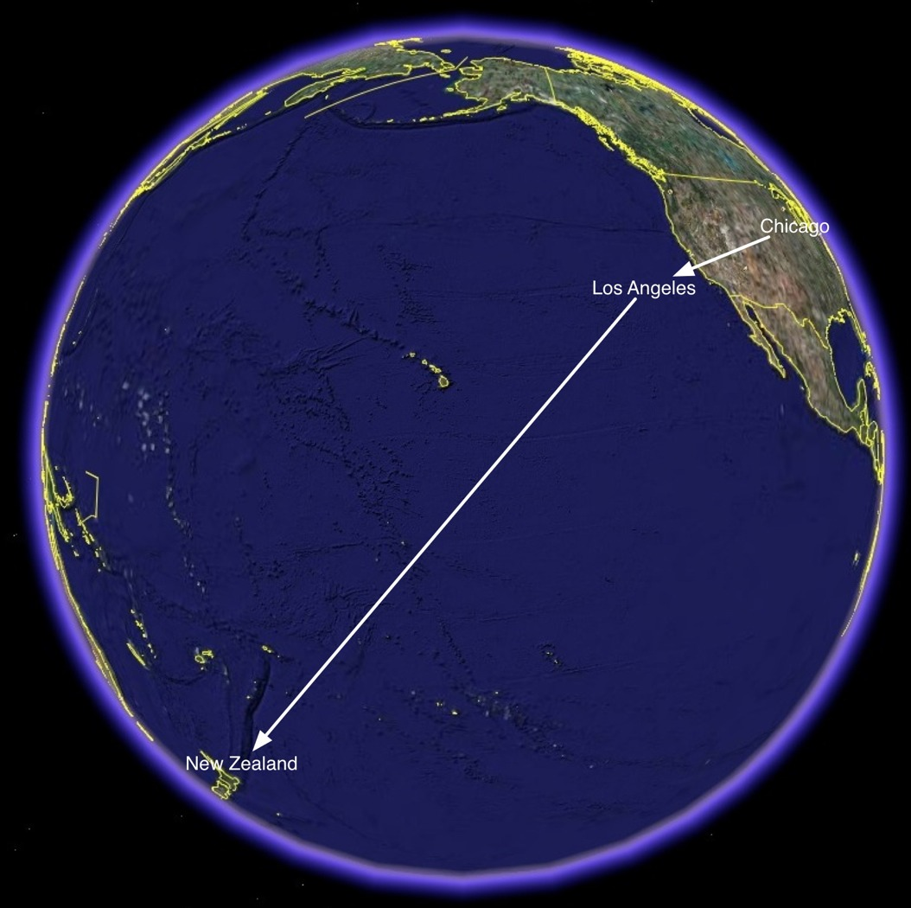

Slide 23
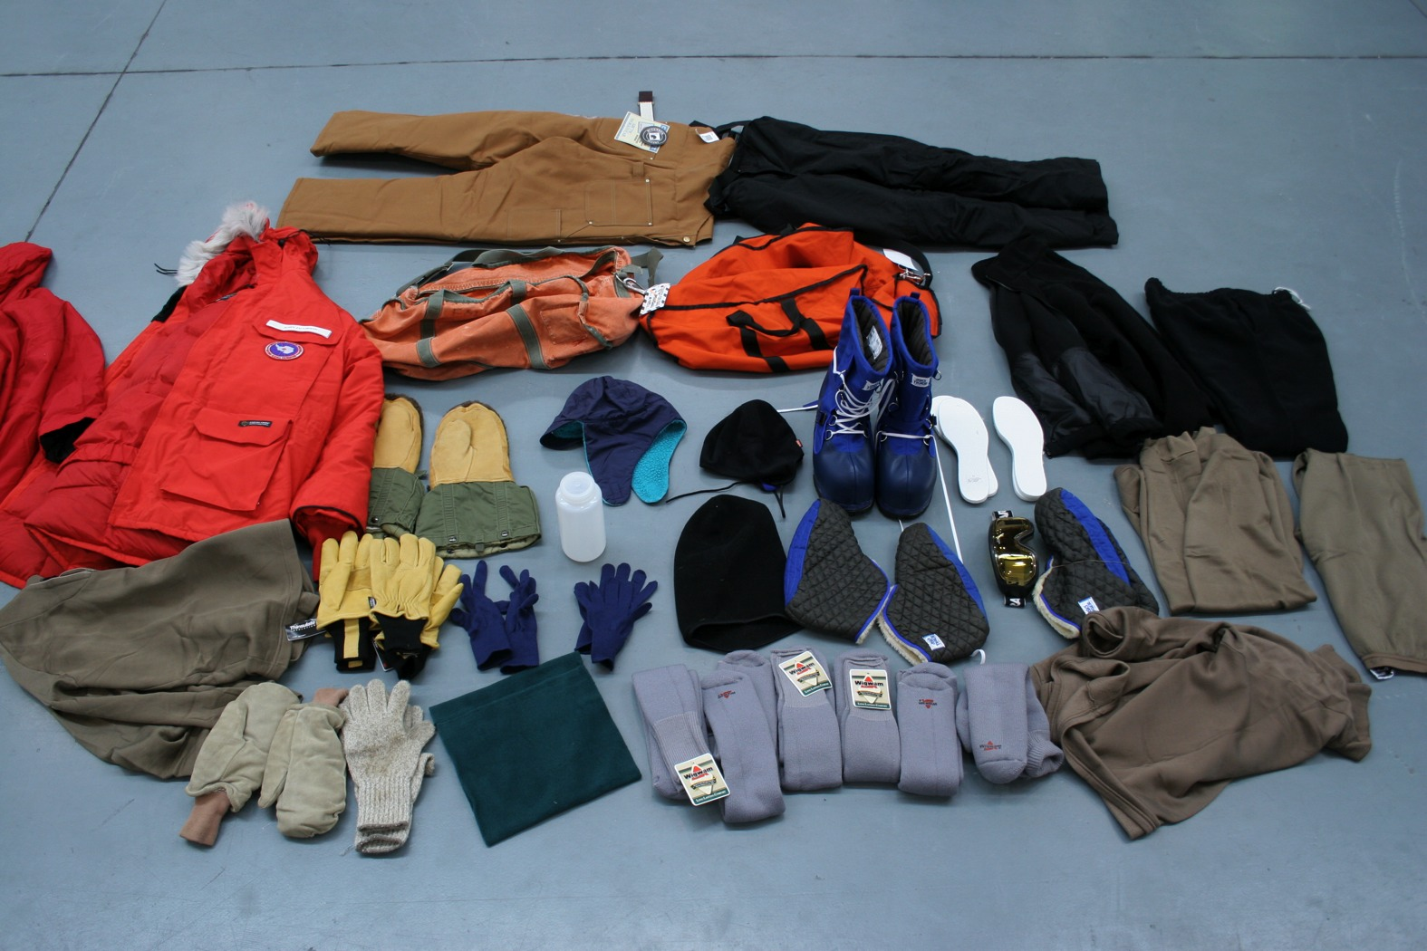
~ 40 lbs

Slide 24
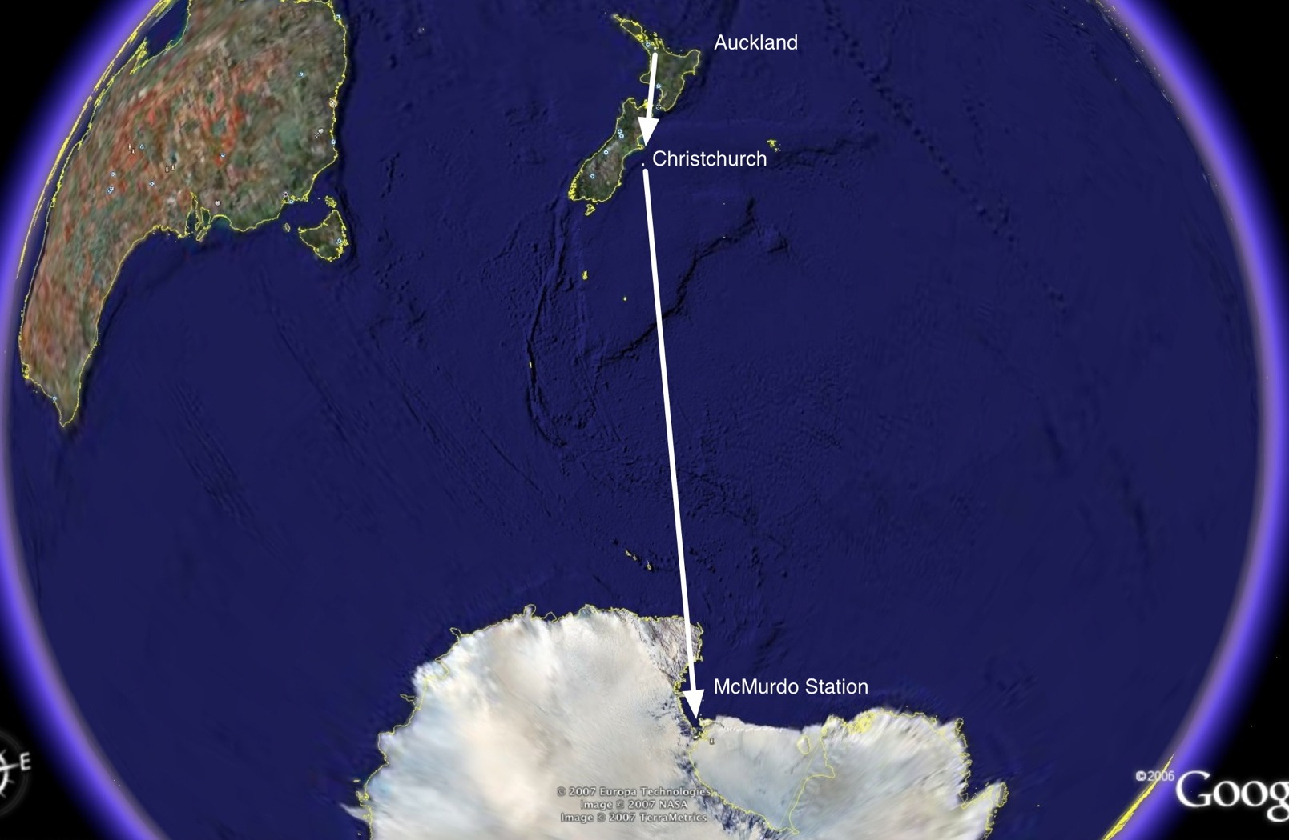

Slide 25
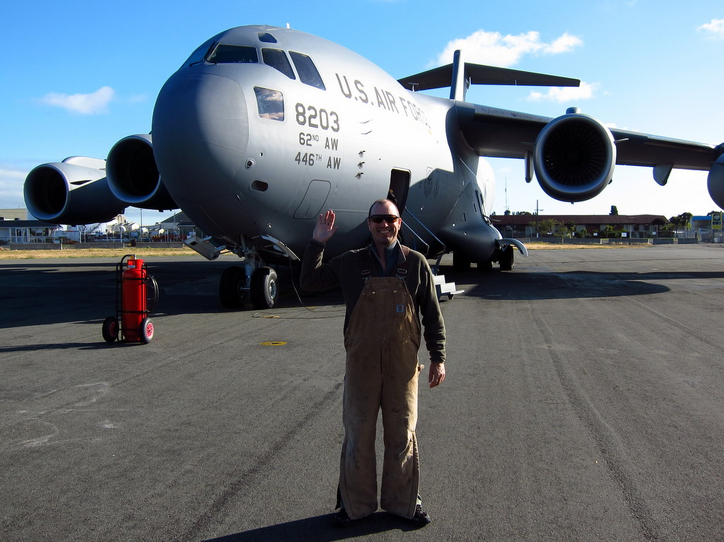
CHC to McM on a C17 out of McChord AFB

Slide 26
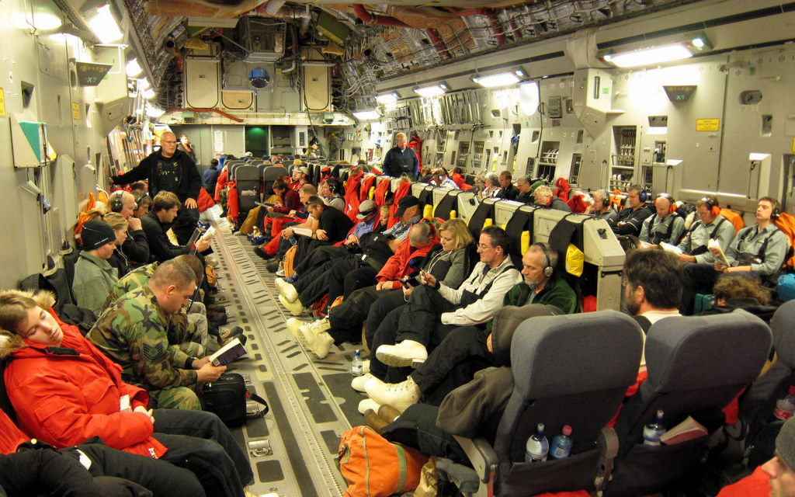
Inside C17

Slide 27
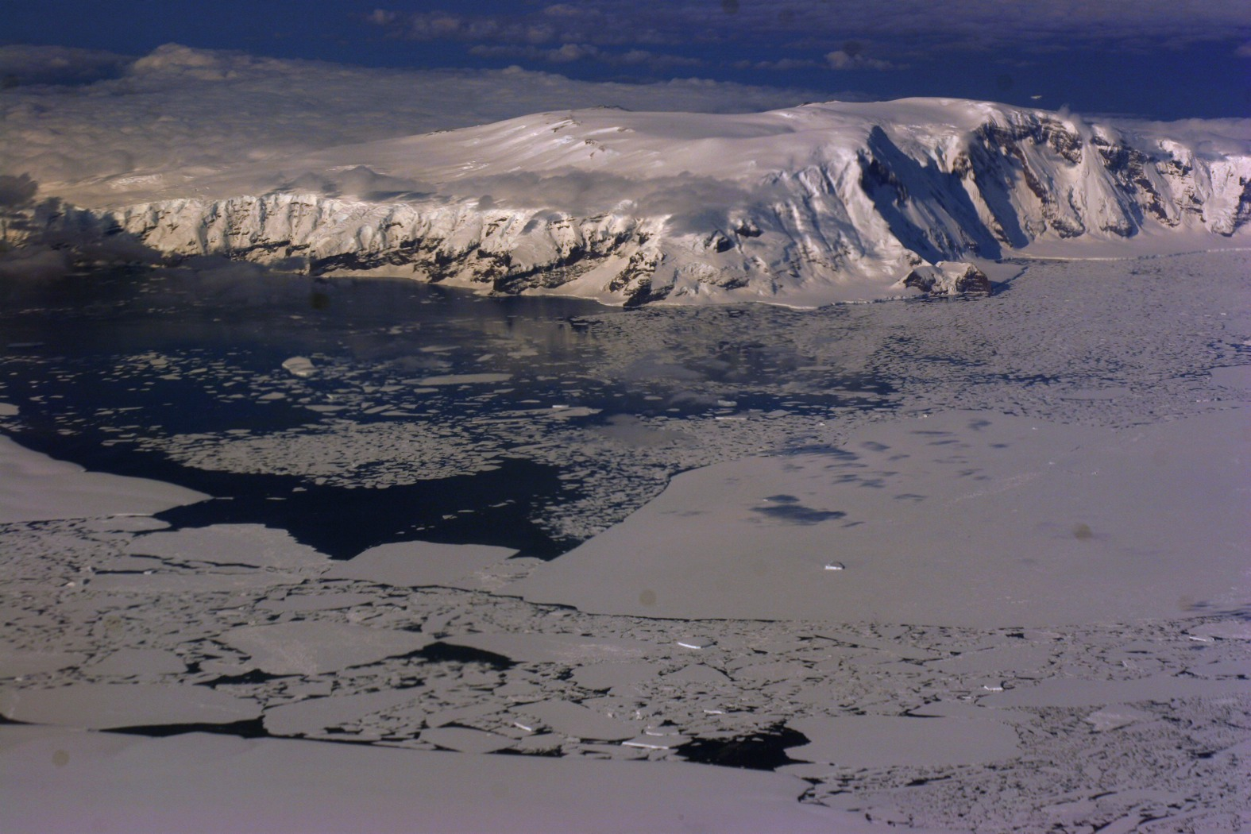

Slide 28
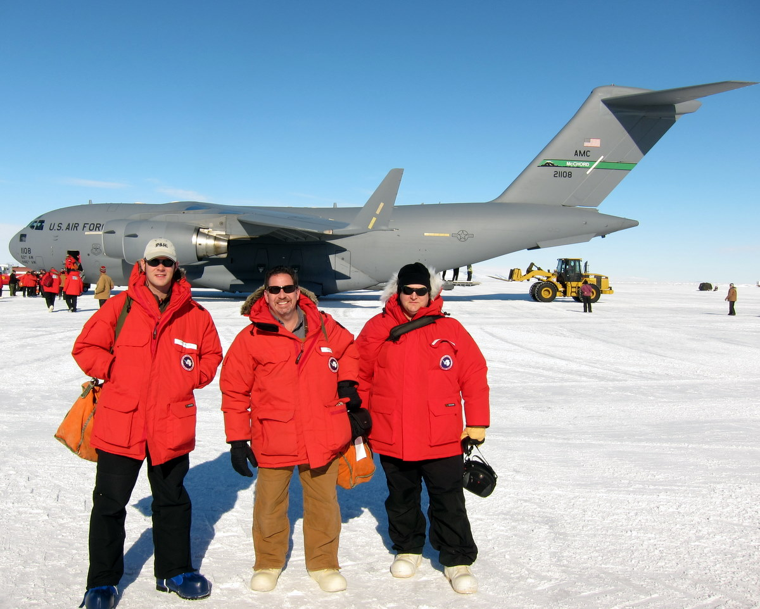

Slide 29
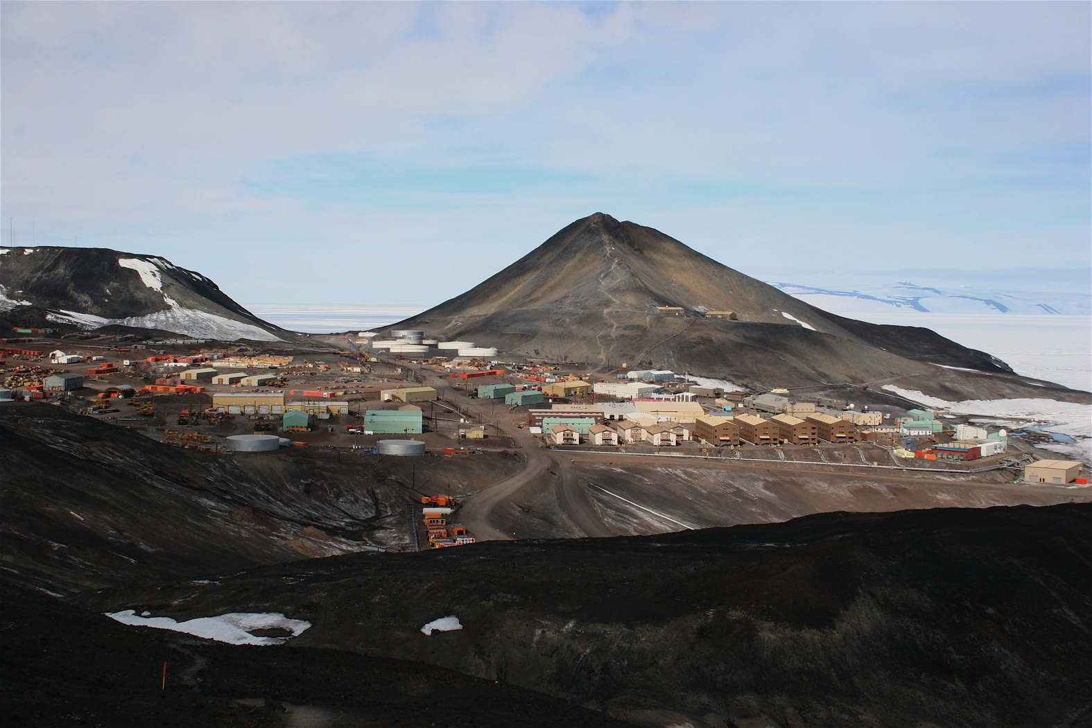
A not so pretty McMurdo Station

Slide 30
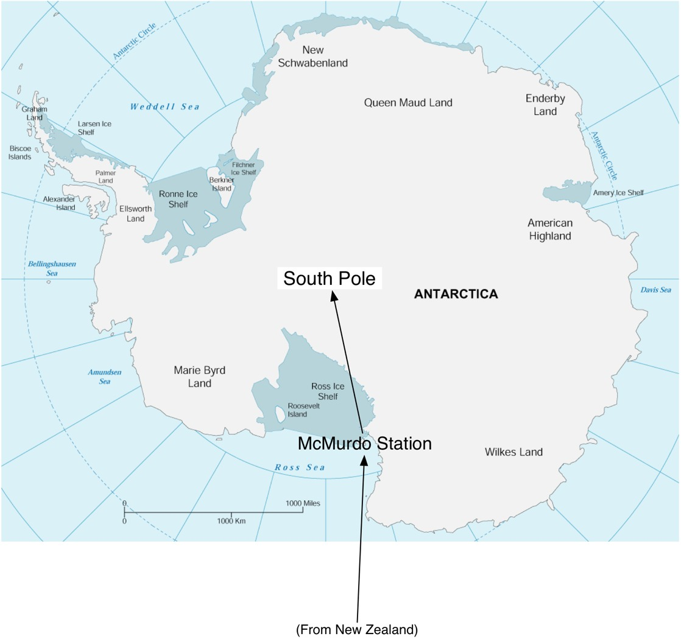

Slide 31
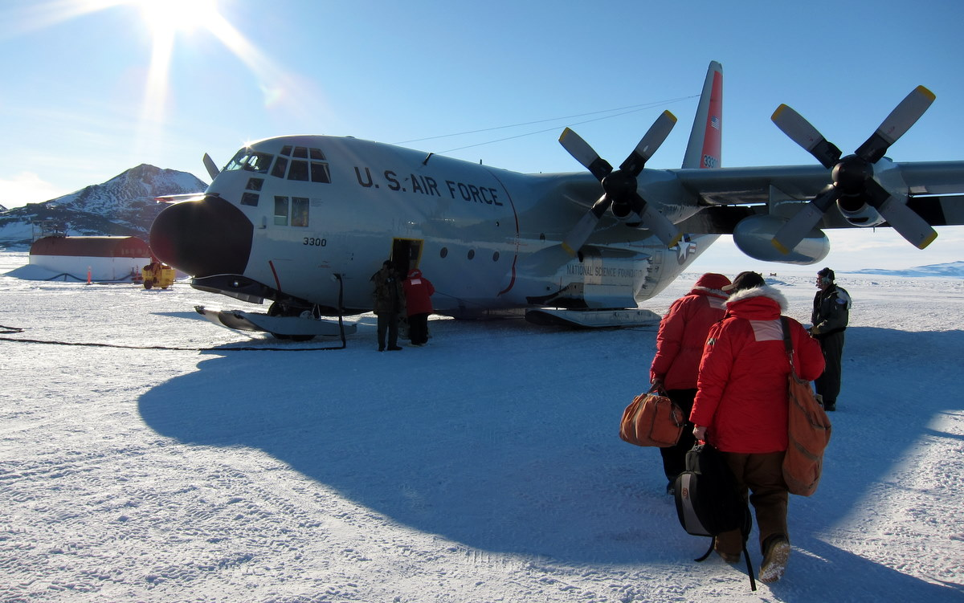
Finally to Pole…
LC-130 Herc from the 109th ANG wing from New York

Slide 32
Inside the Herc

Slide 33
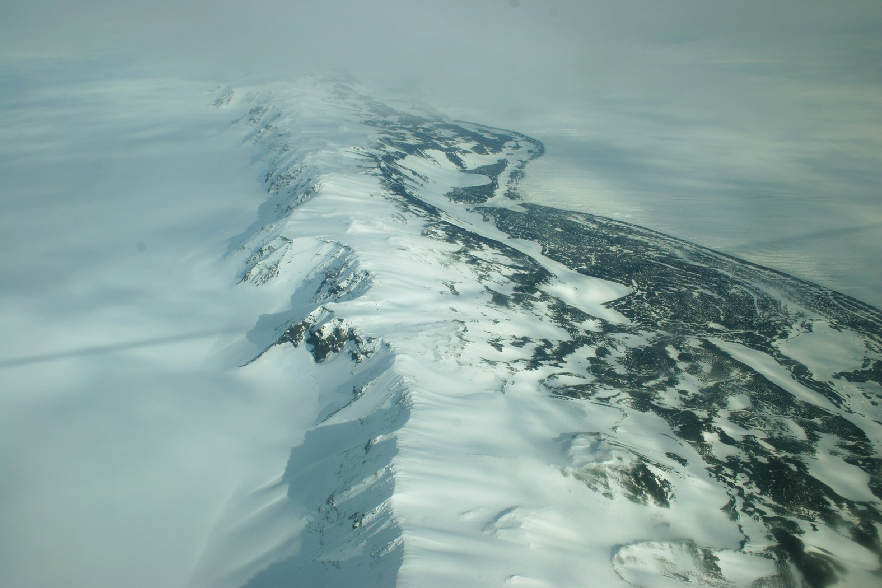

Slide 34
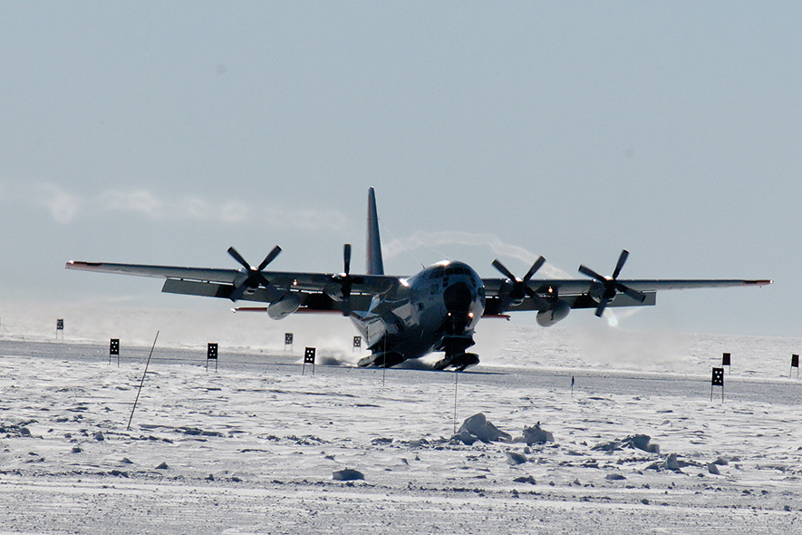
9.5 million pounds of cargo (fuel and equipment) delivered to Pole in support of IceCube over last 8 seasons…lots of flights!
Herc landing at Pole

Slide 35
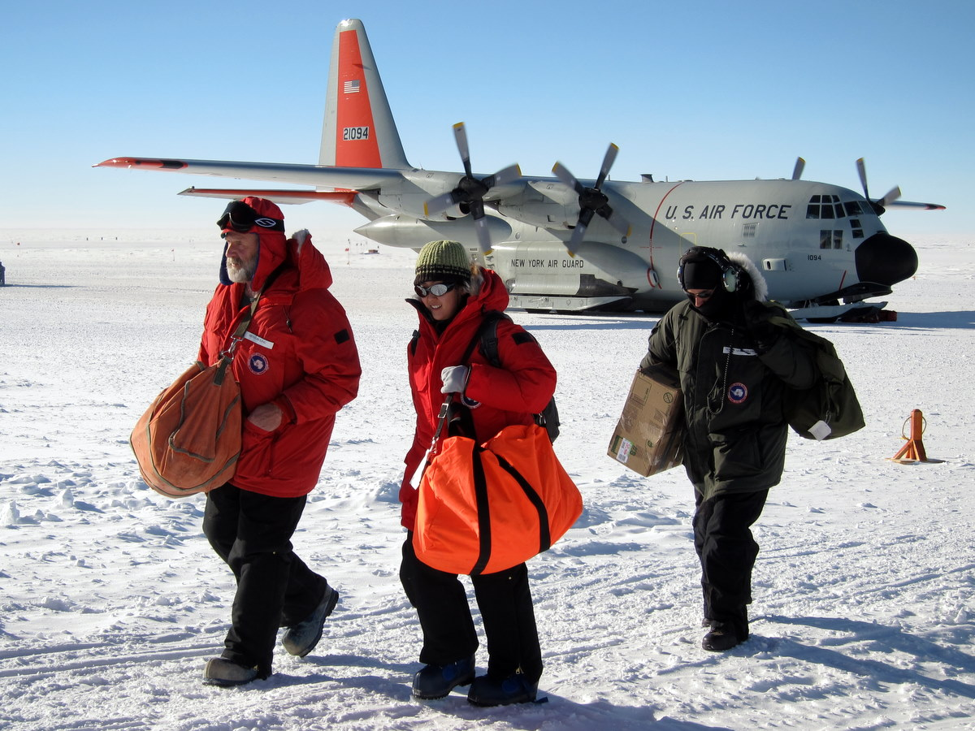
Arrival at Pole

Slide 36
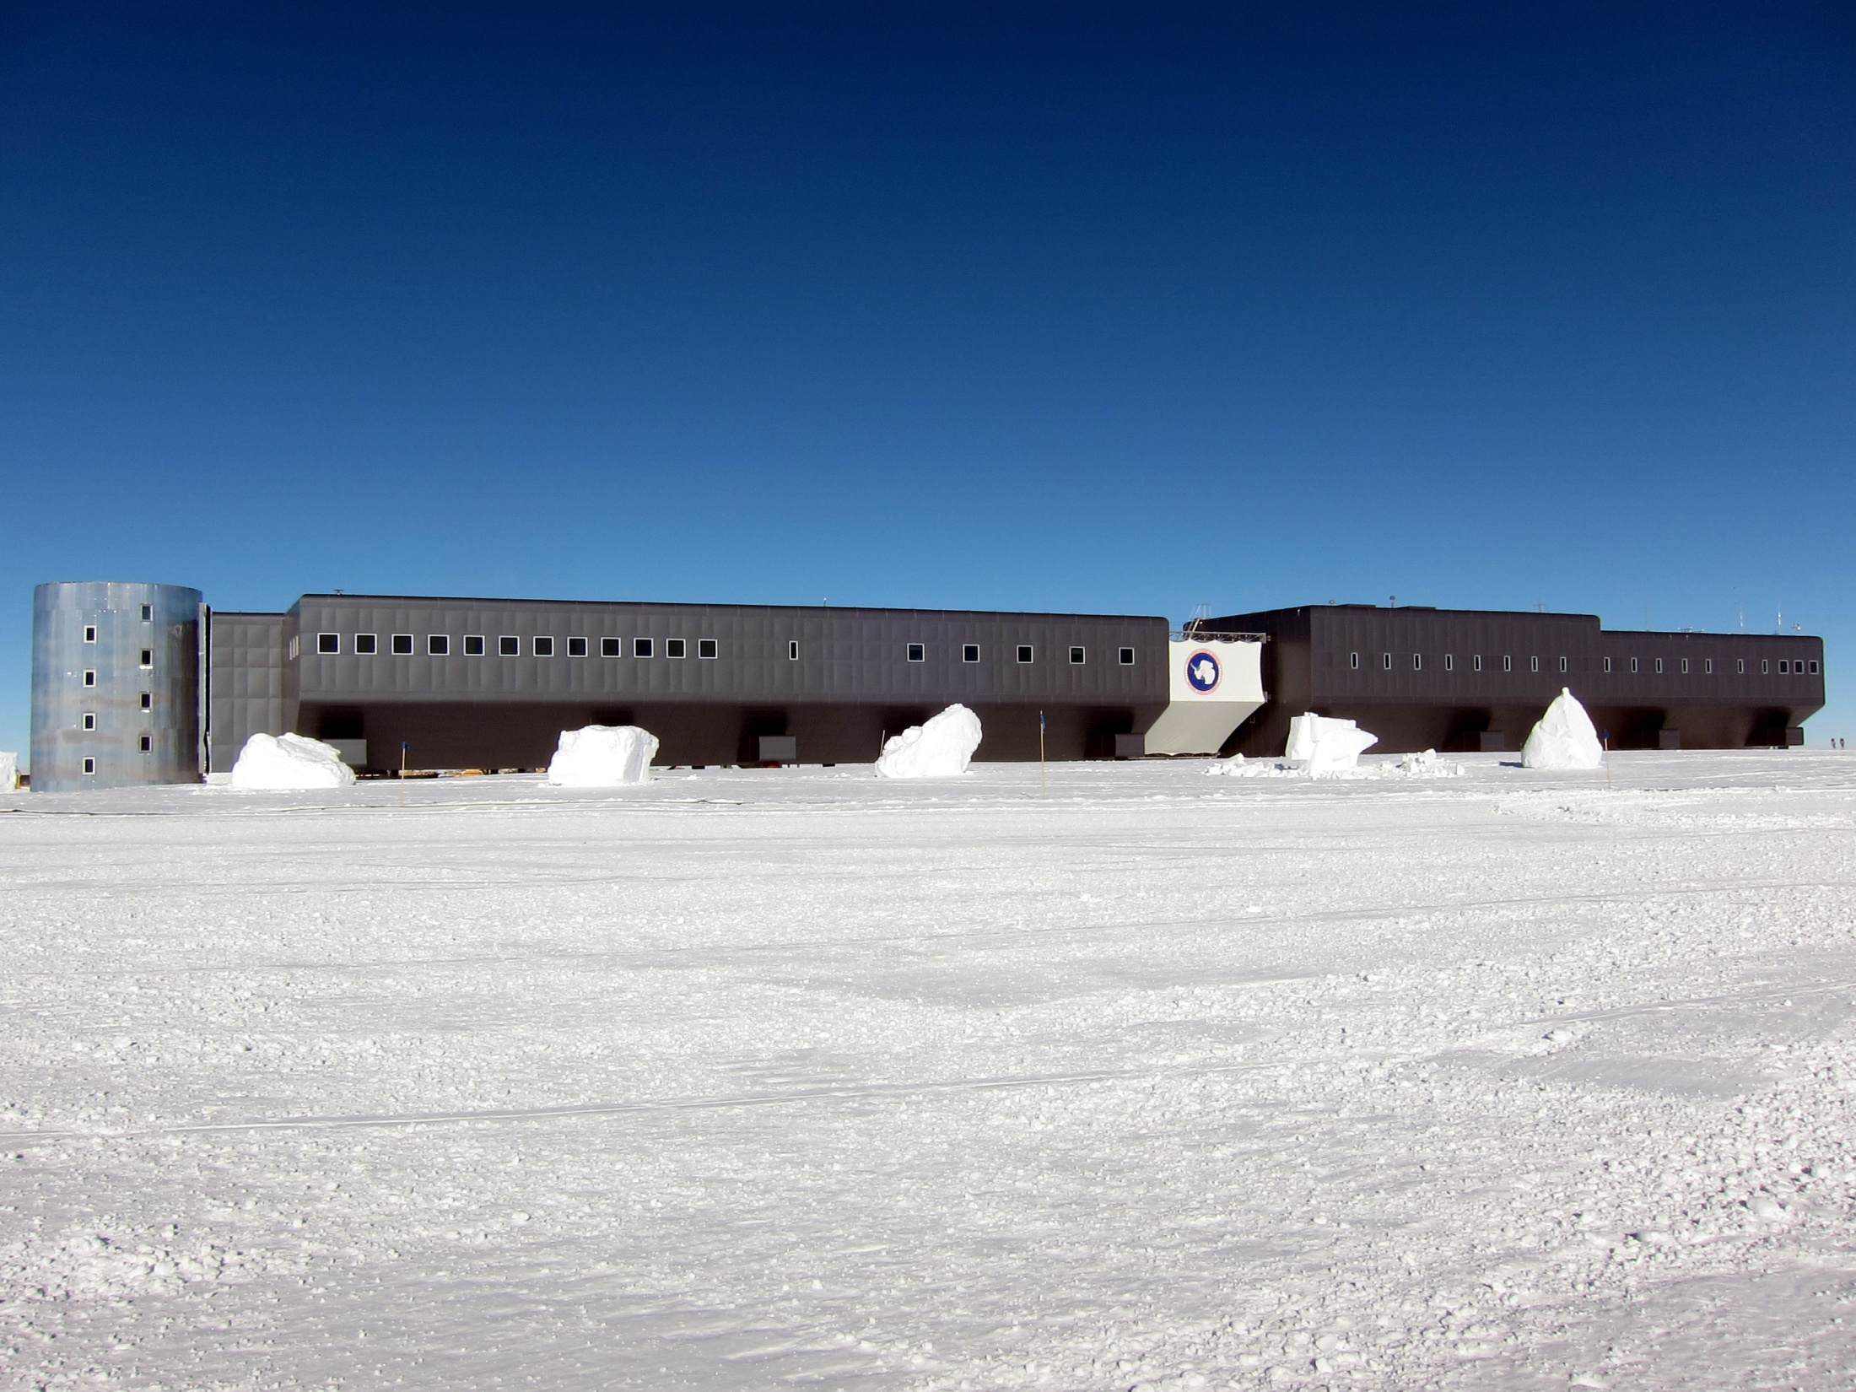
South Pole Station…nice digs
Note absences of penguins…

Slide 37
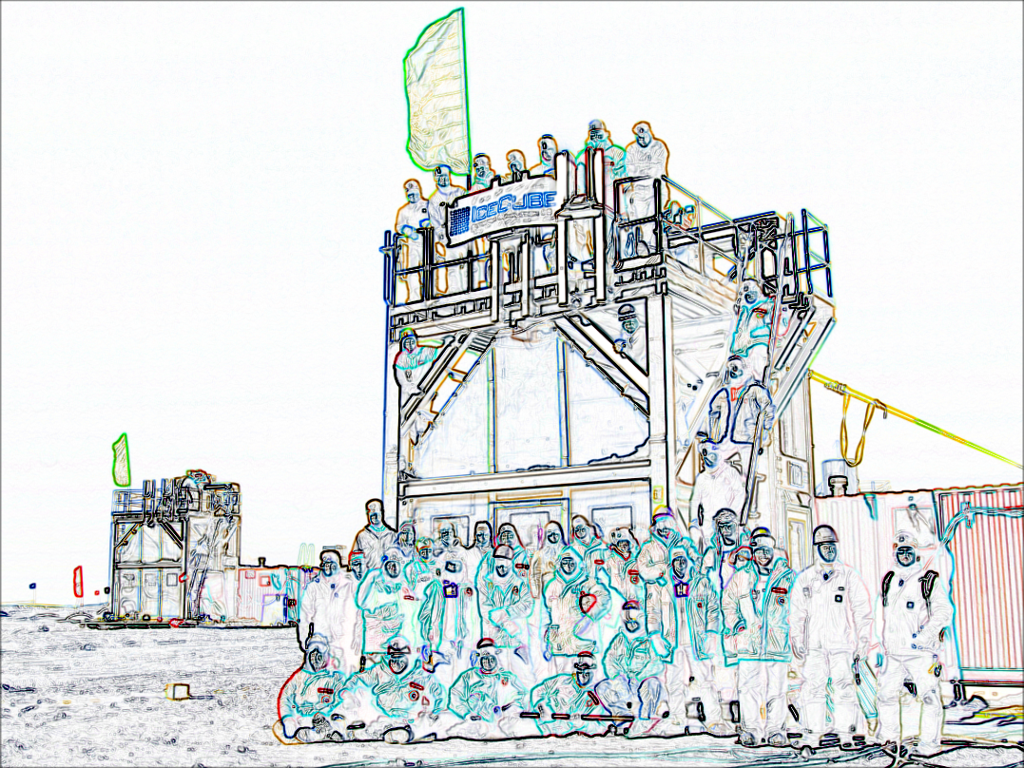
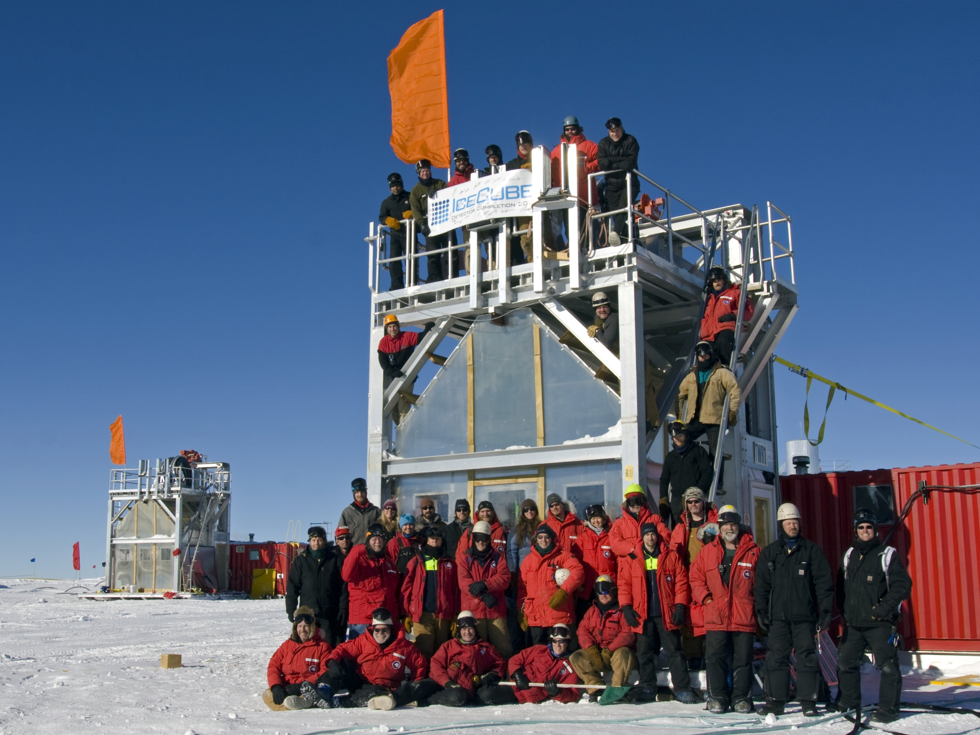
Thank You !

