Slide 1


The IceCube MasterClass
providing high school students an authentic research experience
Sílvia Bravo Gallart , Ellen Bechtol , David Schultz , Megan Madsen , Jean DeMerit and the IceCube Collaboratoin
Sílvia Bravo Gallart, silvia.bravo@icecube.wisc.edu
APS April Meeting, Jan 30, 2017

Slide 2
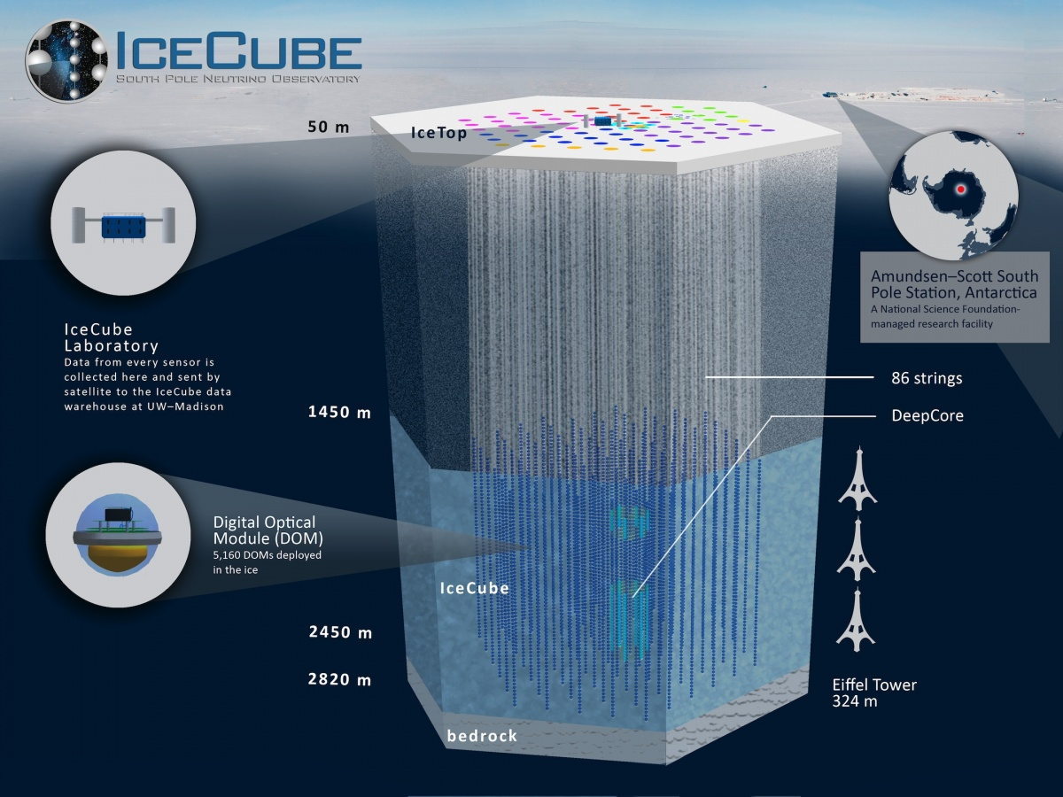

Slide 3
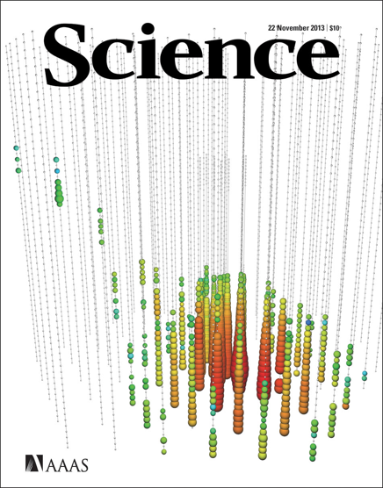
The IceCube Neutrino Observatory is
a cubic-kilometer neutrino detector in Antarctica
a discovery telescope for neutrino astronomy
a powerful detector for cosmic ray physics
a better-than-expected detector for neutrino physics
Headquarters are at UW—Madison. The IceCube Collaboration includes >300 scientists from 48 institutions in 12 countries

Slide 4
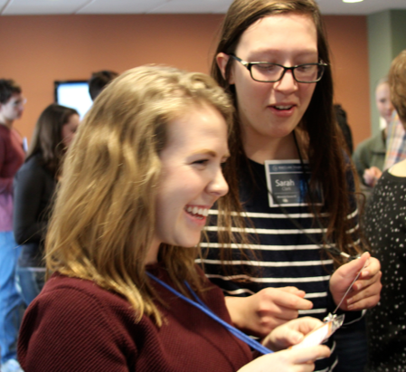
The IceCube MasterClass in a nutshell
Educational program for high schoolers
One-day, hands-on, research-based, intense
Main goal: I COULD BE AN ICECUBER!
Launched in 2014
Inspired by particle physics masterclasses –
Over 500 students so far
In 2017, hosted by 15 institutions in the US & Europe
physicsmasterclasses.org/
Madison
masterclass 2016

Slide 5
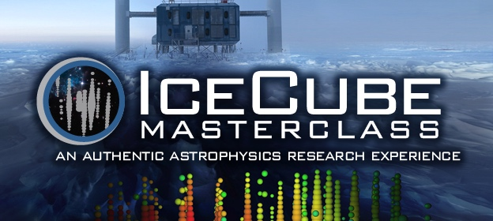
icecube.wisc.edu/masterclass a multilingual website en|es|de
8, 11, 22 March 2017
Now Recruiting!

Slide 6
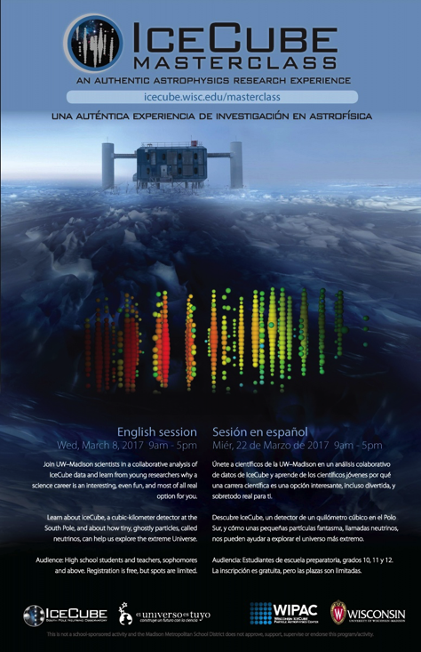
The IceCube MasterClass program
Icebreaker – Neutrinos as pieces of the SM
IceCube lecture
South Pole Webcast (all)
Detector experiences: hands on, demonstrations
Lunch with IceCubers
Analysis: astrophysical neutrinos or CR flux
Presentation to peers –virtual, several institutions
9am to 5pm, 2 breaks mid-morning and lunch

Slide 7
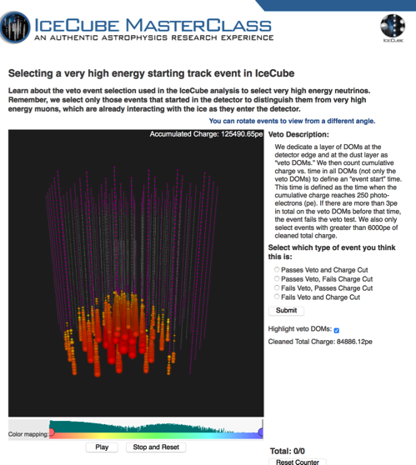
A few words on the analysis about astrophysical neutrinos
Students replicate the discovery of astrophysical neutrinos
Follow the rationale of the Science paper, although with updated data
Main concepts: signal astrophysical neutrinos & background atmospheric muons and neutrinos, what makes signal unique, designing an event selection, meaning and significance of results – tune event selection, point source search using scramble maps
Most activities are online.
We provide guidelines to conduct the activity, including examples of talks.

Slide 8
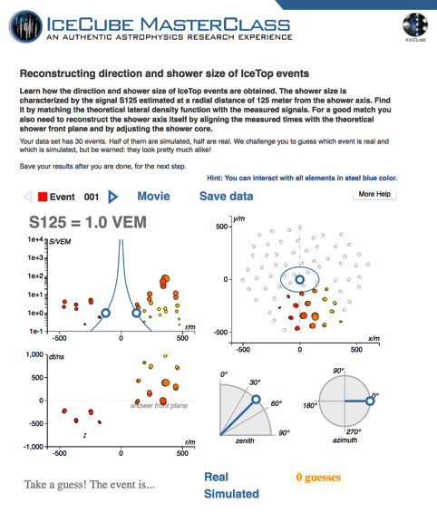
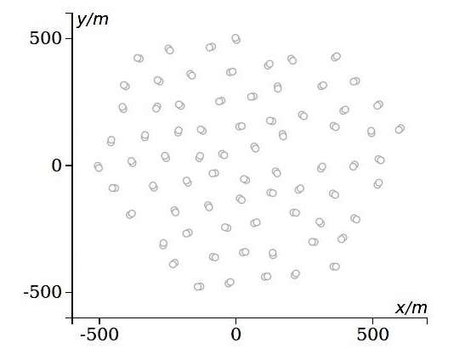
A few words on the analysis about measuring the CR flux
Students replicate a study published on Physical Review D
Follow the rationale of the paper, look at a small sample of data
Main concepts: characterization of a CR shower, what IceTop data tells us about CRs, data vs MC, energy calibration, meaning and significance of results –combine different data samples
Most activities are online.
We provide guidelines to conduct the activity, including all steps to produce the measurement.

Slide 9
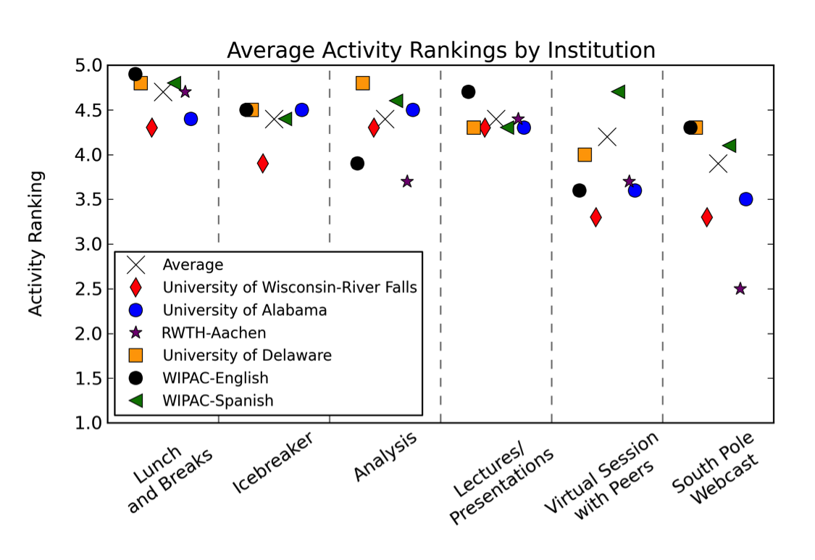
A successful program, although there is room for improvement

Slide 10
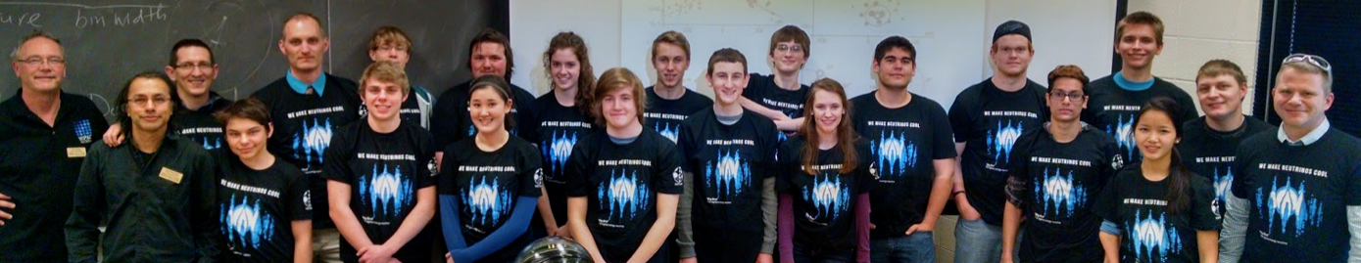
The voices of the students about what they liked and learned say
that the analysis activities were the best of the day >50%
that they have a better understanding of how research works >33%
that they love to interact directly with scientists ~30%
that it was an intense, long day ~30%
that we can improve and reduce lectures ~30%
that this experience will be useful in the future ~25%
they really love pizza ;-)
River Falls, masterclass 2016

Slide 11
A growing community interested in science, and a greater impact on girls
2014, 5 institutions, ~100 students
2015, 9 institutions, ~175 students
2016, 11 institutions, >200 students
20-40% girls
Mostly juniors and seniors
N=90/60
* Male vs Female differences may be larger for broader recruiting approaches

Slide 12
Learning basic concepts also a goal, although not the focus

Slide 13
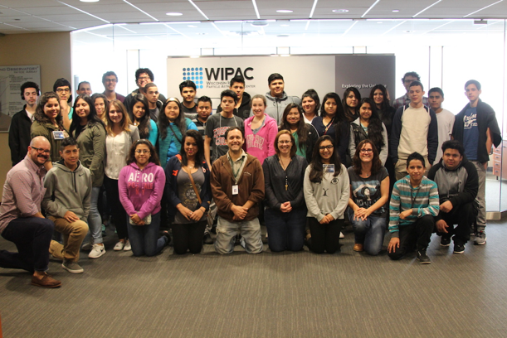
Challenging science is not for AP students only
Madison, masterclass 2016

Slide 14
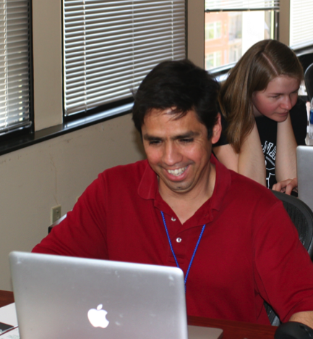
Engaging students and teachers
Teachers often join the activities
Student-teacher collaborative learning
Teachers make connections between classroom curriculum and current research
Both students and teachers are more likely to join other IceCube programs
Madison, masterclass 2014

Slide 15
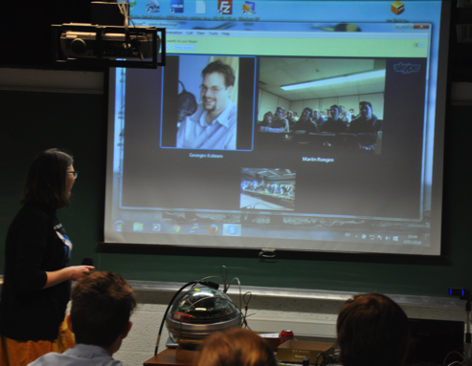
IceCubers acknowledge the benefit of a collaboration wide program
all institutions that join do repeat
activities developed by different groups (2+1)
translations by collaborators
the masterclass has helped them creating links with high schools
ownership of the local event vs collaboration wide support –shared resources –
virtual presentations in Europe, masterclass 2016

Slide 16
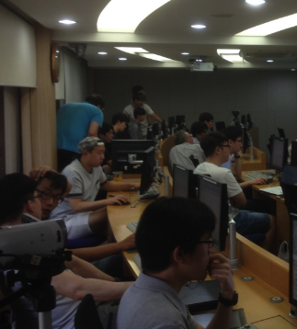
Bringing IceCube research to everyone
Online tools used in outreach events
IceCubers adapt these resources for local events
Physics Teacher papers: icebreaker + research *
Training workshop at AAPT this summer
Future training for all interested teachers *
Korea, summer 2016
* currently working on these

Slide 17
Summary
The IceCube MasterClass program invites high school teachers and students to join an astrophysics research group and replicate a real research
Students engage with the activities and enjoy meeting scientists
After the masterclass, students are more interested in science
Initially developed for students with some interest in science, the masterclass is also a good program to attract underrepresented communities in STEM
The IceCube Collaboration leverages efforts lead by a few institutions to reach broader audiences
We will continue improving the program and expanding the research concepts, techniques and topics

Slide 18
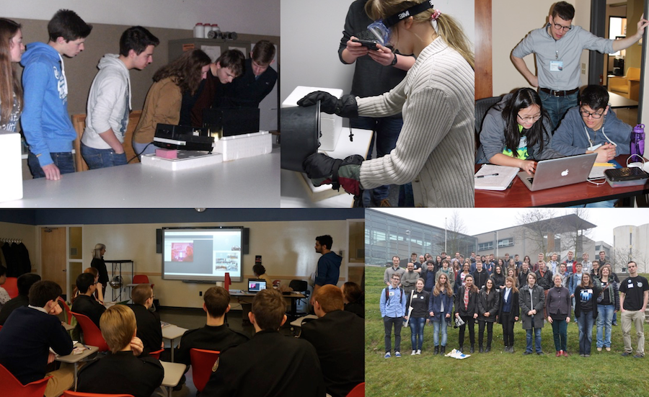

Slide 19
The IceCube MasterClass
“For the first time I understand something about science and physics.” (WIPAC Spanish, 93)
THANKS!
Sílvia Bravo Gallart, silvia.bravo@icecube.wisc.edu

