Slide 1
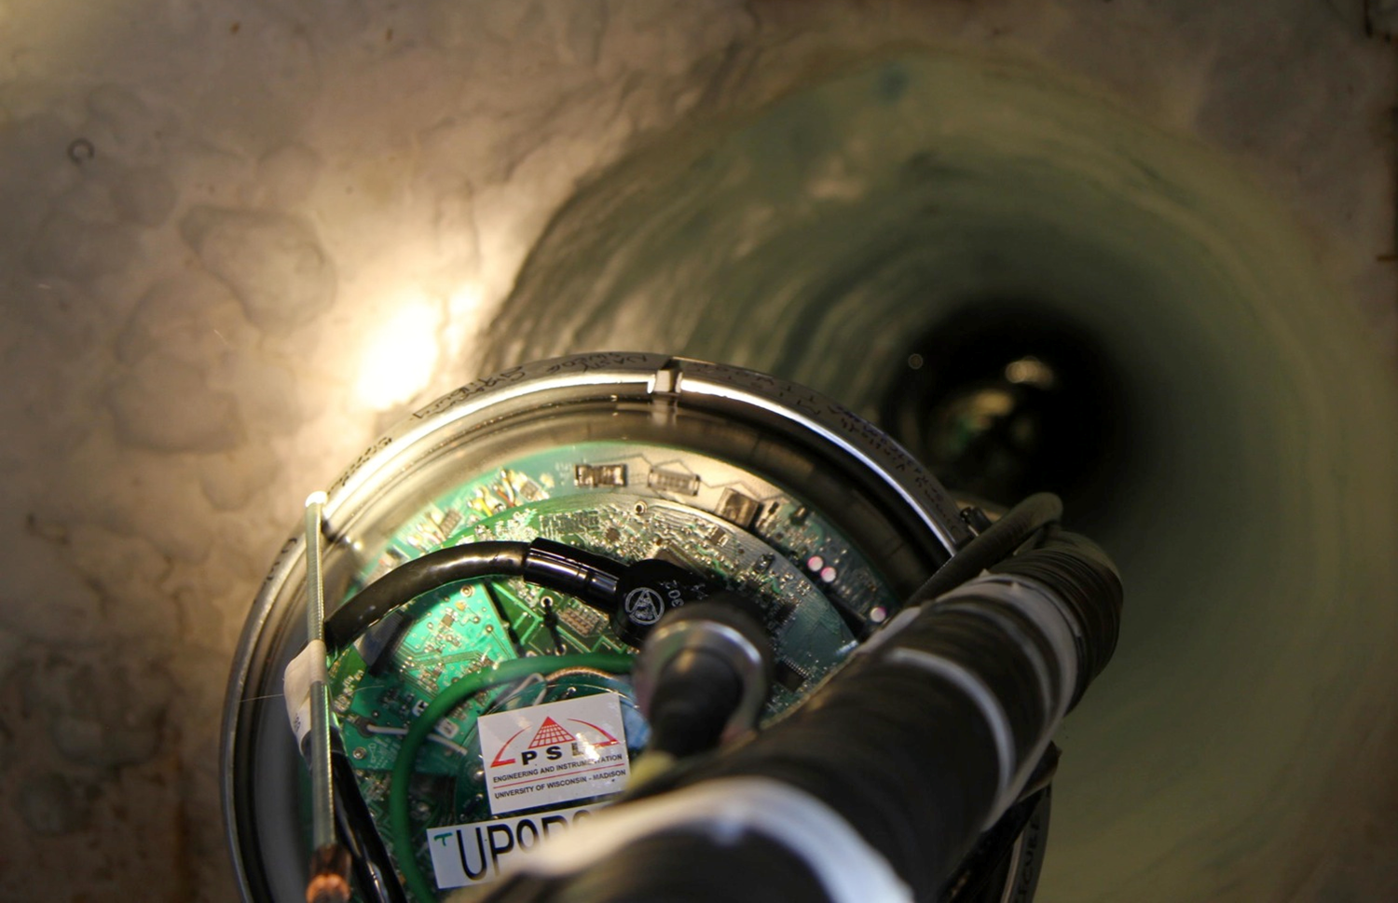
IceCube Management and Operations
A Presentation to the IceCube Science Advisory Panel
Kael Hanson
IceCube Director of Operations
2015.10.19

Slide 2
A Calendar for Facility Maintenance

Slide 3
Each Day in IceCube …
Detector (computing infrastructure included) power consumption 60 kW → 5 GJ/day (~100 gal JP-8 fuel).
Detector collects 250 million cosmic ray events, almost all cosmic ray muons from atmosphere above South Pole (2.5 million events/gallon).
1 TB of data is written to disk by the DAQ
This data is filtered by online farm in ICL and 10% of this data sent north to UW Data Warehouse via satellite links.
2 TB of simulation data generated on 1000’s of cores in UW clusters and on distributed clusters operated by collaboration members.

Slide 4
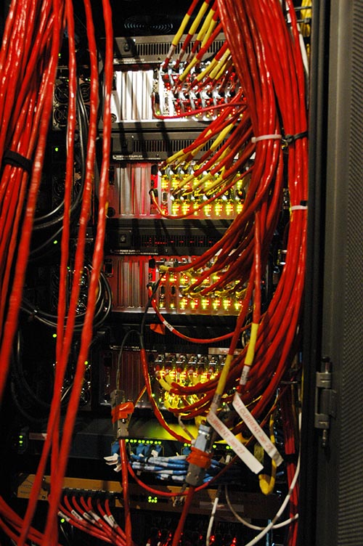
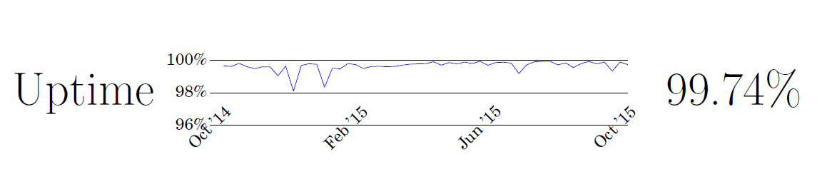
Each Week in IceCube
A power supply dies or a computer crashes at Pole and the winter-over operators must replace or reboot the hardware.
Working groups discuss detector maintenance issues, or simulation issues, and various analysis topics.
Winter overs send their weekly On-Ice Reports to the IceCube collaboration.

Slide 5
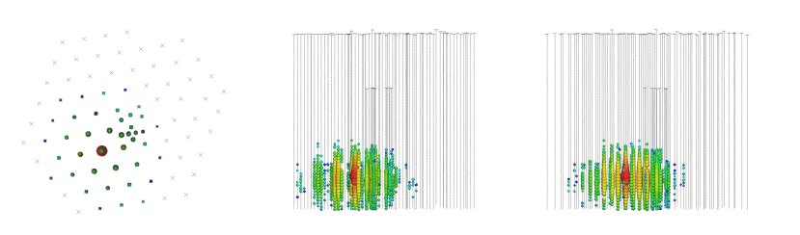
Each Month
DOMCal calibrations are performed at Pole by winter-overs.
Software strike team holds a 5-day code sprint.
We get a HE neutrino interaction inside the IceCube volume

Slide 6
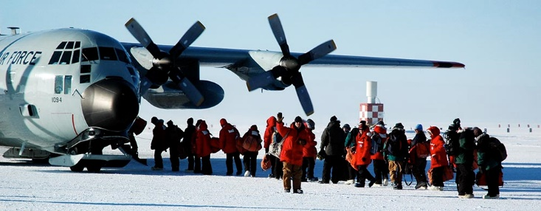
Each Year
South Pole station opens
Crew of 2 IceCube Winter-Overs are rotated – they have been training for 2 months
O(20) collab personnel deploy to Pole to perform activities:
  Computing or DAQ upgrades
  Seasonal calibration campaigns
IceCube run configuration control one yearly cycle
TFT board solicits proposals for new operational states of the detector including allocation of filtering resources and satellite transfer bandwidth.
This state is frozen for 1 year unless major motivation for change.
And, on average, 1 > PeV neutrino lands inside IceCube.

Slide 7
Computing
From G. Merino

Slide 8
Scope of IceCube Computing
South Pole System (SPS)
  DAQ (hubs, 3-4 server class machines)
  Online PnF (30-ish nodes)
  Data storage and satellite transfer
  IT infrastructure
South Pole Test System (SPTS – Madison)
  Scaled-down version of SPS
  Used for debugging/development and release testing.
UW-Madison and Distributed Computing for user jobs as well as simulation mass production
  CPUs – general purpose computing
  GPUs now the main workhorse for photon propagation in ice

Slide 9
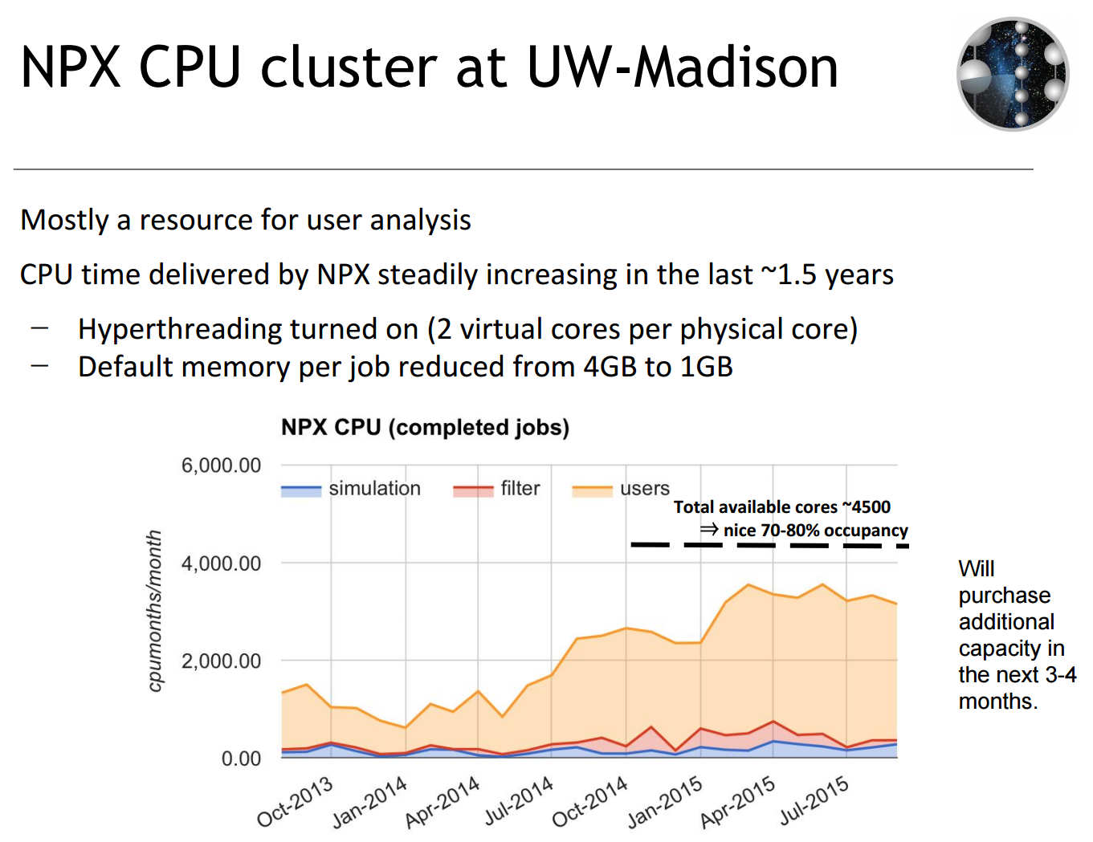

Slide 10
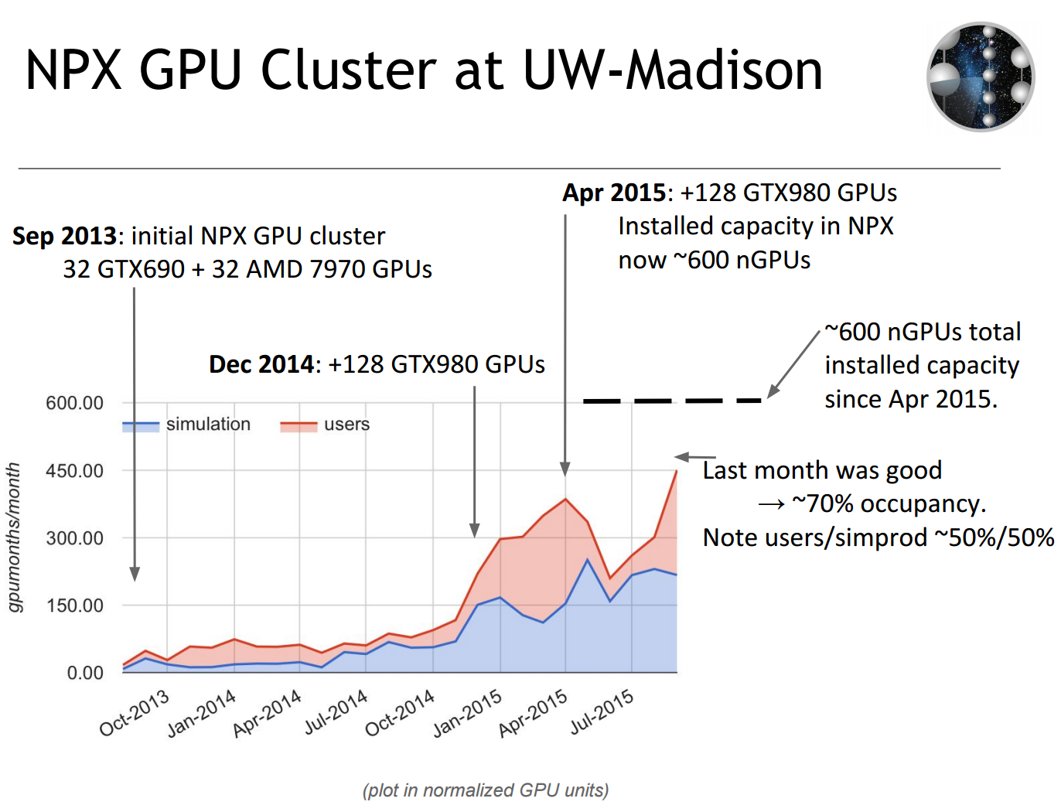

Slide 11
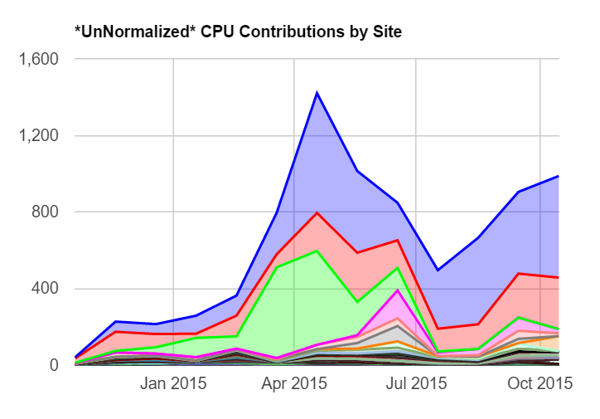
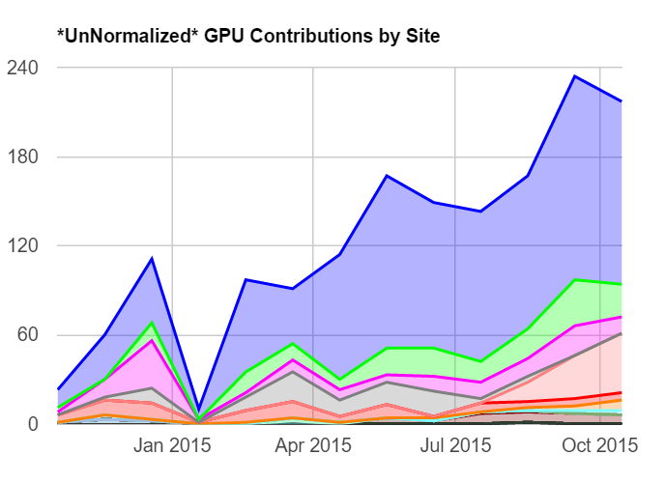
Distributed C/GPUs for Simulation Production
CPU Model: 10% UW Madison, 20% DESY-Z, 70% others + opportunistic resources
GPU Model: 60% UW Madison, 10% DESY-Z, 30% others.

Slide 12
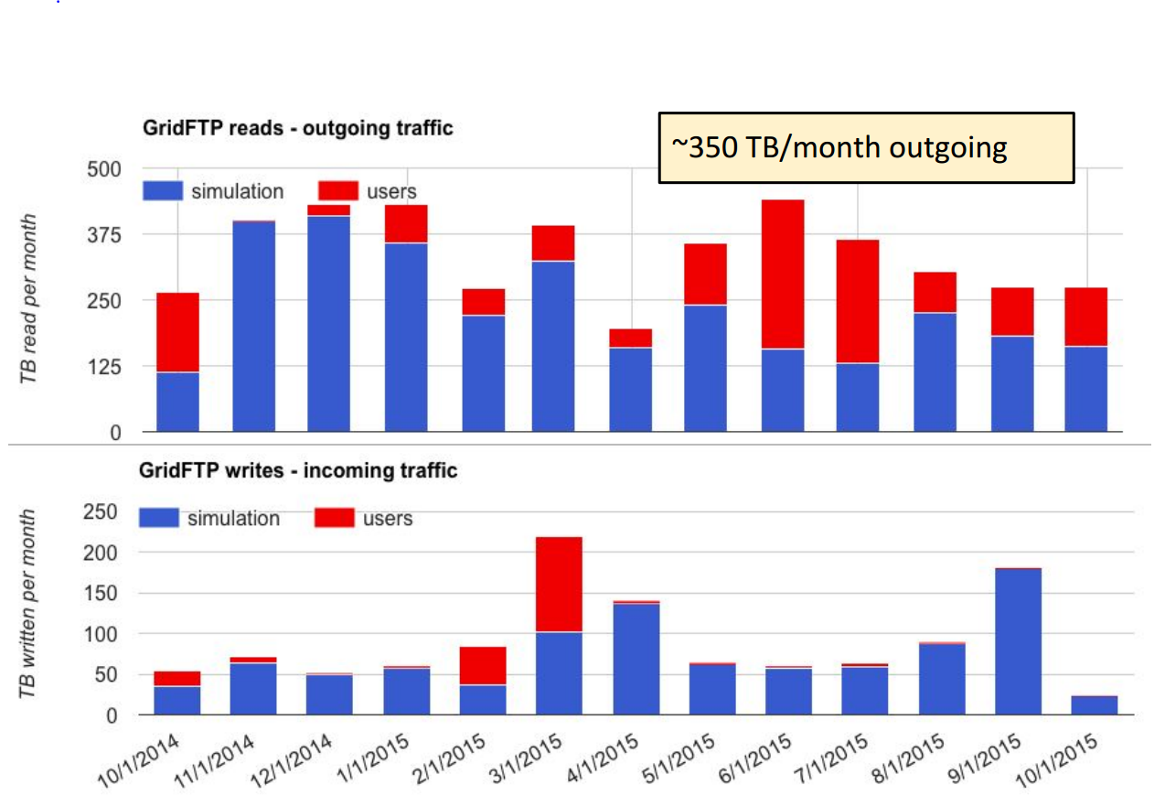
Data Access
Network infrastructure upgrades:
Dec-2014: GridFTP servers upgraded to 20 Gbps
Jan-2015: WIPAC internet 4 → 10 Gpbs
Apr-2015: WIPAC internet 10 → 20 Gbps

Slide 13
Computing Upgrades
During the construction phase and through most of the operations to date SPS / SPTS upgrades approx. every 3 years.
Recent experience with computing hardware has led to re-baseline to 4 year cycle
  Last upgrade was 2013/2014 season and included server upgrades as well as major DAQ hub SBC upgrade.
  Still ample processing headroom.
  We were asked by NSF to postpone major upgrades this season but it is unlikely that we would have do this anyway
Plan major SPS upgrades in years 1 and 4 of next M&O cycle.
For UW Data Warehouse – CPU/GPU upgrades staggered throughout 5 year cycle.

Slide 14
Long-Term Data Archiving
Until now:
  Tapes with 2 copies of RAW data from pole stored in cabinets
  PFFilt+Level2 files on disk at UW-Madison, replicated to DESY-ZN (tape)
A scalable multi-petabyte archive to be preserved for >10 years still needs to be based on tape.
  Tape facilities at UW-Madison not large enough ⇒ expensive.
  Tape facilities at DESY-ZN - OK
After the Collaboration week in May 2015, LBNL pointed out to the possibility of getting tape archive services from NERSC
  Since then, have been in contact to define the scope of the service pledge.
  A draft MoU with NERSC for archiving up to 6PB of IceCube data until 2019 is ready to be signed (thanks S. Klein and L. Gerhardt)

Slide 15
M&O Status

Slide 16
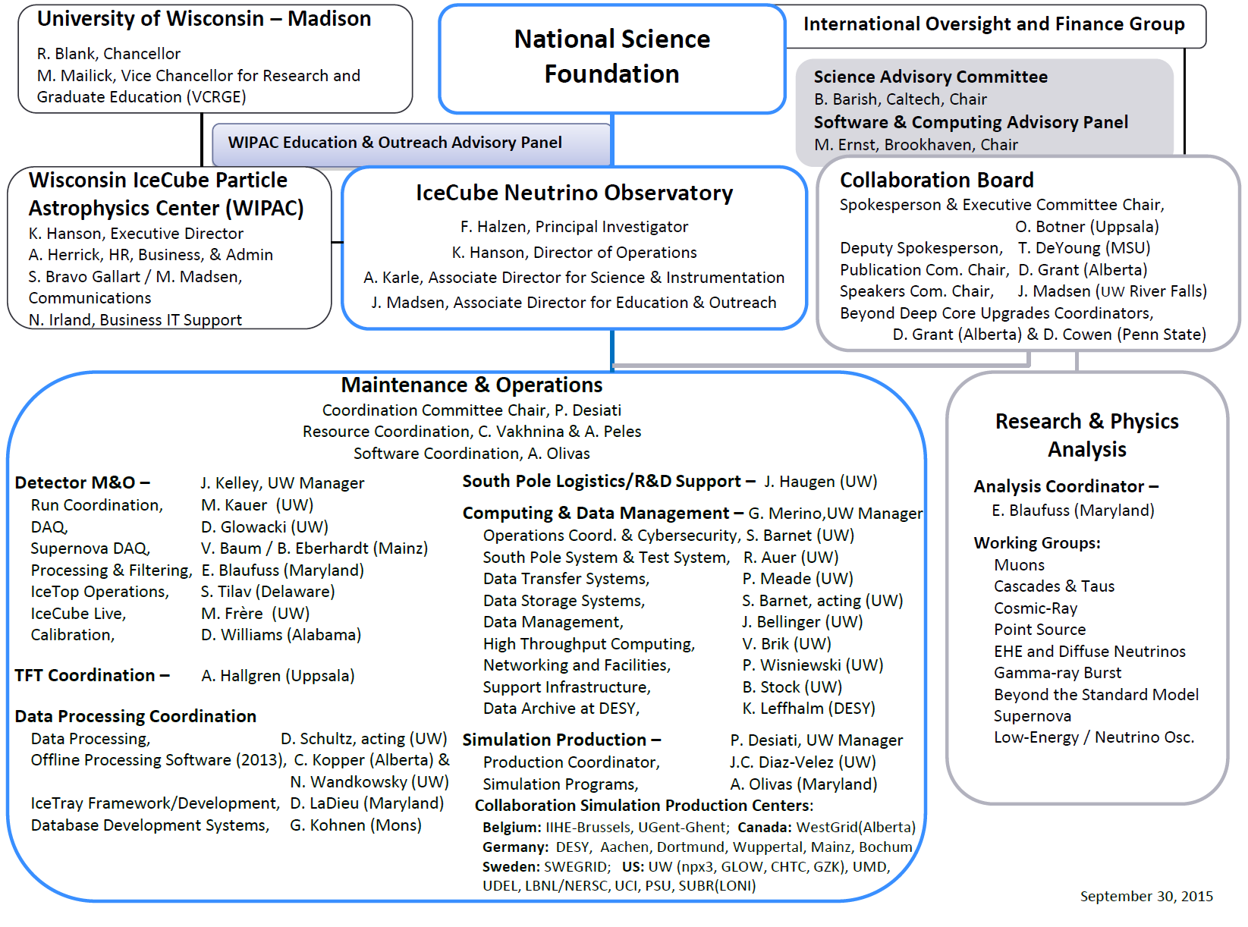
IceCube M&O Org Chart

Slide 17
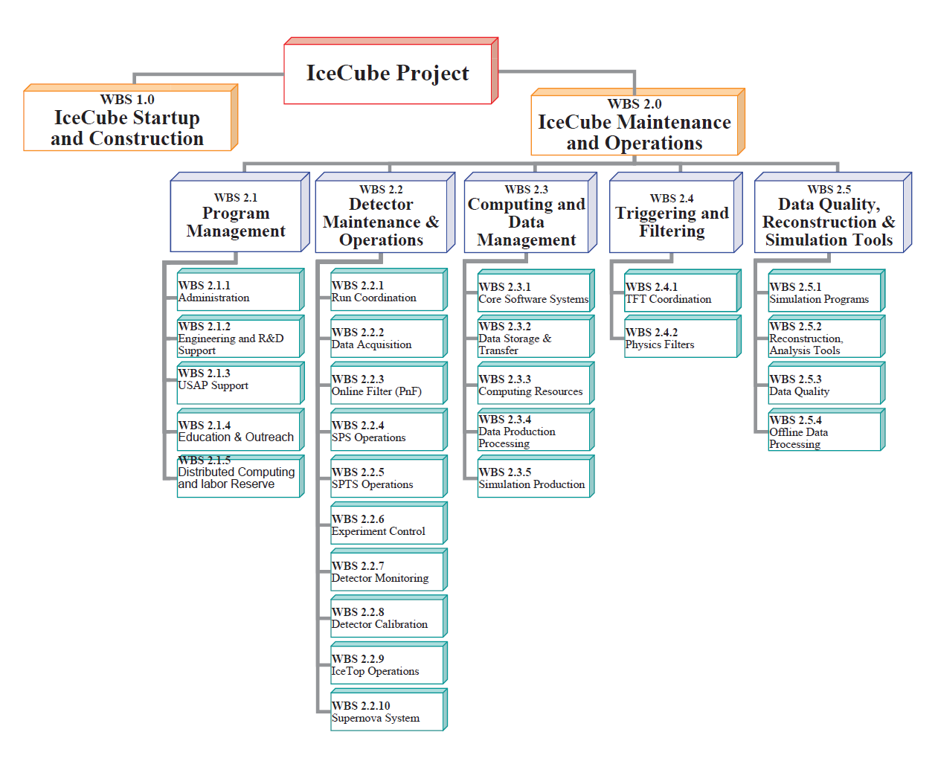
M&O Work Breakdown Structure

Slide 18
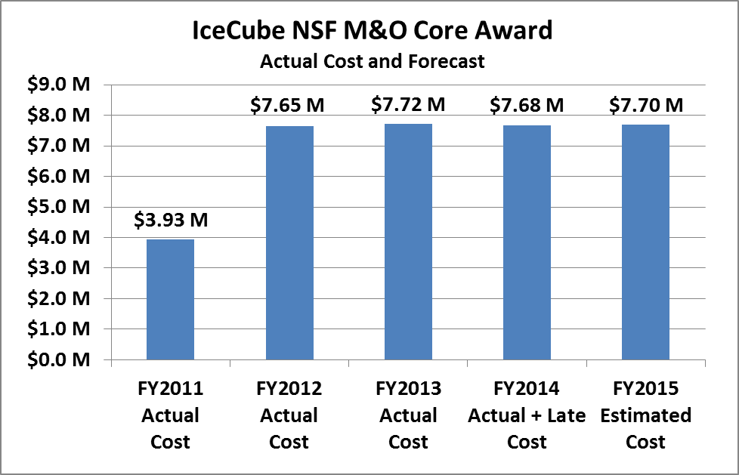
FY2011 – FY2015 M&O Profile
Still significant MREFC activity in FY11 – closeout happened in FY12

Slide 19
Sources of Funds
NSF M&O Core | This 5-Year NSF award mostly covers Core M&O tasks, travel, M&S and service agreements for UW and eight U.S. sub-awardee institutions and contribution to the M&O Common Fund.
NSF Base Grants | NSF IceCube analysis grants support M&O activities done by U.S. graduate students and postdocs.
U.S. Institutional In-Kind | Institutional contribution mostly covers M&O activities done by faculty members, different fellowships and university funded activities.
Non-US Institutional In-Kind | Institutional contribution from Non-U.S. collaborators including labor and travel and contribution to the M&O Common Fund.

Slide 20
M&O Common Fund
IceCube M&O Common Fund was created in April 2007, the start of formal operations:
To enable collaborating institutions to contribute to the costs of maintaining the computing hardware and software required to manage experimental data prior to processing for analysis
Each institution contributes based on the number of Ph.D. authors as indicated in its Institutional MoU
The science group members and M&O responsibilities in the MoUs are updated twice a year
As of April 1st 2010, the annual established rate per Ph.D. author is $13,650.

Slide 21
M&O Common Fund (contd.)
The M&O activities identified as appropriate for support from the Common Fund are those core activities that are agreed to be of common necessity for reliable operation of the IceCube detector and computing infrastructure.
The activities directly support the functions of:
  Winter Over technical support at the South Pole,
  Hardware and software systems for acquiring and filtering data at the South Pole,
  Hardware and software systems for transmitting data via satellite and tape to the UW data center,
  Systems for archiving the data in the central data warehouse at UW and UW Data Center Operations as listed in the Cooperative Agreement.
  IceCube Northern Hemisphere computing for simulation production, mass data filtering, etc.

Slide 22
M&O Common Fund Contributions
 | PhD. authors Apr ’12 | 2013 | PhD. authors Mar. ’14 | 2014 | PhD. authors Apr. ’15 | 2015
 |  | Planned |  | Planned |  | Planned
Total CF Planned | 124 | $1,693 | 129 | $1,777 | 137 | $1,868
U.S. Contribution | 69 | $942 | 67 | $915 | 73 | $996
Non-U.S. Contribution | 55 | $751 | 62 | $862 | 64 | $871
 |  | Actual |  | Actual |  | Actual
Total CF Contributions |  | $1,671 |  | $1,734
U.S. Cash Transfer |  | $942 |  | $915
Non-U.S. Cash Transfer |  | $671 |  | $680
Non-U.S. In-Kind |  | $58 |  | $139
Diff (Actual - Planned ) |  | -$21k |  | -$43k

Slide 23
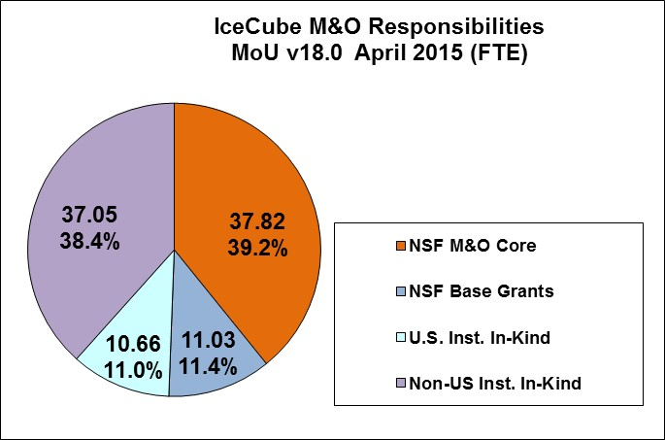
M&O Responsibilities
This is a slightly dated version from April, however situation is largely unchanged. The numbers are FTE (labor) on M&O tasks broken down by funding source.

Slide 24
Coordination of Labor Resources
IceCube Coordination Committee
  Paolo Desiati, Chair
  Maintain list of tasks with priorities from M&O coordinators (ops, sim, calibration, …)
  Orchestrate resources pledged by ILs through formal MoU process
  Proactively ensure manpower exists for operational support of IceCube
IceCube software coordinator appointed earlier this year – Alex Olivas. Strike team formed.
Since April MoU updating Paolo and Alex have been taking active role in MoU process, reviewing and working with ILs to make sure pledges are made in high-impact areas

Slide 25
Measuring M&O Success
The IceCube M&O program has been qualitatively very successful, doubtful that anyone believes otherwise
However, the metrics by which we measure our success are not well-defined except in a few areas: detector livetime, and simulation production are the two widely followed. CF contributions and expenditures are other examples.
Other metrics such number of publications and collaboration population are really collaboration metrics.
We need more metrics, management metrics and technical metrics which demonstrate that we are a forward-looking entity making progress towards goals in a quantifiable manner.

Slide 26
NSF 15-587
Management & Operation of the IceCube Neutrino Observatory 2016-2021

Slide 27
The Solicitation
Solicitation issued July 9, 2015 – close October 7.
Open bid – any US academic or non-academic, non-profit may propose.
As the bidding organization is now in question, how much emphasis should we place on WIPAC?
Budget limit: $35.000M - $7.000M per a with no escalation.

Slide 28
Sub-Awards
Institution | Major Responsibilities
LBNL | DAQ F/W, computing infrastructure, long-term archive
Penn State U | DAQ F/W, simulation production
U Del Bartol | IceTop maintenance, monitoring, calibration
U Maryland | Software coordination, IceTray framework, online filter, simulation software
U Alabama | Detector calibration
Michigan State | Simulation software, simulation production
UW River Falls | Education and outreach coordination

Slide 29
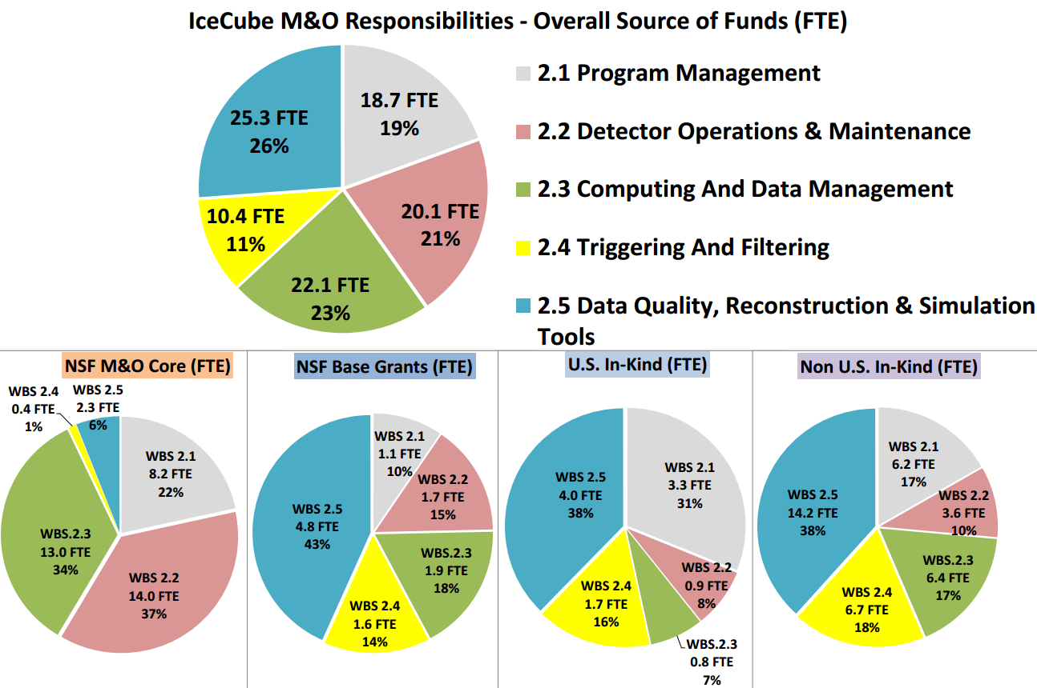
Budget – Overall Source of Funds

Slide 30
Breakdown via WBS

Slide 31
By Cost Category and WBS

Slide 32
M&O Computing Infrastructure Upgrades

Slide 33
The Future

Slide 34
IceCube Gen2
Clearly an MREFC – 360 M$ /wo/ contingency
Should we try to involve DoE?
We are trying to understand from our POs (GEO/PLR and MPS/PHY) when or whether they will support a proposal to do R&D work towards the goal of CDR.

Slide 35
An Optimistic Program Timeline

Slide 36
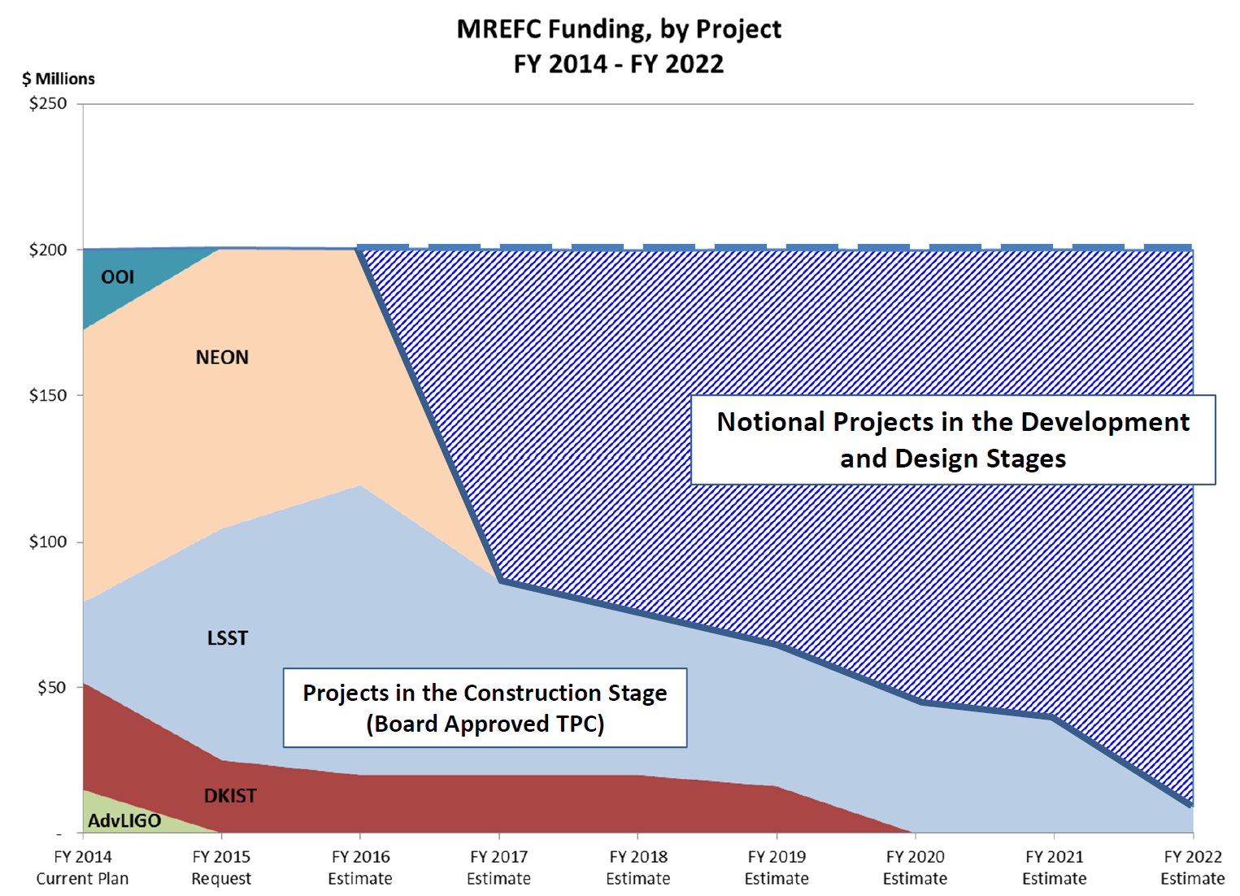
MREFC Profile

Slide 37
Meanwhile, in the Mediterranean
KM3NeT has several (2-3) lines of instrumentation ready to deploy early next year.
They have been on the ESFRI for 10 years, in danger of exit, and have submitted a proposal for EU funds to (a) remain on large infrastructure roadmap and (b) 95 MEUR funds to complete Phase 2 of the KM3NeT plan.
We have serious competition - in addition we are at risk of losing foreign funding opportunities due to lack of forward movement.

