Slide 1
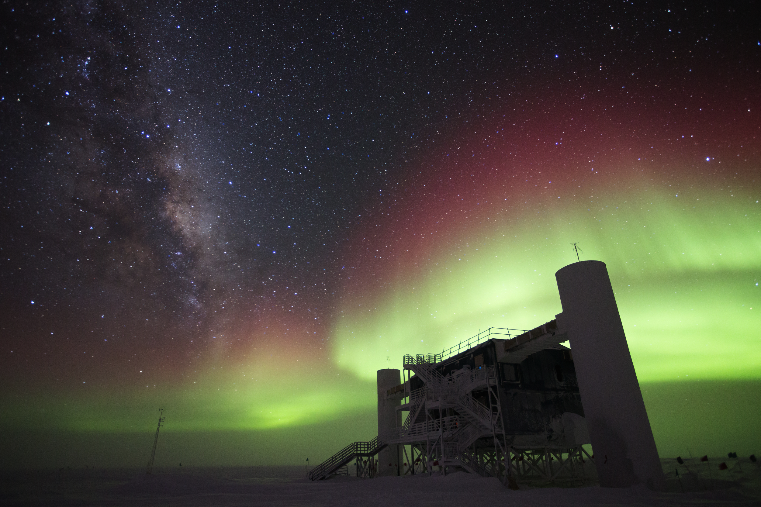

Exploring the Universe with Neutrinos
Silvia Bravo Gallart (WIPAC). February 2015
learn@icecube.wisc.edu // go.wisc.edu/a3qi7z
Notes:
The image shows the IceCube Lab at the South Pole. This building hosts the computers that collect, process and store the signals received from over 5,000 IceCube sensors buried in the ice. From here, data is sent to UW-Madison, WI, by satellite.
This is an actual image taken by IceCube winterover Ian Rees on July 30, 2014.
Read more about it here:
http://icecube.wisc.edu/news/view/250

Slide 2

IceCube: the strangest detector
IceCube is a cubic-kilometer-size detector, with more than 5,000 light detectors frozen in the Antarctic ice at depths between 1,500 and 2,500 meters.
IceCube was built to detect neutrinos produced in galactic and extragalactic sources.
With those neutrinos we will learn more about the most energetic and most violent objects in the Universe!

Slide 3
Notes:
IceCube is a telescope, since it’s looking for signals from outer space, but it is buried in the ice. It looks at the universe using neutrinos instead of light, therefore IceCube takes data all day (and night) long. Many high-energy neutrinos can cross the Earth without interacting with matter. This is why IceCube can see almost the whole sky, day and night. It’s a weird but also an amazing detector.
You can find more information about IceCube here:
http://icecube.wisc.edu/science/icecube/detector
http://icecube.wisc.edu/masterclass/learn
http://icecube.wisc.edu/masterclass/neutrinos

Slide 4
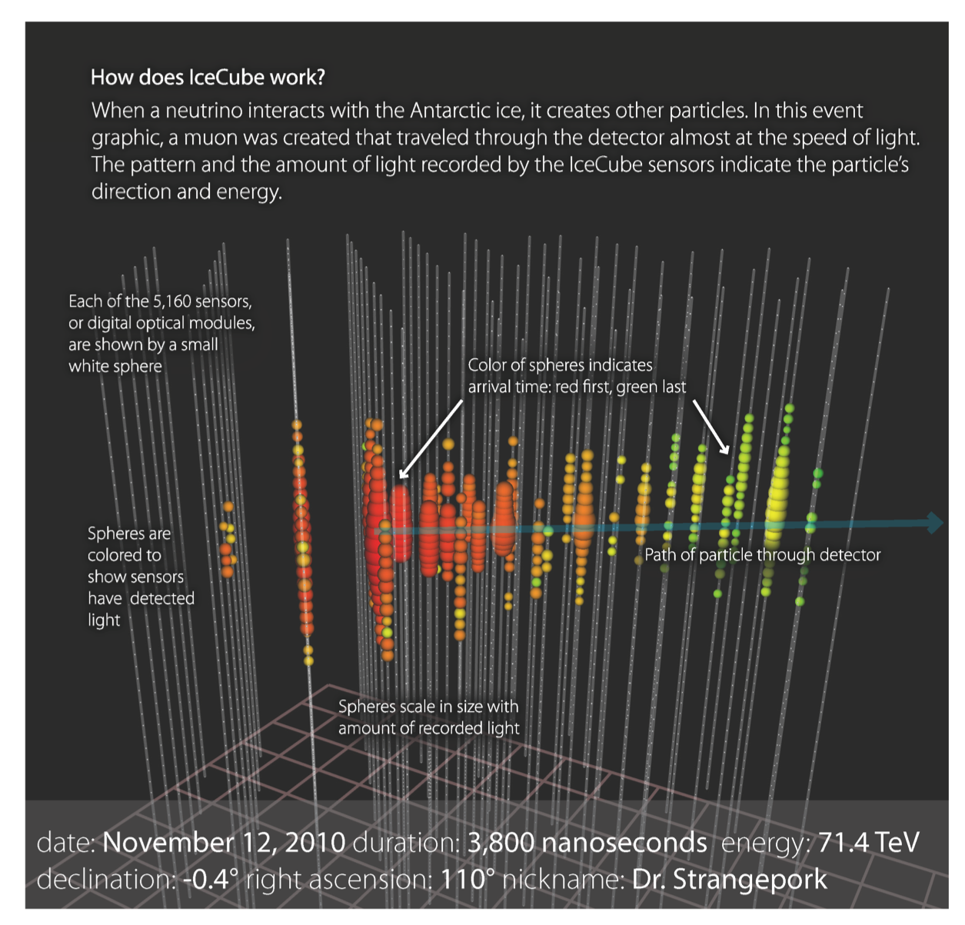
Notes:
We never observe a neutrino directly, but we see the secondary particles created by its interaction with the nucleus of a molecule of ice. Depending on the type of neutrino, an electron, a muon or a tau particle will be created. These are all charged particles that travel faster than light does in the ice and will create a shimmering blue light that IceCube can see.
The image above shows the result of a muon neutrino in IceCube. The secondary particle created in this case, the muon, crosses the detector, and therefore we can measure its direction and energy. These measurements will allow us to estimate the energy and direction of the incoming neutrino.

Slide 5
IceCube: a new era for astronomy
“Classical” Astronomy – electromagnetic spectrum from radio to X-rays.
Gamma-ray Astronomy – photons (light particles) with energies 10^10 larger than optical light.
Cosmic Rays – protons and heavier nuclei with energies up to several Joule, the highest energy particle energies observed in the Universe.
Neutrinos – tightly connected to cosmic rays and their sources, but neutral and not subject to deflection in magnetic fields (easier for “astronomy” because they point to their sources).

Slide 6
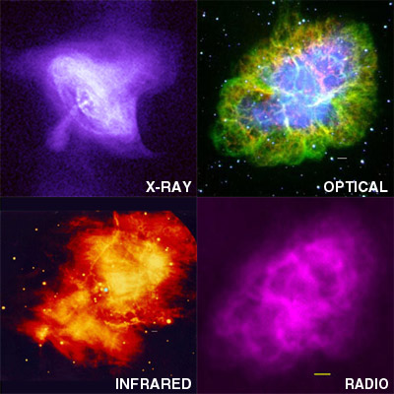
How will the universe look when we explore it using neutrinos?
Notes:
These pictures show the Crab Nebula, a supernova remnant, as seen with different telescopes and techniques. Every time man has used a new telescope, we have discovered new information about our universe: about it’s age, composition and evolution.
IceCube has shown that we can also explore the universe using neutrinos…we are now studying them to see what new things they tell us about the cosmos.

Slide 7
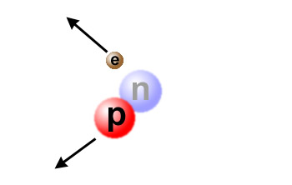
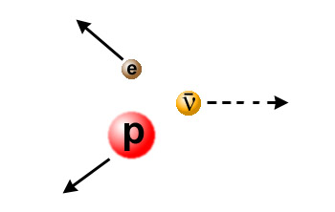
What are neutrinos?
The fundamental building blocks of atoms (and therefore of the world we know) are…
  neutrons
  protons
  electrons
In nuclear reactions, neutrons can turn into protons and vice versa by emitting an electron (β decay).
Something is missing…or total momentum is not conserved!
Notes:
This is the first of three slides explaining how neutrinos were discovered.
Neutrinos were first “detected” as the third component of a nuclear reaction. When a neutron turns into a proton it produces an electron, but these two secondary particles (proton and electron) do not account for the initial total momentum.

Slide 8
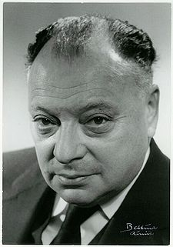
Neutrinos: the ghost particles
To “fix” the picture, Wolfgang Pauli invented a new particle that is very light and has no charge - the neutrino (the “small neutral one”).
Neutrinos usually escape unseen –they interact very little with anything, move almost at the speed of light and are difficult to catch.
“I have done a terrible thing, I have postulated a particle that cannot be detected.”
Wolfgang Pauli (1900-1958)
Notes:
Pauli envisioned a third particle in this nuclear reaction that would carry the “missing” momentum, and he called it the neutrino. This happened in 1930.
But the properties this new particle should have made it almost invisible.

Slide 9
Neutrinos: the ghost particles
The neutrino was eventually detected by Reines and Cowan in 1956 in a nuclear reactor, three years before Pauli’s death.
Pauli’s response: “Everything comes to him who knows how to wait.”
Neutrinos are produced wherever there are nuclear reactions, for example in the Sun. More than 50 trillion (50×10¹²) solar neutrinos pass through your body every second.
Neutrinos rarely interact - they just zip through almost everything - and are therefore hard to detect!
Wolfgang Pauli (1900-1958)
Notes:
A nice short explanation of what neutrinos are:
Explain it in 60 seconds: Neutrino, from Symmetry Magazine
http://www.symmetrymagazine.org/article/april-2010/explain-it-in-60-seconds-neutrino

Slide 10
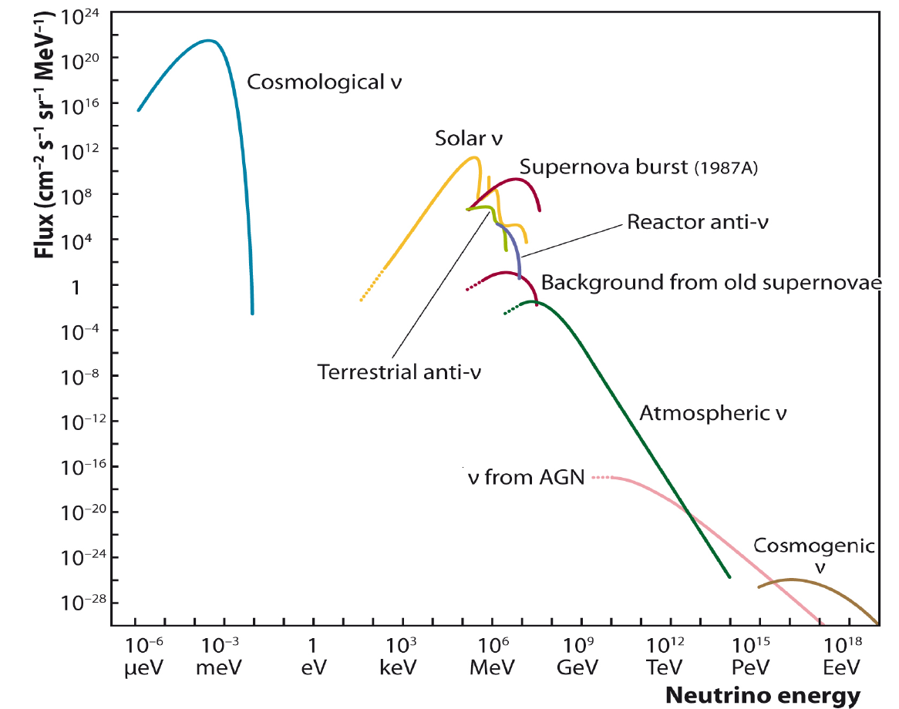
IceCube
Notes:
This image shows different sources of neutrinos and which are the ones that IceCube is looking for. Most neutrinos that reach us are produced by the Sun, but those are too low in energy and are not seen by IceCube.
IceCube was designed to detect the highest energy neutrinos, those with energies above a few TeV. Those neutrinos can only be produced by the interaction of cosmic rays with the atmosphere – which are then called atmospheric neutrinos – or they are produced beyond our Solar System, and are then called cosmic neutrinos.

Slide 11
cosmic ray
…K, charm
Notes:
This image shows the different types of particles that IceCube can detect.
Cosmic rays are high-energy charged particles that constantly bombard the Earth from all directions. They are created in powerful cosmic engines and reach energies higher than any other particle in nature or in a lab. The highest-energy cosmic rays have been measured to have an energy over a million times the energy at the LHC (the particle accelerator at CERN, Geneva, Switzerland, so far the most powerful accelerator made by humans). Most cosmic rays are protons, but they also include heavier nuclei as well as electrons.
Cosmic rays are charged and thus bend on their way to Earth due to the magnetic fields in the galaxy and in intergalactic space. When cosmic rays reach Earth’s atmosphere, they create a shower of particles including neutrinos and muons. These are called atmospheric neutrinos and muons, since they are created in the Earth’s atmosphere. IceCube sees atmospheric neutrinos from all directions, since they can cross through the Earth without interacting. However, IceCube sees only those atmospheric muons created in the Southern Hemisphere, and only a fraction of them in fact, since muons are absorbed after traveling a few kilometers inside the Earth.
IceCube also sees cosmic or astrophysical neutrinos, created beyond the Solar System, that reach the Earth bringing us information about the far and extreme universe. Neutrinos do not bend because they are neutral particles. We think that the same cosmic environment that creates cosmic rays also produces high-energy neutrinos.

Slide 12
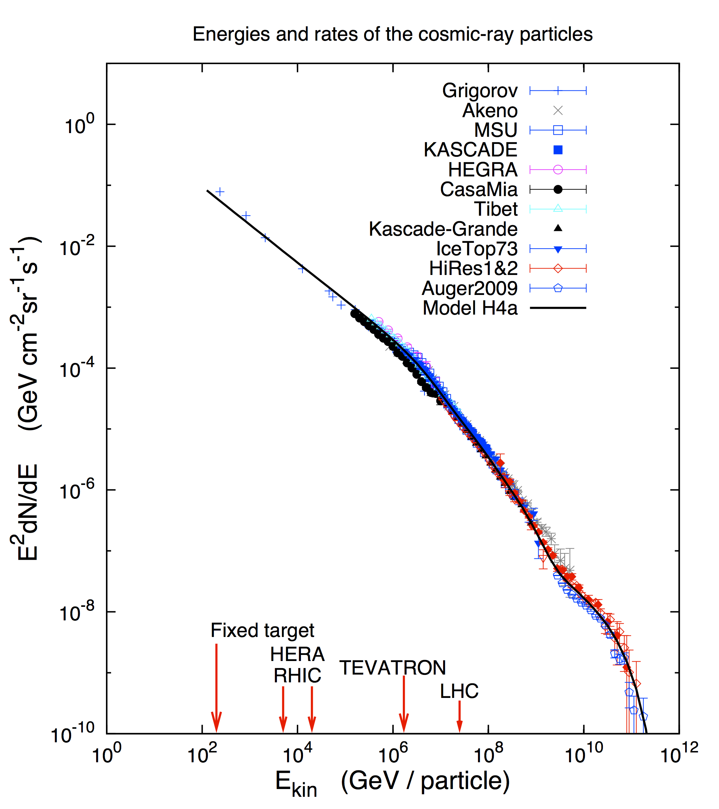
Cosmic-ray energy spectrum
Origins of cosmic rays at energies above GeV?
Supernova remnants
Gamma-ray bursts
Active galactic nuclei
Notes:
The energy spectrum of cosmic rays is well studied, but their origin is a 100-year-old conundrum. How and can where nature accelerate protons – most cosmic rays are protons – to those extreme energies?
Cosmic rays were the first particles to be names “cosmic messengers,” since they can bring us information from the far and extreme universe, from the powerful cosmic engines where protons can be accelerated to energies around and above 10²⁰ eV.
Scientists think that cosmic objects such as supernovas, gamma-ray bursts or active galactic nuclei can be the sources of cosmic rays.
By learning more about cosmic rays, scientist expect to learn more about the insides of these powerful cosmic objects, the most extreme environment in our universe.

Slide 13
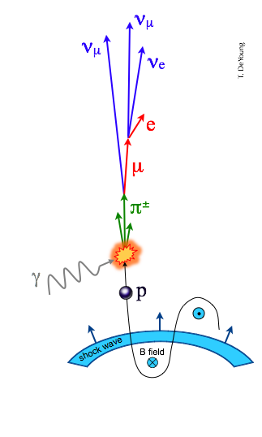
Cosmic messengers
Cosmic rays are not the only messengers from high energy sources - a cosmic ray source is also a beam-dump.
Cosmic rays inevitably interact with radiation and gas surrounding their source, e.g.,
Energy escaping the source is distributed among cosmic rays, gamma rays, and neutrinos.
Notes:
Cosmic rays are not the only cosmic messenger. Neutrinos and gamma rays can also tell us about the most extreme places in the universe.
In the image, we have a schematic of a cosmic source, such as a black hole.
The source accelerates protons to very extreme energies. These protons will interact with the radiation and/or gas around the source and will create secondary particles called pions. Pions are hadrons, as protons are, since they are made up of quarks. Protons, and neutrons, are made up of three quarks, while pions are made up of two quarks.
Charged pions will create neutrinos, as shown in the image, while neutral prions will create gamma rays.

Slide 14
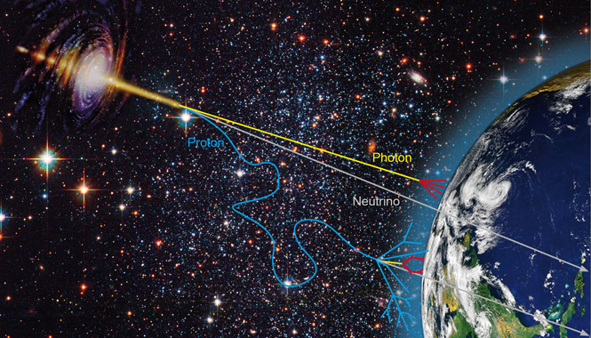
Cosmic messengers
Notes:
The image shows the three types of cosmic messengers: cosmic rays (displayed as a proton), gamma rays (photon) and neutrinos.
As we had seen before, when cosmic rays reach the Earth they do not point to their source since they have been bent while crossing magnetic fields in our galaxy and beyond.
Gamma rays will reach Earth’s atmosphere in a straight line from their sources, but they will immediately interact when penetrating in the atmosphere. Photons, the carriers of the electromagnetic force, interact with any charged particle. If we want to learn about the incoming gamma ray, we need to detect the shower of secondary particles that they create. In fact, there are special telescopes that do so.
Neutrinos, neutral particles that only interact through the weak force, are the only cosmic messengers that will travel without disruption from their sources to detectors on Earth.

Slide 15
Neutrinos as comic messengers
Neutrinos are the ideal
“messenger particle:”
Neutrinos propagate in a straight line and are not easily absorbed – they can get away from the source
However, they are not easily “absorbed” in detectors, either… we need km³ size detectors!
Notes:
Neutrinos are great at reaching the Earth without disruption, but then how can we detect them when they cross our detector?
We need a huge detector, because only one in a million neutrinos will interact.
We need a transparent and dark detector, so that we can observe the effect of the neutrino interaction.

Slide 16
Requirements for a neutrino detector
Large detector volumes – on the order of~ km³ if we want to detect a few neutrinos from astrophysical sources per year.
Neutrinos must interact near or in the detector and produce a particle that can be detected, for example a muon.
The detector must be shielded from the enormous background of atmospheric muons, so it needs to be deep below some absorbing material.
At the same time, the absorbing material must allow for detection of light from particles created by neutrinos.

Slide 17
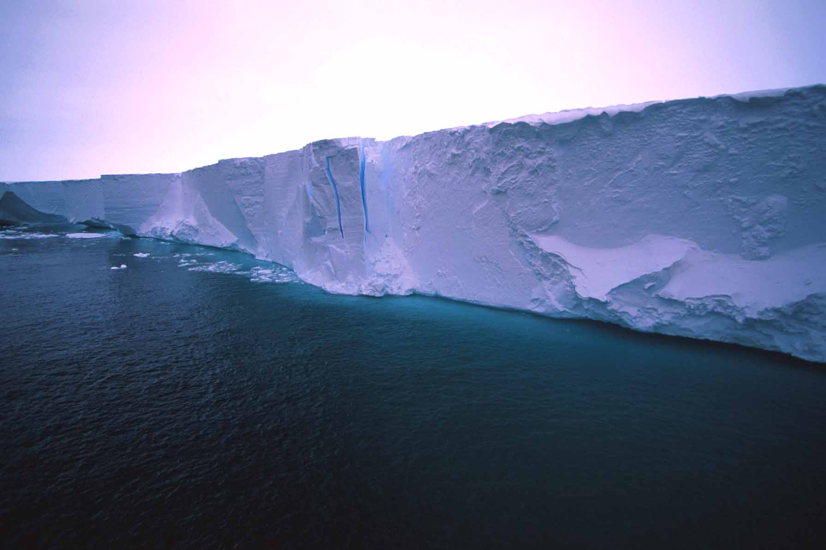
Blue light travels 200+ meters in ice…

Slide 18
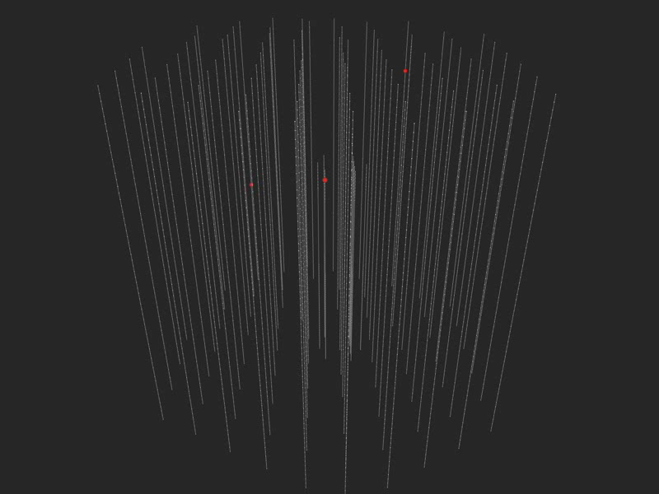
Notes:
IceCube observes neutrinos only indirectly. Very high energy neutrinos that have traveled through the Universe and accidentally crashed into an atomic nucleus in the ice will be observed thanks to the interaction of secondary particles with the ice. The nuclear reaction made by a single neutrino produces a stream of particles that create a burst of blue light, known as Cherenkov light (see video) This shimmering light is detected by an array of optical light sensors, called DOMs, frozen within the ice.
Read more here:
http://icecube.wisc.edu/masterclass/neutrinos

Slide 19
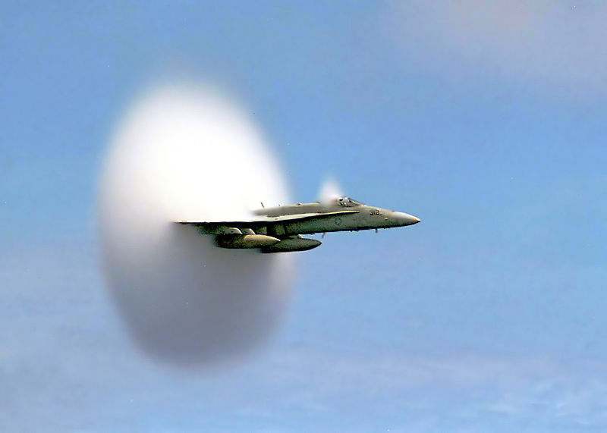
Cherenkov light
… charged particles traveling in a medium faster than the speed of light in that medium.
optical equivalent to supersonic boost

Slide 20
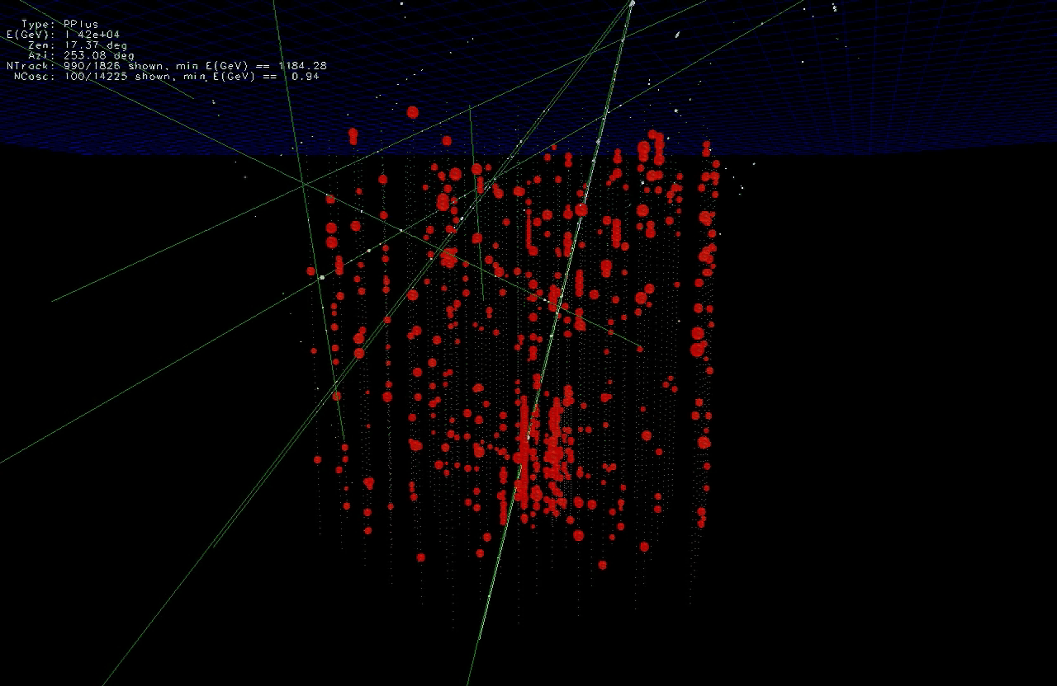

Notes:
But, as we explained before, IceCube sees not only astrophysical or cosmic neutrinos, which are a few per year.
It also sees atmospheric muons and neutrinos…which are much more abundant.
The video shows 10 miliseconds of data in IceCube

Slide 21
… you looked at 10 msec of data!
muons detected per year:
atmospheric* m ~ 10¹¹
atmospheric** n → m ~ 10⁵
cosmic n → m ~ 10
* 2700 per second ** 1 every 6 minutes
Notes:
Muons are the most abundant particles in IceCube. They are produced by the interaction of cosmic rays in the atmosphere, by the interaction of atmospheric muon neutrinos in the ice, and by the interaction of astrophysical muon neutrinos. Atmospheric neutrinos are mainly muon neutrinos. Cosmic neutrinos will come in equal ratios of electron, muon and tau neutrinos.
IceCube sees one atmospheric neutrino per every millon muons. And one cosmic neutrino per every few thousand atmospheric neutrinos! As you can guess, detecting cosmic neutrinos is not easy!

Slide 22
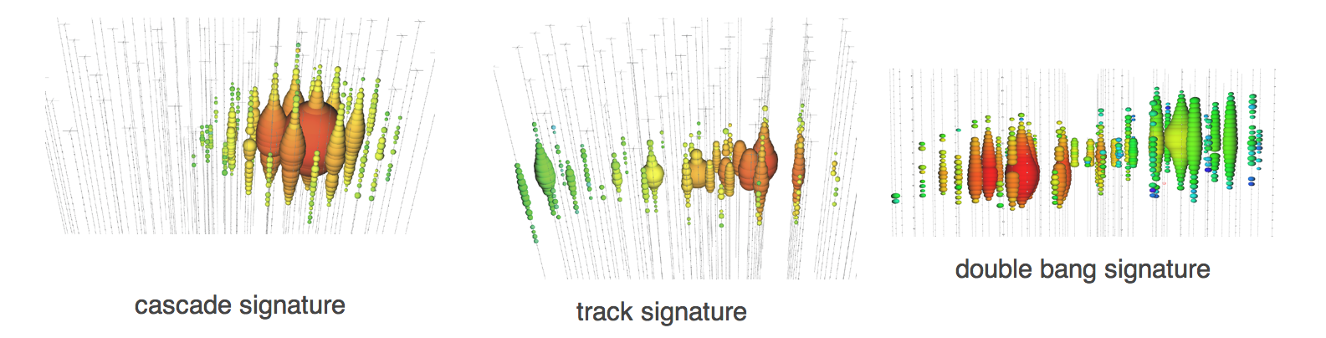
Neutrinos in IceCube
Left: cascade pattern is a typical signature for an electron neutrino, which interacts in the detector producing a shower of particles.
Center: When a muon neutrino interacts in IceCube, it creates a muon as a secondary particle, which crosses the whole detector leaving a track of light in the detector.
Right: The third signature, right, also called the double-bang signature, is produced by a tau neutrino that interacts with the ice creating a hadronic shower and a tau, which decays almost immediately creating a second shower of particles.
Notes:
The image shows three typical signatures, or patterns, in IceCube.
Remember: Red means that light was detected earliest in those IceCube sensors. A bigger sphere tells us that more light was detected in those sensors.
So far, we have never seen a tau-neutrino signature, even though we know that a third of the cosmic neutrinos should be tau neutrinos.

Slide 23
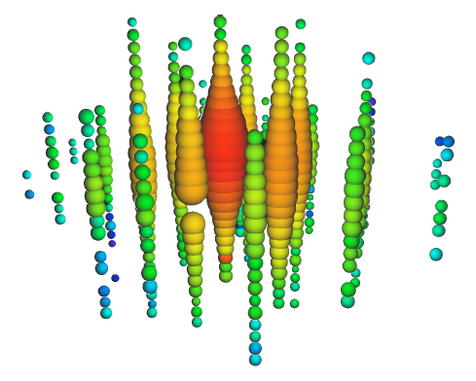
The highest energy neutrinos
PeV neutrinos,
an energy 1,000 times the particles accelerated at LHC
Notes:
IceCube was completed in 2010. In 2013, IceCube announced that it had observed neutrinos with energies above one PeV (a petaelectronvolt, or one thousand times the particles accelerated at the LHC).
Those neutrinos are astrophysical neutrinos, i.e., they were created beyond our Solar System. The first results reported 28 very high energy neutrinos, and in 2014 a few dozen more were presented.
This discovery showed that cosmic neutrinos exist and that we can use them to explore our universe. However, we still have only a few. We need many more to have detailed views of our universe that will allow us to learn new information about the most extreme places in the cosmos.

Slide 24
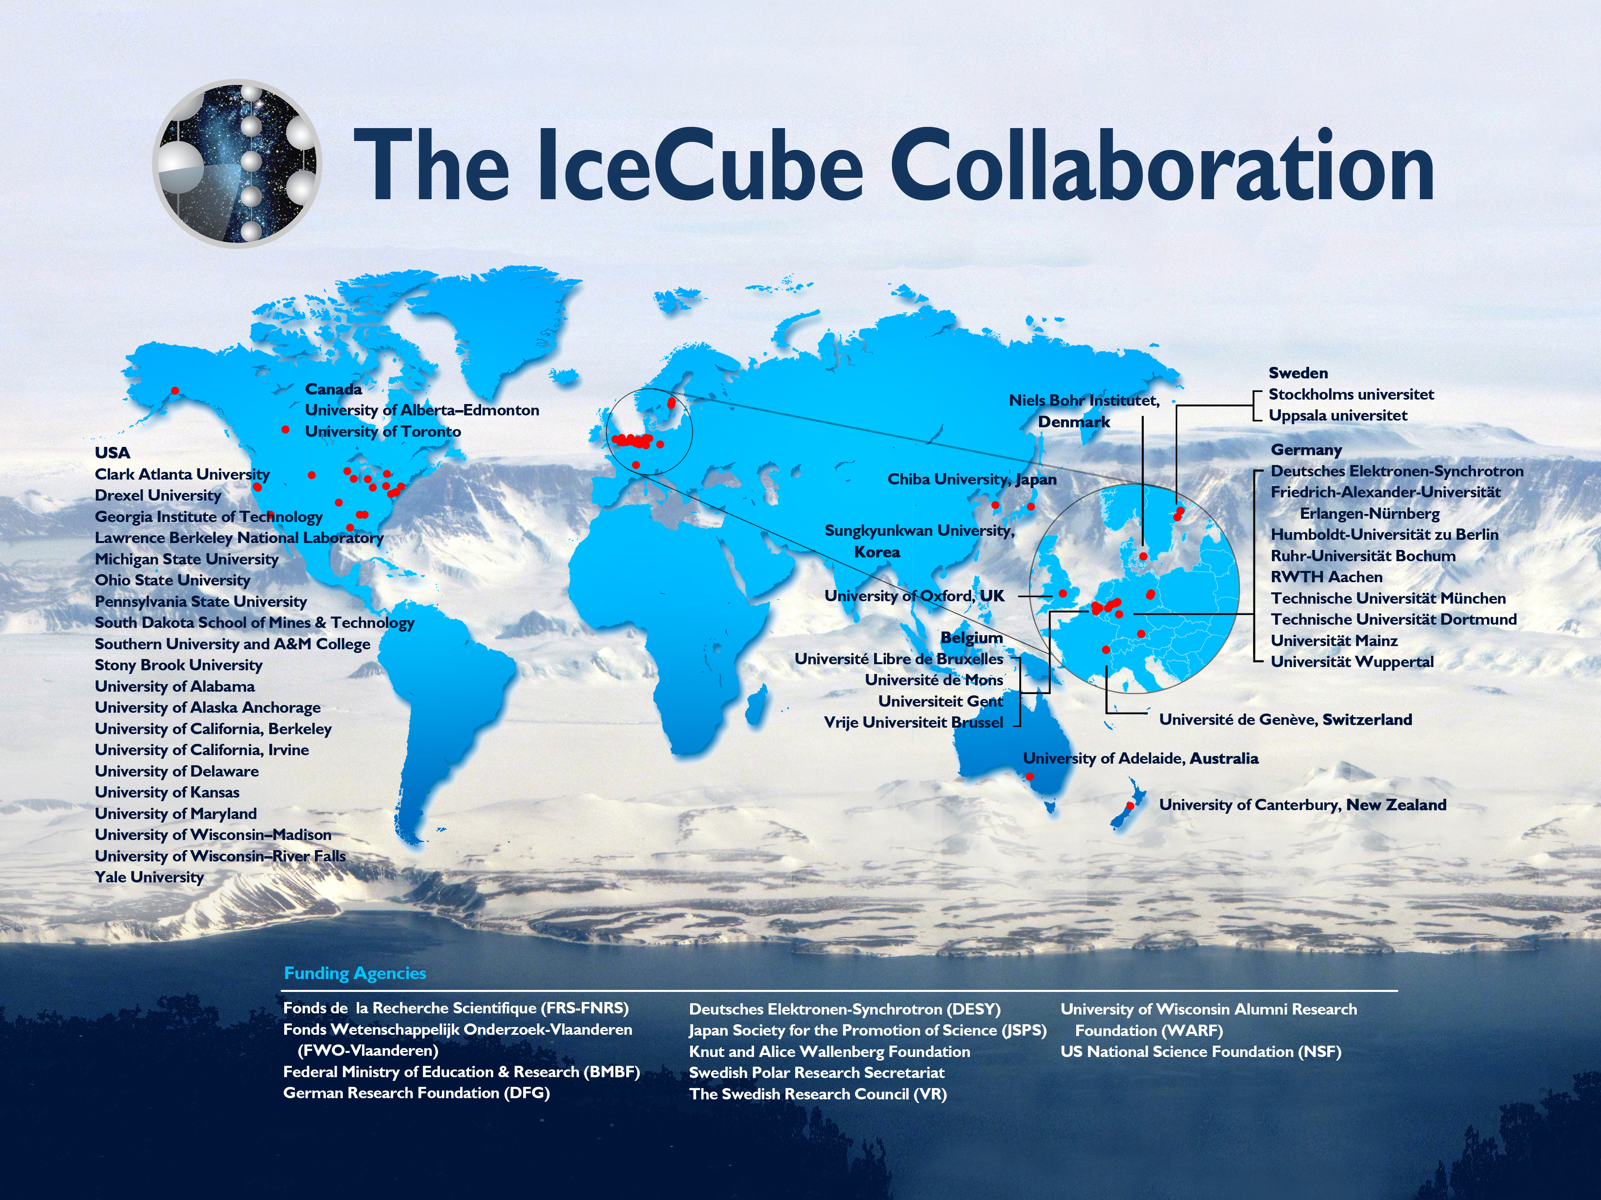
Notes:
IceCube science is run by an international collaboration of over 300 scientists in 44 institutions in 12 countries. UW–Madison is the lead institution.

