Slide 1
Astrophysics @WIPAC

Slide 2
From Astronomy to Astrophysics
“Classical” Astronomy – electromagnetic spectrum from radio to X-rays.
Gamma-ray Astronomy – photons (light particles) with energies 10¹⁰ larger than optical light.
Cosmic Rays – protons and heavier nuclei with energies up to several Joule, the highest energy particle energies observed in the Universe.
Neutrinos – tightly connected to cosmic rays and their sources, but neutral and not subject to deflection in magnetic fields (= easier for “astronomy” because they point to their sources).

Slide 3

Astrophysics
“Classical” Astronomy – electromagnetic spectrum from radio to X-rays.
Gamma-ray Astronomy – photons (light particles) with energies 10¹⁰ larger than optical light.
Cosmic Rays – protons and heavier nuclei with energies up to several Joule, the highest energy particle energies observed in the Universe.
Neutrinos – tightly connected to cosmic rays and their sources, but neutral and not subject to deflection in magnetic fields (= easier for “astronomy” because they point to their sources).

Slide 4
Cosmic Rays the highest energy particles
Cosmic rays are charged particles (protons or heavier nuclei) that continuously rain down on Earth from outer space.
A small fraction of them have energies in excess of several Joules, which makes them the highest energy particles in the known Universe.
Where do they come from? Do they point back to their sources? Can we do astronomy with these particles?
Notes:
Cosmic rays are charged particles (protons or heavier nuclei) that continuously rain down on Earth from outer space.
A small fraction of them have energies in excess of several Joules, which makes them the highest energy particles in the known Universe.
Where do they come from? Do they point back to their sources? Can we do astronomy with these particles?

Slide 5
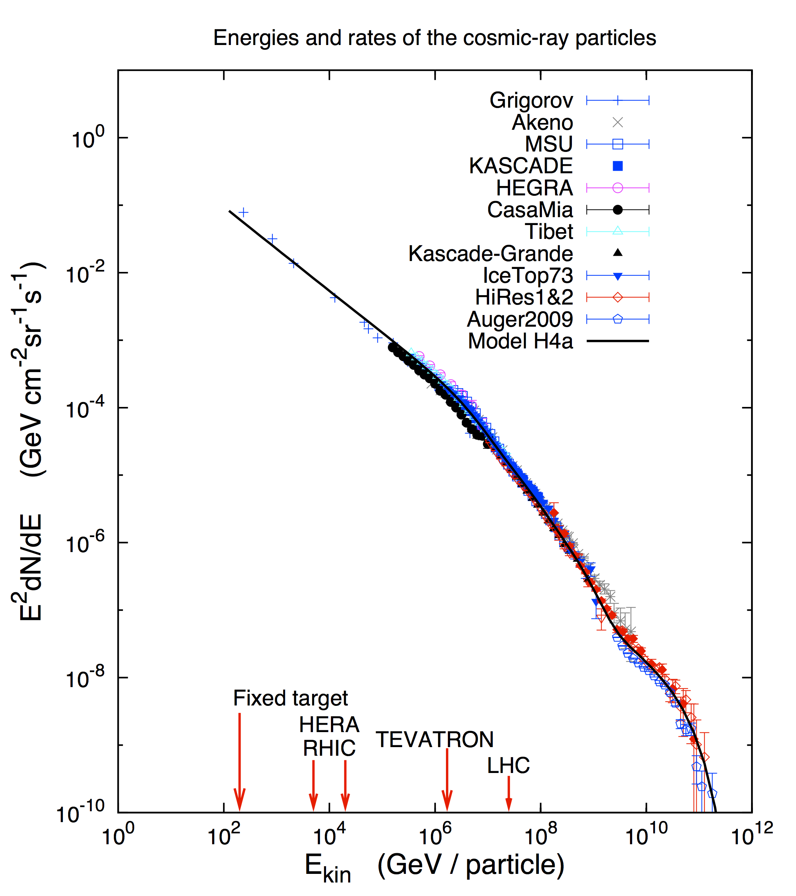
Cosmic Rays Energy Spectrum
The origin of cosmic rays at energies above GeV is unknown - no astrophysical object has ever been definitively identified as an accelerator of high energy nucleons.

Slide 6
Origin of Cosmic Rays
Galactic origin
- Supernovae
- …
Extragalactic origin
- Active Galactic Nuclei
- …
Knee

Slide 7
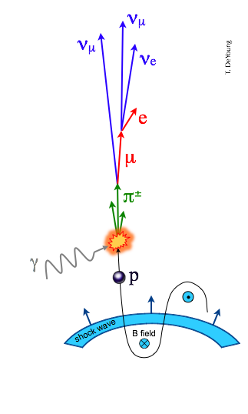
Messenger Particles from the extreme universe
Cosmic rays are not the only messenger from high energy sources - a cosmic ray source is also a beam-dump.
Cosmic rays inevitably interact with radiation and gas surrounding their source, e.g.
Energy escaping the source is distributed among cosmic rays, gamma rays, and neutrinos.

Slide 8
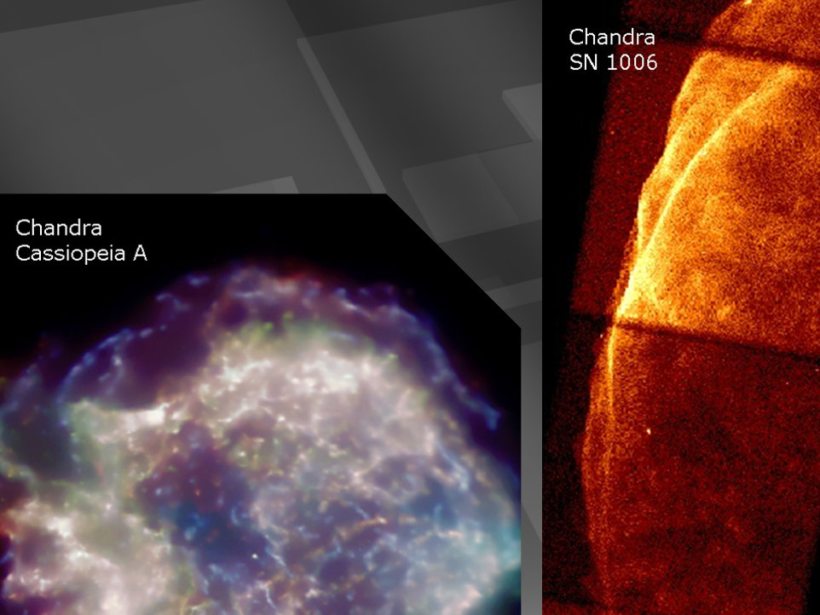
supernova remnants

Slide 9

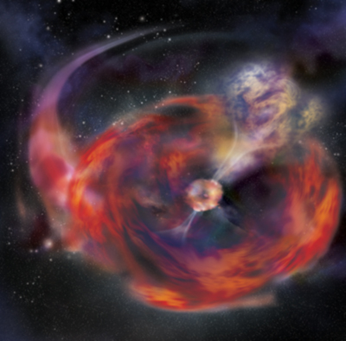

…and if the star collapses to
a black hole…
gamma ray burst
happens in seconds
not thousands of years
beamed along the spin
axis of the black hole
simulation not image

Slide 10
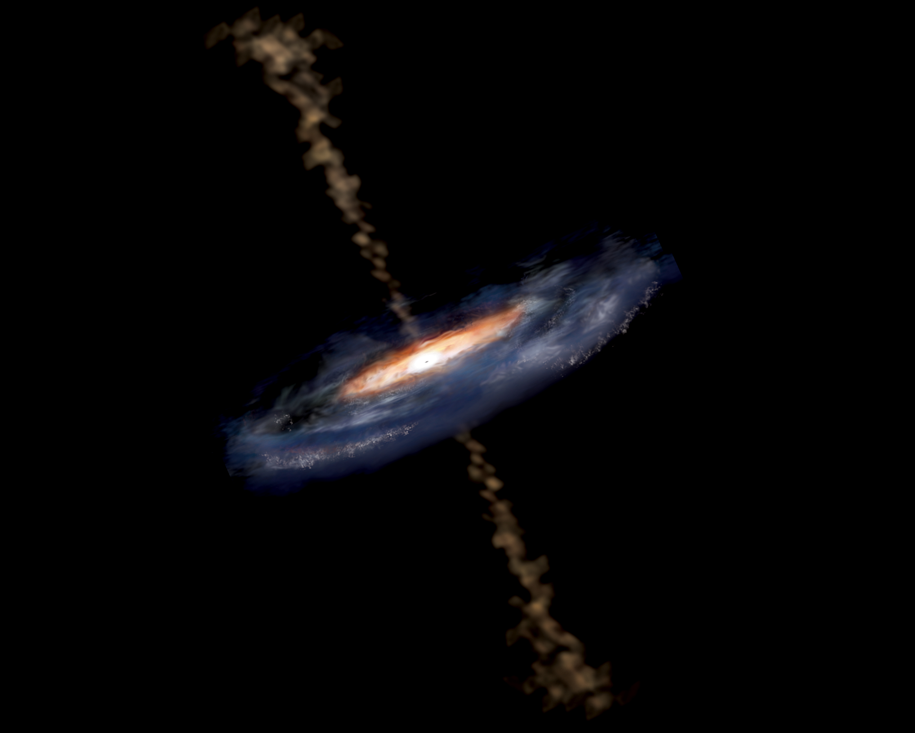
active galaxy particle flows near supermassive black hole

Slide 11
Astronomy with Neutrinos
Neutrinos are the ideal “messenger particle:”
  Neutrinos propagate in a straight line and are not easily absorbed - they can get away from the source!
  However, they are not easily “absorbed” in detectors, either… we need km³ size detectors!

Slide 12
Requirements for a Neutrino Detector
Large detector volumes - of order ~ km³ if we want to detect a few neutrinos from astrophysical sources per year…
Neutrinos must interact near or in the detector and produce a particle that can be detected, for example a muon.
The detector must be shielded from the enormous background of atmospheric muons, so it needs to be deep below some absorbing material.
At the same time, the absorbing material must allow for detection of light from particles created by neutrinos.

Slide 13
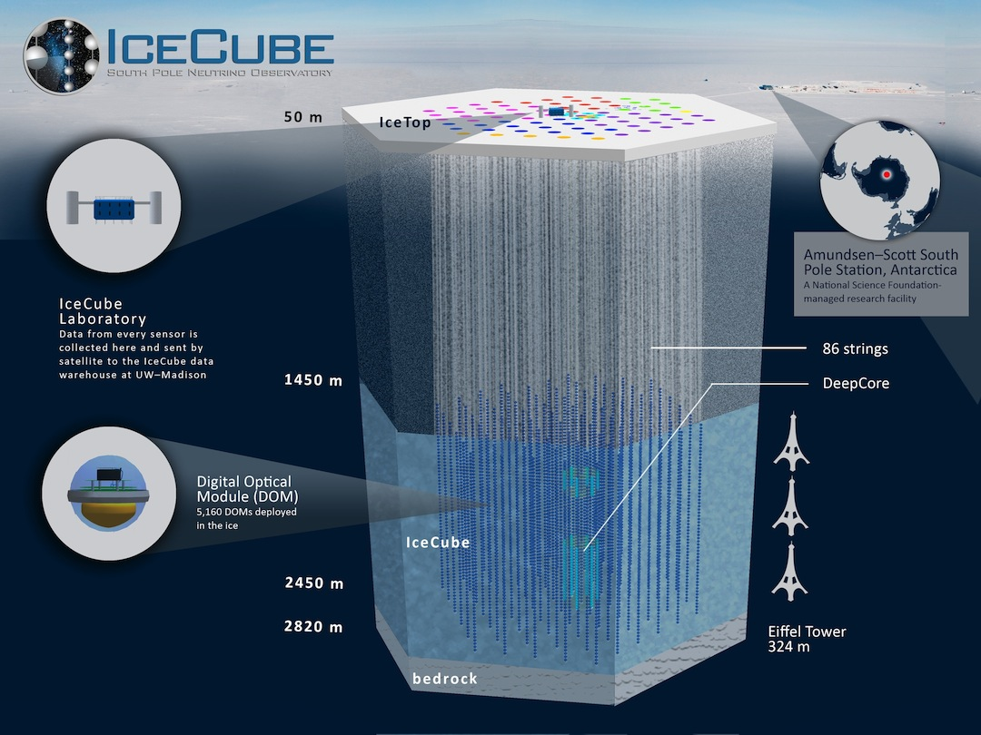

Slide 14
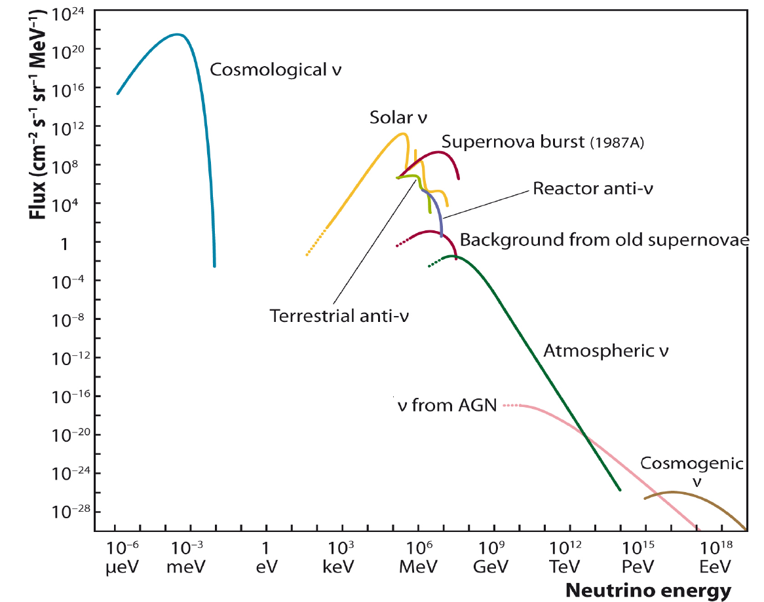
Neutrino production
IceCube
Neutrinos are produced wherever there are nuclear reactions. More than 50 trillion (50×10¹²) solar neutrinos pass through your body every second.
Neutrinos rarely interact - they just zip through almost everything - and are therefore hard to detect!

Slide 15
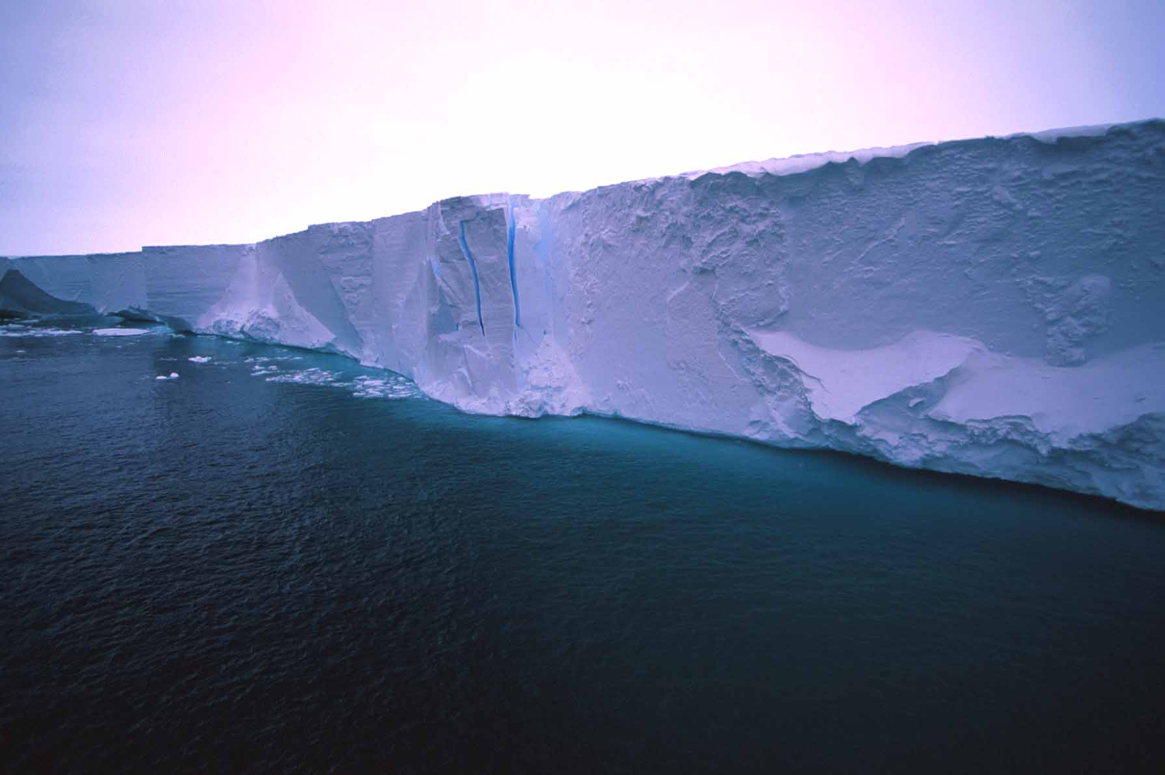
Blue light travels 200+ meters in ice…

Slide 16
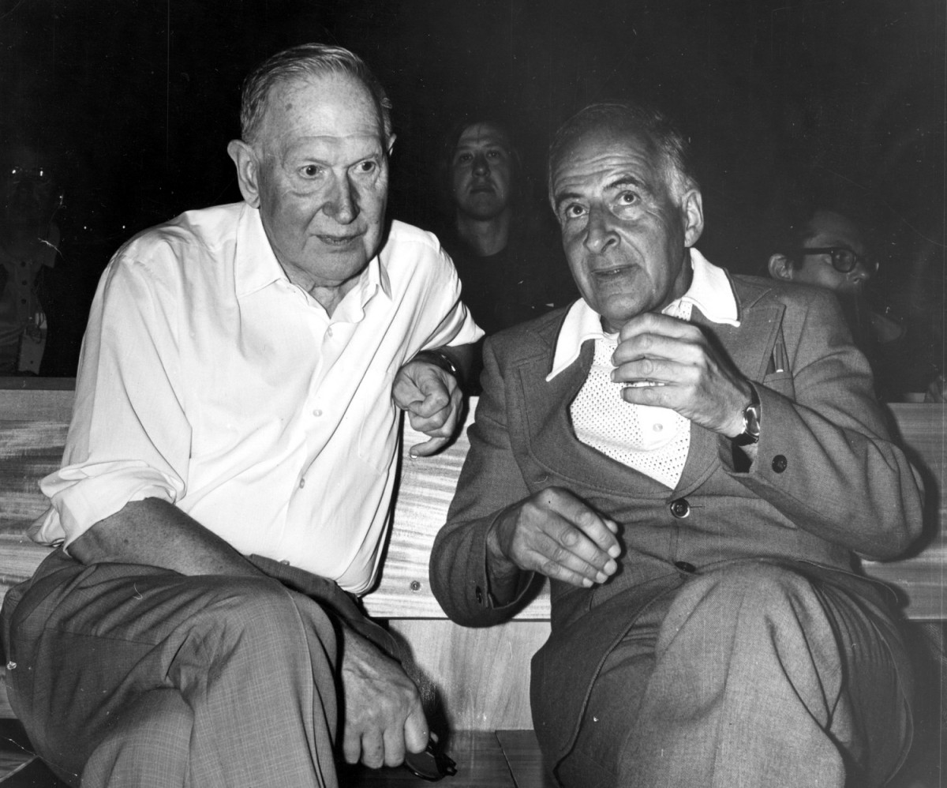
M. Markov
1960
B. Pontecorvo
M.Markov :
we propose to install detectors
deep in a lake or in the sea and
to determine the direction of
charged particles with the help
of Cherenkov radiation.

Slide 17
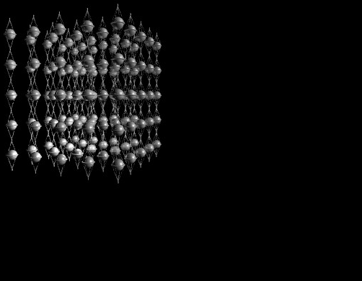
IceCube Concept
The muon produces Cherenkov light, and photomultipliers capture and map the light.
μ
ν_{μ}

Slide 18
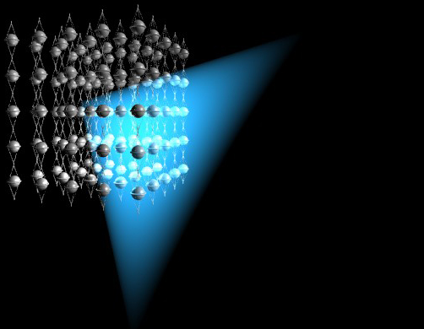
IceCube Concept
The muon produces Cherenkov light, and photomultipliers capture and map the light.
μ
ν_{μ}

Slide 19
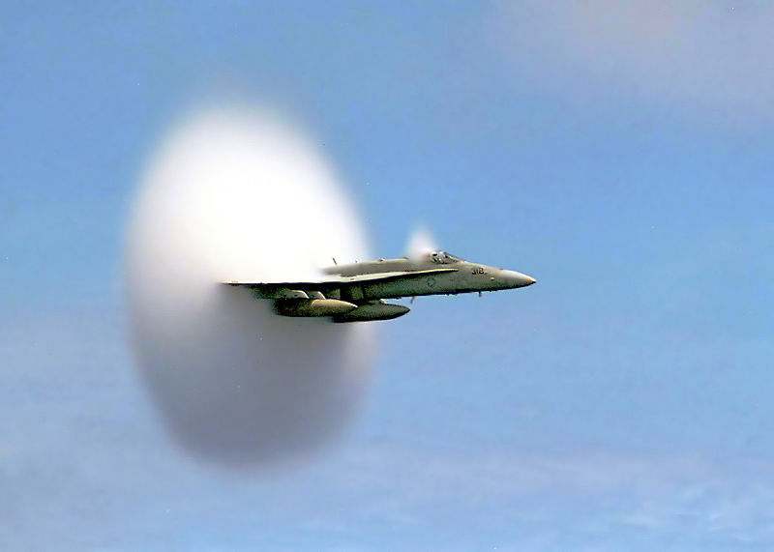
Cherenkov Light
… is produced by charged particles traveling faster than the speed of light.
optical equivalent to supersonic boost

Slide 20
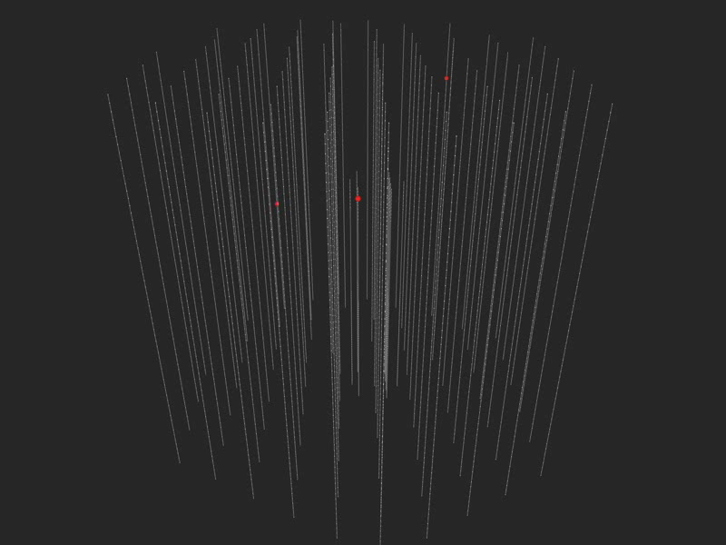

Slide 21

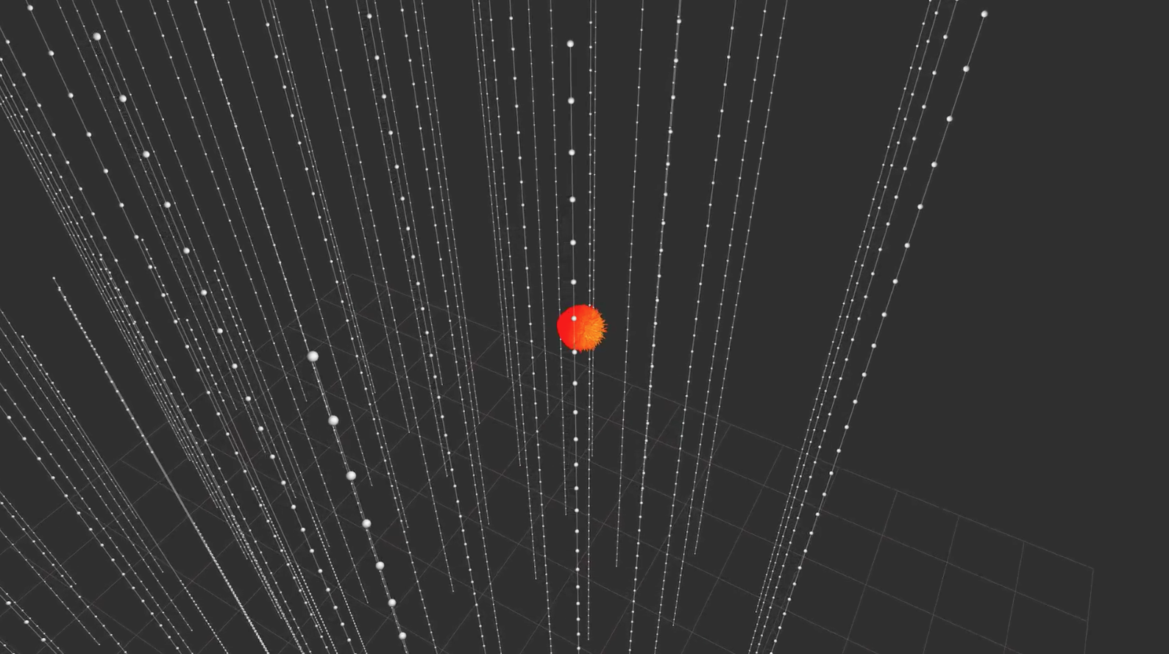

Slide 22
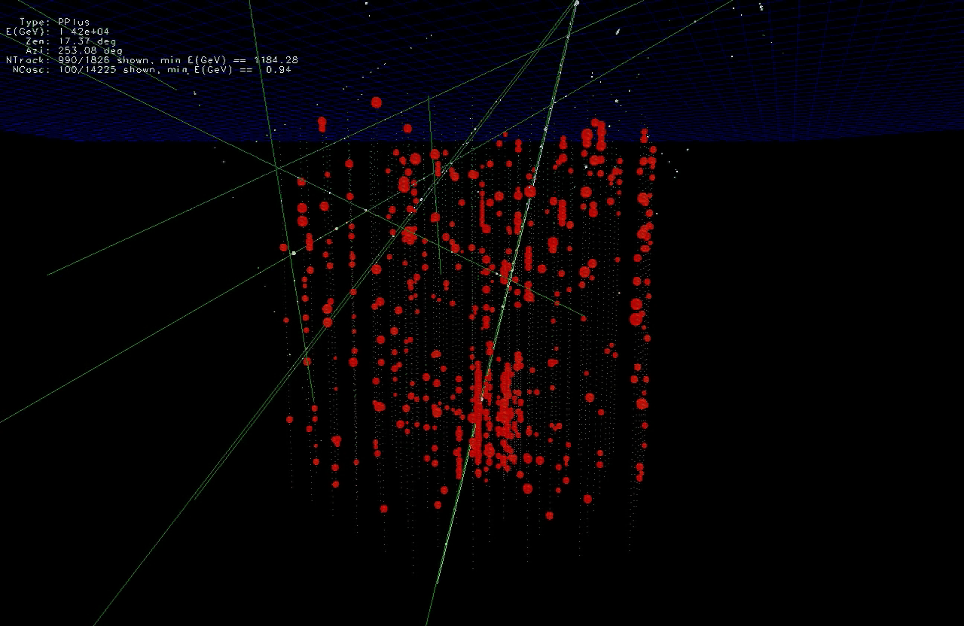

Slide 23
… you looked at 10msec of data !
muons detected per year:
atmospheric* m ~ 10¹¹
atmospheric** n → m ~ 10⁵
cosmic n → m ~ 10
* 2700 per second ** 1 every 6 minutes

Slide 24
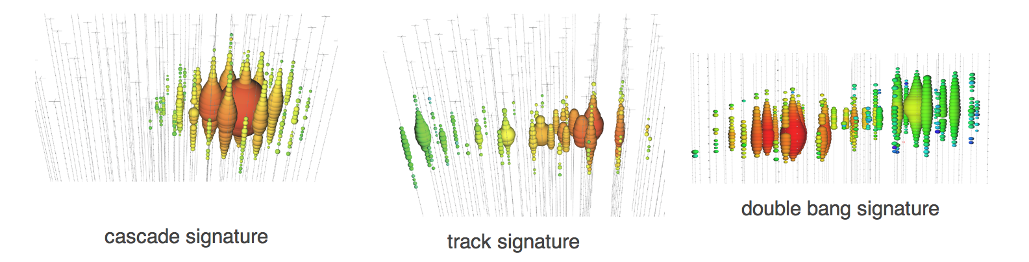
Neutrinos in IceCube
Left: cascade pattern is a typical signature for an electron neutrino, which interacts in the detector producing a shower of particles.
Center: When a muon neutrino interacts in IceCube, it creates a muon as a secondary particle, which crosses the whole detector leaving a track of light in the detector.
Right: The third signature, right, also called the double-bang signature, is produced by a tau neutrino that interacts with the ice creating a hadronic shower and a tau, which decays almost immediately creating a second shower of particles.

Slide 25
Neutrinos in IceCube: skymaps

Slide 26
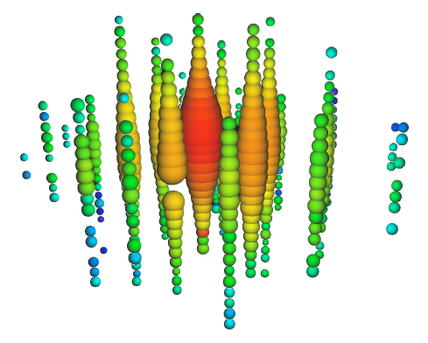
IceCube: science results
PeV neutrinos: highest energy neutrinos ever

Slide 27
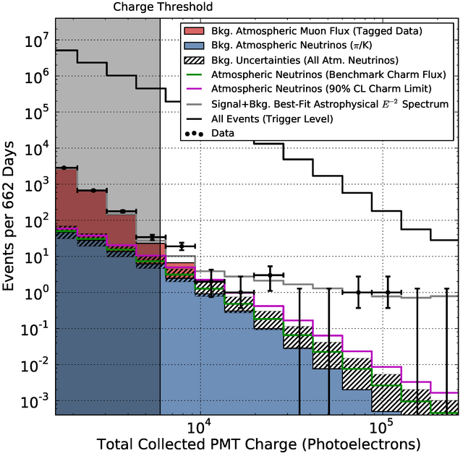
IceCube: science results
First astrophysical neutrino flux

Slide 28
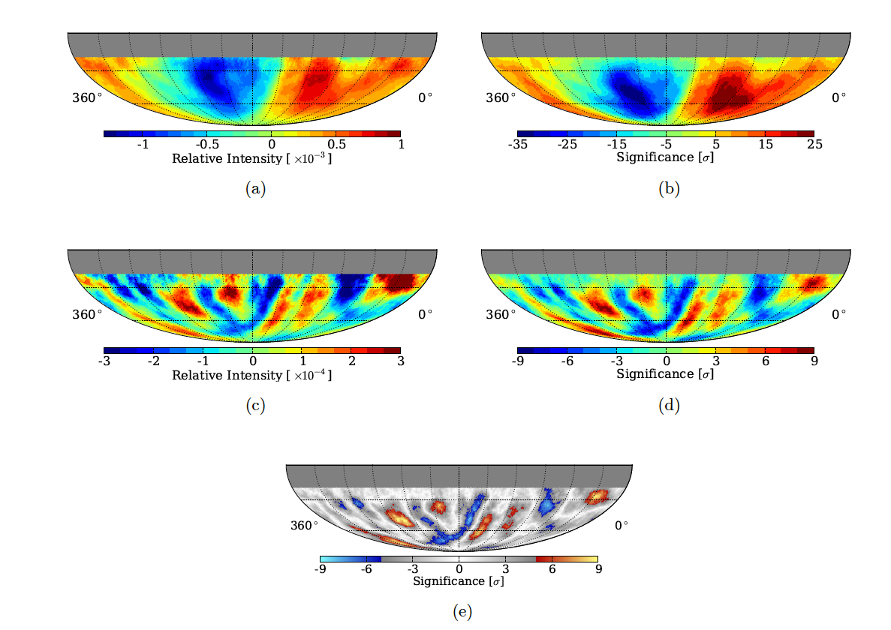
IceCube: science results
Cosmic ray anisotropies

Slide 29
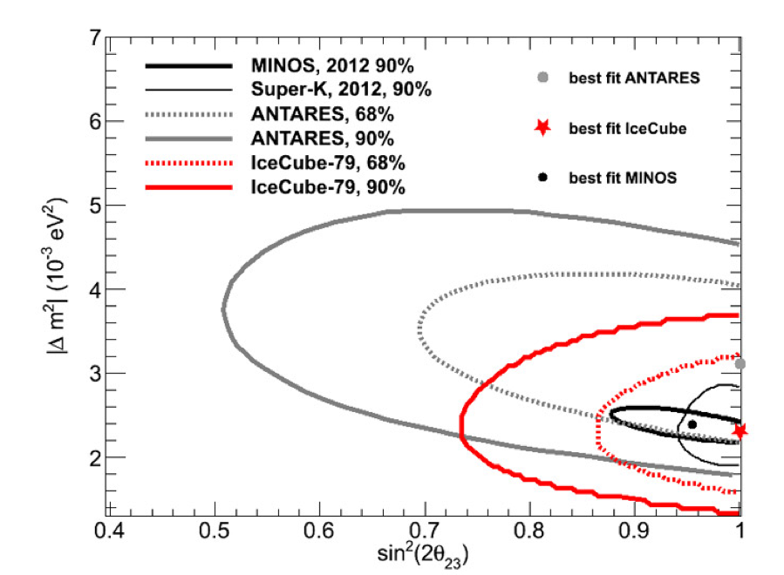
IceCube: science results
Neutrino oscillations

Slide 30
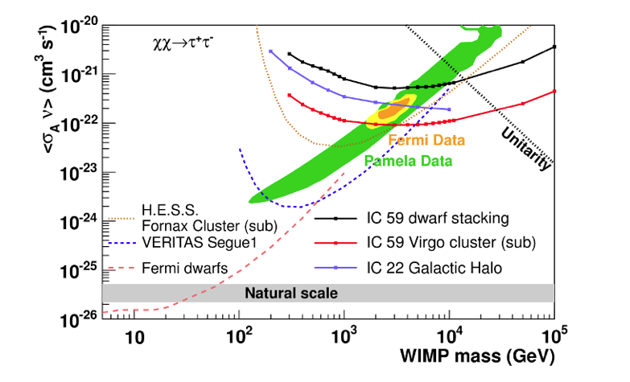
IceCube: science results
Dark matter searches

Slide 31
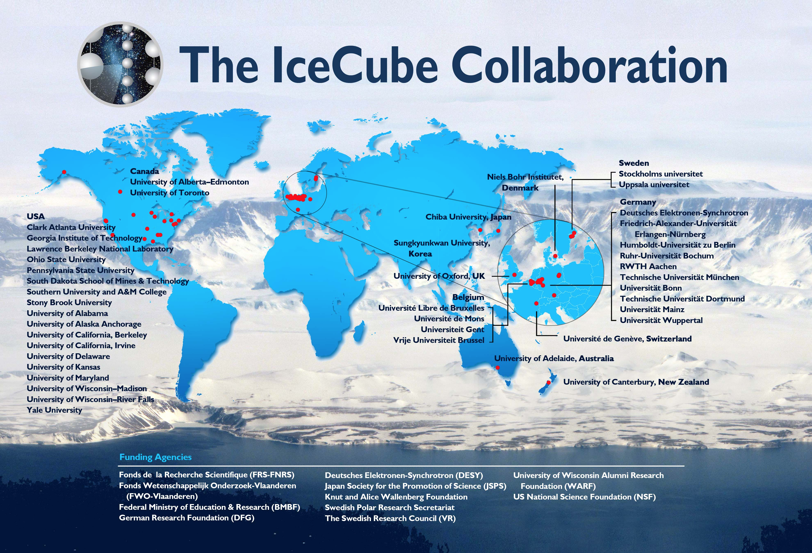
WIPAC (UW-Madison, WI) is IceCube lead institution

Slide 32
Neutrino production
IceCube
ARA
GZK neutrinos are cosmogenic neutrinos inevitably produced by the highest energy CRs.
IceCube is too small to detect GZK neutrinos with a reasonable rate. We need a 100 or more cubic km detector.

Slide 33
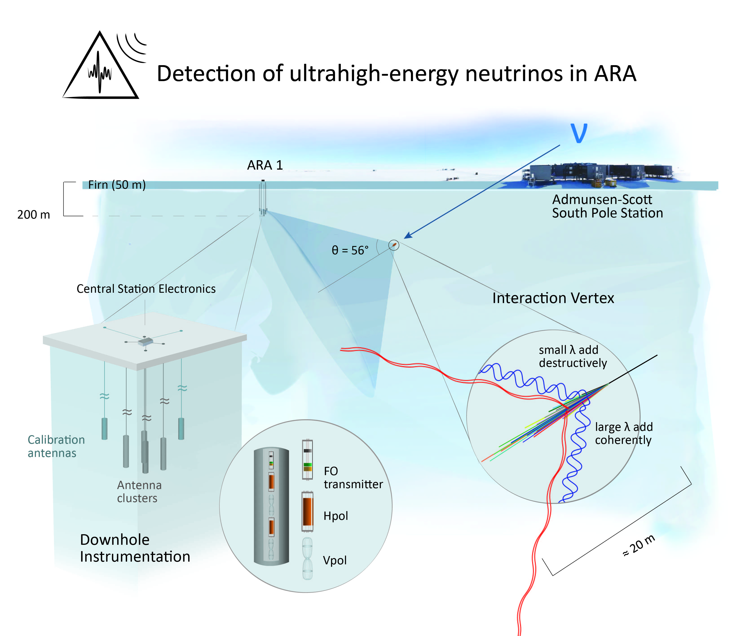

Slide 34
ARA37
Rev 2/4/13
Deployed ARA Station
Planned ARA Station 13/14
Test Bed
IceCube
3
1
South Pole Station
Deployed Cabling
WT3
7 (?)
6
2
Planned 13/14 Cabling
Skiway
5
4
2 km

Slide 35
Astrophysics
“Classical” Astronomy – electromagnetic spectrum from radio to X-rays.
Gamma-ray Astronomy – photons (light particles) with energies 10¹⁰ larger than optical light.
Cosmic Rays – protons and heavier nuclei with energies up to several Joule, the highest energy particle energies observed in the Universe.
Neutrinos – tightly connected to cosmic rays and their sources, but neutral and not subject to deflection in magnetic fields (= easier for “astronomy” because they point to their sources).

Slide 36
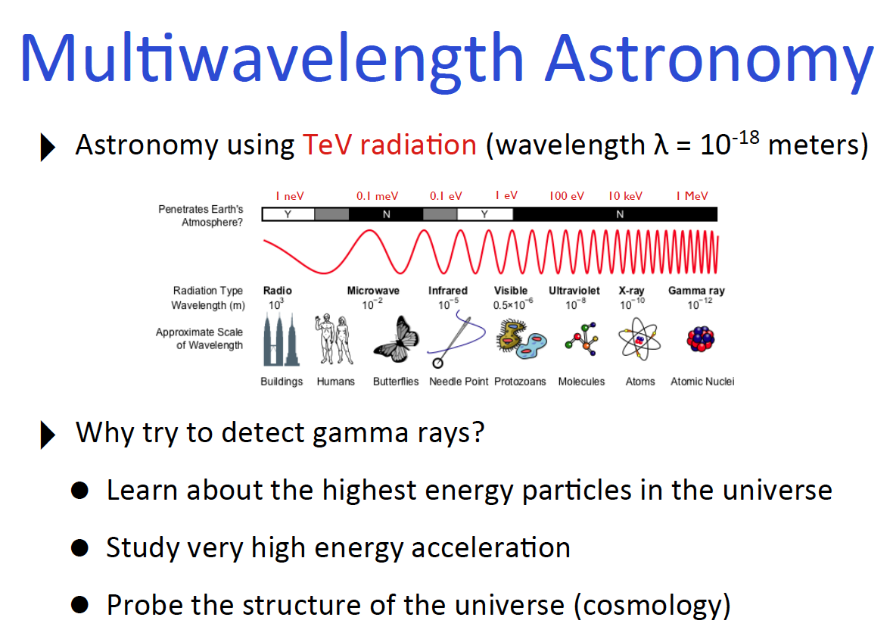

Slide 37
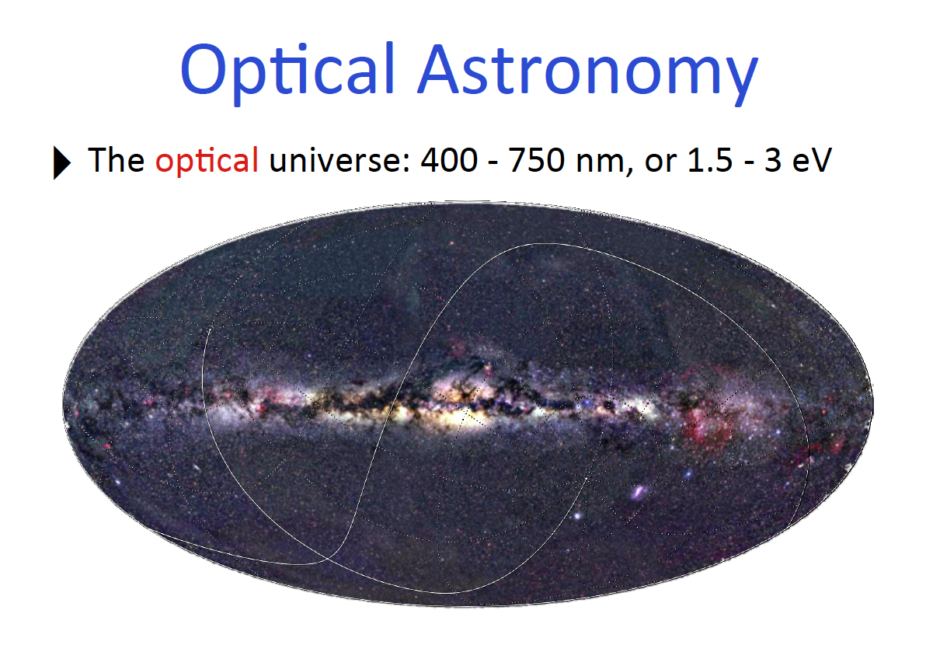

Slide 38
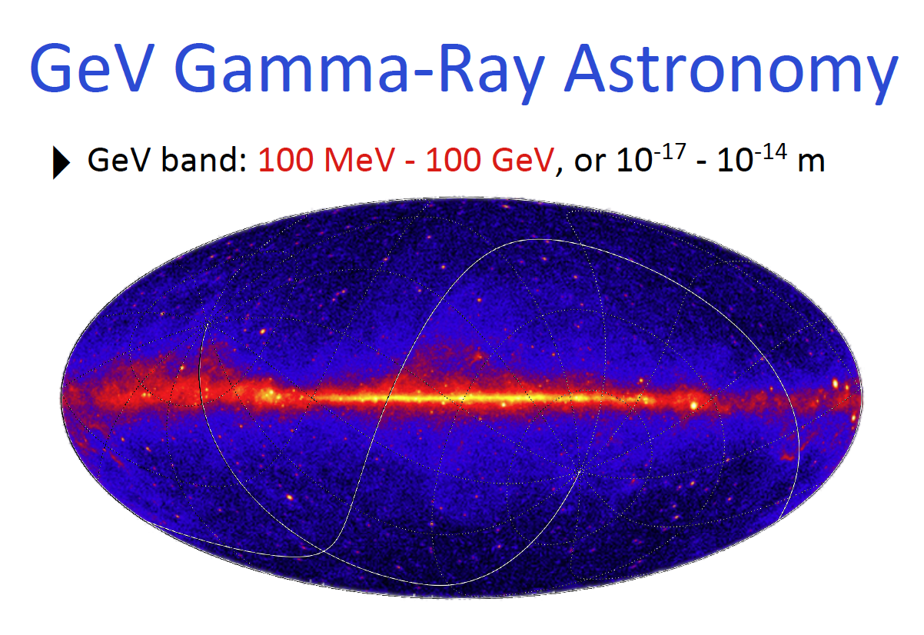

Slide 39
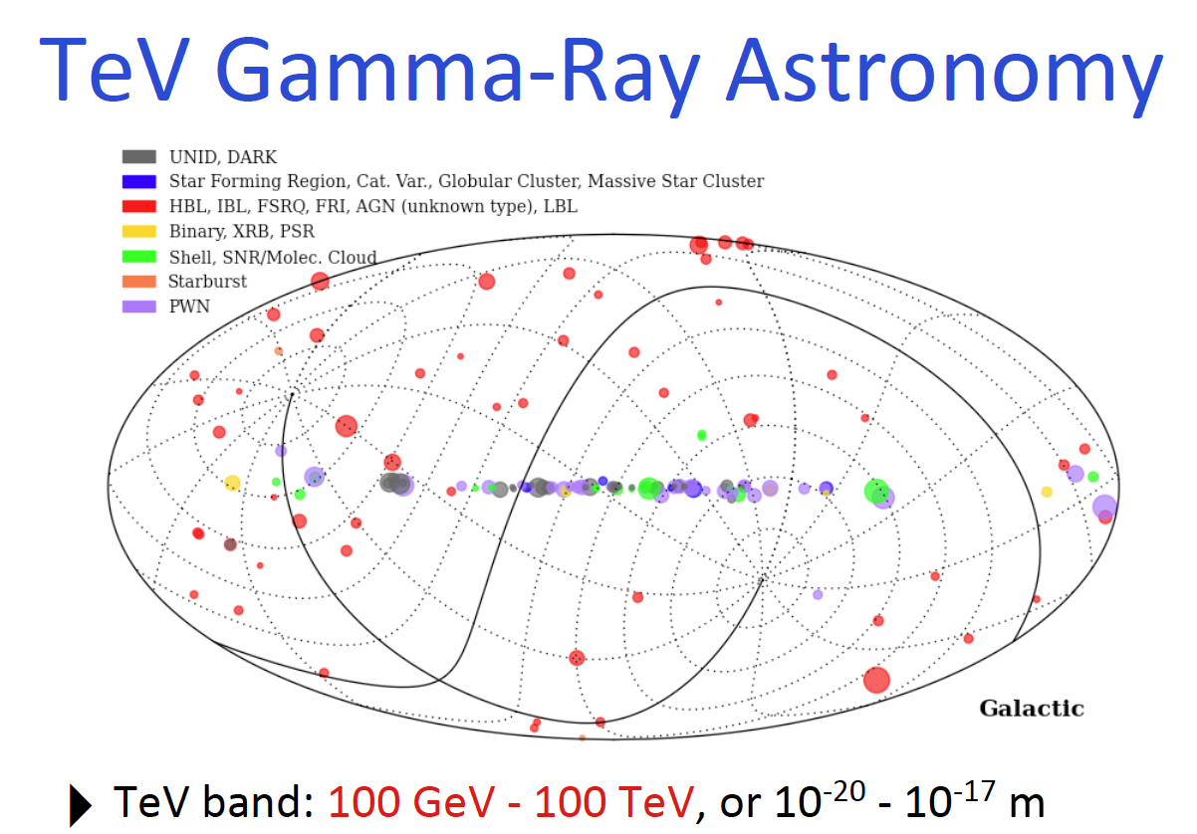

Slide 40
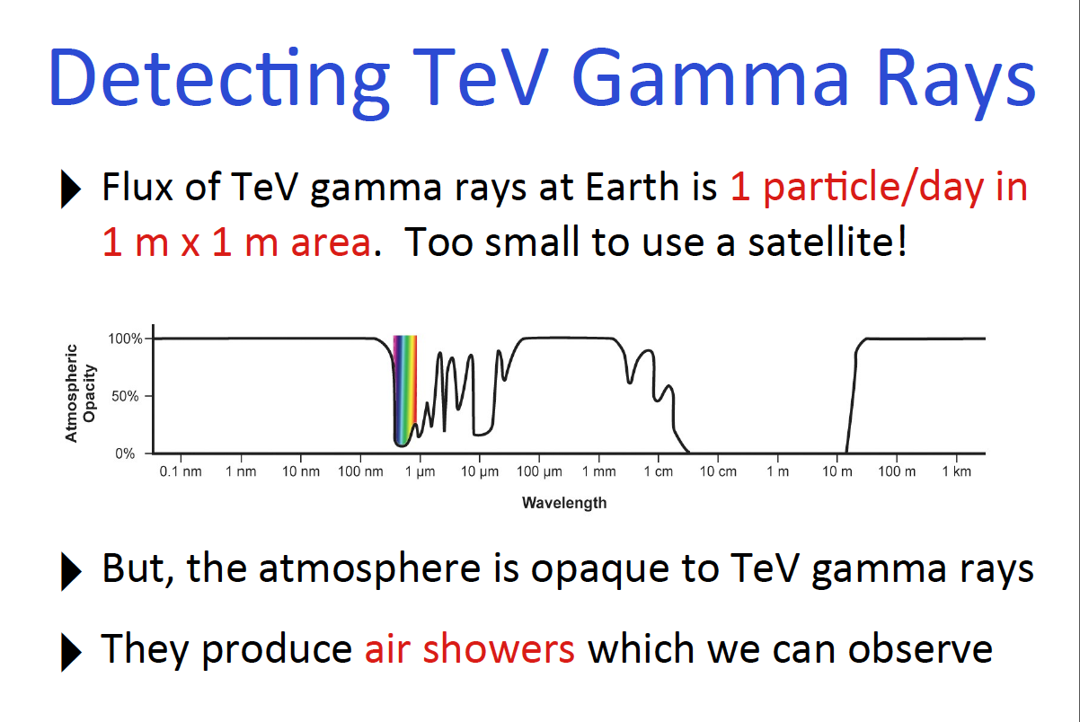

Slide 41
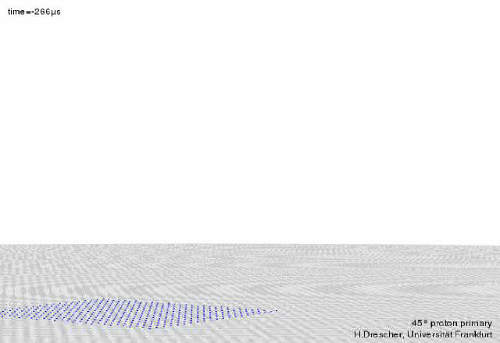
Cosmis Ray Air Shower (Proton)

Slide 42
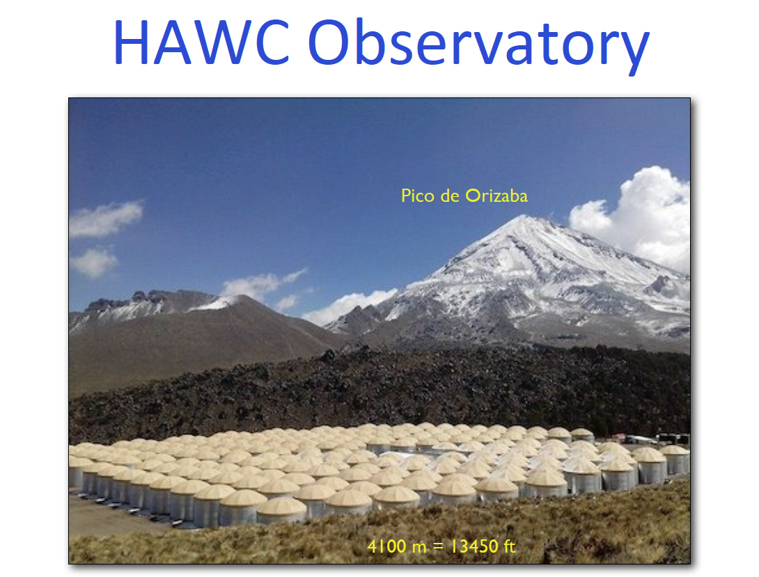
The HAWC Collaboration includes more than 30 institutions in Mexico, USA and Poland. University of Maryland, College Park is the lead institution.

Slide 43
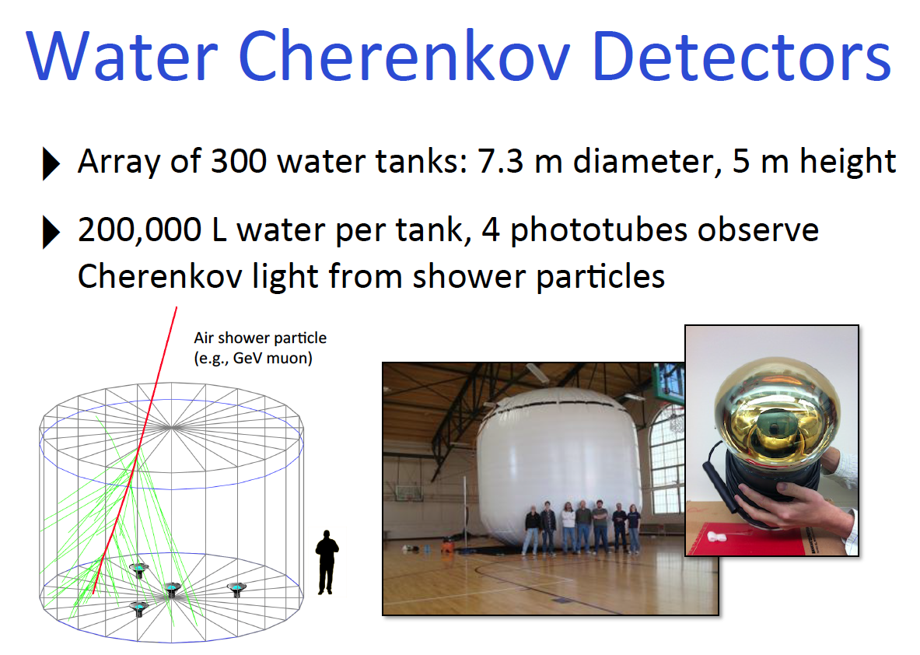

Slide 44
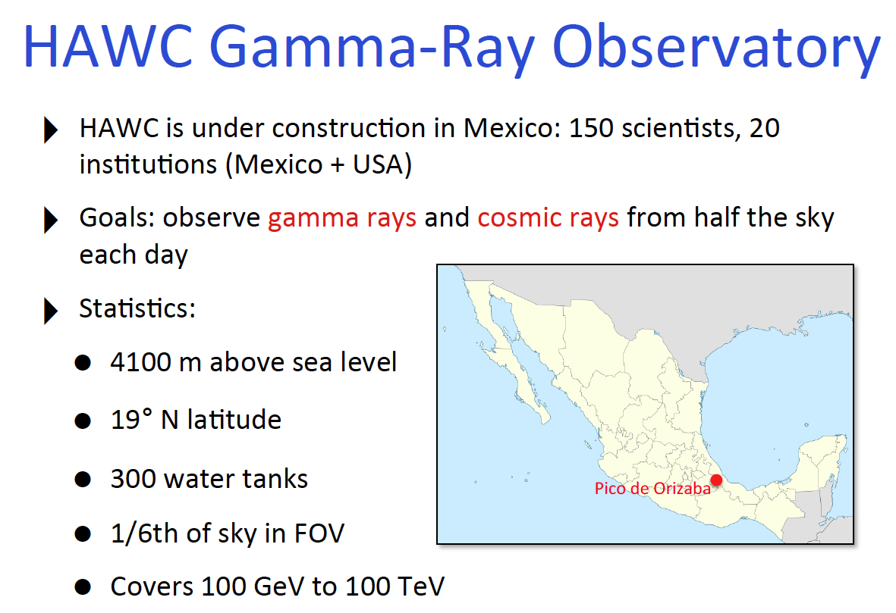

Slide 45
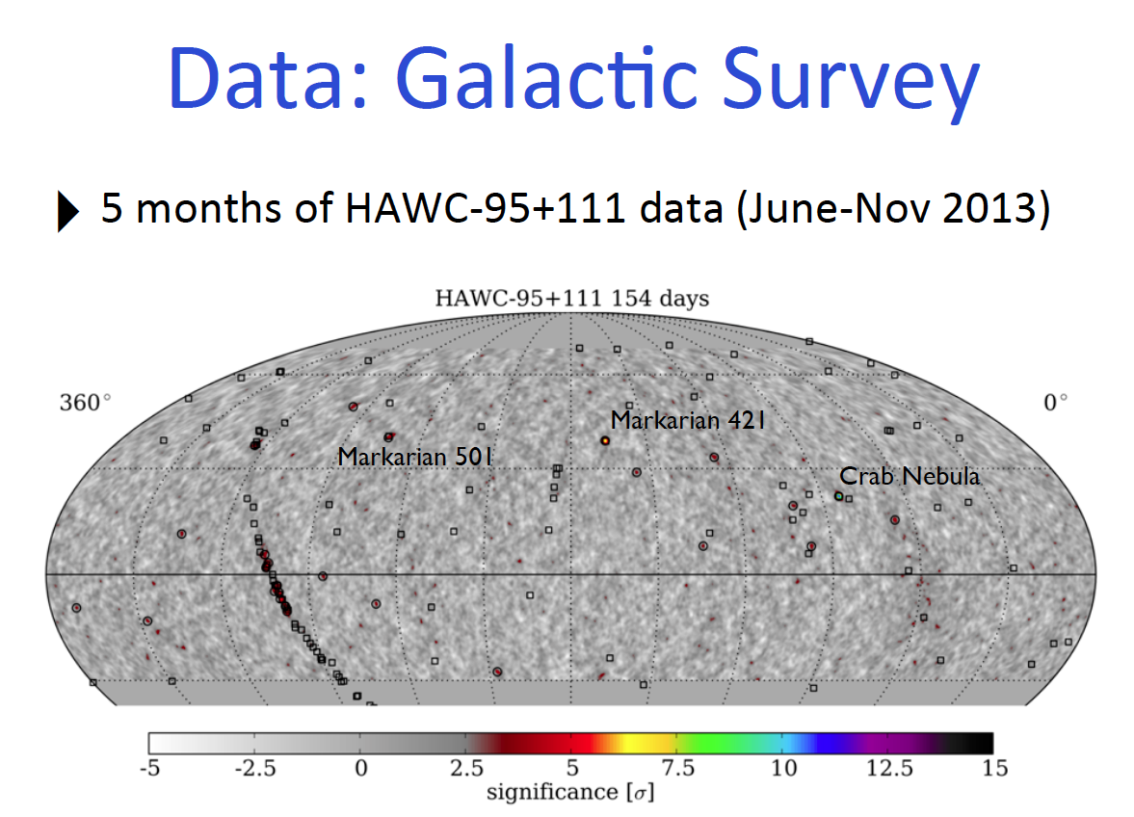

Slide 46
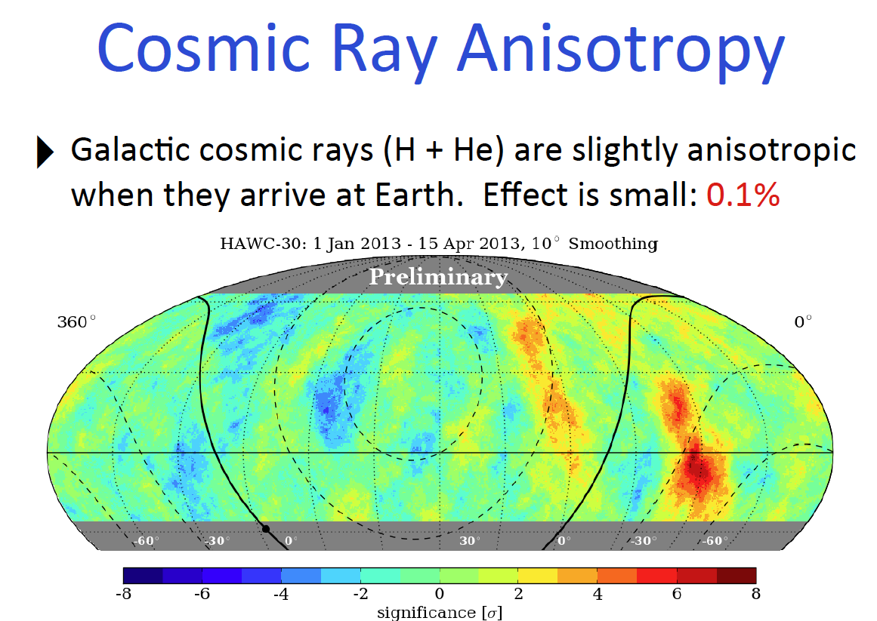

Slide 47
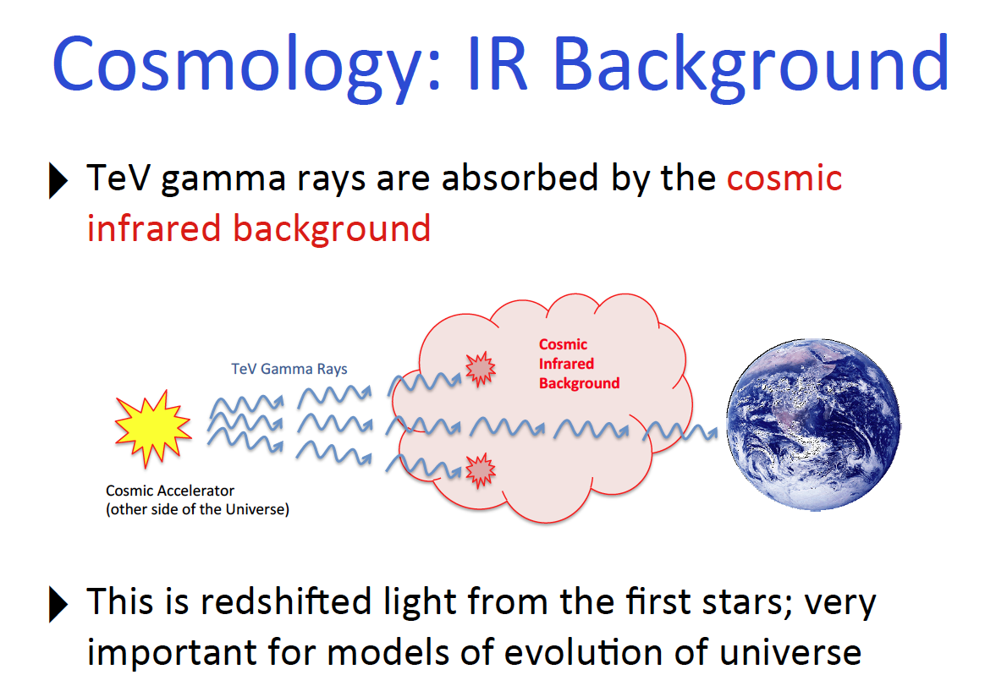

Slide 48
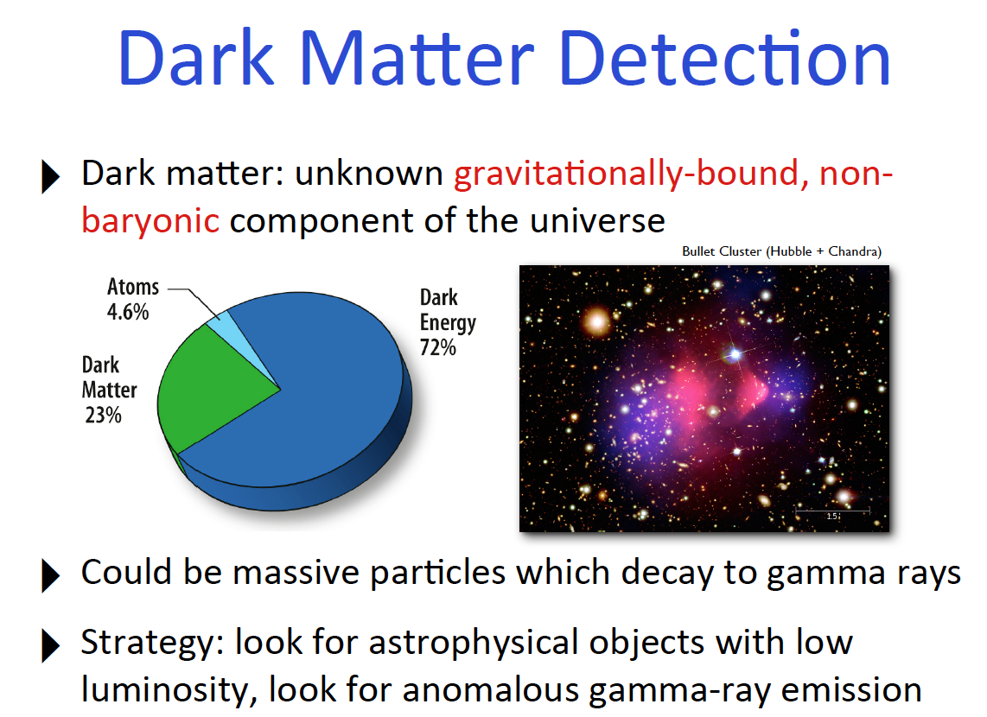

Slide 49
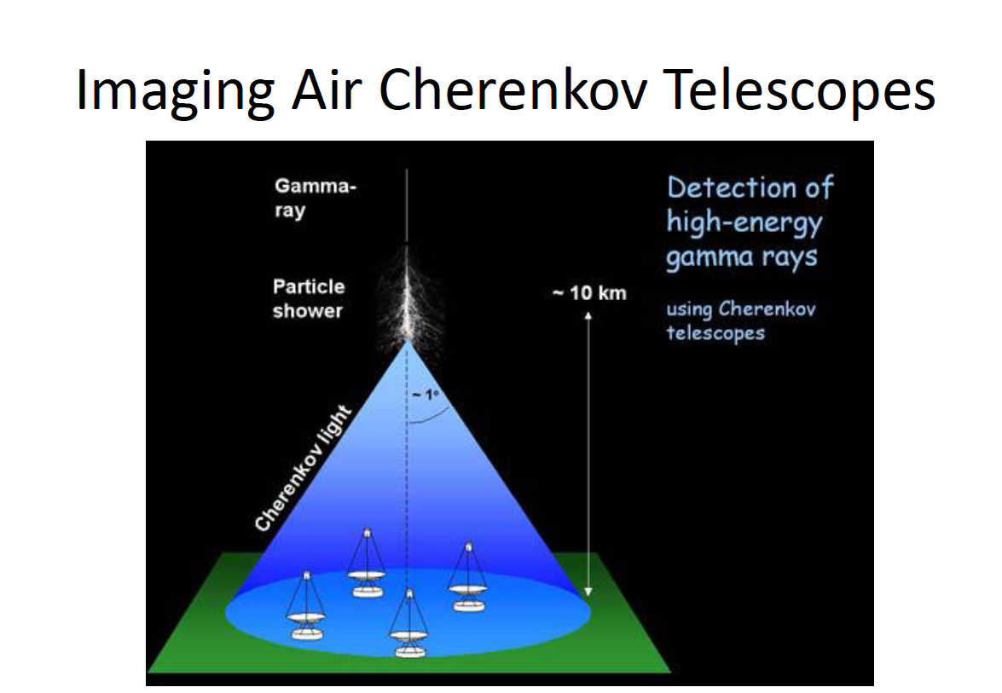

Slide 50
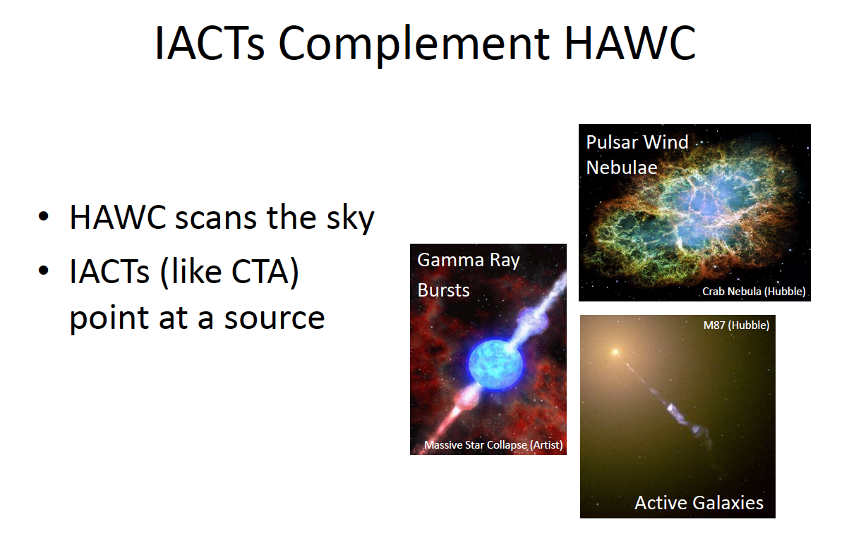
Notes:
Current systems of Cherenkov telescopes use at most four telescopes, providing best stereo imaging of particle cascades over a very limited area, with most cascades viewed by only two or three telescopes. An array of many tens of telescopes will allow the detection of gamma-ray induced cascades over a large area on the ground, increasing the number of detected gamma rays dramatically, while at the same time providing a much larger number of views of each cascade. This results in both improved angular resolution and better suppression of cosmic-ray background events.

Slide 51
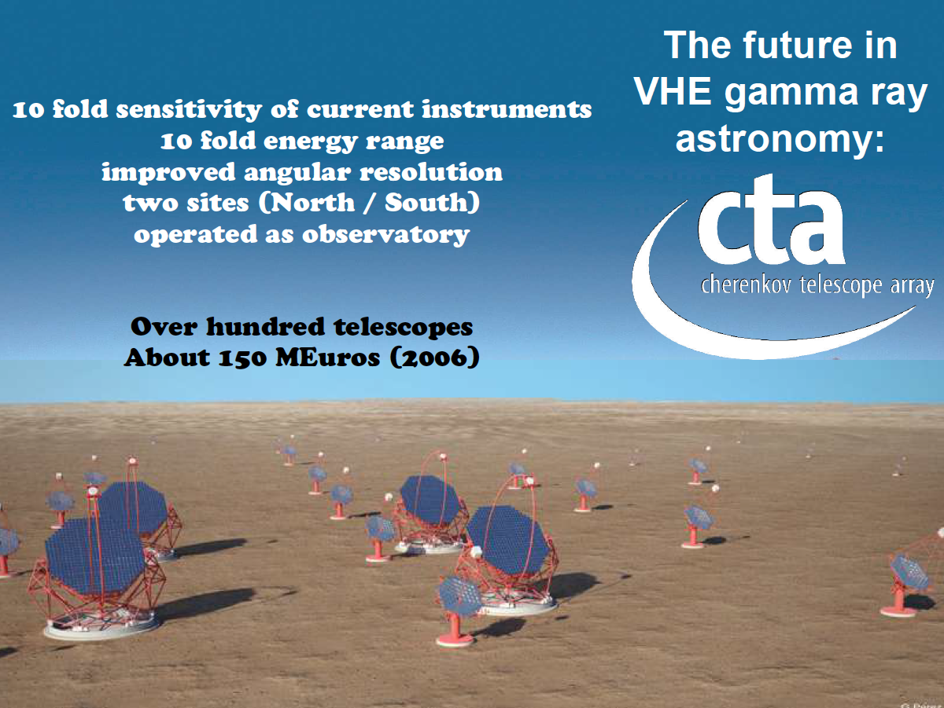
An introduction to CTA
see video
An artists impression of the Cherenkov Telescope Array. Source G. Perez, SMM, IAC
see video here
Notes:
On 10 April 2014 Government representatives met in Munich and decided to start negotiations with the two sites for the planned 99-dish array in the Southern Hemisphere: Aar in Namibia and ESO’s Paranal-Amazones site in the Atacama Desert of northern Chile, keeping Leoncito in Argentina as a third option. The site selection will be closed by the end of 2014.
For the 19-dish array in the Northern Hemisphere, four sites remain in the running: two in the United States and one each in Mexico and Spain. The selection of this site is not expected to take place in 2014.
Astronomers hope to be ready to start construction by the end of 2015 and to begin full operations in around 2020.

Slide 52
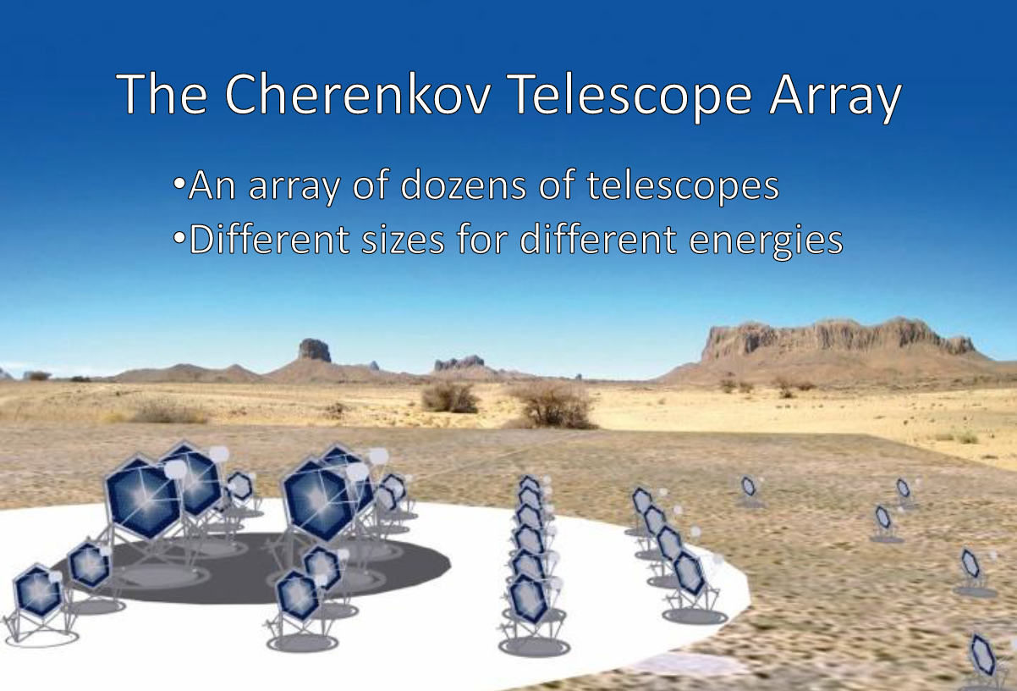
Currently developing and testing prototypes. The CTA Consortium consists of over 1000 scientists working in 194 institutes from 29 countries

