Slide 1
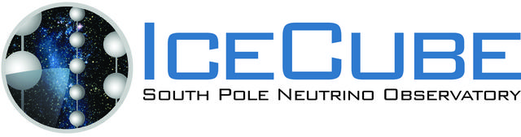


Cosmic neutrinos & cosmic particles in IceCube
Evidence for high energy astrophysical neutrinos
and
the cosmic-ray connection

Slide 2
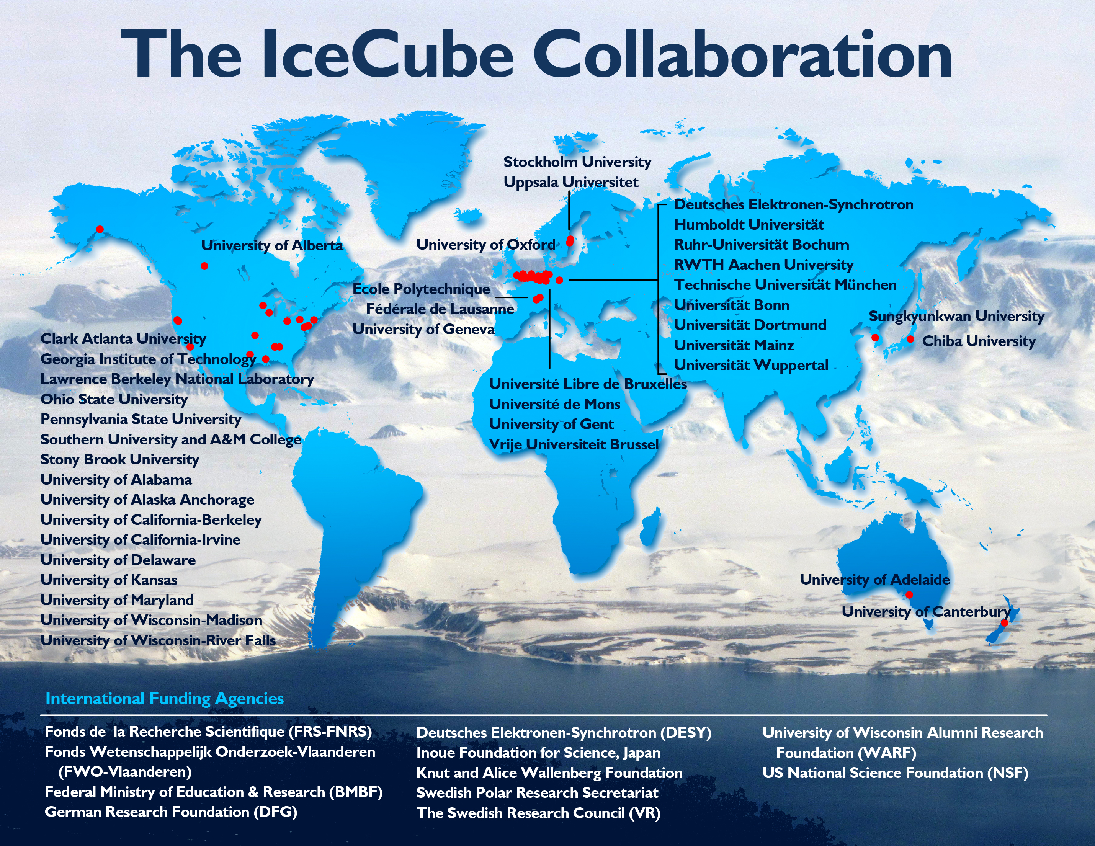
UD is part of a large collaboration

Slide 3
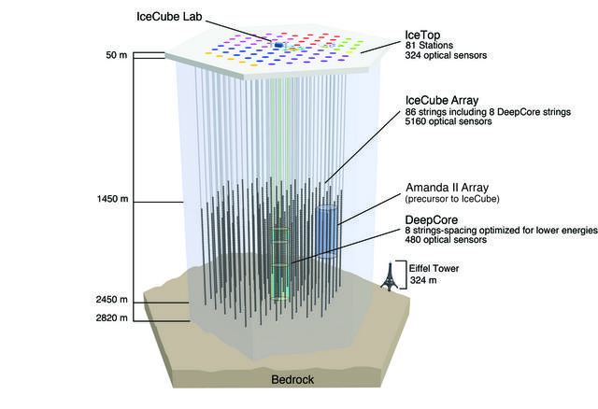
Deployment history
2002: proposal
2003-04 staging
2004-05 1 4
2005-06 9 16
2006-07 22 26
2007-08 40 40
2008-09 59 59
2009-10 79 73
2010-11 86 81
Deep strings
Surface stations

Slide 4
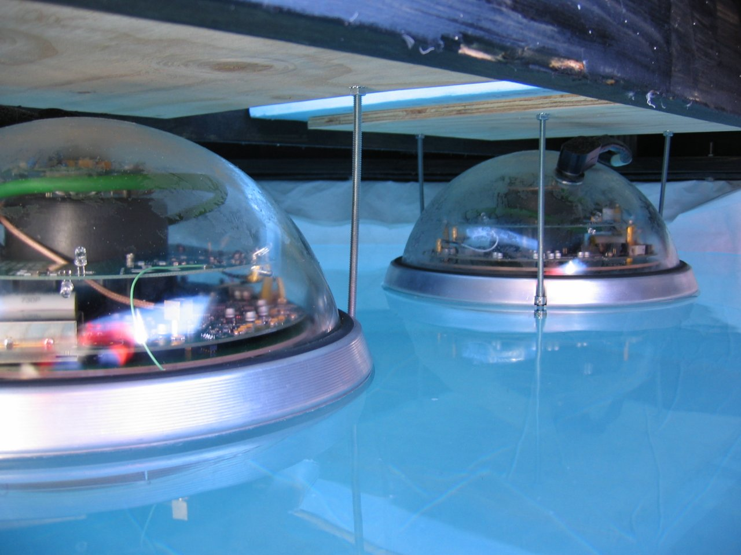

Slide 5
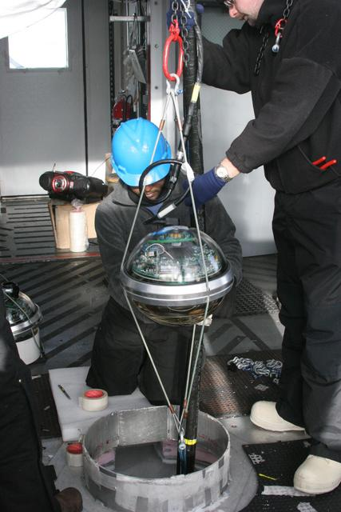
IceCube Digital Optical Module and deployment
LED Flasher board
HV board
Main board for digitizing & time stamping

Slide 6
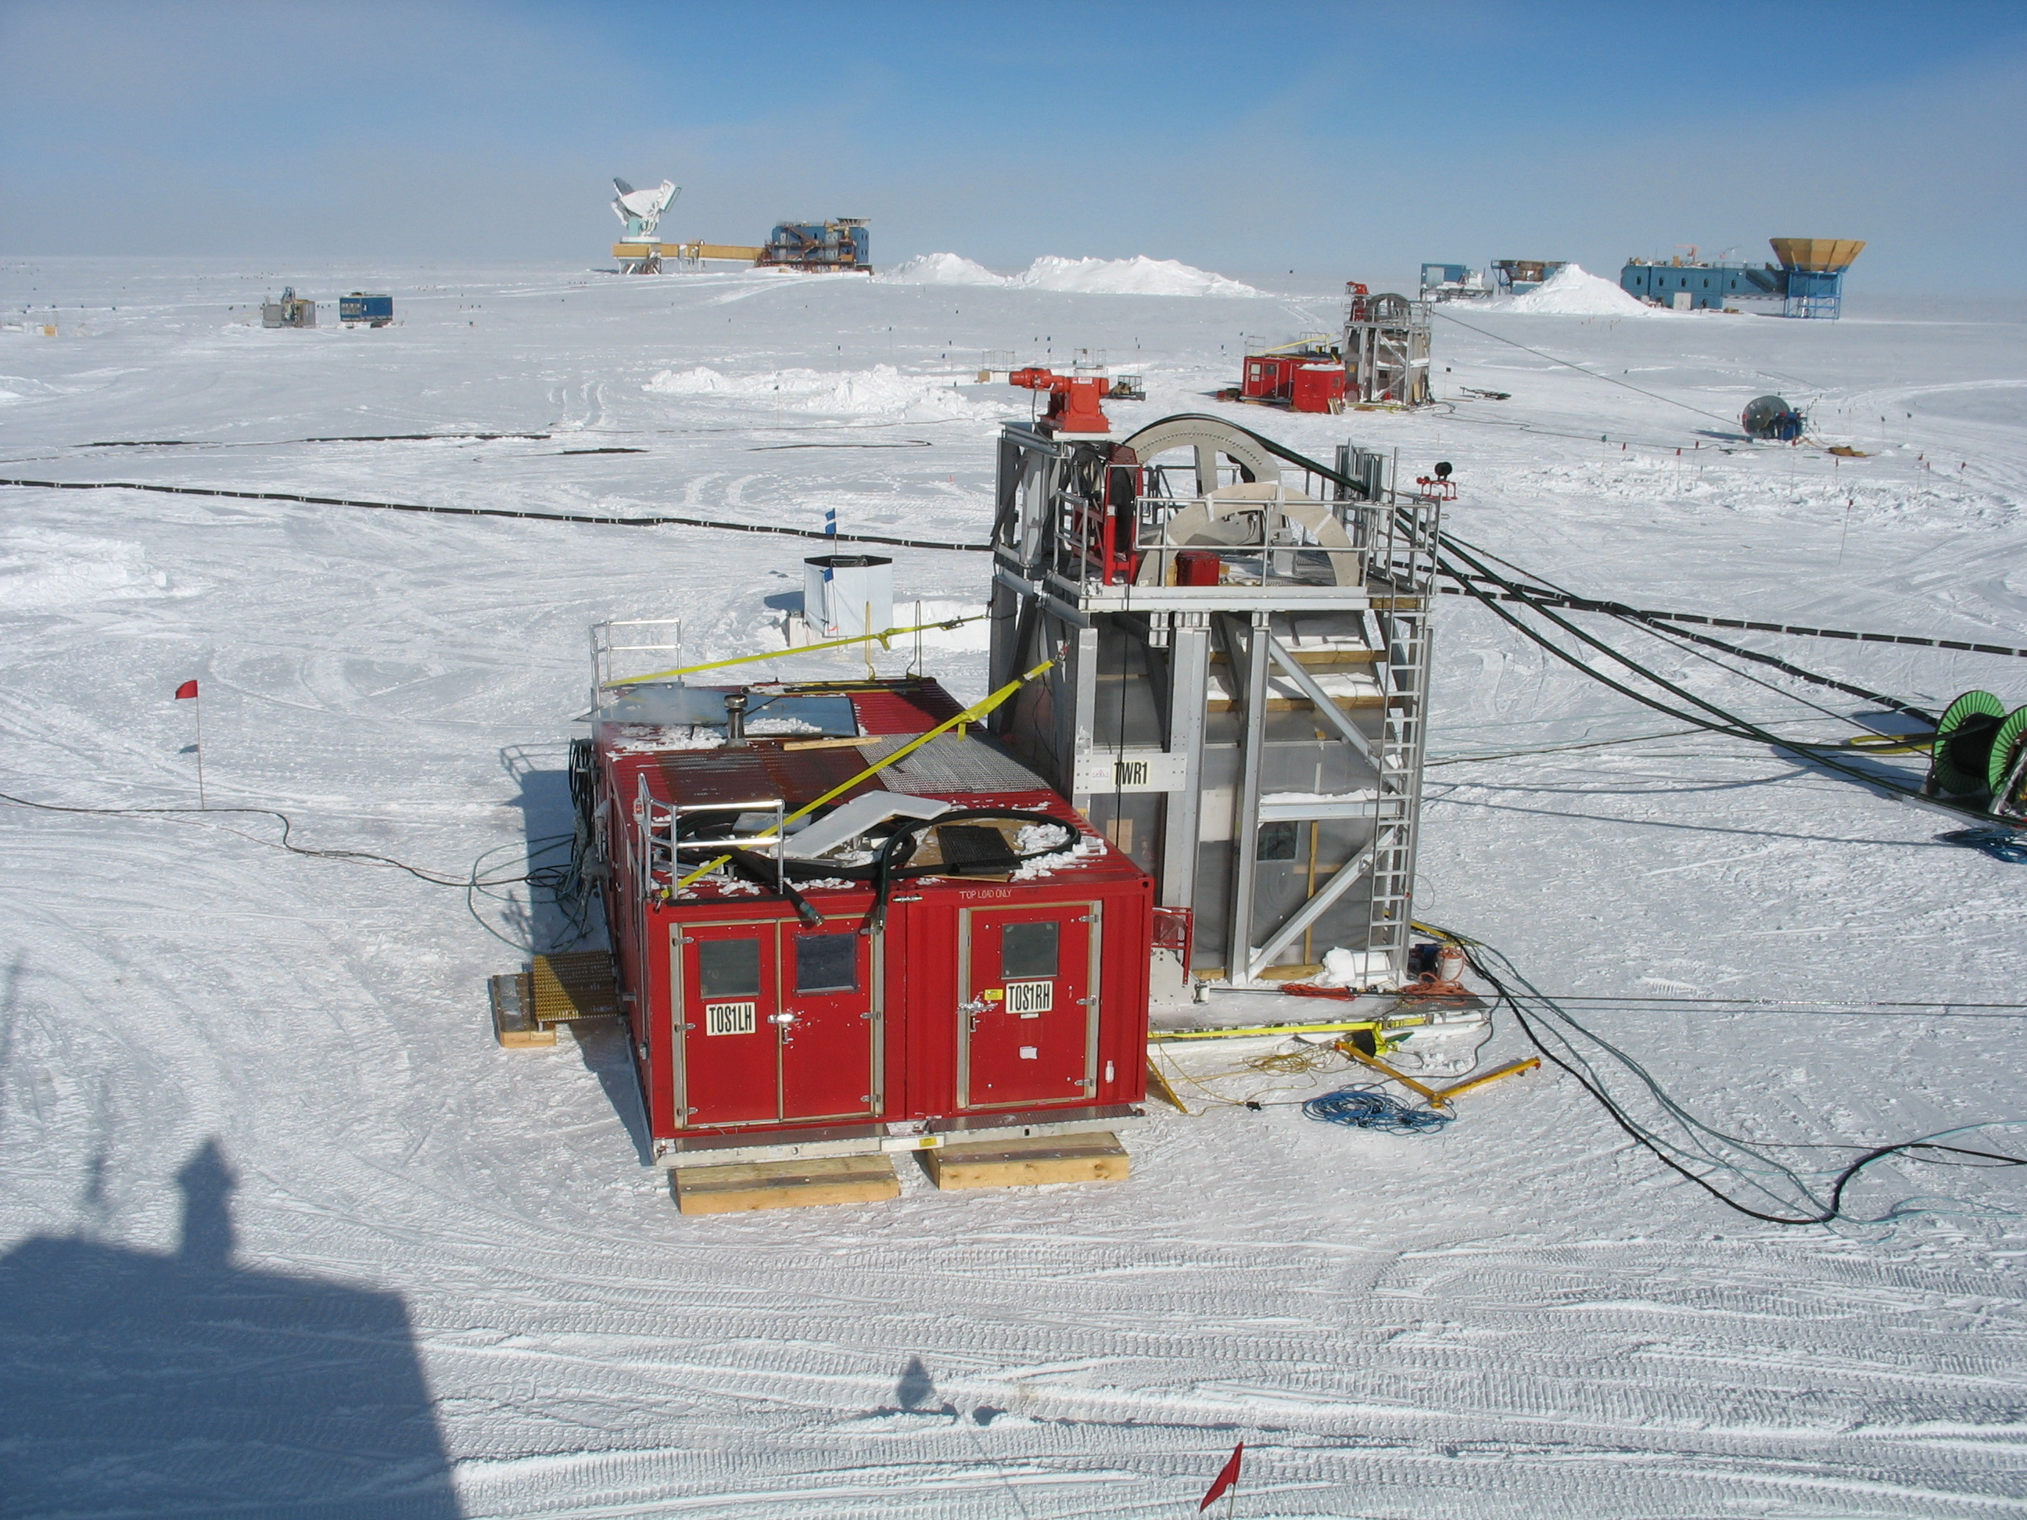

Slide 7
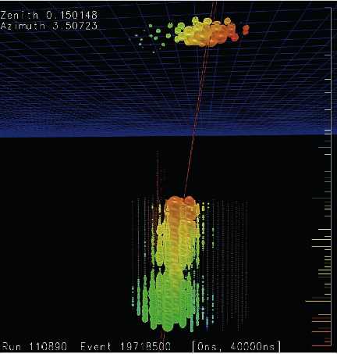
5 μs
Dust layer at 2100 m

Slide 9
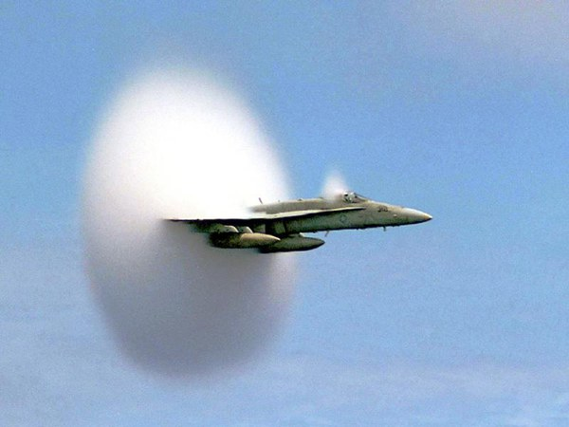
What we measure:
Cherenkov radiation from charged particles
Sonic boom
  Coherent shock wave from object traveling faster than speed of sound in air
Cherenkov radiation
  Coherent electromagnetic “shock” wave from charged particle traveling faster than speed of light in a transparent medium

Slide 10
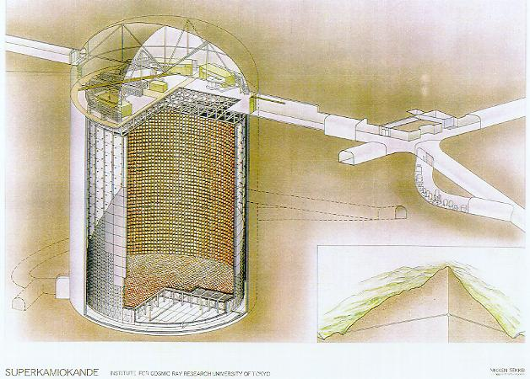
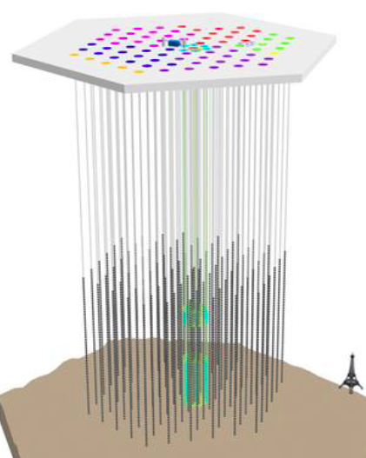
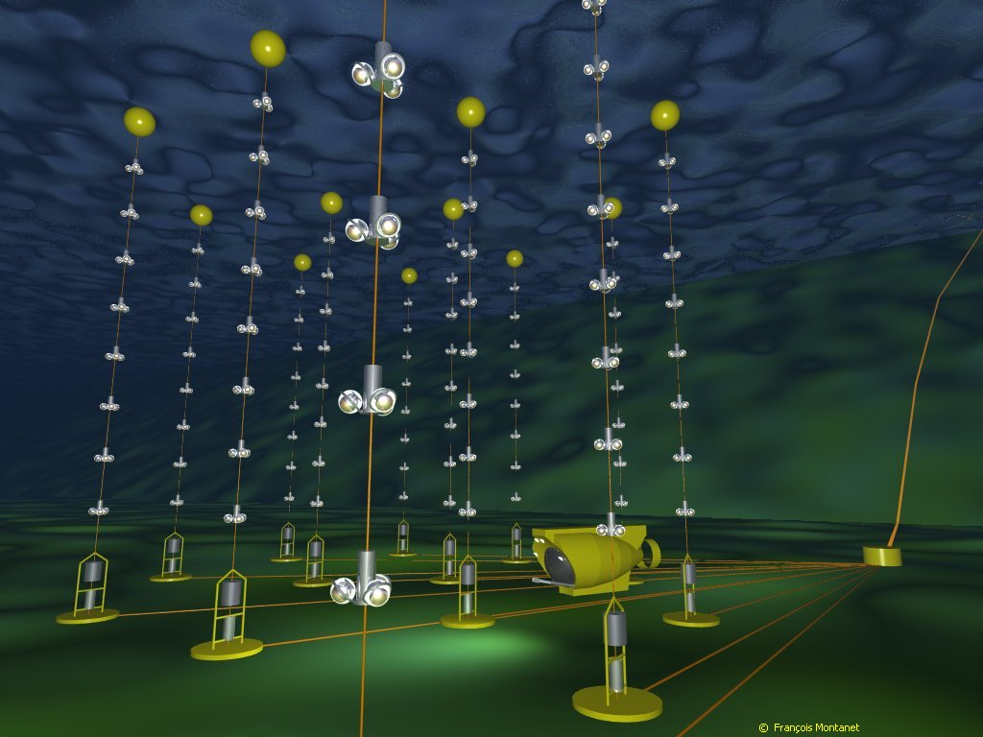
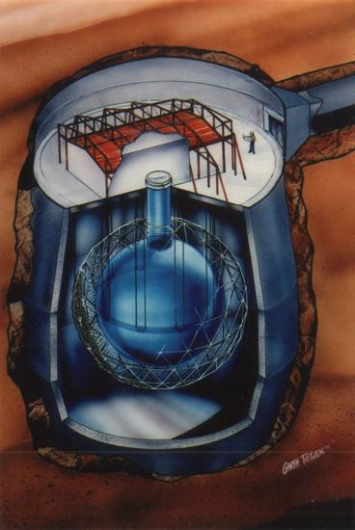
Detecting neutrinos in H₂0
Proposed by Greisen, Reines, Markov in 1960
Heritage:
DUMAND
IMB
Kamiokande
Baikal
AMANDA
Super-K
SNO
IceCube
ANTARES
Neutrino must interact
to be detected

Slide 11
Motivation
Astronomy with electromagnetic probes
  Optical,
  Longer wavelengths: IR, microwave, radio
  Shorter wavelengths: UV, X-ray, gamma-ray
  All are modified by scattering and absorption
Charged particles (cosmic rays)
  deflected by magnetic fields in space and do not point back to the sources
Neutrinos: a new probe of the high energy Universe
  Not deflected or absorbed
  But hard to detect because they interact only weakly

Slide 12
Cosmic ray – neutrino connection
Cosmic rays are accelerated
  in galactic sources such as supernova remnants
  In extragalactic sources such as active galaxies and gamma-ray bursts
Cosmic ray sources produce γ-rays in two ways
  From radiation by accelerated electrons
  From decay of π⁰ produced by interactions of accelerated cosmic-ray protons or nuclei with gas or photons
High energy ν are produced only in hadronic collisions:
  From decay of π/K produced when cosmic rays interact with gas in or near their sources
  Or from photo-pion production on CMB or EBL

Slide 13
Cosmic Rays
Span a large energy range
Rate decreases quickly as energy increases
Counting rate of tanks at surface is due to particles in the GeV range and below
Energy range of interest
  TeV – EeV for neutrinos
  PeV – EeV for cosmic rays
1 GeV = mc² of proton
TeV = 1000 GeV
PeV = 1 million GeV
EeV = 1 billion GeV
Galactic
Extra-Galactic
1 GeV = rest mass energy of a proton

Slide 14
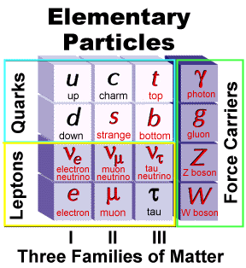
Neutrinos interact feebly—why?
Because weak force is carried by massive W,Z
Force carrier
Elementary particles are point-like (without structure)
Ordinary matter is composite and is mostly empty space
proton = { u u d }
neutron = { u d d }
nucleus = collection of protons and neutrons
Force is by exchange of massive W or Z with u, d quarks in the target nuclei

Slide 15
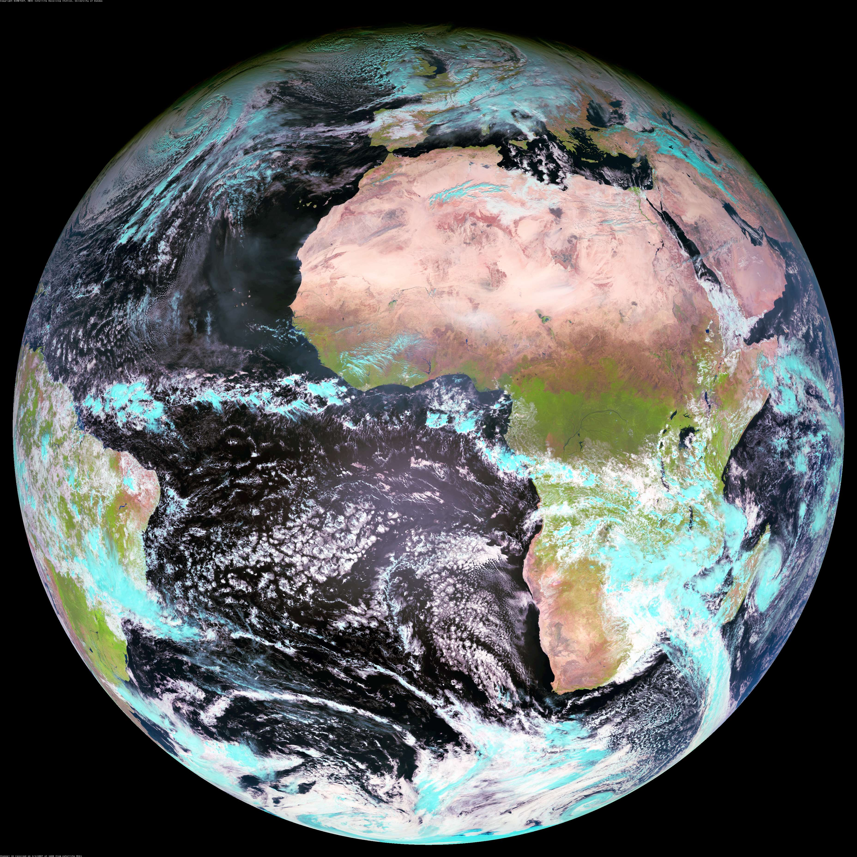
Upward ν in IceCube
S.P.
Fraction absorbed
Passing fraction

Slide 16
Upward neutrinos in IceCube
Must have low enough energy to get through the Earth (depends on direction)
Must produce a signal in the detector
  – induced muon from neutrino interaction in the rock or ice below the detector (highest rate)
  Neutrino of any flavor interacts inside detector
Product ≈ 10⁻⁵ is fraction of ν of this energy that interact in detector

Slide 17
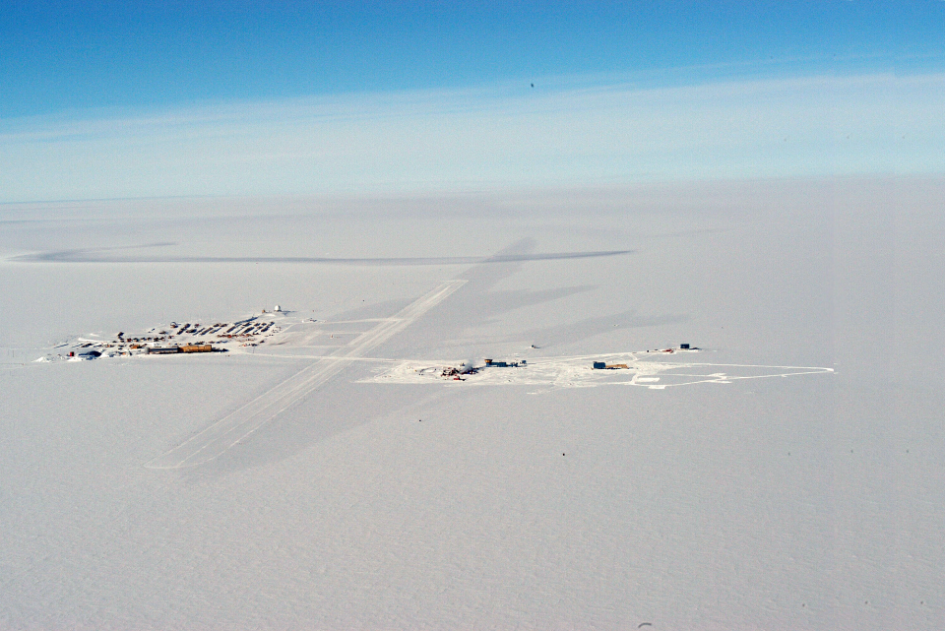
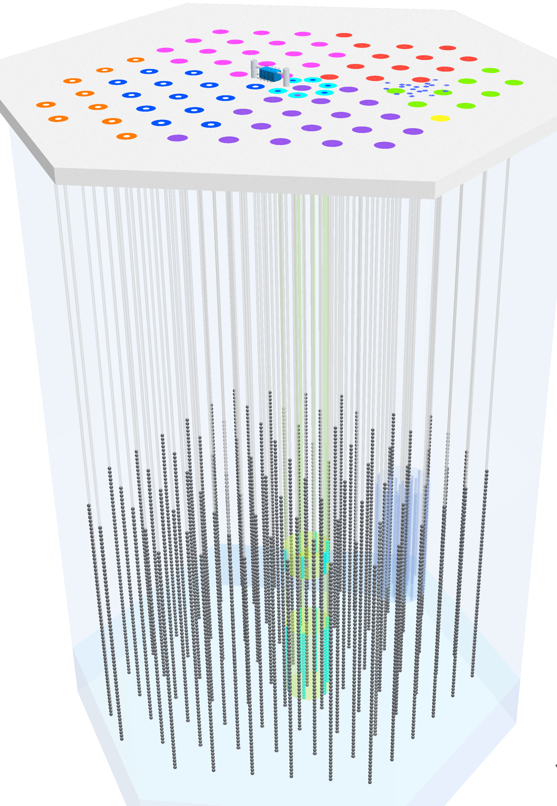
A 3-D cosmic-ray detector:
Two different kinds of events
Closely related scientifically:
Cosmic rays after propagation
Neutrinos from cosmic ray sources
ν_{e}:ν_{μ}:ν_{τ} = 1:2:0 → 1:1:1
Cosmic ray showers from above
South Pole
2835 m.a.s.l.
IceTop
Neutrinos from all directions
ν_{μ}-induced μ (from below)
all flavors starting inside detector
1450 m
IceCube
2450 m
Atmospheric muons

Slide 18
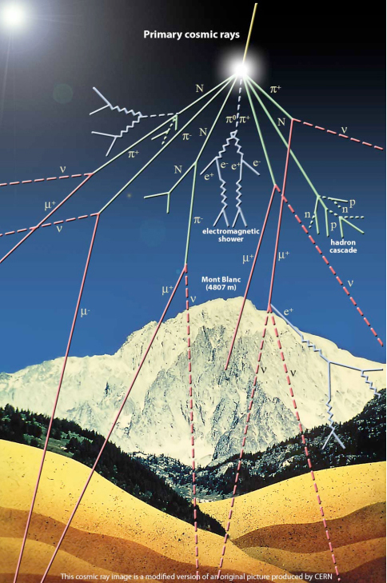
15 km
Air Shower (not to scale)
Initiated by a single, high energy cosmic-ray (proton or nucleus)
Or by a single gamma-ray
Starting altitude around 15 to 20 km
Particles interact and cascade
Showers from protons, nuclei include about 10% muons
Showers from photons have few muons
Can we distinguish photons, protons, nuclei on the basis of muon content???
500 m

Slide 19
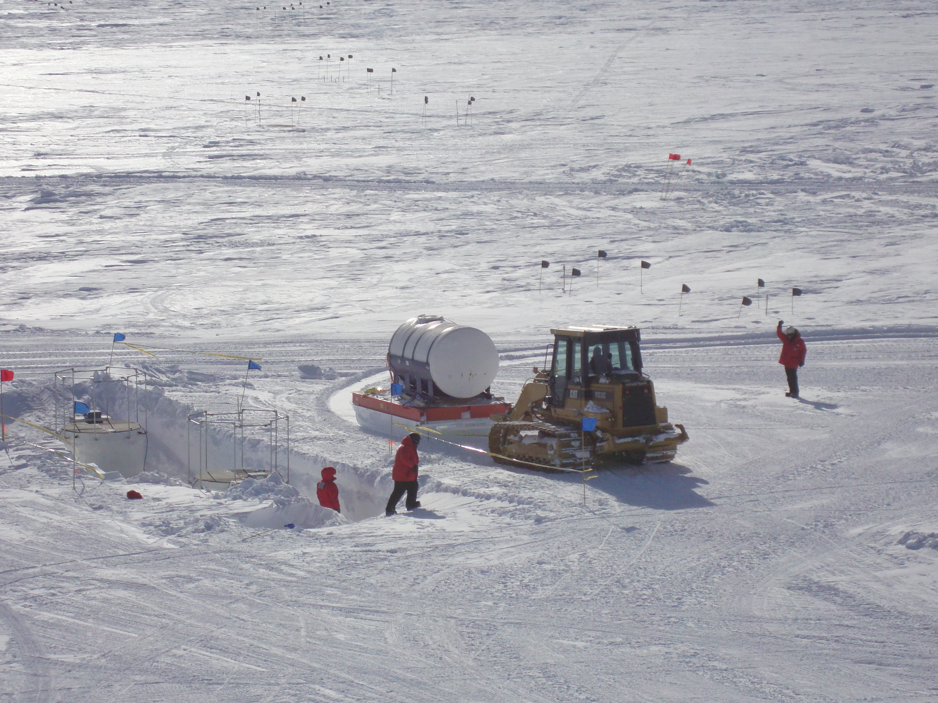
Detecting showers in IceTop
Two tanks per station separated by 10 meters
In the densely populated part of a shower, both tanks are hit
Single tank hit has a higher probability of being a muon

Slide 20
Neutrino events in deep IceCube
ν-induced μ entering from below
PeV = 10⁶ GeV = 10¹⁵ eV. These are the highest energy neutrinos ever detected!
Two PeV cascades starting inside the detector
PRL 111, 021103 (2013)
Large energy
→ atmospheric origin unlikely

Slide 21
Starting event
Event starts in fiducial volume
Light from vertex spreads spherically with v=c/1.31
Muon moves ahead with v = c
ID confirmation by timing
Jakob van Santen

Slide 22
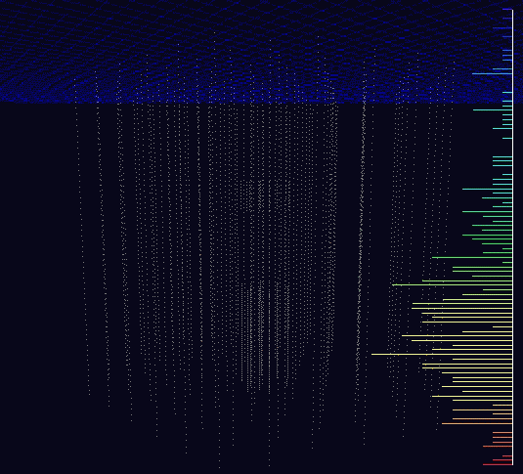


Slide 23
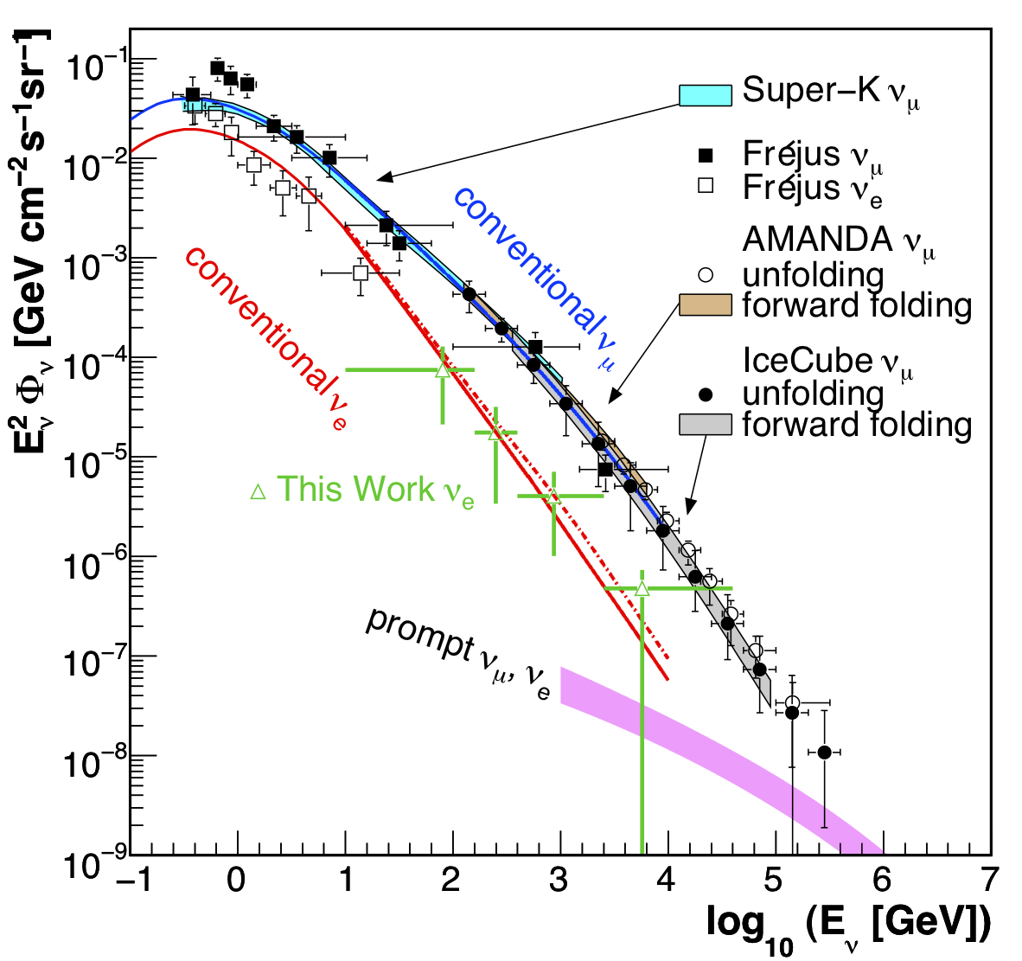
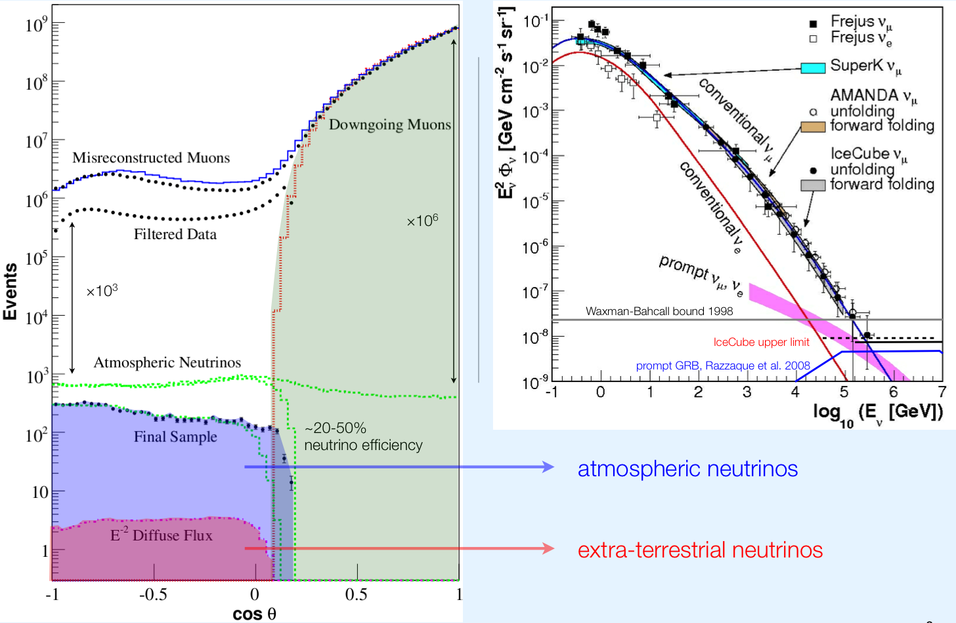
Most events are not astrophysical ν!
2.5 kHz
Astrophysical ν
~ 1 per million
~ 1 per billion

Slide 24
Search strategy for astrophysical ν
Look for a hard, high-energy component above the atmospheric background
  Upward ν_{μ} induced muons
    Highest rate
  Events starting in the detector
    Lower rate, but
    Atmospheric ν background is lower
Look for excess of events in the ν_{μ} skymap

Slide 25
Charge distribution of events compared to expected backgrounds
Agreement with expected muon punch-through below 6000 p.e.
6 ± 3.4 expected above 6000 p.e.
Blue region shows conventional atmospheric ν background with prompt estimate hatched
Non-prompt: 4.6 ± 1.2 expected
+ 1.5 prompt
Total expected background:
12.1 ± 3.4
Concentrated at low energy

Slide 26
Energy and direction of 28 events
Bins in sin(δ) contain equal solid angle

Slide 27
Sky map of 28 events
For ν_{μ} tracks (x’s on plot) angular resolution is ≤ 1º
For cascades (+’s on plot) resolution is 10º – 15º
Shower events p-value = 8%

Slide 28
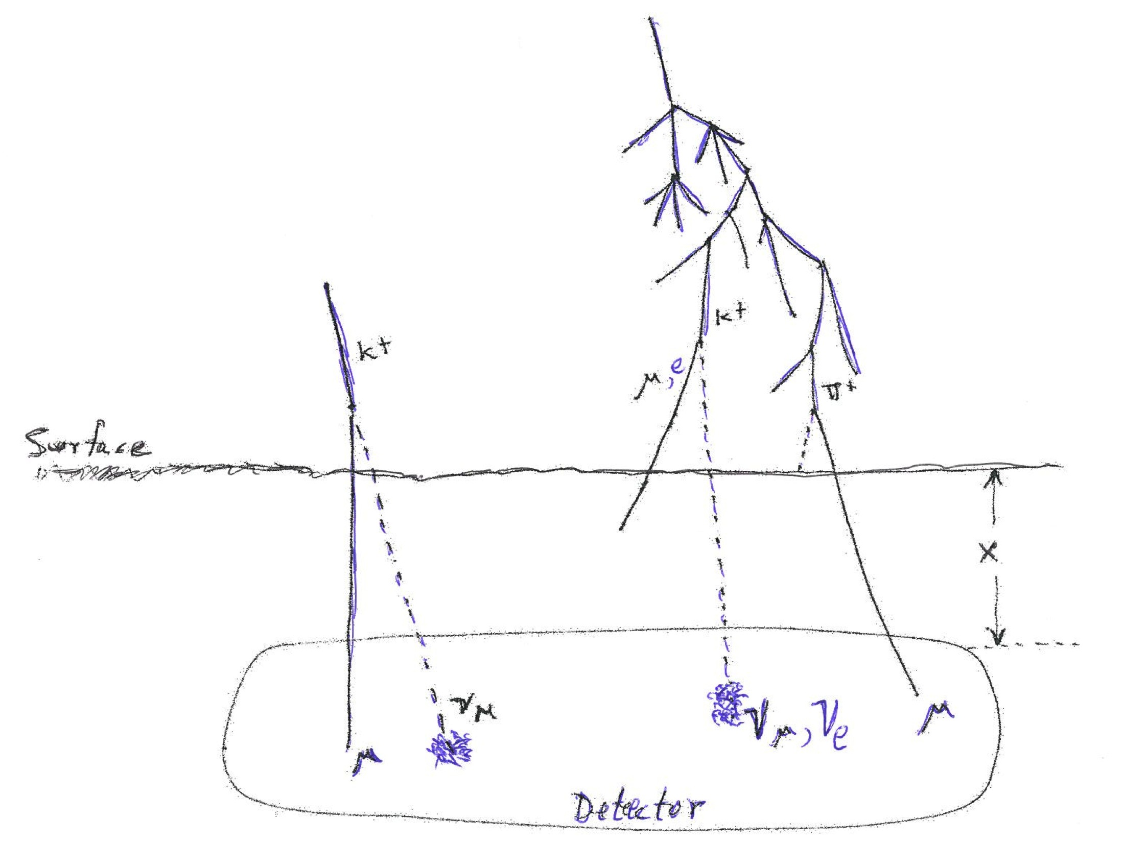
Atmospheric neutrino self veto
Two cases
2. Veto by an unrelated μ
--also applies to ν_{e}
Requires Monte Carlo or numerical integration
1. Stefan Schönert et al.
Phys. Rev. D79 (2009) 043009
Can be evaluated analytically

Slide 29
E_{ν}-θ self-veto region
Earth shadow – neutrinos suppressed
Sketch of atmospheric ν self veto region
Atmospheric μ (or ν)

Slide 30
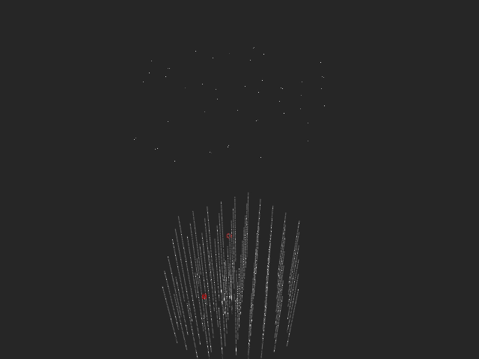
Surface veto example? (Event 28)

Slide 31
Summary of evidence
Excess of events at high energy (hard spectrum)
Flavor ratio:
  expect 2:1 cascades/tracks
  Observe 3:1, but energy not fully contained
Angular dependence
  Events from above without accompanying
  Several events with directions not allowed for energetic atmospheric neutrinos

Slide 32
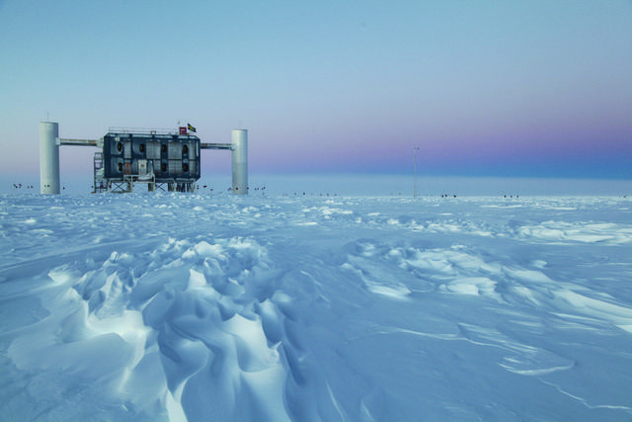

Slide 33
Questions?

