Slide 1



Cosmic neutrinos & cosmic particles in IceCube
Master class on
Neutrino Astronomy
Welcome!

Slide 2
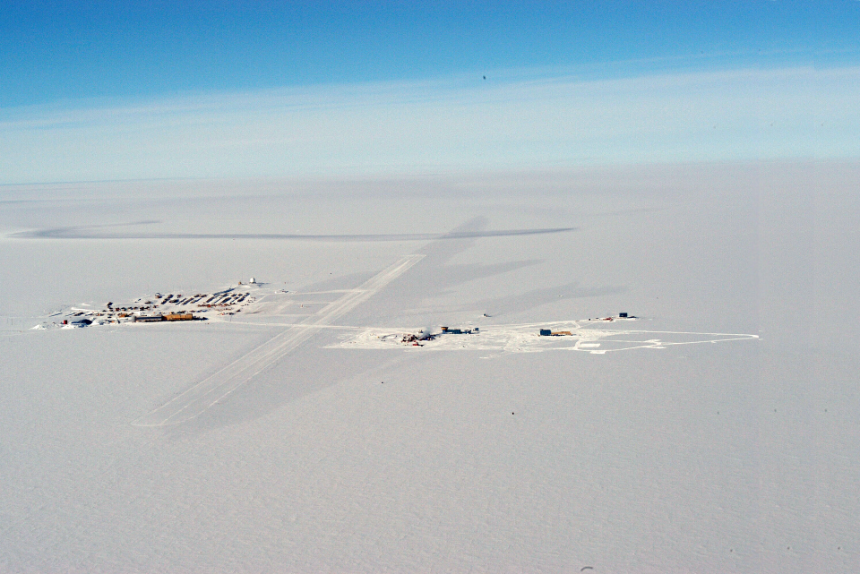
South Pole
2835 m.a.s.l.

Slide 3
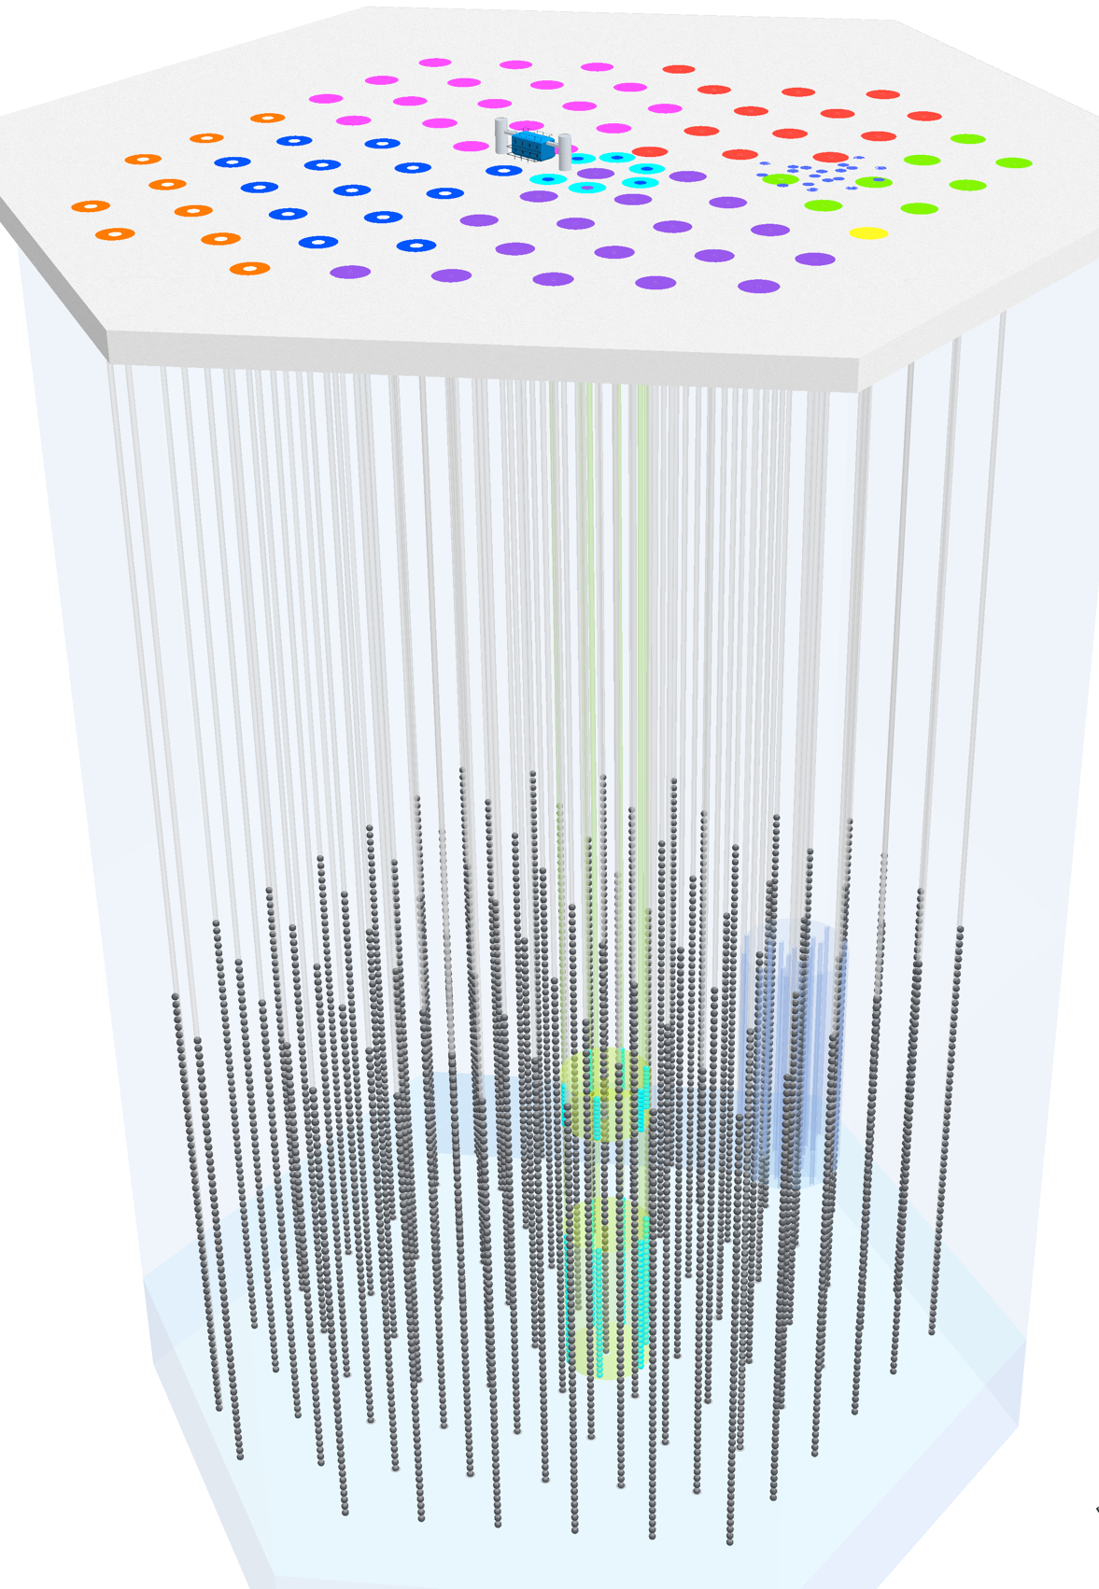
IceCube is a particle detector. It looks at particles from cosmic accelerators.
Cosmic ray showers from above
South Pole
2835 m.a.s.l.
IceTop
Neutrinos from all directions
ν_{μ}-induced μ (from below)
all flavors starting inside detector
1450 m
IceCube
2450 m
Atmospheric muons

Slide 4
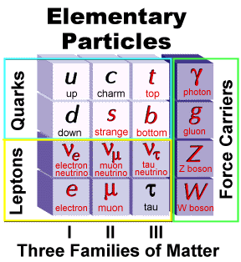
Neutrinos interact feebly—why?
Because weak force is carried by massive W,Z
Force carrier
Elementary particles are point-like (without structure)
Ordinary matter is composite and is mostly empty space
proton = { u u d }
neutron = { u d d }
nucleus = collection of protons and neutrons
Force is by exchange of massive W or Z with u, d quarks in the target nuclei

Slide 5
Particle theme
Each student’s name tag will identify her or him as a particle
Particles may be electrically neutral or charged
Some particles feel all three foreces
Strong, electromagnetic, weak
Some particles feel only e-m and weak
Some particles (neutrinos) interact only by the weak force

Slide 6
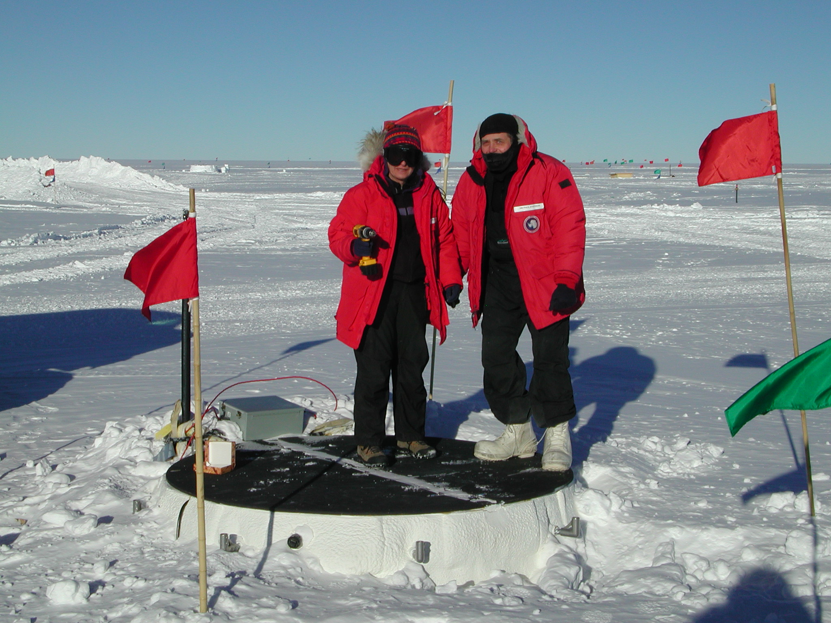
Introductions:
Serap Tilav
Paul Evenson

Slide 7
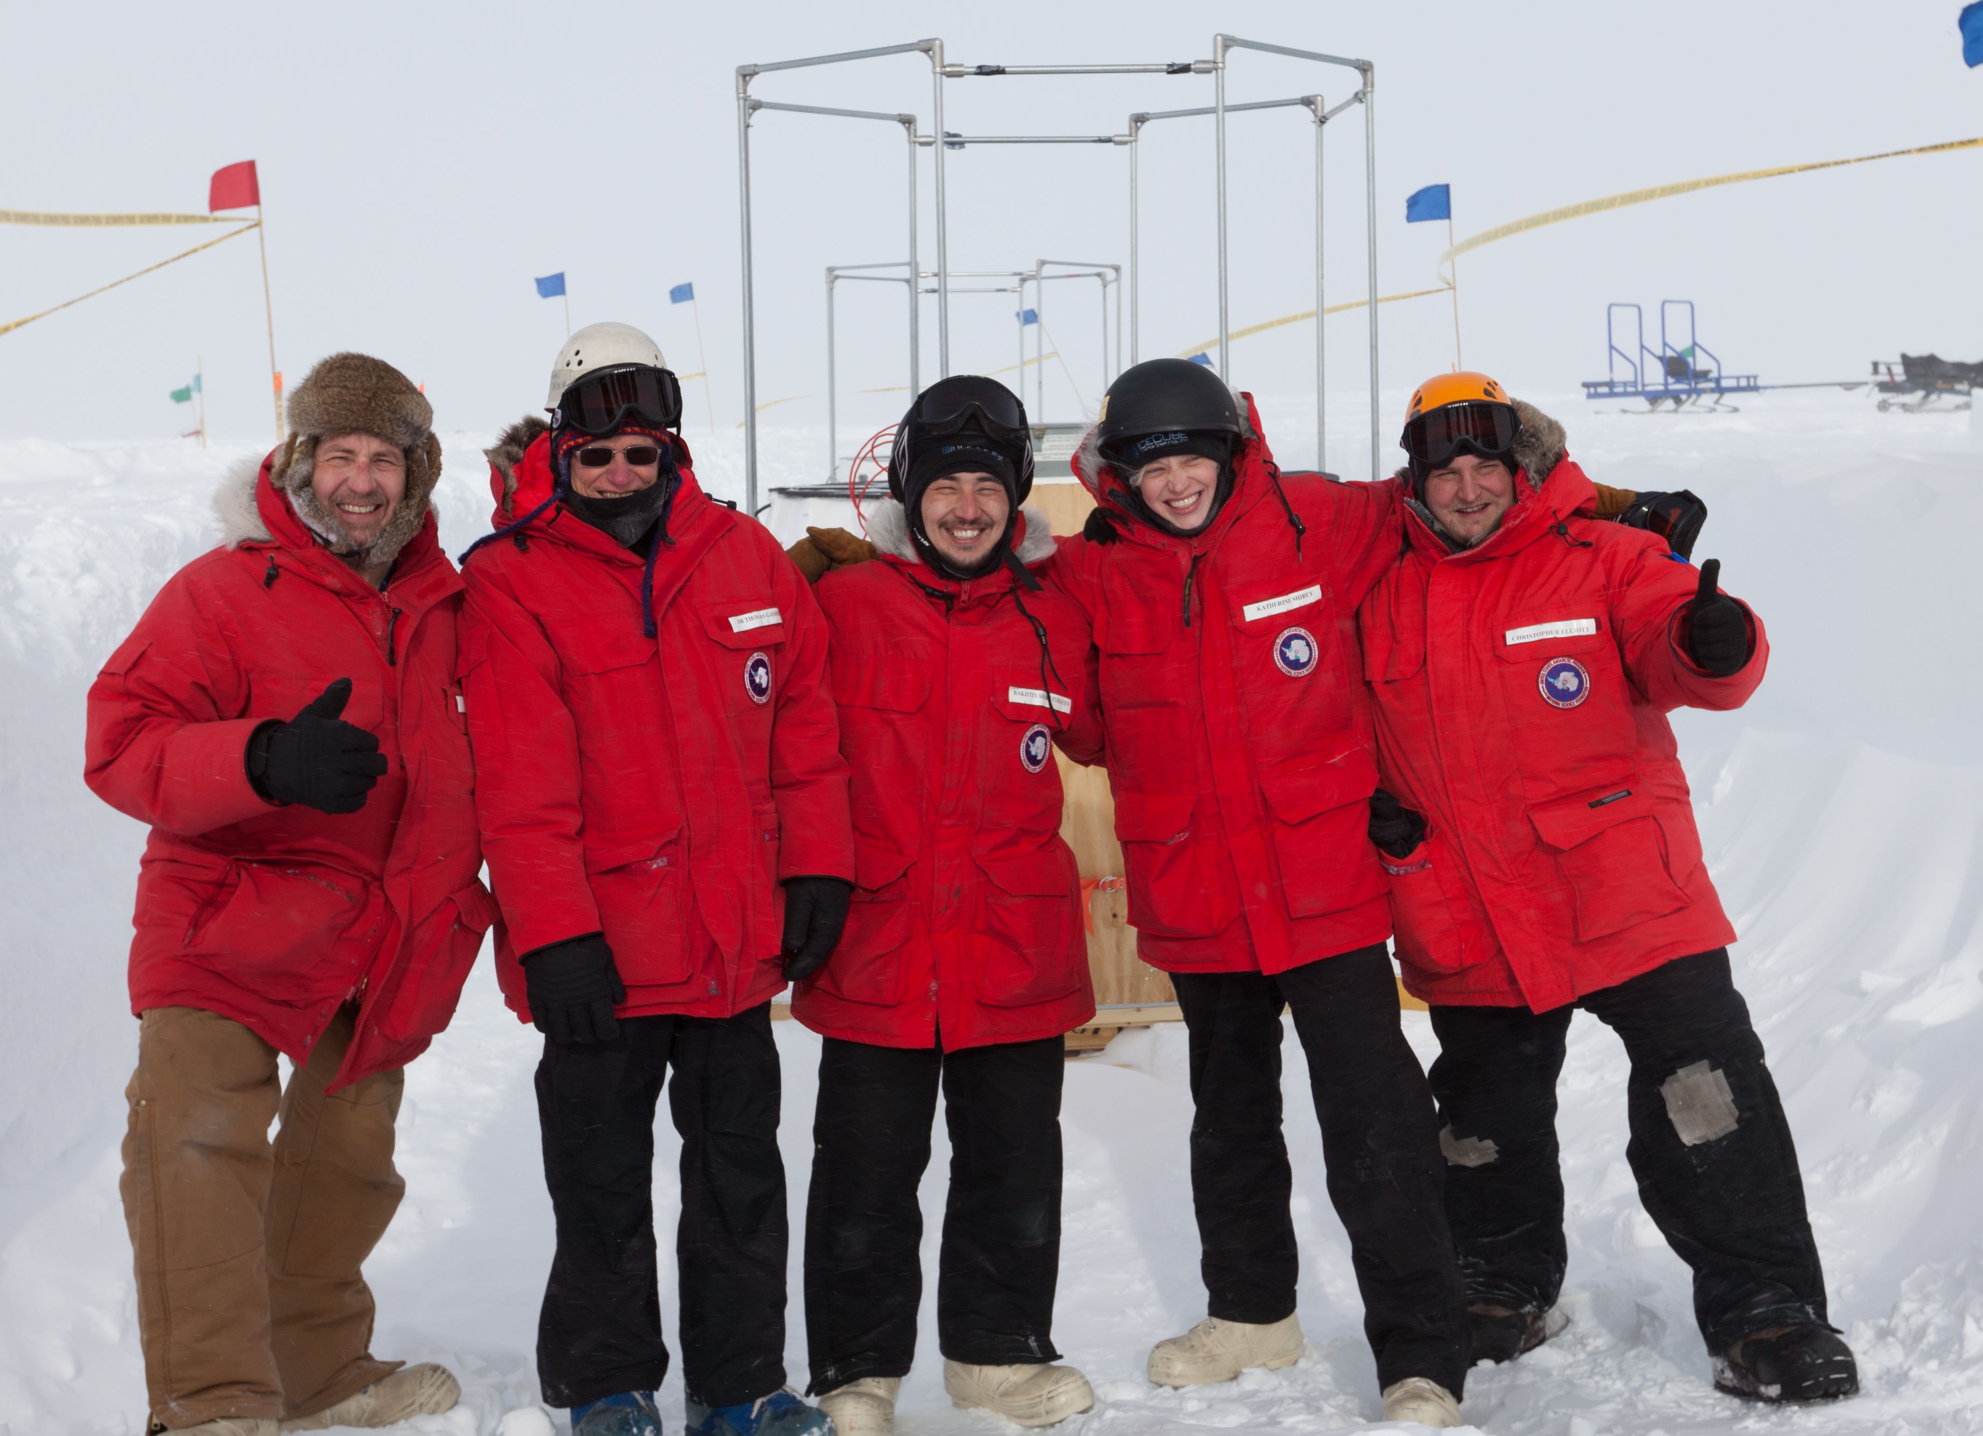
2010-11 season
Tom
Gaisser
Bakhtiyar
Ruzybayev
James Roth
Katey Shirey*
Chris Elliott
*High school teacher from DC area, now a candidate astronaut

Slide 8
Welcome to UD!

