Slide 4
81
324

Slide 5
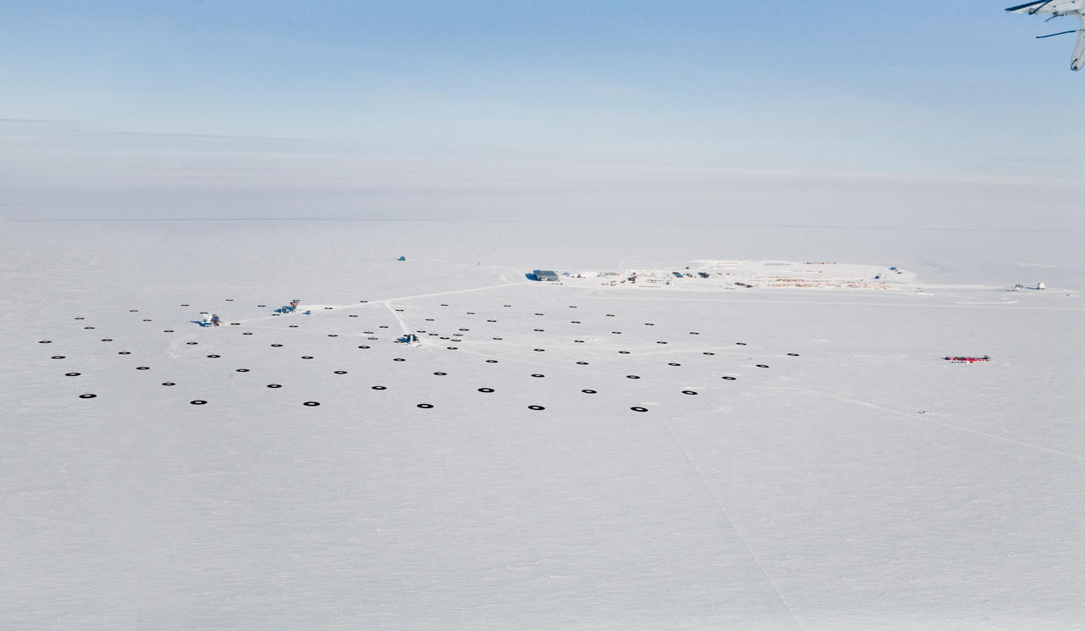
IceCube @ South Pole
completed in 2010-2011 austral season

Slide 6
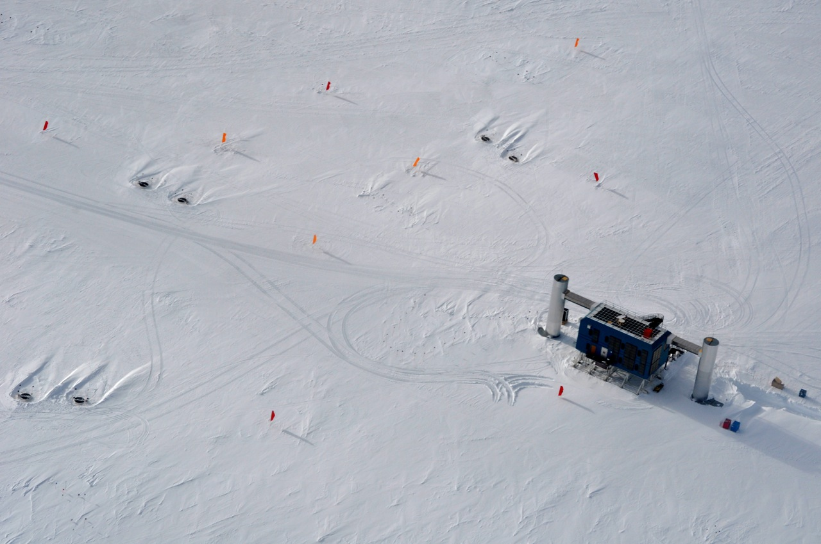
125m
10m
IceCube Laboratory
South Pole, Feb 2011
Serap Tilav

Slide 13
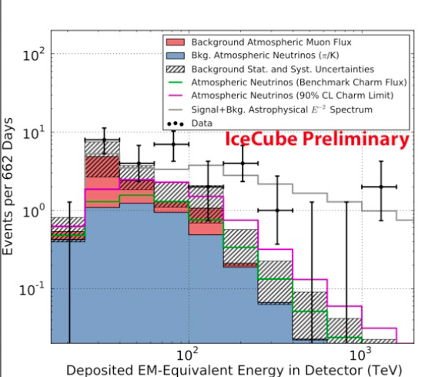
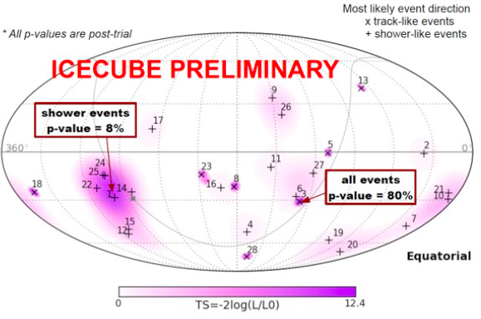
28 events on a background of 10.6 (+4.5/-3.9)
Directions
in Equatorial Coordinates
Energy Spectrum
Harder than any
expected atmospheric
background
No significant clustering
5 events near Galactic Center

Slide 14
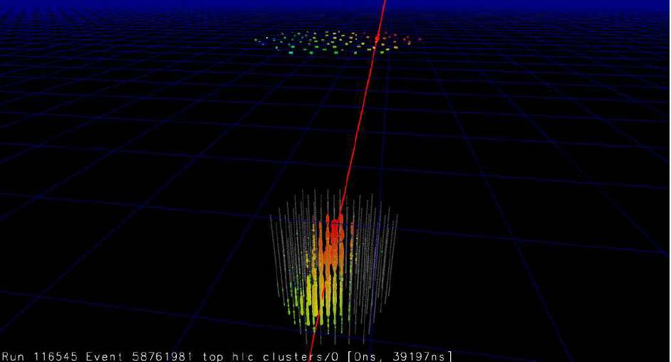
IceCube
Neutrino Telescope & 3D Cosmic Ray Detector
Air shower detection
@ 2835m altitude (692 g/cm²)
IceTop surface air shower array
81 Stations on the surface
2 Ice Cherenkov Tanks per Station
2 Digital Optical Modules per Tank
IceTop
EM component near shower max
shower size & arrival times over 1km²
IceCube
Muonic component @ 1450m-2450m depth in ice
muon bundle energy over 1km
IceCube Array
86 Strings @1450-2450 m depth in ice
60 Digital Optical Modules per String
IceTop: Calibration device for IceCube
➔ measure cosmic ray spectrum and composition as input to neutrino calculations

Slide 15
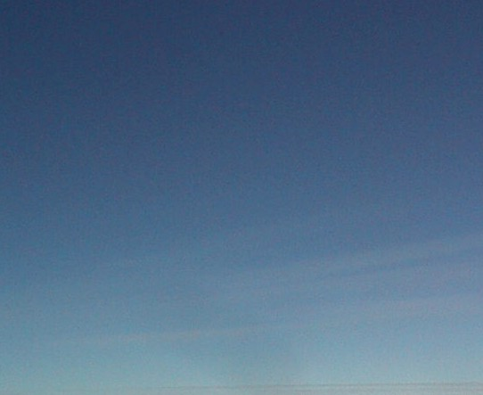
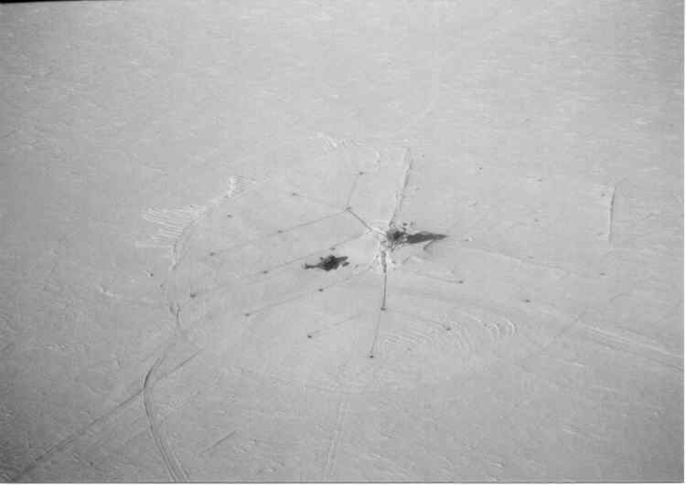
Primary Cosmic Ray
Interaction with atmospheric nuclei
Air Shower

Slide 16
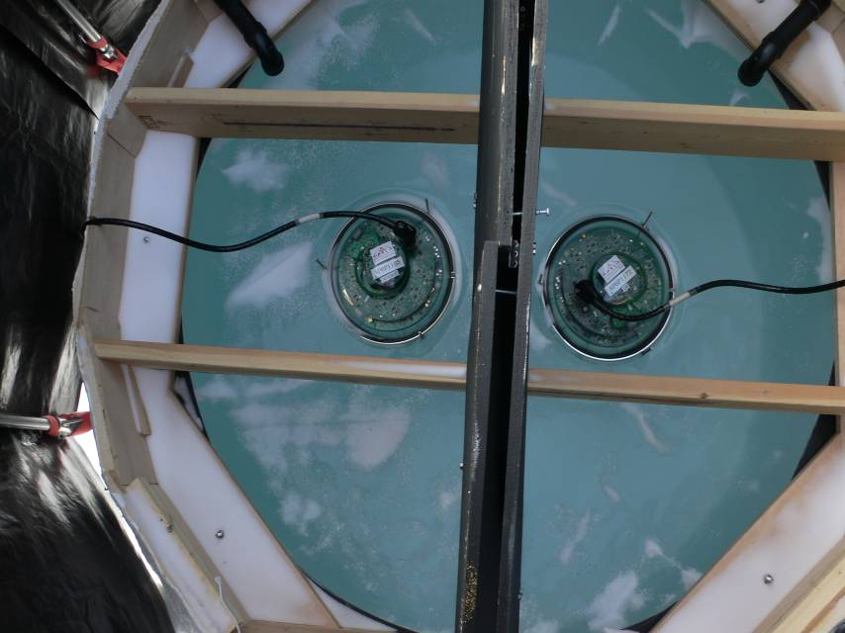
IceTop Tank
perlite
0.9 m
ice
Diffusely reflecting liner
2 m
Solid block of clear ice
“ Ice Cherenkov Tank”
Single tank detects secondary
particles in air showers :
-- MeV e±
-- converting γ
-- ~1 GeV μ
Light yield (Cherenkov and stochastic) for each particle type is derived from a detailed GEANT4 simulation and parameterized

Slide 17
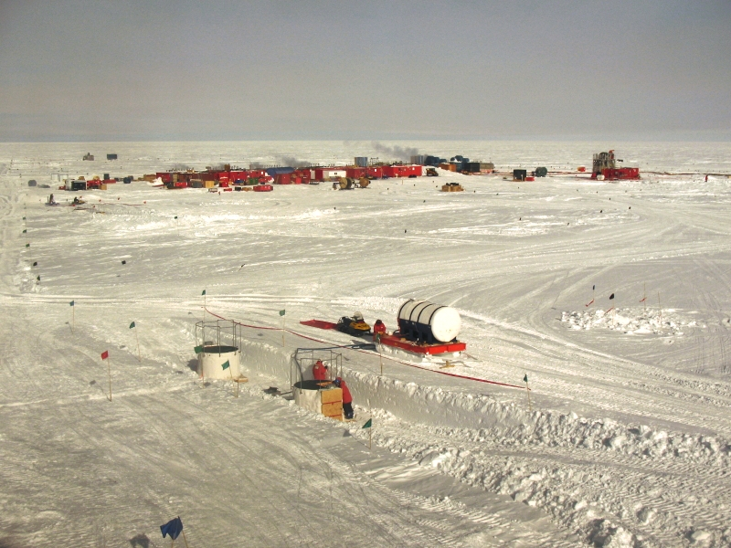
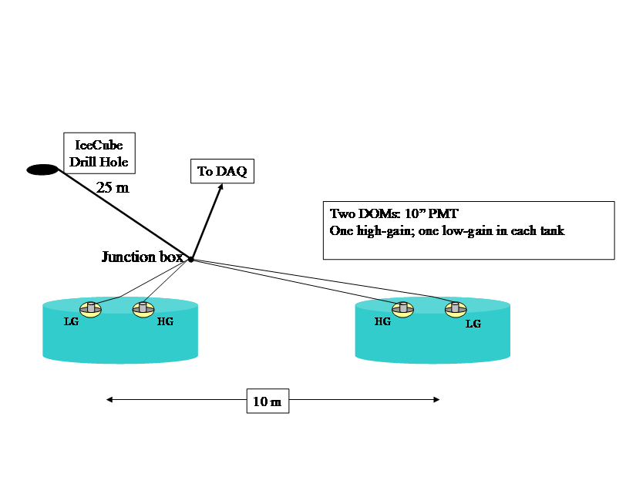
IceTop Station
Photo: James Roth, Dec 8, 2007
2 tanks per station
1 tank hit → muon, e or γ
both tanks hit → air shower
2 DOMs per tank
1 HG, 1 LG for dynamic range

Slide 18
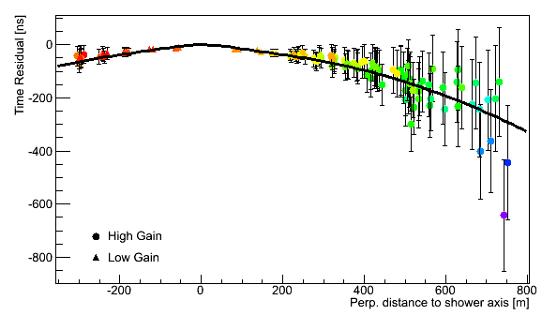
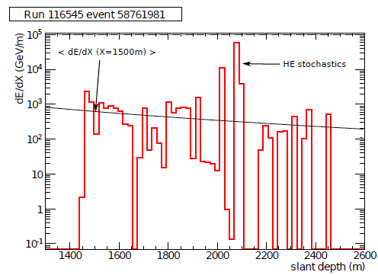
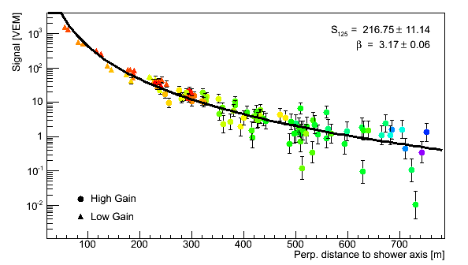
Air Shower Reconstruction
On the surface:
Shower core: x,y,z
Shower direction: θ,ϕ
Shower front
from arrival times
β
S₁₂₅
S₁₂₅ : signal at r = 125m
β : slope at r = 125m
κ : fixed at 0.3
On the surface:
IceTop shower size S₁₂₅ and β
In deep ice:
Muon bundle energy loss
dE/dX (GeV/m) and stochastic behavior

Slide 19
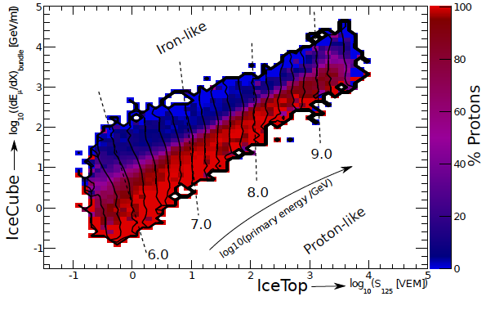
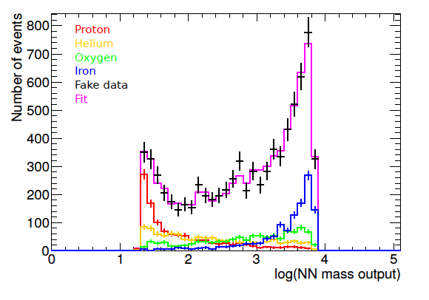
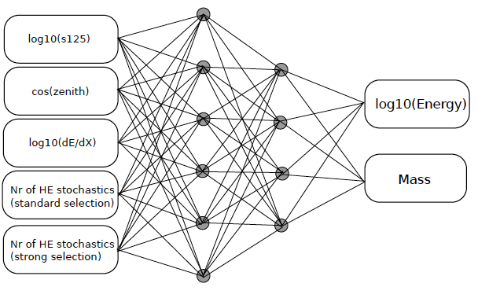
IceCube-79 / IceTop-73 Coincidence Analysis
5-6-4-2 Neural Network to map 5 observables to Primary Energy and Mass
Energy spectrum directly from NN output
Composition from fitting data in E_{reco} bins to template histograms (H,He,0,Fe) from NN mass output
e.g. Template histograms for 4 mass groups in one energy bin for a fake dataset scrambled from MC

Slide 20
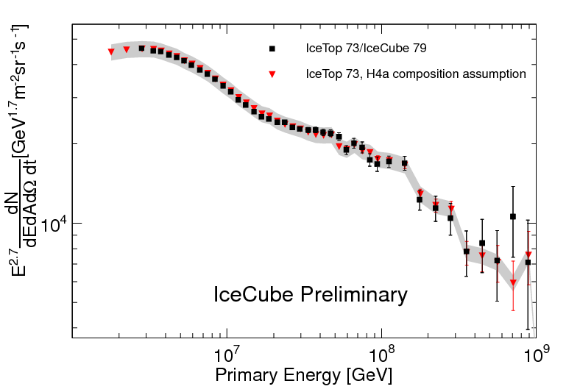
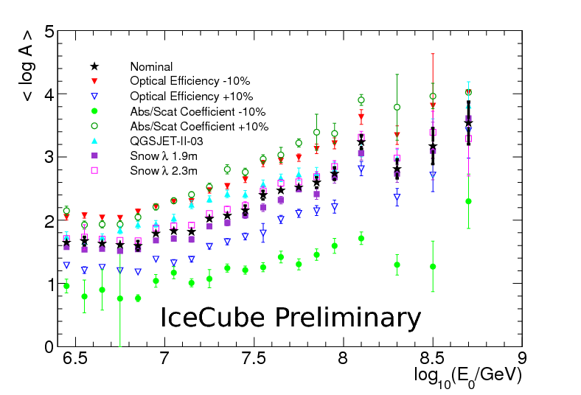
IceCube-79 / IceTop-73 Coincidence Analysis
Large structures in PeV cosmic-ray spectrum
Composition
<lnA>
gray band is ±7 composition systematics of IceTop-73 analysis
Highest resolution spectrum ever measured by air-shower experiment
Spectrum does not follow a simple power law
clear trend towards heavier composition up to ~100 PeV

Slide 21
New era in ν astronomy
A step closer in understanding
high-energy cosmic particles

