Slide 1

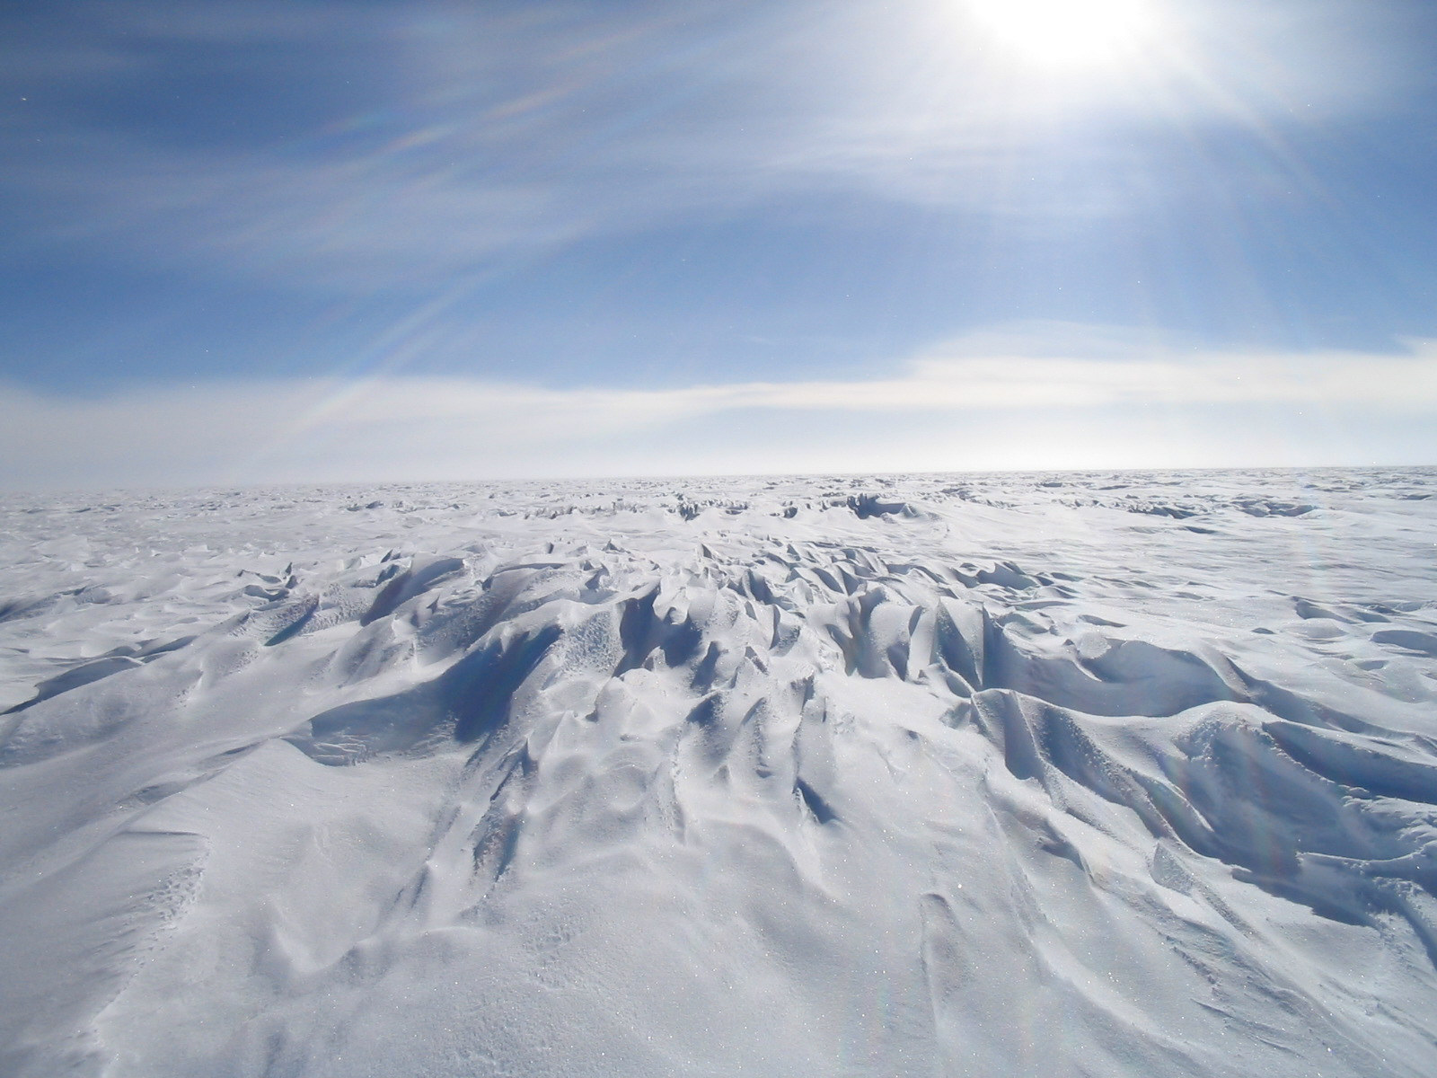
Towards Neutrino Astronomy: the IceCube Experiment at the South Pole
James Madsen
IceCube Associate Director for Education and Outreach
May 21, 2014

Slide 2
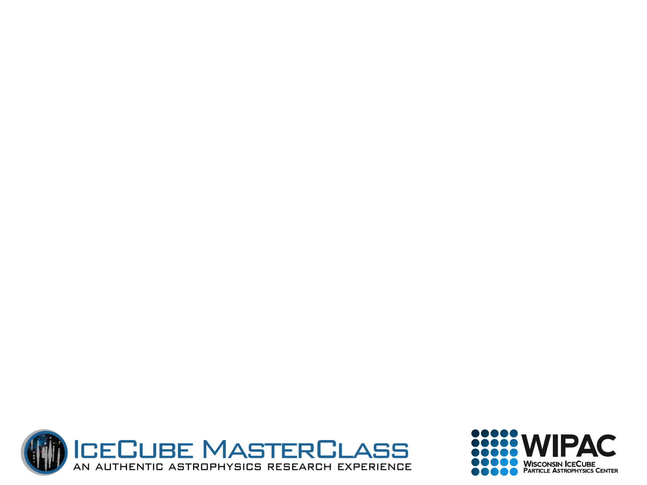
IceCube: the strangest detector
IceCube is a cubic-kilometer-size detector, with more than 5,000 light detectors frozen in the Antarctic ice at depths between 1,500 and 2,500 meters.
IceCube was built to detect neutrinos produced in galactic and extragalactic sources.
With those neutrinos we will learn more about the most energetic and most violent objects in the Universe!

Slide 3
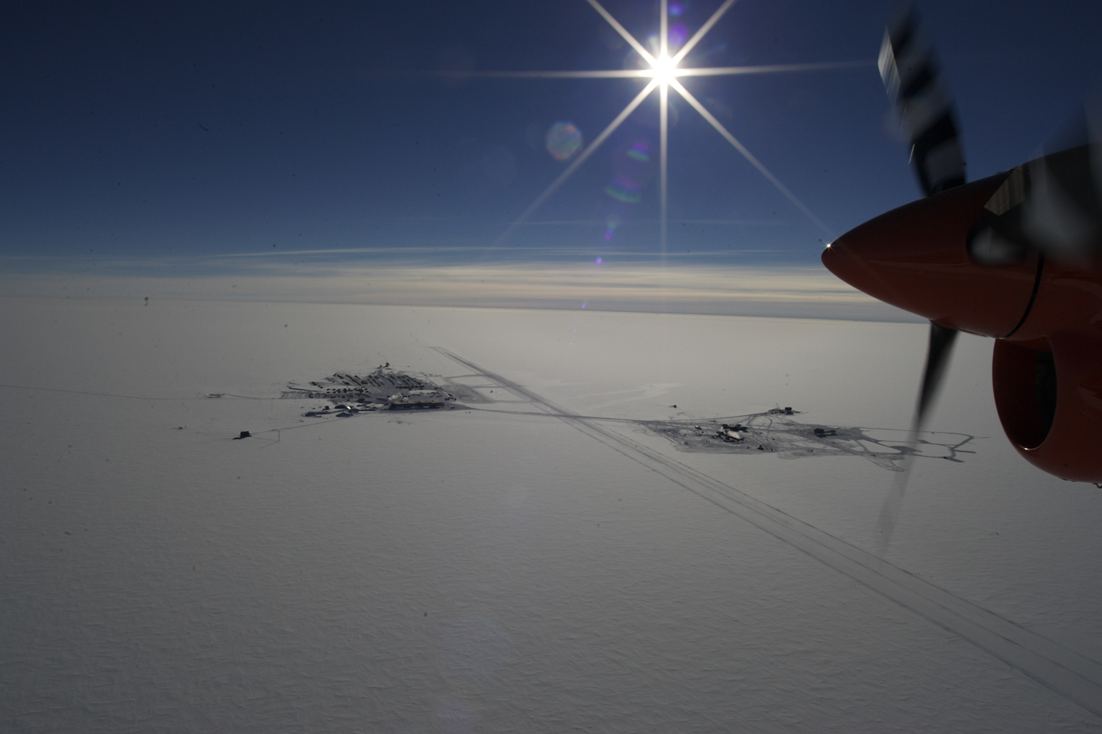
Amundsen-Scott South Pole Station

Slide 4
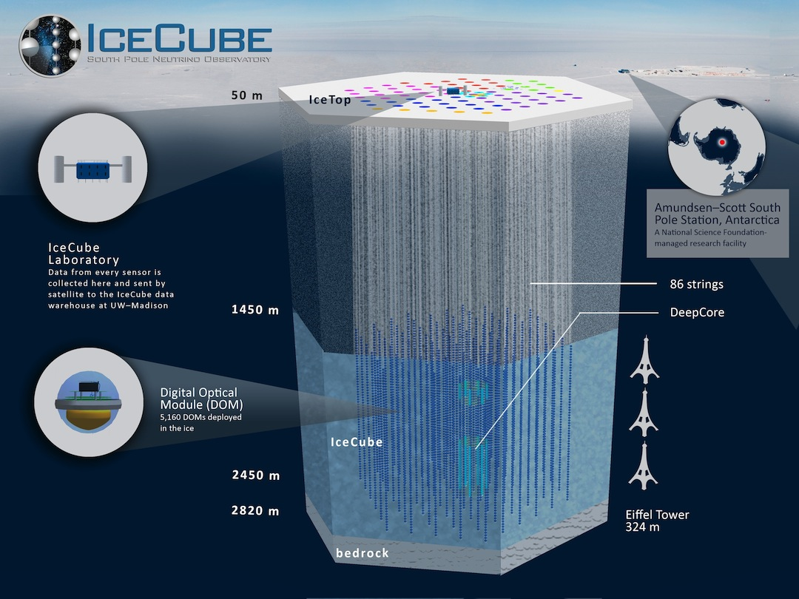

Slide 5
IceCube: a new era for astronomy
“Classical” Astronomy – electromagnetic spectrum from radio to X-rays.
Gamma-ray Astronomy – photons (light particles) with energies 10¹⁰ larger than optical light.
Cosmic Rays – protons and heavier nuclei with energies up to several Joule, the highest energy particle energies observed in the Universe.
Neutrinos – tightly connected to cosmic rays and their sources, but neutral and not subject to deflection in magnetic fields (= easier for “astronomy” because they point to their sources).

Slide 6
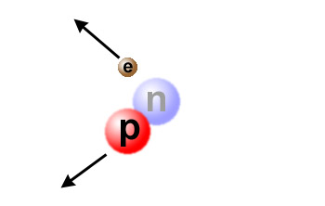
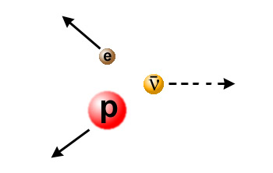
Neutrinos
The fundamental building blocks of atoms (and therefore of the world we know) are…
  Neutrons
  Protons
  Electrons
In nuclear reactions, neutrons can turn into protons and vice versa by emitting an electron (β decay).
Something is missing… or total momentum is not conserved!

Slide 7
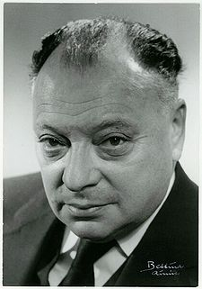
Neutrinos: the ghost particles
To “fix” the picture, Wolfgang Pauli invented a new particle that is very light and has no charge - the neutrino (the “small neutral one”).
Neutrinos usually escape unseen - they interact very little with anything, move almost at the speed of light and are difficult to catch.
“I have done a terrible thing, I have postulated a particle that cannot be detected.”
Wolfgang Pauli (1900-1958)

Slide 8
Neutrinos: the ghost particles
The neutrino was eventually detected by Reines and Cowan in 1956 in a nuclear reactor, three years before Pauli’s death.
Pauli’s response: “Everything comes to him who knows how to wait.”
Neutrinos are produced wherever there are nuclear reactions, for example in the Sun. More than 50 trillion (50×10¹²) solar neutrinos pass through your body every second.
Neutrinos rarely interact - they just zip through almost everything - and are therefore hard to detect!
Wolfgang Pauli (1900-1958)

Slide 9
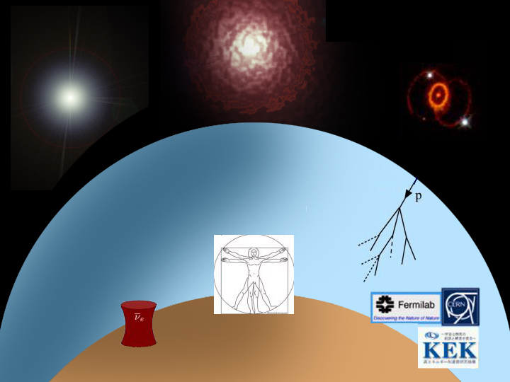
Big Bang
Sun
Supernova
1987a
Atmosphere
Human Body
Nuclear
Reactors
Accelerators
Earth

Slide 10
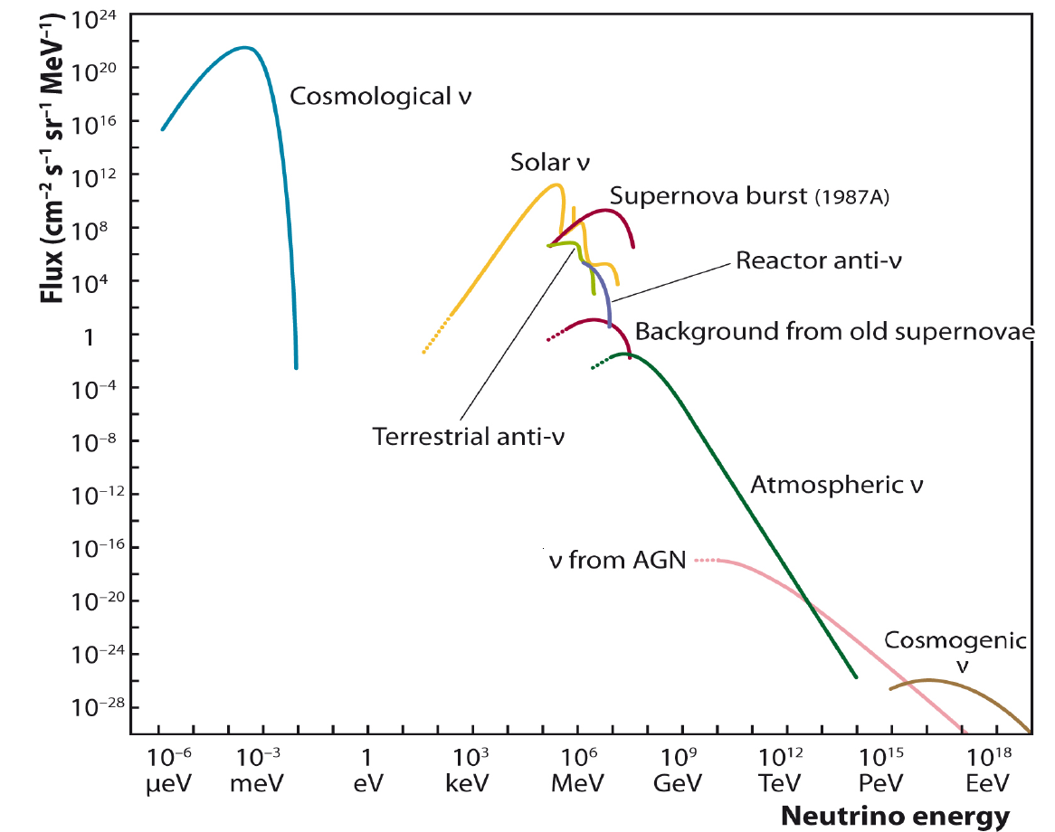
IceCube

Slide 11
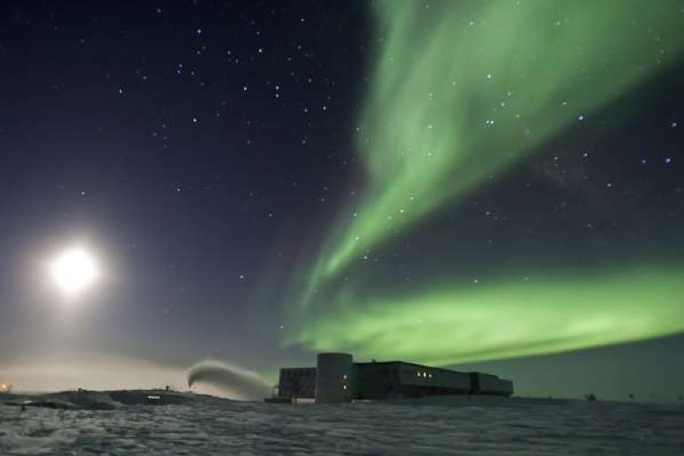
Why do we expect to see neutrinos from astrophysical sources?

Slide 12
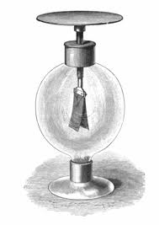
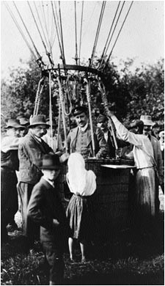
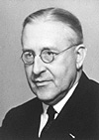
Victor Hess, 1912
Electroscopes discharge slowly even if no radioactive material is around - does the Earth radiate?
Victor Hess (1883-1964)

Slide 13
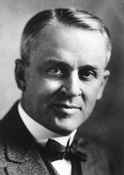
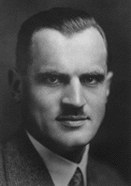
Cosmic Rays
Nuclei? Electrons? Photons?
After their discovery, the chemical nature of cosmic “radiation” was unclear for some time.
The name “cosmic rays” reflects Robert Millikan’s belief that they were gamma rays from space.
In the 1930s, it became clear that cosmic rays are mainly energetic particles.
Most ultra-high-energy cosmic rays are protons and heavier nuclei.
Robert A. Millikan
(1868-1953)
Arthur H. Compton
(1892-1962)

Slide 14

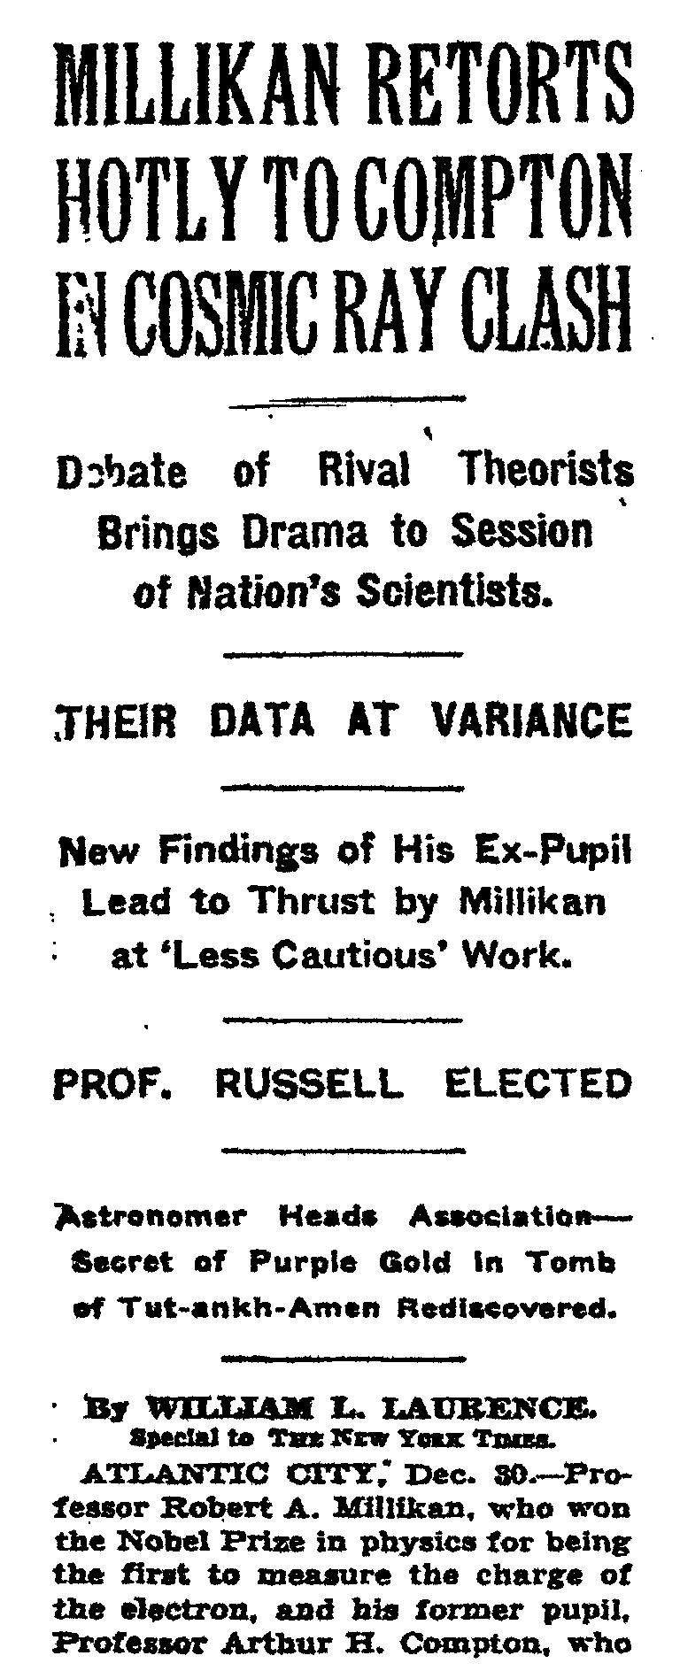
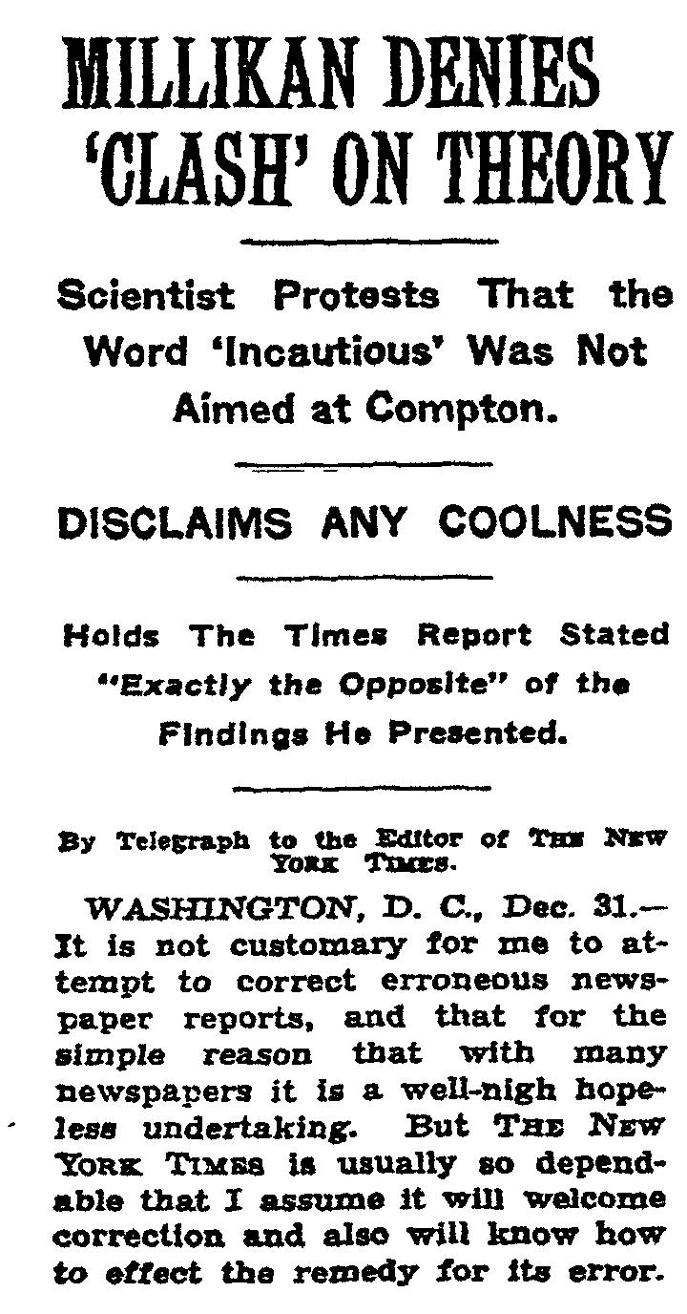
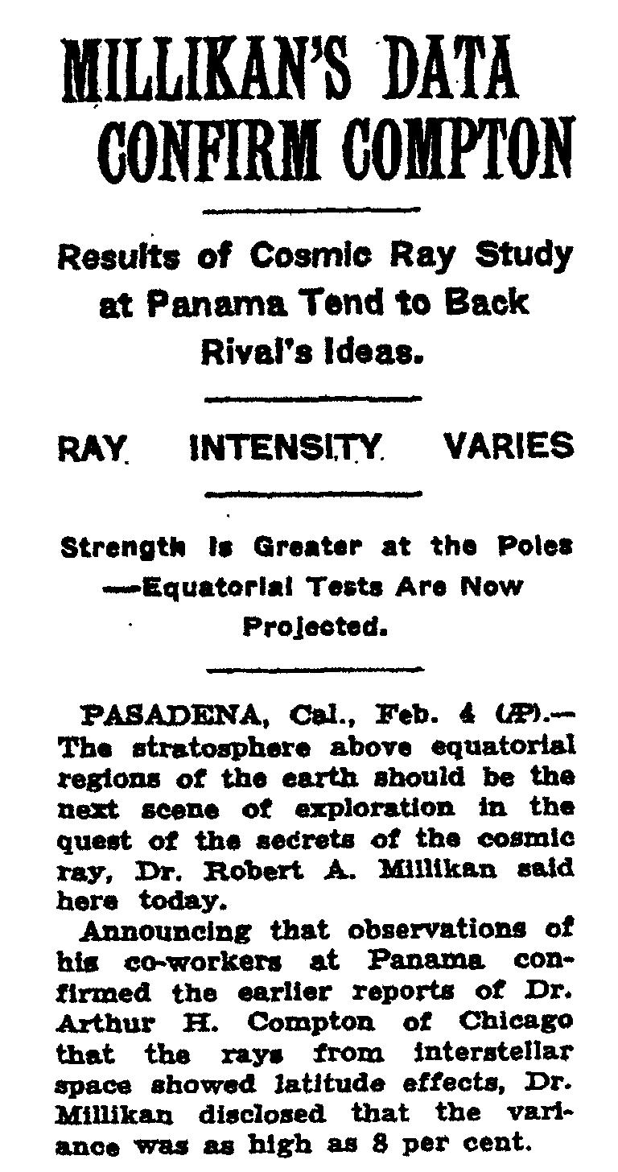

Slide 15
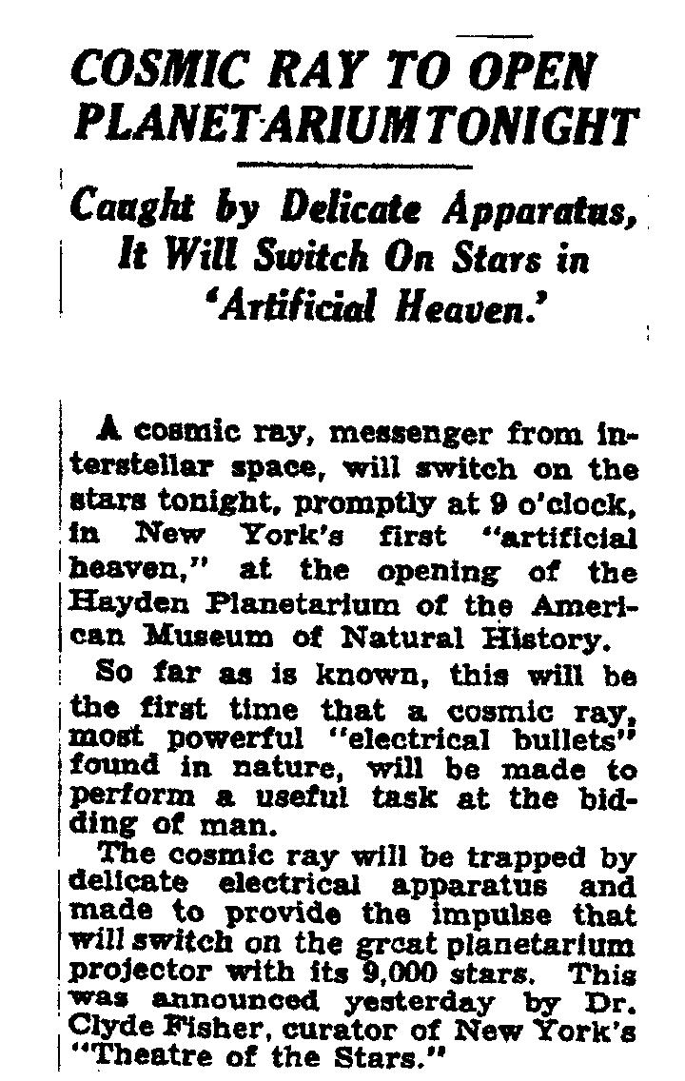
New York Times, Oct. 2, 1935
Opening of the Hayden Planetarium at the American Museum of Natural History
“So far as is known, this will be the first time that a cosmic ray… will be made to perform a useful task at the bidding of man.”

Slide 16
Cosmic rays: the highest energy particles
Cosmic rays are charged particles (protons or heavier nuclei) that continuously rain down on Earth from outer space.
A small fraction of them have energies in excess of several Joules, which makes them the highest energy particles in the known Universe.
Where do they come from? Do they point back to their sources? Can we do astronomy with these particles?
Notes:
Cosmic rays are charged particles (protons or heavier nuclei) that continuously rain down on Earth from outer space.
A small fraction of them have energies in excess of several Joules, which makes them the highest energy particles in the known Universe.
Where do they come from? Do they point back to their sources? Can we do astronomy with these particles?

Slide 17
Electronvolt eV
Our usual unit of energy, the Joule, is inconvenient when dealing with sub-atomic particles. Particle physicists therefore usually use of different unit, the electronVolt.
1 electronVolt (eV) is the amount of energy gained by an electron (or a particle with the same charge) when it is accelerated through an electrostatic potential difference of 1 Volt.
e⁻
1 eV = 1.60 ×10⁻¹⁹ Joule
-
+
1V

Slide 18
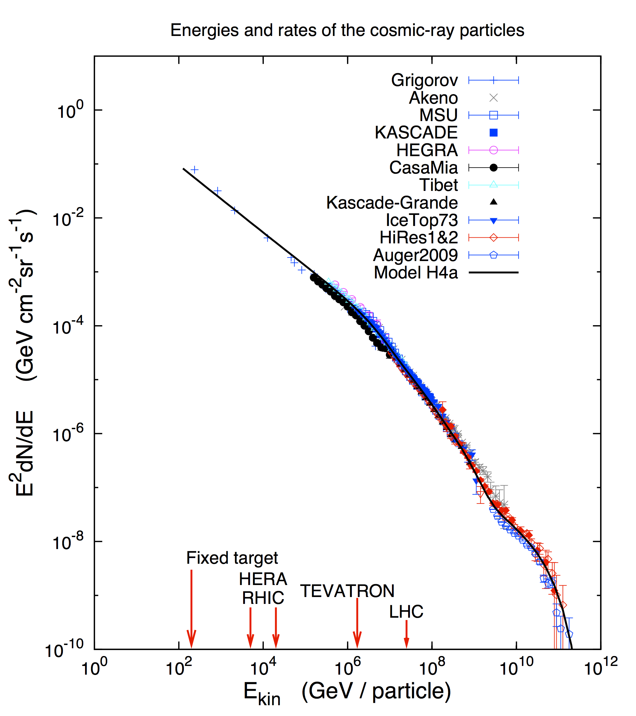
Cosmic Rays Energy Spectrum
The origin of cosmic rays at energies above GeV is unknown - no astrophysical object has ever been definitively identified as an accelerator of high energy nucleons.

Slide 19
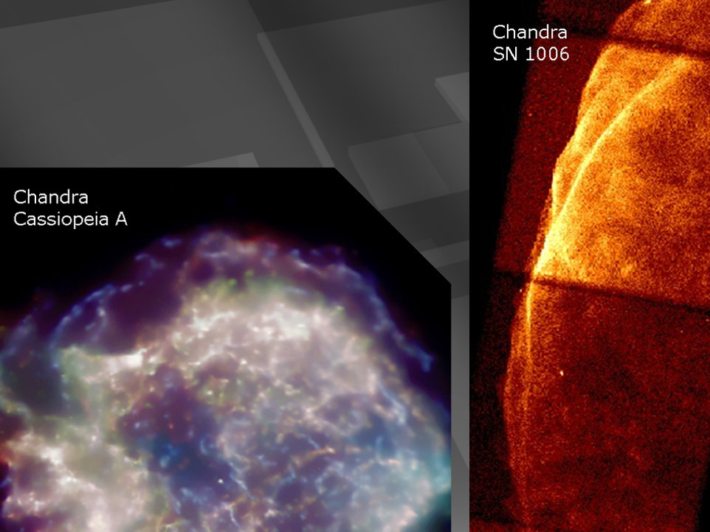
supernova remnants

Slide 20

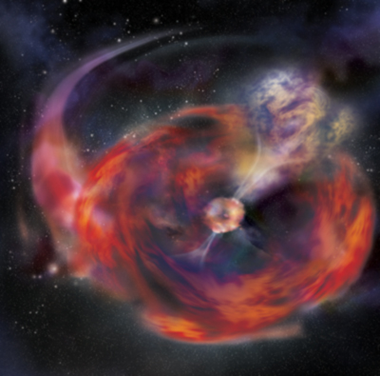

…and if the star collapses to
a black hole…
gamma ray burst
happens in seconds
not thousands of years
beamed along the spin
axis of the black hole
simulation not image

Slide 21
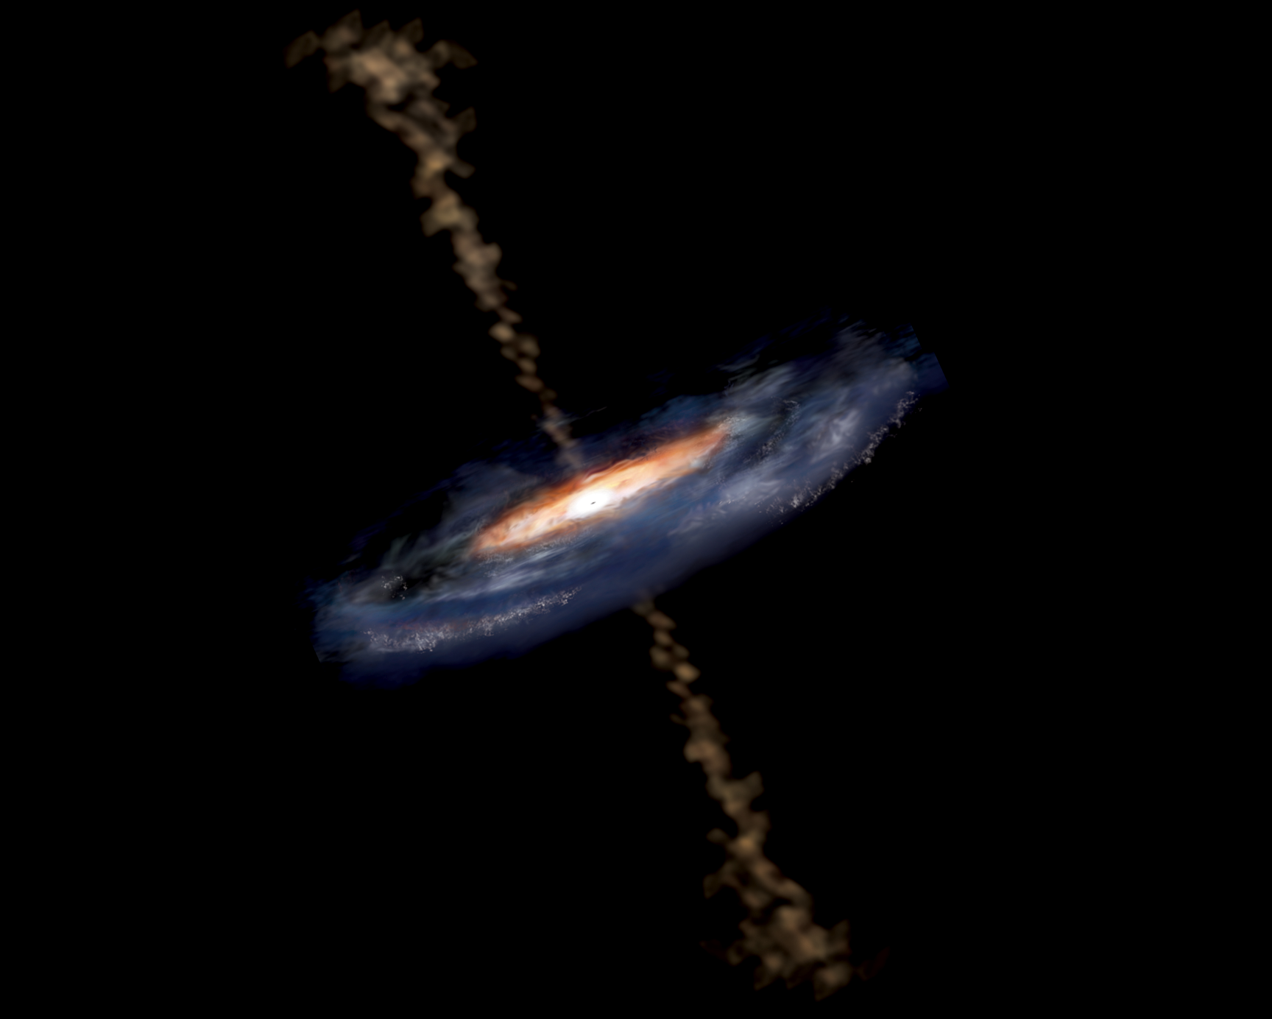
active galaxy particle flows near supermassive black hole

Slide 22
Origin of Cosmic Rays
Galactic origin
- Supernovae
- …
Extragalactic origin
- Active Galactic Nuclei
- …
Knee

Slide 23
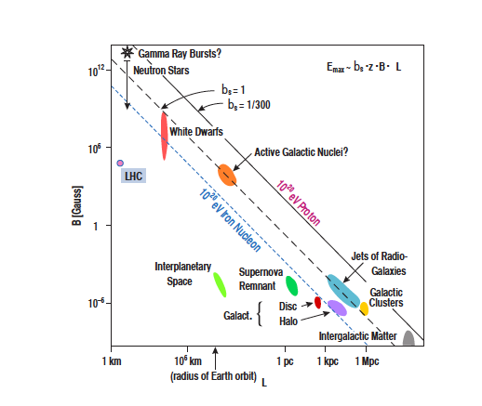
Extragalactic Sources?

Slide 24
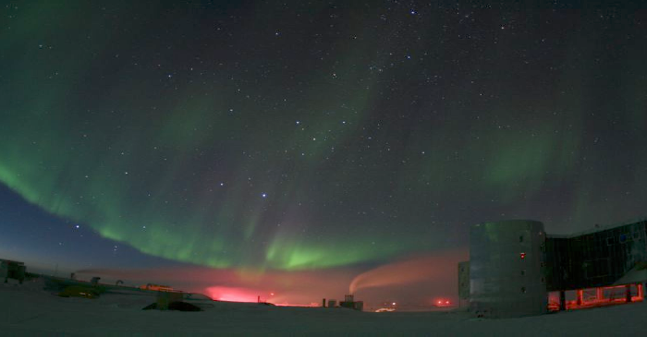
How can we find the sources of cosmic rays?
Do cosmic rays point back to their sources?
Is astronomy with (charged) particles possible?

Slide 25
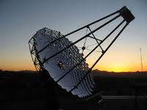
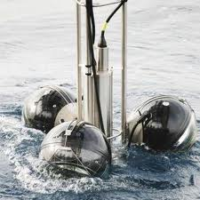

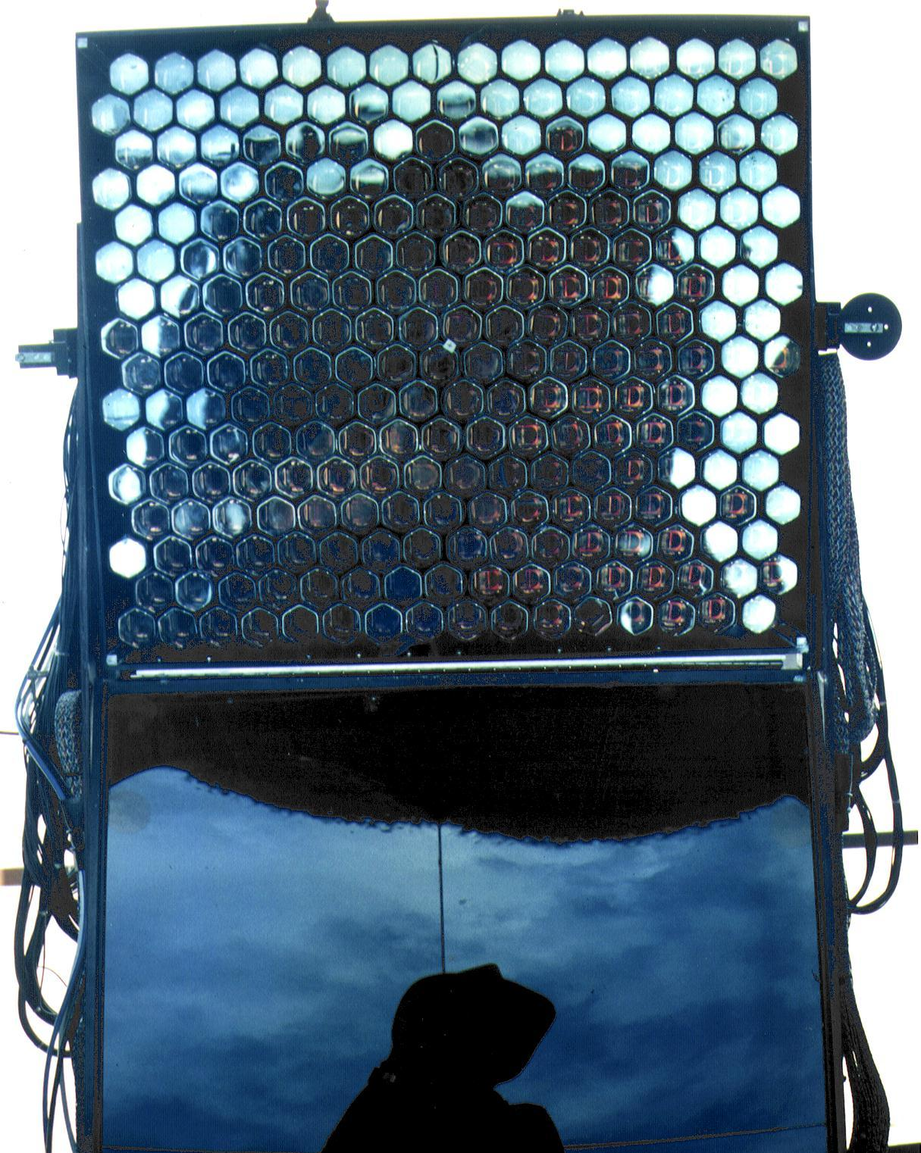
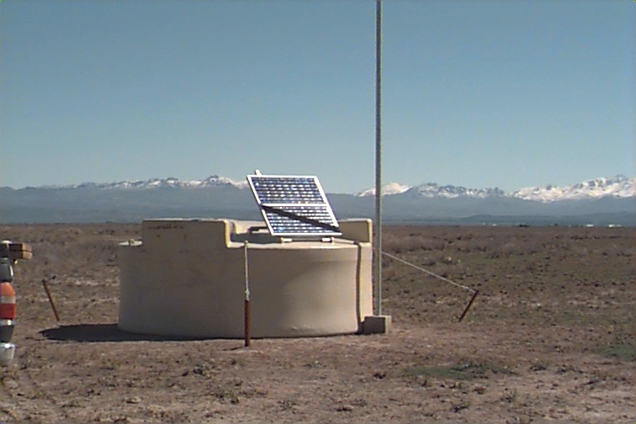
A World-Wide Effort
Antares/
KM3NeT
Veritas
Arizona
Yakutsk
Haverah Park
HiRes/TA
Lake Baikal
Utah
Milagro
AGASA
HAWC
Mexico
H.E.S.S.
Namibia
Auger
SUGAR
Argentina
IceCube
South Pole

Slide 26
Integral Flux
flux
1 particle
per m² per second
1 particle
per m² per year
“Knee”
1 particle
per km² per year
Requires large,
Earth-bound detectors!
“Ankle”
energy

Slide 27
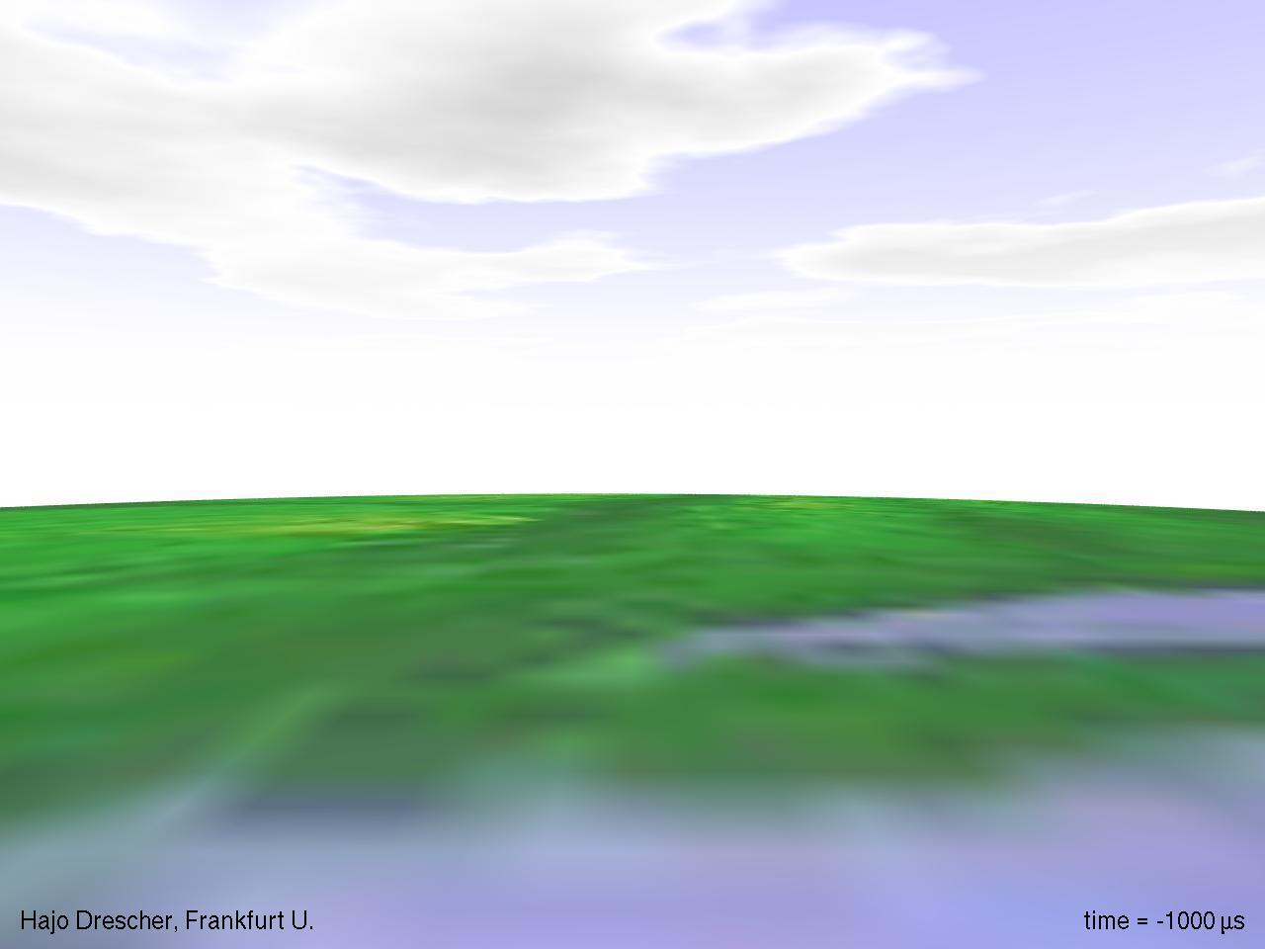

Slide 28
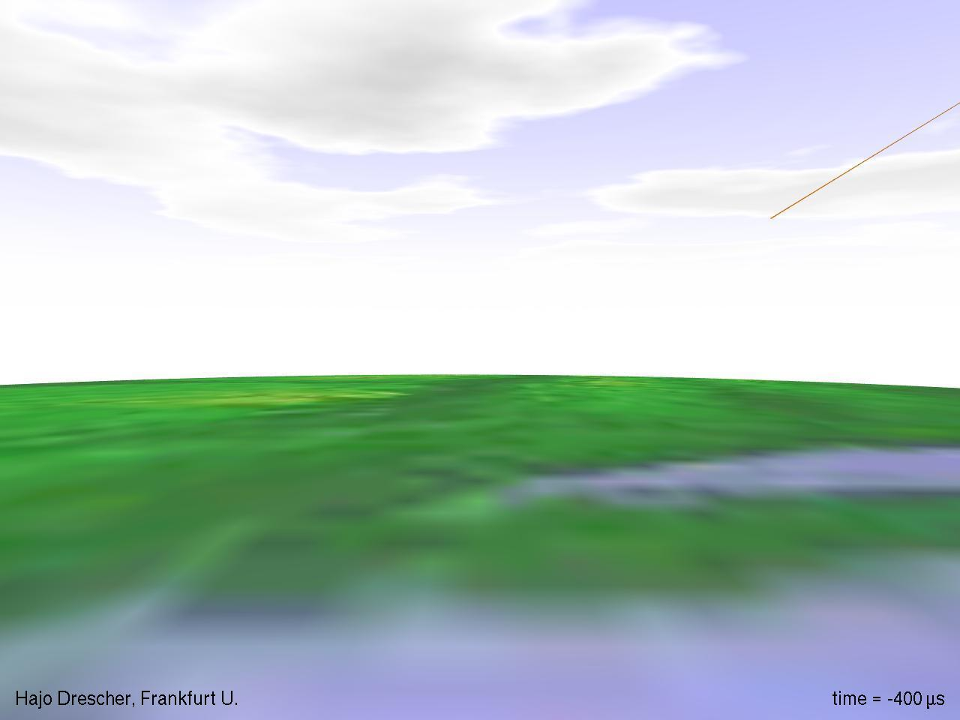

Slide 29
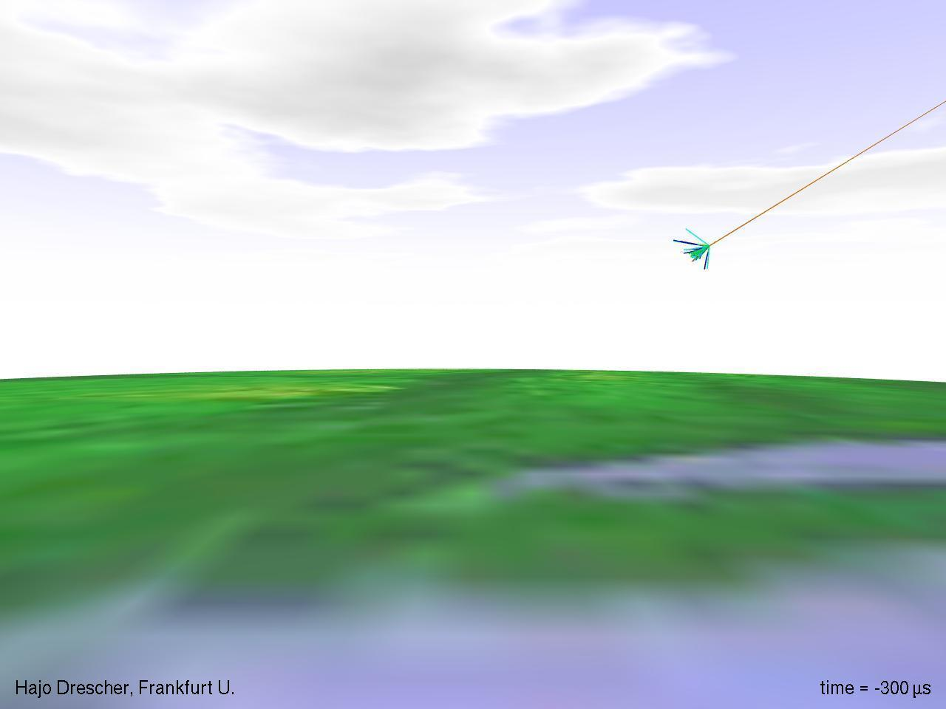

Slide 30
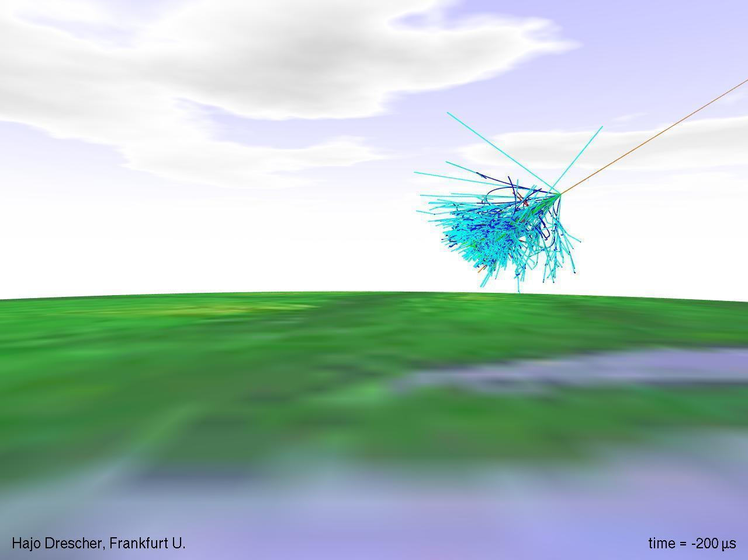

Slide 31
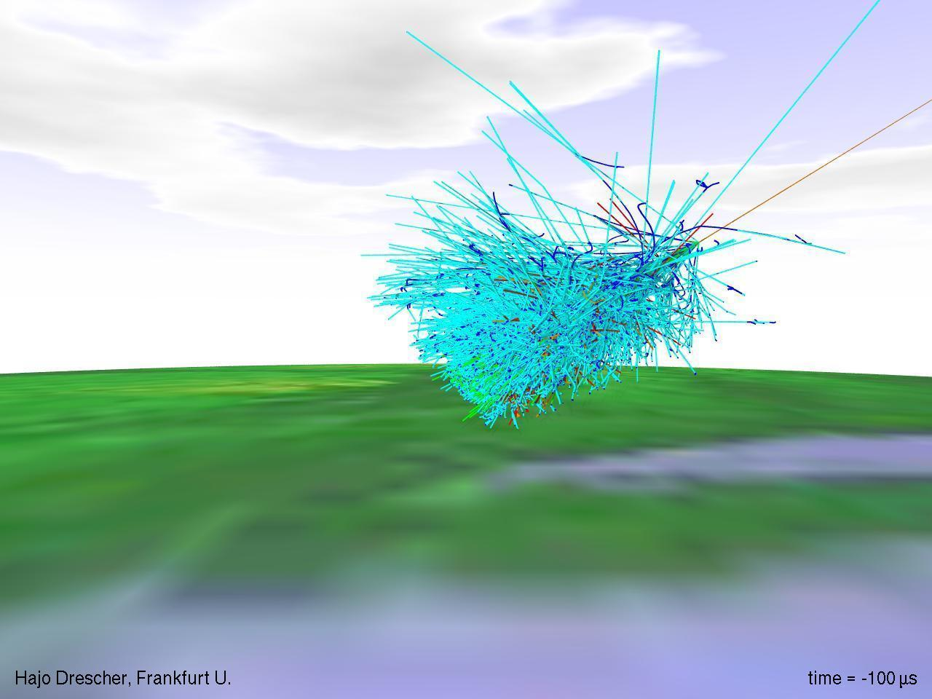

Slide 32
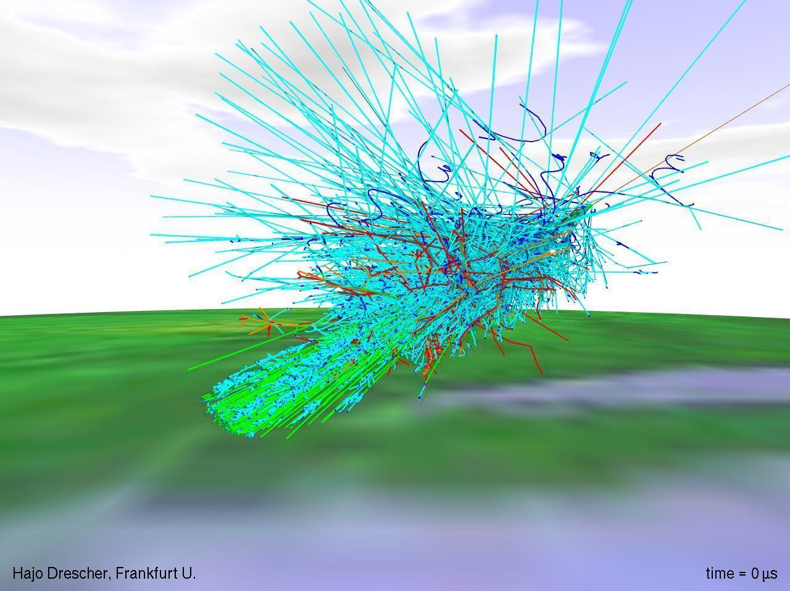

Slide 33
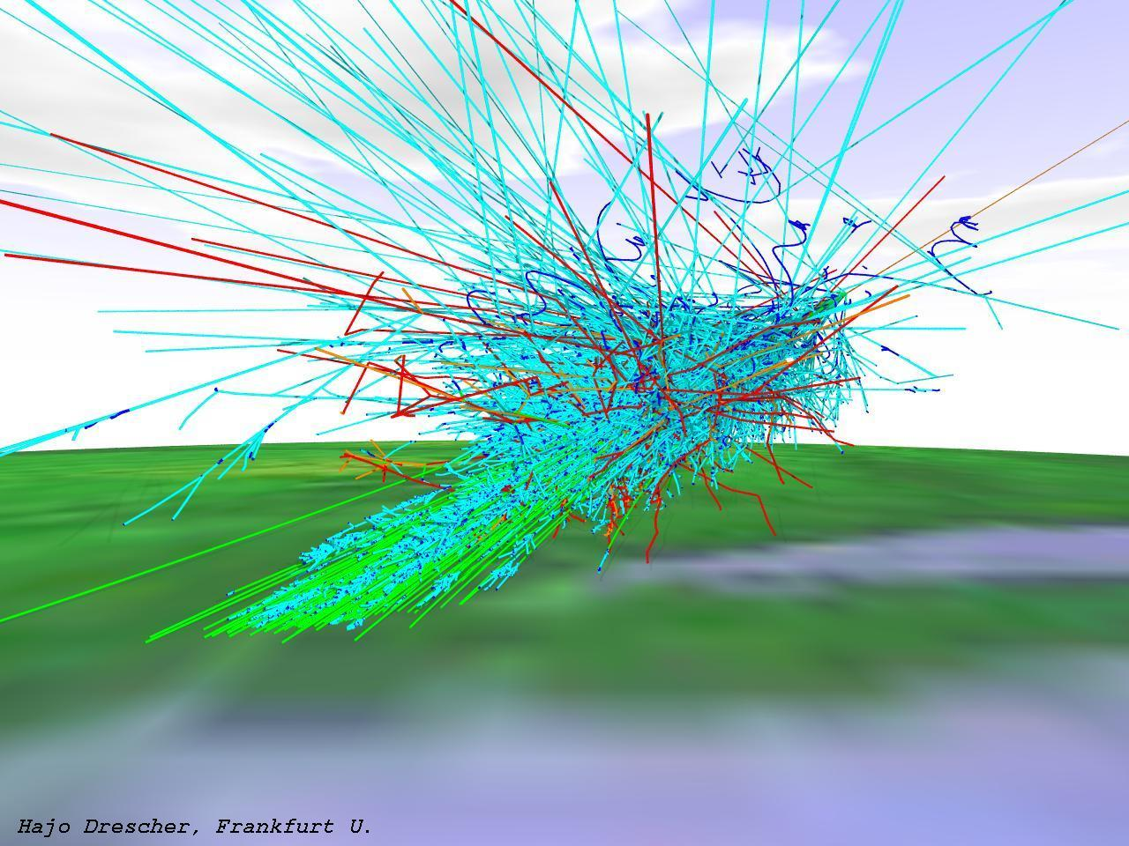
muon flux at sea level:
1 per cm² per minute

Slide 34
There are first indications that the cosmic ray flux might not be isotropic at the highest energies, but no source has been positively identified so far.
Maybe the particles do not point back to their sources - intergalactic and Galactic magnetic fields might scramble the arrival directions even at the highest energies!
Cosmic rays are not the only messenger from high energy sources -where there are cosmic rays, there are also neutrinos!

Slide 35
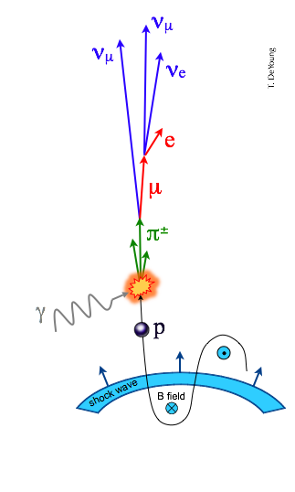
Messenger Particles
Cosmic rays are not the only messenger from high energy sources - a cosmic ray source is also a beam-dump.
Cosmic rays inevitably interact with radiation and gas surrounding their source, e.g.
Energy escaping the source is distributed among cosmic rays, gamma rays, and neutrinos.

Slide 36
supernova remnants

Slide 37
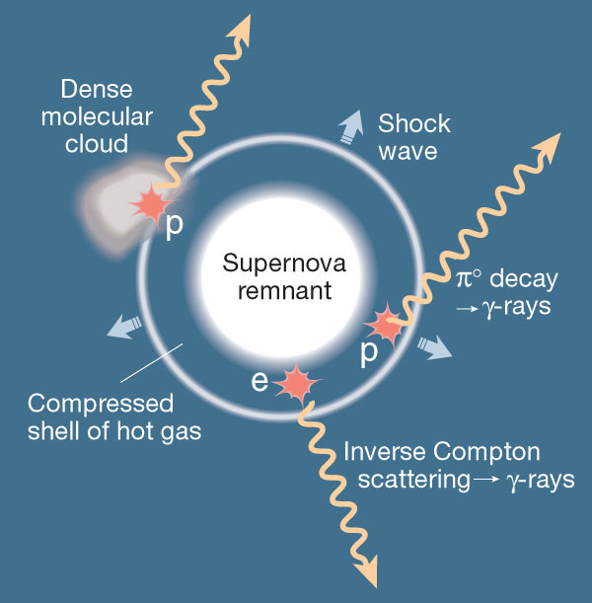
neutrinos
from supernova
remnants :
molecular
clouds in star-forming regions where super-nova explode: beam dumps!

Slide 38
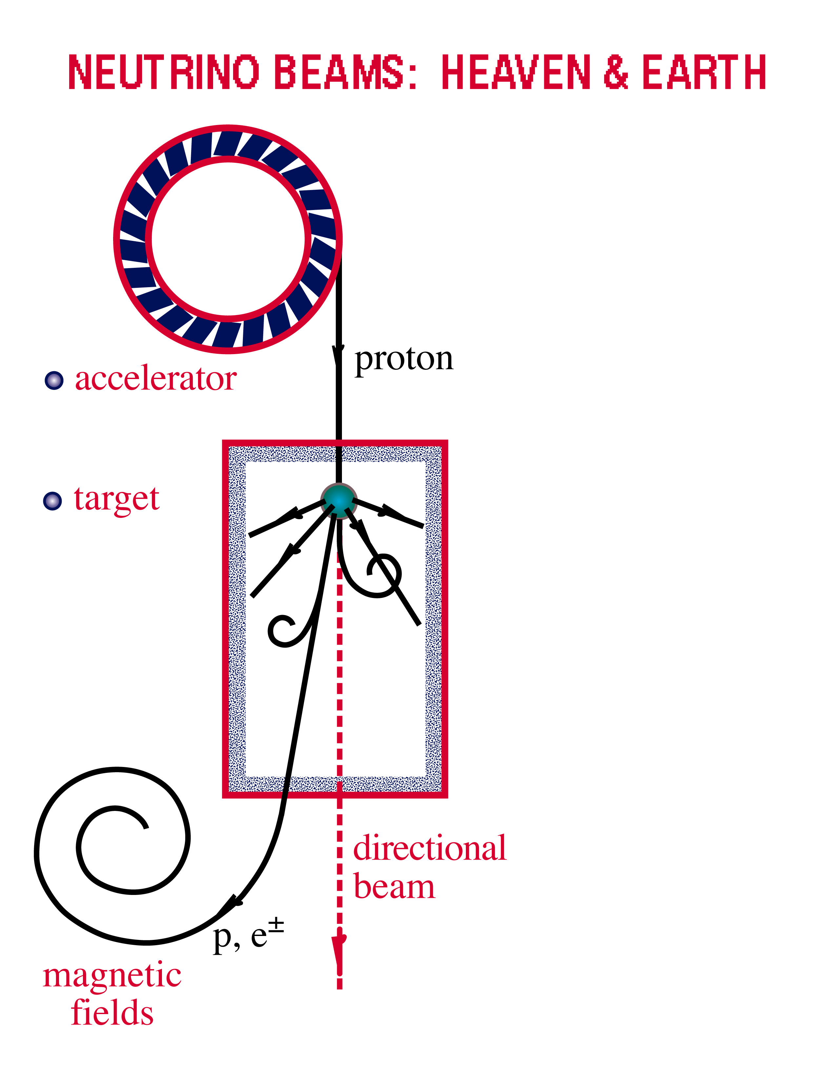
Neutrino Beams: Heaven & Earth
ν and γ beams : heaven and earth
NEUTRINO BEAMS: HEAVEN & EARTH
black hole
radiation
and dust
p + γ → n + π⁺
^{~ cosmic ray + neutrino}
→ p + π⁰
^{~ cosmic ray + gamma}

Slide 39
neutral pions
are observed as
gamma rays
charged pions
are observed as
neutrinos
π⁰
π⁺
π⁻
γ
γ
ν_{μ} μ⁺
ν μ⁻
e⁺ e⁻
e⁺
γ
e⁻
μ⁺
e⁺
γ
e⁺
ν_{e}
ν_{μ}
Notes:
39

Slide 40
Neutrino Production
Neutrinos are the ideal “messenger particle:”
  Neutrinos propagate in a straight line and are not easily absorbed - they can get away from the source!
  However, they are not easily “absorbed” in detectors, either… we need km³ size detectors!

Slide 41
Requirements for a Neutrino Detector
Large detector volumes - of order ~ km³ if we want to detect a few neutrinos from astrophysical sources per year…
Neutrinos must interact near or in the detector and produce a particle that can be detected, for example a muon.
The detector must be shielded from the enormous background of atmospheric muons, so it needs to be deep below some absorbing material.
At the same time, the absorbing material must allow for detection of light from particles created by neutrinos.

Slide 42
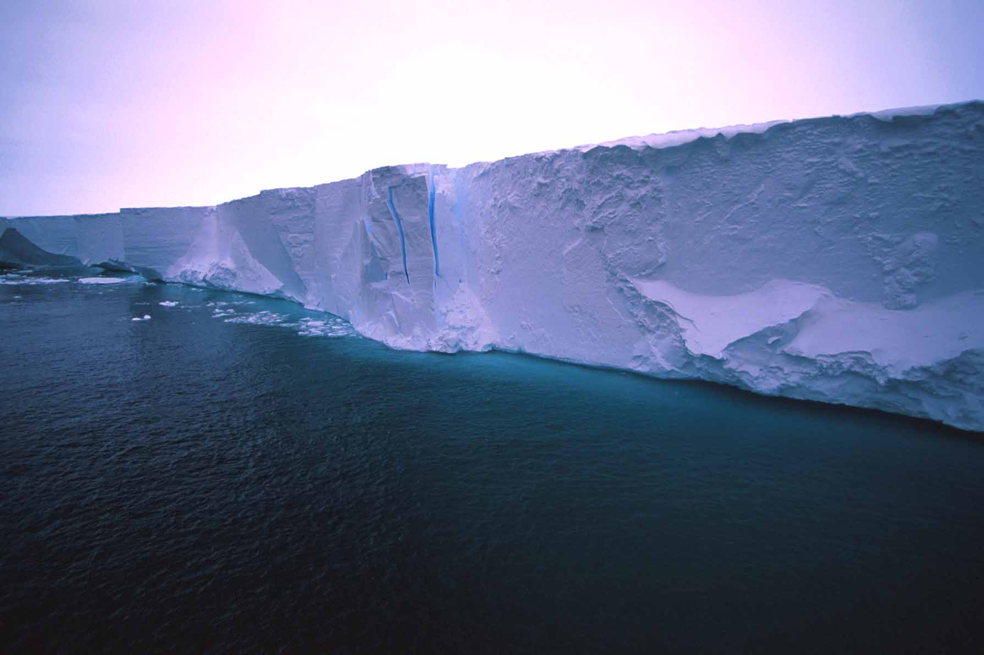
Blue light travels 200+ meters in ice…

Slide 43
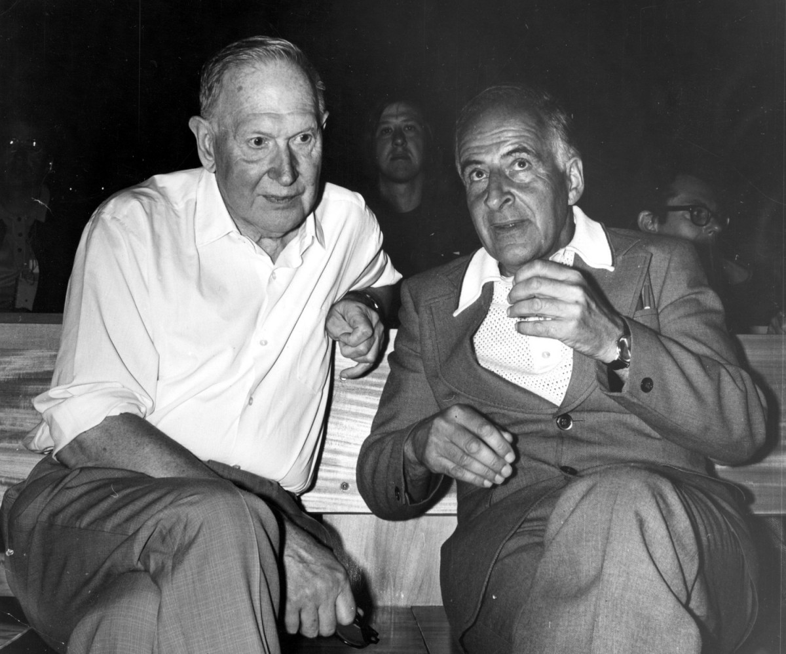
M. Markov
1960
B. Pontecorvo
M.Markov :
we propose to install detectors
deep in a lake or in the sea and
to determine the direction of
charged particles with the help
of Cherenkov radiation.

Slide 44
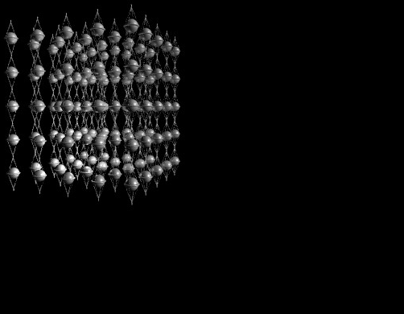
IceCube Concept
The muon produces Cherenkov light, and photomultipliers capture and map the light.
μ
ν_{μ}

Slide 45
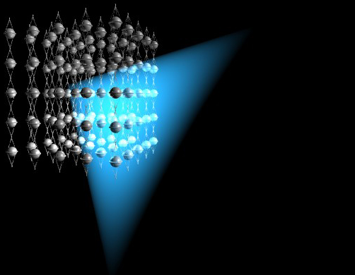
IceCube Concept
The muon produces Cherenkov light, and photomultipliers capture and map the light.
μ
ν_{μ}

Slide 46
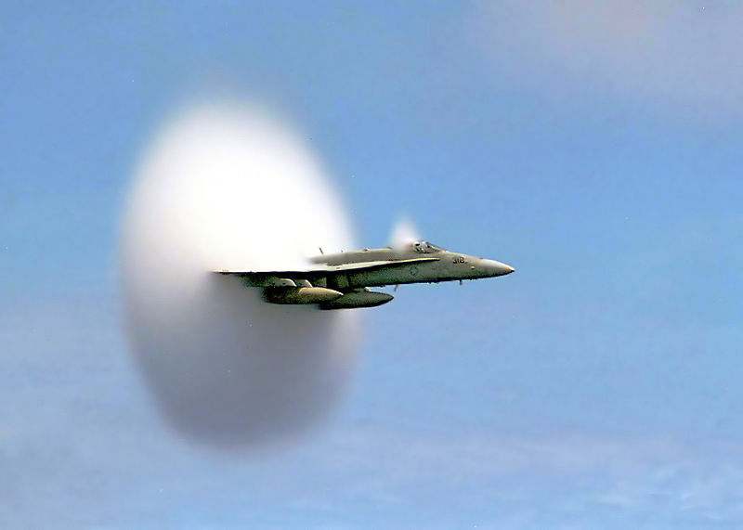
Cherenkov Light
… is produced by charged particles traveling faster than the speed of light.
optical equivalent to supersonic boost

Slide 47
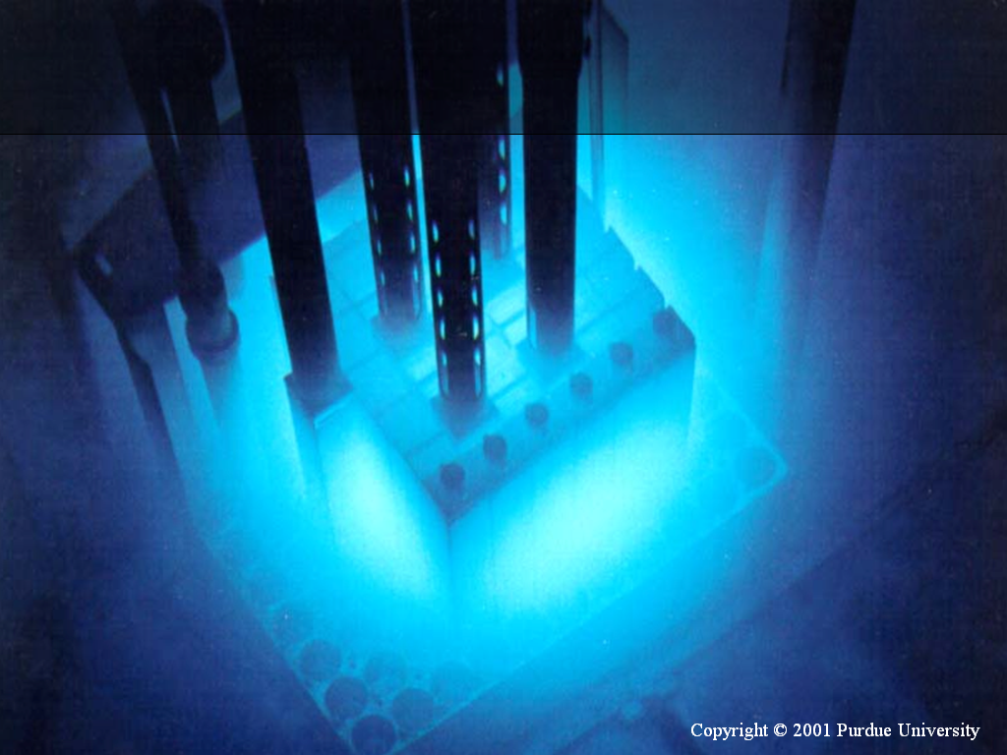

Slide 48
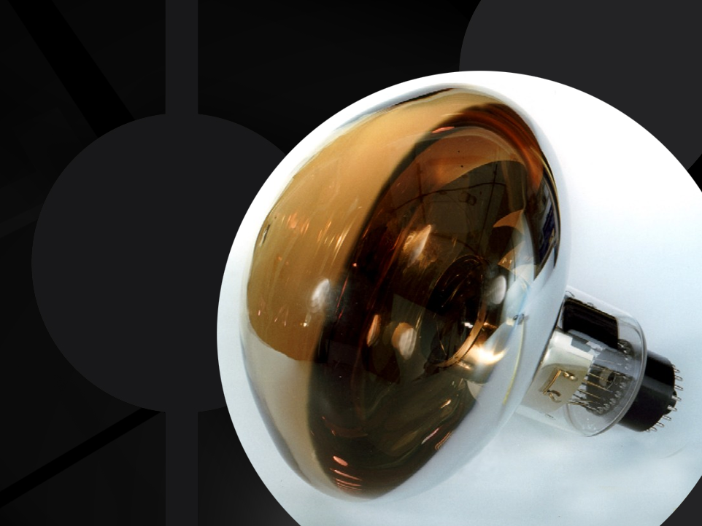
photomultiplier
tube

Slide 50
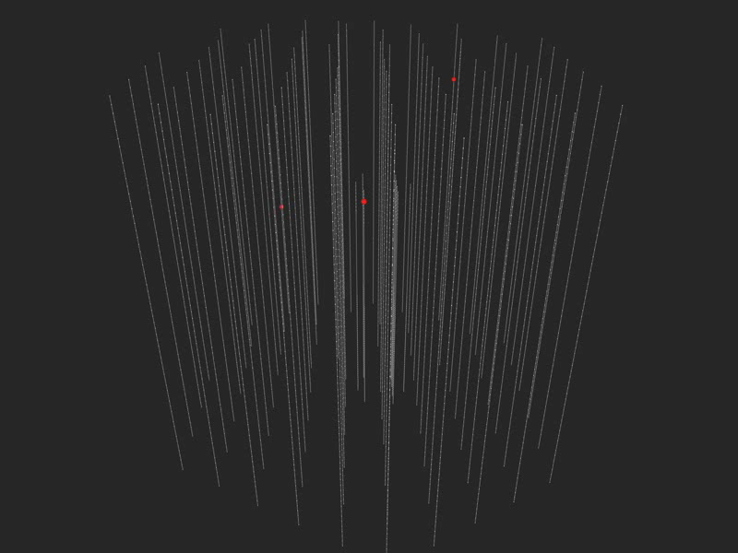

Slide 51

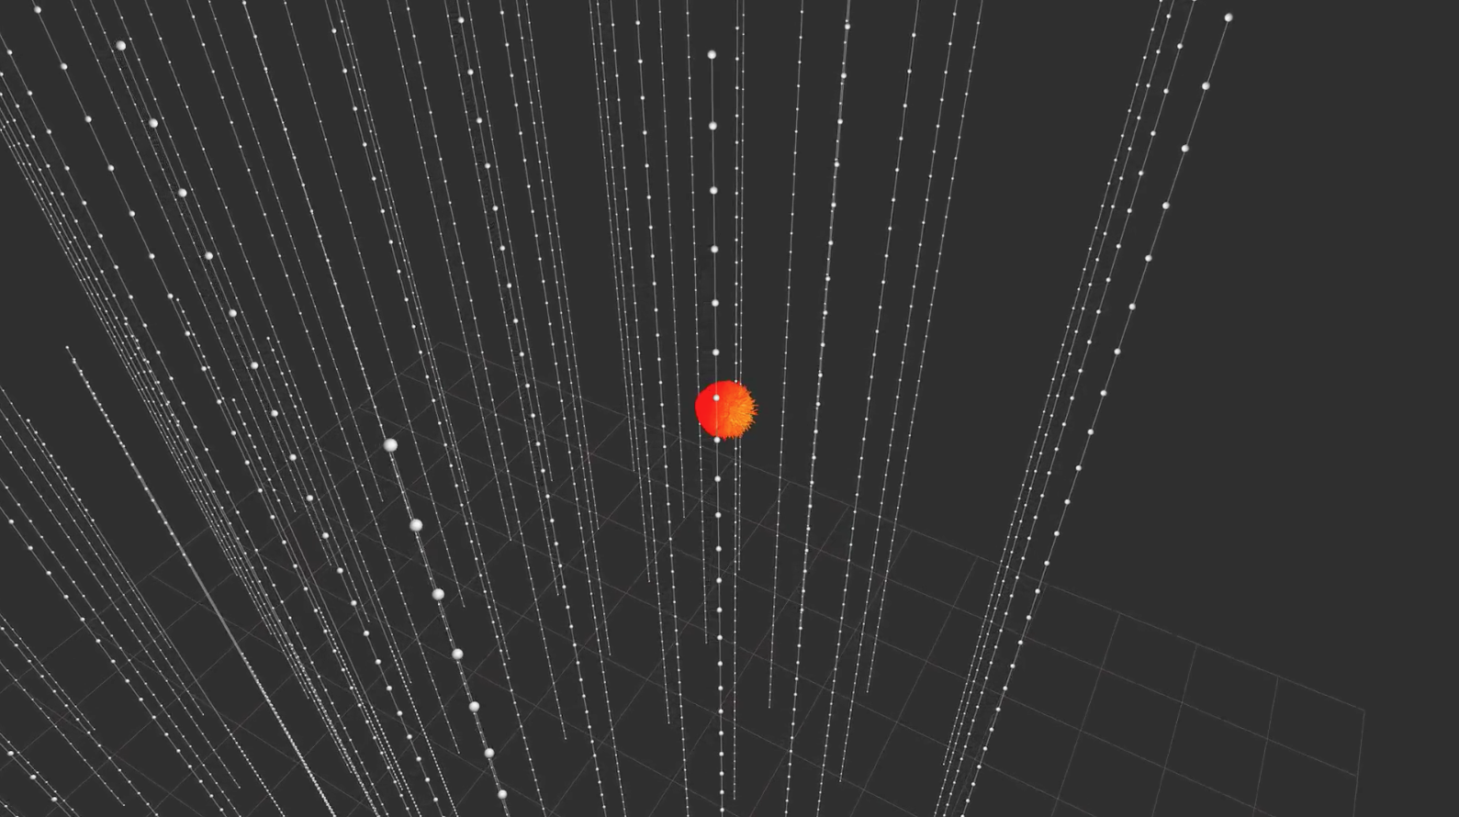

Slide 52
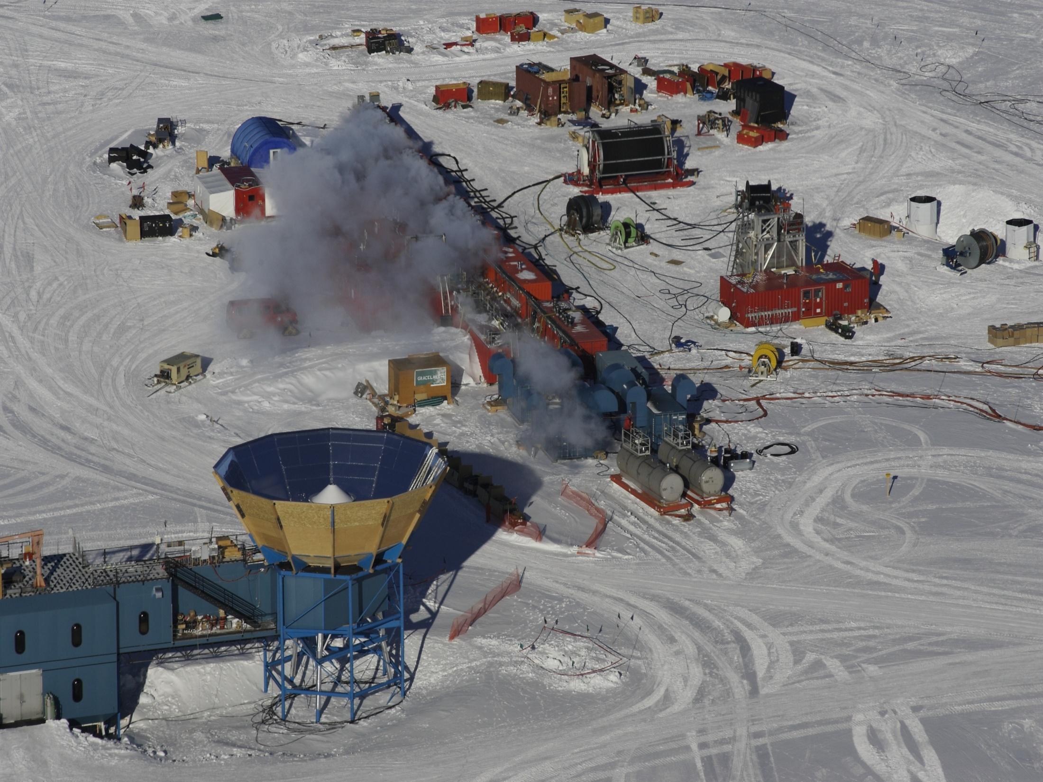
IceCube Site
nozzle delivers →
  200 gallons per minute
  7 Mpa
  90 degree C
  → 4.8 megawatt heating plant

Slide 53
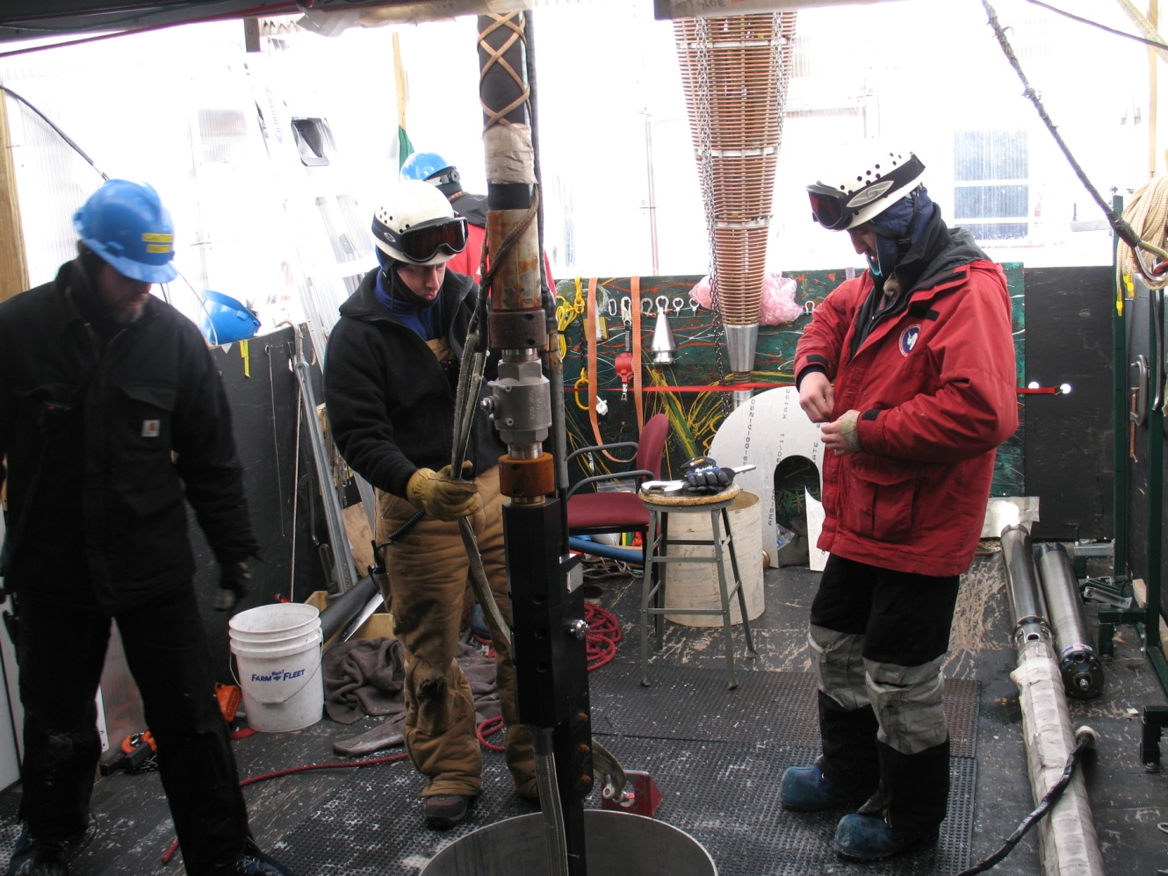


drilling and deployment
2 days per hole
3.5 cm/second
53

Slide 54
A photomultiplier
starts its journey
to 2500 m…

Slide 55


Slide 56


architecture of independent DOMs
LED flasher board
HV board
main board

Slide 57

Digital Optical Module (DOM)
… each DOM independently collects light signals like this…
…time stamps them with 2 nanoseconds precision and sends them to a computer that sorts them into muon and neutrino events…
Digitized Waveform
Notes:
57

Slide 58

IceCube Configurations
IC-86
10-11 Season
IC-79
09-10 Season
IC-59
08-09 Season
IC-40
07-08 Season
IC-1
04-05 Season
IC-9
05-06 Season
IC-22
06-07 Season
M. Santander

Slide 59


Slide 60
… you looked at 10msec of data !
muons detected per year:
atmospheric* m ~ 10¹¹
atmospheric** n → m ~ 10⁵
cosmic n → m ~ 10
* 2700 per second ** 1 every 6 minutes

Slide 61


Slide 62

IC40 Data ~ 1 TeV neutrino-induced muon
2010 July 24
Chad Finley - Oskar Klein Centre - Stockholm University
62

Slide 63

IC40 Data ~ 300 TeV cosmic ray muon bundle
2010 July 24
Chad Finley - Oskar Klein Centre - Stockholm University
63

Slide 64

Neutrinos in IceCube
Left: cascade pattern is a typical signature for an electron neutrino, which interacts in the detector producing a shower of particles.
Center: When a muon neutrino interacts in IceCube, it creates a muon as a secondary particle, which crosses the whole detector leaving a track of light in the detector.
Right: The third signature, right, also called the double-bang signature, is produced by a tau neutrino that interacts with the ice creating a hadronic shower and a tau, which decays almost immediately creating a second shower of particles.

Slide 65
Neutrinos in IceCube: skymaps

Slide 66

IceCube: science results
PeV neutrinos: highest energy neutrinos ever

Slide 67

IceCube: science results
First astrophysical neutrino flux

Slide 68

IceCube: science results
Cosmic ray anisotropies

Slide 69

IceCube: science results
Neutrino oscillations

Slide 70

IceCube: science results
Dark matter searches

Slide 71


