Slide 1
Askaryan Radio Array

Slide 2
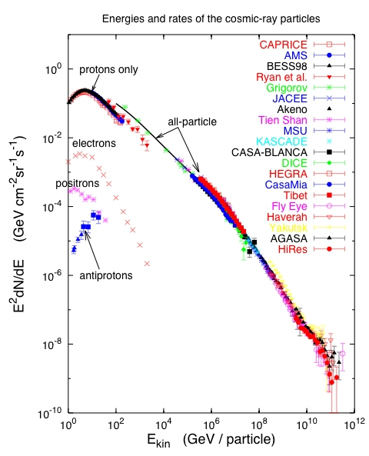
T. Gaisser 2005
T. Gaisser 2005
Atmospheric
neutrinos:
AMANDA, IceCube
Waxman –Bahcall upper bound
IceCube E^-2 upper limit
Galactic neutrino
flux model:
e.g., Ingelman & Thunman
Cosmogenic neutrino flux,
e.g. ESS (blue line)
Notes:
Cosmic rays have been observed to energies above 1E20eV. Spectrum and composition give some ideas of the nature of the acceleration and transport.
Most candidates of astrophysical neutrinos are closely related to the observation of high energy cosmic rays. We know that cosmic rays exist to highest energies. Possible sources are SN remnants, active galaxies or gamma ray bursts. Neutrino production may take place in the source region or on other, not too dense targets such as the Earth’s atmosphere, the interstellar medium or the cosmic microwave background.

Slide 3
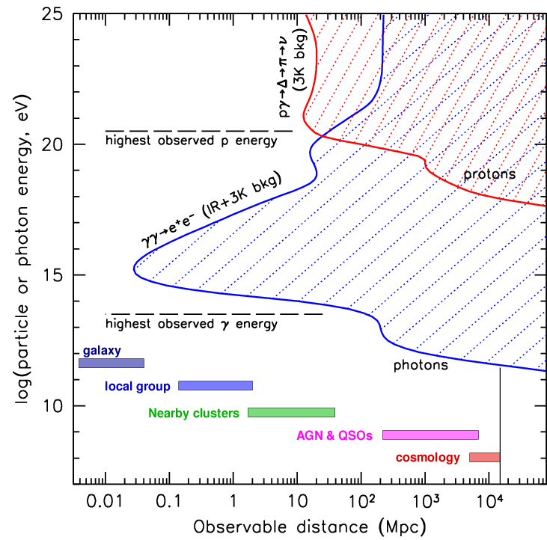
Neutrinos as messengers
Study of the highest energy processes and particles throughout the universe requires PeV-ZeV neutrino detectors
To “guarantee”EeV neutrino detection, design for the GZK neutrino flux
Existence of extragalactic neutrinos inferred from CR spectrum, up to 10²⁰ eV, and similarly, Galactic up to 10¹⁸ eV
Need gigaton (km³) mass (volume) for TeV to PeV detection, and teraton at 10¹⁹ eV
Neutrino detection associated with EM sources will ID the UHECR sources
“EM Hidden” sources may exist, visible only in neutrinos.
Neutrino eyes see farther (z>1), and deeper (into compact objects), than gamma-photons, and straighter than UHECRs,with no absorption at (almost) any energy

Slide 4
Detection mechanism proposed by G. Askaryan (1962):
Measure the coherent RF signal generated by neutrino interaction in dielectric media (such as ice)
moves as a compact bunch, a few cm wide and ~1cm thick → Moving net charge in a dielectric
wavelengths shorter than the bunch length suffer from destructive interference
charge asymmetry in particle shower development results in a 20% excess of electrons over positrons in a particle shower
nucleus
L is the length of the bunch
E > 10¹⁷eV
Particle cascade
electric field strength proportional to the square of the shower energy
Add coherently!
Notes:
The emission of a coherent radio signal comes from the charge asymmetry in particle shower development. The asymmetry is due to combined effects of positron annihilation and Compton scattering on atomic electrons. There is a 20% excess of electrons over positrons in a particle shower, which moves as a compact bunch, a few cm wide and ~1cm thick, at a velocity above the speed of light in the medium. The frequency dependence of Cherenkov radiation emitted is dP proportional to nu dnu. For radiation with wavelength lambda much greater than l, where l is the length scale of the bunch, the radiated electric field will add coherently and thus be proportional to the square of the shower energy. A radio signal emitted by a particle shower in a dielectric material such as ice or salt is coherent up to a few GHz, is linearly polarized, and lasts less than a nanosecond. A shower with energy less than 10^19 eV interacting in ice will produce a peak strength of ~1mV/m/Mhz at the distance of 1 km.

Slide 5
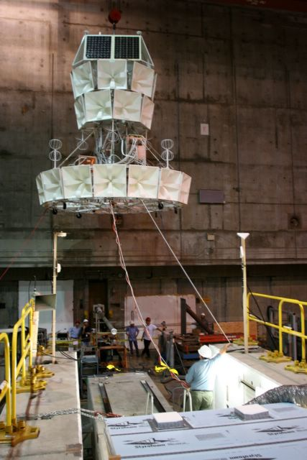
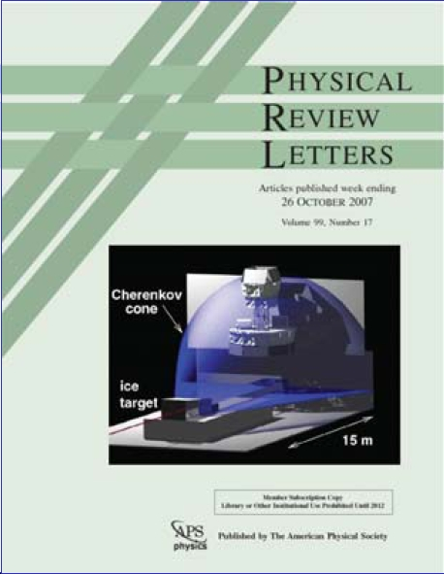
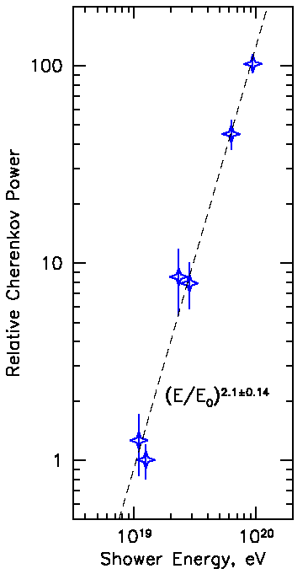
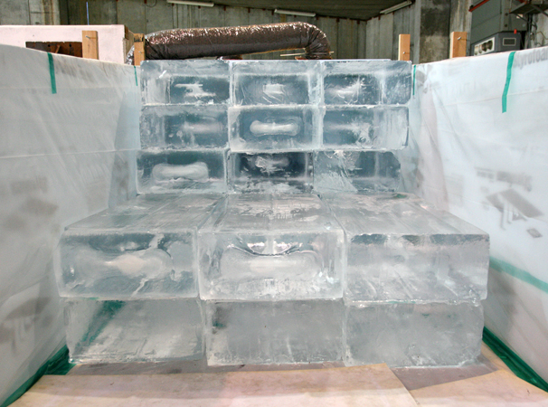
Validation at SLAC
ANITA I beamtest at SLAC (June06): proof of Askaryan effect in ice
Coherent (Power ~ E²)
Linearly Polarized
“Little Antarctica”

Slide 6
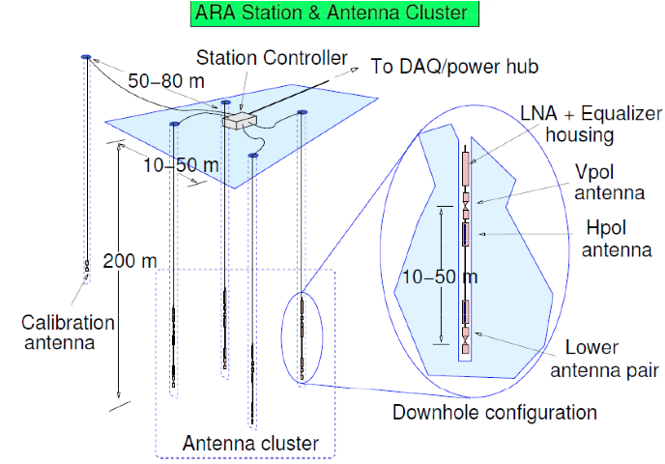
~15m
~15m

Slide 7
ARA37
Rev 2/4/13
Deployed ARA Station
Planned ARA Station 13/14
Test Bed
IceCube
3
1
South Pole Station
Deployed Cabling
WT3
7 (?)
6
2
Planned 13/14 Cabling
Skiway
5
4
2 km

Slide 8
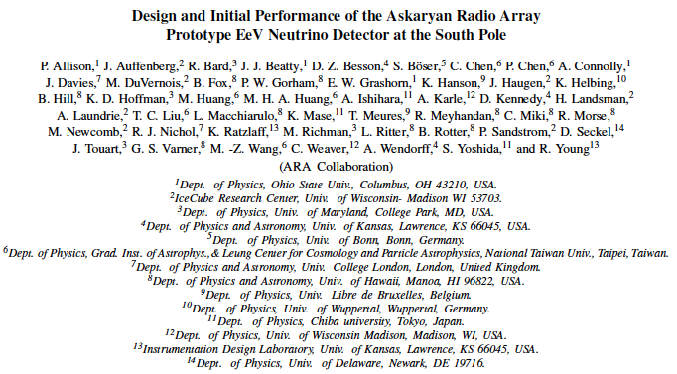
ARA- Collaboration
ARA is an international Collaboration
14 institutions
~50 authors
.

Slide 9
DM-Ice

Slide 10
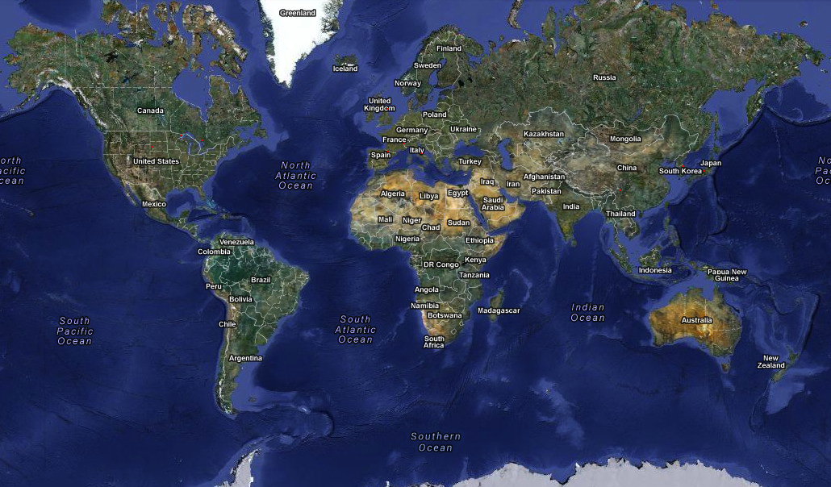
A World of Dark Matter Searches
Soudan:
CDMS
CoGeNT
Boulby:
DRIFT
Canfranc:
ANAIS
ArDM
Rosebud
Modane:
EDELWEISS
YangYang:
KIMS
Homestake:
LUX
SNOLAB:
DEAP/CLEAN
PICASSO
COUPP
Gran Sasso:
CRESST
DAMA/LIBRA
DarkSide
XENON
Kamioka:
XMASS
Jinping:
Panda-X
CDEX
ANDES:
(planned)
South Pole:
DM-Ice

Slide 11
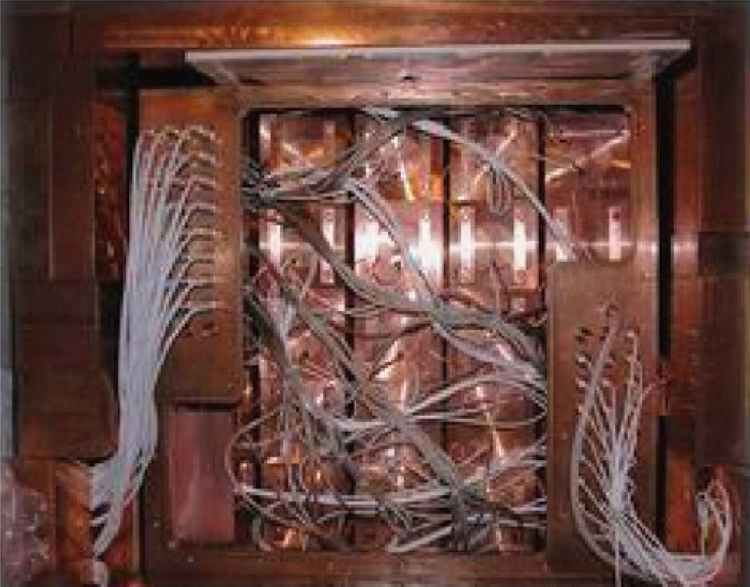
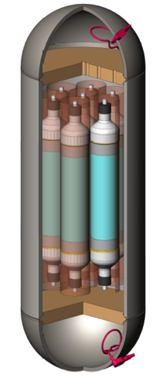
Addressing Potential Instrumental Effects
Solution:
Replicate experiment with same target material and setup,
but different systematics and well-characterized backgrounds.
DAMA/LIBRA
250 kg NaI(Tl) crystals
5x5 array
LNGS, Italy
DM-Ice
250 kg NaI(Tl) crystals
7-crystal arrays (x2)
Northern Hemisphere
+ South Pole, Antarctica

Slide 12
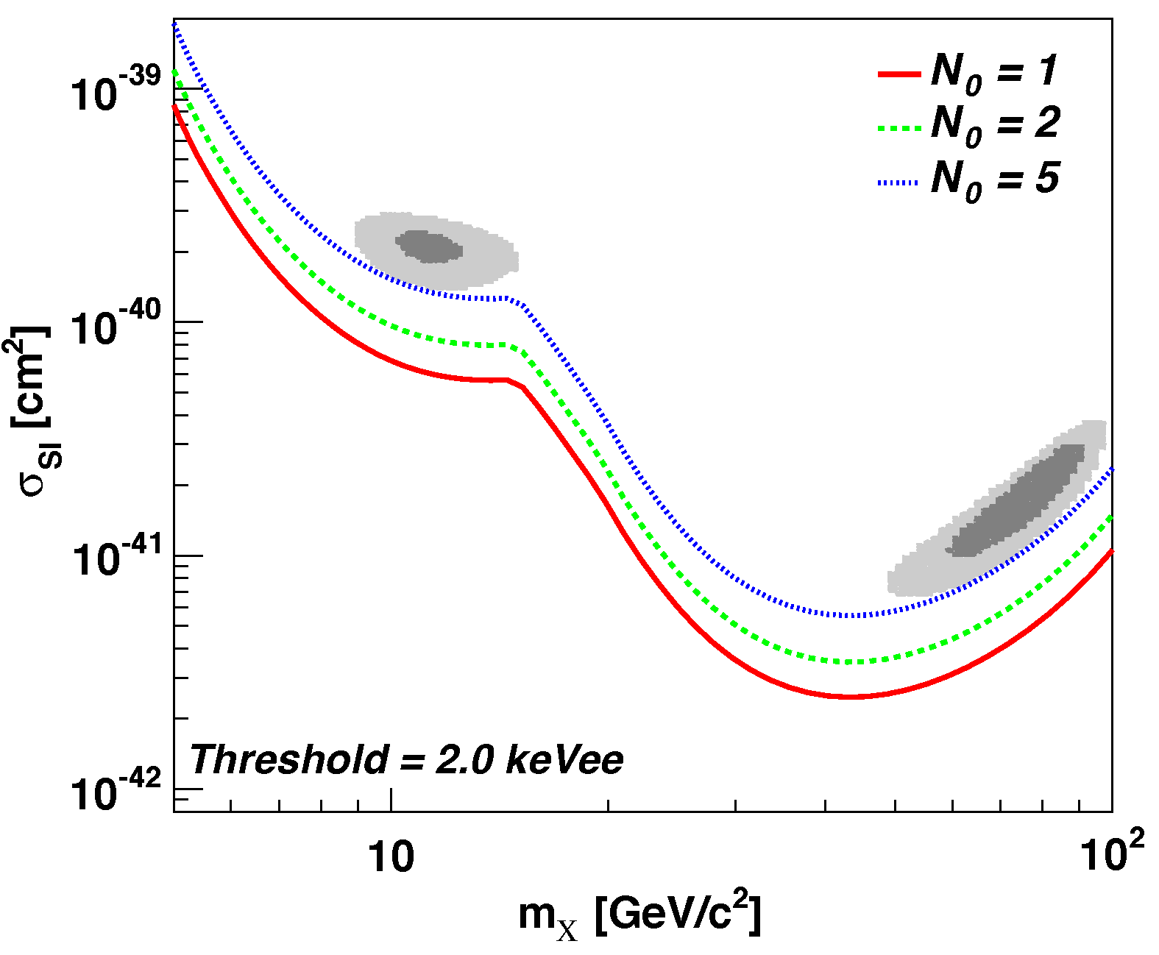
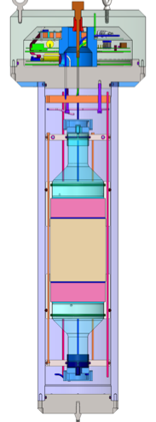
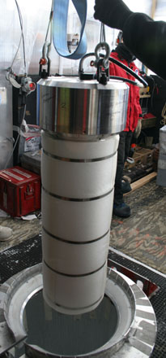
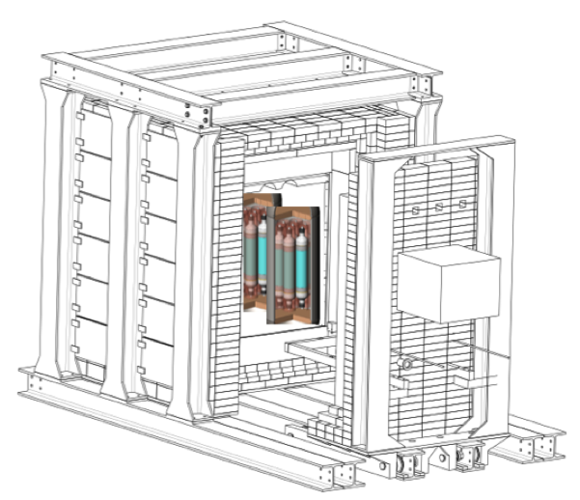
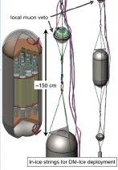
DM-Ice Phases
Goal:
Unambiguously test DAMA claim
Exclusion within 500 kg*yr
Experimental Phases:
DM-Ice17 DM-Ice250 North DM-Ice250 South
Cherwinka et al. Astropart. Phys. 35 (2012)
17 kg NaI(Tl) at 2450 m under South Pole ice
Operating since 2011
2x125 kg NaI(Tl) modules at underground lab
Same detectors deployed at South Pole (as necessary)

Slide 13
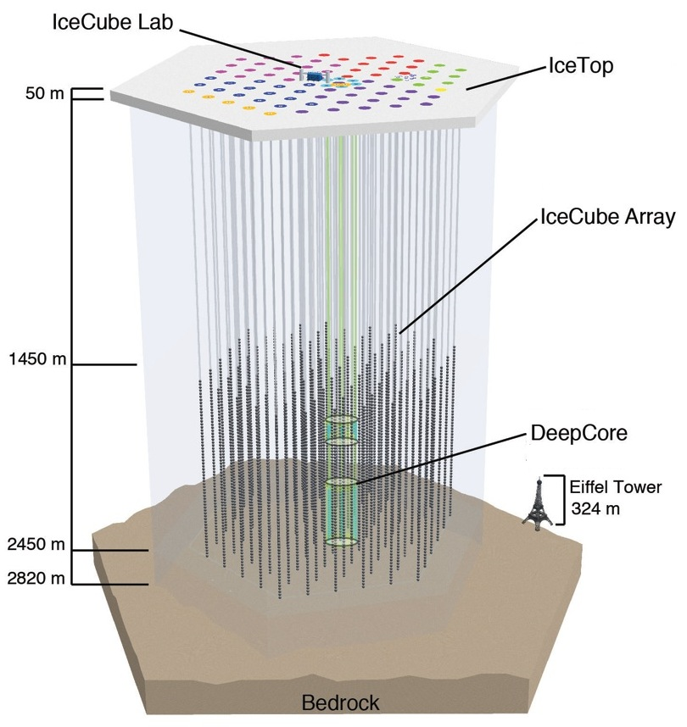
DM-Ice17 (Phase I)
(2x) 8.5-kg NaI(Tl) modules
Installed Dec 2010
Data run from June 2011
Goals:
Demonstrate the feasibility of deploying NaI(Tl) crystals in the Antarctic Ice for a dark matter detector
In-situ measurement of the radiopurity of the Antarctic ice / hole ice at 2450 m depth
Study environmental stability
Study the capability of IceCube to veto muons
String #7
String #79

Slide 14
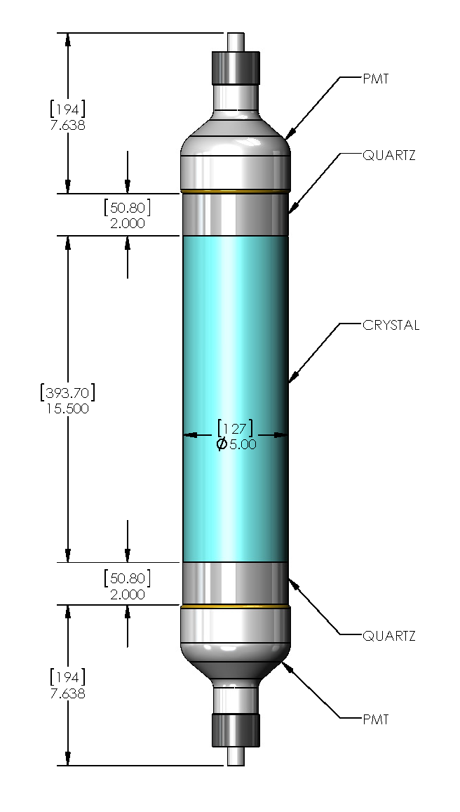
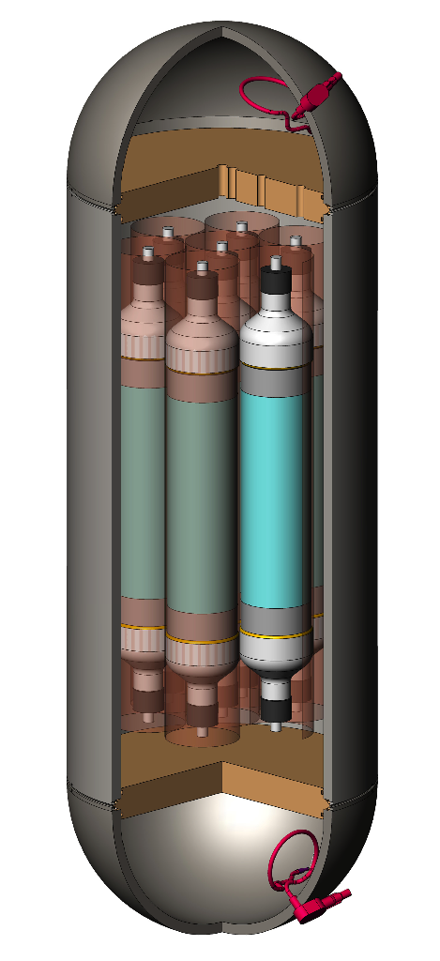
DM-Ice250 (Phase II and III)
Modular detector
125 kg NaI(Tl)
7-crystal array
3:1 aspect ratio
Test crystal work begins next month!

Slide 15
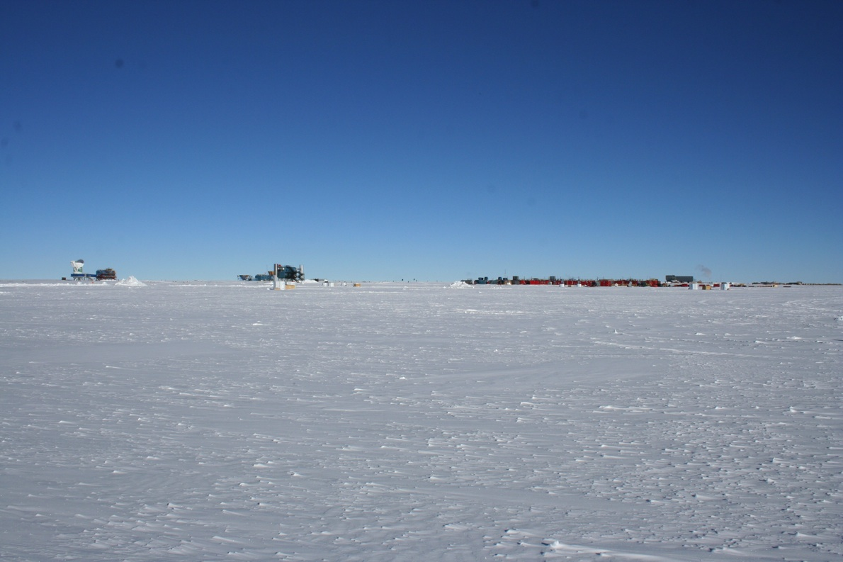
DM-Ice Collaboration
Yale University
Reina Maruyama, Karsten Heeger, Brooke Russell
University of Wisconsin – Madison
Francis Halzen, Michael DuVernois, Antonia Hubbard, Albrecht Karle, Matt Kauer, Walter Pettus, Zachary Pierpoint, Bethany Reilly
University of Sheffield
Neil Spooner, Vitaly Kudryavtsev, Calum Macdonald, Matt Robinson, Sam Telfer, Lee Thompson, Dan Walker
Boulby Underground Science Facility
Sean Paling
Fermilab
Lauren Hsu
University of Illinois at Urbana-Champaign
Liang Yang
University of Alberta
Darren Grant
Pennsylvania State University
Doug Cowen, Ken Clark
NIST-Gaithersburg
Pieter Mumm
University of Stockholm
Chad Finley, Per Olof Hulth, Klas Hultqvist, Chistian Walach
DigiPen
Charles Duba, Eric Mohrmann
SNOLAB
Bruce Cleveland

