Slide 1


Status of the IceTop air shower array at the South Pole
Fabian Kislat, DESY
13th ICATPP, Como
October 3rd, 2011

Slide 2
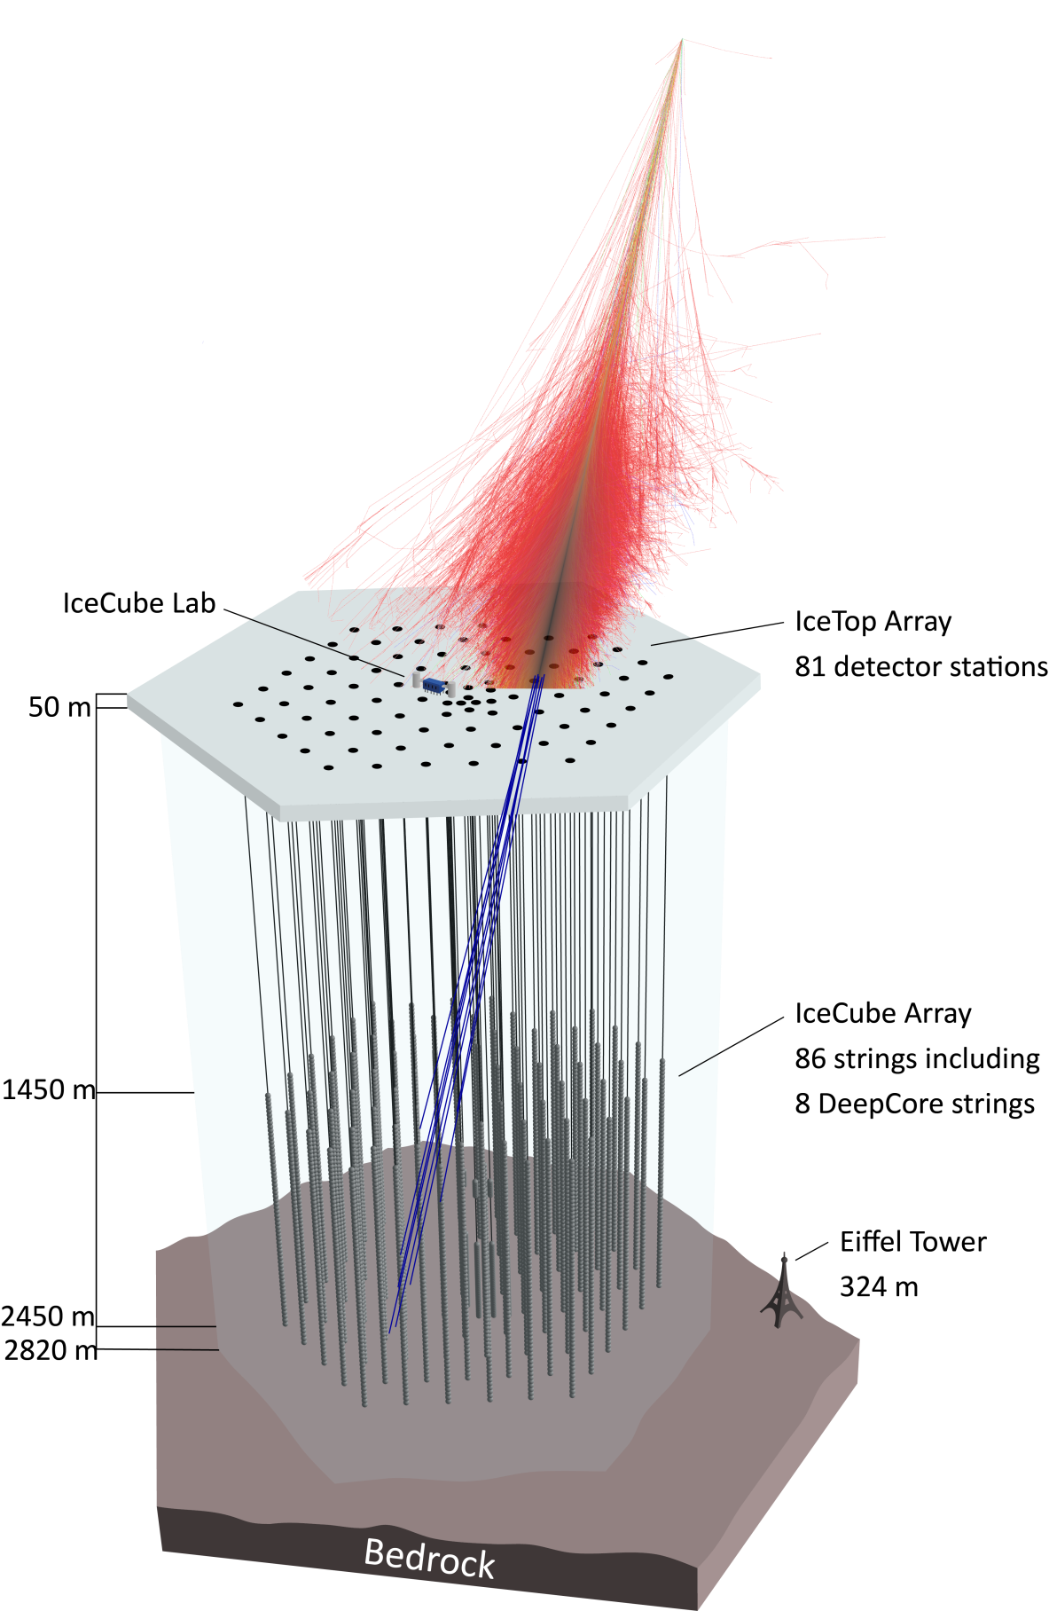
IceCube and IceTop
1km² air shower array
1km³ neutrino telescope
3D air shower detector
2835 m.a.s.l. – 690g/cm²
125m detector spacing
Energy range 300TeV – 1EeV
Electromagnetic component in IceTop
TeV muon bundle in IceCube

Slide 3
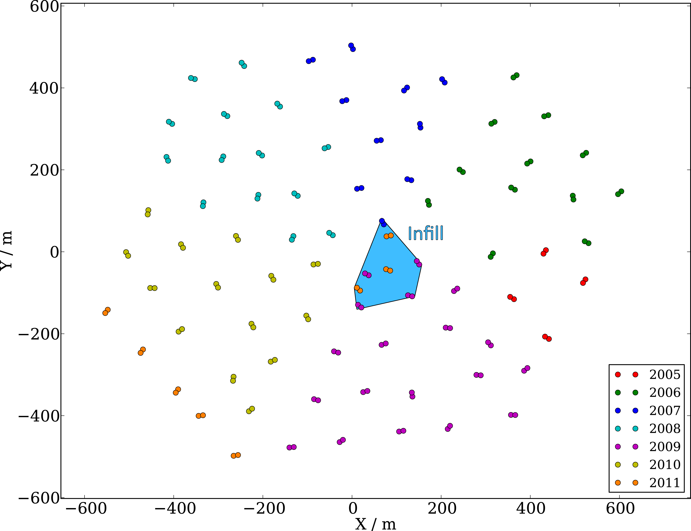
IceTop Array
81 detector stations

Slide 4
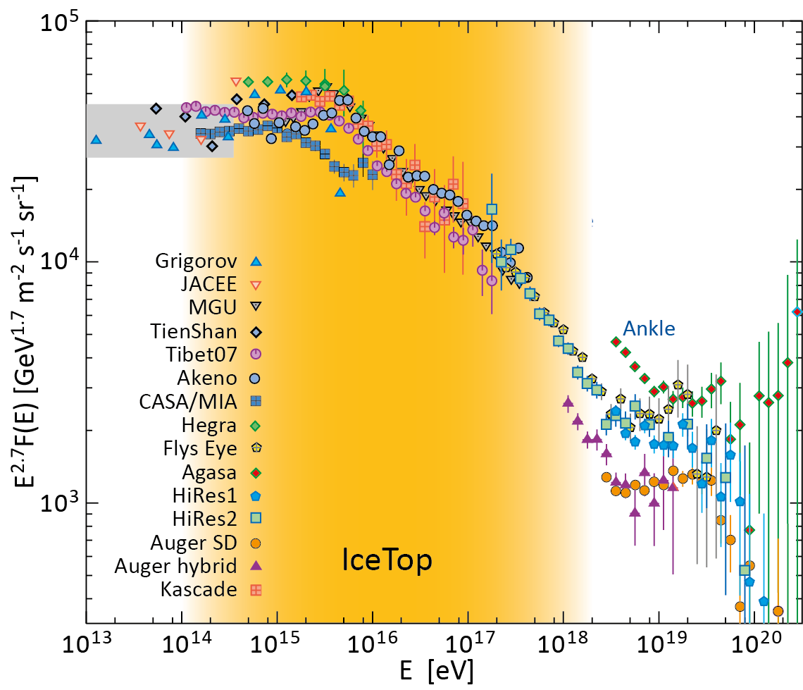
IceTop Energy Range
Threshold: 300TeV
Infill: ~100TeV
  Overlap with direct measurements
Max. energy: O(1EeV)
Limited by statistics
  Connection to Auger
Knee and 2nd knee
End of galactic cosmic rays?
Spectrum and composition: Important information on acceleration mechanisms

Slide 5
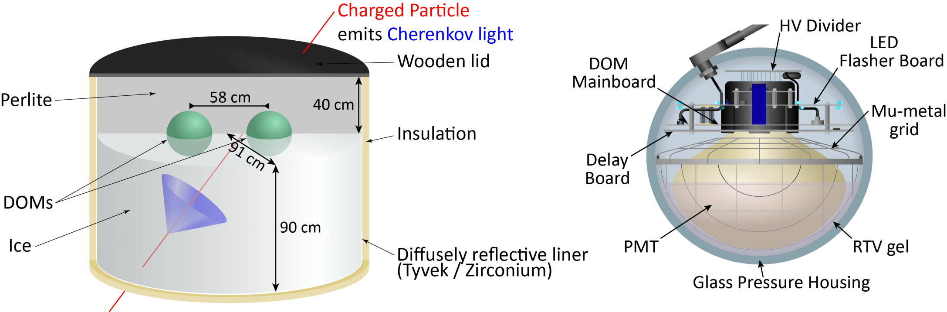
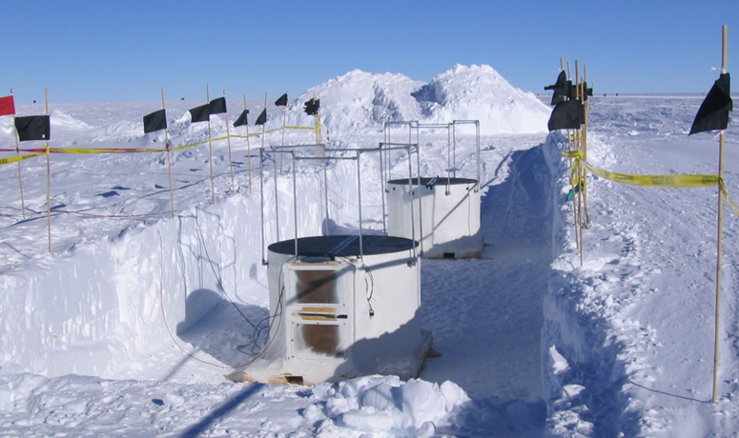
IceTop Tanks
LG
HG
Local
Coincidence
LG
HG

Slide 6
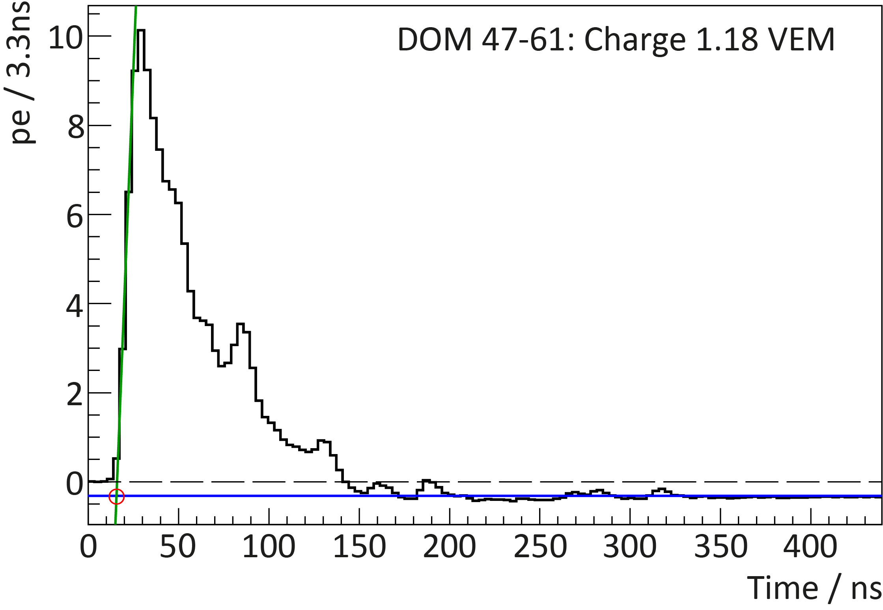
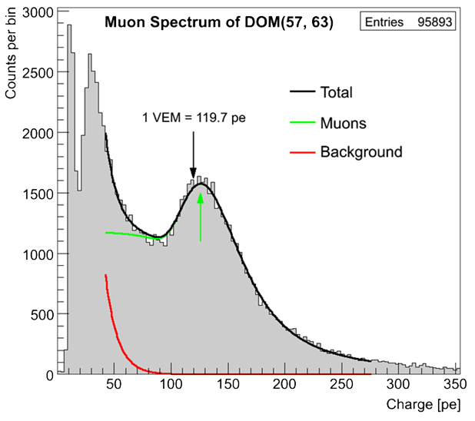
Signals and Calibration
DOMs record 422ns waveforms
Signals dominated by photons
Calibration using single muons
  Large number of muons from low energy primaries
  Distinctive light yield from muons
  Position of “muon peak” = 1 Vertical Equivalent Muon

Slide 7
Air shower reconstruction

Slide 8
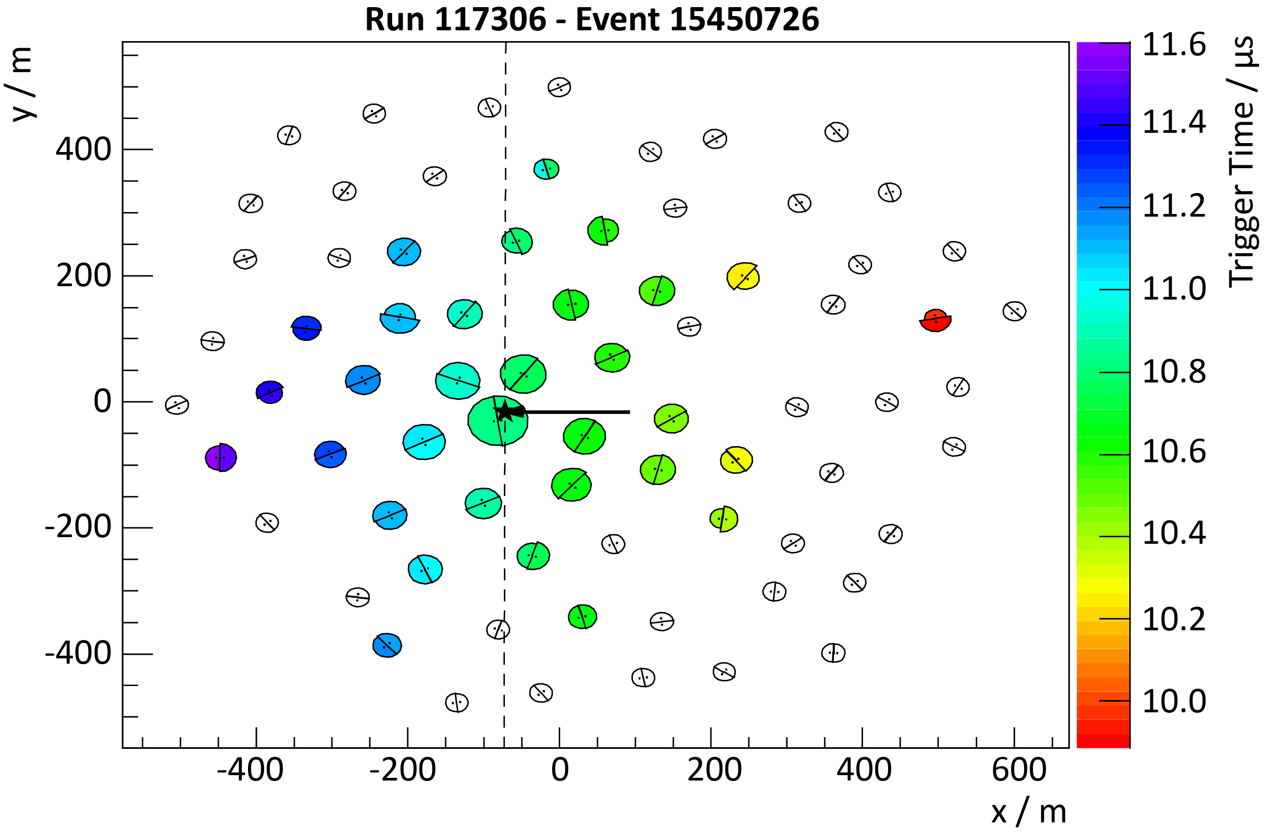
Air Shower Footprint

Slide 9
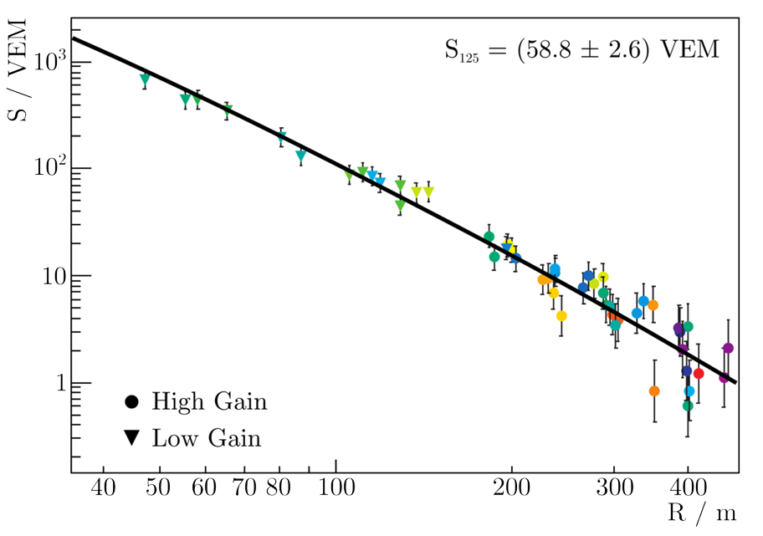
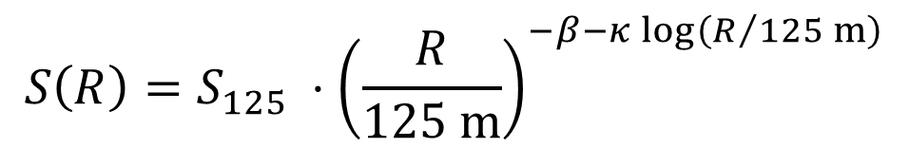
Lateral Distribution Function
Shower size
S125 (VEM)
Slope β
$$S\left(R\right)=S_{125} ⋅{\left(\frac{R}{125 m}\right)}^{−β−κ\log\left(R/{125 m}\right)}$$
κ = 0.303 = const

Slide 10
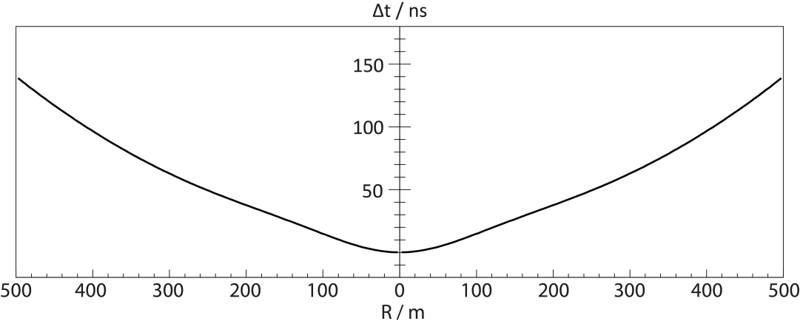
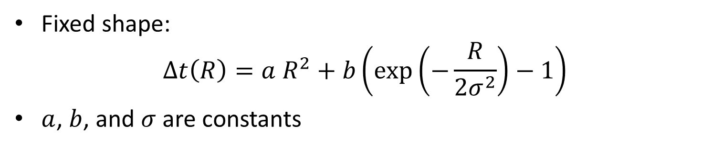
Shower Front
Fixed shape:
$Δt\left(R\right)=a R^{2}+b\left(\exp\left(−\frac{R}{2σ^{2}}\right)−1\right)$
$a$, $b$, and $σ$ are constants

Slide 11
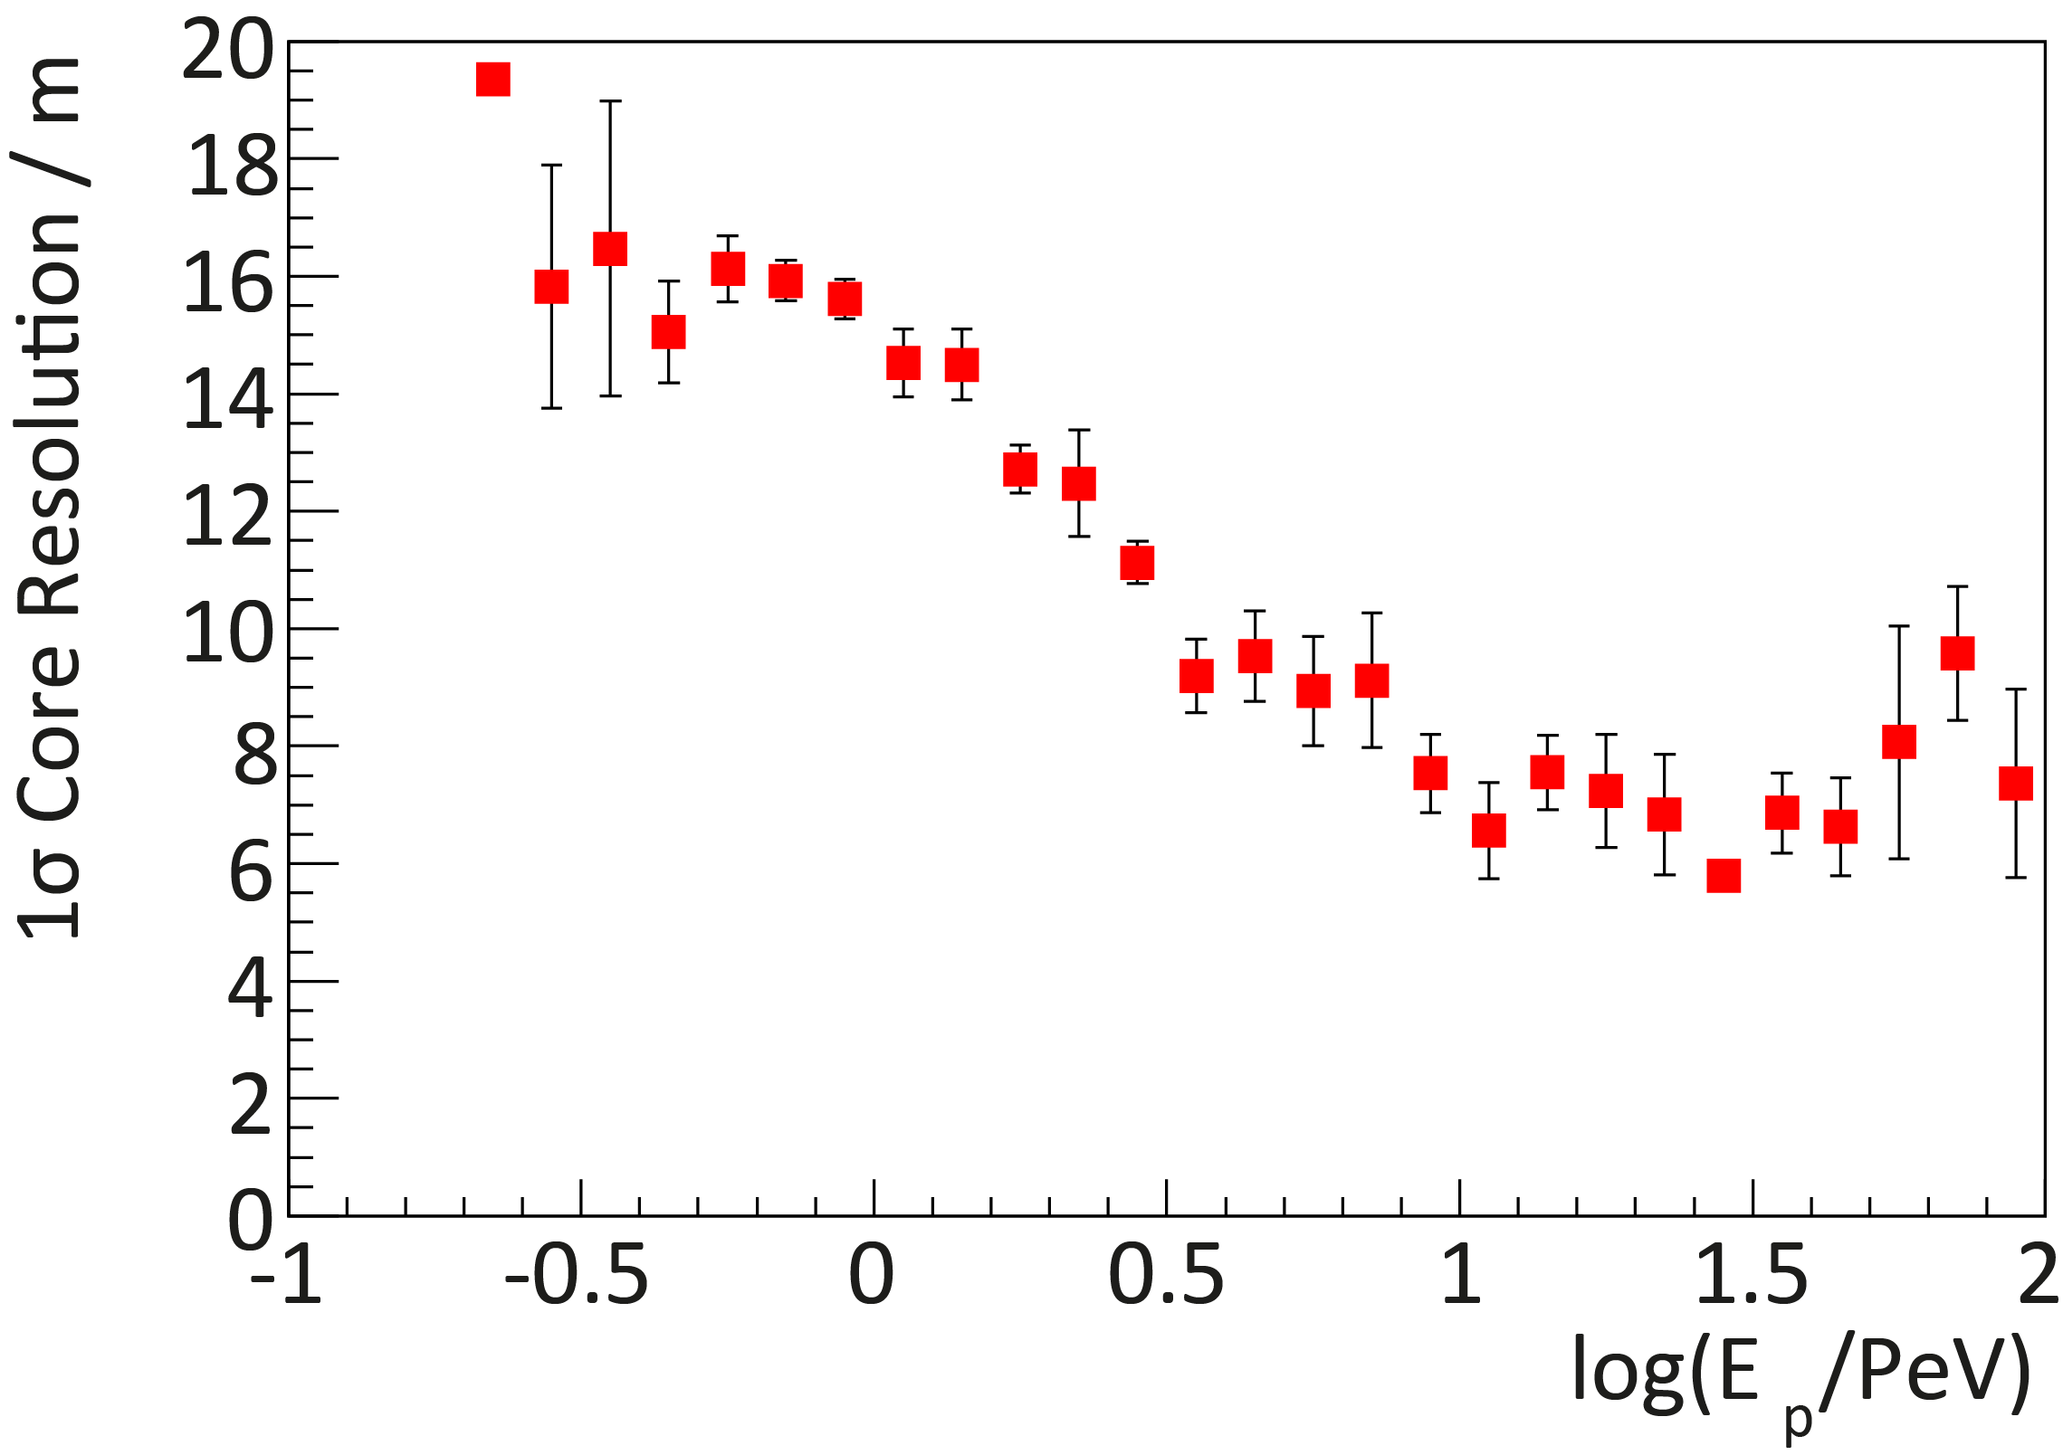
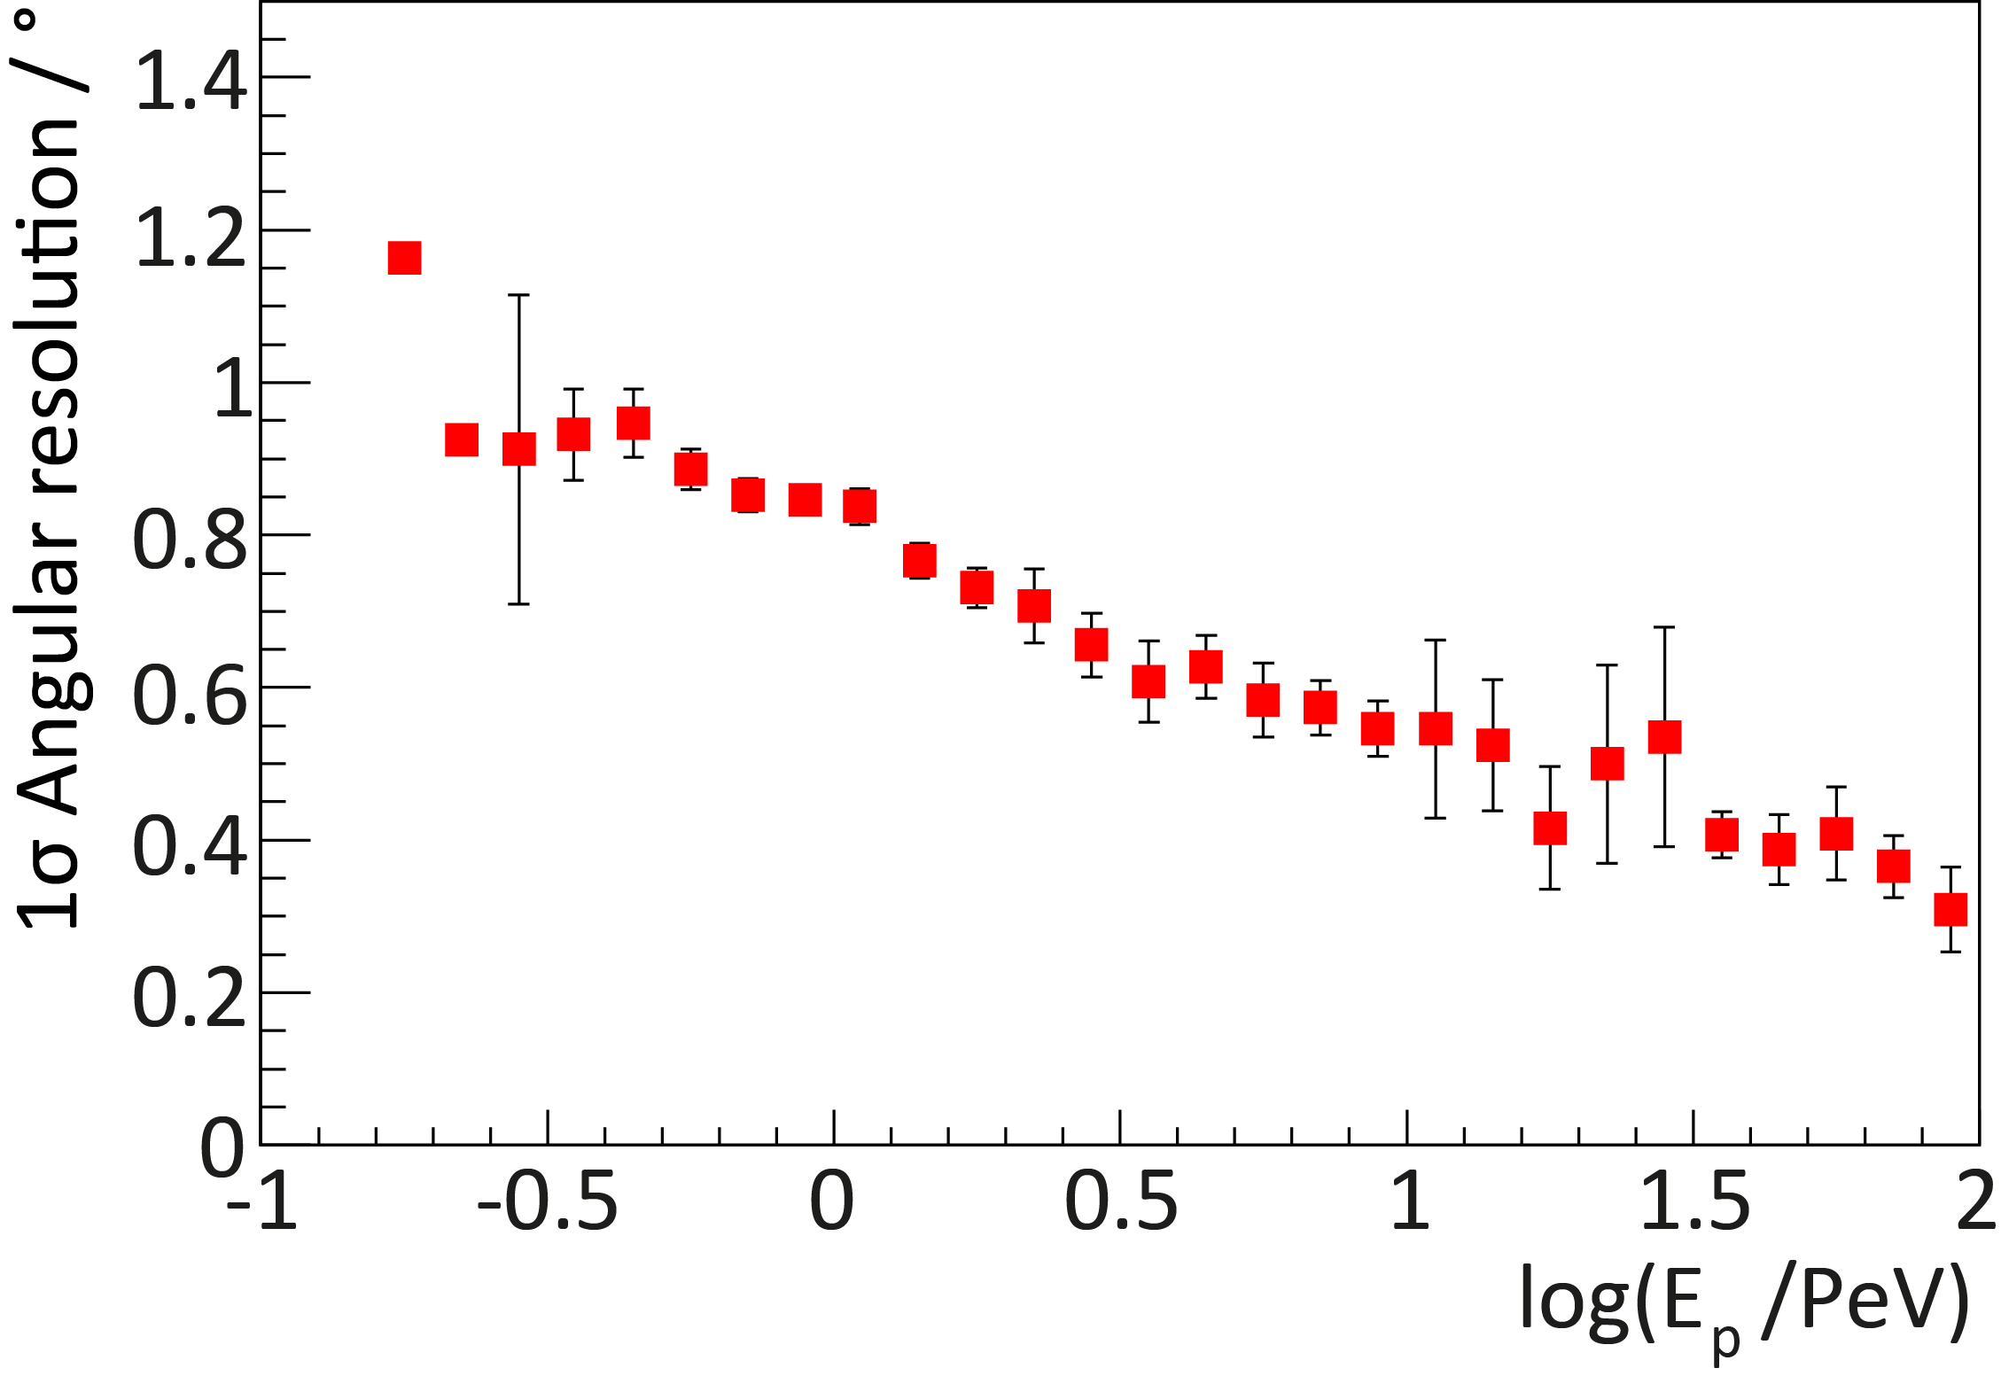
Reconstruction Performance
26-station configuration
After containment cuts:
  Core position resolution < 10m
  Angular resolution < 1°

Slide 12
Spectrum & Composition

Slide 13
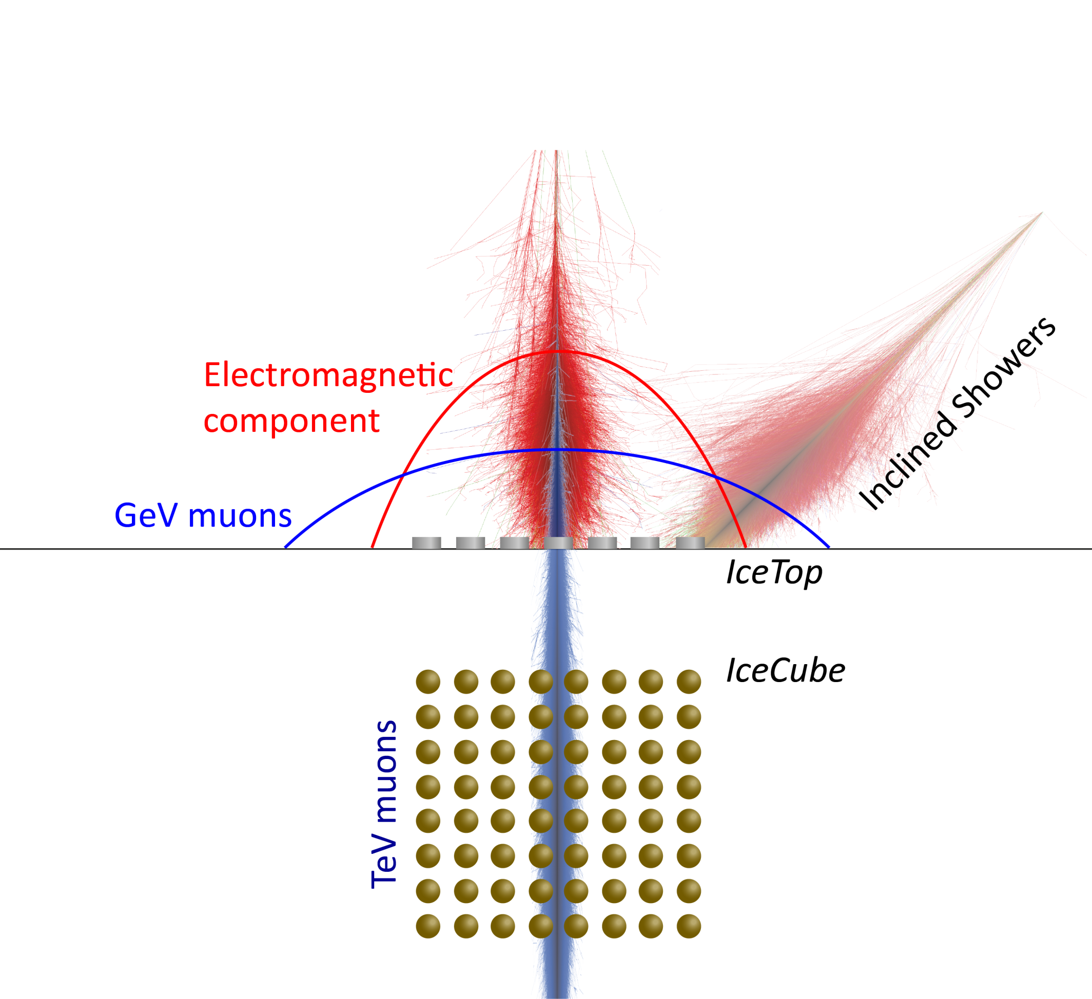
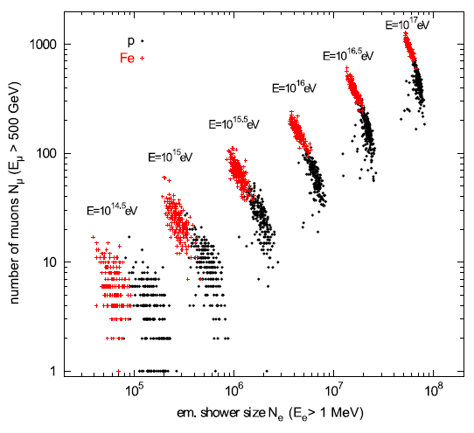
Composition Measurement with IceTop
µ
iron
proton
EM

Slide 14
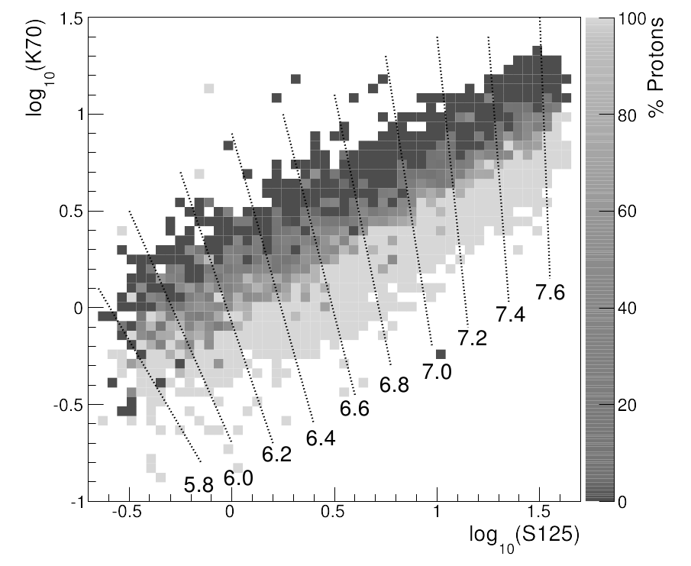
IceTop-IceCube Coincidences
Preliminary
Neural network
Inputs:
  Shower size S₁₂₅
  Muon bundle size K70
Outputs:
  Primary energy
  Primary mass

Slide 15
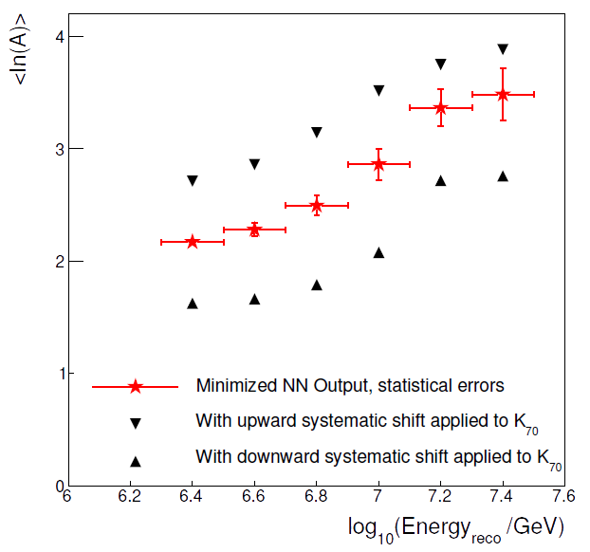
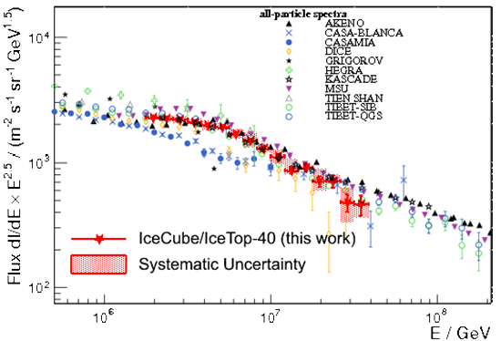
IceTop-IceCube Coincidences
Preliminary
Preliminary
40-Station configuration
Sub-Array with only small amount of snow on tanks
1 month of data
Systematics dominated

Slide 16
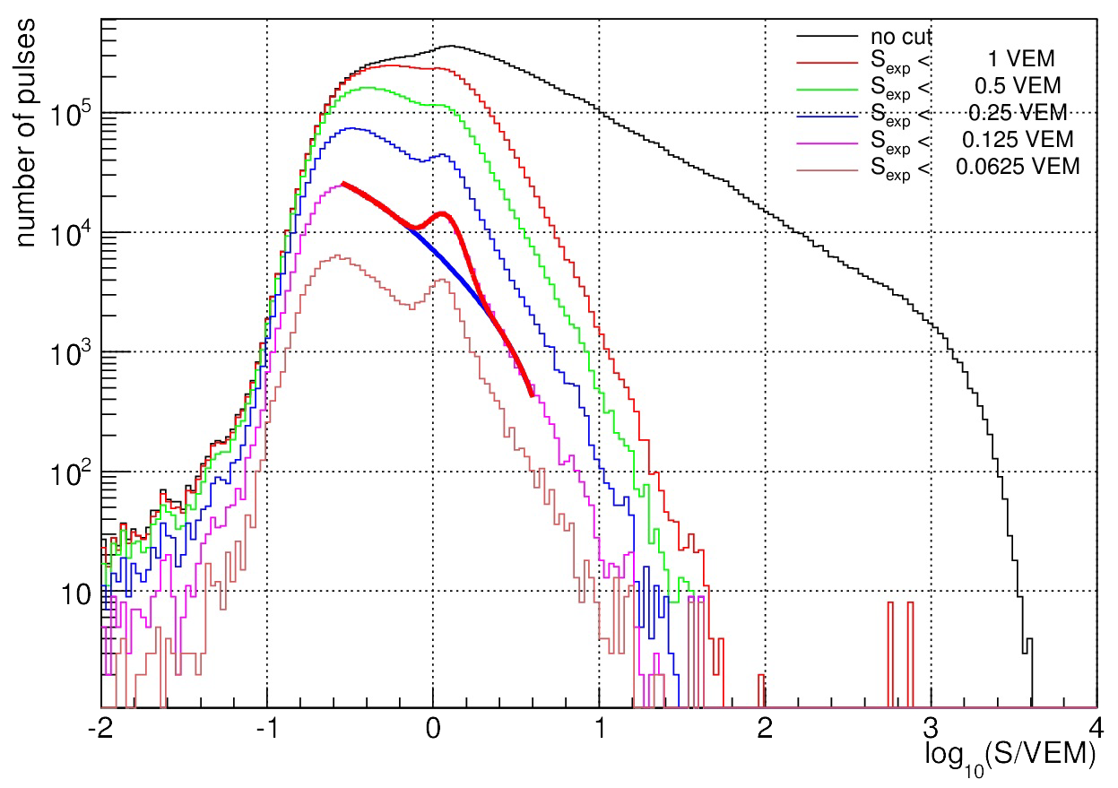
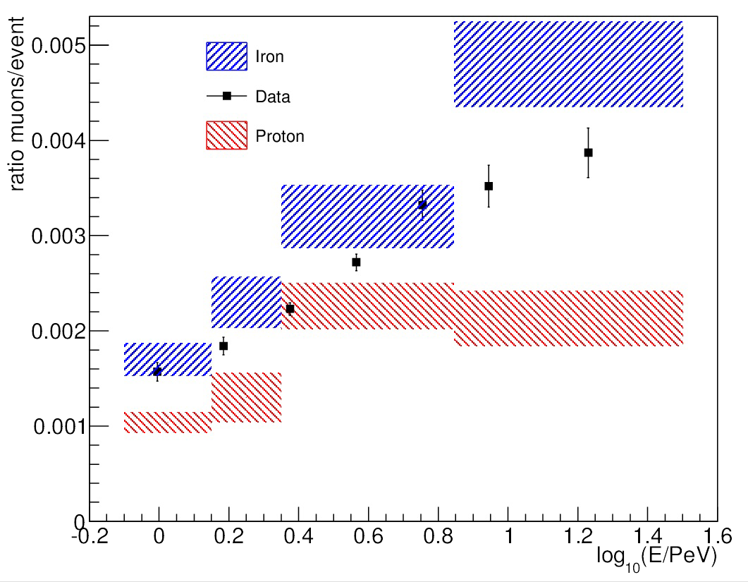
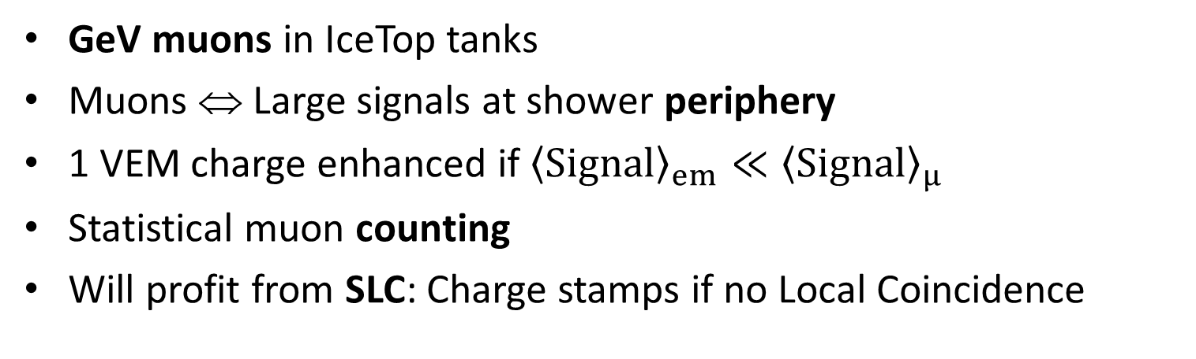
Muon Counting in IceTop
Preliminary
muon
peak
Preliminary
GeV muons in IceTop tanks
Muons ⇔ Large signals at shower periphery
1 VEM charge enhanced if ${\left\langle \text{Signal}\right\rangle }_{em}≪{\left\langle \text{Signal}\right\rangle }_{μ}$
Statistical muon counting
Will profit from SLC: Charge stamps if no Local Coincidence

Slide 17
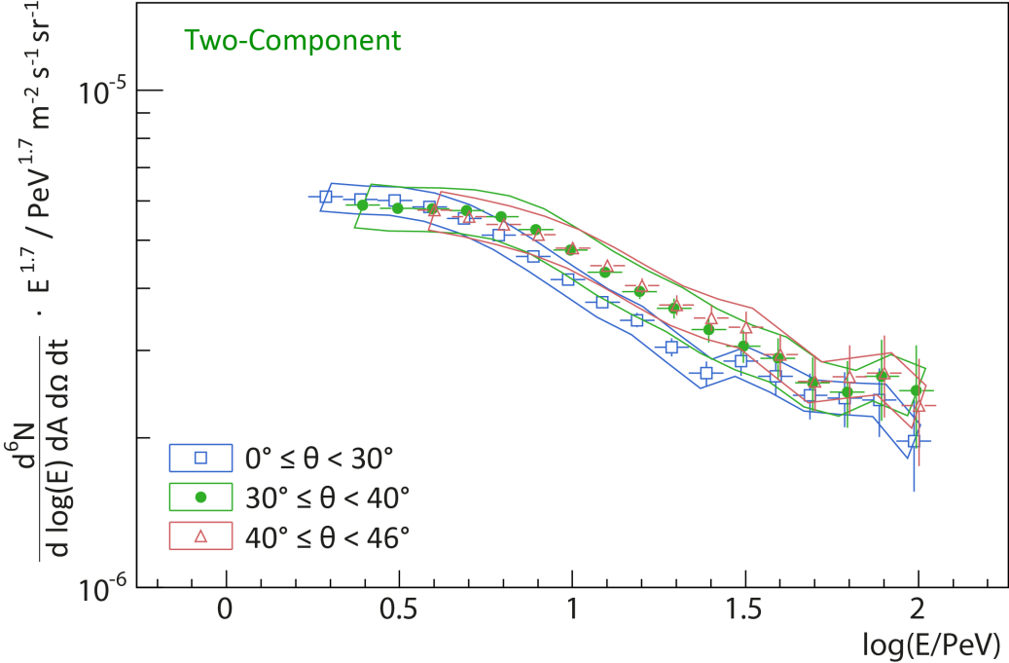
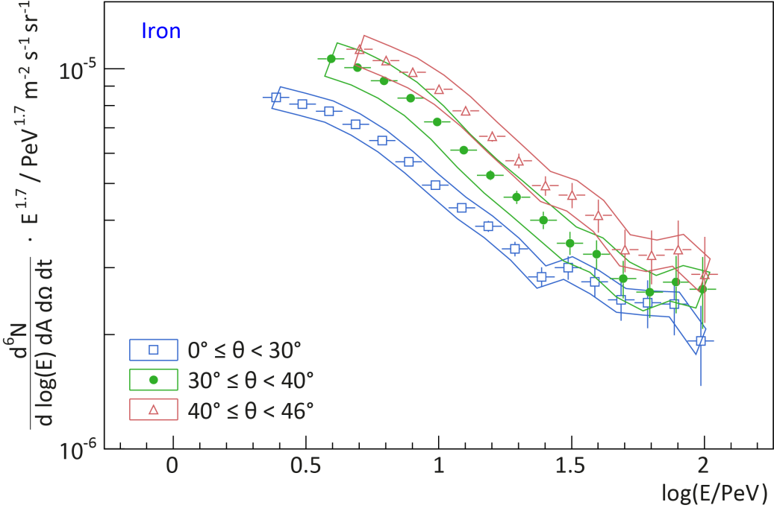
Inclined Showers
Preliminary
Energy spectra in different zenith angle ranges
Heavier primaries
⇒ stronger shower attenuation
Isotropy
⇒ spectra must agree
Composition sensitivity from shower development
IceTop-26 analysis 1-100PeV
Preliminary

Slide 18
Other Analyses

Slide 19
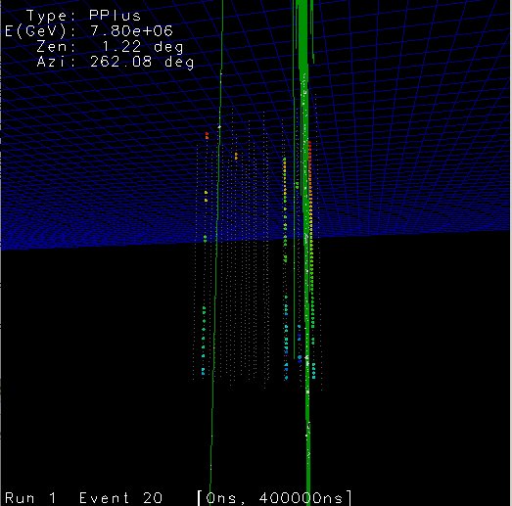
High-p_{T} muons
Muon separation spectrum > 150m
Test of models
High-p_{T} muons from charm decays
IceTop delivered direction reconstruction

Slide 20
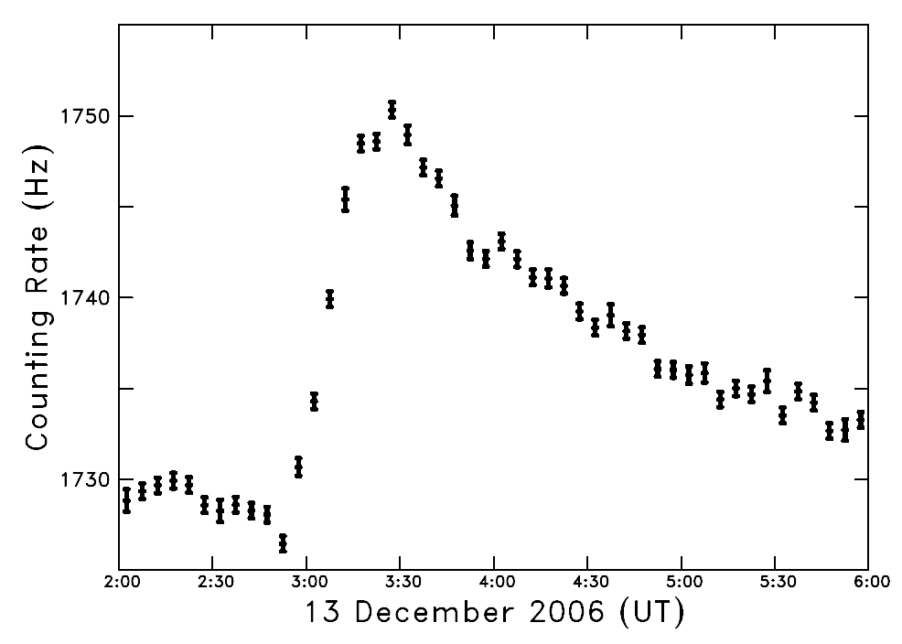
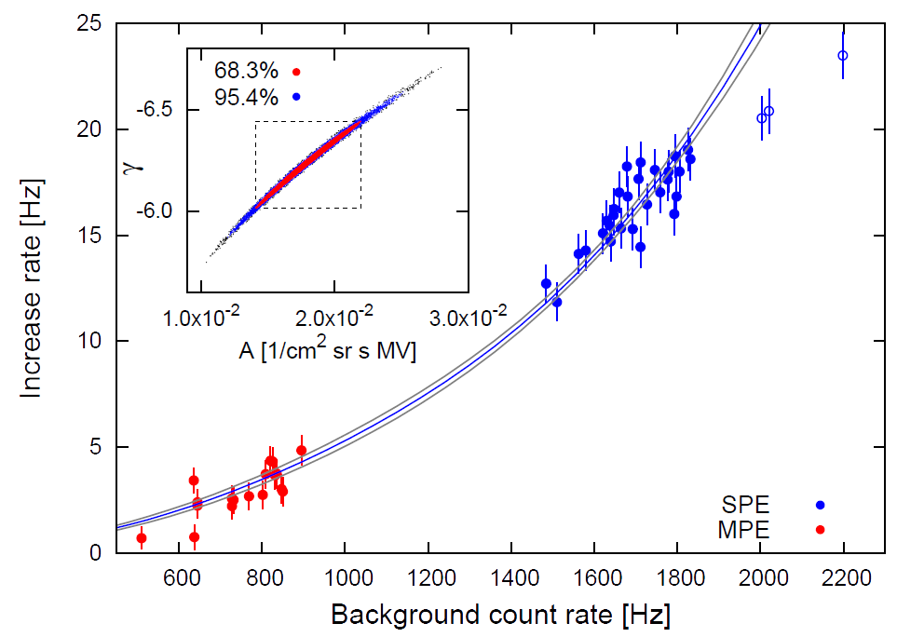
Low-energy transient events
Discriminator rates sensitive to GeV primary flux
Additional discriminators:
  Various thresholds
  Spectroscopy
Solar flares
Supernovae
GRBs
Solar flare
ApJ Lett 689 (2008) L68
Different
thresholds

Slide 21
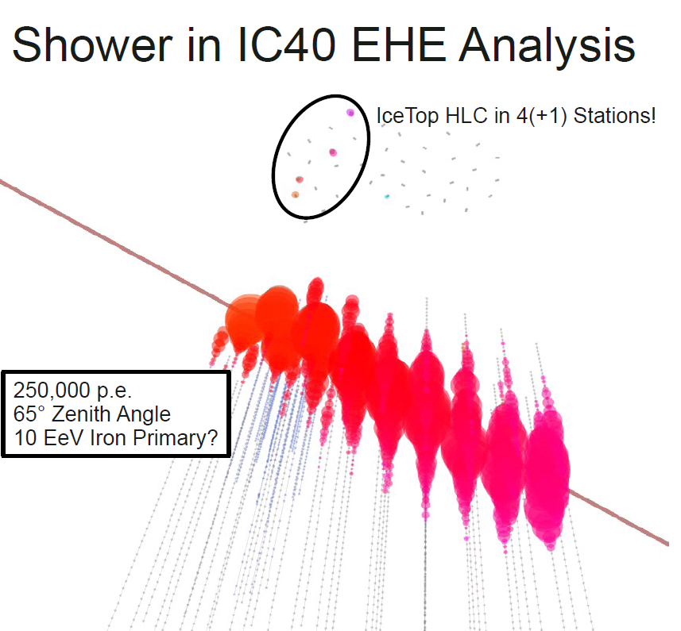
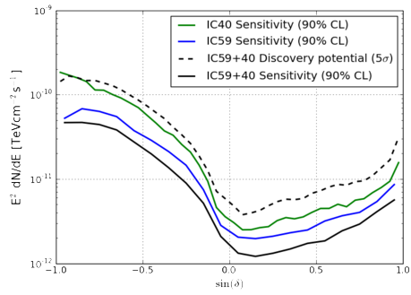
Veto for neutrino search
Earth not transparent for PeV neutrinos
Look above horizon
Large atmospheric muon background
Use IceTop as veto
At sufficiently high energy:
  ~ 100% background rejection
  > 90% signal efficiency
SLC: Improve capabilities
  Larger zenith angles
Simple
IceTop veto
down-going

Slide 22
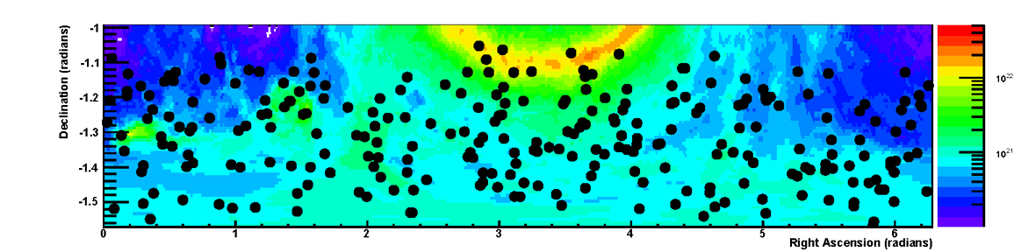
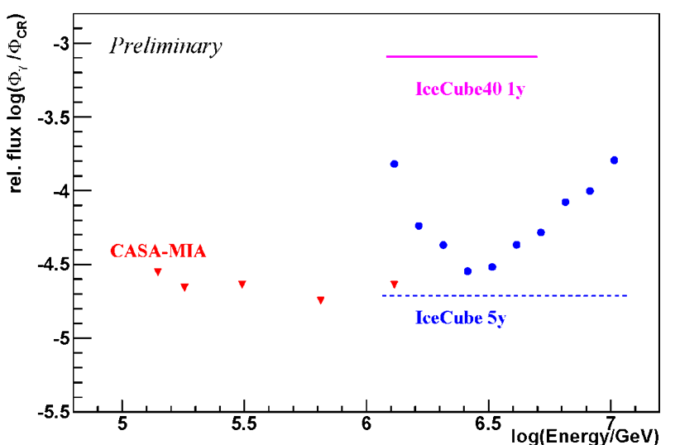
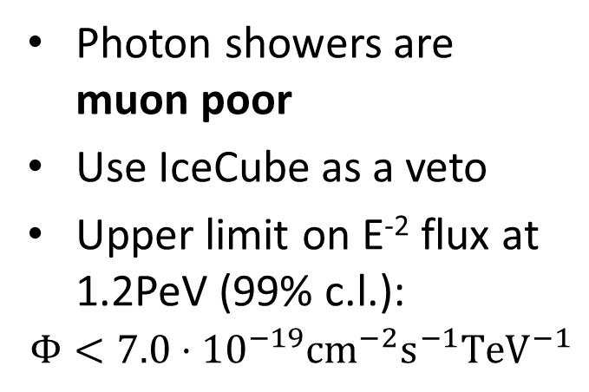
PeV Photon search with IceCube veto
Preliminary
Photon showers are muon poor
Use IceCube as a veto
Upper limit on E⁻² flux at 1.2PeV (99% c.l.):
$$Φ<7.0⋅{10}^{−19}{cm}^{−2}s^{−1}{TeV}^{−1}$$

Slide 23
Summary
IceCube/IceTop construction complete
First results:
  Cosmic-ray energy spectrum and composition
  Physics of air showers
  Heliospheric physics, transient events
  EAS veto for high-energy neutrino searches
  …
Ongoing efforts:
  Composition measurement with muons in IceCube
  Cosmic-ray anisotropy measurement
Future plans:
  Horizontal air showers
  Radio extension (RASTA)

