Slide 1
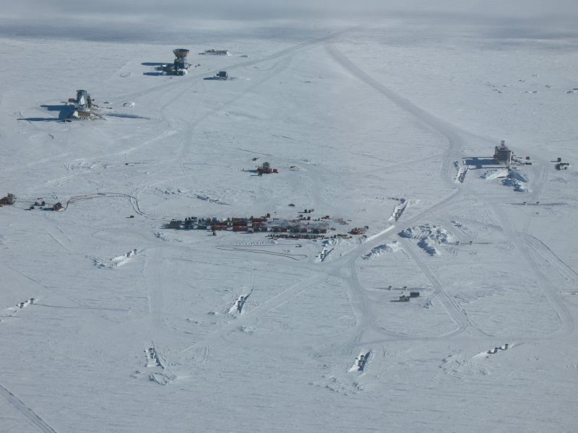
High energy neutrinos
Review of results from
IceCube (including IceTop),
Antares, Baikal
& ANITA

Slide 2
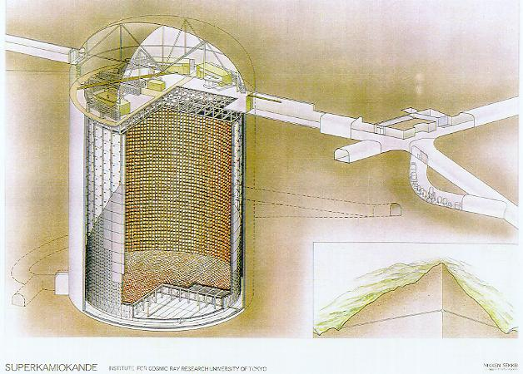
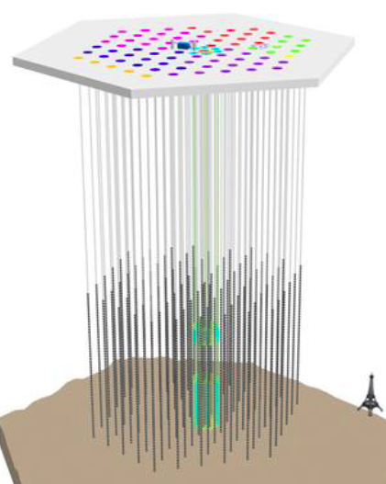
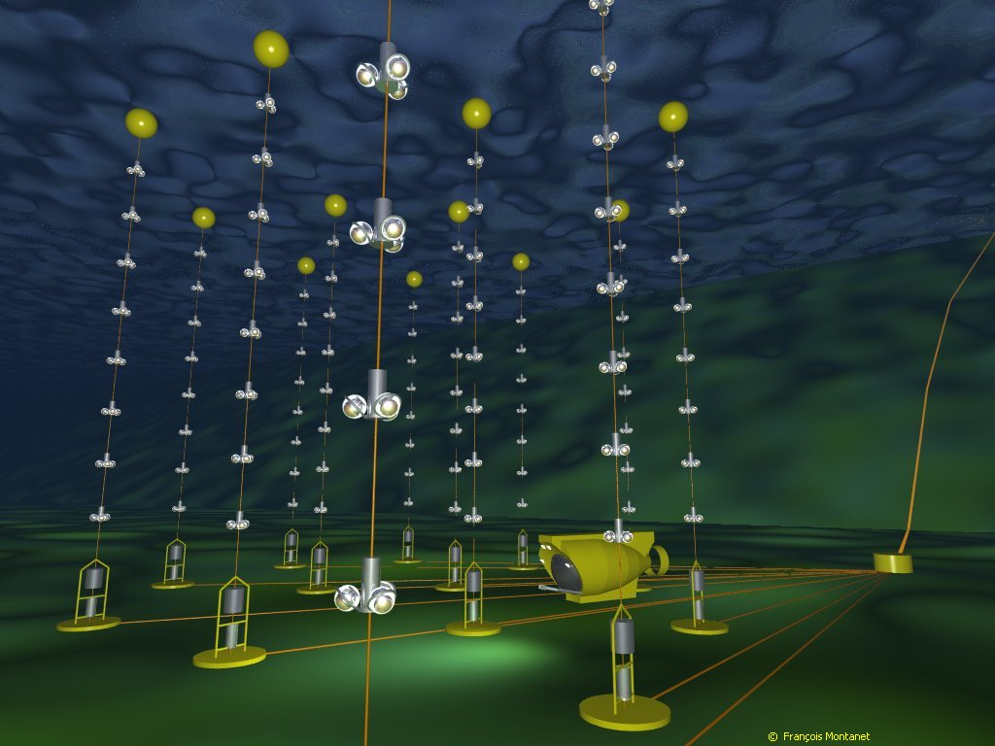
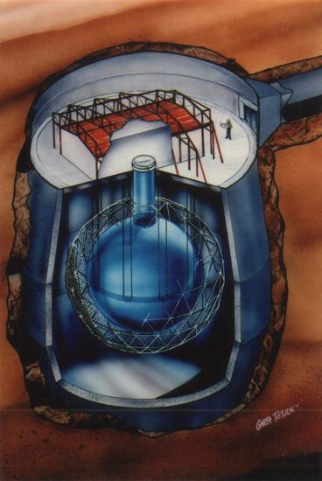
Detecting neutrinos in H₂0
Proposed by Greisen, Reines, Markov in 1960
Heritage:
DUMAND
IMB
Kamiokande
Baikal
AMANDA
IceTop
Super-K
SNO
IceCube: 86 strings
& 81 IceTop stations: completed 2010-11
ANTARES
All use Cherenkov light from charged products of ν interactions

Slide 3
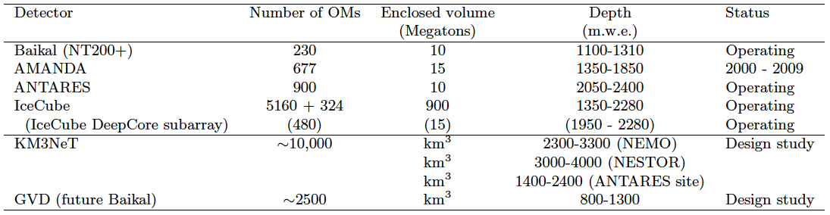
High-energy Neutrino telescopes
Look for an excess above the steep spectrum of atmospheric ν
Large volume--coarse instrumentation--high energy (> TeV)
as compared to Super-K with 40% photo-cathode over 0.05 Mton
= 4 x 10⁵ cm² / kT compared to 50 for Antares & 2 for IceCube

Slide 4
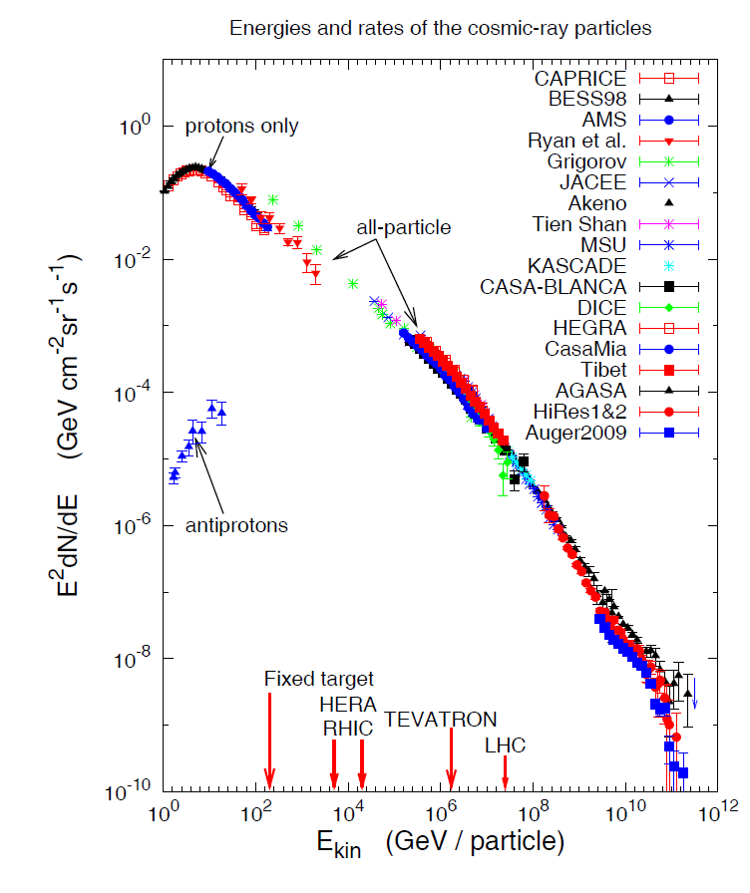
Cosmic-ray connection - I
Neutrino production at cosmic-ray sources
  Galactic SNR can accelerate particles into nearby molecular clouds
  Extra-galactic jets (in AGN or GRB) may share power between c.r. & ν
Expect a few TeV ν/yr in a gigaton detector in hadronic scenarios
  Sets km³ scale for HE neutrino astronomy
Galactic
Extra-Galactic

Slide 5
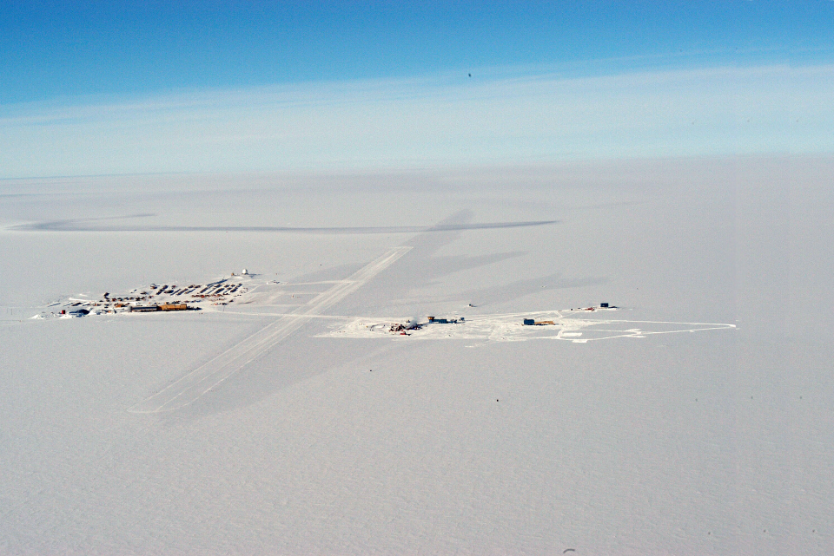
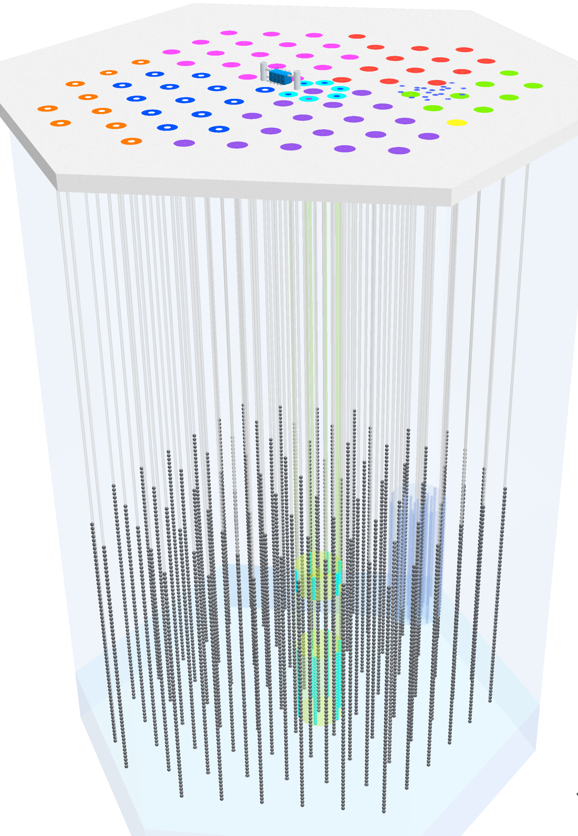
A 3-D cosmic-ray detector:
Two different kinds of events
Closely related scientifically:
Neutrinos from cosmic ray sources
Cosmic rays after propagation
Cosmic ray showers from above
South Pole
2835 m.a.s.l.
IceTop
1450 m
IceCube
Neutrinos from all directions
2450 m
Primarily ν_{μ}-induced μ
from below

Slide 6
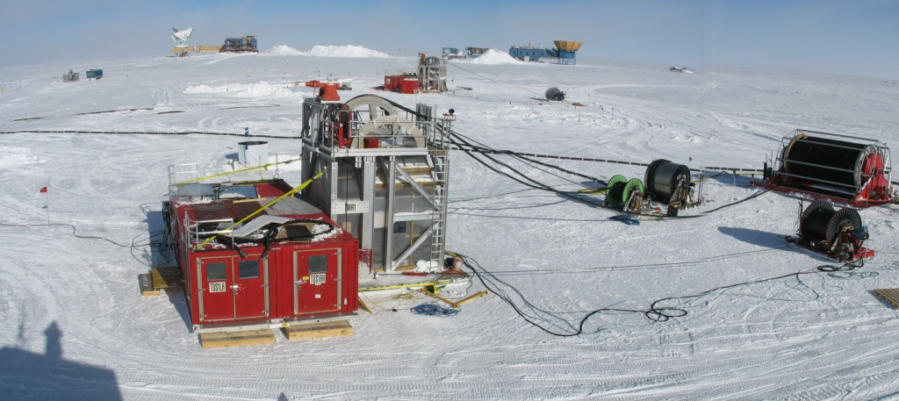
IceCube drilling & deployment
LED Flasher board
HV board
Digital Optical Module
Timing accurate to <3 ns over full array including IceTop
Main board for digitizing & time stamping

Slide 7
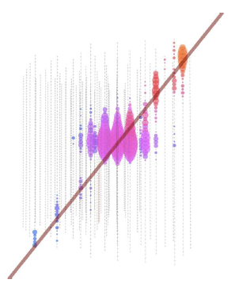
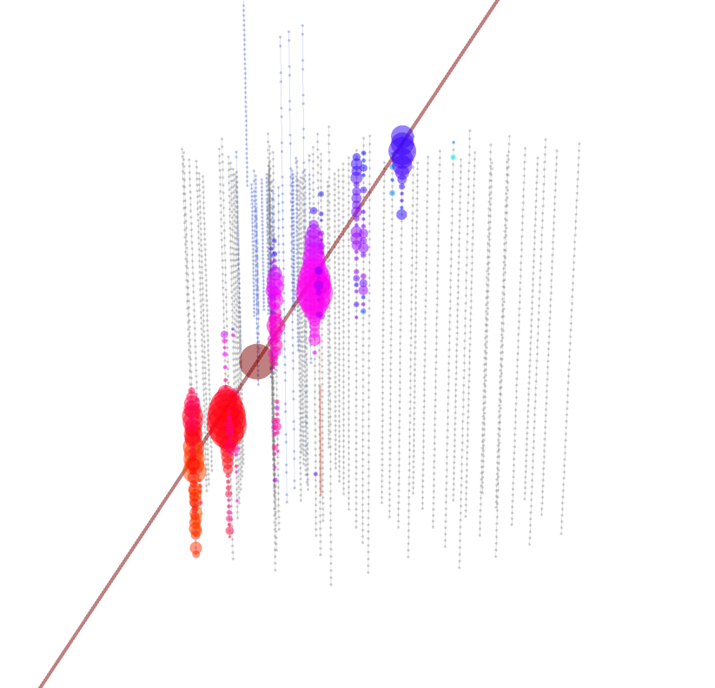
High-energy events in IceCube
Color code: red/orange = earlier; magenta/blue = later
downward
upward
Atmospheric muon with 80 TeV burst
~100 TeV ν_{μ} induced muon

Slide 8
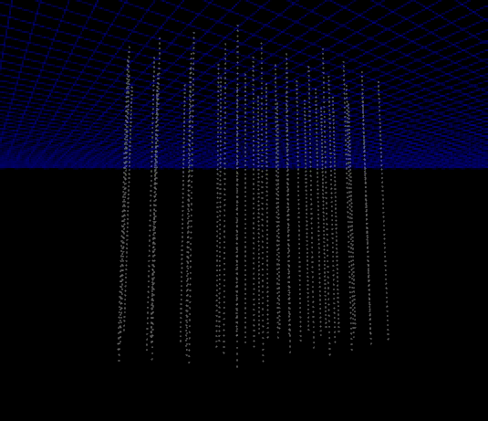
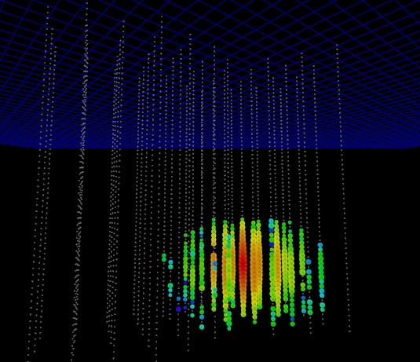
High energy cascade candidate
A cascade event, candidate for
a high energy ν_{e} ~50 TeV

Slide 9
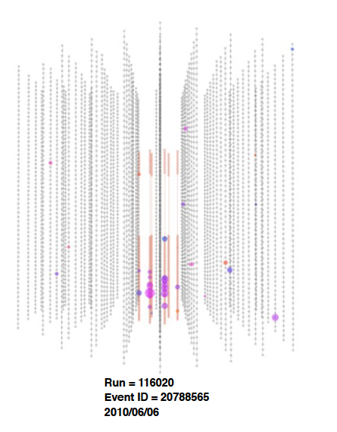
Downward muon bundle illuminates Deep Core subarray
Cascade event candidate in Deep Core

Slide 10
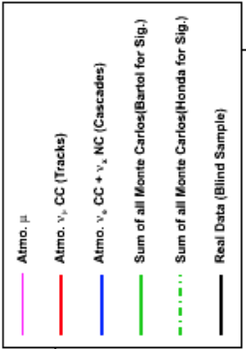
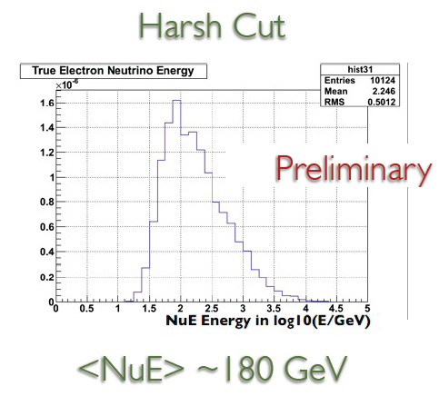
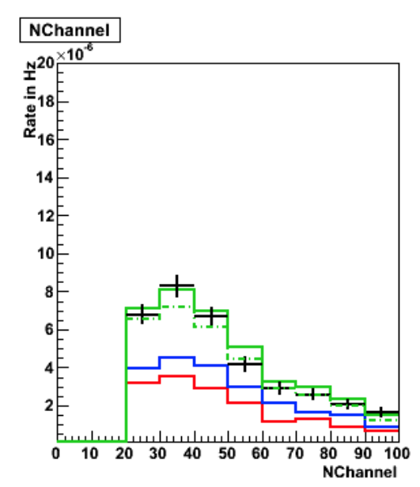

Cascade events with Deep Core

Slide 11
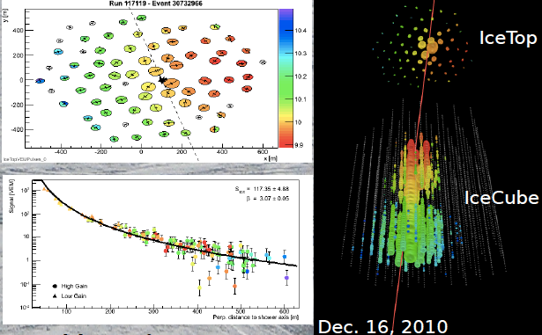
Air shower in IceCube/IceTop
Zenith angle = 5.6 deg, E ~ 170 PeV

Slide 12
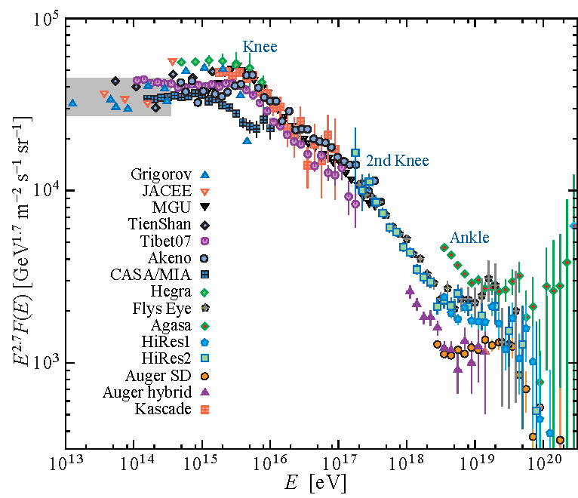
Energy range of IceCube/IceTop
< PeV > EeV
Threshold energy
  < 300 TeV
Maximum energy
  Limited by km² size
  Coincident events
    A⋅Ω = 0.3 km² sr
    E_{max} = EeV
  IceTop only ( θ < 60º)
  or in-ice trigger
    A⋅Ω = 3 km² sr
    E_{max} = 3 EeV
Anchor to direct measurement of composition ~300 TeV
Look for transition to extra-galactic < EeV

Slide 13
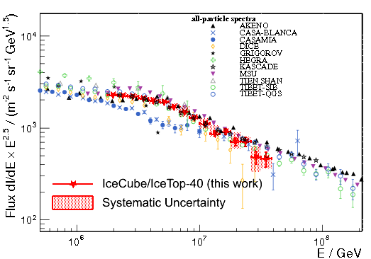
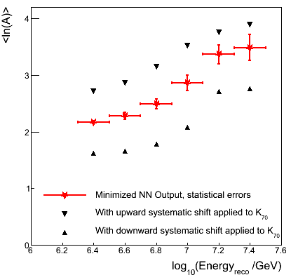
IceTop – InIce Coincidences IC 40
ICRC paper #923
preliminary
iron
μ bundle size
preliminary
proton
shower size
unfolding: energy & mass

Slide 14
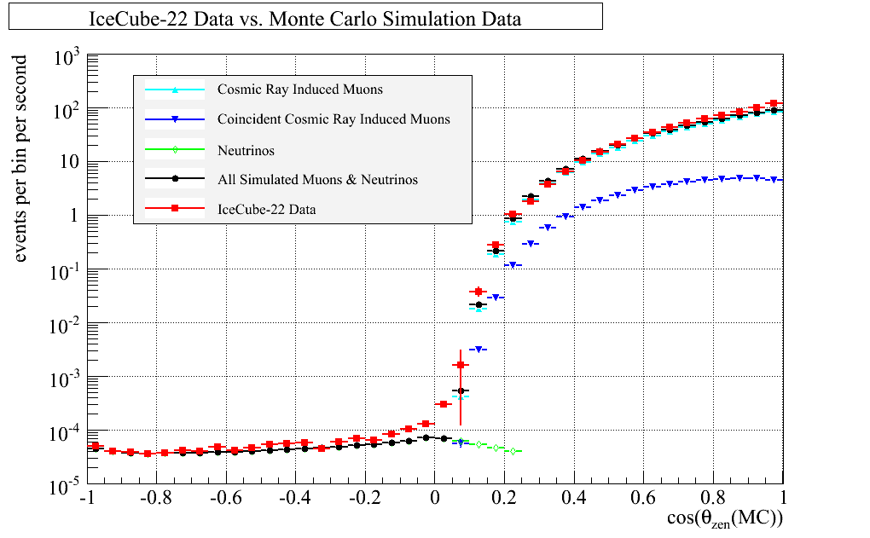
Muons underground
Muons enter detector from all directions
At 2 km in water downward muons are 10⁶ x upward rate
Analysis must distinguish true upward events from misreconstructed atmospheric muons
Upward
ν_{μ} → μ
Downward atmos. μ
All-sky plot of muons in IceCube-22 from 2007 (P. Berghaus, IceCube, ISVHECRI-2008 arxiv.org/abs/0902.0021)

Slide 15
Detecting muon neutrinos
Rate = Neutrino flux
  x Absorption in Earth
  x Neutrino cross section
  x Size of detector
  x Range of muon (for ν_{μ})
Range favors ν_{μ}
  ~4 to 15 km.w.e. for
  E_{ν} ~ 10 to 1000 TeV
A_{eff} (m²)
E_{ν} (GeV)
Earth becomes opaque to ν, first for vertically upward (~30 TeV) then for more horizontal (~PeV)

Slide 16
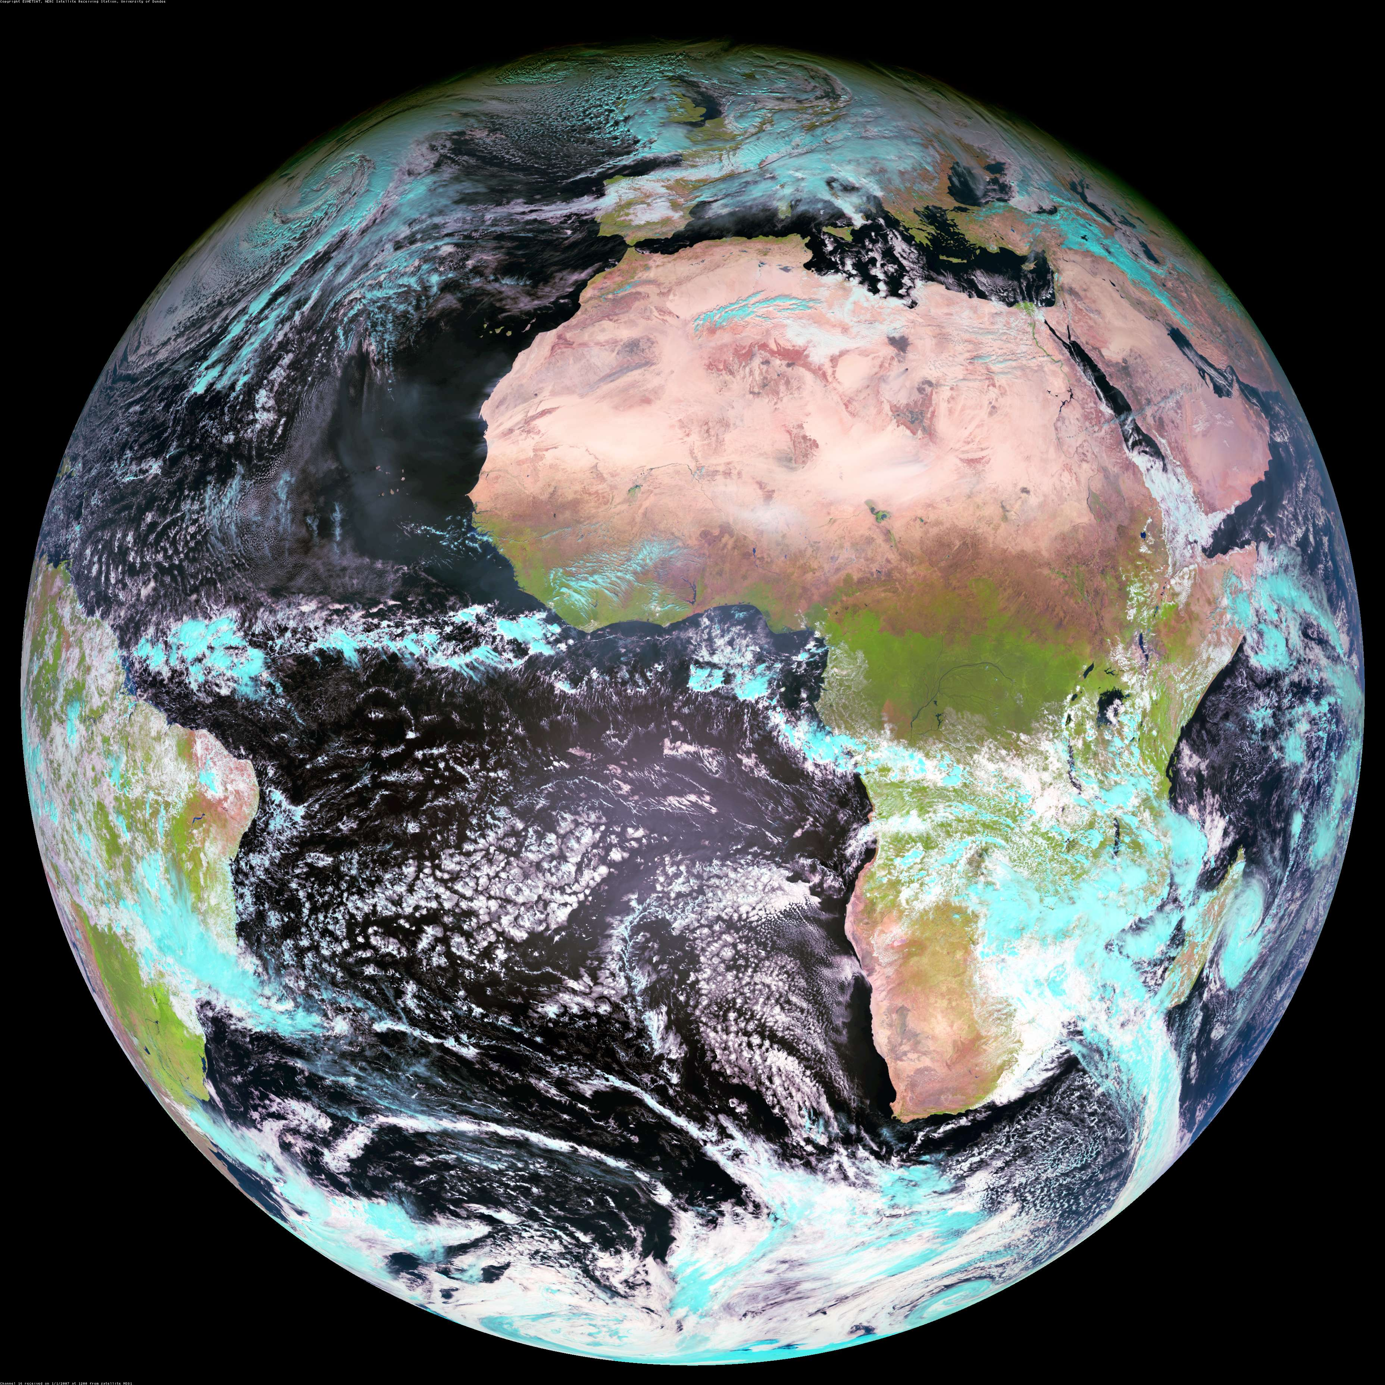
Upward ν_{μ} in IceCube
S.P.
Zone 1 l: -30 to -90 ; 3.14 sr
Zenith: 90 < θ < 120º
(40% of Zone 1 is over the
Antarctic continent)
Zone 2, l: -30 to +30; 2.30 sr
Zenith 120 < θ < 150º
Note: 43% of Zone 1 is in declination -65º < δ < -90º --over Antarctica. Contains
~25% of IceCube ν_{μ}.
Seasonal temperature like
South Pole: δT ~ ± 7.5%,
α_{T} ~ 0.54 → δRate ~ ± 4%
Zone 3, l: +30 to +90, 0.84 sr
Zenith: 150 < θ < 180º
Cosmic ray produces ν in atmosphere that puts a muon into the detector

Slide 17
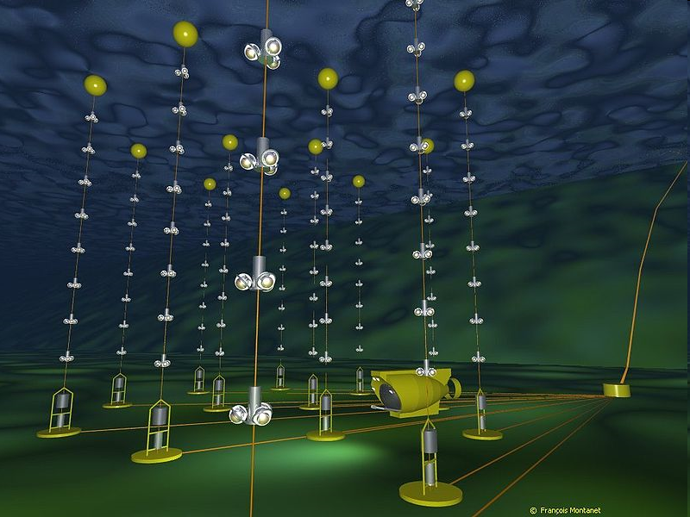
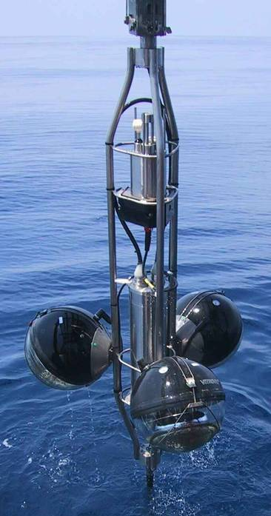
The ANTARES detector
Buoy
12 lines of 75 PMTs
25 storeys / line
3 PMTs / storey
~900 PMTs
Storey
14.5 m
350 m
40 km to
shore
Junction
Box
~60 m
Submarine links
Completed in May 2008

Slide 18
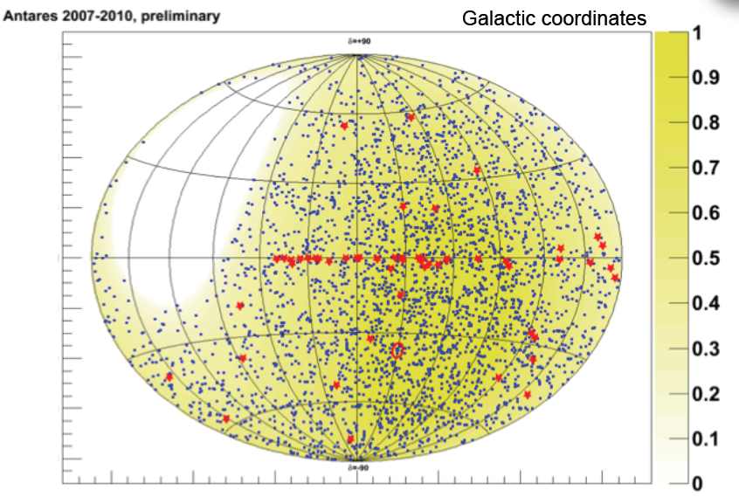
Searching for point sources
--three strategies
All sky
Selected sources
Flaring sources
  Triggered
  Untriggered
Antares search 2007 – 2010:
3058 upward ν candidates.
Red boxes are selected sources
(Claudio Bogazzi, ICRC 2011)

Slide 19
in Galactic coordinates (Gisela Anton, ν-2010)
Northern detector has more
Galactic sources in F.O.V.
Whether a source produces p → ν, γ depends on its environment – next talk

Slide 20
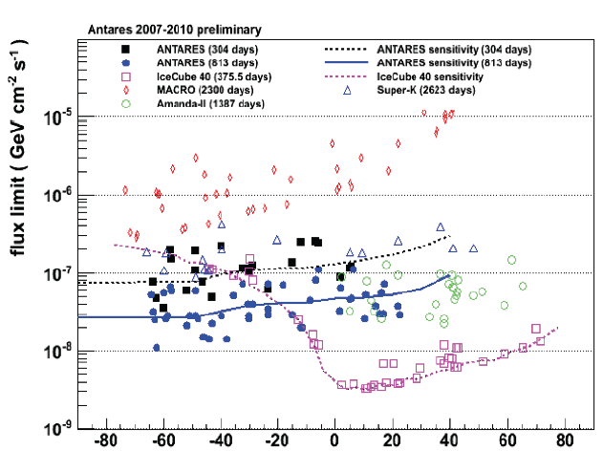
Searches for selected sources
Antares 4 yrs
IceCube-40
1 yr

Slide 21
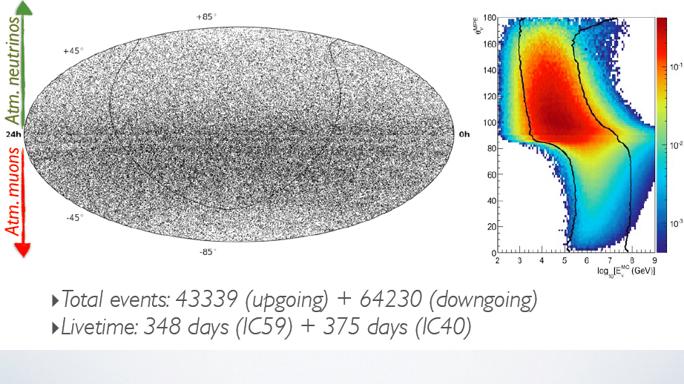
Search for point sources in IceCube
Note high energy threshold for downward events

Slide 22
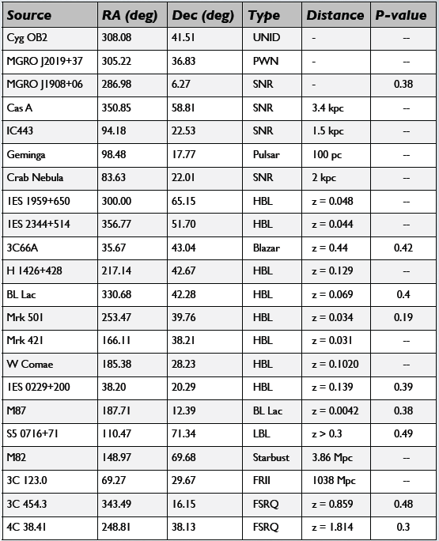
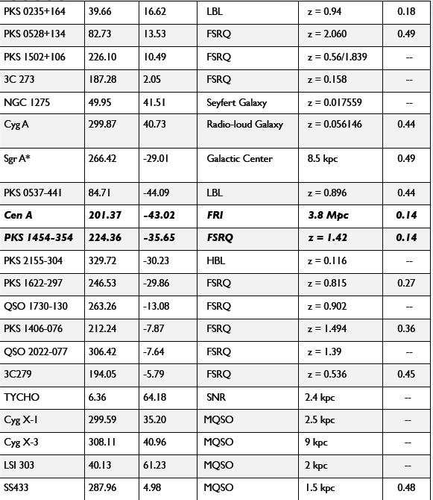
IceCube selected sources
(13 galactic SNR etc, 30 extragalactic active galaxies, etc.)

Slide 23
Search for diffuse flux of ν
Neutrinos are not absorbed. Therefore
All sources out to Hubble radius contribute
Hard spectrum
  Expect -2.0 to -2.4 differential spectral index
  Compared to -3.0 to -3.7 for atmospheric ν
Look for excess of high-energy events above background of atmospheric neutrinos

Slide 24
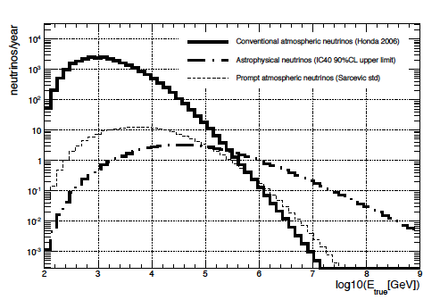
Measurement of ν_{μ}-induced μ
Fit 3 components:
  Atmospheric ν from K± and π± (0.3 – 85 TeV)
    Use Honda 2007 to 10 TeV
    + power-law extrapolation
    ~ cos⁻¹ (θ)
  Prompt ν ( 10 – 600 TeV )
    Harder spectrum to > 10⁷ GeV (~E^{-2.7}), isotropic
  Astrophysical ν
    Isotropic, with E⁻² spectrum assumed (35 – 7000 TeV)
  Note different response for astro. ν vs atmos. ν
π and K-decay
Astrophysical
Prompt
Result of fit:
Consistent with only K, π atmospheric ν to 100 TeV
Charm component not yet seen “intrinsic” charm in doubt?
No astrophysical neutrinos seen yet

Slide 25
IceCube ν_{μ}: measurements & limits
Waxman
-Bahcall Limit
IceCube 40
arXiv:1104.5187

Slide 26
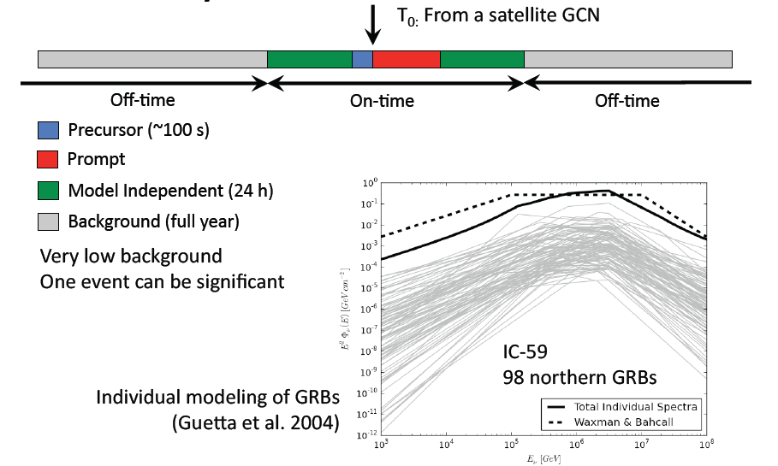
Search for neutrinos from GRB

Slide 27
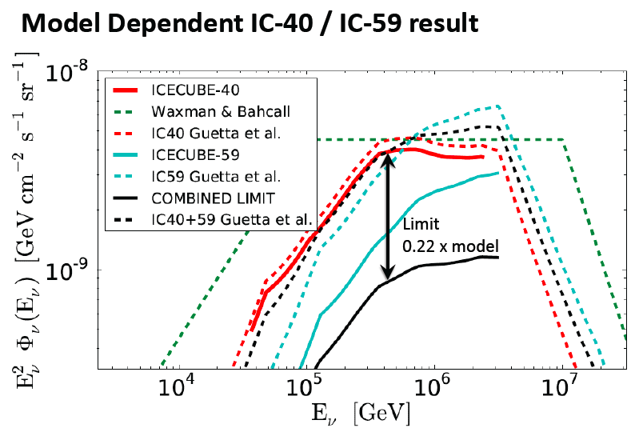
8 events expected
None seen

Slide 28
Where are the neutrinos?
What do the limits mean?

Slide 29
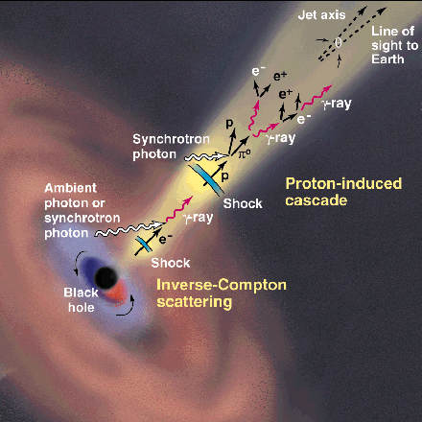
Generic model I
CR acceleration occurs in jets
  AGN or GRB
Abundant target material
  Most models assume photo-production:
    p + γ → Δ⁺ → p + π⁰ → p + γ γ
    p + γ → Δ⁺ → n + π⁺ → n + μ + ν
Ideal case ( ~ “Waxman-Bahcall limit”)
  Strong magnetic fields retain protons in jets
  Neutrons escape, decay to protons & become UHECR
  Extra-galactic cosmic rays observed as protons
  Energy content in neutrinos ≈ energy in UHECR
This picture disfavored as limits go below W-B
http://www.ucd.ie/math-phy
/rieger/science.gif
Waxman, Bahcall, PRD 59,
023002 (1998). Also
TKG astro-ph/9707283v1

Slide 30
Generic model II
UHECR are accelerated in external shocks analogous to SNR
  See E.G. Berezhko, 0809.0734 & 0905.4785
  mixed composition (accelerate whatever is there)
  Low density of target material
  → lower level of TeV-PeV neutrino production
Diagram from A.Ferrari, Ann Revs A&A 36 (1998) 539

Slide 31
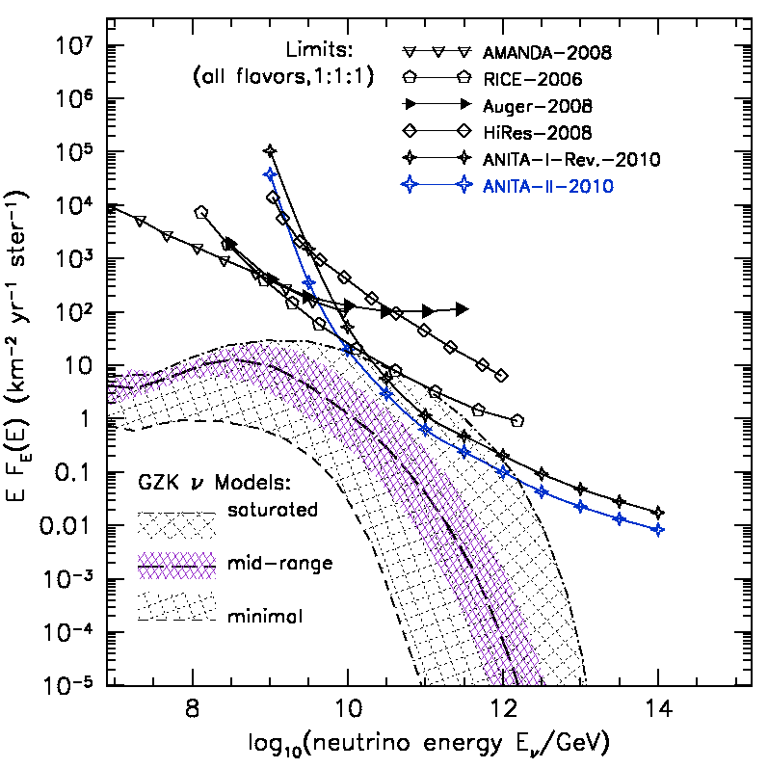
Cosmogenic (GZK) neutrinos
Cosmic ray connection - II
UHECR exist, therefore
  Neutrino production occurs during propagation via
  p + γ_{CMB} → π⁺ → ν
  E_{th} ~ 5 x 10¹⁹ eV
  Even if no ν from CR sources
Intensity depends on
  Spectrum at sources
  Evolution of sources
  Composition of UHECR (Heavy nuclei give less ν)
ANITA
arXiv:1011.5004

Slide 32
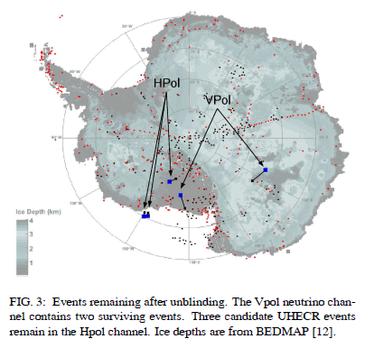
Radio Detection of neutrinos
ANITA-II over Antarctica
Vpol:1 neutrino candidate;
HPol:3 > 10¹⁹ eV cosmics
http://arxiv.org/abs/1003.2961

Slide 33
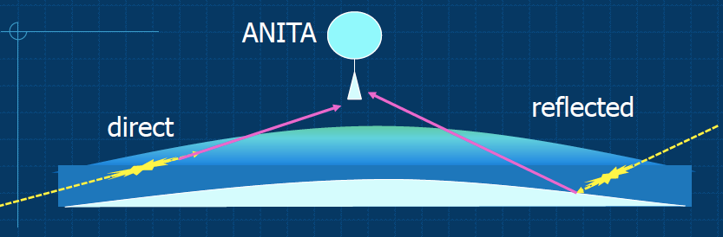
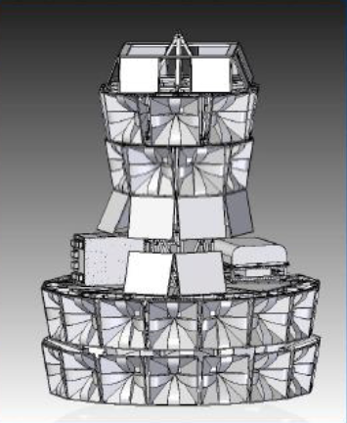
ANITA also detects ~10¹⁹ eV CR
Pisin Chen, Trieste, June 2011
ANITA-III optimized for UHECR as well as ν will fly over Antarctica in 2013-14

Slide 34
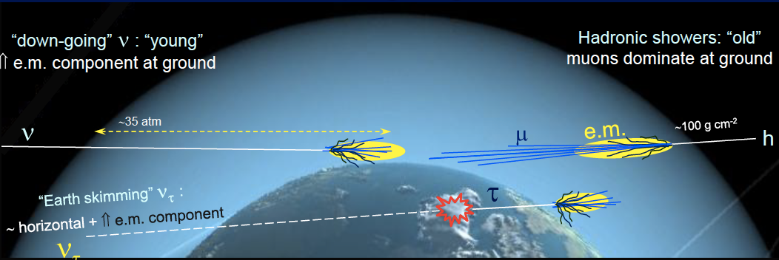
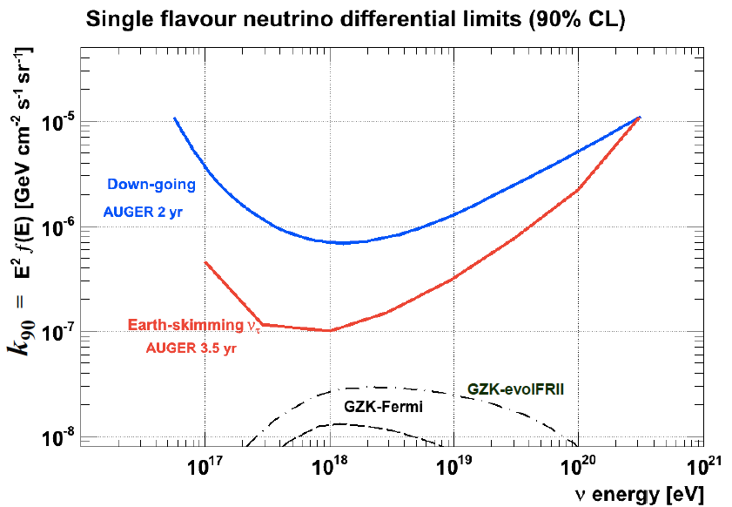
Auger as a neutrino detector
J. Luis Navarro, TeVPA, 2011
Late developing, horizontal air showers and Earth skimming ν_{τ} → τ → shower are signals for cosmogenic neutrinos in large air shower detectors

Slide 35
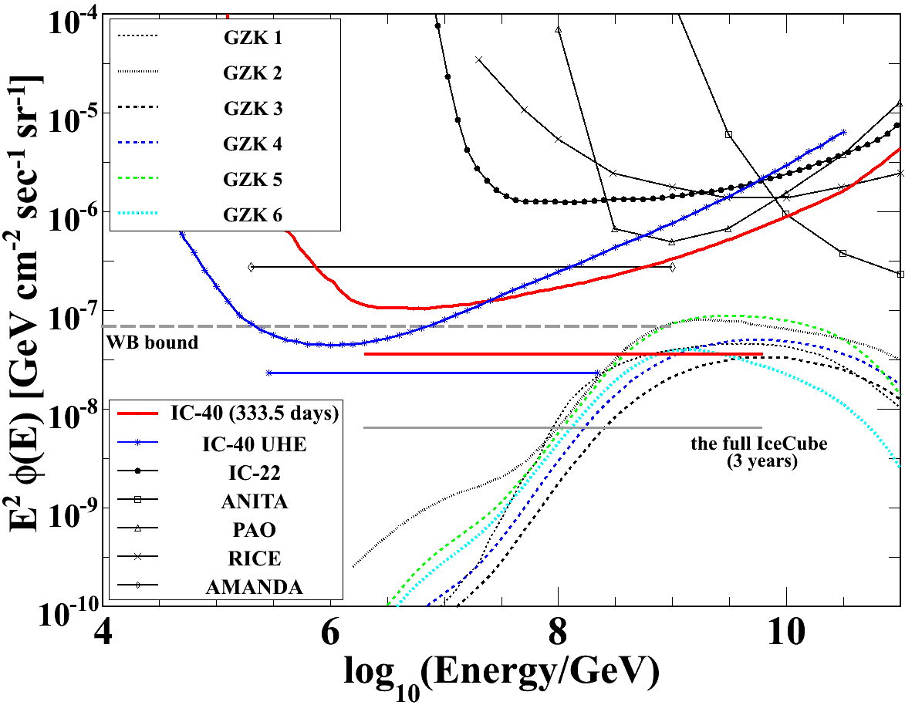
IceCube limits on cosmogenic ν
GZK search looks for
  very bright events
  near the horizon
  with compact initial burst of light
  Complementary to diffuse ν_{μ} search that starts by measuring atmospheric ν_{μ}
  Blue lines show results that include cascades
  Model 6 (Fermi max): expect 0.4 events
IceCube-40 arXiv:1103.4250
All-flavor limits assuming ν_{μ} ~ ν_{τ} ~ ν_{e}

Slide 36
Summary
Pushing below Waxman-Bahcall “limit” in 100 TeV – 10 PeV range disfavors proton dominance of extragalactic cosmic rays
Expect rapid improvements in IceCube sensitivity to astrophysical ν:
  IC59 + IC79 data currently in analysis
  Include both cascade and track-like events
  Full IceCube-86 operating since May 2011
Need larger acceptance to measure cosmogenic neutrinos

Slide 37
Future projects
Km3NeT: plan for multi-gigaton detector in Mediterranean
  Also GVD at Baikal
Measure cosmogenic (GZK) neutrinos in EeV range
  ARA (Askaryan Radio Array)
    First test deployment next to IceCube in January, 2011
    Further deployments planned for next season at South Pole
  ARIANNA radio antennas on Ross Ice Shelf
Beyond Deep Core for lower energy. Two stages:
  Lower threshold below 10 GeV for WIMP searches & oscillations
  Very dense instrumentation for proton decay
Dark Matter Ice – two pilot scintillators deployed at 2500 m in IceCube holes in December, 2010
  Seasonal variation of background opposite to DAMA,
  Seasonal variation of DM signal universal

Slide 38
The Neutrino Detector Spectrum
NOνA
Accelerator-based
OPERA
K2K,
T2K
MINOS
Energy ↔ Volume
MiniBooNE
10 MeV
100 MeV
1 GeV
10 GeV
100 GeV
1 TeV
10 TeV
1 EeV
SNO, Borexino,
KamLAND, Double CHOOZ,
Daya Bay, etc.
ANITA,
RICE, Auger, ARIANNA,...
Super-K
AMANDA, Baikal, ANTARES
DeepCore
IceCube, KM3NeT
Gap
Atmospheric/Astrophysical
Gamma Ray Bursts
Neutrino Oscillations
Soft Galactic Cosmic Ray Accelerators
Dark
Matter

