Slide 1
High-Energy Astrophysics with Neutrino Telescopes
Ignacio Taboada Georgia Institute of Technology Aug 2, 2011 – TeV PA

Slide 2
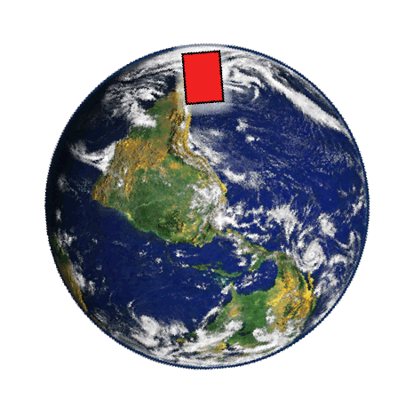
Neutrinos as astronomical messengers
Cosmic accelerator
C.R.
Photon
10²¹
CMB star-light
Neutrinos
10¹⁸
B
10¹⁵
Neutrino
Energy (eV)
Photons
Cosmic ray
10¹²
10⁹

Slide 3
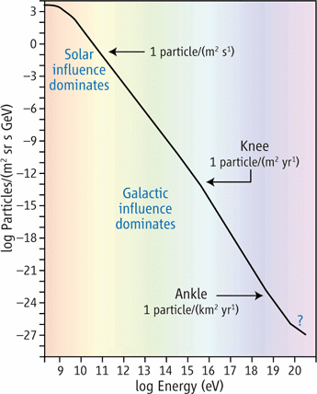
The origin of cosmic rays
Cosmic ray spectrum
Galactic: SN remnants
Extragalactic: AGNs / GRBs / Other
Expect a few TeV ν/yr in a gigaton detector

Slide 4
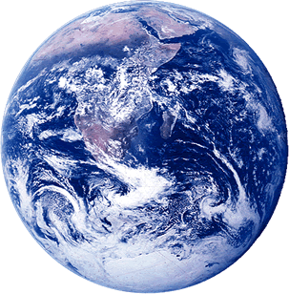
High-energy neutrino detection: traditional way
Earth
Cosmic
Ray
Astrophysical neutrino
Atmospheric Neutrino
Atmospheric
muon
Build BIG (1 km³ ice/water)
Build underground Use Earth as a filter
Cosmic
Ray

Slide 5
High-energy neutrino detection: traditional way
Earth
Cosmic
Ray
Astrophysical neutrino
Now 4π sr
Atmospheric Neutrino
Atmospheric
muon
Build BIG (1 km³ ice/water)
Build underground Use Earth as a filter
Cosmic
Ray

Slide 6
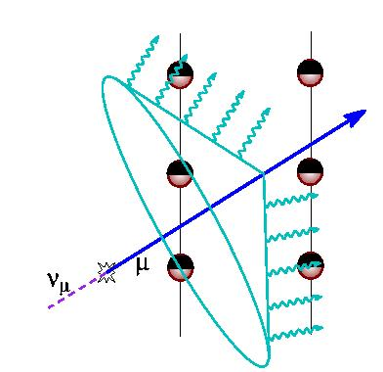
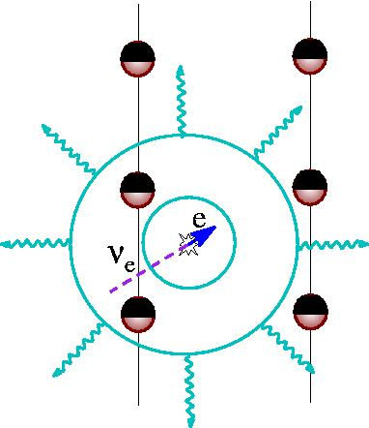
Neutrino detection in water/ice
Tracks
Cascades
O(km) muon tracks
Light point sources
Good angular resolution Ice: <1º Sea/Lake: <0.1º
ν_{μ} sensitivity
Good energy resolution
Poor/no directionality
4π sensitivity
All flavor sensitivity

Slide 7
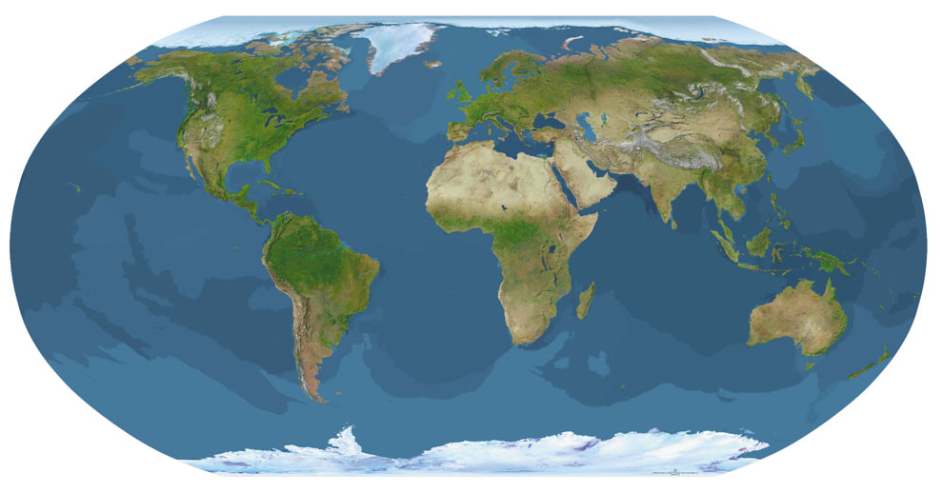
A bit of history
Antares (’06 – today)
Nestor NEMO (test)
Baikal (‘92 –today)
Km3Net (future)
Dumand (1970s – 1990s)
AMANDA (‘94 – ‘08) IceCube
(’05 – today)
Neutrinos & Dark Matter session: IceCube, Antares & Pierre Auger presentations

Slide 8
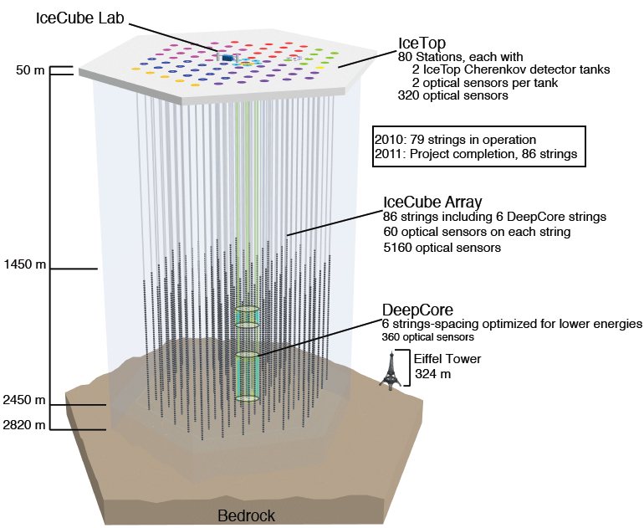
81
324

Slide 9
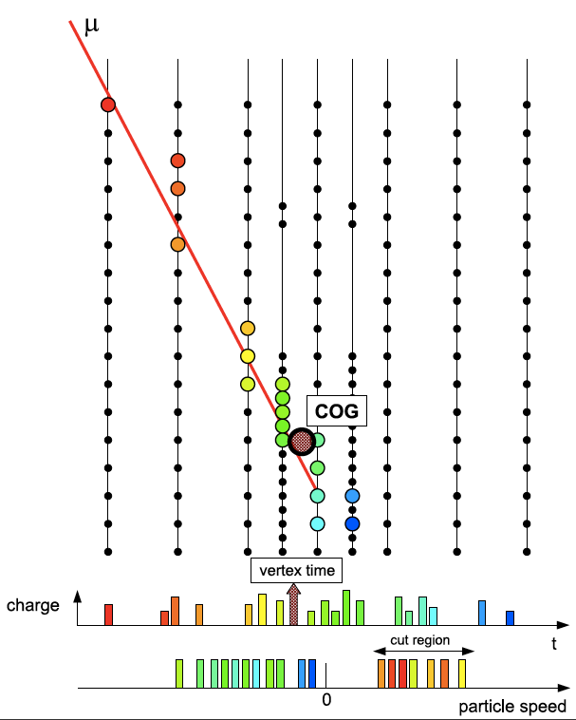
IceCube’s DeepCore
Superb muon veto
10 – 300 GeV over 4 π sr
Search for DM
Neutrino Oscillations
Choked GRBs

Slide 10
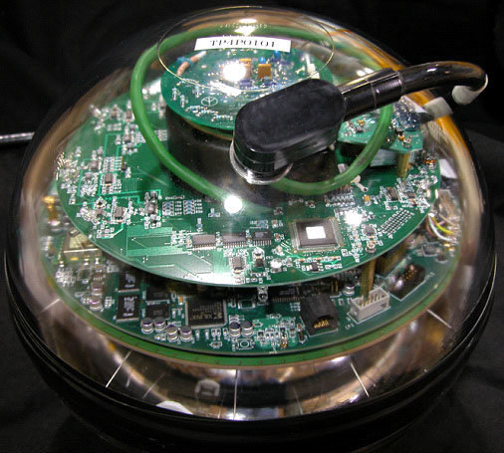
IceCube Performance
DOM Low Noise rate (500 Hz) (300 Hz with deadtime -> SN search)
99% DOMs are operational
Uptime: 99.6% (June 2011)
2 kHz of muons
220 atm. ν_{μ} per day

Slide 11
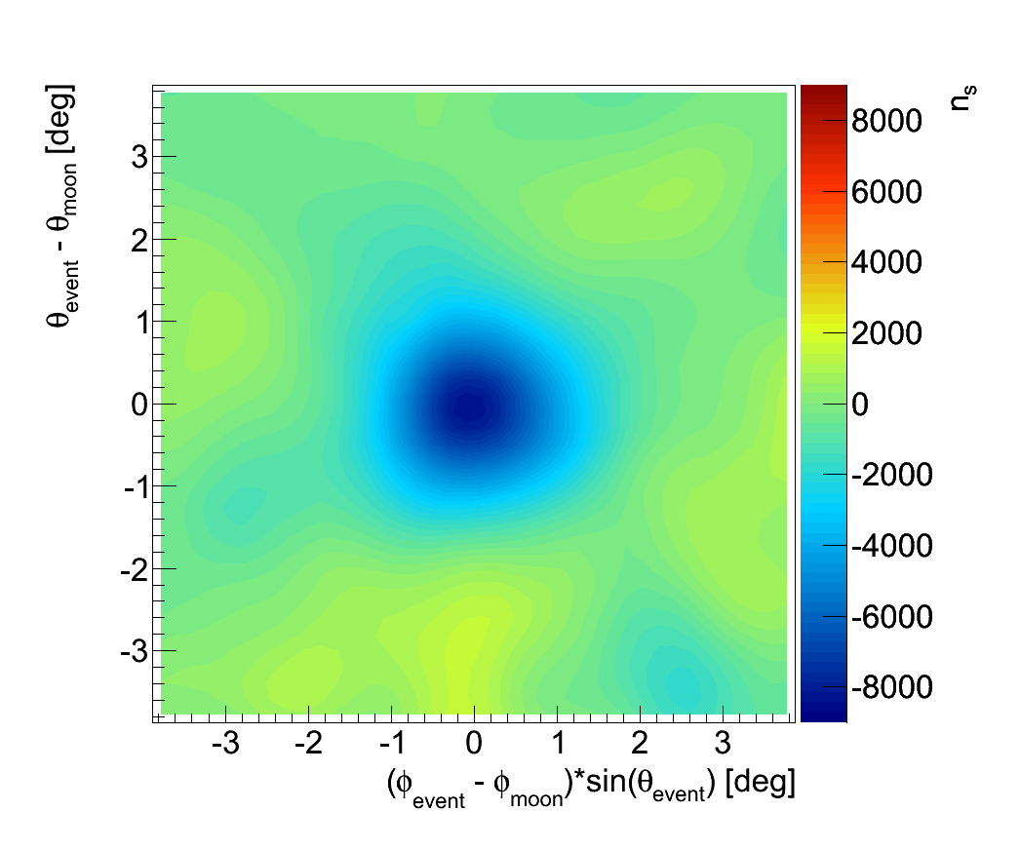
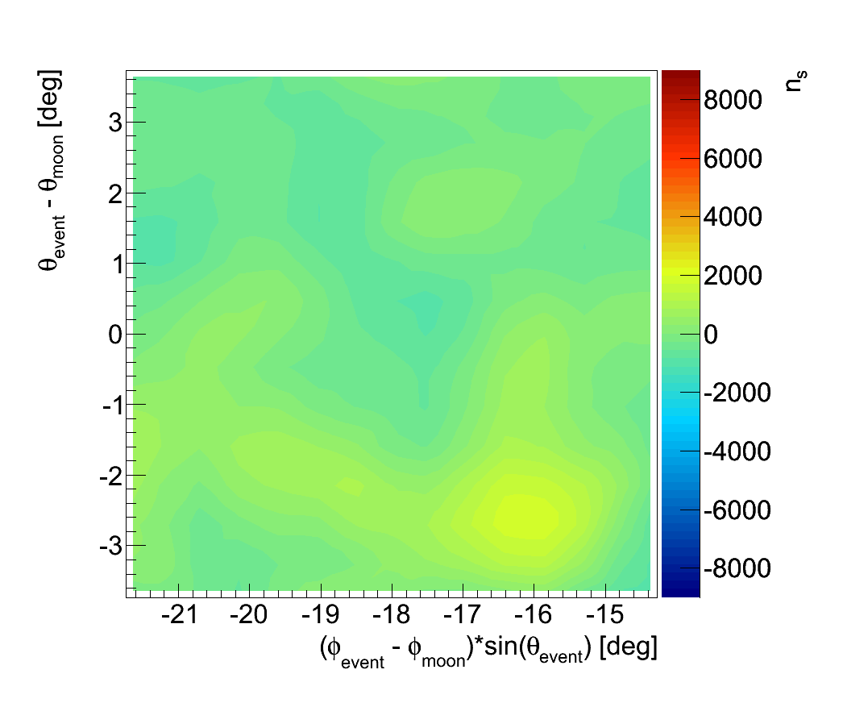
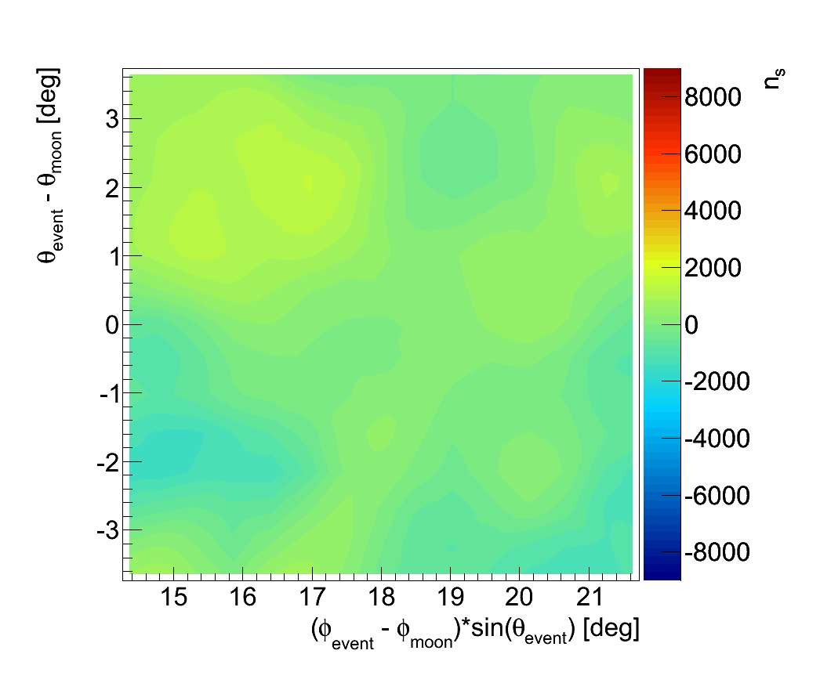
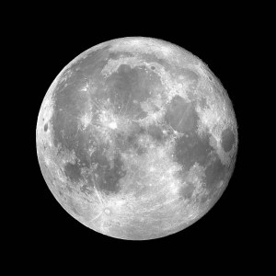
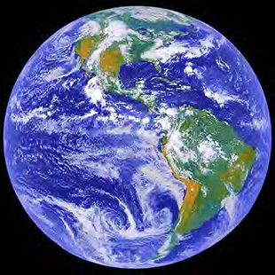
Moon Shadow
IC-59 On source PRELIMINARY
Unbinned method
IC-40 > 10 σ (15 moon cycles)
IC-59 > 13 σ (14 moon cycles)
Full IceCube: >5 σ each moon cycle
Test PSF
IC-59 off-source
“left”
IC-59 off-source “right”
Cosmic Rays

Slide 12
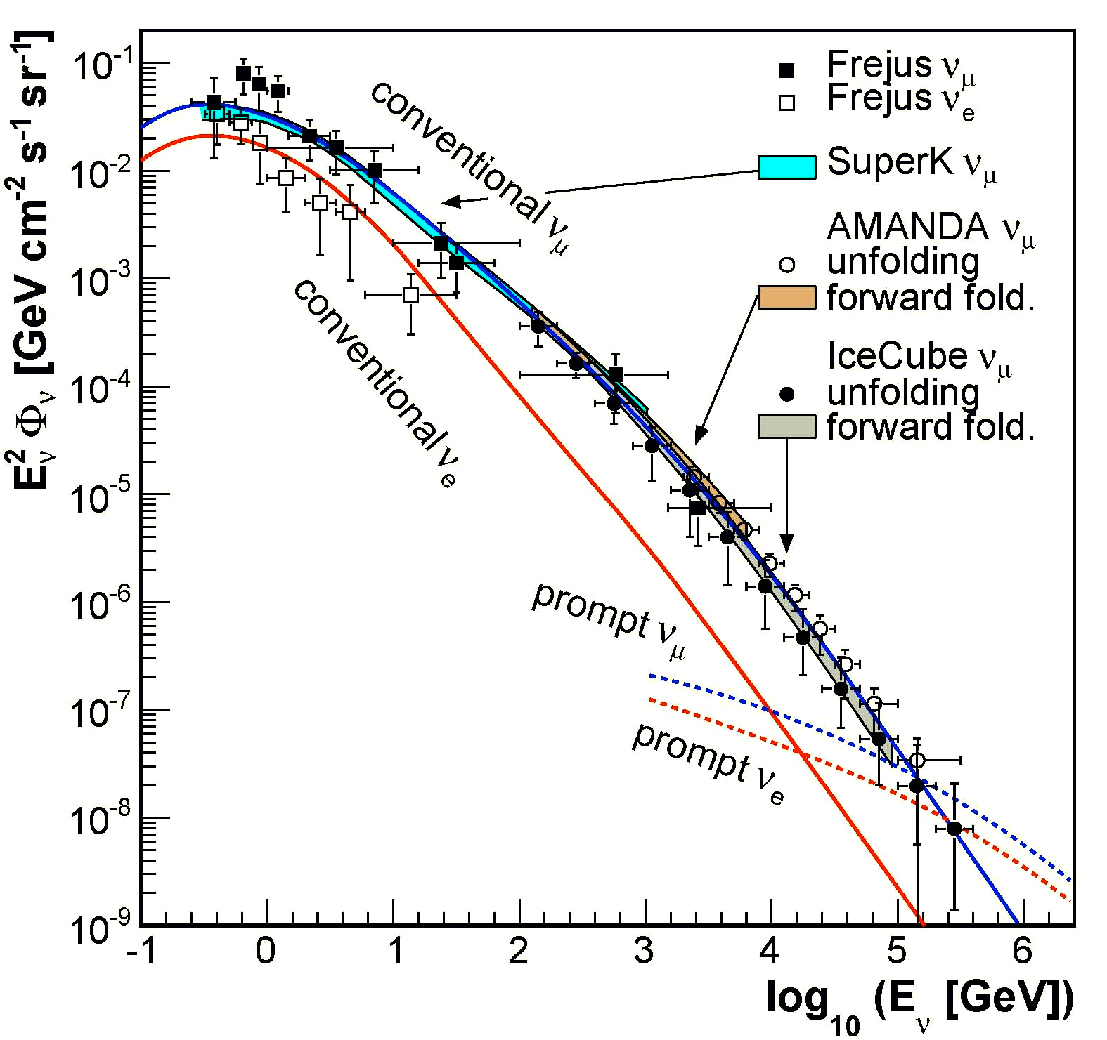
Atmospheric Neutrinos
IceCube ν_{μ} spectrum with IC-40
New IceCube cascade channel results at ICRC next week.

Slide 13
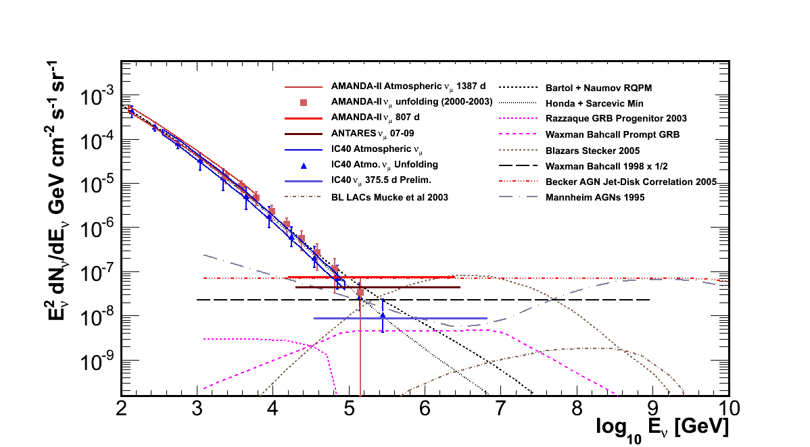
Diffuse ν_{μ} flux limits

Slide 14
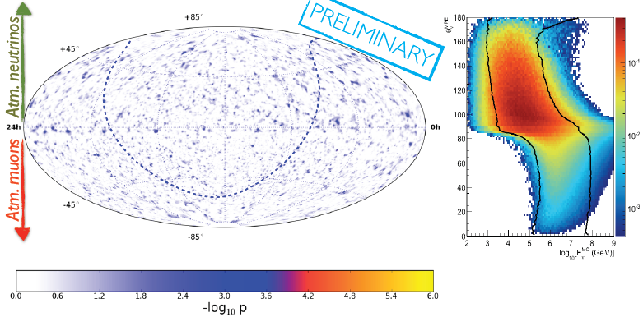
Time Integrated Point Source Search
Combined IC40/IC59
Hottest Spot: post trial 74.2 %
See Talk by J.A. Aguilar later today

Slide 15
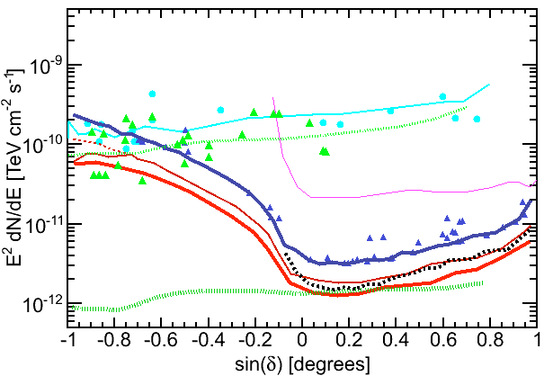
Time Integrated Point Sources
SuperK
Antares
AMANDA
IC-40
IC59
IC-80 (pred)
IC40+IC59
KM3Net

Slide 16
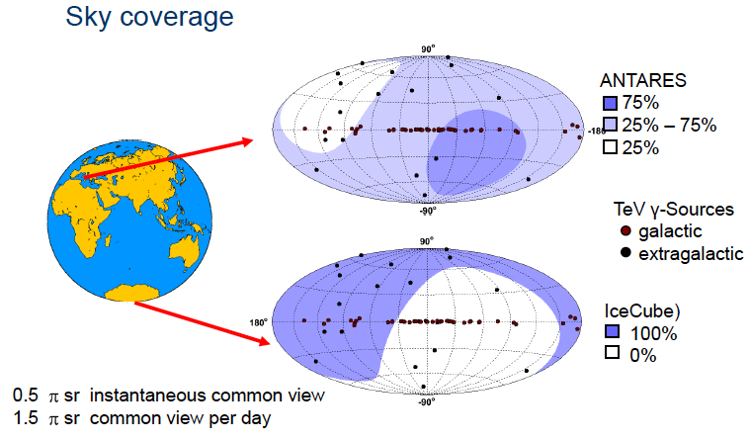
Antares and Km3Net: Mediterranean detectors
(Slide by G. Anton, Neutrino 2010)

Slide 17
Are GRBs sources of UHE C.R.?
E ≈ 10¹⁸ – 10²⁰ eV
Power needed to produce UHE C.R.
Power in GRBs

Slide 18
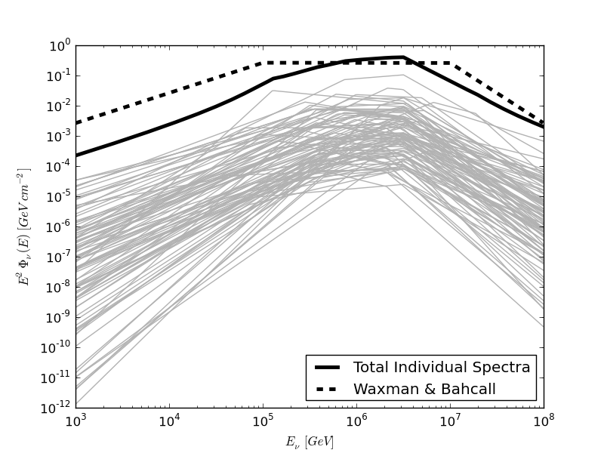
Gamma Ray Bursts
T_{0:} From a satellite GCN
Off-time
On-time
Off-time
Precursor (~100 s)
Prompt
Model Independent (24 h)
Background (full year)
Very low background One event can be significant
IC-59 98 northern GRBs
Individual modeling of GRBs (Guetta et al. 2004)

Slide 19
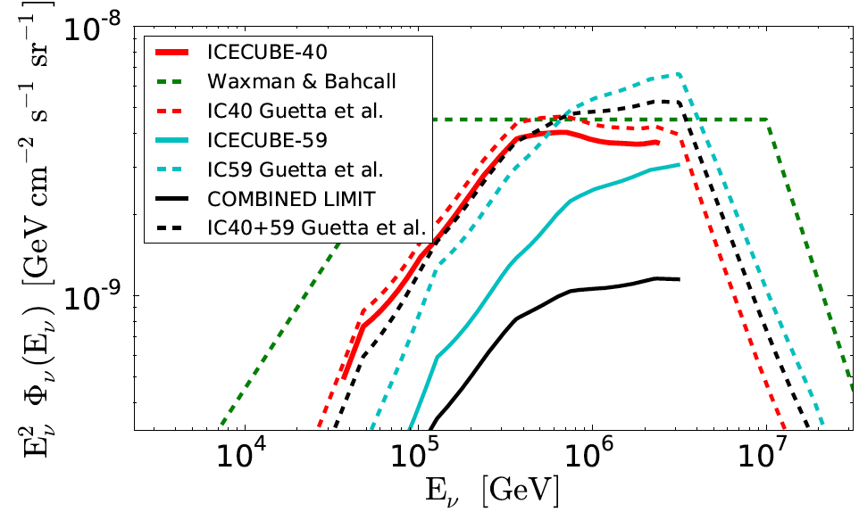
Model Dependent IC-40 / IC-59 result
Limit 0.22 x model

Slide 20
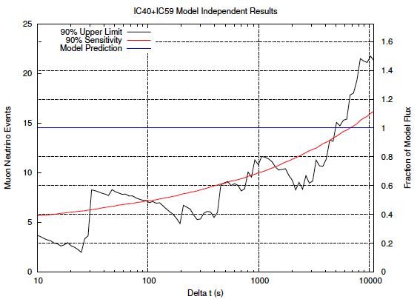
Model Independent IC40 / IC59

Slide 21
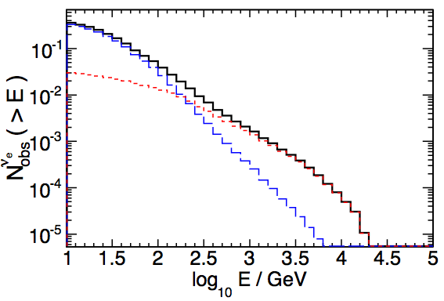
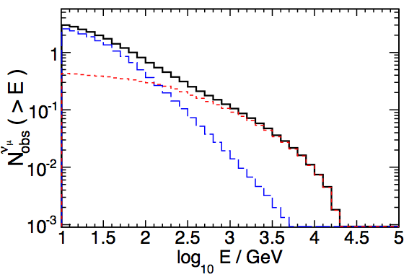
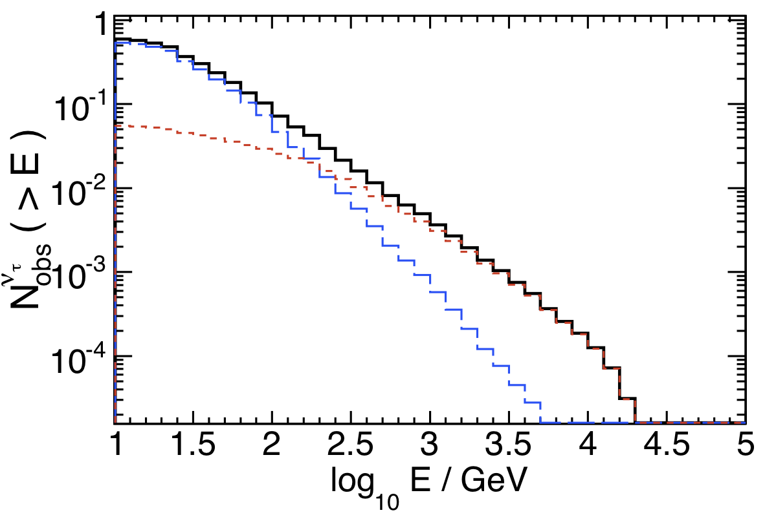
DeepCore and Choked GRBs
kaon
pion
ν_{e}
ν_{μ}
Supernova at 10 Mpc with default Ando & Beacom parameters and oscillations
10.5 events all flavors
ν_{τ}
See also talk by C. Finley on follow-up of IceCube neutrino alerts

Slide 22
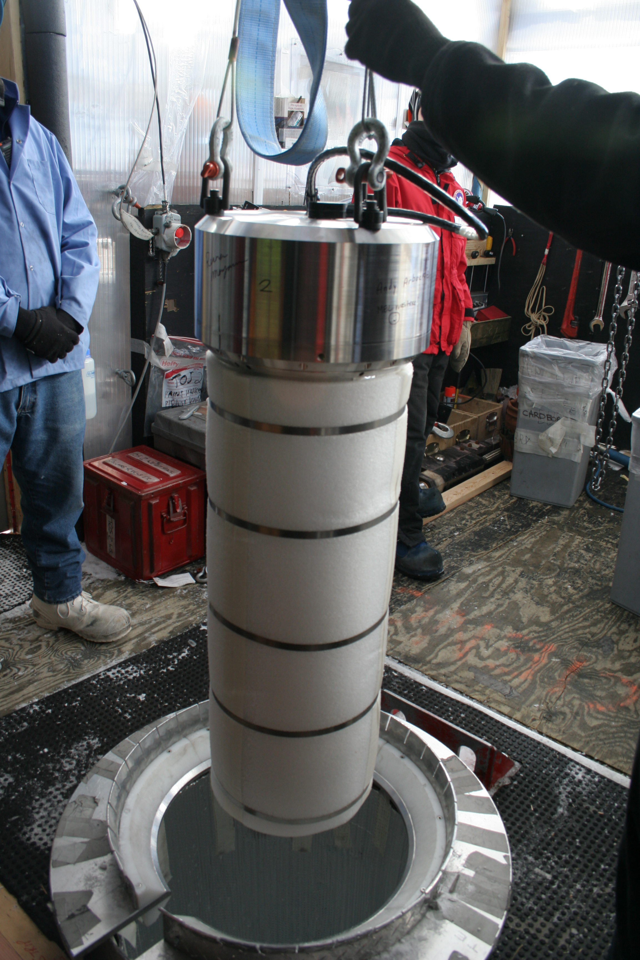
South Pole future for Neutrino Astrophysics
ARA (Askaryan Radio Array) for EHE. Aims for greater sensitivity than ANITA. Test 01/2011
Beyond DeepCore (~GeV) Proposed expansion of present Deep Core
Dark Matter Ice – two pilot scintillators deployed at 2500 m in IceCube holes. 12/2010

Slide 23
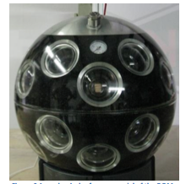
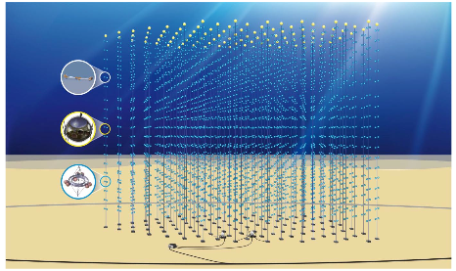
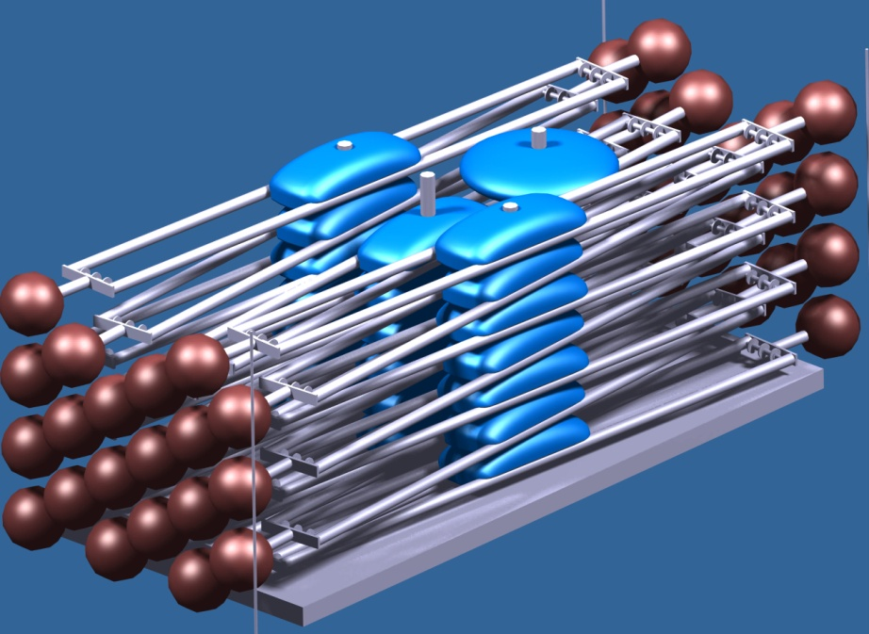
KM3Net
Preparatory phase 2008-2012
Start of construction depends on funding
5 year construction
Site not chosen yet
5 km³
Figures from P. Sapienza, NuTel 2011

Slide 24
Conclusions
IceCube is now complete. Already interesting results for GRBs. Pay attention to galactic sources over the next 2-3 years.
DeepCore opens new possibilities: Dark Matter, neutrino physics, 4 π sensitivity …
South Pole is being transformed into a neutrino facility
In a pessimistic scenario, Km3Net may be needed to see galactic sources.

Slide 25
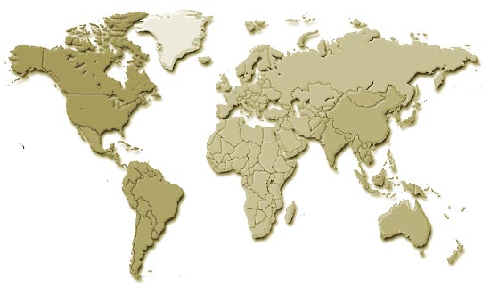
The IceCube Collaboration
Sweden:
Stockholm U.
Uppsala U.
USA:
Clark Atlanta U.
Georgia Inst. Tech.
LBNL – Berkeley
Pennsylvania State U.
Southern U. and A&M College U. Alabama - Tuscaloosa
U. Alaska - Anchorage
U. California – Berkeley
U. California – Irvine
U. Delaware & Bartol Res. Inst.
U. Kansas
U. Maryland
U. Wisconsin – Madison
U. Wisconsin – River Falls
U.K.
U. Oxford
Germany:
DESY - Zeuthen
Humboldt U.
Max Planck Inst. - Heidelberg
RWTH Aachen
U. Dortmund
U. Mainz U. Wuppertal
Netherlands:
Utrecht U.
Belgium:
U. Libre de Bruxelles
U. Gent
U. Mons-Hainaut
Vrije U. Brussel
Japan:
Chiba U.
Switzerland:
École Polytech. Fédérale - Lausanne
New Zealand:
U. Canterbury
Antarctica:
Amundsen-Scott Station

Slide 26
Backup

Slide 27
History
IceCube
GRBs
UHE
Anisotropy
DeepCore
Atmospheric neutrinos
Pointers to point sources, dark matter & follow up.
Antares -> Pointers to talks
KM3Net
Baikal -> Brief mention
Anita? DM-ice? Future at South Pole?

