Slide 1
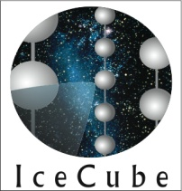

Cosmic ray physics
With icecube
Shahid Hussain
for the ICECUBE collaboration
University of Delaware, USA
March 02, 2011
1

Slide 2
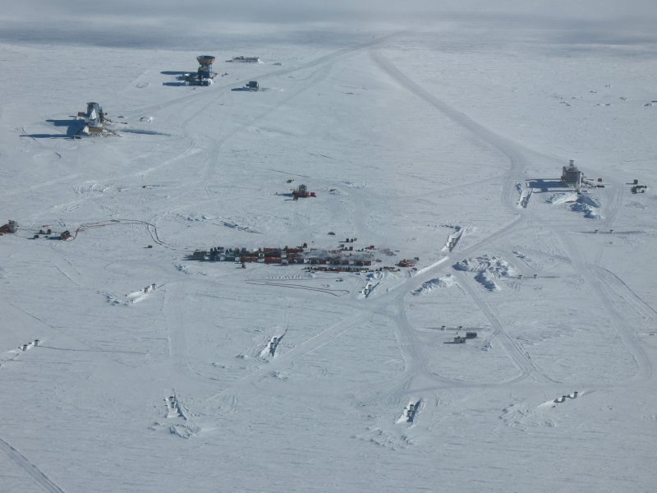
Outline
Cosmic rays
ICECUBE
Cosmic ray measurements with ICECUBE
125 m
2

Slide 3
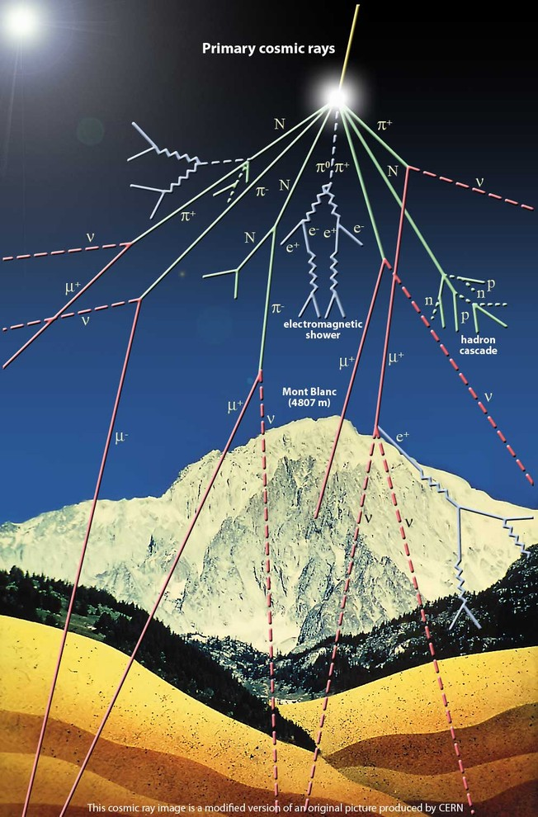
cosmic rays Produce air showers
Radiation from space discovered by
Victor Hess (1912)
Direct/indirect detection
  Direction, spectrum, composition
Physics questions
  Sources?
  Acceleration mechanism?

Slide 4
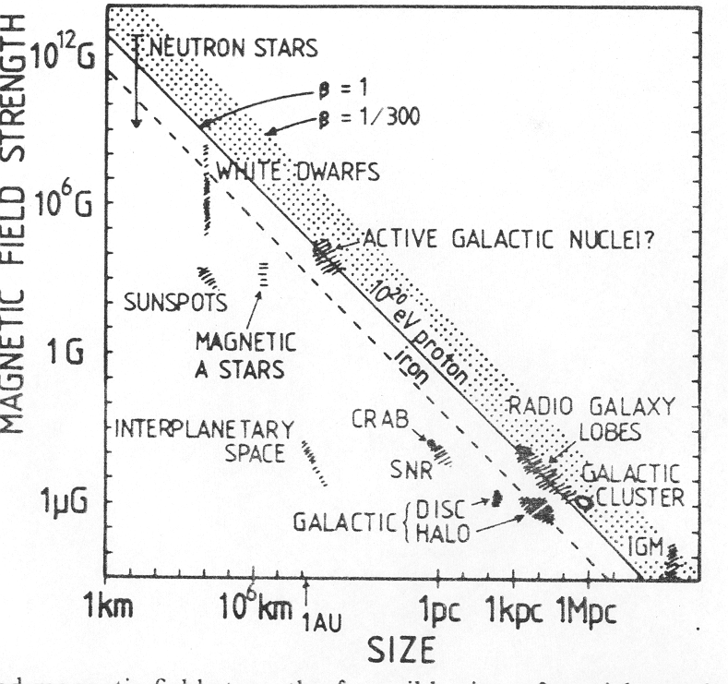
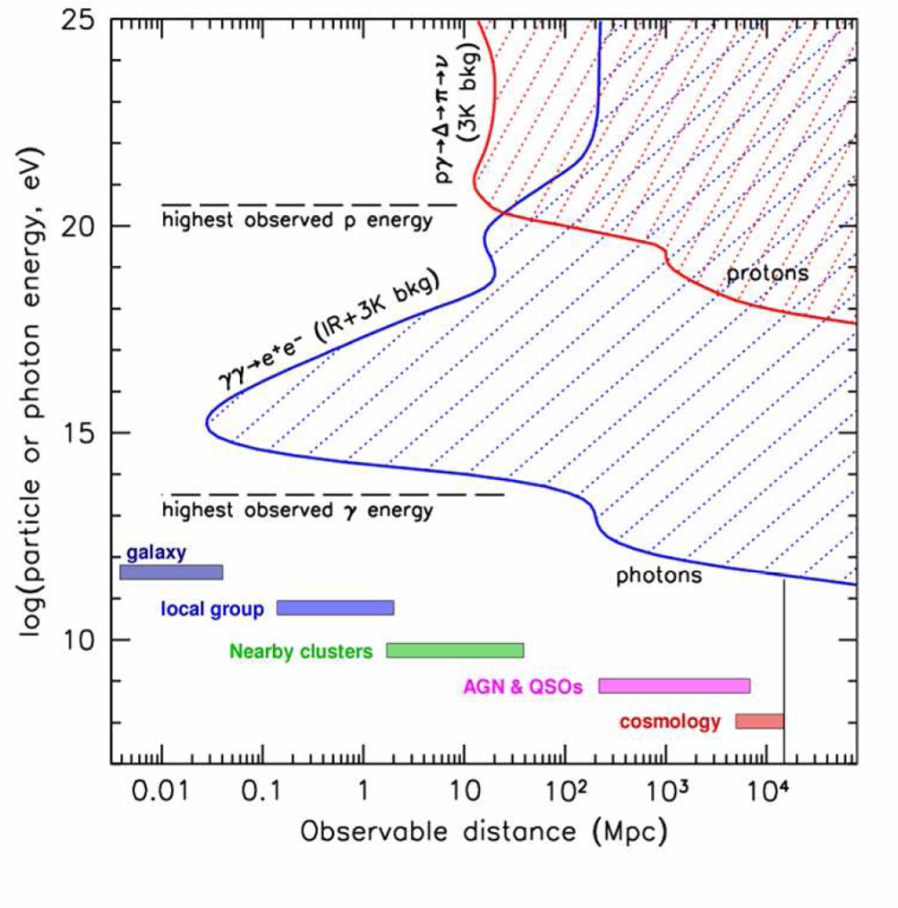
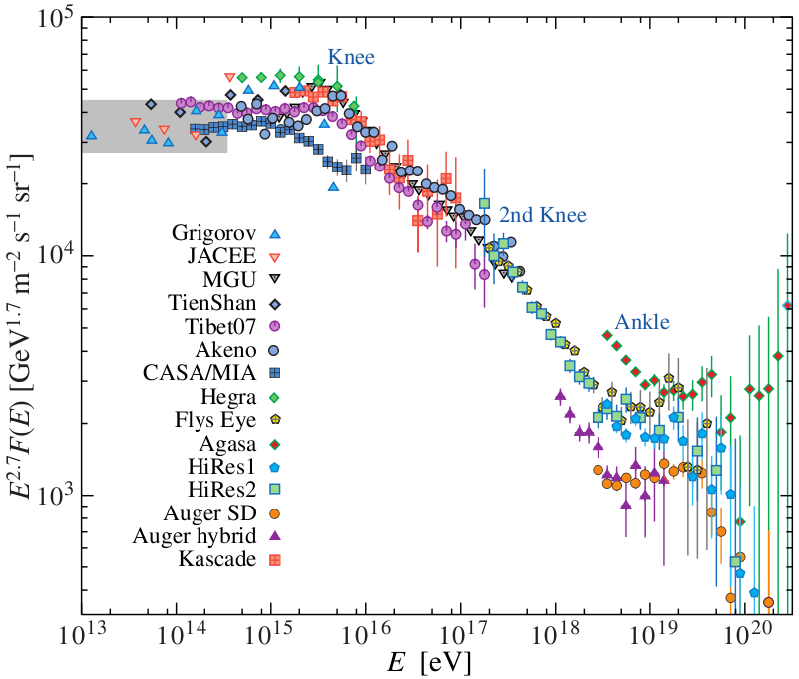
Cosmic ray sources?
Hillas plot
Astrophysical objects:
Magnetic field vs. object size
Transparency of the Universe:
Particle energy vs. Object distance
P. Gorham

Slide 5
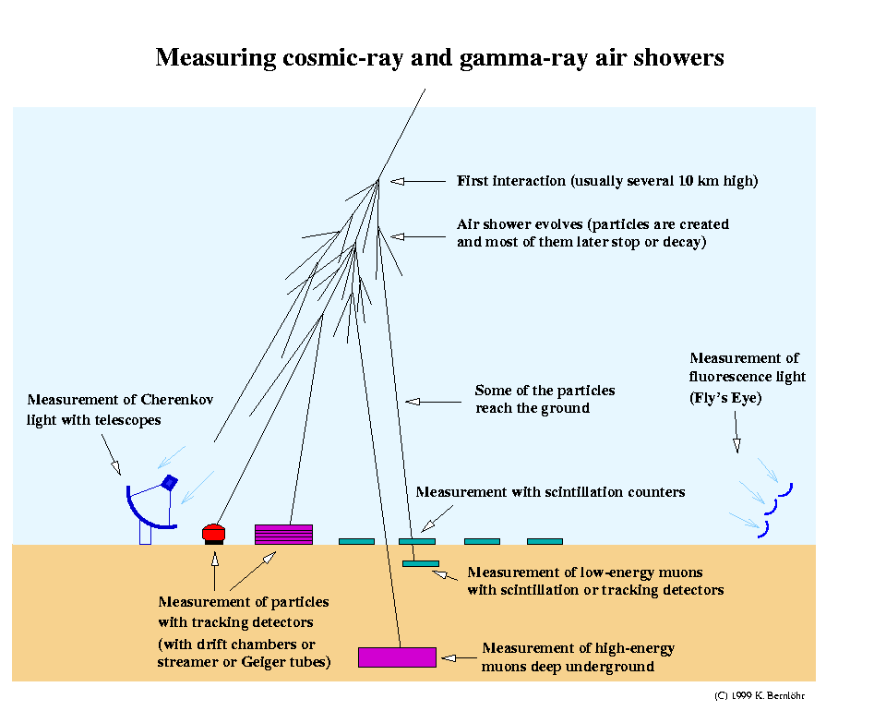
Air showers-- detection methods

Slide 6
ICECUBE
Detection principle: optical Cherenkov radiation
Detector medium: South Pole ice
Physics
  Neutrinos: Main discovery target is astrophysical neutrinos
  Cosmic rays (~100 TeV to ~1 EeV)
  Dark matter (indirect search)
  Monopoles and other exotic particles
  Cross sections (neutrino-nucleon, air showers)
Animations:
  ICECUBE geometry Downward event Upward event
6

Slide 7
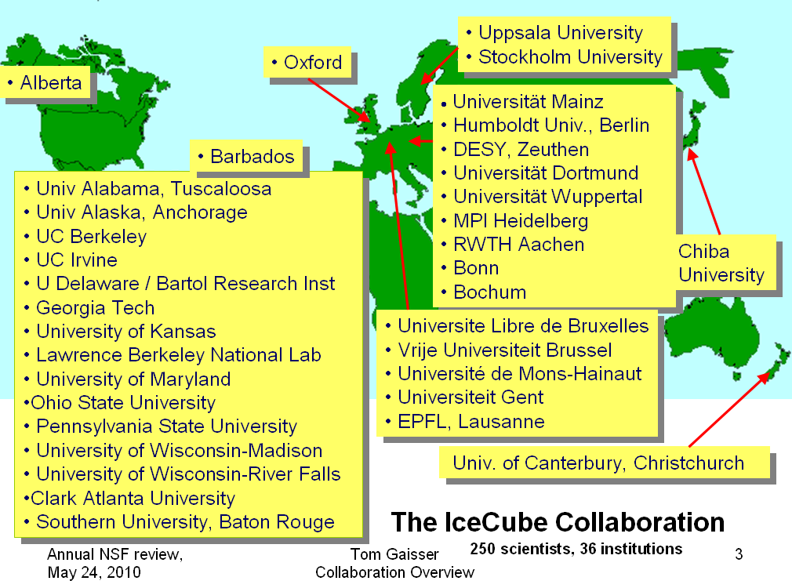

Slide 8
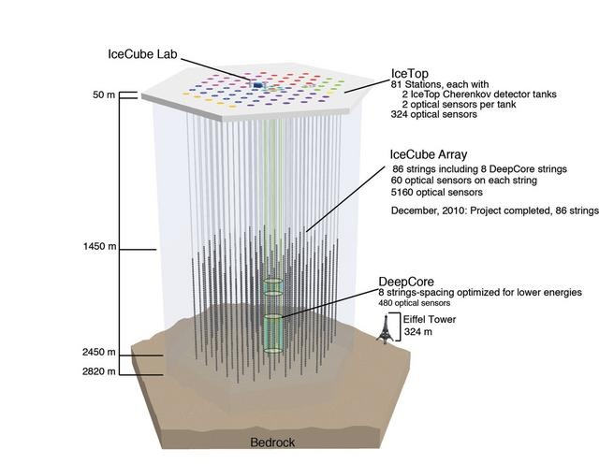
ICECUBE: 3D view
Ice properties measured with
LED and LASER sources
Average optical parameters at 400 nm:
  λ_{abs} ~110 m, λ_{sca} ~20 m above the dust layer
  λ_{abs} ~220 m, λ_{sca} ~40 m below the dust layer

Slide 9
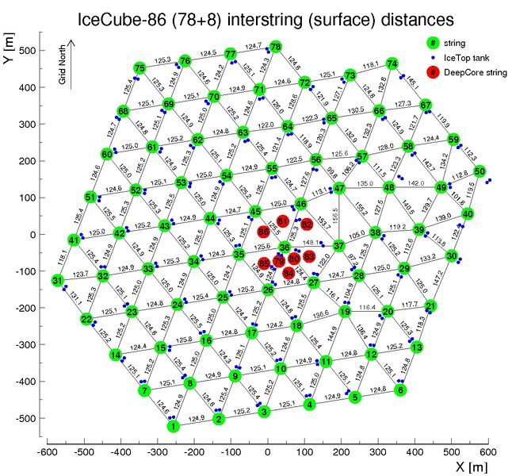
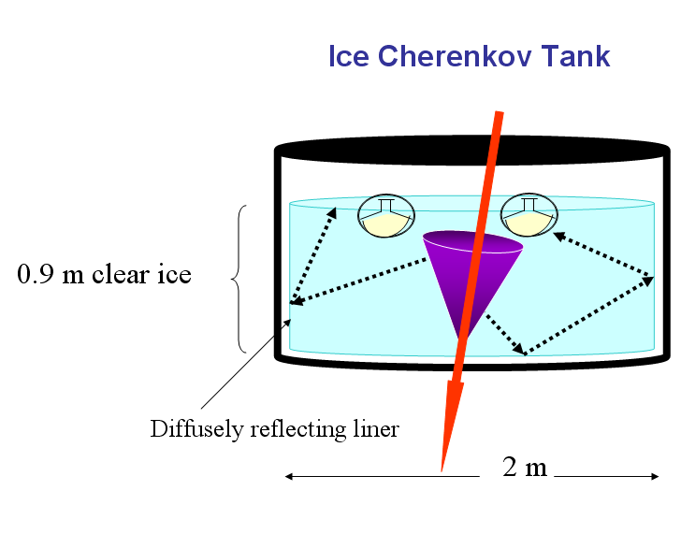
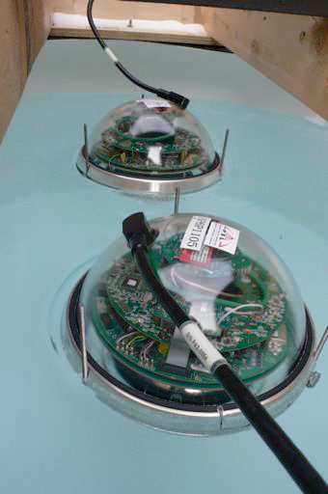
ICECUBE- top view
IceTop Tank
DOMs in a Tank
Digital optical module (DOM)
9

Slide 10
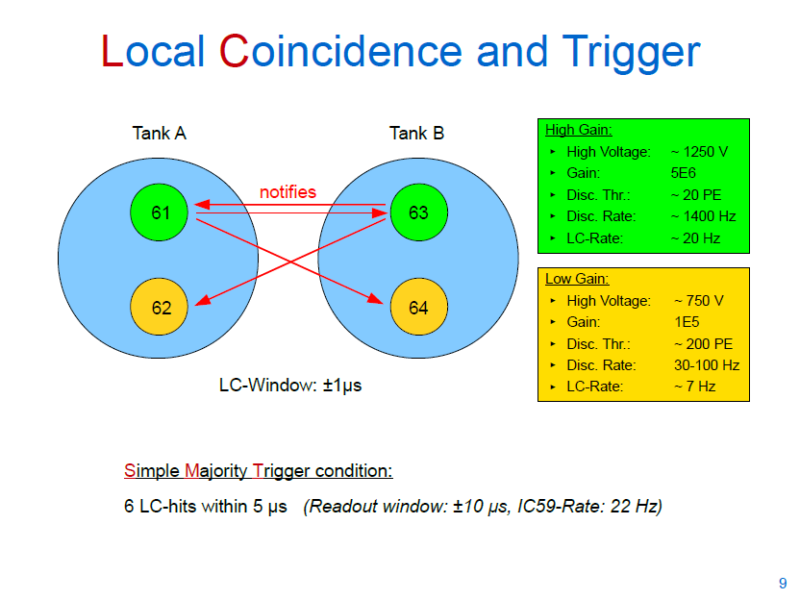
250ns
Tilo W.

Slide 11
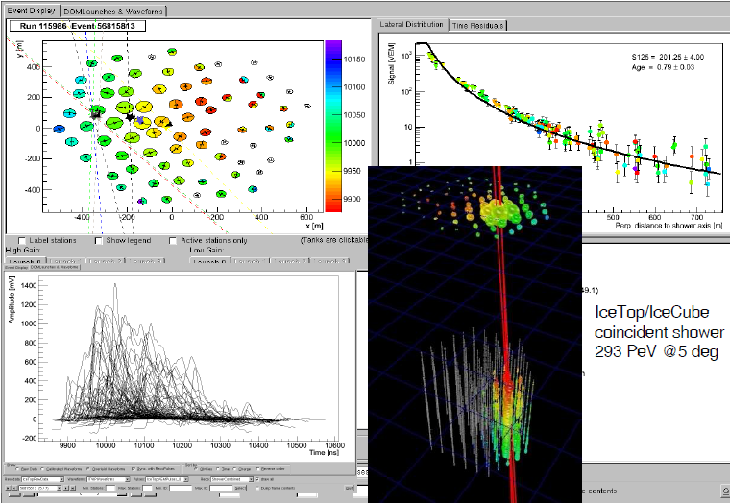
Event example: June 2010 data

Slide 12
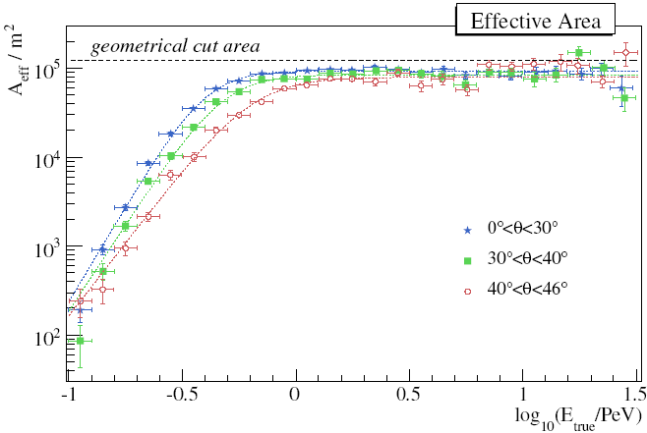
IceTop-only (26 stations) analysis example
Effective area and resolution
direction | ≈1.5°
core | ≈ 9 m
energy | ≈ 0.06 (in log₁₀)
Fabian et al

Slide 13
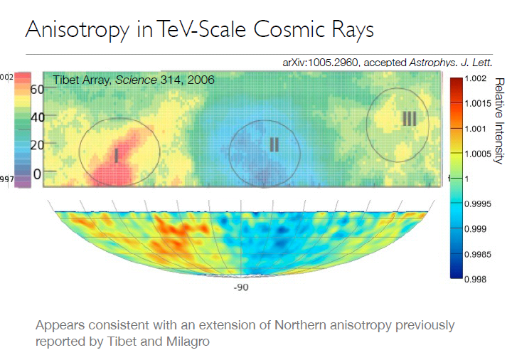
Example of an InIce-only analysis

Slide 14
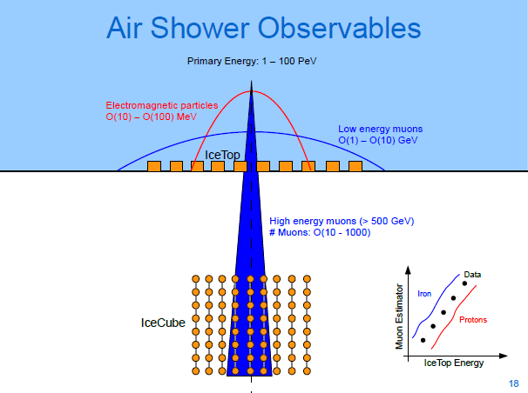
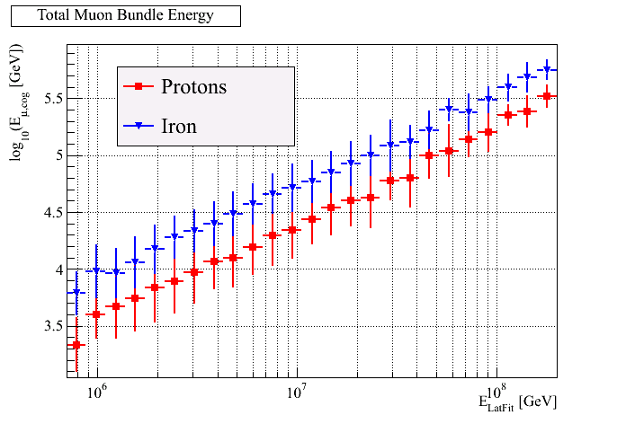
Several analyses underway:
Combine surface and InIce information
Composition analysis
Analyze small showers for comparison with direct measurements
Search for PeV gamma rays
Search for Muons with large transverse momentum
patrick
Simulations: correlation between surface and InIce energy deposition; sensitivity to composition.

Slide 15
Summary– ICECUBE as a cosmic ray observatory
ICECUBE is now fully deployed; data analyses underway
Energy range covered ~100 TeV-1 EeV
  Overlap with direct measurements
  Main goal is to understand galactic to extra-galactic transition region
Energy estimation
  em and mu components with IceTop
  Muon component InIce
Direction measurement
  both IceTop and InIce
Cosmic ray composition resolution
  Combined information from IceTop, InIce, and angular distribution of events

Slide 16
Extra slides

Slide 17
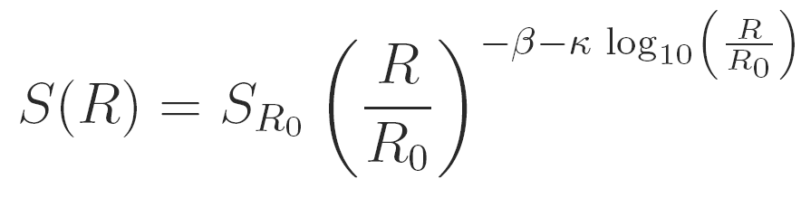




Event reconstruction (IceTop only):
Likelihood function
Lateral distribution function
toprec likelihood function:
Charge likelihood function:
L0 involves:
Time likelihood function:
17

Slide 18
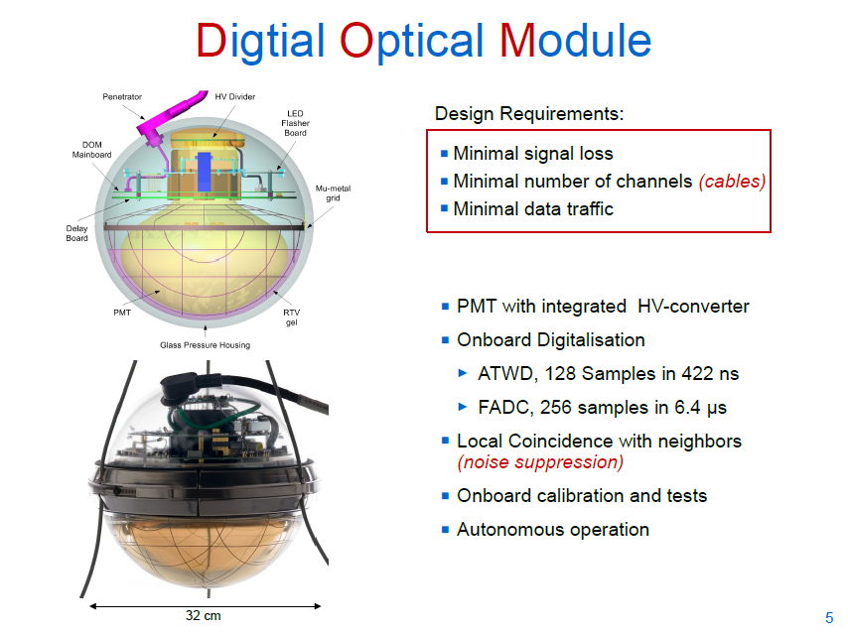
f
Tilo W.

Slide 19
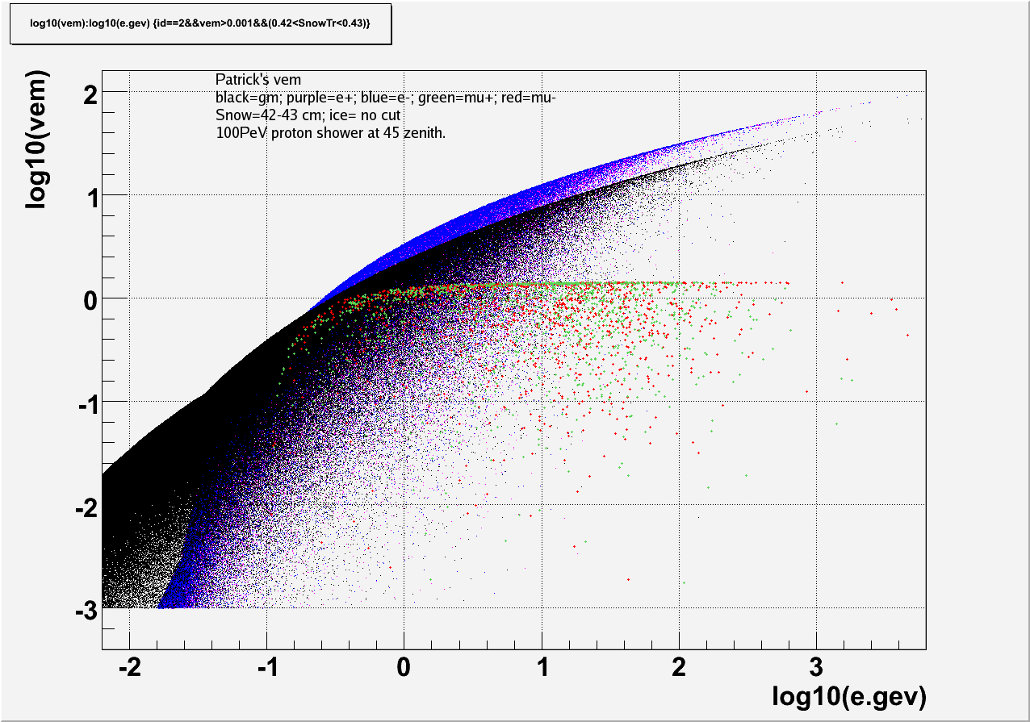
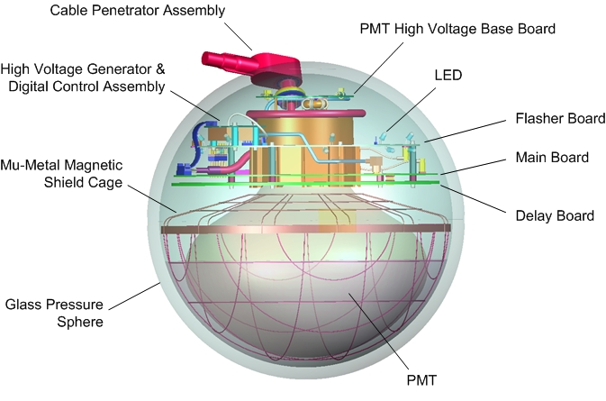
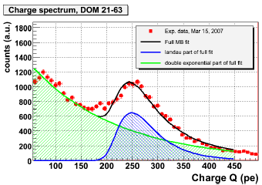
VEM definition and DOM Calibration
DOM

Slide 20
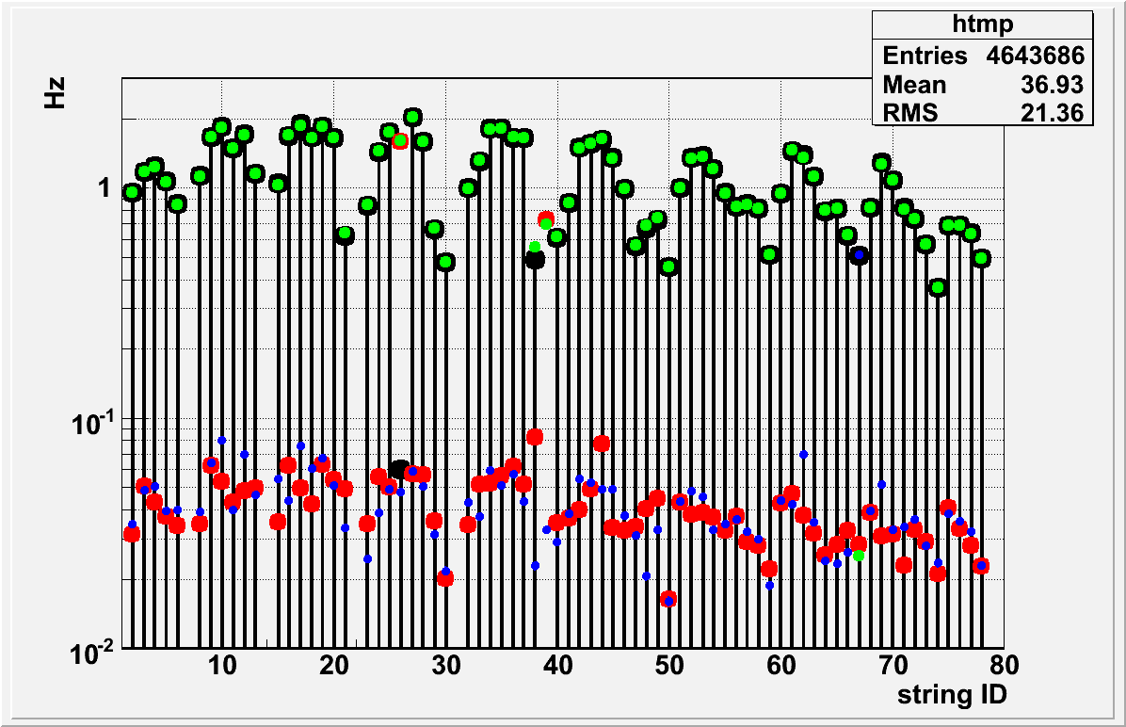
DOM launch rates due to air showers
HG
LG

Slide 21
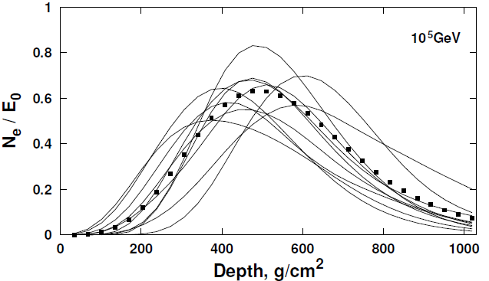
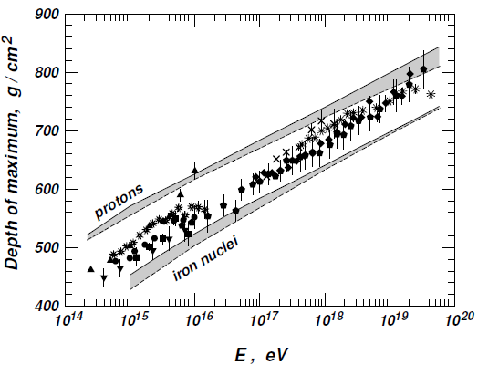
Air showers– longitudinal profiles
Jaime Alvarez-Mu˜niz et al 2002
Todor 2008

Slide 22
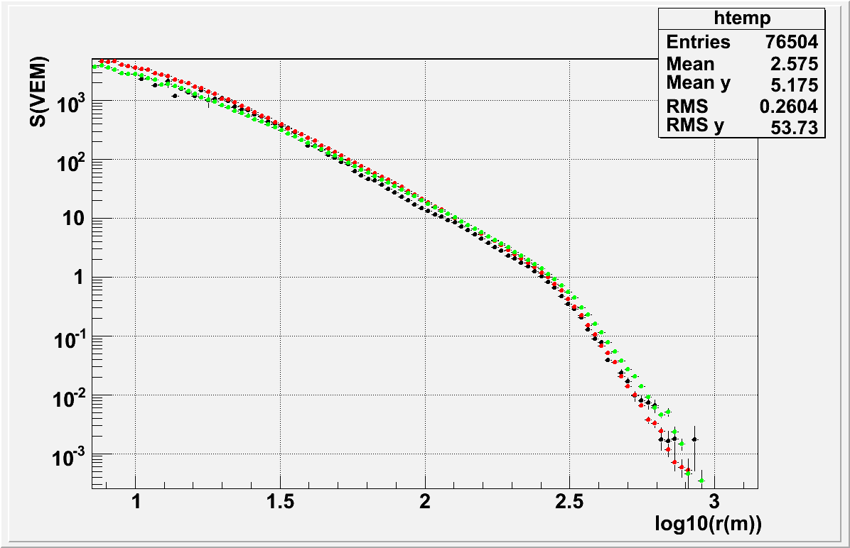
Lateral profile of air shower signals measured with IceTop
10 PeV proton simulation
10 PeV iron simulation

Slide 23
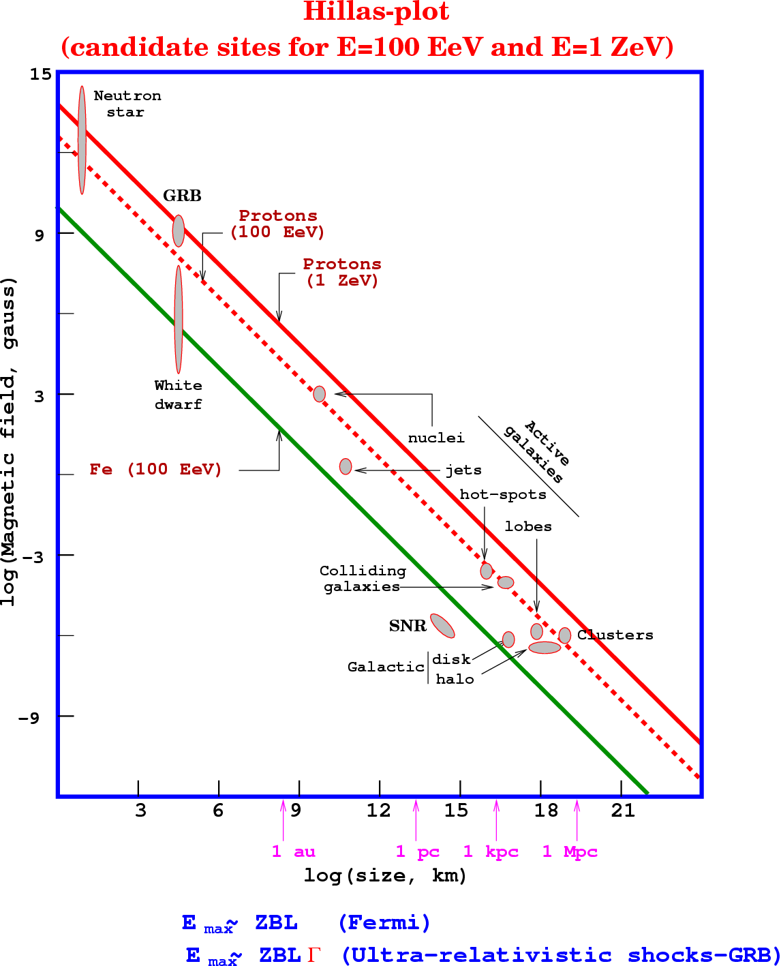
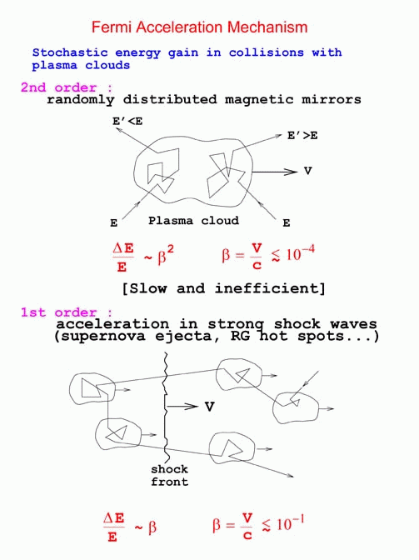

Slide 24
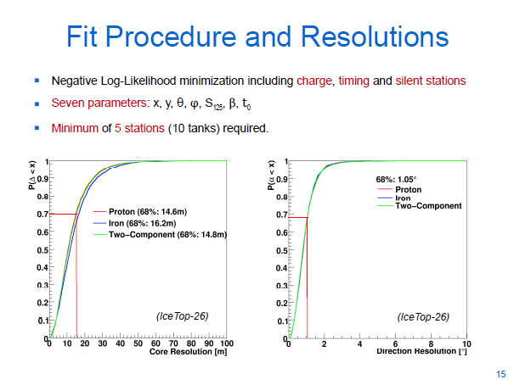
IceTop-only (26 stations) analysis example
Tilo

