Slide 1
Search for Dark Matter with IceCube
Catherine De Clercq for the IceCube Collaboration
Vrije Universiteit Brussel
w3.iihe.ac.be

Slide 2
Outline
Weakly Interacting Massive Particles as Cold Dark Matter
The IceCube neutrino detector
Search for neutrino signals of WIMP annihilations in the Sun and near the Galactic Centre
IceCube + DeepCore : prospects for Dark Matter discovery in the coming years

Slide 3
Dark matter
Evidence for Dark Matter from observations
Indirect detection

Slide 4
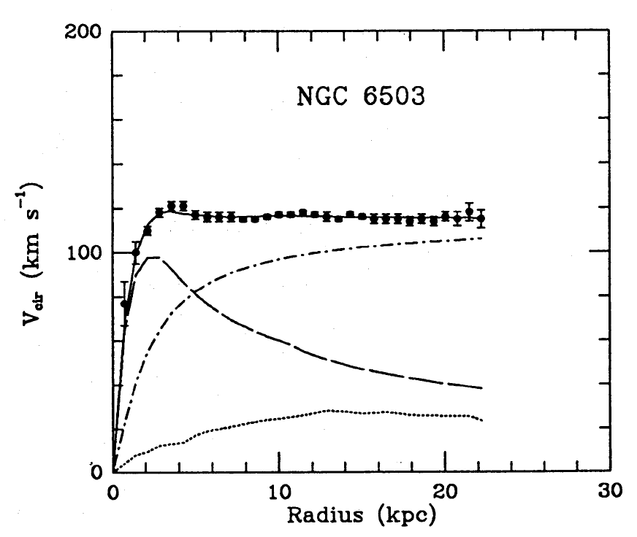
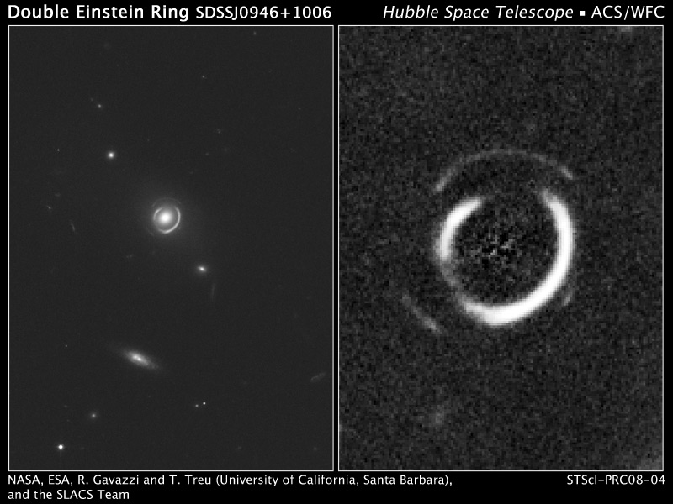
Observations
Galaxy rotation curves
Gravitational lensing
Begeman et al. 1991
Dark halo
light
gas

Slide 5

WIMPs as cold Dark Matter
Weakly Interacting Massive Particles
Non-relativistic at freeze-out
Mass [GeV-TeV]
Can make up cold DM with
observed abundance
Bullet Cluster
@ NASA
≈ 0.21 WMAP
O(Weak interactions)

Slide 6
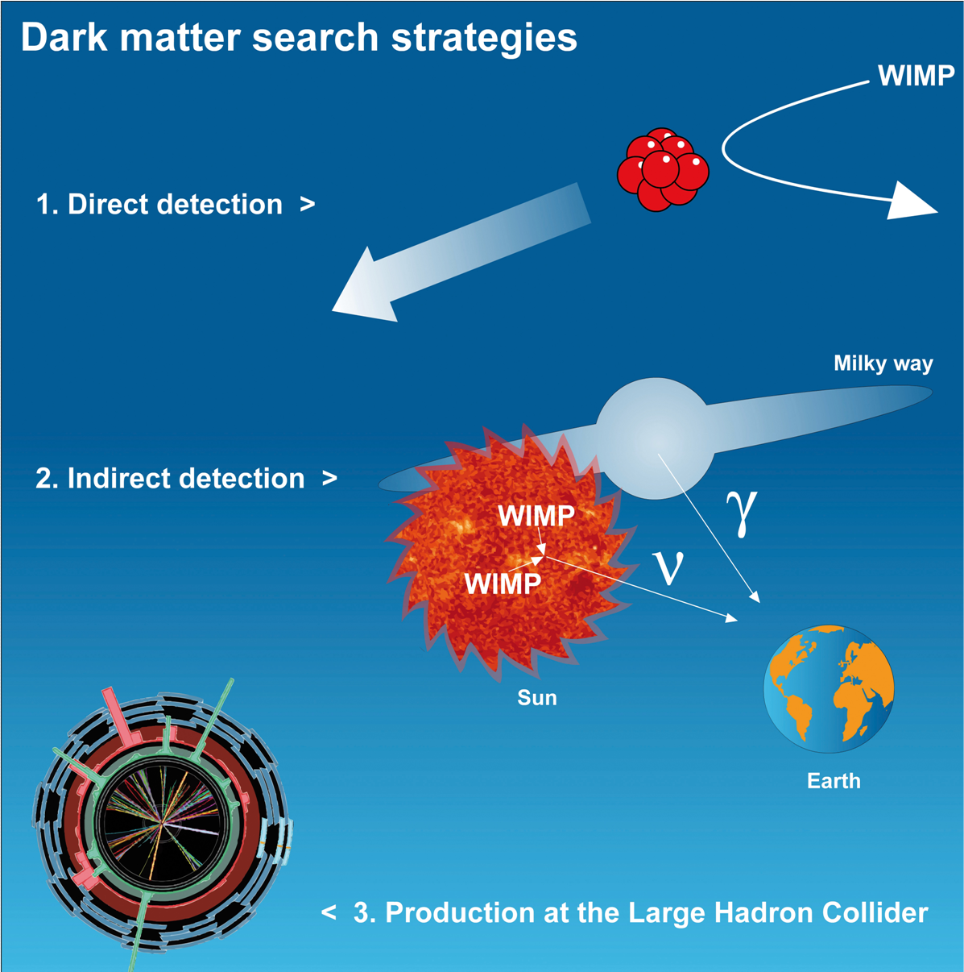
Detection

Slide 7
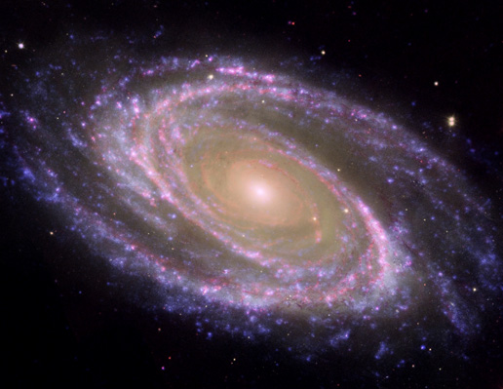
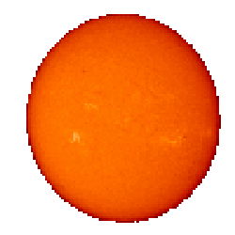

Indirect detection
WIMP
WIMP
e⁺, γ, υ, p

Slide 8
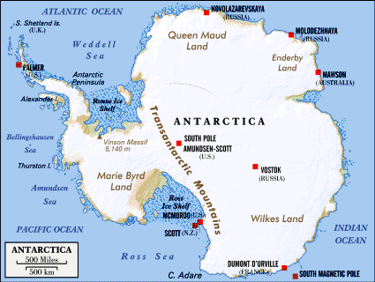
IceCube
Mission
Instrument
Neutrino detection

Slide 9
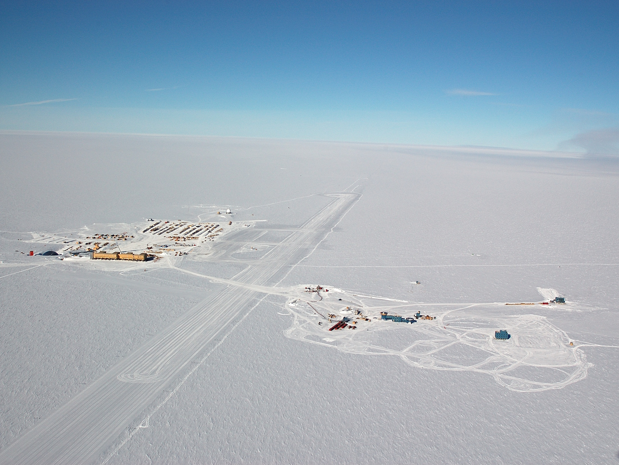
Amundsen Scott
South Pole Station
IceCube observatory
1km
At 1.5-2.5 km depth
Station
Control
room
Skiway

Slide 10
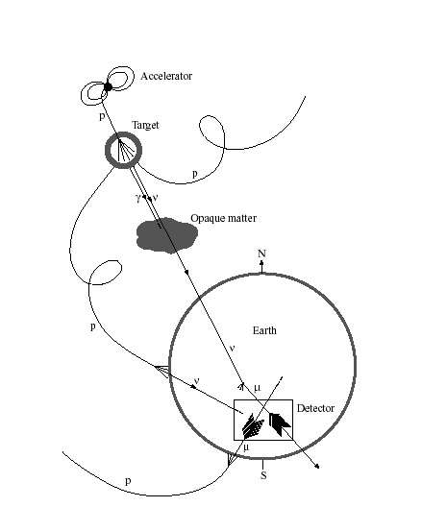
IceCube Mission
search for extra-terrestrial neutrinos → natural accelerators producing HE cosmic rays
Such as
  Active Galactic Nuclei
  Gamma Ray Bursts
  SuperNovae
Indirect Dark Matter search
Cosmic ray air showers with IceTop
Astronomische
bron
p
?
?
?
IceCube
IceCube

Slide 11
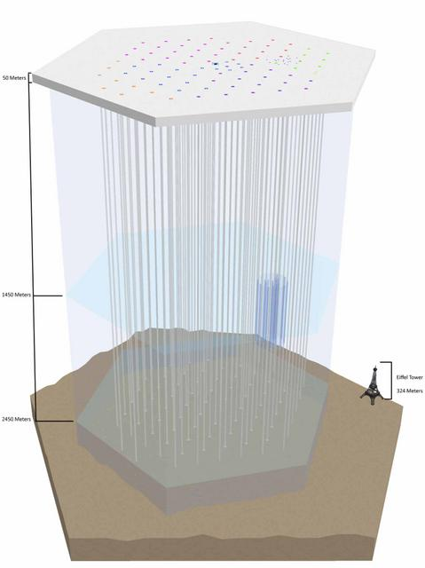
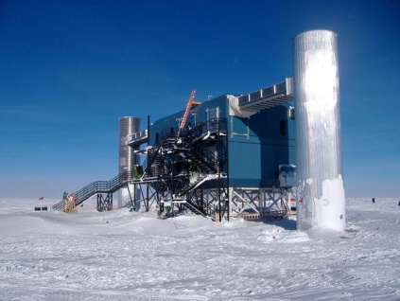
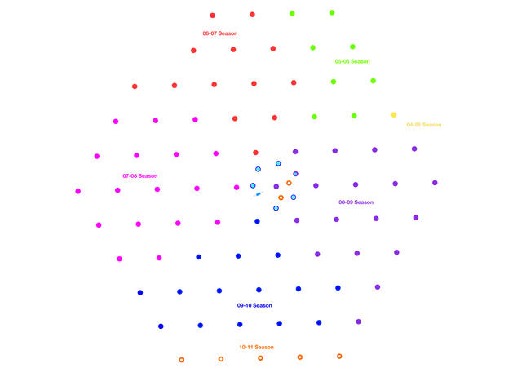
IceCube detector
Control room
IceTop
AMANDA
-1450m
1 km
-2450m
Array of 80 strings
with 60 Digital Optical Modules

Slide 12
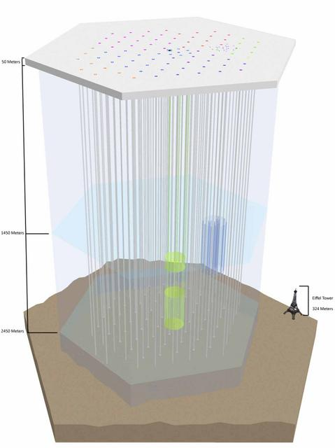
IceCube detector
Control room
IceTop
AMANDA
-1450m
DeepCore
-2450m
DeepCore
Denser spacing
Low energy GeV-TeV
Southern hemisphere

Slide 13
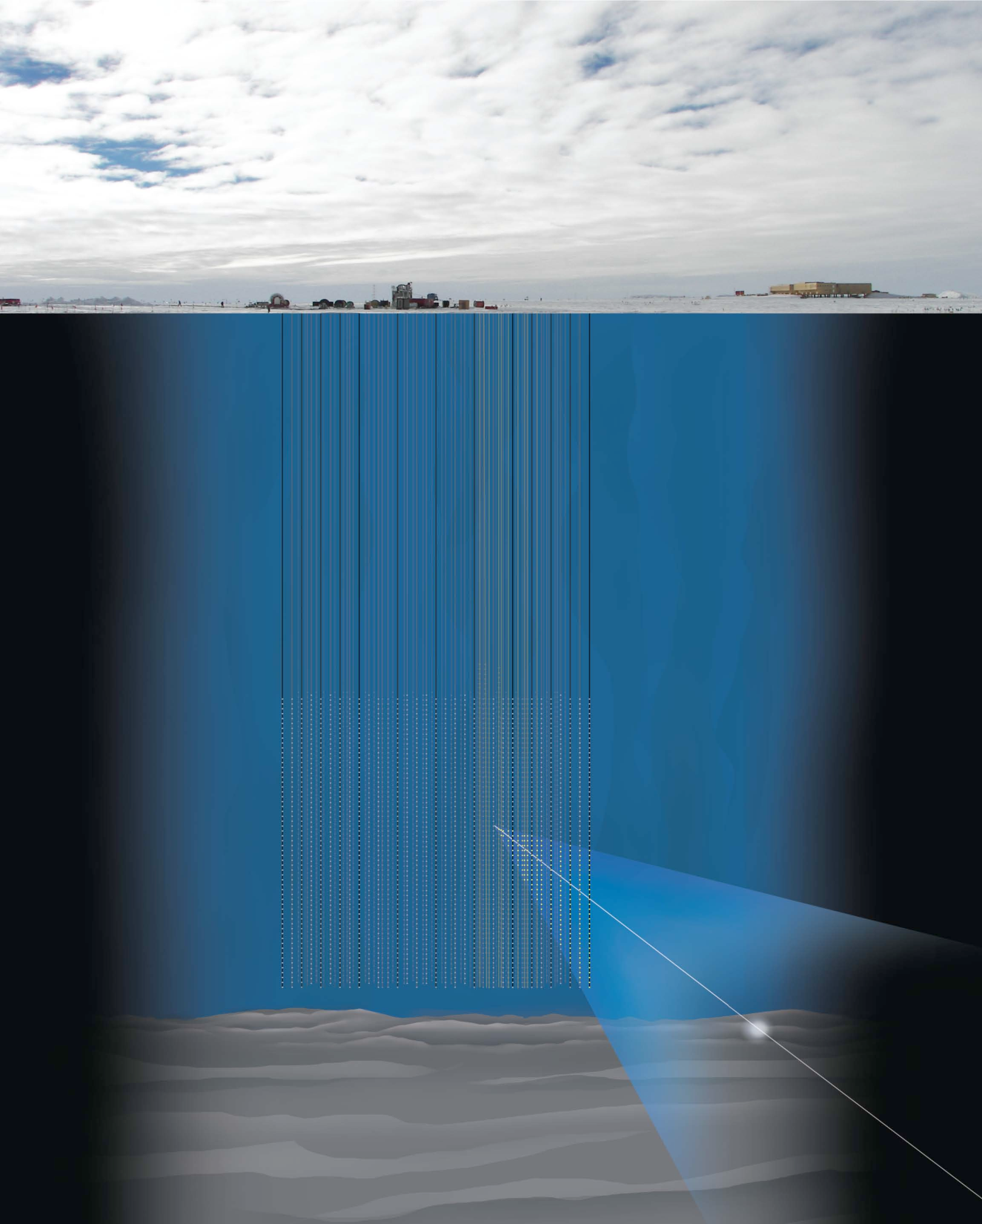
Neutrino detection & reconstruction
Record Cherenkov light pattern
Reconstruct muon track
Assume muon track aligned to neutrino path
IceCube
Light sensors
Muon track
Charge Current interaction
neutrino

Slide 14
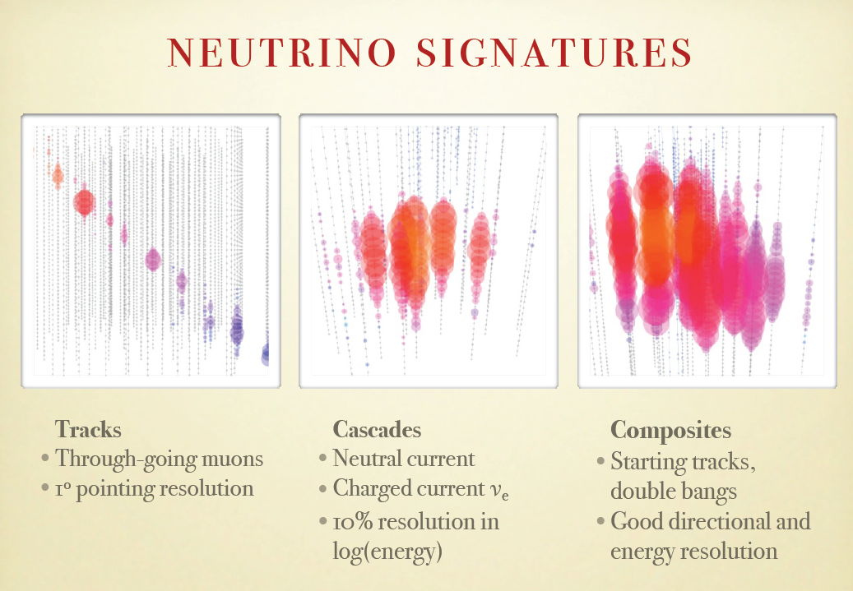
ν_{µ}

Slide 15
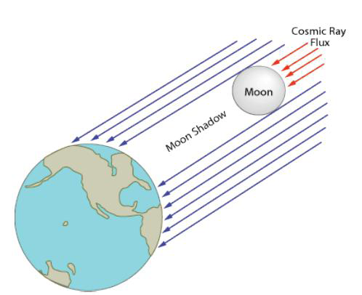
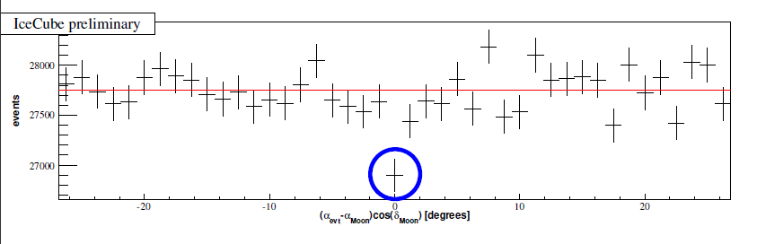
Pointing resolution
Simulation : 1 TeV muon → ΔΨ ≈ 1°
moon shadow observation → ΔΨ  1.25°
  IC40 (2008) 8 lunar months
  5σ deficit in atmospheric muon flux
# events near moon
IceCube preliminary - ICRC 2009

Slide 16
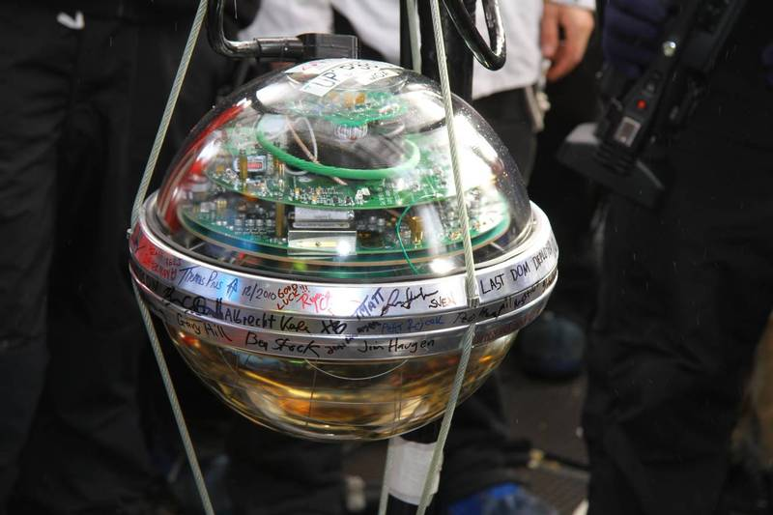
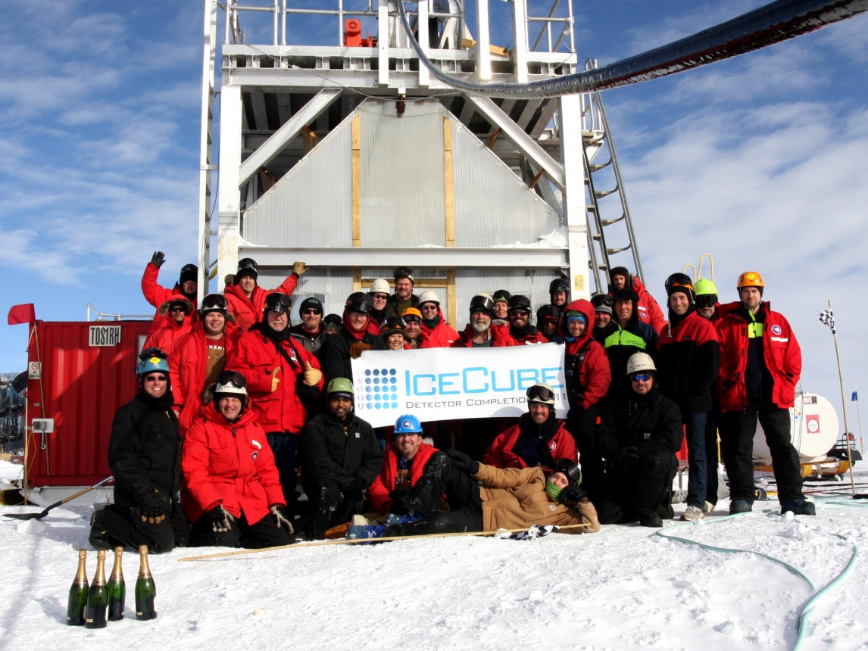
IceCube was completed on 18 December!
(Nature.com) Giant, frozen neutrino telescope completed - December 18, 2010
Last optical module
ScienceDaily (Dec. 19, 2010) — Culminating a decade of planning, innovation and testing, construction of the world's largest neutrino observatory, installed in the ice of the Antarctic plateau at the geographic South Pole, was successfully completed December 18, 2010, New Zealand time.

Slide 17
Search for dark matter
  WIMP annihilations in the Sun
  WIMP annihilations near the Galactic Centre

Slide 18
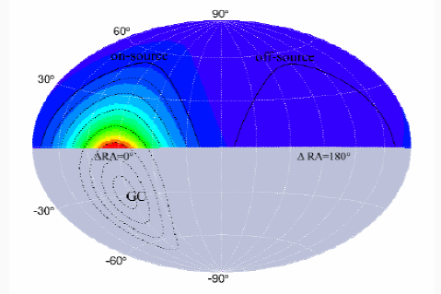
Different strategies
Neutrinos from WIMP annihilations in the Sun: AMANDA, IC22
Neutrinos from WIMP annihilations in the galactic halo and near the galactic centre: IC22, IC40
Neutrinos from WIMP annihilations in the centre of the Earth : work in progress

Slide 19
Solar WIMPs
Data filtering
Muon flux and WIMP annihilation rate
WIMP-proton scattering cross section

Slide 20
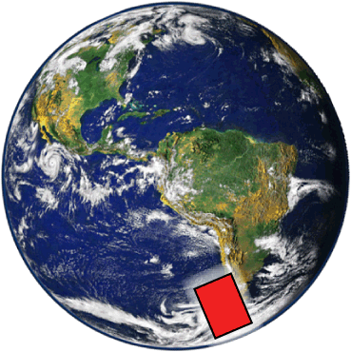
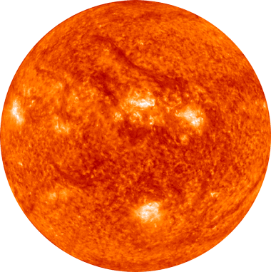
Solar WIMPs: detection principle
ρ_{χ}
velocity
distribution
χ
Earth
Sun
σ_{scatt}
ν_{μ}
ν int.
_{capture}
μ
Detector
_{annihilation}

Slide 21
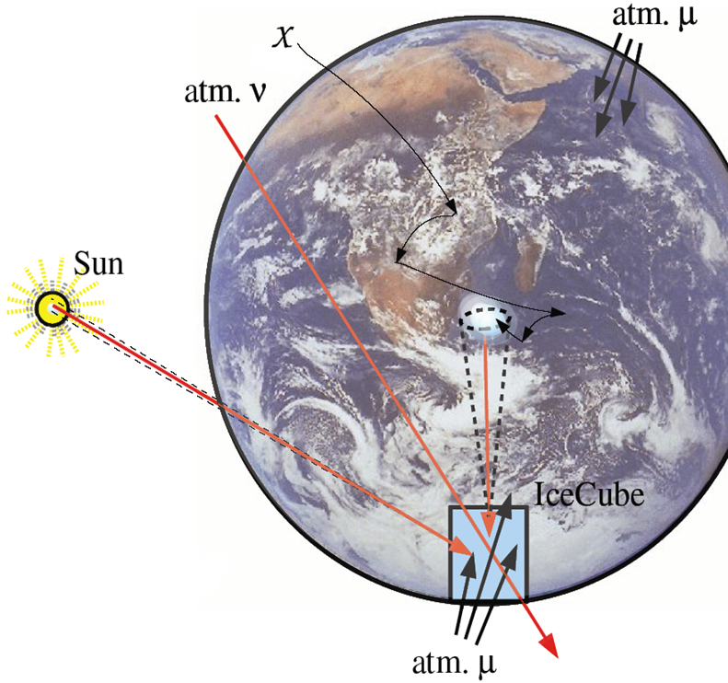
signal and background
BG
A few 10’000 atmospheric neutrinos per year from northern hemisphere
signal
Max. a few neutrinos per year from WIMPs
~10¹⁰ atmospheric muons per year from southern hemisphere
BG

Slide 22
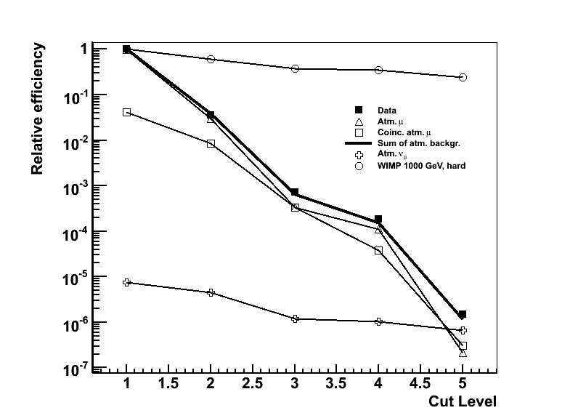
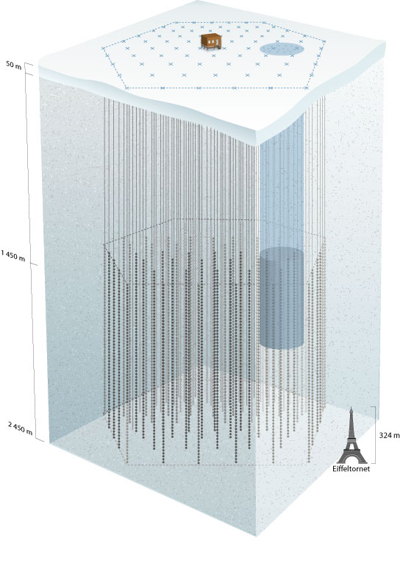
Data filtering
Muon tracks from ν_{μ} Charged Current interactions
When Sun below horizon: March-September
Nearly horizontal tracks
Different levels of filtering
1TeV WIMP, hard channel
selection efficiency  20%
dataΣ(atm BG)
AMANDA
Atm µ+µµ
µ
ν
Atm. ν
IceCube

Slide 23
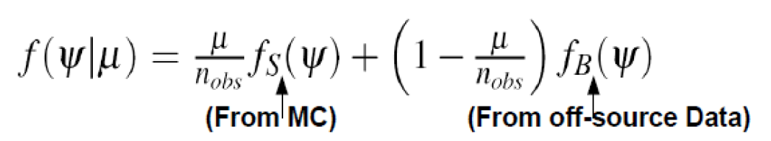
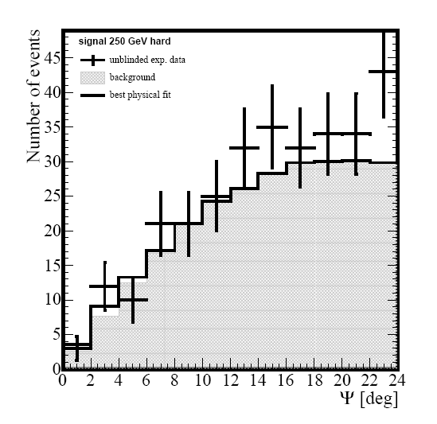
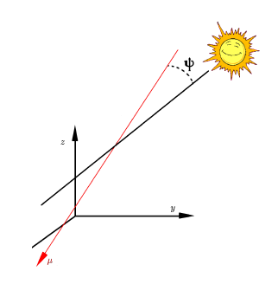
Signal content from fit
Model dependent
From MC simulations
From off-source data
Neutralino 250 GeV to WW
Data, AMANDA 812d
Background
Best fit
µ
preliminary

Slide 24
Search results
No evidence for a signal in ~ 900 days livetime
→ upper limits on neutralino annihilation rate in Sun & resulting muon flux
AMANDA dedicated search M(WIMP) [50-5000 GeV] | Angular resolution 3 – 7 degrees | 812 days livetime | 2001-06
IceCube 22 strings dedicated search M(WIMP) [250-5000 GeV] | ≈ 3 degrees | 104 days | 2007

Slide 25
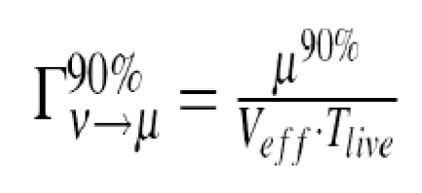
Annihilation rate & muon flux
experiment
MSSM MC simulation
DarkSusy
neutralino
annihilation
rate
Muon flux

Slide 26
Neutralino models considered
Assume MSSM with R-parity conservation
Neutralino χ₀¹ (LSP) is popular CDM candidate: weakly interacting, stable, massive
Consider 7 masses
and 2 annihilation channels
Simulation with WIMPSIM (Blennow & Edsjö JCAP 2008)

Slide 27
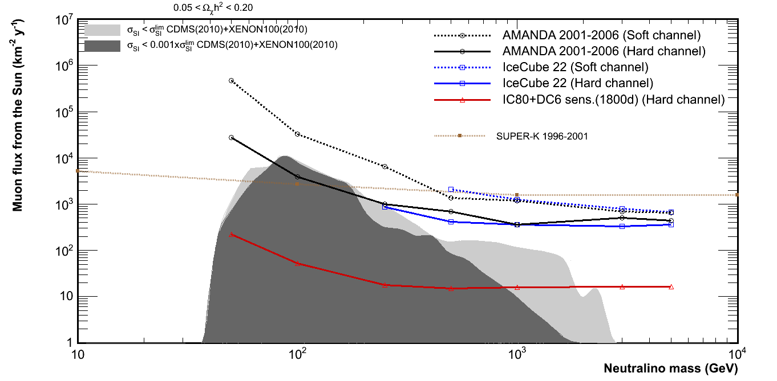
Muon flux from solar neutralinos
AMANDA 01-06
preliminary
Super-K
Desai (PRD 2004)
IceCube 2007
Abassi (PRL 2009)
MSSM model predictions
allowed by colliders & direct searches

Slide 28
Scattering cross section
muon flux → scattering cross section
Assume
  equilibrium between capture in Sun and annihilation
  Spin-dependent scattering dominates capture in Sun
For given final state
Wikström & Edsjö, JCAP 2009

Slide 29
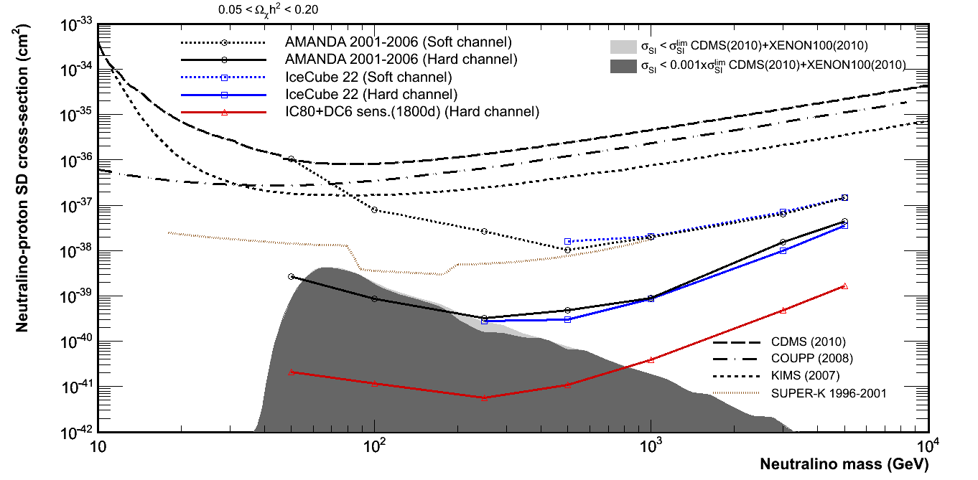
Spin dependent scattering cross section
Direct searches
CDMS
COUPP
KIMS
Super-K
Desai (PRD 2004)
AMANDA 01-06
preliminary
IceCube 2007
Abassi (PRL 2009)
MSSM model predictions
allowed by colliders & direct searches

Slide 30
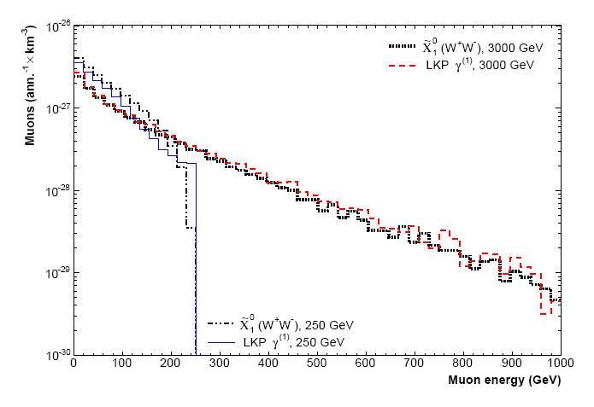
LKP annihilations in the Sun
IC22 data re-interpreted in model of Universal Extra Dimensions
KK-parity conserved → Lightest Kaluza Klein Particle γ⁽¹⁾ is DM candidate
similar observed muon energy spectra for neutralino & LKP
3 TeV LKP γ⁽¹⁾
250 GeV
3 TeV χ⁰
Muon energy (GeV)

Slide 31
LKP annihilations in the Sun
Experiment – IC22 angular distribution
UED MC simulation
LKP annihilation rate in Sun
DarkSusy
Muon flux
at Earth
γ⁽¹⁾p Scattering
cross section

Slide 32
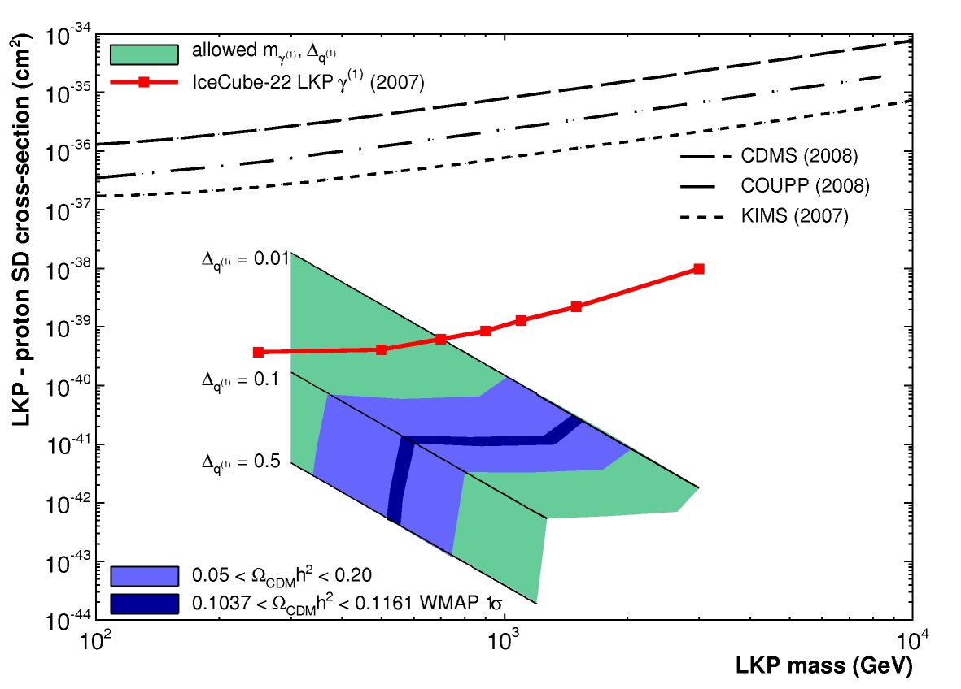
LKP-proton SD cross section
IceCube 2007

Slide 33
WIMPs in the halo
Large scale anisotropy near Galactic Centre
Dedicated GC search
Self-annihilation cross section

Slide 34
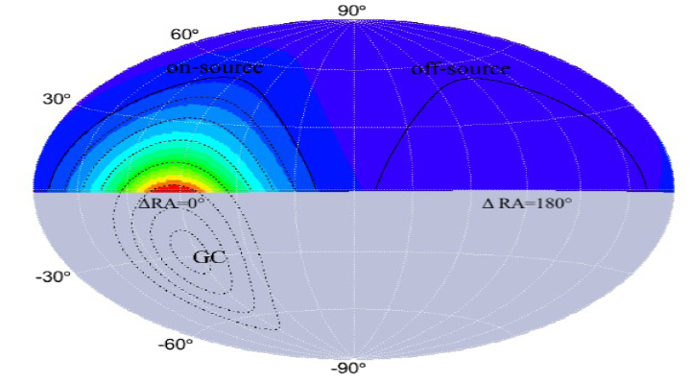
Large scale neutrino anisotropy
Search for anisotropy near Galactic Centre in IC22 point source sample
Background in ‘ON’ = BG in ‘OFF’ = atmospheric ν + µ
Northern hemisphere =
IceCube ν field of view
On-source
Off-source
24h
0h

Slide 35
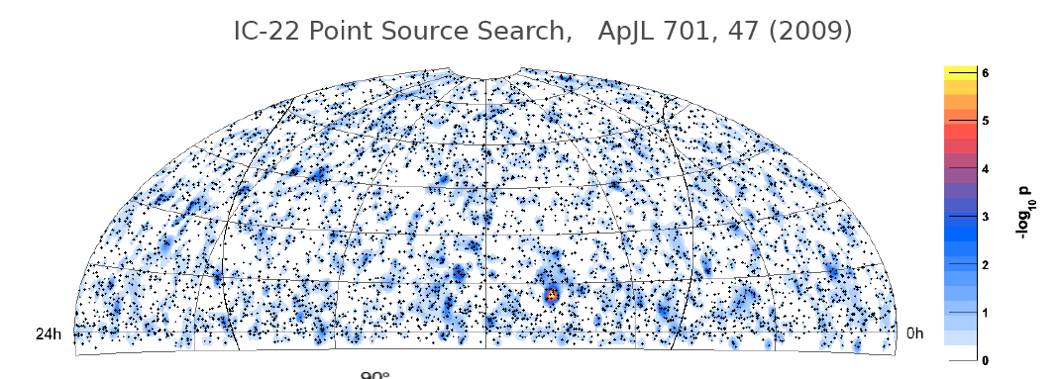
Large scale neutrino anisotropy
5114 events in 276 days in 2007
No anisotropy found
Northern hemisphere =
IceCube ν field of view

Slide 36
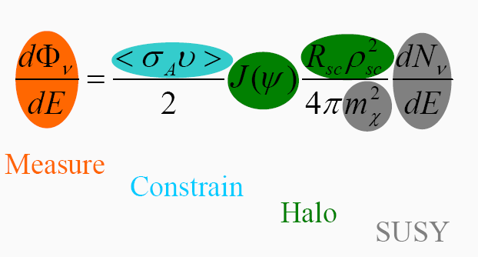
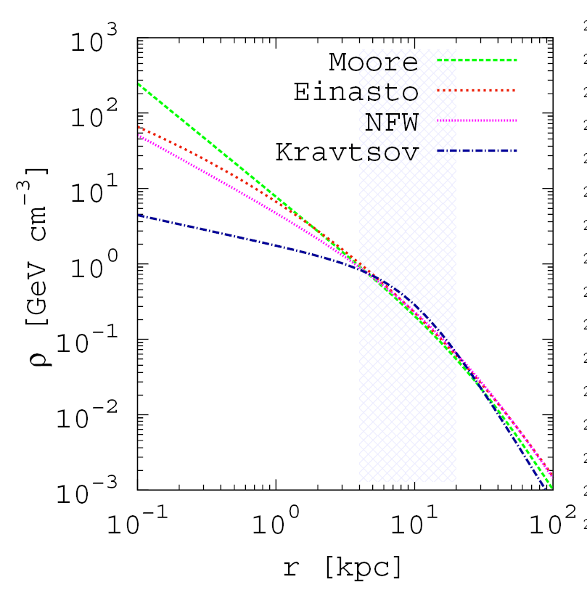
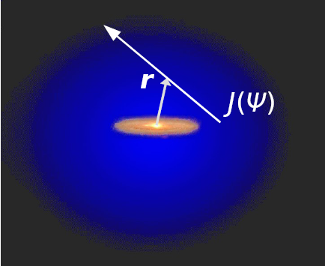
Neutralino annihilation in the halo
Halo models

Slide 37
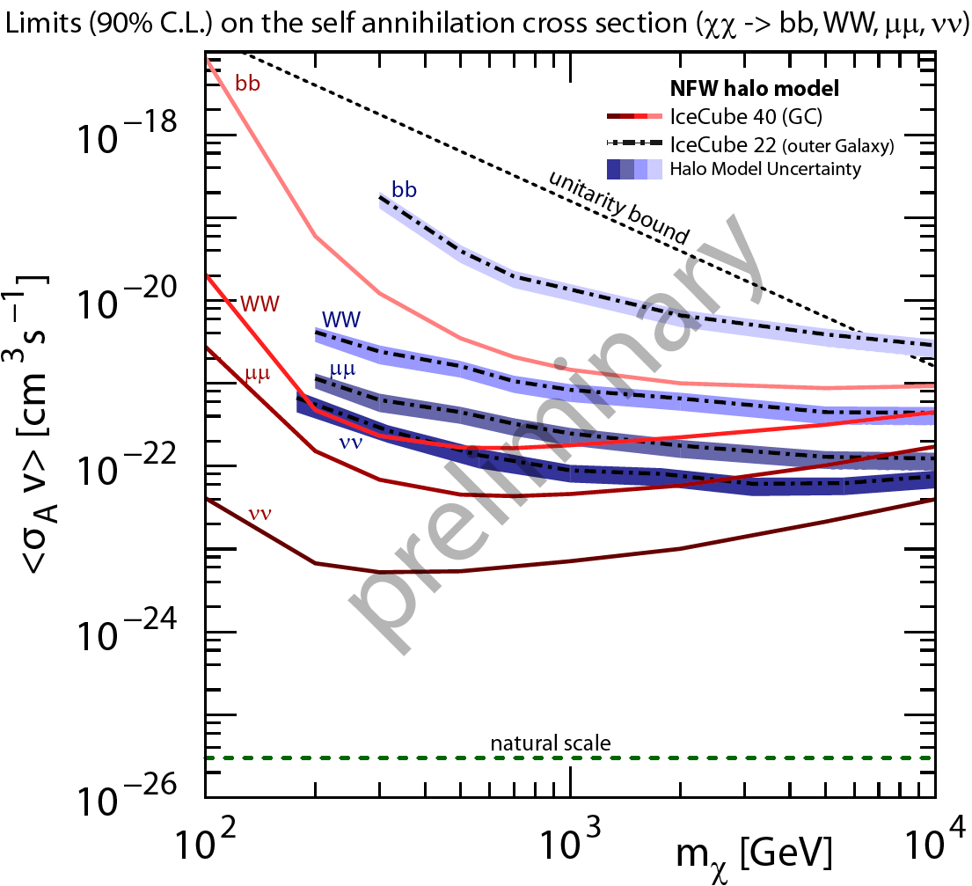
Limits on self-annihilation cross section
IC22 anisotropy
NFW halo model
4 annihilation
channels

Slide 38
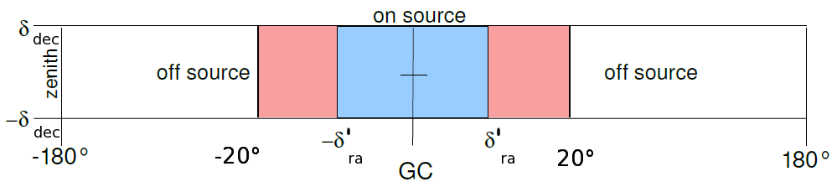
Neutrinos from Galactic Centre
Search in IC40 point source sample (2008) for excess in direction of Galactic Centre
! Southern hemisphere : use few outer layers as veto against atmospheric muon background
No excess found in GC search bin
veto
region
fiducial
volume

Slide 39
Limits
IC22 anisotropy
IC40 Galactic
centre search
NFW halo model
4 annihilation channels

Slide 40
IceCube + DeepCore prospects

Slide 41
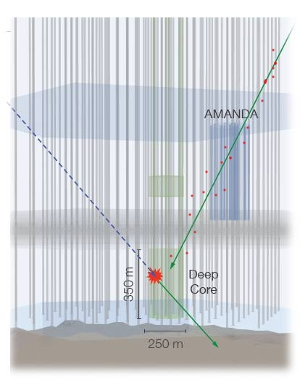
DeepCore and WIMPs
DeepCore : low energy extension in deep clear ice
Use IceCube as veto against downgoing atmospheric muons
Extend field of view to southern hemisphere in [10GeV-fewTeV] domain
Galactic Centre
year round solar WIMPs

Slide 42
Muon flux from solar neutralinos
AMANDA 01-06
IceCube 2007
IceCube + DeepCore
5 years sensitivity

Slide 43
Neutralino scattering in Sun
IceCube 2007
AMANDA 01-06
IceCube + DeepCore
5 years sensitivity

Slide 44
Summary
Icecube/AMANDA data was used to search for indirect neutrino signal from WIMP annihilations in Sun & near Galactic Centre
No signal was found & upper limits were set on muon flux at Earth and Spin Dependent cross sections
IceCube is completed and is largest ν detector in operation
Within 5 years sensitivity to DM signals will
improve by order of magnitude in [30GeV-5TeV]
Unclude sources in Southern hemisphere

Slide 45
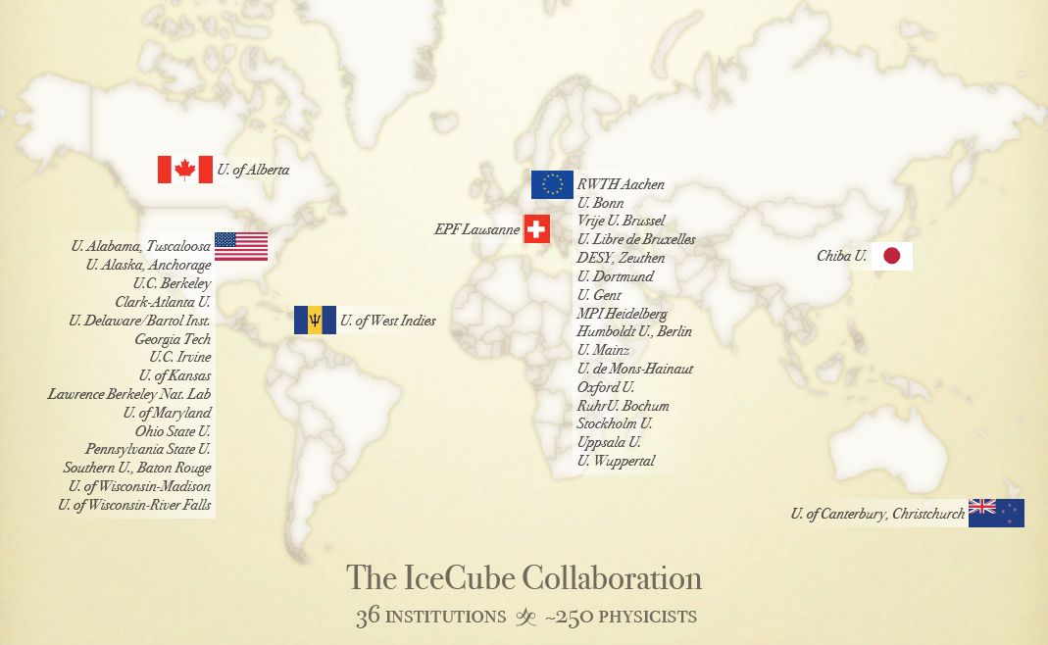
IceCube collaboration
Icecube.wisc.edu

