Slide 1
Data Management Challenges

Slide 2
Agenda
Current Status
Projected Data and Computing Needs
Computing Resources
Waveform Compression Progress
Simulation Production
Data Production Processing
Outlook

Slide 3


Current Status
Available computing resources
Datacenter at Madison
  Central data repository for IceCube
  Central compute cluster
  Access and user accounts for the full collaboration
  Central infrastructure services
  (DB, WWW, Mail, etc.)
Collaboration contributed computing resources
  Computing resources for MC production
  Temporary storage for MC datasets
  Secondary data storage for European access

Slide 4
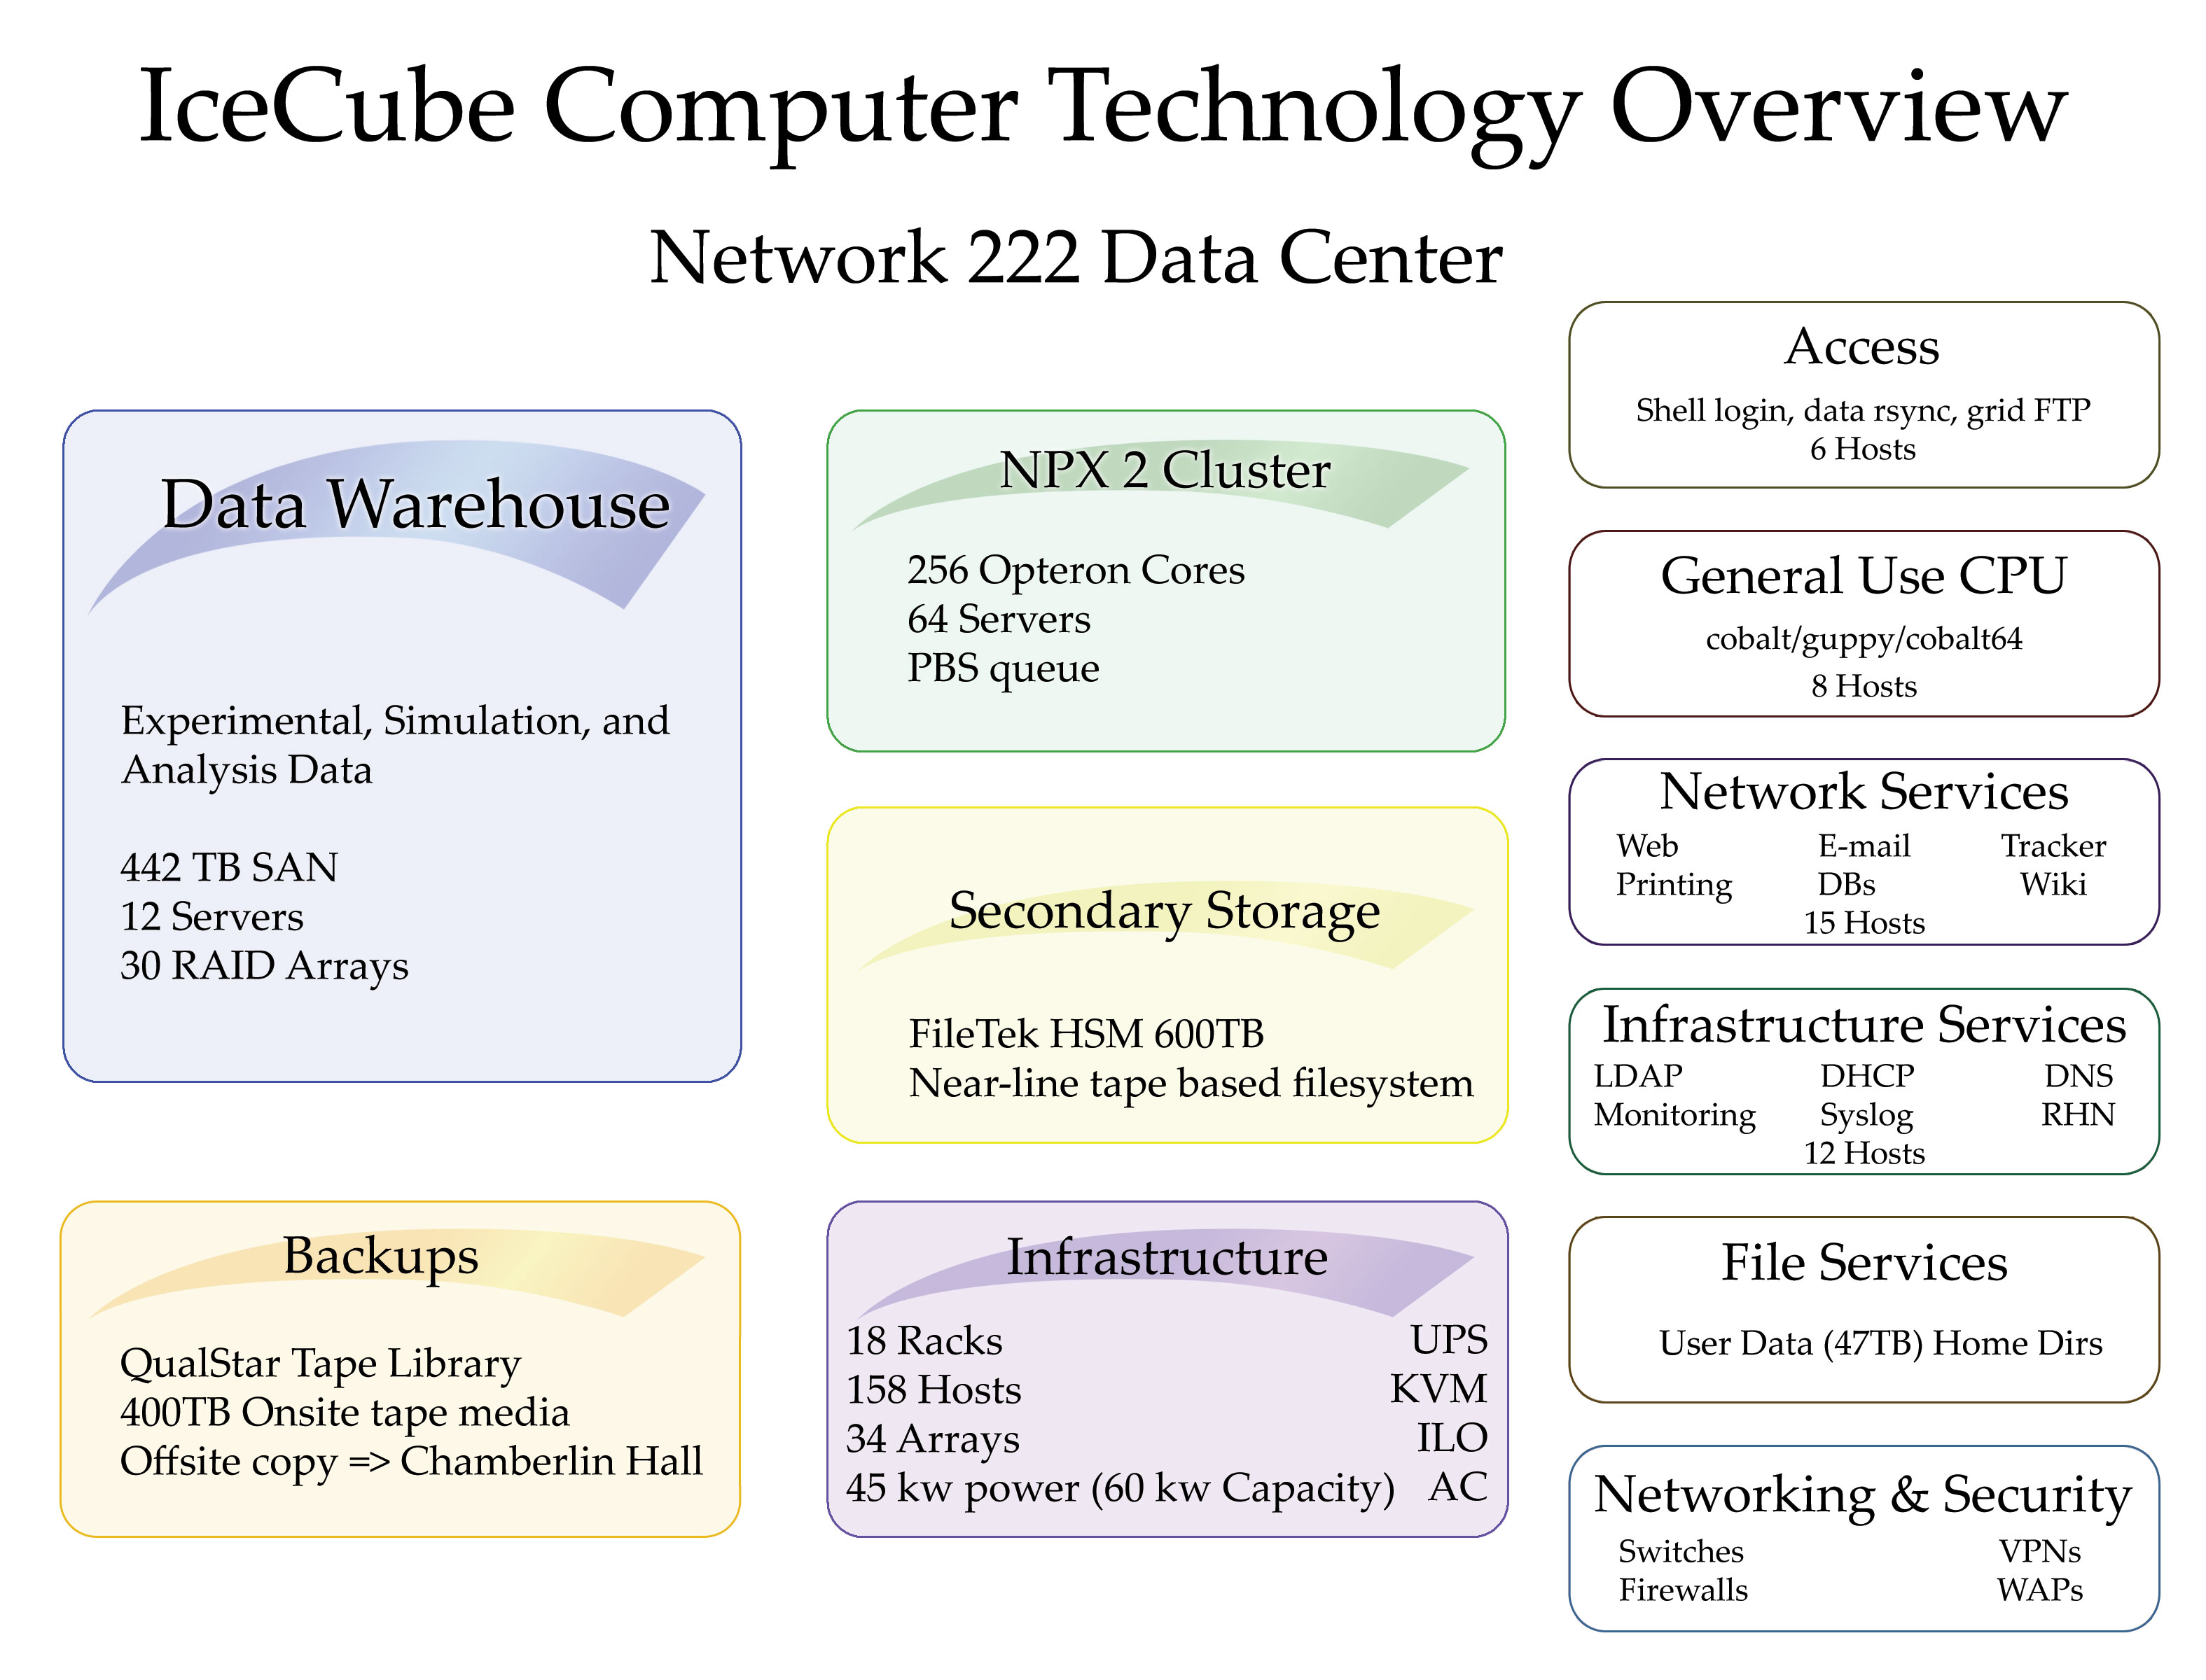
Current Status
Logical view of the IceCube Datacenter

Slide 5
Projected Data and Computing Needs
Increase in data rate
Raw data files have increased considerably in size
  Adding SLC readouts increases raw data by a factor of > 2
  IC40 ~ 325 GB / day
  IC59 ~ 660 GB / day
  IC80 ~ 1000 GB /day
  Compression is useful for limiting satellite transfer needs
  SLC hits can’t be compressed after feature extraction and increase processed data volume
Need to increase storage for analysis datasets and simulation beyond original plan
  Some increase from contingency
  Continuous increase due to technology evolution and standard replacement cycle
Simulation resources increased due to good GRID usage
  More MC data to store
  Use filtering also on MC data (only partly a reduction)

Slide 6
Projected Data and Computing Needs
Increase in data rate
 | IC40 | IC59 | IC86
Trigger rate | 1200 Hz | 1800 Hz | 2700 Hz
Raw data uncompressed | 630 GB/day | 1300 GB/day | 2000 GB/day
Raw data compressed | 325 GB/day | 660 GB/day | 1000 GB/day
Filtered data | 35 GB/day | 55 GB/day | 82 GB/day
Level1 data | 50 GB/day | 70 GB/day | 105 GB/day
Level2 data | 85 GB/day | 200 GB/day | 300 GB/day
Storage 1 Year | 60 TB | 120 TB | 180 TB
Storage 5 years Level2 |  |  | 550 TB
Analysis data |  |  | 200 TB
Total exp data |  |  | 930 TB
Simulation data |  |  | ~ 1.1 TB

Slide 7
Projected Data and Computing Needs
Increase in data rate
 | Tape storage | Data accessible from online disk
 | Experimental raw data [TB] | Experiment [TB] | Simulation {TB] | Analysis [TB[ | Total [TB]
2010 | 900 | 250 | 300 | 90 | 640
2011 | 1400 | 350 | 450 | 120 | 920
2012 | 1900 | 450 | 650 | 160 | 1260
2013 | 2400 | 550 | 850 | 250 | 1650
2014 | 2900 | 650 | 1000 | 350 | 2000

Slide 8
Projected Data and Computing Needs
Increase in data rate

Slide 9
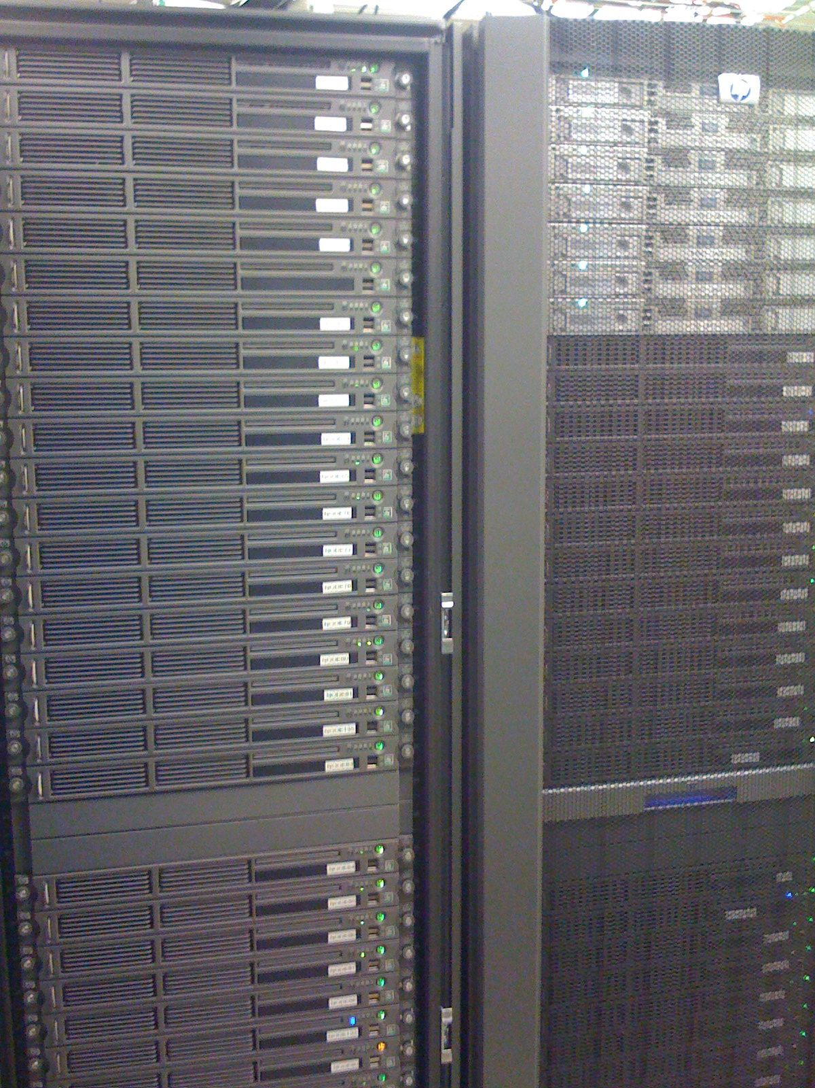
Computing Resources
HPC compute cluster
HPC compute cluster
  64 x 4 core Servers
  4 x 16 core blades
  320 Opteron cores (2.3 – 2.4 GHz)
High memory per core
  4 GB
Planned extension
  32 x 8 core Servers
  256 Nethalem cores
3 year replacement cycle
keep 2 generations of clusters for processing and user analysis

Slide 10
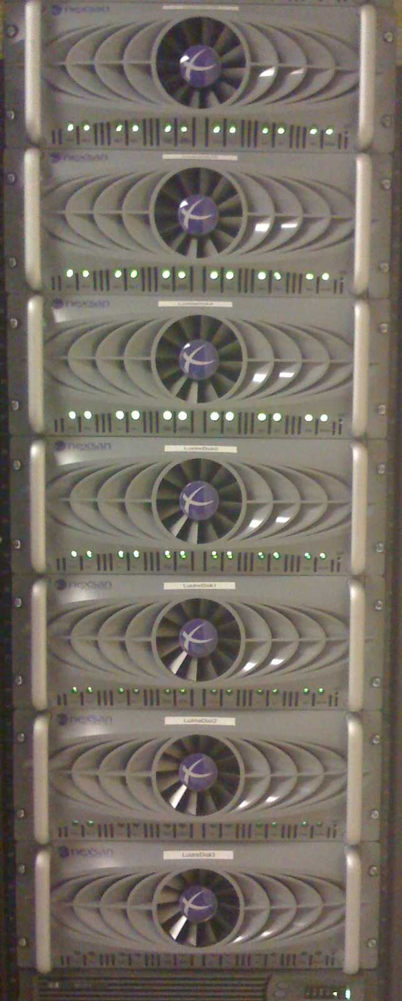
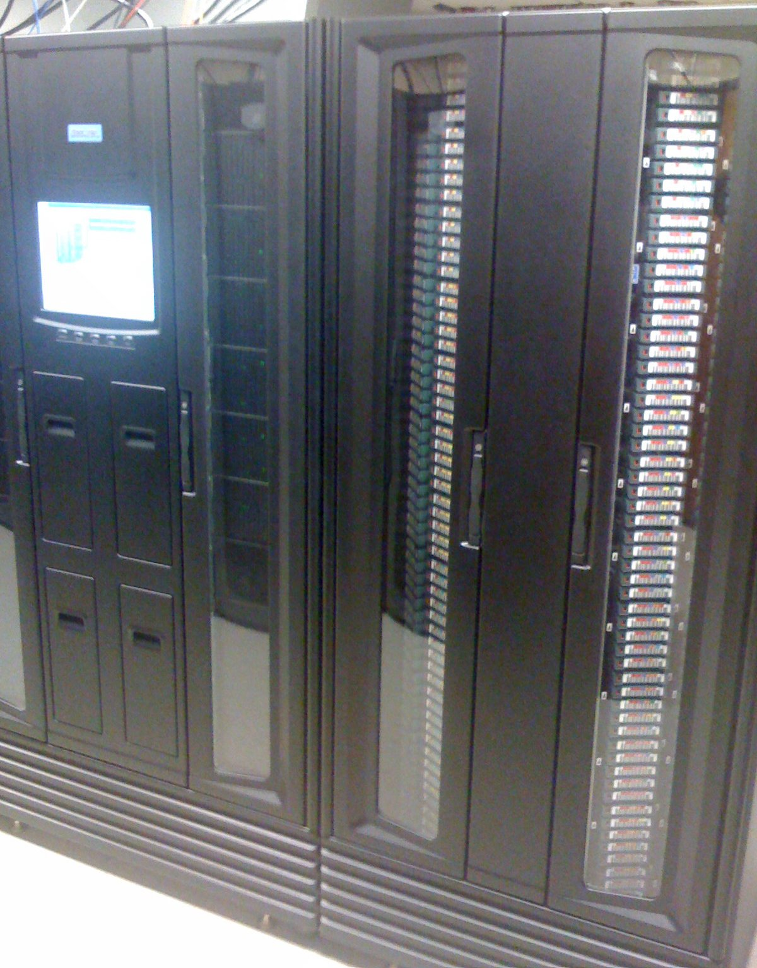
Computing Resources
The central data repository
404 TB SAN
  15 high capacity units
  76% used
  exp/sim/ana
45 TB user space
Tape library with 1.3 PByte tape capacity
Needs continuous expansion by replacement with newest technology in a 4 year cycle
(assuming 50% disk capacity growth per year)

Slide 11
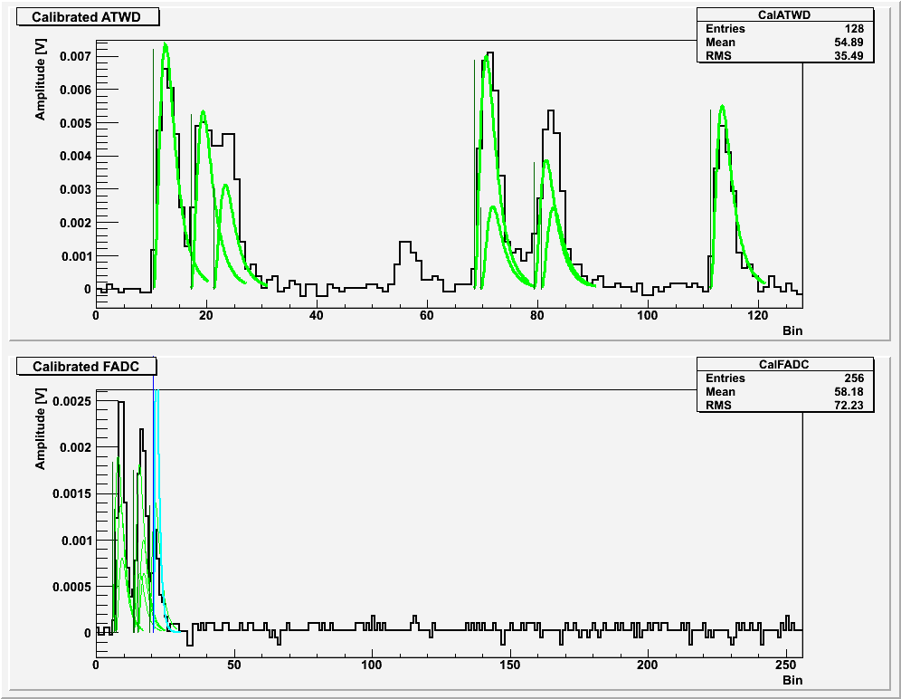
Waveform Compression Progress
Feature Extraction

Slide 12
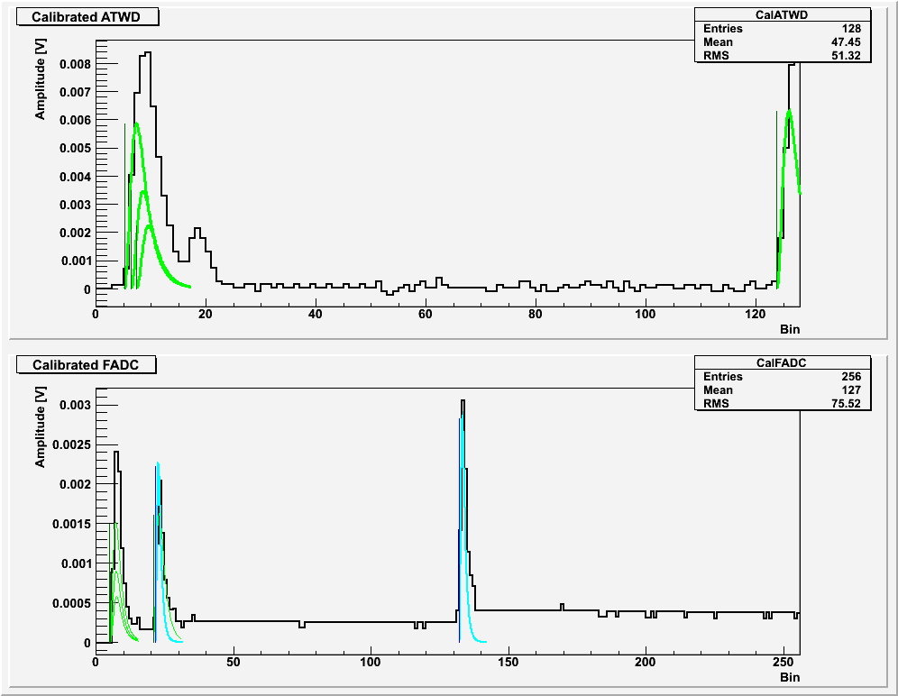
Waveform Compression Progress
Feature Extraction

Slide 13
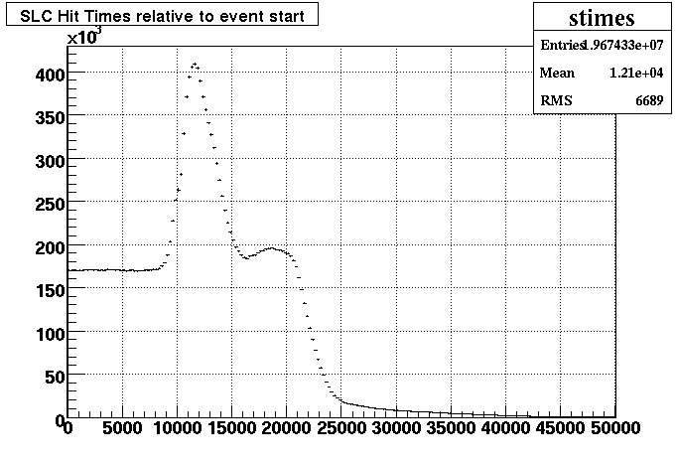
Waveform Compression Progress
SLC hit reduction

Slide 14
Waveform Compression Progress
Feature Extraction
Identified several problems with Feature Extraction
  Splitting of pulses due to waveform templates and selected unfolding algorithm
  High storage usage due to usage of floating point numbers
  Some bugs identified during the process
High increase of SLC hits
  Need of event cleaning due to high number of noise hits

Slide 15
Waveform Compression Progress
Feature Extraction
Started rewrite of FeatureExtractor
  Analysis of several approaches
    Better unfolding algorithms
    New templates
    Several bug fixes
  Needs still some time
    New ideas needed
Work on SLC hit cleaning in progress
  Can reuse some algorithms from AMANDA
  Some more studies needed to determine potential savings

Slide 16

Simulation Production
Available GRID resources
Produce MonteCarlo dataset for the collaboration
  Signal generation
    ν_{μ}, ν_{e}, ν_{τ}
    WIMPs
    Monopoles
  Background
  generation
    Muons from cosmic ray air showers
      Need at least 4000 cores for real time simulation
Distributed production leveraging GRID resources

Slide 17
Simulation Production
Available GRID resources
 | Institute | Cores |  | Disk Space | Farm Type | FTE
 |  | Guaranteed | Available | TB |  | In-kind
US | UW GLOW (US) | 140 | 800 | 190 | Grid
 | UW NPX2 (US) | 100 | 256 |  | Batch
 | UW CHTC (US) | 100 | 700 |  | Batch
 | UMD (US) | 140 | 278 | 5 | Batch | 0.40
 | PSU (US) | 100 | 560 |  | Batch | 0.40
 | LBNL PDSF (US) | 50 | 700 | 2 | Batch | 0.20
 | UDEL (US) | 40 | 136 | 50 | Batch | 0.40
 | LONI (US) | 200 |  |  | Batch | 0.20
Germany | Aachen (DE) | 90 | 200 | 15 | Grid | 0.40
 | Dortmund (DE) | 150 | 300 | 30 | Grid | 0.40
 | Dortmund (DE) | 100 |  | 20 | Batch
 | Mainz (DE) | 230 | 400 | 26 | Grid | 0.40
 | Wuppertal (DE) | 64 | 128 | 17 | Grid | 0.40
 | Wuppertal (DE) | 150 |  | 30 | Batch
 | DESY (DE) | 400 | 700 | 100 | Batch | 0.40
 | DESY (DE) | 100 | 200 | 20 | Grid
Sweden | SweGrid (SE) | 100 | 400 |  | Grid | 0.20
Belgium | Brussels (BE) |  |  |  |  | 0.20
 | Totals | 2,254 | 5,758 | 505 |  | 4.00

Slide 18
Data Production Processing
Steps of central processing
  Level1: unpacking an first guess reconstructions
  Level2: high level reconstructions
Optimize use of limited resources
  Provide high level reconstructions of tracks, cascades, air showers, EHE events, etc for all types of analysis
Provide analysis ready data in the shortest time possible
Fast feedback to detector operations on analysis level data quality

Slide 19
Data Production Processing
IC40 reconstructions
Reconstruction | Percentage of events | CPU time / day
Linefit | 100%
SPEFitSingle | 100 % | 1.0 day
SPEFit32 | 66 % | 21.3 days
SPEFit32Paraboloid | 35 % | 4.8 days
SPEFit32Umbrella | 66 % | 0.6 days
SPEFit32Bayesian | 9 % | 3.0 days
SPEFit16Split (4 times) | 9 % | 3.3 days
SPEFit16SplitBayesian (4 times) | 9 % | 3.8 days
MPEFit | 66 % | 1.1 days
MPEFitParaboloid | 35 % | 8.6 days
SPEFit32PhotorecTrack | 35 % | 1.6 days
SPEFit32PhotorecEnergy | 66 % | 0.1 days
MPEFitPhotorecEnergy | 35 % | 0.1 days
SPE32FitMuE | 66 % | 0.05 days
MPEFitMuE | 66 % | 0.05 days
CombinedSPEFitSingle | 22 % | 0.5 days
CombinedSPEFitParaboloid | 22 % | 1.7 days
JamsSPEFit32 | 22 % | 16 days
CascadeLlh (4 recos) | 30 % | 1.2 days
CascadeLlhAmOnly (4 recos) | 10 % | 0.3 days
CascadeLlhCombined (2 recos) | 10 % | 0.15 days
EHE (3 recos) | 2 %
Shower front (3 recos) | 5 % | 0.02 days

Slide 20
Summary
Data storage is impacted by higher then expected data volumes.
  Importance of SLC hits has significantly increased with the extension to low energy physics
Simulation and data production centrally managed and providing all datasets for scientific analysis
  Relying heavily on distributed and GRID resources to achieve the goals of MC production
  Centralized data processing leveraging the high speed access to the data in the Madison datacenter
Urgent need to expand storage and computing
  Faster processing needed
  More reserve for unexpected reprocessing

Slide 21
Summary
Need to raise awareness in the collaboration of best use of limited resources
  Use online filtering as level3 trigger.
    e.g.: Don’t define raw data as hardware triggered data but software filtered data.
    (Only write filtered data to tape)
  Earlier reduction of datasets with harder cuts
    Efficiency needs to be defined as loss at final cut level and not only based on signal efficiency
  Limit use of expensive reconstructions to reduce CPU requirements
    More intelligent event cleaning
    Pattern recognition and event categorization
Lots of ideas, but time and manpower needed to implement
  Competing against exciting discovery potential of physics analysis

