Slide 1
Cosmic-ray spectrum and composition
--Implications for neutrinos
and vice versa

Slide 2
Outline
Cosmic ray – neutrino connections
Cosmic rays and neutrinos in IceCube
Atmospheric neutrinos
New limits on astrophysical neutrinos
Implications for models of sources
Summary

Slide 3
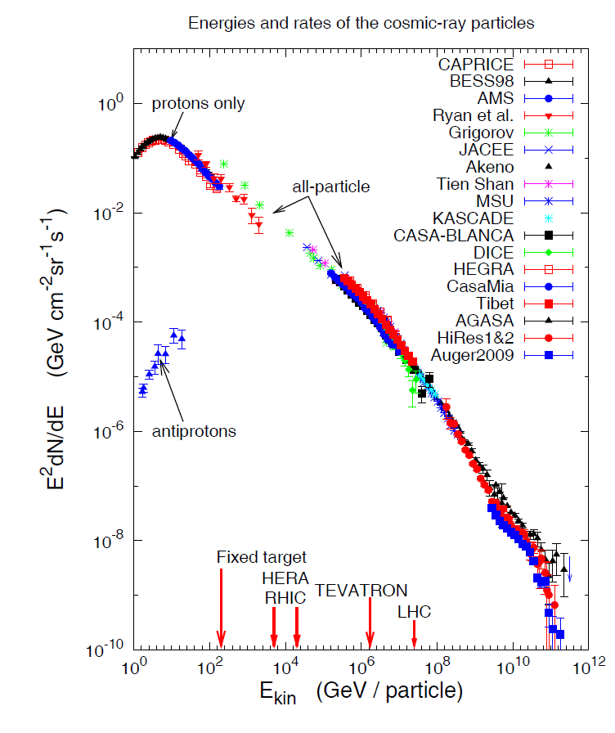
Cosmic-ray connection - I
Galactic SNR can accelerate particles into nearby molecular clouds
Extra-galactic jets (in AGN or GRB) may share power between c.r. & ν
Expect a few TeV ν/yr in a gigaton detector in hadronic scenarios
Sets km³ scale for HE neutrino astronomy
Galactic
Extra-Galactic

Slide 4
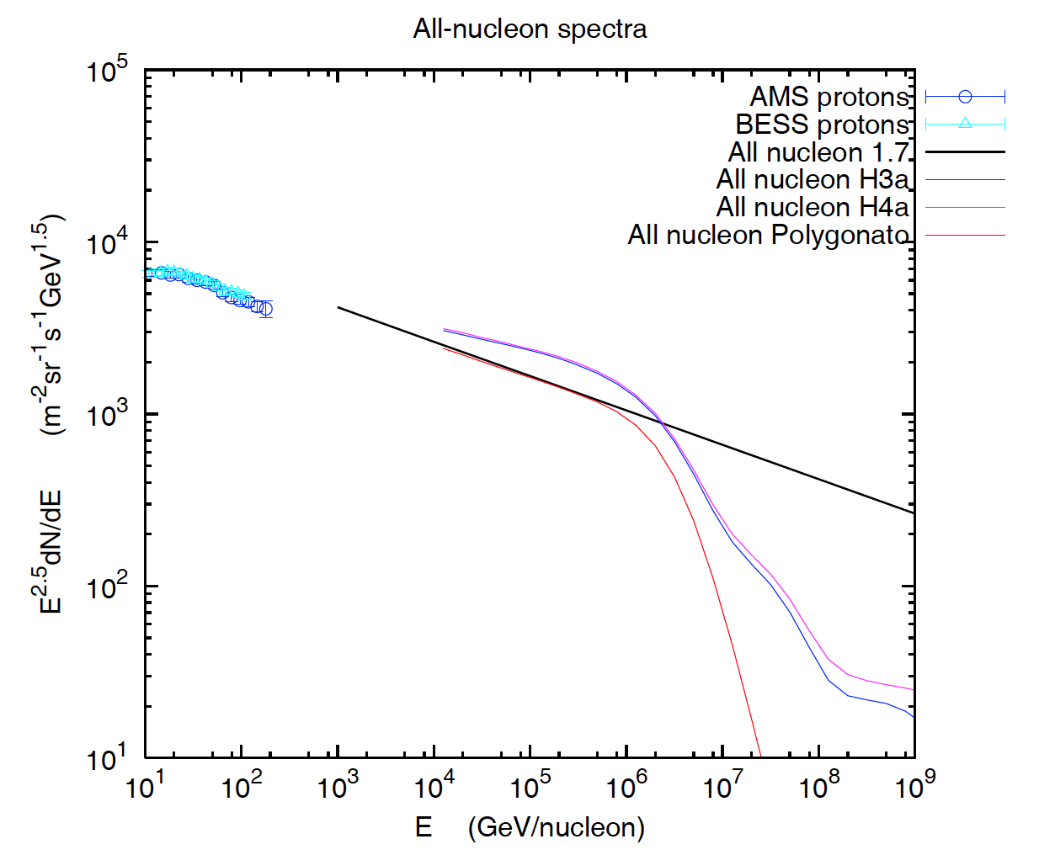
Cosmic-ray connnection – II: atmospheric ν from nucleon spectrum
All-particle spectrum modeled with 3 populations & 5 groups of nuclei
Spectrum of nucleons
Realistic

Slide 5
New information ~TeV
ATIC, CREAM, PAMELA
  Proton ≠ Helium
  Pamela break →
    New population?
  Spectral hardening
    E > 200 GeV/A
    Teresa, next talk
PAMELA, Adriani et al., arXiv:1103.4055

Slide 6
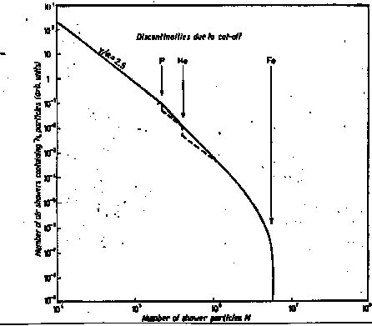
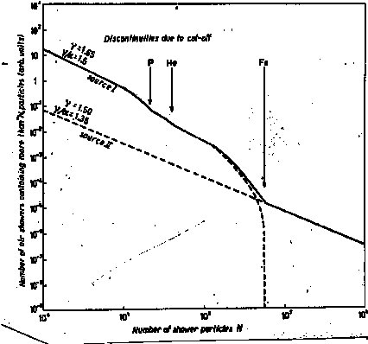
Where is the galactic – extragalactic transition?
Peters cycle: systematic increase of < A >
approaching E_{max}
<A> should begin to decrease again
for E > 30 x E_{knee}
gyro-radius = Pc / ZeB ≡ R (rigidity) / B
→ E_{total} (knee) ~ Z x R(knee)
B. Peters, Nuovo Cimento 22 (1961) 800

Slide 7
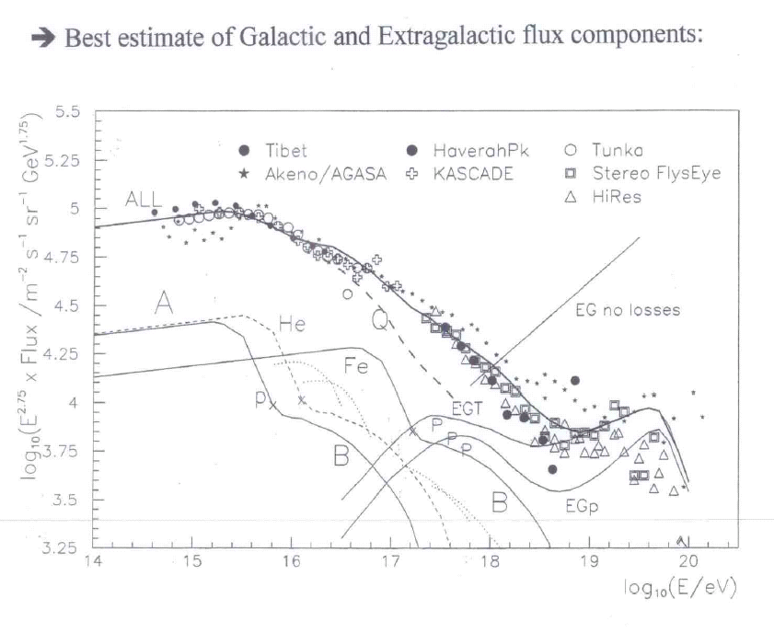
HILLAS (Aspen, 2005)

Slide 8
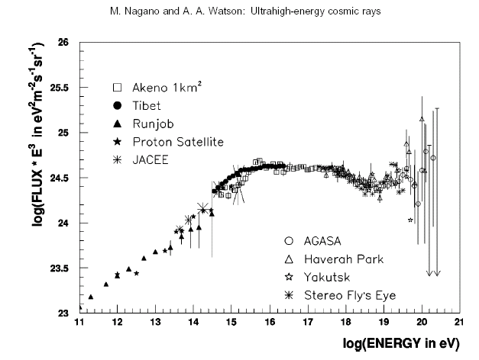

Galactic component B?
B
E-G
A

Slide 9
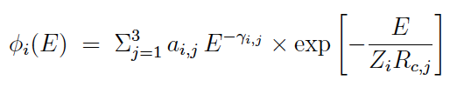

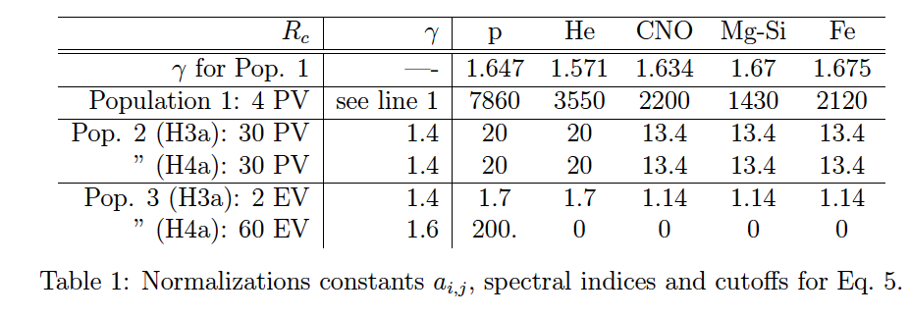
Toy model fits:
3 populations
5 nuclear groups,
Exponential cutoff in rigidity
All particle spectrum

Slide 10
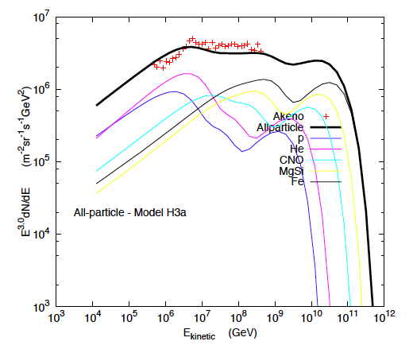
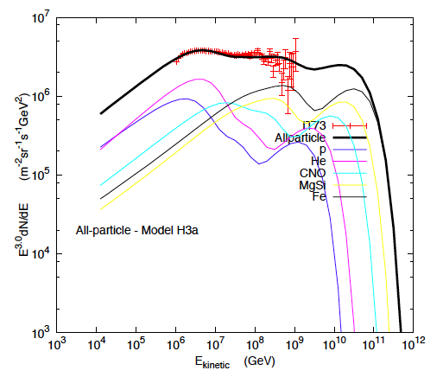
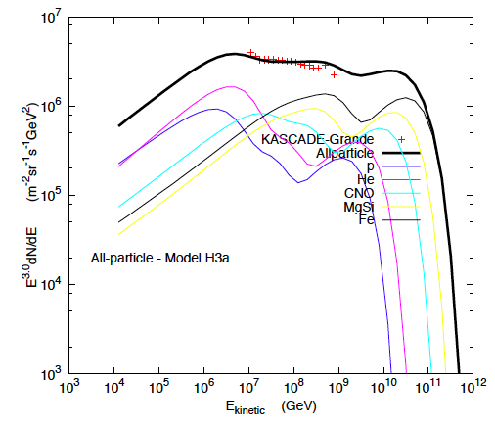
Primary spectrum
& composition:
1st knee
Component B
2nd knee
All-particle spectrum modeled with 3 populations & 5 groups of nuclei
IceTop prelimary
(arbitrary normalization)
Kascade-Grande
Talk this afternoon

Slide 11
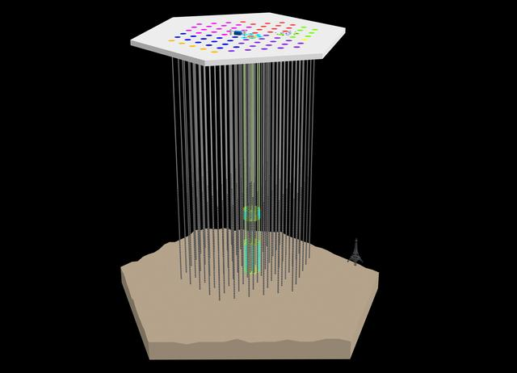
IceTop
81 stations, 324 DOMs
2004-05 1 1
2005-06 8 9
2006-07 13 22
2007-08 18 40
2008-09 19 59
2009-10 20 79
2010 11 7 86
DeepCore
8 strings
IceCube
86 strings, 5160 DOMS
IceCube construction complete !

Slide 12
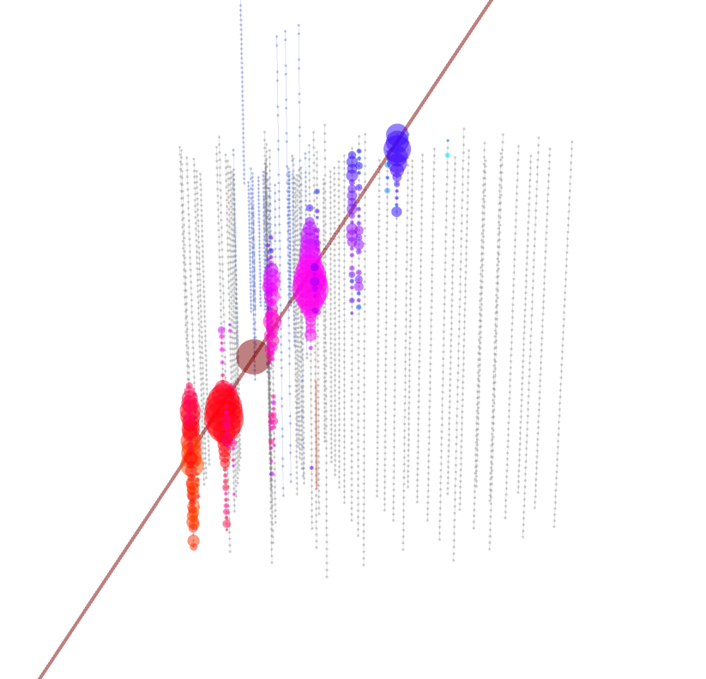
High-energy events in IceCube-40
~ EeV air shower
~100 TeV ν_{μ} induced muon

Slide 13
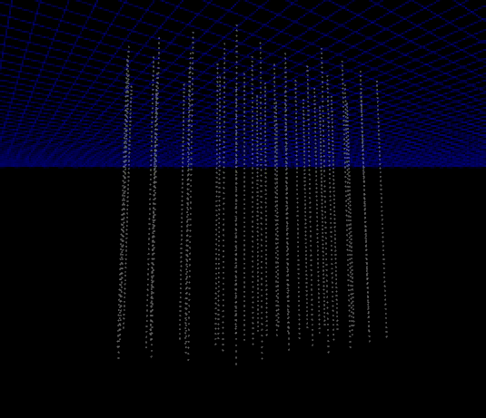
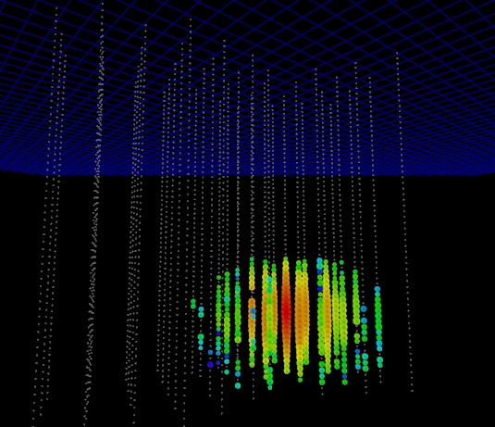
More events
A cascade event, candidate for
a high energy ν_{e} ~50 TeV

Slide 14
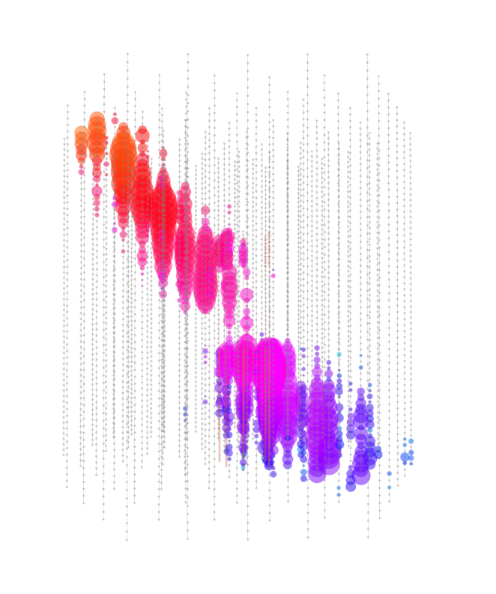
IC-79 event: downward muon bundles
~100 PeV primary cosmic ray
~ 300 muons in deep IceCube
IceCube Deep Core talk by Doug Cowen Friday

Slide 15
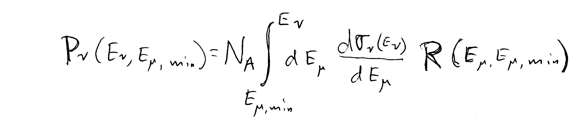
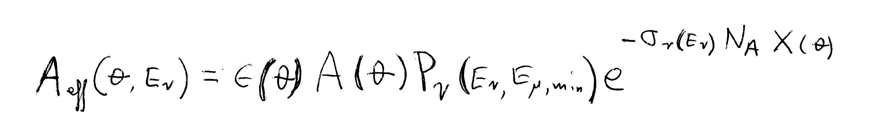
Detecting neutrinos
Rate = Neutrino flux
  x Absorption in Earth
  x Neutrino cross section
  x Size of detector
  x Range of muon (for ν_{μ})
Range favors ν_{μ}
  ~4 to 15 km.w.e. for
  E_{ν} ~ 10 to 1000 TeV
For threshold
E_{μ} > 1 TeV
Probability to detect ν_{μ}-induced μ

Slide 16
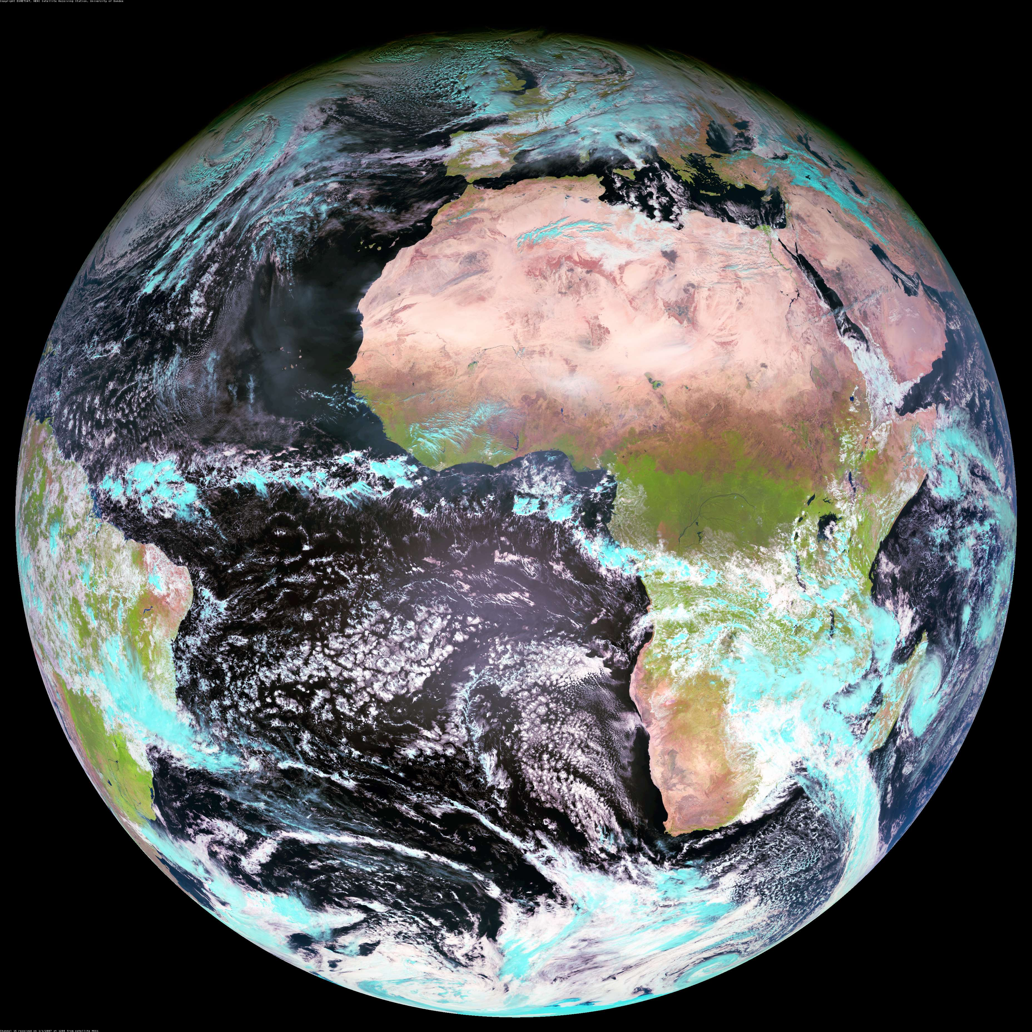
Atmospheric ν in IceCube
S.P.
Zone 1, l: -30 to -90 ; 3.14 sr
Zenith: 90 < θ < 120º
(40% of Zone 1 is over the
Antarctic continent)
Zone 2, l: -30 to +30; 2.30 sr
Zenith 120 < θ < 150º
Note: 43% of Zone 1 is in declination -65º < δ < -90º --over Antarctica. Contains
~25% of IceCube ν_{μ}.
Seasonal temperature like
South Pole: δT ~ ± 7.5%,
α_{T} ~ 0.54 → δRate ~ ± 4%
Zone 3, l: +30 to +90, 0.84 sr
Zenith: 150 < θ < 180º
Cosmic ray produces ν in atmosphere that puts a muon into the detector

Slide 17
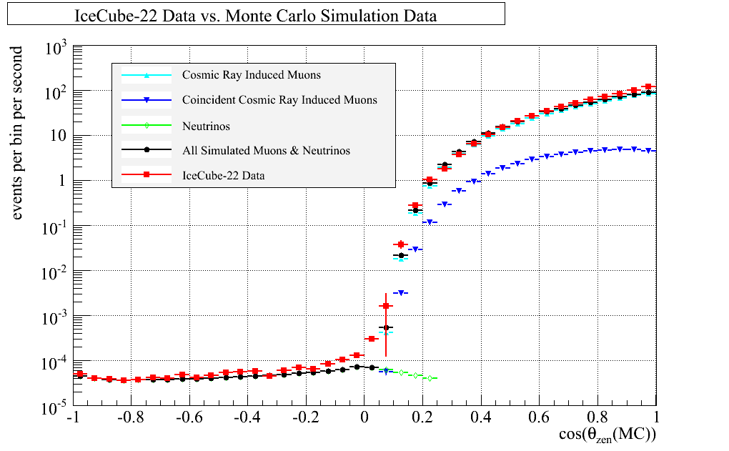
Cuts and event reconstruction
40-string IceCube:
  375 days livetime in 08/09 @ 1 kHz =3.3x10¹⁰ triggers, 99.9999% muons
  8 x 10⁸ filtered & sent over satellite from S.P.
  Quality cuts applied to get ~14,000 upward ν_{μ} induced muons
Upward
ν_{μ} → μ
Downward atmos. μ
All-sky plot of muons in IceCube-22 from 2007 (P. Berghaus, IceCube, ISVHECRI-2008 arxiv.org/abs/0902.0021)

Slide 18
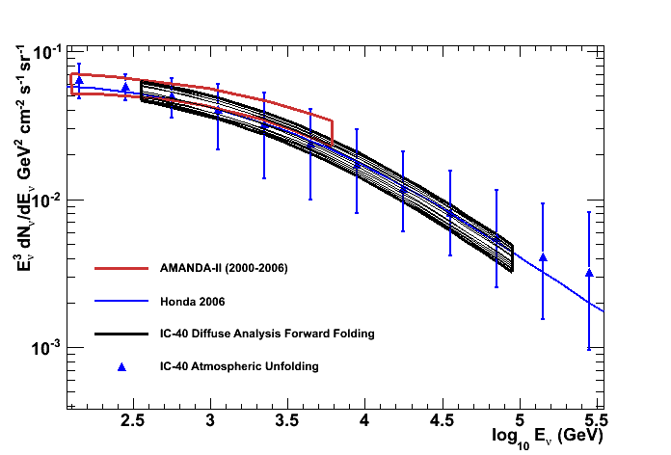
Atmospheric ν_{μ} with IceCube-40
Two analyses:
Unfolding
Forward folding as a by-product of a search for diffuse astrophysical ν
Look in detail at 2
Phys. Rev. D 79, 102005 (2009)
arXiv:1104.5187
PHYSICAL REVIEW D 83, 012001 (2011)

Slide 19
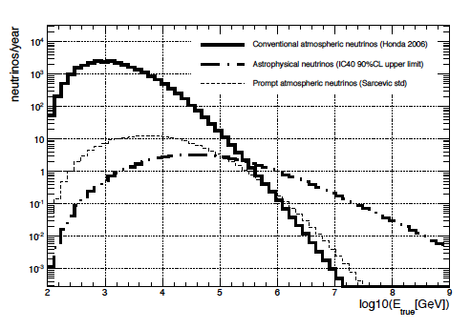
Measurement of ν_{μ}-induced μ
Fit 3 components:
  Atmospheric ν from K± and π± (0.3 – 85 TeV)
    Use Honda 2007 to 10 TeV
    + power-law extrapolation
    ~ cos⁻¹ (θ)
  Prompt ν ( 10 – 600 TeV )
    Harder spectrum to > 10⁷ GeV (~E^{-2.7}), isotropic
  Astrophysical ν
    Isotropic, with E⁻² spectrum assumed (35 – 7000 TeV)
  Note different response for astro. ν vs atmos. ν
π and K-decay
Astrophysical
Prompt
Neutrino energy at production
Measured dE/dX

Slide 20
Results of likelihood fit
IceCube preliminary
Consistent with only K, π atmospheric ν to 100 TeV
Charm component not yet seen; “intrinsic” charm in doubt?
No astrophysical neutrinos seen yet

Slide 21
IceCube ν_{μ}: measurements & limits
Waxman
-Bahcall Limit
IceCube 40
arXiv:1104.5187
Plot: Sean Grullon, UW

Slide 22
Comments on diffuse ν results
Input to analysis
  Specific spectrum assumed for atmospheric ν from decay of π and K (Honda et al., PR D75:043006,2007)
    Extrapolate with power law for E_{ν} > 10 TeV up to 10 PeV
  For prompt ν use Enberg et al.. PR D 78, 043005, 2008
  Overall normalization fitted for each component with a single fitted slope for both components
Limitations of this analysis
  Limits depend on simple power-law extension of conventional atmospheric ν_{μ} to E_{ν} > PeV
  Neutrino spectrum must steepen to some extent above 100 TeV to reflect the knee in the primary spectrum
  Bounds on prompt and astrophysical ν will be relaxed to some extent with a more realistic assumption for shape of atmospheric ν
  Recent calculation extends calculation of ν_{μ} to > PeV
    Illana, Lipari, Masip, Meloni, Astropart. Phys. 34 (2011) 663

Slide 23
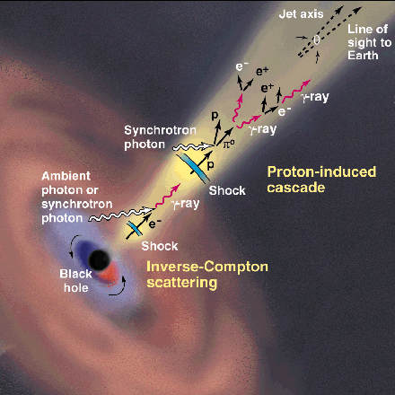
Generic model I
CR acceleration occurs in jets
  AGN or GRB
Abundant target material
  Most models assume photo-production:
    p + γ → Δ⁺ → p + π⁰ → p + γ γ
    p + γ → Δ⁺ → n + π⁺ → n + μ + ν
Ideal case ( ~ “Waxman-Bahcall limit”)
  Strong magnetic fields retain protons in jets
  Neutrons escape, decay to protons & become UHECR
  Extra-galactic cosmic rays observed as protons
  Energy content in neutrinos ≈ energy in UHECR
This picture disfavored as limits go below W-B
http://www.ucd.ie/math-phy
/rieger/science.gif
Waxman, Bahcall, PRD 59,
023002 (1998). Also
TKG astro-ph/9707283v1

Slide 24
Generic model II
UHECR are accelerated in external shocks analogous to SNR
  See E.G. Berezhko, 0809.0734 & 0905.4785
  mixed composition (accelerate whatever is there)
  Low density of target material
  → lower level of TeV-PeV neutrino production
Diagram from A.Ferrari, Ann Revs A&A 36 (1998) 539

Slide 25
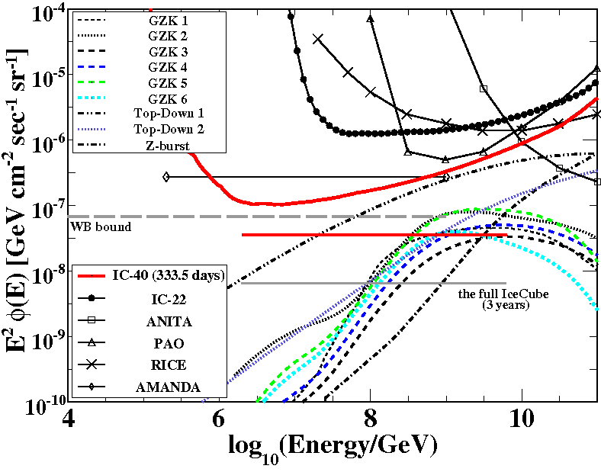
IceCube limits on cosmogenic ν
GZK search looks for
  Very bright events
  Near the horizon
  with compact initial burst of light
Range of sensitivity
  PeV – EeV
  Complementary to diffuse ν_{μ} search that starts by measuring atmospheric ν_{μ}
  Model 6 (Fermi max): expect 0.4 events
IceCube-40 arXiv:1103.4250
All-flavor limits assuming ν_{μ} ~ ν_{τ} ~ ν_{e}

Slide 26
Summary
Pushing below Waxman-Bahcall “limit” in 100 TeV – 10 PeV range disfavors proton dominance in 1 – 100 PeV range
Expect significant improvements in IceCube sensitivity to astrophysical ν:
  IC59 + IC79 in analysis; IC86 running
  Better analysis
    Use more realistic atmospheric neutrino spectrum
    Use angular dependence
    Better understanding of systematics

